Slide 1
Room Temperature Mechanical Loss of Silicon Nitride-Silica Quarter-wave Stacks Deposited by Plasma Enhanced Chemical Vapor Deposition (PECVD) Method
Huang-wei Pan, Ling-chi Kuo, Meng-yun Wu, Shu-yu Huang, Yu-hang Juang, Chia-wei Lee, Shiuh Chao
Principle Investigator: Prof. Shiuh Chao
Institute of Photonics Technologies,
National Tsing Hua University,
Hsinchu, Taiwan,
R.O.C.
LIGO-G1601702
Notes:
Ladies and gentlemen, my name is Huang-wei Pan, from National Tsing Hua University Taiwan. My adviser is Prof. Shiuh Chao. The topic I want to share with you is “Room Temperature Mechanical Loss of Silicon Nitride-Silica Quarter-wave Stacks Deposited by Plasma Enhanced Chemical Vapor Deposition (PECVD) Method”.

Slide 2
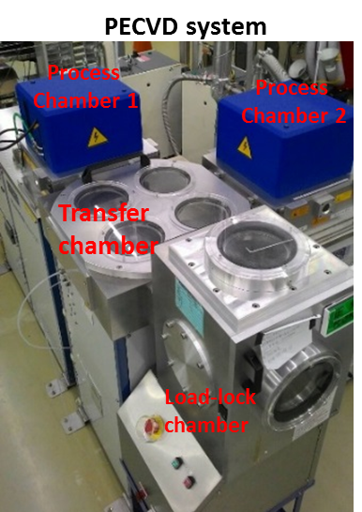
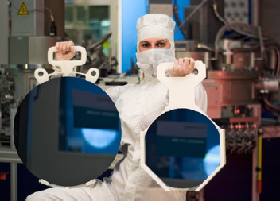
Large area uniform coating on silicon wafer up to 18“ (450mm) by Plasma Enhanced Chemical Vapor Deposition (PECVD) is a common practice in silicon-IC industry
http://www.linx-consulting.com/pages/450mm_processing.html
At NTHU, we are exploring mirror deposition for LIGO by using PECVD
Notes:
As we know, large area uniform coating on silicon wafer up to 18“ (450mm) by Plasma Enhanced Chemical Vapor Deposition (PECVD) is a common practice in silicon-IC industry. Since silicon is the potential substrate for next generation GW mirror, at NTHU, we are exploring mirror deposition for LIGO by using PECVD on silicon.

Slide 3
Candidate Silicon IC-Compatible CVD Thin Films for Optical Application
 | a-Si | SiC | SiNx | SiO₂
Refractive index @ 1550 nm | 3.5^{[1]} | 3.2-2.6^{[11,12]} | 2.6-1.8^{[16][30]} | 1.45^{[19,20]}
Absorption range | <700 nm^{[2]} | <380 nm ^{[13]} | <510 nm^{[17]} | <200 nm^{[21]}
Young’s modulus (GPa) | 100 ~ 150^{[3-5]} | 392 ~ 694^{[14]} | 85~210^{[16]} | 72~83^{[20,22-25]}
Stress# (MPa) | -400 ~ -900^{[6,7]} | -160 ~ -510^{[15]} | +600 ~ 1200 ^{[16]} | +60 ~ -257^{[25]}
Loss angle at RT | 3.3x10⁻⁴ e beam^{[8]} 5x10⁻⁴ sputter^{[8]} 4x10⁻⁴ IBS ^{[31]} 9x10⁻⁵ IBS ^{[10]} | -- | ~2x10⁻⁶ high stress ^{[18]} ~3x10⁻⁴ stress relief ^{[18]} 7.5x10⁻⁵ SiN_{0.40} @107Hz 1.4x10⁻⁵ SiN_{0.87} @107Hz^{[30]} | 1.49x10⁻⁴ 1x10⁻⁴ IBS ^{[26-28]}
Cryogenic loss peak | Depends on H⁺-concentration and heat treatment^{[8-10]} | -- | Depends on N-concentration (Preliminary results will be presented in poster session by Mr. Kuo) | 5x10⁻⁴ @20K^{[29]}
# - : compressive +: tensile
Notes:
Here we present some candidate thin film materials in silicon IC compatible CVD process in this table. For optical application, a-Si, silicon carbide (SiC) are typically high-index materials. And SiO2 is the low-index one. SiN can be used as low index material when paired with a-Si and high index material when paired with SiO2, or it can be paired with itself with alternating composition. The absorption range of these materials are in short wavelength range which is far from LIGO’s application (1064 nm &1550 nm). For mechanical concern, SiC and SiN show high young’s modulus, indicating that they are stiffer thin film materials in mechanics. Furthermore, stress should also be considered for high reflective mirror coating to avoid substrate warping effect.
For loss angle at RT, most of those films are in 10-4 range (a-Si, SiO2 and stress relief SiN). However, SiN films show loss angle in 10-5 which is lower than the other materials. In addition, cryogenic peak is also a criterion to judge a material. Literatures show that the appearance of a-Si cryogenic peak depends on hydrogen concentration and heat treatment. And SiO2 shows a peak at about 20K after 600℃heat treatment. For SiN, cryogenic peak depends on N concentration in SiN films. Moreover, we have a poster to present the preliminary cryogenic result of our SiN films by Mr. Kuo.

Slide 4
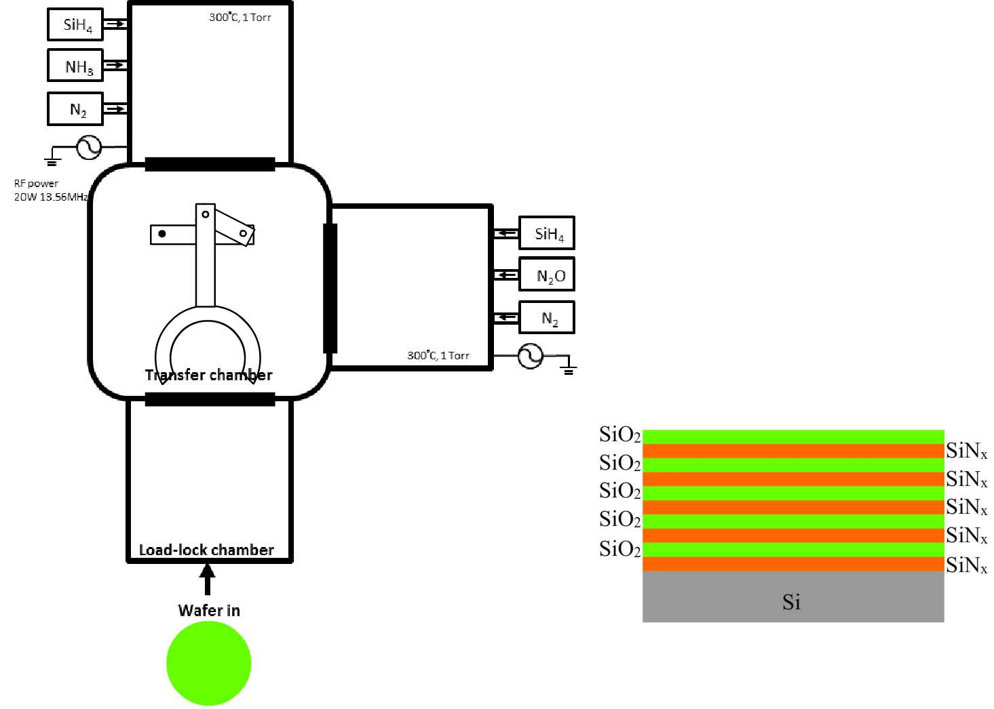
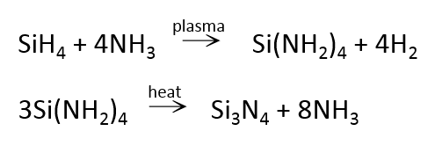
Plasma Enhanced Chemical Vapor Deposition (PECVD)
for multi-layer dielectric mirror coating
Process chamber 1：SiNx
Process chamber 2： SiO₂
Silicon substrate side view
Notes:
This page I’ll show you the process for multi-layer dielectric mirror coating by PECVD. This is a PECVD instrument with dual process chambers. Two materials, SiNx and SiO2 for example, are deposited in two individual chambers with their own reactive gases. Put silicon wafers in the load-lock chamber, then a robot arm transfers silicon wafer into the process chamber. This wafer is transferred in between these two chambers alternately to deposit SiN and SiO2 to perform a HR mirror coating. This process is mature and well-established in silicon IC manufacture.

Slide 5
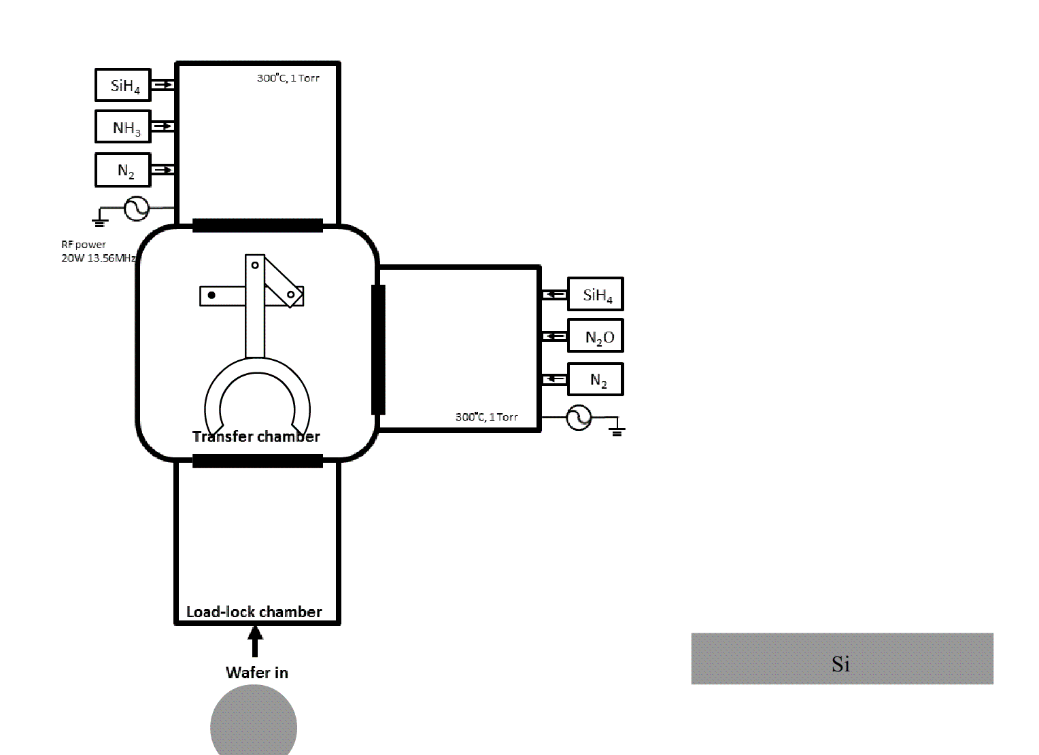
Plasma Enhanced Chemical Vapor Deposition (PECVD)
for multi-layer dielectric mirror coating
Process chamber 1：SiNx
Process chamber 2： SiO₂
Silicon substrate side view
Notes:
Let’s see the process cartoon. We deposited SiNx as high index layer and SiO2 as low index layer with each layer having one QW thickness. The process time for each pair is around 12 minutes. After several rounds, HR mirror coating were finished. So dual-reactor CVD in conventional silicon-IC process can be used for HR optical coatings. The cost is believed to be lower than the ion beam sputter method.

Slide 6
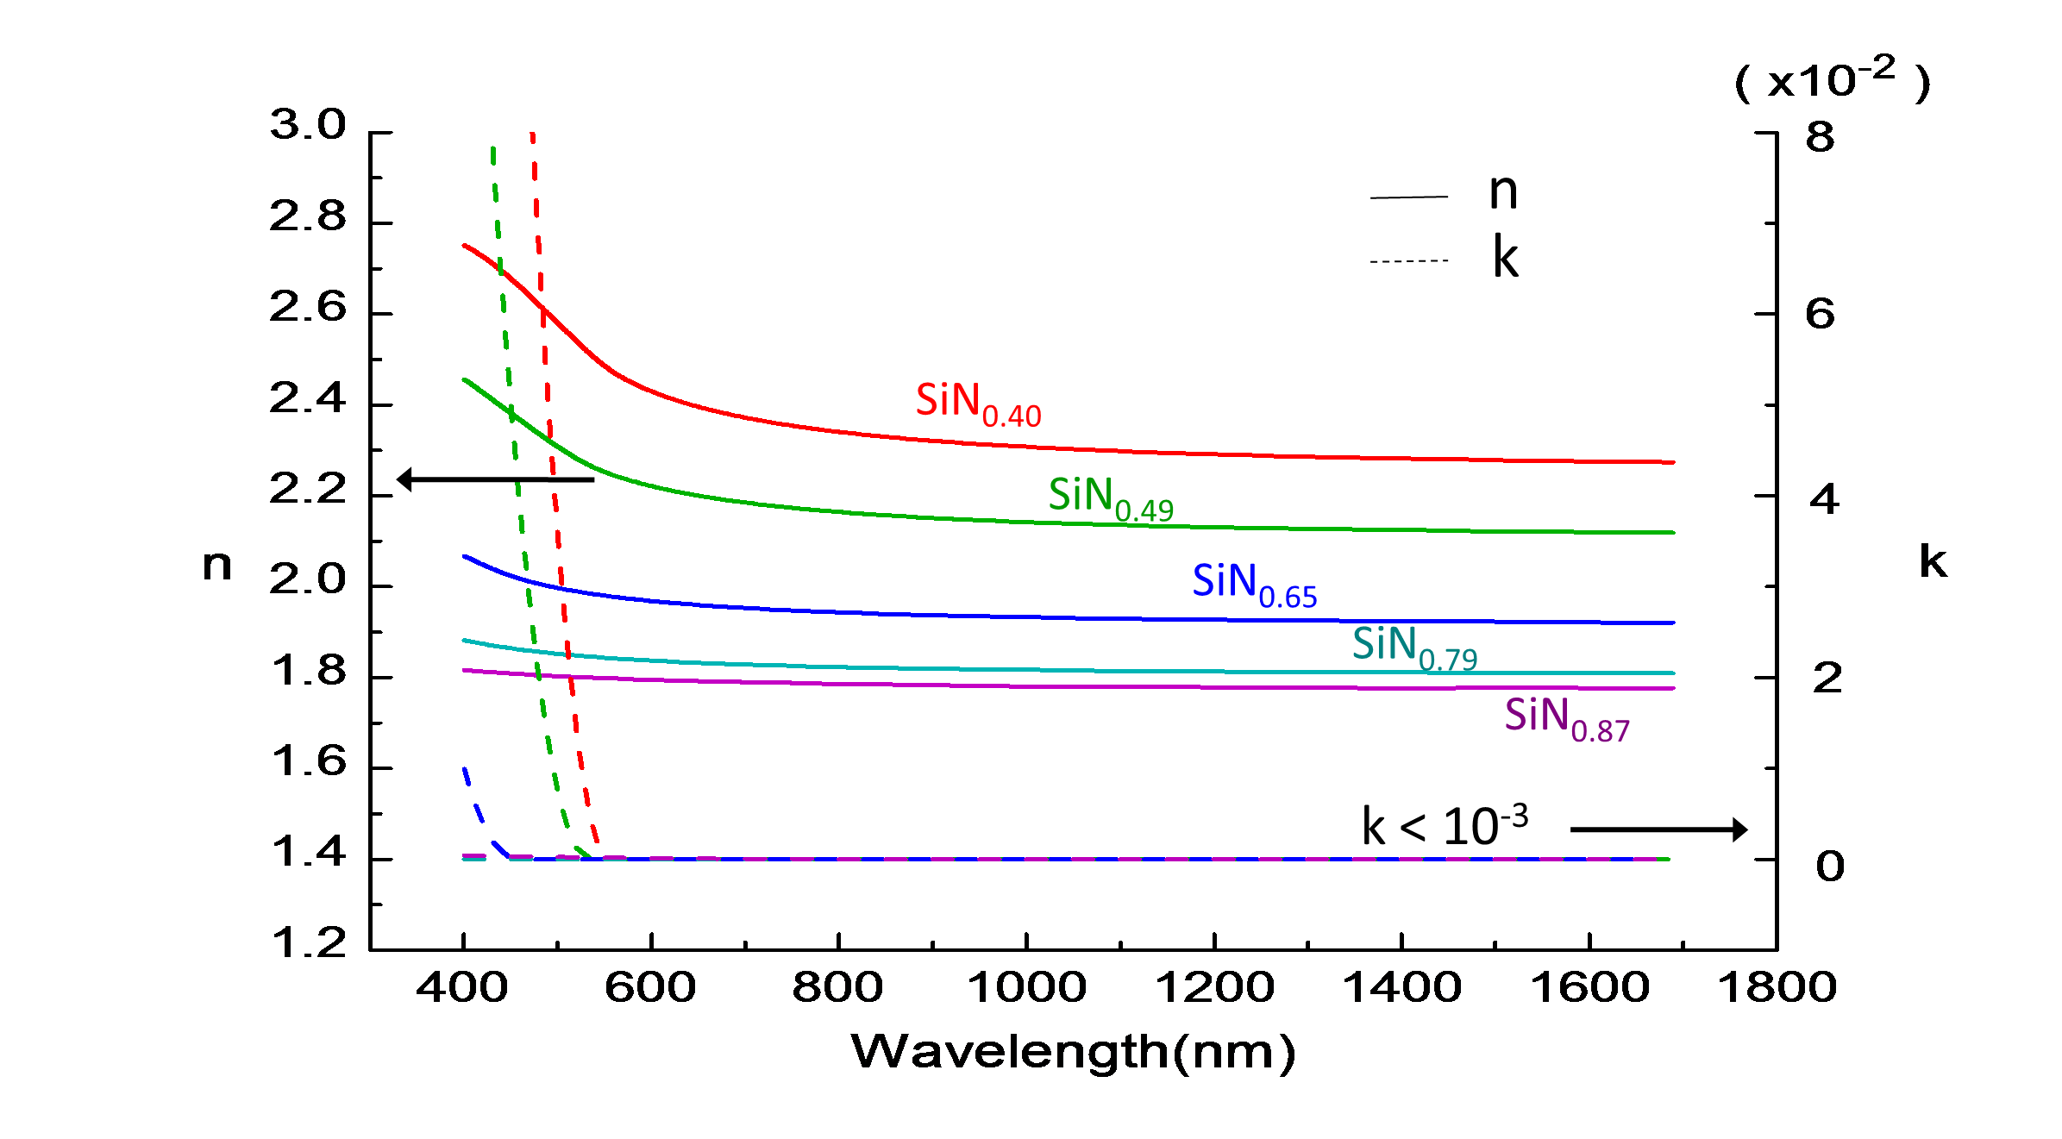
What We Had Last Year for SiNx
Stress and Young’s modulus
Refractive index and extinction coefficient
High stress SiN_{0.87} film deposited by PECVD, LIGO-G1501068
Coating loss
Frequency (Hz)
Notes:
What we had last year for SiNx, we fabricated silicon nitride films with different silicon/nitrogen composition from 0.4 to 0.87 by adjusting the gas flow ratio between silane and amornia in the PECVD process. Then we found out the refractive indices decreasing with increasing nitrogen concentration, from 2.28 to 1.78 at 1550 nm wavelength. And also the extinction coefficient are less than 10-3 which is the detection limit of ellipsometer. In addition, stress and Young’s modulus also increasing with increasing nitrogen concentration as shown in the figure.
And we had investigated the loss angle of high stress SiN0.87 film which refractive index is 1.78. As can be seen, coating loss of SiN0.87 film is in 10-5 order in the frequency range from ~100 Hz to 6500 Hz. It is lower than that of the 600°C annealed 14.5% TiO2-doped tantala.

Slide 7
Coating Loss for PECVD SiO₂, SiN_{0.40} and SiN_{0.87}
SiO₂ (n=1.45)
SiN_{0.40} (n=2.28)
SiN_{0.87} (n=1.78)
Coating loss *
Frequency (Hz)
We chose SiO₂ as the low index layer and SiN_{0.40} as the high index layer for quarter-wave (QW) stacks.
* First two modes are bending modes and others are torsional modes. Higher order bending modes are not shown due to high fluctuation in the clamp loss.
Notes:
This page shows coating loss of SiO2 and SiNx films deposited by PECVD. As a low index layer, SiO2 has higher loss than SiNx films. SiNx films are in 10-5 order at ~100Hz even with different N concentration from 0.4 to 0.87. We chose SiO2 as the low index layer and SiN0.40 as the high index layer for quarter-wave (QW) stacks

Slide 8
SiN_{0.4}/SiO₂ QW Stacks
SiN_{0.40} (n= 2.28)
Stresses are compensated
tensile stress +120MPa
‧‧‧
1-pair SiN_{0.40}/SiO₂ QW stack
4-pair SiN_{0.40}/SiO₂ QW stack
SiO₂ (n=1.45)
compressive stress -150MPa
material* | Refractive index# @1550nm | Young’s modulus (GPa) | Stress (MPa) | Loss angle ~100Hz @ RT
SiO₂ | 1.45±0.01 | 83.8±1.3 | -158.2±6.0 | (1.49±0.12) x10⁻⁴
SiN_{0.40} | 2.28±0.01 | 103.7±5.6 | 120.2±15.5 | (7.49±0.72) x10⁻⁵
*All films are amorphous structure as deposited
We have deposited samples with 1, 2, 3 and 4 pairs QW stacks.
Notes:
We chose SiO2 as the low index layer and SiN0.40 as the high index layer for quarter-wave (QW) stacks because of higher index difference and stress compensation between SiN0.40 and SiO2.We have deposited samples with 1, 2, 3 and 4 pairs QW stacks to investigate the loss of these stacks.

Slide 9
Coating Loss of SiN_{0.40}/SiO₂ QW Stacks
Deposited by PECVD
Coating loss*
Frequency (Hz)
The coating losses of 1-4 pair are in 10⁻⁵ order at 100 Hz.
The coating loss does not increase with pair number, indicating that there is no significant loss in SiN_{0.40}/SiO₂ interface.
* First two modes are bending modes and others are torsional modes. Higher order bending modes are not shown due to high fluctuation in the clamp loss.
Notes:
Here we show the coating loss of SiN0.40/SiO2 QW stacks with different number of pairs from 1 to 4. As can be seen, coating loss of 1-4 pair are in 10-5 order at 100Hz. Moreover, coating loss of pairs does not increase with pair number, indicating that there is no significant loss in SiN0.40/SiO2 interface.

Slide 10
Conclusion
Dual-reactor CVD in conventional silicon-IC process can be used for large area HR optical coatings.
SiN_{0.40}/SiO₂ QW pairs deposited by all-CVD process showed room temperature mechanical loss in 10⁻⁵ at 100 Hz, lower than Ta₂O₅-TiO₂/SiO₂ in current GW detector.
The coating loss of SiN_{0.40}/SiO₂ QW stack does not increase with pair number, indicating that there is no significant loss in SiN_{0.40}/SiO₂ interface.
Notes:
Let’s conclude. Dual-reactor CVD in conventional silicon-IC process can be used for HR optical coatings. And SiN0.40/SiO2 QW pairs deposited by all-CVD process showed room temperature mechanical loss in 10-5 at 100 Hz, lower than Ta2O5-TiO2/SiO2 in current GW detector. The coating loss of SiN0.40/SiO2 QW stack does not increase with pair number, indicating that there is no significant loss in SiN0.40/SiO2 interface.
We have a poster to present the cryogenic loss of the silicon nitride films. Welcome to attend the poster session and have discussion.

Slide 11
References for the table in page 3
[1]B. J. Frey, et al, “Temperature-dependent refractive index of silicon and germanium”, SPIE Conference Series, vol. 6273, p. 2, June 2006.
[2] G. D. Cody,et al, “Disorder and the optical-Absorption Edge of Hydrogenated Amorphous Silicon” ,Vol. 47 No.20 PHYS REV. LETT. 16 NOVEMBER (1981)
[3] H.W. Pan, et al, “Stress effect on mechanical loss of SiNX and α-Si film deposited by PECVD method on silicon cantilever”, LVC meeting, Pasadena USA, , Mar.17th ,2015, LIGO- G1500195,
[4] R. Kuschnereit, et al, “Mechanical and elastic properties of amorphous hydrogenated silicon films studied by broadband surface acoustic wave spectroscopy” Appl. Phys. A 61,269-276 (1995)
[5] R. B. Wehrspohn et al, “Relative importance of the Si–Si bond and Si–H bond for the stability of amorphous silicon thin film transistors”, J. APPLIED PHYSICS VOL 87, No11, JANUARY (2000)
[6] C. K. Chung, et al “Fabrication and characterization of amorphous Si films by PECVD for MEMS”, J. Micromech. Microeng. 15 (2005) .
[7] P Danesh, et al, “Mechanical stress in thin a-Si:H films”, Semicond. Sci. Technol. 15 (2000) 971–974.
[8] X. Liu et al, “low energy excitations in amorphous films of silicon and germanium”, Phys. Rev. B 58, 9067 (1998).
[9] X. Liu, et al, “Internal friction of amorphous and nanocrystalline silicon at low temperatures”, Mater. Sci. Eng. 442, 307 (2006).
[10]P. G. Murray, et al, “Ion-beam sputtered amorphous silicon films for cryogenic precision measurement systems”, Phys. Rev. D 92, 062001 (2015)
[11] J Cardenas,et al, “Optical nonlinearities in high-confinement silicon carbide waveguides”, Optics Letters Vol. 40, No. 17, 2015.
[12] M. A. Nigro et al. “Measurement of the IR absorption induced by visible radiation in amorphous silicon and silicon carbide thin films by an in-guide technique”, Optical Materials 30 (2008) 1240–1243
[13] J. B. CASADY, “STATUS OF SILICON CARBIDE (SIC) AS A WlDE-BANDGAP SEMICONDUCTOR FOR HIGH-TEMPERATURE APPLICATIONS: A REVIEW”, Solid-State Electronics Vol. 39, No. I0, pp. 1409-1422, 1996
[14] L. Jiang, et al “A review of silicon carbide development in MEMS applications”, Int. J. Computational Materials Science and Surface Engineering, Vol. 2, Nos. 3/4, 2009 .
[15] C. K. Chung et al, “Global and local residual stress in silicon carbide films produced by plasma-enhanced chemical vapor deposition”, Surface & Coatings Technology 200 (2006) 4825 – 4834
[16] A Stoffel, et al, “LPCVD against PECVD for micromechanical applications”, J. Micromech. Microeng. 6 (1996) 1–13.
[17] S. V. Deshpande, et al, “ Optical properties of silicon nltride films deposited by hot filament chemical vapor deposition”, J, Appl. Phys. 77 (12), 15 June (1995)
[18] D. R. Southworth , et al. “Stress and Silicon Nitride A Crack in the Universal Dissipation of Glasses”, PhysRevLett.102.225503(2009)
[19] V.B. Braginsky, et al, “Thermodynamical fluctuations in optical mirror coatings”, Physics Letters A 312 (2003) 244–255
[20]H.W. Pan, et al, “Mechanical loss of silica film on silicon cantilever deposited by PECVD method”, LVC meeting, Pasadena, USA, Mar.17th ,2015, LIGO-G1500194
[21] Y. N. Xu, et al, “Electronic structure and optical properties of a and P phases of silicon nitride, silicon oxynitride, and with comparison to silicon dioxide”, PHYS. REV. B VOL 51, No. 24 15 JUNE (1995) .
[22] J. Thum,et al, “Stress hysteresis during thermal cycling of plasma-enhanced chemical vapor deposited silicon oxide films”, J. Appli. Phys. 91, 2002,
[23] Z. Cao , “Microbridge testing of plasma-enhanced chemical-vapor deposited silicon oxide films on silicon wafers”, J. Appli. Phys.97, 2005
[24] Y.G. Jung , “Evaluation of elastic modulus and hardness of thin films by nanoindentation”, J. Mater. Res. 19, 2004,
[25] J. K. Choia ,et al, “Effects of process parameters on the growth of thick SiO2 using plasma enhanced chemical vapor deposition with hexamethyldisilazane”,Surface and Coatings Technology 131 2000.
[26]D. R.Crooks, et al, “Experimental measurements of mechanical dissipation associated with dielectric coatings formed using SiO2, Ta2O5 and Al2O3”Class. Quan. Grav. 23 (2006)4953-4965
[27]S. Penn, “Exploring Coating Thermal Noise via Loss in Fused Silica Coatings”Proc.Amaldi 2009,LIGO -G0900600
[28]I. Martin, “Studies of materials for use in future interferometric gravitational wave detectors”,PhD thesis, University of Glasgow, (2009)
[29] M. Principe, “Reflective coating optimization for interferometric detectors of gravitational waves”,Vol. 23, No. 9 OPTICS EXPRESS, 4 May 2015 p.10938
[30] S. Chao, et al, “Room temperature mechanical loss of high stress silicon nitride film measured by cantilever ring‐down method on double‐side coated cantilever” LVC meeting, Budapest, Hungary,Sep. 1st ,2015, LIGO‐G1501068
[31] J. Steinlechner, et al, “Thermal noise reduction and absorption optimization via multimaterial coatings”, PHYSICAL REVIEW D 91, 042001 (2015)
Notes:
可能被問的問題
1. SiNx的光學吸收?
We have measured the extinction coefficient of SiN films with ellipsometer. The extinction coefficients were below the detection sensitivity, 10-3, of ellipsometer. We will need to use more sensitive apparatus such as PCI to measure the optical absorption of the SiN films.
2. SiN0.87 loss angle很低，為何不用SiN0.87來做QW stack?
We chose SiN0.40 as high index layer because of the high index difference and stress compensation with SiO2 layer. High index difference reduces the total thickness of QW stack. And stress compensation avoid the substrate warping effect, especially in our silicon cantilever substrate.
3. 有嘗試過退火嗎?
We are investigating the annealing effect of SiN films. We wish that annealing could reduce loss angle and optical loss without crystallization.

Slide 12
Thank You For Your Attention
Notes:
4. 高階bending mode怎麼沒show?
Higher order bending modes have large fluctuation in clamping loss due to tiny misalignment of clamping. We have modeled the clamping loss by using finite element method and will write the results in LIGO technical memo.
5. 目前做到4 pair，有計畫再做更多層數堆疊嗎?
We are preparing to demonstrate a QW stack HR mirror coating on silicon substrate by PECVD at NDL. And do the measurement what we can do, including reflectivity at 1550 nm, thickness variation, crystallization, composition etc.
6. 低溫loss
We have a poster presenting the cryogenic loss of SiN films. In brief, SiN0.4 does not have cryogenic peak and with loss angle as low as 10-5 at 10K. Welcome to attend the poster session for further discussion.

