Slide 1
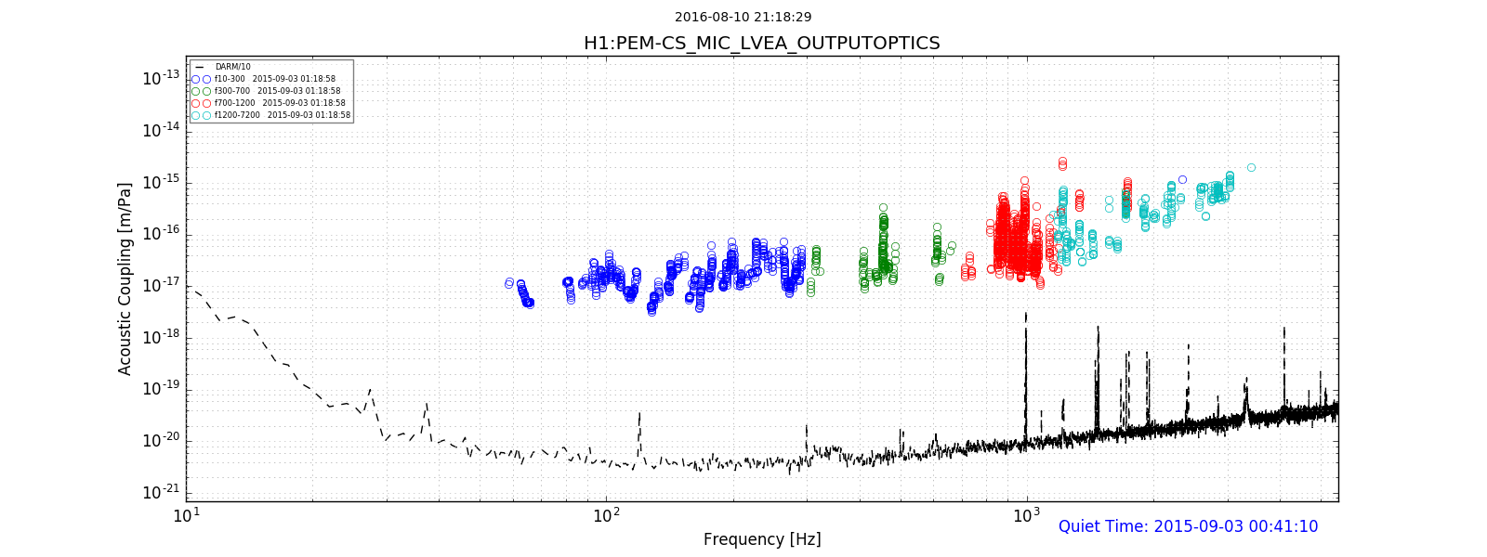
Environmental Monitoring:
Coupling Function Calculator
LIGO-T1600387
Julia Kruk
Cornell University, Physics ‘18
LIGO SURF 2016: Working under Robert Schofield

Slide 2
Generally Speaking...
LIGO-T1600387
Environmental Monitoring at LIGO is a study of how ambient environmental noise impacts the signal in DARM: this includes magnetic, acoustic and vibrational coupling.
Coupling Functions: demonstrate the response in DARM to various kinds of coupling.
The purpose of the Coupling Function Calculator and other software I wrote is to decrease the chances of the veto of gravitational waves due to false classification as environmental noise in DARM by factors of 10.

Slide 3
Coupling Functions as used during, and before, O1
LIGO-T1600387
To understand how various environmental signals affect various parts of the interferometer, collecting data that would later be used to make improvements to sensitivity.
Analyzing environmental coupling in specific locations during the time of a trigger to determine its legitimacy.
A few were calculated at a time, sometimes only for specific frequency bands.
After injections, some channels had excessively high upper limit coupling functions although there no actual coupling at that location.

Slide 4
Using Coupling Functions Now:
LIGO-T1600387
The Coupling Function Calculator allows the user to evaluate multiple channels at the same time: you could calculate functions for all PEM sensors around a chamber, an entire region, a building, or all of the PEM sensors installed along the interferometer if you wish.
By running broader searches, we can produce coupling functions that are lower upper limits and reduce the possibilities of false dismissals. This is because the program enables us to catch misleading data results during the injection process, and help improve the manner in which injections are conducted.
This may not only help improve sensitivity, but make the gravitational wave vetting process faster and more accurate.

Slide 5
Calculating Coupling Factors:
LIGO-T1600387
Four TimeSeries extractions from the server must be made: sensor during trigger, DARM during trigger, sensor quiet and DARM quiet.
FFT this data to obtain an amplitude density spectrum.
Spectrum and DARM signal calibrations are applied.
Certain threshold are used in order to ensure that we are actually seeing a signal at the sensor and a corresponding signal in DARM.

Slide 6
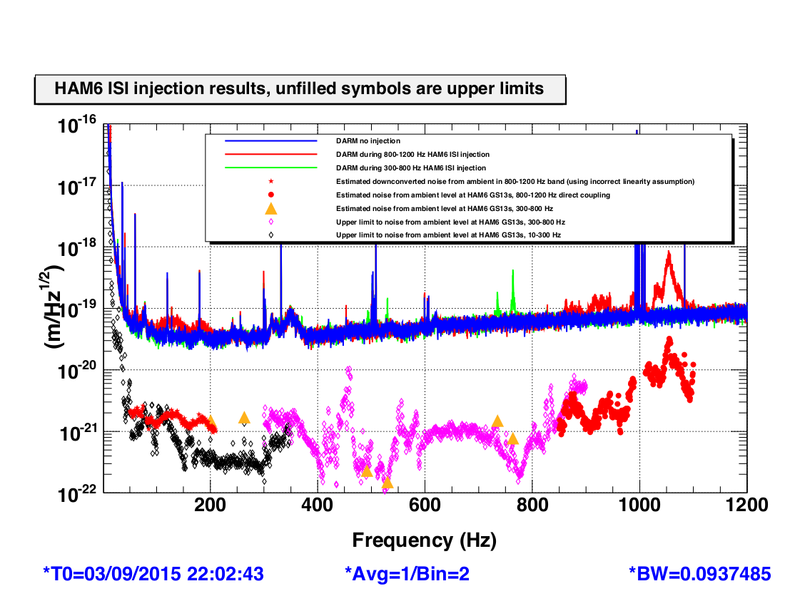
Coupling Functions are not Transfer Functions:
LIGO-T1600387
This is because of coherence: we are not as strict about it.
We are very interested in noncoherent events because this is usually an indication of up/down conversions.

Slide 7
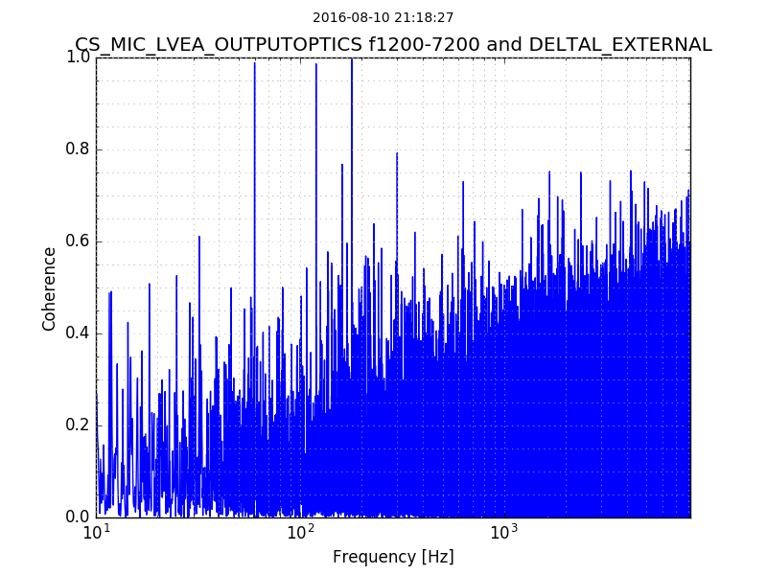
LIGO-T1600387
However, the code still calculates for it and notifies the user when the coherence for a particular channel is especially low, as an indication that they should take a closer look at the data.
Coherence is outputted in the same csv file that holds the coupling factor data for each frequency bin.
The code also generates coherence plots for easier examination.
These procedures need to be requested in the configuration file.

Slide 8
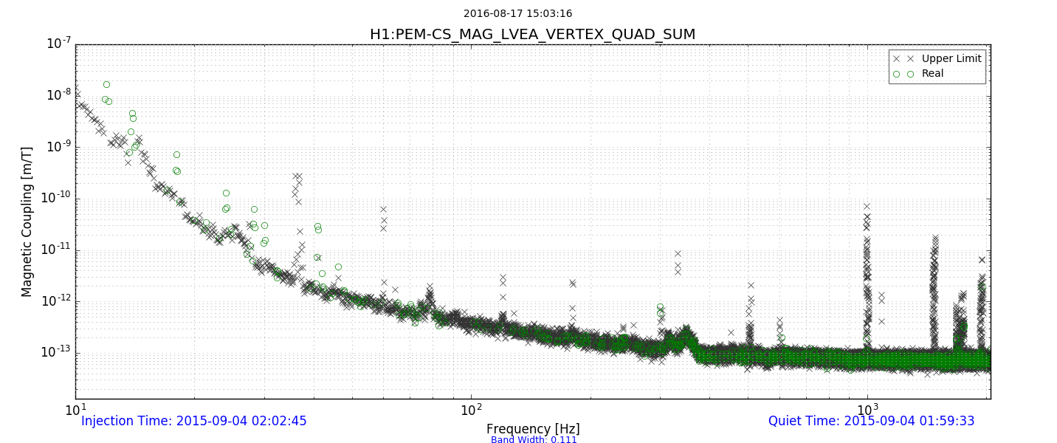
Producing Coupling Functions a channel at a time:
LIGO-T1600387

Slide 9
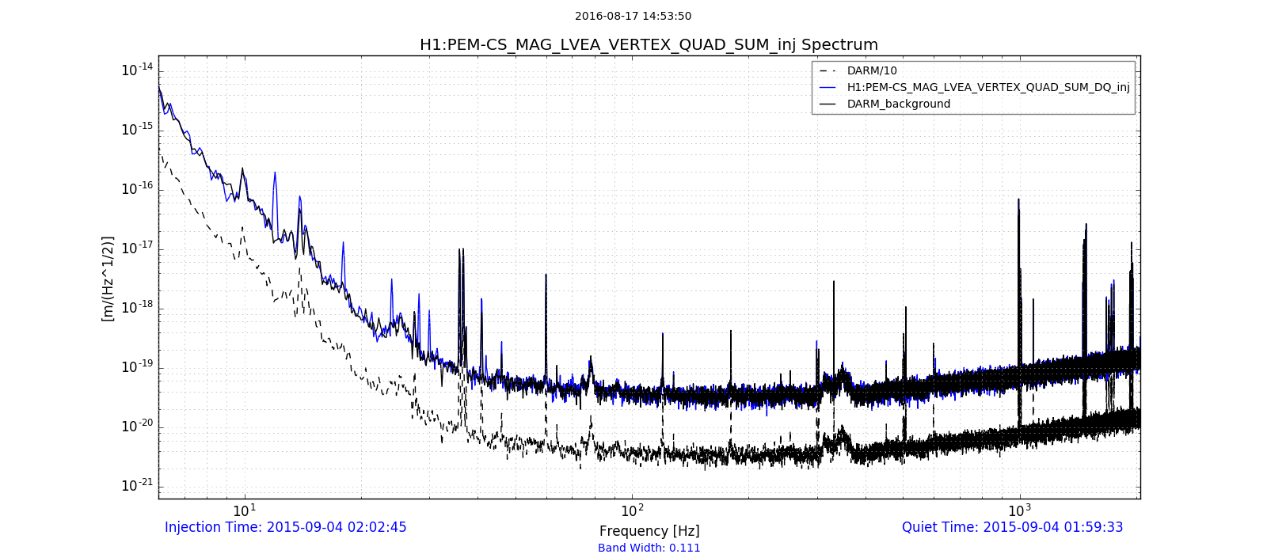
Plotting Corresponding Spectrums:
LIGO-T1600387

Slide 10
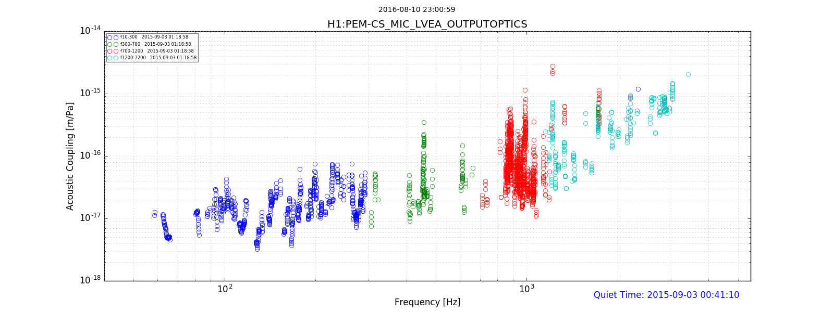
Frequency Band Plotting for Coupling Functions:
LIGO-T1600387

Slide 11
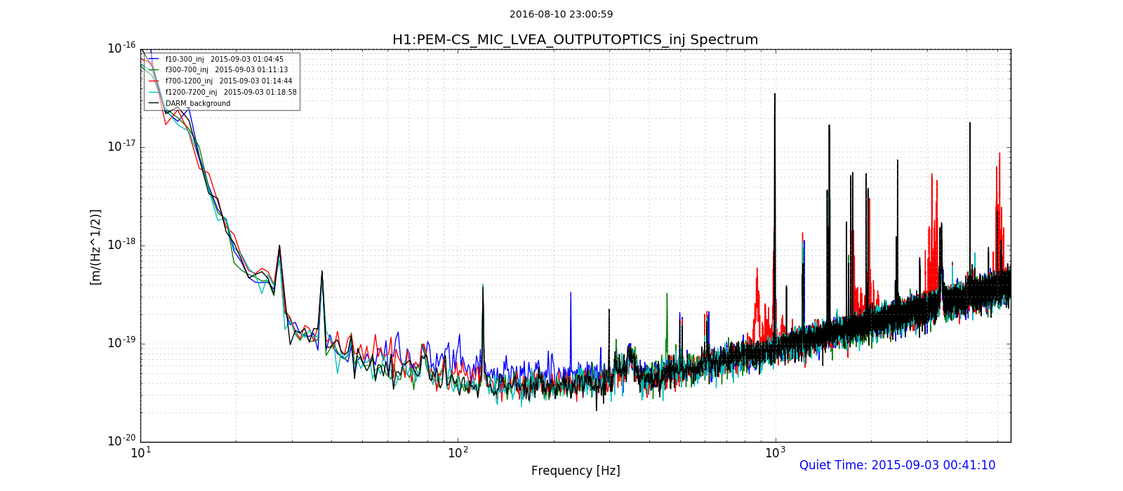
Superimposed Spectrums:
LIGO-T1600387

Slide 12
Other Features of the Program:
LIGO-T1600387
Most of the variables can be manipulated through a configuration file.
Links to the PEM.ligo.org channel database for easy extraction of calibration factors: the user would only need to edit this information in one place.
Calculates and plots Estimated Ambients on outputted spectrum.
The program will package the calculated data in a dated directory, and put it in whichever directory the user specifies.
Outputs a csv file that documents all the data used for the creation of the plots. These files are then used in the Lowest Coupling Function code (currently being written).

Slide 13
User Friendliness!
LIGO-T1600387
This program was designed to be as user friendly as possible: make it easier on the SURFs, fellows and folks at LLO.
Includes:
Configuration files
Options Parser
Interactive Mode
Easily-interpretable error messages
These scripts are intended to remain a black box for as long as possible.

Slide 14
Configuration Files:
There is a default config file, yet the program accepts custom files if specified in the options parser.
Contains both optional and mandatory variable input. If input is provided incorrectly, the program return very specific error messages that will guide the user in fixing the problem.

Slide 15
Things still in the works:
LIGO-T1600387
Lowest Coupling Function Calculator:
This program will take csv output from the Coupling Function Calculator for the same channel at different injection times and pick out the lowest upper limit coupling factors for each frequency bin.
The output function will then be placed in a specific directory in preparation for upload to the PEM.ligo.org site.
The lowest coupling functions will be used in gravitational wave vetting.
PEM.ligo.org Query Code:
A small code that will update the channel calibration factors used in the coupling programs when the PEM.ligo.org database is edited.

Slide 16
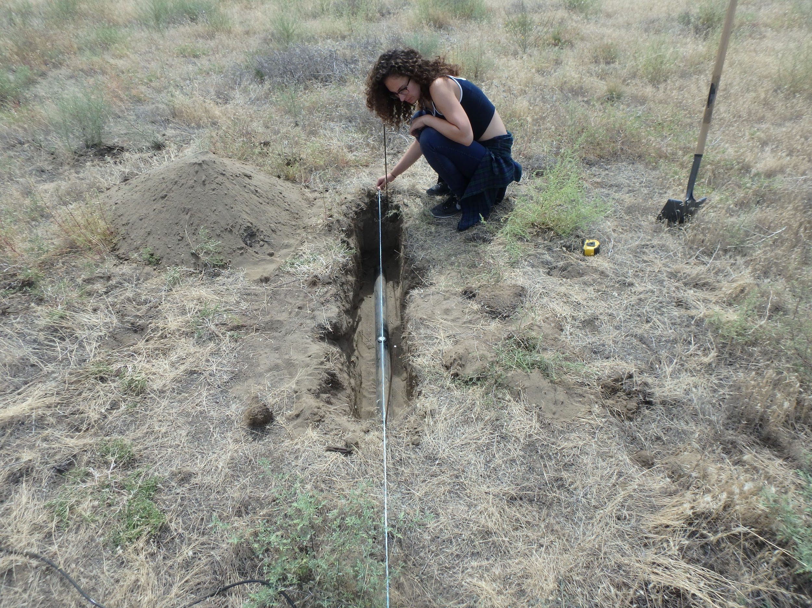
Other cool things we did:
LIGO-T1600387

Slide 17
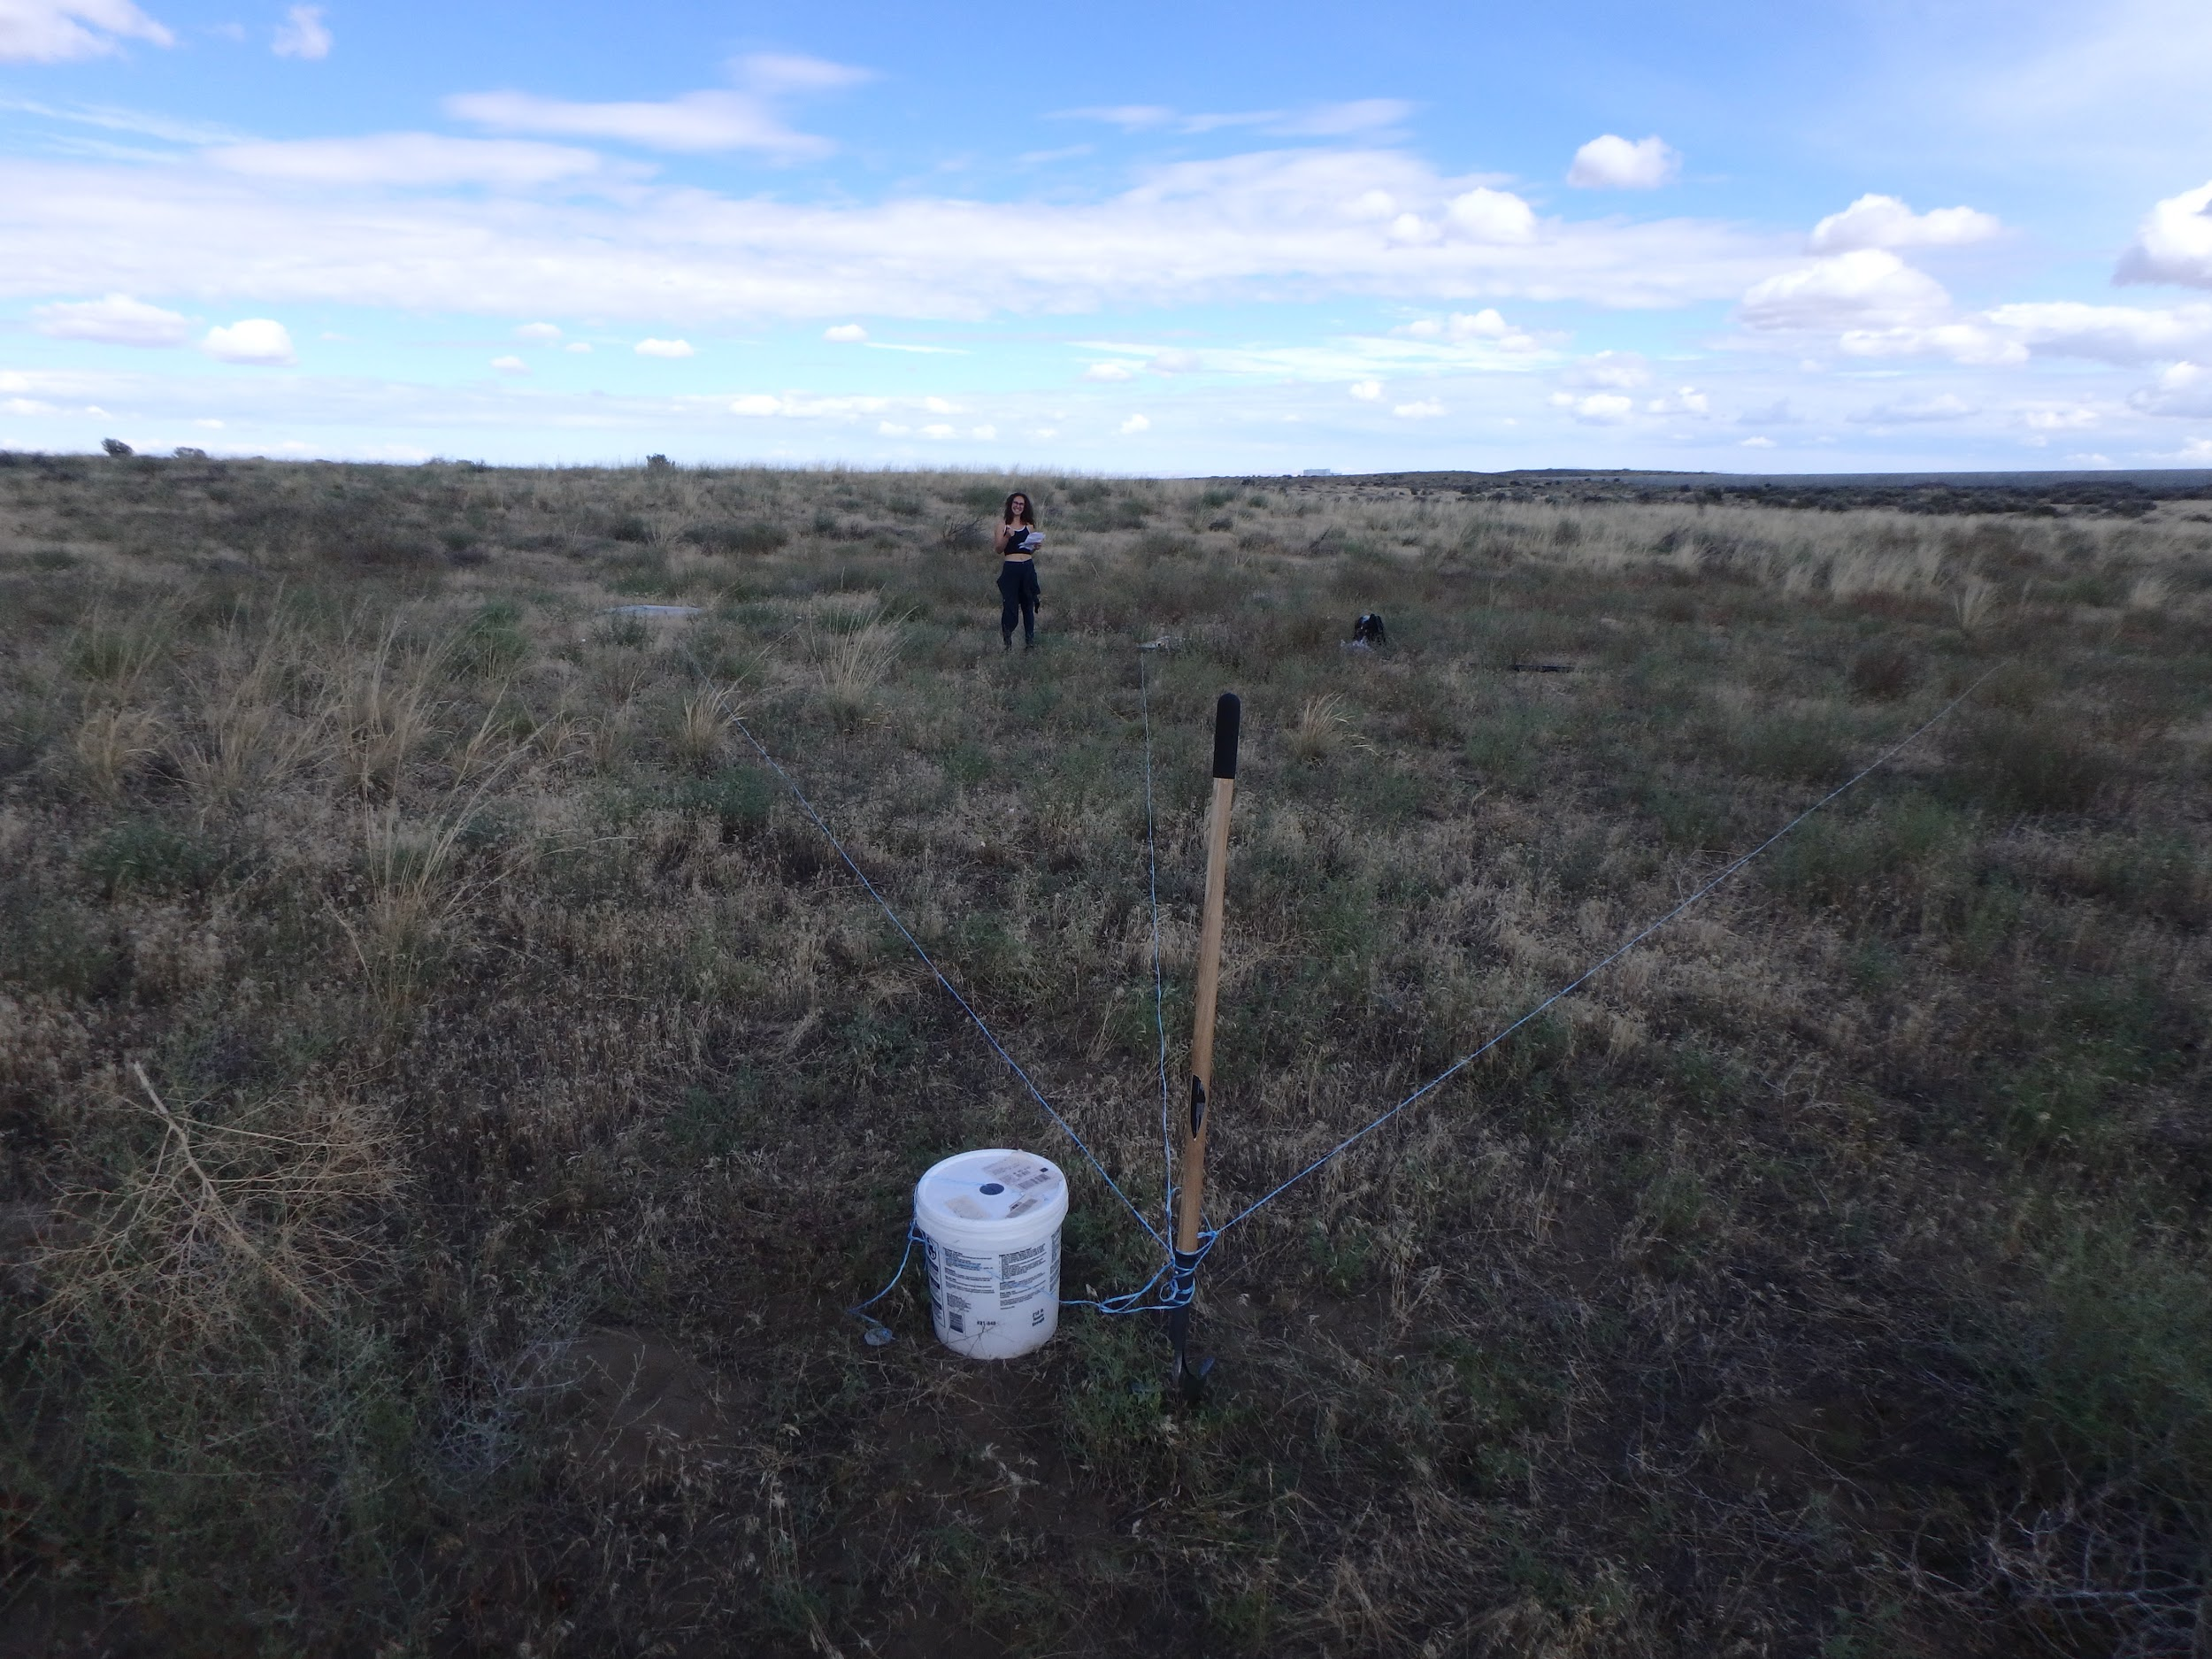
LIGO-T1600387

Slide 18
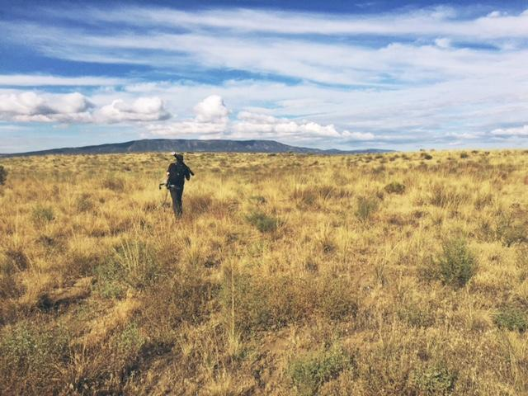
Thank you!
LIGO-T1600387

