Slide 1
Developing Methods of Gravitational Wave Detector Characterization
Author: Praful Vasireddy
Mentors: Maximiliano Isi, Gautam venugopalan, rana adhikari

Slide 2
Caltech 40m Prototype Interferometer

Slide 3
Benefits of having a small-scale controls prototype
Controls prototype: not worried as much about controlling the noise, main goal is to test new features regarding controlling parts of the interferometer
Convenient to make changes at the interferometer
Less expensive and catastrophic when something goes wrong at a small-scale prototype
Easier to handle a 100x smaller instrument
Example of new controls system developed at the 40m: ALS (Arm Length Stabilization)
Notes:
What does ALS do?

Slide 4
Detector Characterization
Detector characterization: understanding state of the interferometer in its environment
Detecting gravitational waves is possible because of the work to study and identify noise sources
Must be able to distinguish noise from signal to make any detections
Improving knowledge of noise sources increases the range in which gravitational waves can be detected
Learning how to isolate and remove noise from the signal

Slide 5
Summary Pages
Webpages that display various plots of data channels which provide information about different parts of the interferometer
Updated every 30 minutes
Open to the public
Helpful for quickly diagnosing issues and debugging
Limitation: no information about physical state of detector, only display readout of data channels

Slide 6
MEDM Screens
MEDM: Motif Editor and Display Manager
Status screens which display the current state of different parts of the interferometer
Display information about physical status of interferometer
Useful for debugging, checking that things are working

Slide 7
MEDM Tab on Summary Pages
Goal: integrate MEDM screens into summary pages so that physical information is displayed
Began with some scripts that took screenshots of MEDM screens
Implemented into summary pages
Archive lookup function that allows users to check an MEDM screen at a given time for debugging and identifying issues
Could be transferrable to actual sites (Guardian)
MEDM

Slide 8
Measuring Coupling of Acoustic Noise to Interferometer
Goal: determine what effect acoustic noise at the interferometer has on data readout and cancel that effect
Need to amplify microphone signal
EM172 microphones have a frequency range of about 50 Hz to 20 kHz
Previous work: amplify at one central location
New system: amplify at every microphone
Noise picked up in signal travel is now no longer amplified

Slide 9
Amplifier Circuit

Slide 10
Frequency Response
Notes:
What is the meaning of the switch at 4 kHz in the phase response?

Slide 11
Spectra

Slide 12
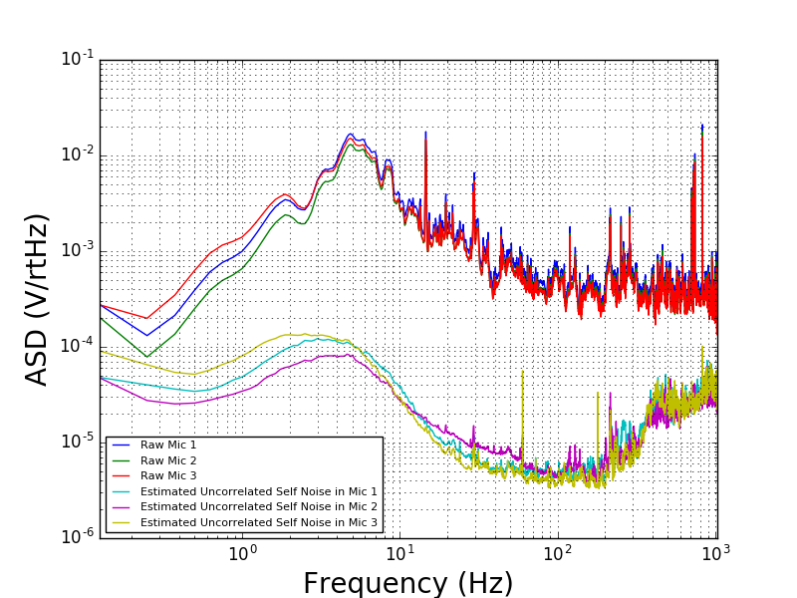
Measuring Self Noise
Notes:
How does the frequency-dependent calculation actually work?

Slide 13
Setting Up the Microphones
Setup needs to be isolated from ground motion and not pick up motion of the air at the microphone
Suspension accomplishes this- need a heavy enough box
Microphone needs to be attached to amplifier circuit
Needs to be able to be changed easily if gain is tweaked, etc.

Slide 14
Microphone Box Design

Slide 15
Microphone Locations at the 40m
Tradeoff between having the microphones near the noise sources and near the optics and important parts of the interferometer
Near noise source: get clearest data about the noise being produced in the interferometer, not much information about coupling to interferometer readout
Near interferometer: observe the noise that the interferometer hears
Future work: design a system that optimizes the location to observe coupling

Slide 16
Microphone Layout

Slide 17
Next Week
Make a prototype box with amplifier circuit and suspend
Set up a data channel
Add new tab to summary pages

Slide 18
Acknowledgements
Maximiliano Isi, Gautam Venugopalan, Rana Adhikari, Eric Quintero, Steve Vass, Lydia, Aakash Patil, Varun Kelkar, Koji Arai, Yoichi Aso

