Slide 1
3D Printing LIGO Chamber
Ellie Parisi
Dr. Calum Torrie, Dr. Norna Robertson

Slide 2
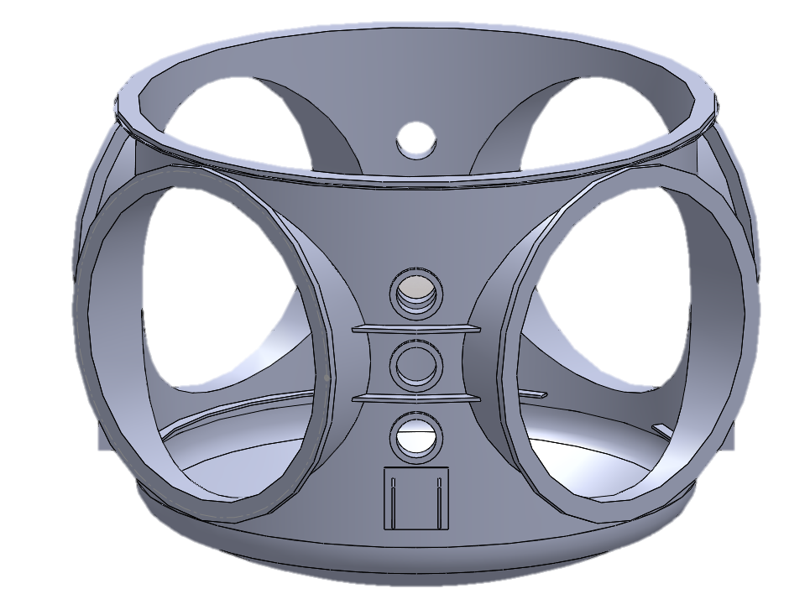
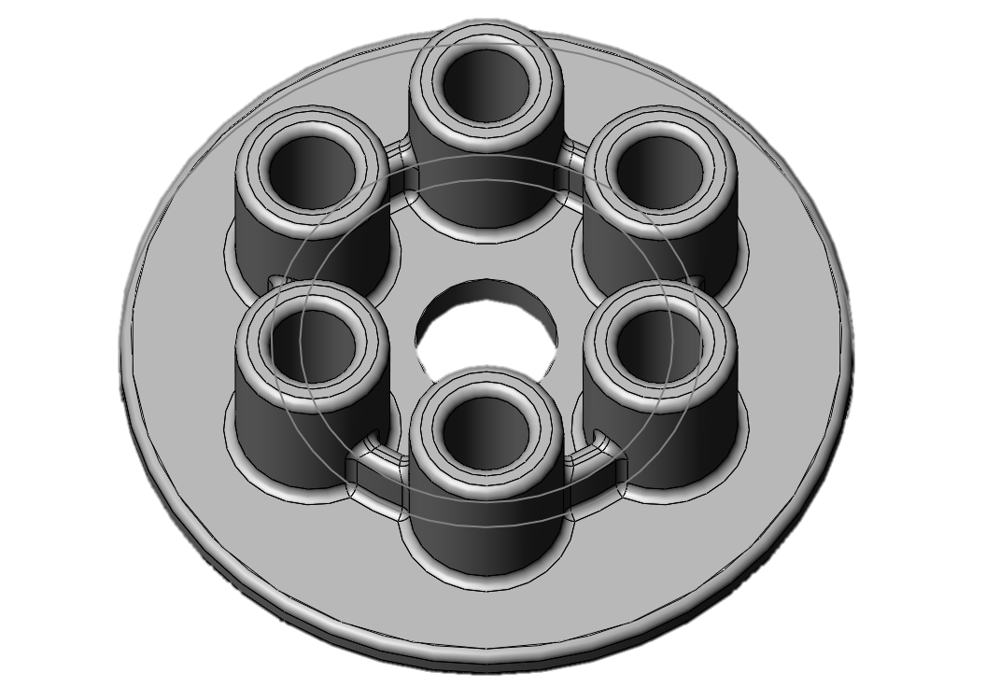
3D Printing
Solidworks to create 3D models to print
Planning to print larger parts at Chandler School
Overall goal:
Print 3D Mini-LIGO chamber
Make LIGO chamber files and instructions on how to print widely available
Future work:
Simplify LIGO chamber files to 3D print successfully
3D Print Quad Suspension

Slide 3
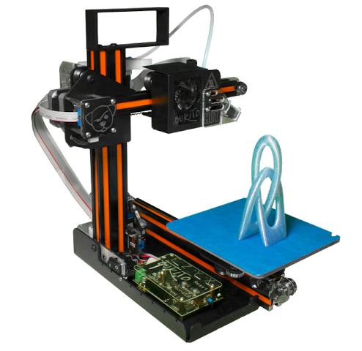
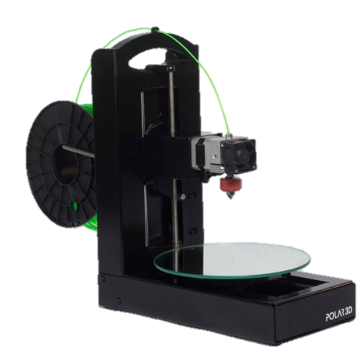
3D Printer Comparison
Lulzbot Taz 5
-$1,870
-28 x 28 x 25 cm build size
-Lots of plastic types supported
Bukito
-$799
-12.5 x 15 x 12.5 cm build size
-Small and portable
Polar 3D
-$599
-20.3 x 20.3 x 15.2 cm build size
-Has own app and educational resources
-Uses polar coordinates

