Slide 1
Astronomical Catalogs for Locating Gravitational-wave Events
Kunyang Li
Roy Williams
LIGO SURF 2016

Slide 2
Skymap Viewer
Galaxy Stellar Mass Estimation
Method 1: B Mag (blue light)
Method 2: W1-W2 method (MIR)
Method 3: Evolutionary Population Synthesis and SED fitting (red light)
Comparison between catalogs
Galaxy Cluster Stellar Mass Estimation
Method 1: Using cluster richness (optical)
Method 2: Using total luminosity (X-Ray)
Method 3: Using Sunyaev–Zel'dovich Effect (G lensing)
Metallicity Estimation
Metallicity from SED fitting
Method 1: mass-metallicity relation (MZR)
Future Work
Summary

Slide 3
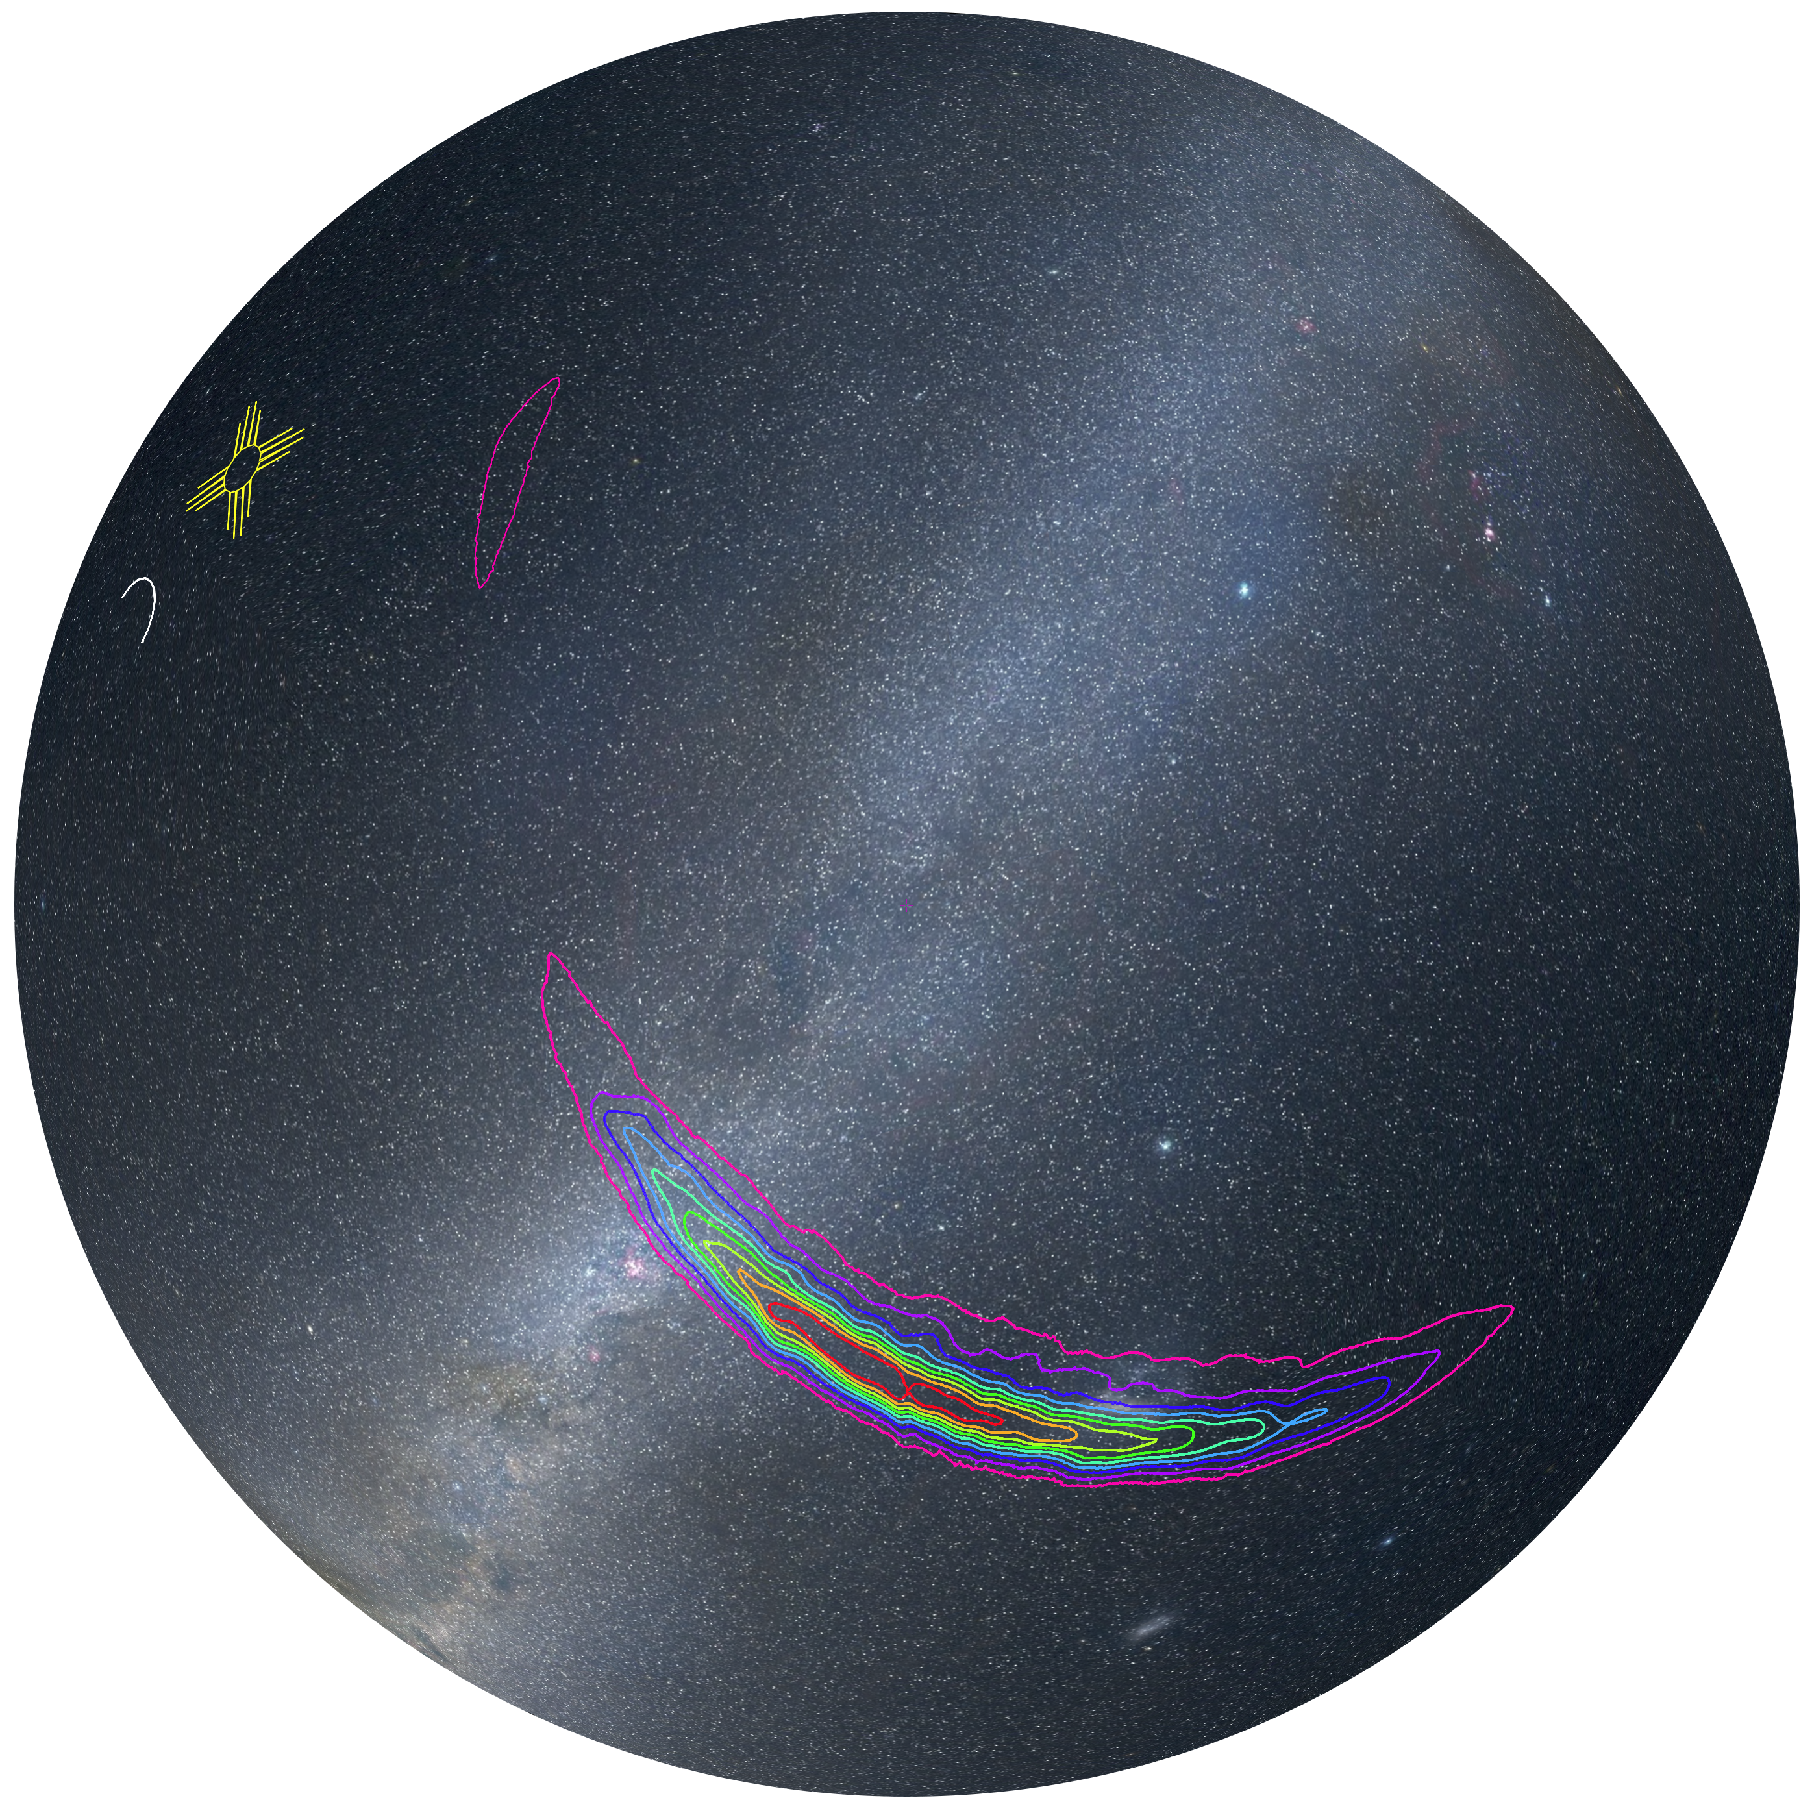
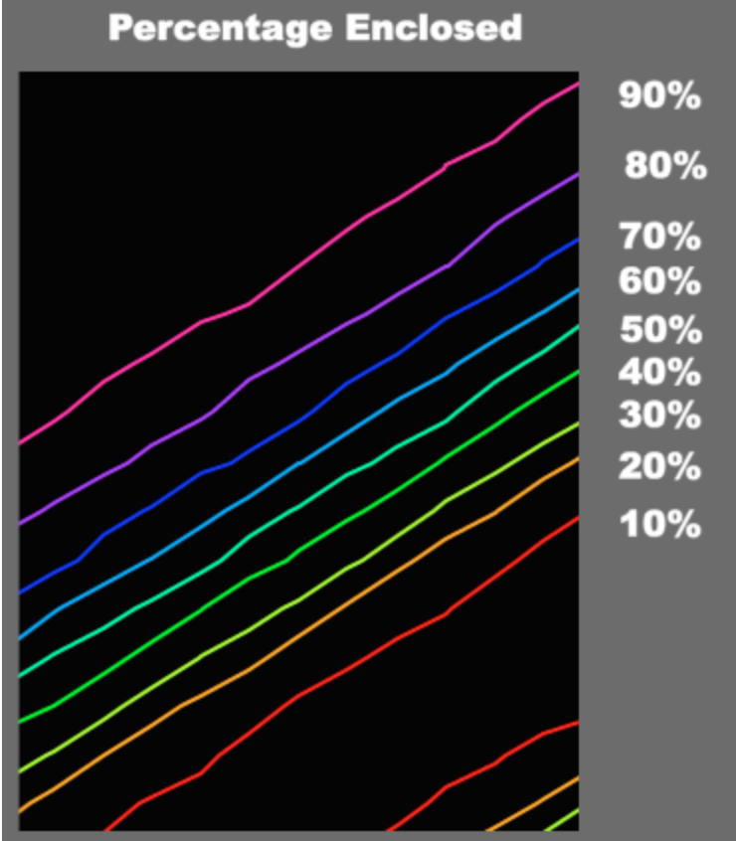
Skymap Viewer
Skymap Viewer is an interactive, web-based tool to display a sky map along with a host of relevant information for follow-up observers.
The sky map is shown as a contour plot, each color-coded line enclosing a given percentage of the total probability.
GW150914

Slide 4
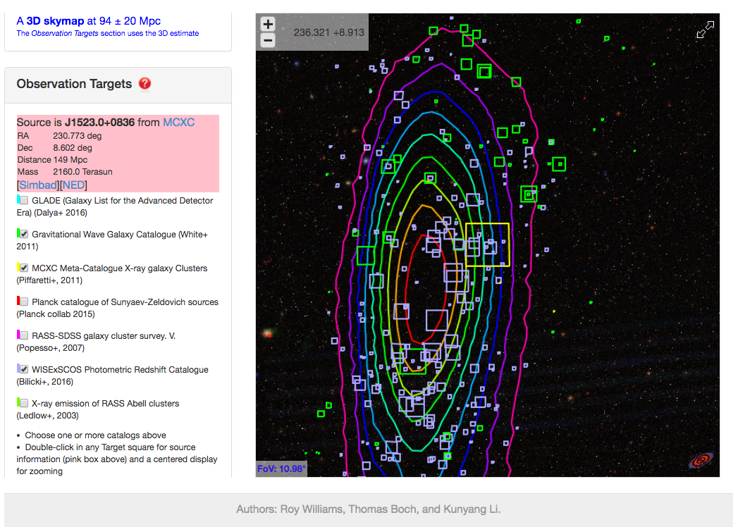
Skymap Viewer
FOV=15d
catalogs checked:
GWGC (OPT)
2MASS-GLADE
WISExSCOS galaxies
Planck (SZ)
RASS-SDSS (X-Ray)
RASS-Abell
MCXC galaxy clusters
area of each square is prop. to MASS * 3D prob density
double-click in square for pink info and centering
Skymap Viewer coming soon to
https://losc.ligo.org/s/skymapViewer/
(R.Williams, T.Boch, K.Li)

Slide 5
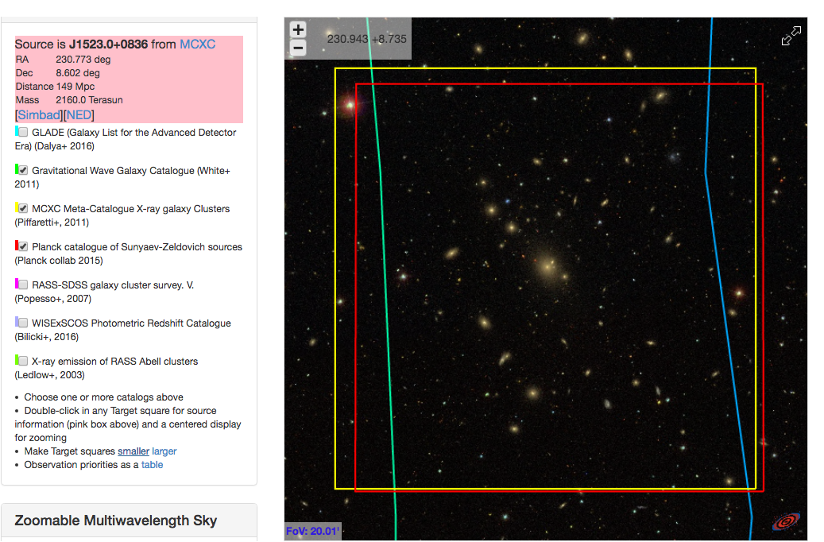
FOV=0.5d
keep zooming
here is prime observational target Abell 2063
Skymap Viewer coming soon to
https://losc.ligo.org/s/skymapViewer/
(R.Williams, T.Boch, K.Li)

Slide 6
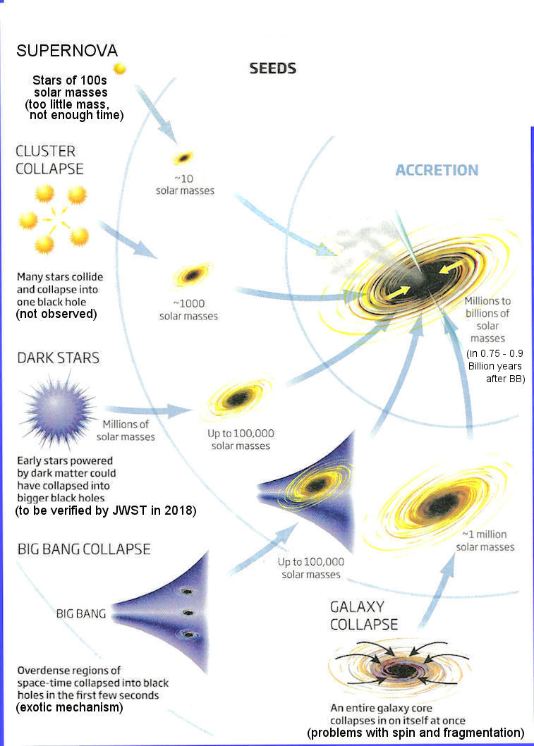
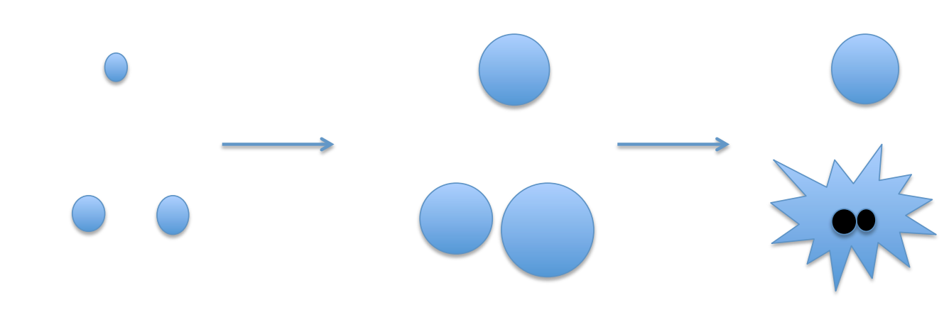
Mass as Priors
Probability = MASS * 3D prob density (GW signal)
Number of GCs (Dynamical interaction) $∝$ galaxy stellar mass
DM (Primordial BHs) $∝$ galaxy stellar mass
Low Metallicity (only required by massive BBHs)
Pop III stars
BBHs in hierarchal three-body system
Rotational mixing

Slide 7
Galaxy Stellar Mass Estimation
Method 1: Using B band photometry data to estimate galaxy stellar mass:
Assumption: all stars in galaxies have the same mass-to-light ratio of the Sun
Input: apparent B band magnitude, redshift (z)
$M_{g}≅L_{B}∗\frac{M_{⨀}}{L_{B⨀}}$
$$Output:galaxy stellar mass M_{g}$$
Method 2: Using W1-W2 band photometry data:
The W1 band ($3.4 μm)$of WISE survey is dominated by the light from old stars and can be used as an effective measure of stellar mass (Jarrett et al. 2013).
$$Input:W1, W2, redshift$$
$$\log\left(\frac{M_{stellar}}{L_{W1}}\right)=−1.96\left(W_{1}−W_{2}\right)−0.03$$
$$Output:galaxy stellar mass M_{stellar}$$

Slide 8
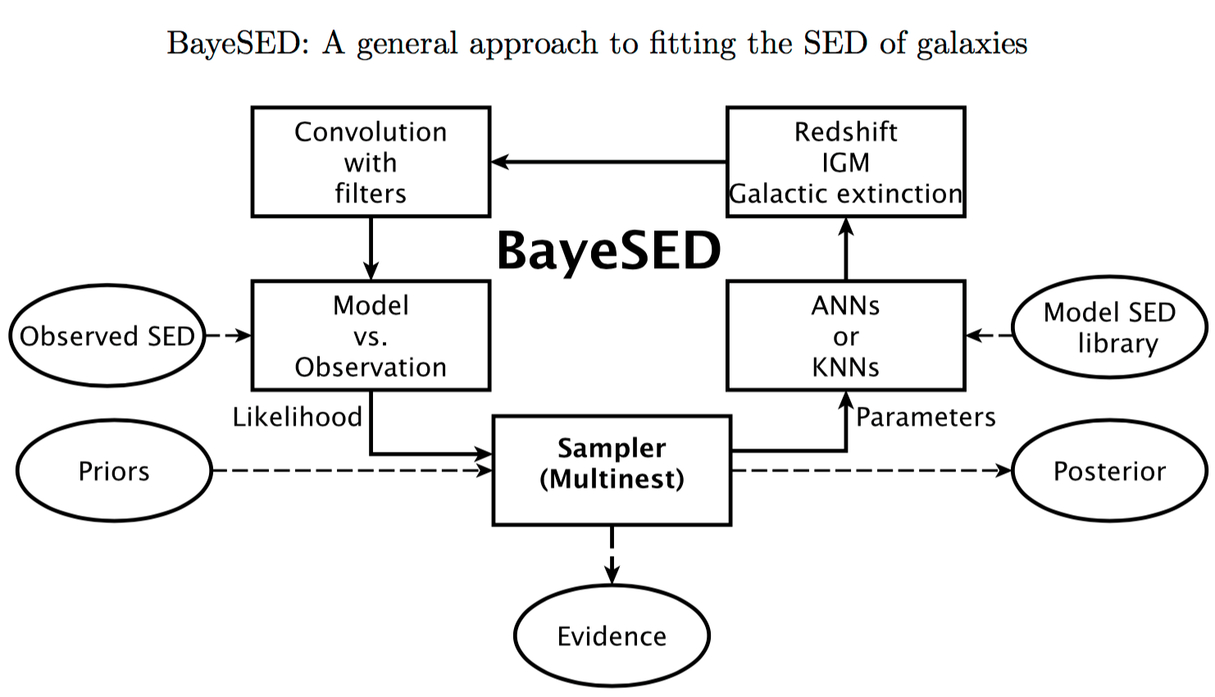
Galaxy Stellar Mass Estimation
Method 3: Evolutionary Population Synthesis and SED fitting (BayeSED)
BayeSED code algorithm flow chart:
Input B JHK photometry data (broad band SEDs), redshift
Output include galaxy stellar mass, metallicity, etc.
B JHK
Calzetti (2000) dust screen
B JHK
Bruzual Charlot (2003) (BC2003)
Han & Han 2014

Slide 9
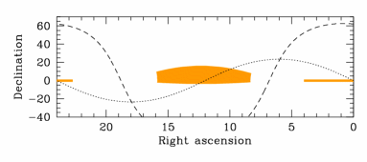
Stellar mass comparison between galaxy catalogs
Stripe 82-Massive Galaxy Catalog (S82-MGC)
S82-MGC is a part of the SDSS that was covered many times
2 magnitudes deeper than the SDSS survey
Relatively precise stellar mass estimated by Bayesian SED fitting between Y JHK photometry from the UKIDSS Large Area Survey (LAS) and FSPS models (FSPS: Flexible Stellar Population Synthesis Conroy et al. 2010)
Covers only a small area: ~250 ${degree}^{2}$,
Can be used to compare mass estimated by different methods

Slide 10
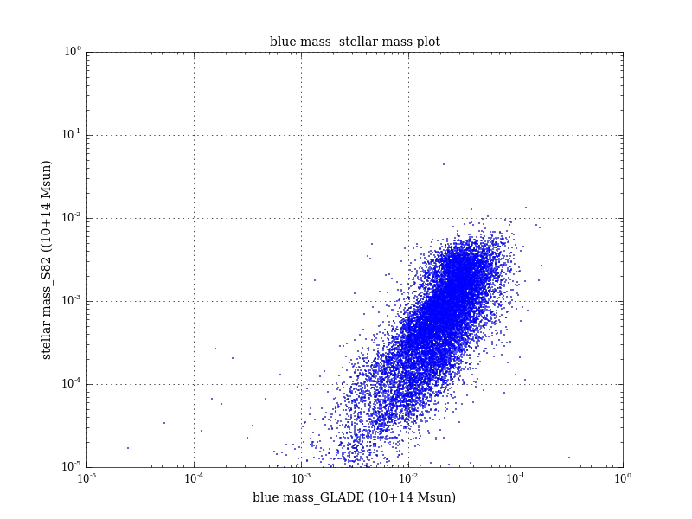
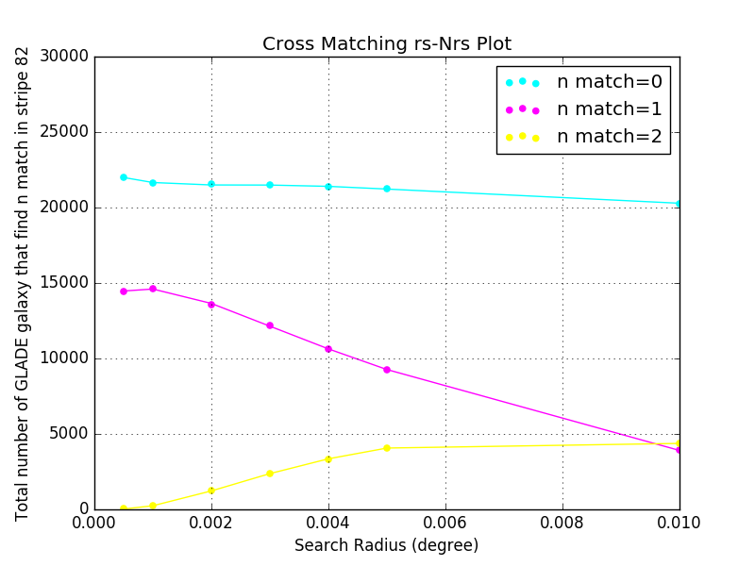
Stellar mass comparison between galaxy catalogs
Comparison between GLADE (B mag method) and S82-MGC
Cross-matching GLADE and S82-MGC using best search radius (~0.01 deg)
Compare stellar mass of the same group of galaxies (14,878) estimated by applying B mag method and SED fitting method to data from two catalog.
Mass estimation using B mag method is larger by ~2 mag due to $\frac{M_{⨀}}{L_{B⨀}}>({\frac{M}{L})}_{ave} (L_{B⨀}$< $L_{⨀})$ because heavy dust attenuation in blue band

Slide 11
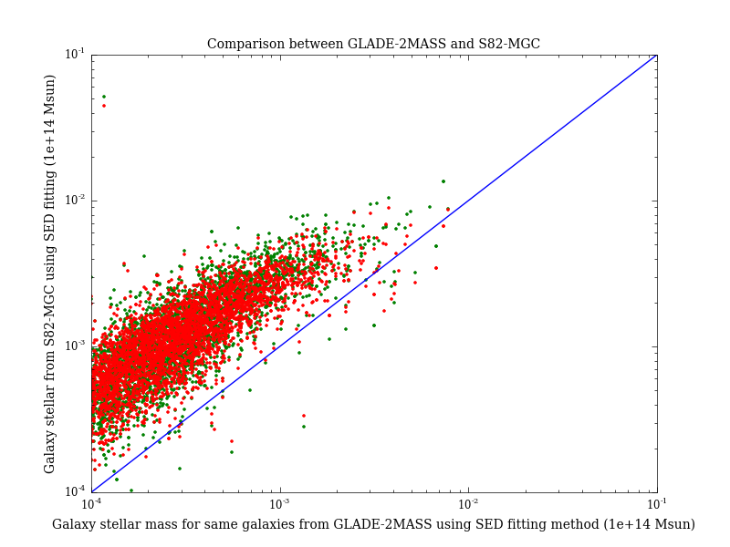
Stellar mass comparison between galaxy catalogs
Comparison between GLADE-2MASS (SED fitting method) and S82-MGC
Cross-matching GLADE-2MASS and S82-MGC using best search radius ( 0.0005 deg)
Mass estimation is smaller than expected: lack of photometry data in optical and NIR band (VRIY)

Slide 12
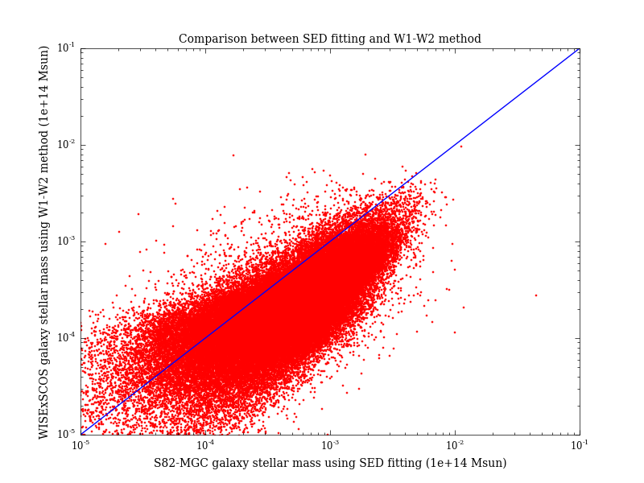
Stellar mass comparison between galaxy catalogs
Comparison between WISExSCOS (W1-W2 method) and S82-MGC
Cross-matching WISExSCOS and S82-MGC using best search radius (~0.01 deg)
Compare stellar mass of the same group of galaxies (74,403) estimated by using W1-W2 method and SED fitting method
Mass estimation agree with expectation

Slide 13
Galaxy Cluster Stellar Mass Estimation
Method 1: Using galaxy richness of a cluster(Optical)
Estimate galaxy cluster mass using the stacked velocity dispersion- richness relation derived from MacBCG catalog data (Koester et al. 2007) and Virial theorem
$$Input:dynamical radius, richness$$
$$\ln{σ\left(N_{200}\right)}=\left(5.52±0.04\right)+\left(0.31±0.01\right)ln⁡(N_{200})$$
$M_{200}=\frac{5R_{200}∗σ{\left(N_{200}\right)}^{2}}{G}$ (Virial theorem)
$$Output:galaxy cluster mass$$
Estimate galaxy cluster mass using the central halo mass-richness relation (Sheldon et al. 2007) derived by applying cross-correlation cluster lensing method on SDSS II data
$$Input: richness$$
$$M200|20=(8.8±0.4±1.1)×{10}^{13}h^{−1}M_{⨀}$$
$$α=1.28±0.04$$
$$M200\left(N200\right)=M200|20∗{\left(\frac{N200}{20}\right)}^{α}$$
$$Output:galaxy cluster mass$$

Slide 14
Galaxy Cluster Stellar Mass Estimation
Method 2: Using total luminosity (X-Ray)
X-Ray observation: no cluster richness valid
Mass estimation from L500 (the approximate total luminosity) using the L-M relation given in Arnaud et al. (2010)
$$Input:total luminosity (L_{500})$$
$$h{\left(z\right)}^{−7/3}\frac{L_{500}}{{10}^{44}}\frac{erg}{s}=C{\left(\frac{M_{500}}{3×{10}^{14}M_{⨀}}\right)}^{α}$$
$$\log\left(C\right)=0.274$$
$α=1.64$
$$Output:cluster mass (M_{500})$$
Method 3: Using Sunyaev–Zel'dovich Effect (gravitational lensing)
Planck catalog (439) : cluster mass provided by using gravitational lensing (von der Linden et al. 2014b; Hoekstra et al. 2015)

Slide 15
Mass-distance distribution plot of 5 catalogs in Skymap Viewer

Slide 16
Metallicity Estimation
For all GLADE-2MASS galaxies, metallicities are estimated together with stellar mass using the BayeSED.
Metallicities of WISExSCOS galaxies, on the other hand, are derived from stellar mass using the empirical mass-metallicity relation:
Assumption: metallicity of a galaxy is uniform and equals to the mean metallicity of the star forming gas in the galaxy.
$$Input:galaxy mass \left(M_{gal}\right), redshift (z)$$
$$\log\left(\frac{Z_{gas}}{Z_{Sun}}\right)=0.35\left[\log\left(M_{gal}\right)−10\right]+0.93e^{−0.43z}−1.05$$
$$Output:galaxy metallicity (Z_{gas})$$
The mass-metallicity relation comes from high-resolution cosmological simulation suite FIRE , and it agrees with both gas and stellar metallicity measurements observed at low redshifts for ${10}^{4}<M_{gal}<{10}^{11}M_{⨀} ,$as well as the data at higher redshifts.

Slide 17
Future Work
More catalogs (PanSTAR, etc.)
Improve the accuracy in stellar mass estimation
Add metallicity and SFR to each galaxy
Better localization from GW network (HLVIK) will make Skymap Viewer more helpful

Slide 18
Summary
Mass and distance estimations for 7 catalogs
Observation priority is constructed by stellar mass * skymap
Testing different stellar mass estimation by cross-matching with S82-MGC (SDSS)

Slide 19
Thank you!
Dr. Roy Williams
Dr. George Djorgovski

Slide 20
References
[2] Harold G. Jr.; Olowin Ronald P. Abell George O.; Cor- win. “A catalog of rich clusters of galaxies”. In: Astro- physical Journal 70 (1989), pp. 1–138.
[3] Bundy Kevin et al. “The Stripe 82 Massive Galaxy Project. I. Catalog Construction”. In: The Astrophys- ical Journal Supplement Series 221.Issue 1 (2015). doi: 10.1088/0067-0049/221/1/15.
[4] Bundy Kevin et al. “The UKIRT Infrared Deep Sky Survey (UKIDSS)”. In: MNRAS 379.Issue 4 (2007), pp. 1599–1617. doi: 10.1111/j.1365-2966.2007.12040.x.
[5] Maciej Bilicki et al. “TWO MICRON ALL SKY SUR- VEY PHOTOMETRIC REDSHIFT CATALOG: A COMPREHENSIVE THREE-DIMENSIONAL CEN- SUS OF THE WHOLE SKY”. In: The Astrophysical Journal Supplement Series 210.1 (2013).
[6] Planck Collaboration: P.A.R. Ade et al. “Planck 2015 results. XXIV. Cosmology from Sunyaev-Zeldovich clus- ter counts”. In: Astronomy Astrophysics szcosmo2014 (2014).
[7] Xiao-Qing Wen et al. “The stellar masses of galaxies from the 3.4 m band of the WISE All-Sky Survey”. In: MNRAS (2013). doi: 10.1093/mnras/stt939.
[8] Maciej et al. Bilicki. “WISE SuperCOSMOS Photo- metric Redshift Catalog: 20 Million Galaxies over 3/pi Steradians”. In: The Astrophysical Journal Supplement Series 225.1 (2016). doi: 10.3847/0067-0049/225/1/5.
[9] Ilias; Mun ̃oz Julian B.; Ali-Ha ̈ımoud Yacine; Kamionkowski Marc; Kovetz Ely D.; Raccanelli Alvise; Riess Adam G. Bird Simeon; Cholis. “Did LIGO detect dark matter?” In: eprint arXiv 1603.00464 (2016).
[10] Thomas Boch. Aladin Lite. 2014. url: http://aladin.u- strasbg.fr/AladinLite/ (visited on 10/2014).
[11] S. Bruzual G.; Charlot. “Stellar population synthesis at the resolution of 2003”. In: MNRAS 344.4 (2003), pp. 1000–1028. doi: 10.1046/j.1365-8711.2003.06897.x.
[12] Daniela et al. Calzetti. “The Dust Content and Opac- ity of Actively Star-forming Galaxies”. In: The As- trophysical Journal 533.2 (2000), pp. 682–695. doi: 10.1086/308692.
[13] Gilles Chabrier. “Galactic Stellar and Substellar Initial Mass Function”. In: The Publications of the Astronom- ical Society of the Pacific 115.809 (2003), pp. 763–795. doi: 10.1086/376392.
[14] M. E et al. Cluver. “Galaxy and Mass Assembly (GAMA): Mid-infrared Properties and Empirical Rela- tions from WISE”. In: The Astrophysical Journal 782.2 (2014). doi: 10.1088/0004-637X/782/2/90.
[15] Ofer Collister Adrian A.; Lahav. “ANNz: Estimat- ing Photometric Redshifts Using Artificial Neural Net- works”. In: ().
[16] James E.; White Martin Conroy Charlie; Gunn. “The Propagation of Uncertainties in Stellar Population Syn- thesis Modeling. I. The Relevance of Uncertain Aspects of Stellar Evolution and the Initial Mass Function to the Derived Physical Properties of Galaxies”. In: The Astrophysical Journal 699.Issue I (2009), pp. 486–506. doi: 10.1088/0004-637X/699/1/486.
[17] James E.; White Martin Conroy Charlie; Gunn. “The Propagation of Uncertainties in Stellar Population Synthesis Modeling. II. The Challenge of Comparing Galaxy Evolution Models to Observations”. In: The As- trophysical Journal 708.Issue I (2010), pp. 58–70. doi: 10.1088/0004-637X/708/1/58.
[18] S. P. et al. Driver. “Galaxy and Mass Assembly (GAMA): survey diagnostics and core data release”. In: Monthly Notices of the Royal Astronomical Soci- ety 413.2 (2011), pp. 971–995. doi: 10.1111/j.1365- 2966.2010.18188.x.
19] Dawn K. et al. Erb. “H Observations of a Large Sample of Galaxies at z 2: Implications for Star Formation in High-Redshift Galaxies”. In: The Astrophysical Journal 647.1 (2006), pp. 128–139. doi: 10.1086/505341.
[20] E.S.Phinney. “The rate of neutron star binary mergers in the universe - Minimal predictions for gravity wave detectors”. In: Astrophysical Journal Letters 380.ISSN 0004-637X (1991), pp. 17–21. doi: 10.1086/186163.
[21] G. Galgo czi-P. Raffai R. S. de Souza G. D alya Z. Frei.
[32] Xiangcheng et al. Ma. “The origin and evolution of the galaxy mass-metallicity relation”. In: MNRAS 456.2 (2016), pp. 2140–2156. doi: 10.1093/mnras/stv2659.
[33] F. et al. Mannucci. “LSD: Lyman-break galaxies Stellar populations and Dynamics - I. Mass, metallicity and gas at z 3.1”. In: MNRAS 398.4 (2009), pp. 1915–1931. doi: 10.1111/j.1365-2966.2009.15185.x.
[34] Paul; Cantiello Matteo; MacFadyen Andrew I. Perna Rosalba; Duffell. “The Fate of Fallback Matter around Newly Born Compact Objects”. In: ApJ 781.2 (2014). doi: 10.1088/0004-637X/781/2/119.
[35] M.; Pratt G. W.; Pointecouteau E.; Melin J.-B. Pif- faretti R.; Arnaud. “The MCXC: a meta-catalogue of x-ray detected clusters of galaxies”. In: Astronomy As- trophysics 534.A109 (2011).
[36] Meagan; Pattabiraman Bharath; Chatterjee Sourav; Haster Carl-Johan; Rasio Frederic A. Rodriguez Carl L.; Morscher. “Binary Black Hole Mergers from Globular Clusters: Implications for Advanced LIGO”. In: Physi- cal Review Letters 115.5 (2015).
[37] Kunyang Li. Roy Williams Thomas
An Extended List of Galaxies for Gravitational-Wave Searches in the Advanced Detector Era. 2016. url: http://aquarius.elte.hu/glade/GLADE ̇Documentation ̇1.3.pdf
(visited on 01/2016).

Slide 21
References
[19] Dawn K. et al. Erb. “H Observations of a Large Sample of Galaxies at z 2: Implications for Star Formation in High-Redshift Galaxies”. In: The Astrophysical Journal 647.1 (2006), pp. 128–139. doi: 10.1086/505341.
[20] E.S.Phinney. “The rate of neutron star binary mergers in the universe - Minimal predictions for gravity wave detectors”. In: Astrophysical Journal Letters 380.ISSN 0004-637X (1991), pp. 17–21. doi: 10.1086/186163.
[21] G. Galgo czi-P. Raffai R. S. de Souza G. D alya Z. Frei.
[32] Xiangcheng et al. Ma. “The origin and evolution of the galaxy mass-metallicity relation”. In: MNRAS 456.2 (2016), pp. 2140–2156. doi: 10.1093/mnras/stv2659.
[33] F. et al. Mannucci. “LSD: Lyman-break galaxies Stellar populations and Dynamics - I. Mass, metallicity and gas at z 3.1”. In: MNRAS 398.4 (2009), pp. 1915–1931. doi: 10.1111/j.1365-2966.2009.15185.x.
[34] Paul; Cantiello Matteo; MacFadyen Andrew I. Perna Rosalba; Duffell. “The Fate of Fallback Matter around Newly Born Compact Objects”. In: ApJ 781.2 (2014). doi: 10.1088/0004-637X/781/2/119.
[35] M.; Pratt G. W.; Pointecouteau E.; Melin J.-B. Pif- faretti R.; Arnaud. “The MCXC: a meta-catalogue of x-ray detected clusters of galaxies”. In: Astronomy As- trophysics 534.A109 (2011).
[36] Meagan; Pattabiraman Bharath; Chatterjee Sourav; Haster Carl-Johan; Rasio Frederic A. Rodriguez Carl L.; Morscher. “Binary Black Hole Mergers from Globular Clusters: Implications for Advanced LIGO”. In: Physi- cal Review Letters 115.5 (2015).
[37] Kunyang Li. Roy Williams Thomas
An Extended List of Galaxies for Gravitational-Wave Searches in the Advanced Detector Era. 2016. url: http://aquarius.elte.hu/glade/GLADE ̇Documentation ̇1.3.pdf
(visited on 01/2016).
[22] P. A. A.; de Carvalho R. R.; Kohl-Moreira J. L.; Capelato H. V.; Djorgovski S. G. Gal R. R.; Lopes. “The Northern Sky Optical Cluster Survey. III. A Clus- ter Catalog Covering PI Steradians”. In: The Astronom- ical Journal 137.2 (2009), pp. 2981–2999.
[23] A. C.; Irwin M. J.; MacGillivray H. T. Hambly N. C.; Davenhall. “The SuperCOSMOS Sky Survey - III. Astrometry”. In: Monthly Notices of the Royal As- tronomical Society 326.4 (2001), pp. 1315–1327. doi: 10.1111/j.1365-2966.2001.04662.x.
[24] A. M. et al. Hopkins. “Galaxy And Mass Assem- bly (GAMA): spectroscopic analysis”. In: Monthly No- tices of the Royal Astronomical Society 430.3 (2013), pp. 2047–2066. doi: 10.1093/mnras/stt030.
[25] Philip F. et al. Hopkins. “Galaxies on FIRE (Feedback In Realistic Environments): stellar feedback explains cosmologically inefficient star formation”. In: MNRAS 445.1 (2014), pp. 581–603. doi: 10.1093/mnras/stu1738.
[26] Erin S.; Wechsler Risa H.; Rozo Eduardo; Koester- Benjamin P.; Frieman Joshua A.; McKay Timothy A.; Evrard August E.; Becker Matthew R.; Annis James Johnston David E.; Sheldon. “Cross-correlation Weak Lensing of SDSS galaxy Clusters II: Cluster Density Profiles and the Mass–Richness Relation”. In: eprint arXiv 0709.1159 (2007).
[27] T. A.; Annis J.; Wechsler R. H.; Evrard-A.; Bleem L.; Becker M.; Johnston D.; Sheldon E.; Nichol R.; Miller C.; Scranton R.; Bahcall N.; Barentine J.; Brewington H.; Brinkmann J.; Harvanek M.; Kleinman S.; Krzesin- ski J.; Long D.; Nitta A.; Schneider D. P.; Sneddin S.; Voges W.; York D. Koester B. P.; McKay. “A MaxBCG Catalog of 13,823 Galaxy Clusters from the Sloan Dig- ital Sky Survey”. In: The Astrophysical Journal 660.1 (2007), pp. 239–255.
[28] Peter Meszaros Ian Shoemaker Nicholas Senno Kohta Murase Kazumi Kashiyama. “Ultrafast Outflows from Black Hole Mergers with a Mini-Disk”. In: ApJ Letter 822.1 (2016). doi: 10.3847/2041-8205/822/1/L9.
[29] Shea; Clausen Drew; Hopkins Philip Lamberts Astrid; Garrison-Kimmel. “When and where did GW150914 form?” In: eprint arXiv:1605.08783 (2016). doi: 2016arXiv160508783L.
[30] Henry et al. Lee. “On Extending the Mass-Metallicity Relation of Galaxies by 2.5 Decades in Stellar Mass”. In: The Astrophysical Journal 647.2 (2006), pp. 970– 983. doi: 10.1086/505573.
[31] J et al. Liske. “Galaxy And Mass Assembly (GAMA): end of survey report and data release 2”. In: Monthly Notices of the Royal Astronomical Society, 452.2 (2015), pp. 2087–2126. doi: 10.1093/mnras/stv1436.
Boch. Skymap Viewer. https://losc.ligo.org/s/skymapViewer 08/2016).
2016. (visited on
[38] Takayuki Seto Naoki; Muto. “Resonant trapping of stars by merging massive black hole binaries”. In: MNRAS 451.4 (2011). doi: 10.1111/j.1365-2966.2011.18988.x.
[39] M. F et al. Skrutskie. “The Two Micron All Sky Survey (2MASS)”. In: The Astronomical Journal 131.Issue 2 (2006), pp. 1163–1183. doi: 10.1086/498708.
[40] Christy A. et al. Tremonti. “The Origin of the Mass- Metallicity Relation: Insights from 53,000 Star-forming Galaxies in the Sloan Digital Sky Survey”. In: The Astrophysical Journal 613.2 (2004), pp. 898–913. doi: 10.1086/423264.
[41] E. J.; Dhillon V. S. White Darren J.; Daw. “A list of galaxies for gravitational wave searches”. In: Classical and Quantum Gravity 28.8 (2011). doi: 10.1088/0264- 9381/28/8/085016.
[42] Edward L et al. Wright. “The Wide-field Infrared Sur- vey Explorer (WISE): Mission Description and Initial On-orbit Performance”. In: The Astronomical Jour- nal 140.6 (2010), pp. 1868–1881. doi: 10.1088/0004- 6256/140/6/1868.
[43] Donald G et al. York. “The Sloan Digital Sky Sur- vey: Technical Summary”. In: The Astrophysical Jour- nal Supplement Series 120.3 (2000), pp. 1579–1587. doi: 10.1086/301513.
[44] Zhanwen Han Yunkun Han. “BayeSED: A General Ap- proach to Fitting the Spectral Energy Distribution of Galaxies”. In: ApJS 215.2 (2014). doi: 10.1088/0067- 0049/215/1/2.
[45] Nobuhiro; Finoguenov Alexis; Smith Graham P.; Piffaretti-Rocco; Valdarnini Riccardo; Babul Arif; Evrard August E.; Mazzotta Pasquale; Sanderson Alas- tair J. R.; Marrone Daniel P. Zhang Yu-Ying; Ok- abe. “LoCuSS: A Comparison of Cluster Mass Measure- ments from XMM-Newton and Subaru—Testing Devi- ation from Hydrostatic Equilibrium and Non-thermal Pressure Support”. In: The Astrophysical Journal 711.2 (2010), pp. 1033–1043.

Slide 22
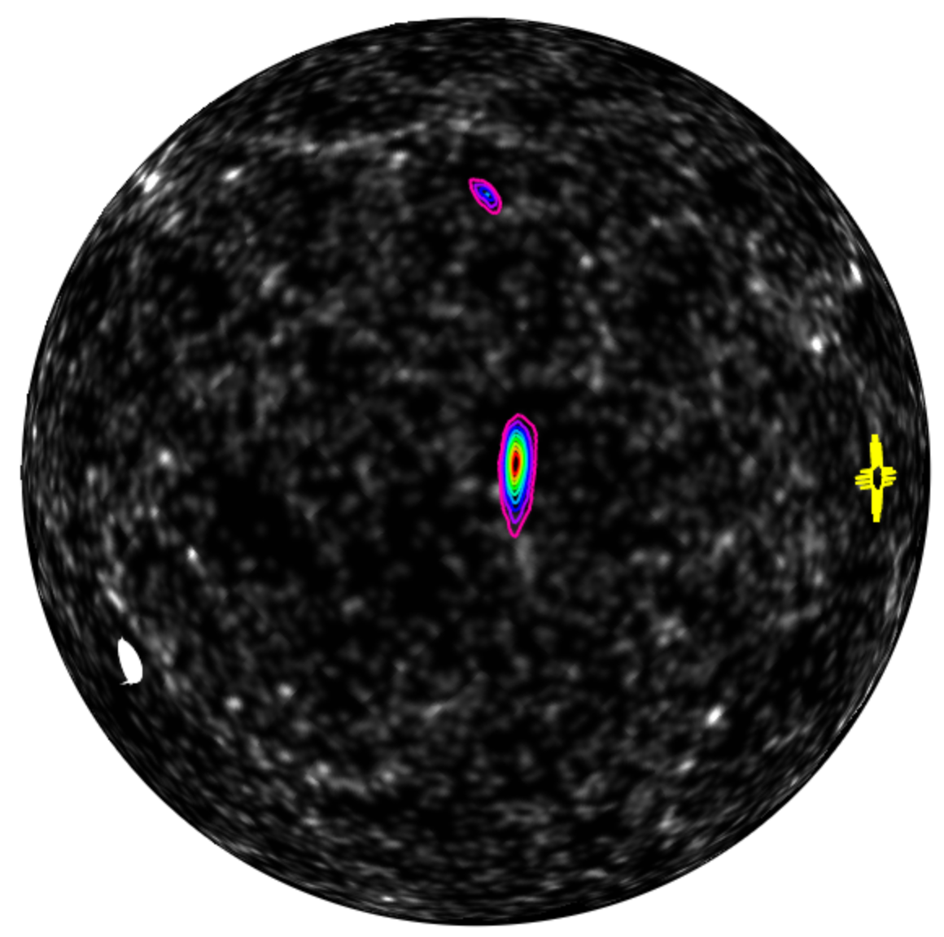
Extra Slids
FOV=180d
simulated HLV skymap from First2Years
contours are deciles of probability
many backgrounds, here shown 2MASS galaxy density*
* density of 2MASS galaxies 85 to 128 Mpc Antolini+Heyl 1602:07710
Skymap Viewer coming soon to
https://losc.ligo.org/s/skymapViewer/
(R.Williams, T.Boch, K.Li)

Slide 23
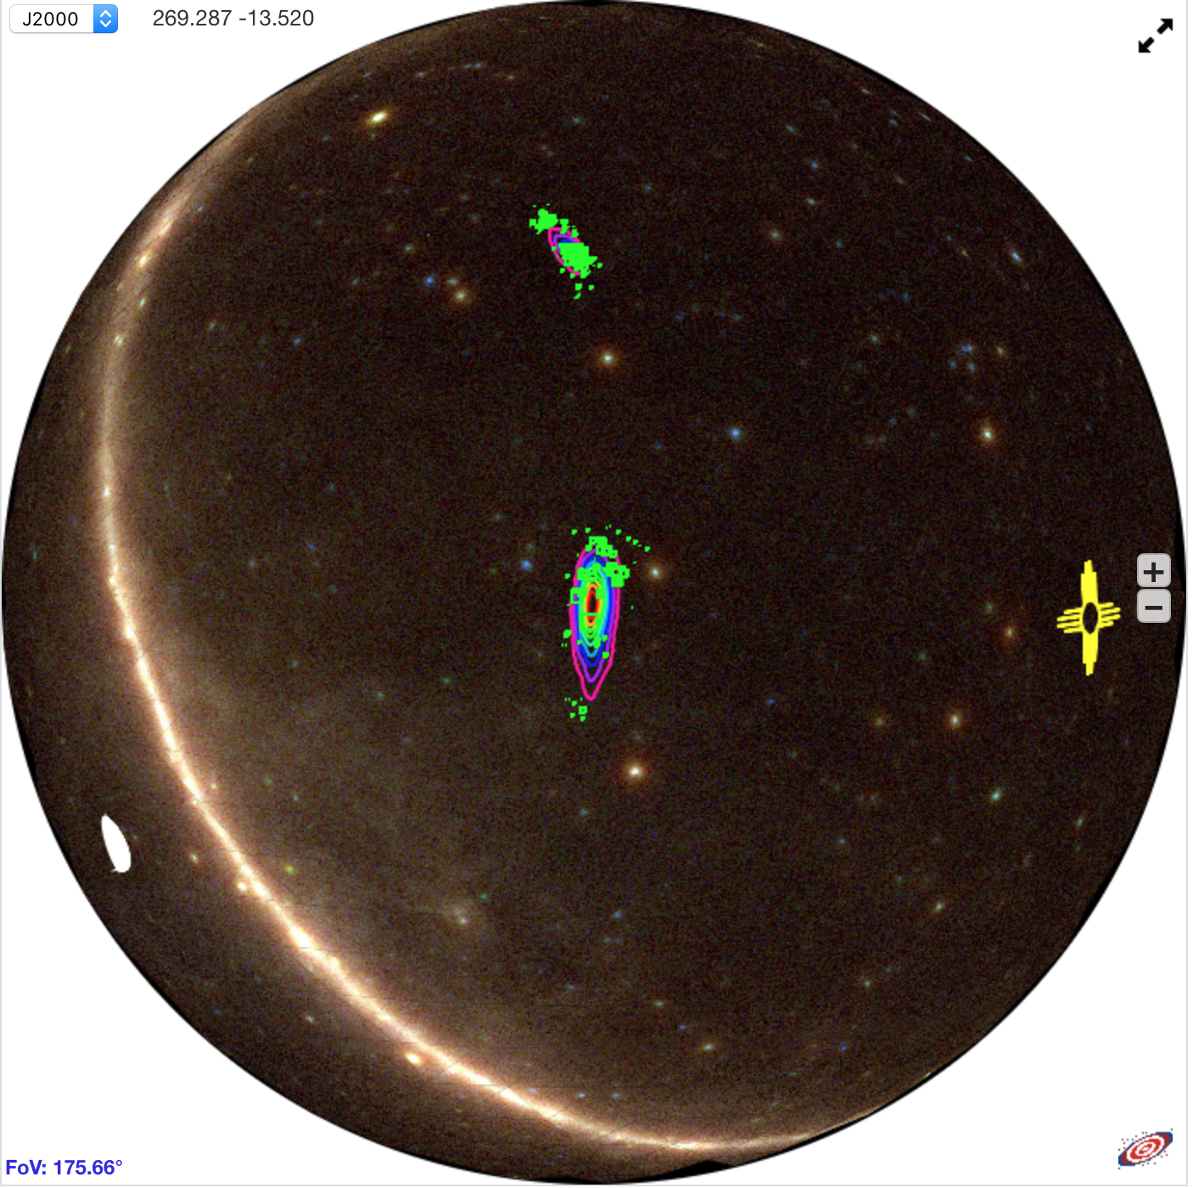
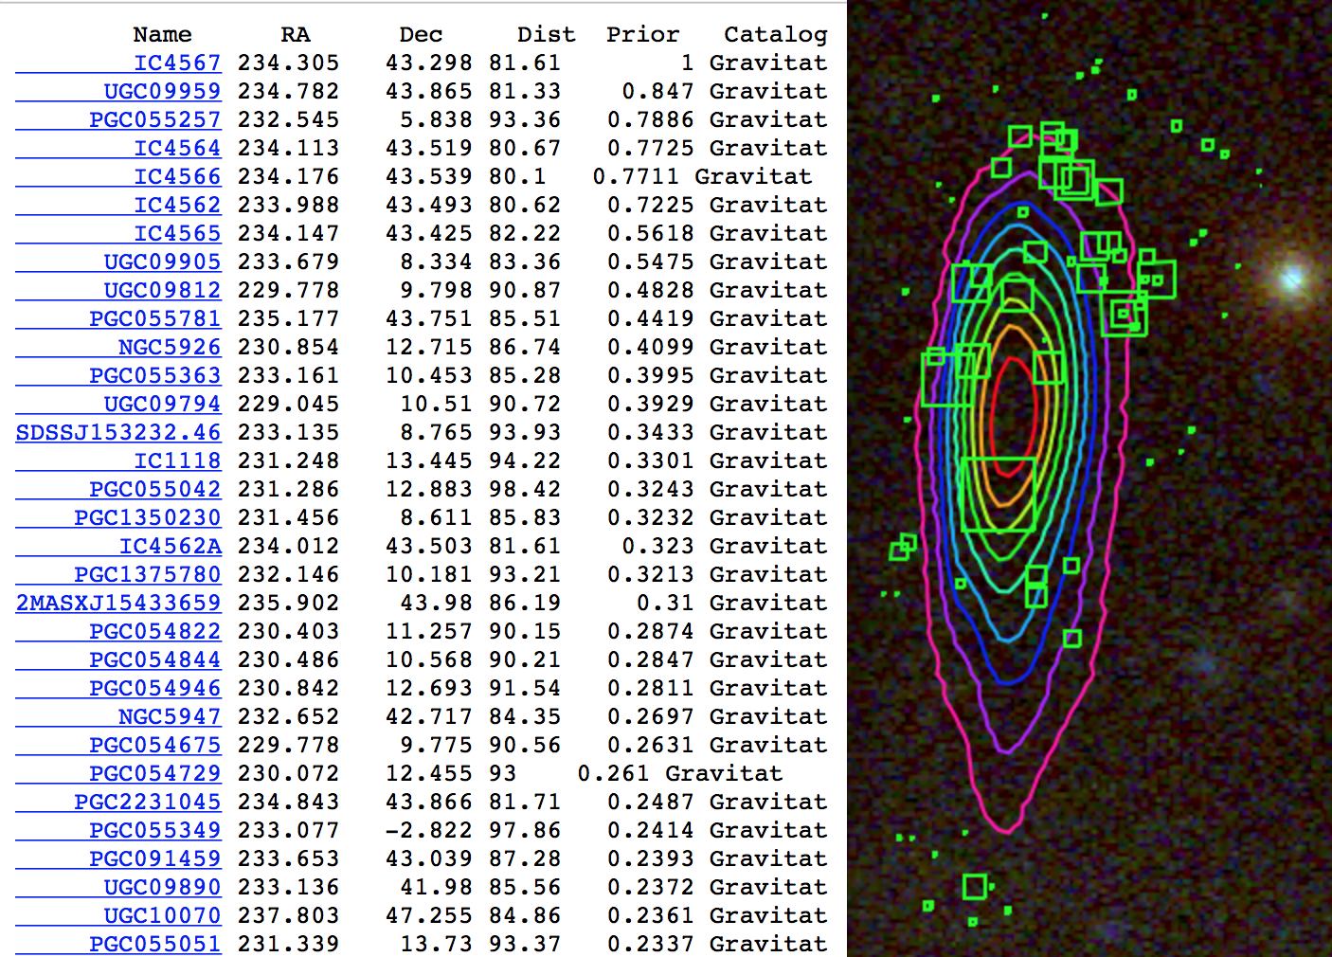
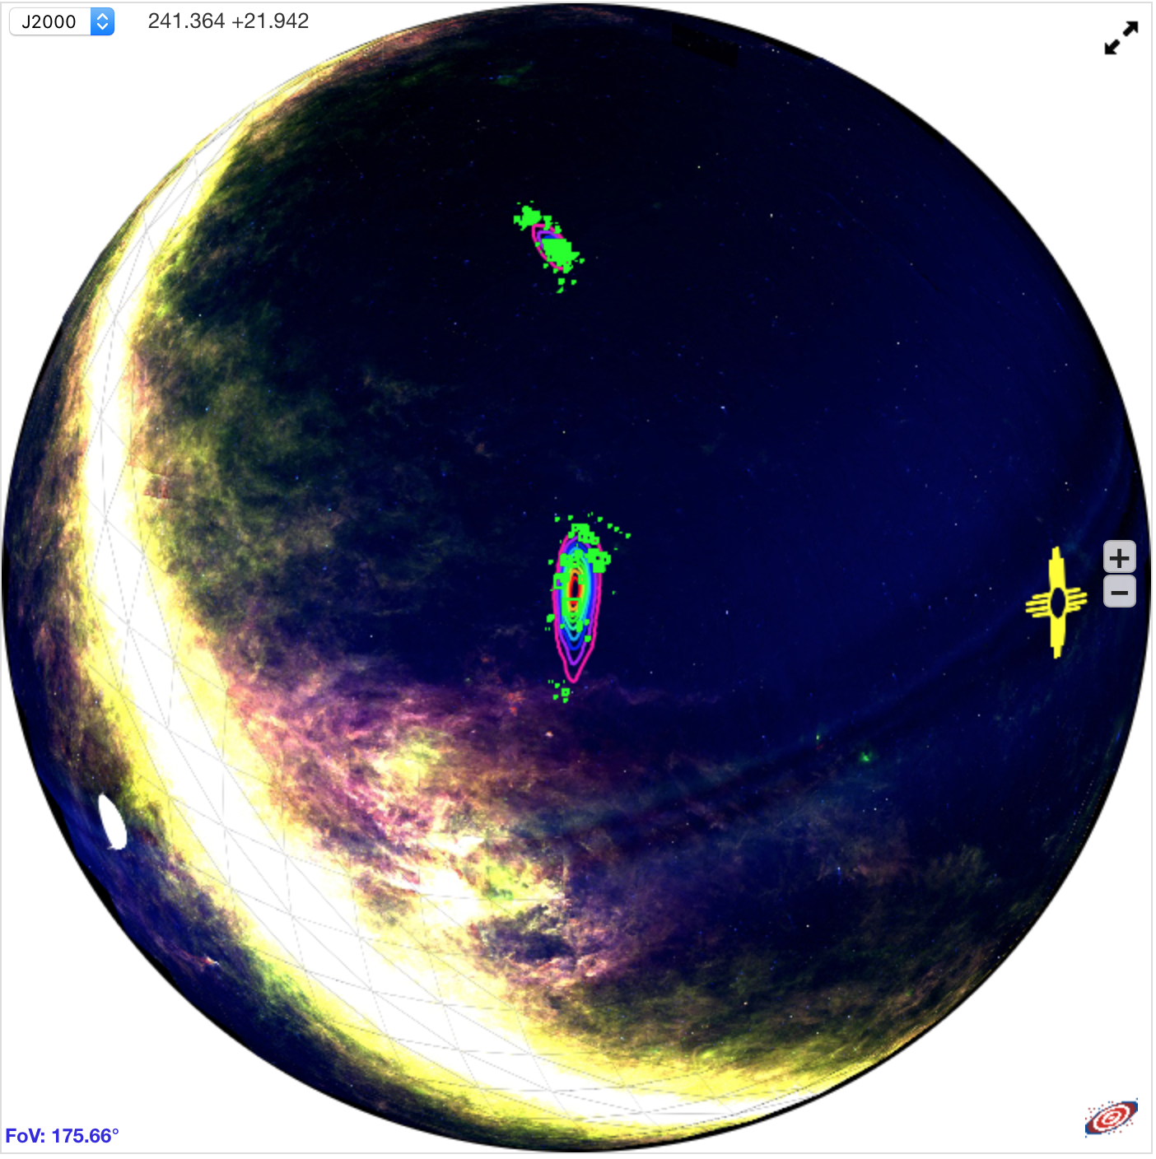
Skymap Viewer
AladinLite enables drill-down from whole-sky to arc-second resolution, including image surveys from radio to gamma-ray wavelengths.
Visualize arbitrary astronomical catalogs in terms of observation priority , which combines knowledge from the gravitational wave detection (the sky map), with known astrophysical objects (i.e. galaxies and galaxy clusters).
Fermi (Gama-Ray)
IRAS (IR)

Slide 24
Galaxy Stellar Mass Estimation
Method 1: Using B band photometry data to estimate galaxy stellar mass:
Assumption: all stars in galaxies have the same mass-to-light ratio of the Sun
Input: apparent B band magnitude, redshift (z)
$$m_{B}−M_{B}=5\log\left(d\right)−5$$
$$L_{B}=\frac{L_{B⨀}}{{10}^{0.4(M_{B}−M_{B⨀})}}$$
$M_{g}≅L_{B}∗\frac{M_{⨀}}{L_{B⨀}}$
$M_{B⨀}$=5.48 mag (absolute magnitude of the Sun in B band)
$L_{B⨀}$=$\frac{{3×10}^{33}erg}{s}$ (B band luminosity of the Sun)
$M_{⨀}$=${1.989×10}^{30}kg$ (mass of the Sun)
$$Output:galaxy stellar mass M_{g}$$

Slide 25
Galaxy Stellar Mass Estimation
Method 3: Using W1-W2 band photometry data
The W1 band ($3.4 μm)$of WISE survey is dominated by the light from old stars and can be used as an effective measure of stellar mass (Jarrett et al. 2013).
$$Input:W1, W2, redshift$$
$$\log\left(\frac{M_{stellar}}{L_{W1}}\right)=−1.96\left(W_{1}−W_{2}\right)−0.03$$
$$L_{W1}\left(L_{⨀}\right)= {10}^{−0.4(M−M_{Sun})}$$
-$M_{Sun}=3.24$
-$M:W_{1}band absolute magnitude$
-$W_{1}−W_{2}:rest frame color$
$$Output:galaxy stellar mass M_{stellar}$$

Slide 26
Galaxy Stellar Mass Estimation
GLADE-2MASS catalog (548,876 galaxys): B, J, H, K band magnitude and redshift
Evolutionary population synthesis model library: Bruzual Charlot (2003) (BC2003)
IMF (Initial Mass Function) adopted: Chabrier (2003)
SFHs (Star Formation History) of galaxies: $SFR∝ e^{t/τ}$
t : the time since the start of star formation
$τ$ : the e-folding star formation timescale
Dust attenuation:
A uniform dust screen
Dust extinction law adopted: Calzetti et al. (2000)
BC2003 parameter grid:
$\log\left(\frac{τ}{yr}\right) ∈\left[6.5, 11\right], step size=0.1 yr$
$\log\left(\frac{t}{yr}\right) ∈\left[7.0, 10.1\right], step size=0.05 yr$
$Av ∈\left[0, 4\right], step size=0.2$
Metallicity $∈\left\{0.004, 0.008, 0.02, 0.05\right\}$
243,434 model SEDs in the library, which we used to compare with observed galaxy SEDs in GLADE-2MASS.

Slide 27
Stellar mass comparison between galaxy catalogs
Comparison between GLADE (B mag method) and S82-MGC
Cross-matching GLADE and S82-MGC using best search radius (~0.01 deg)
Compare stellar mass of the same group of galaxies (14,878) estimated by applying B mag method and SED fitting method to data from two catalog.

Slide 28
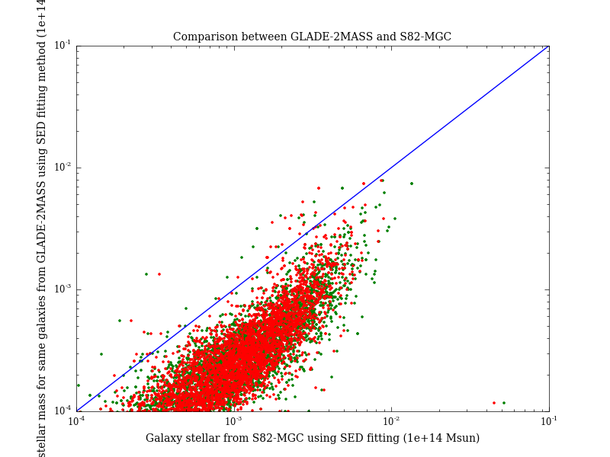
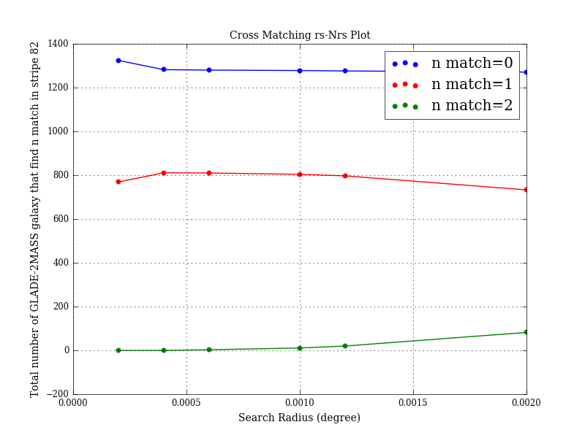
Stellar mass comparison between galaxy catalogs
Comparison between GLADE-2MASS (SED fitting method) and S82-MGC
Cross-matching GLADE-2MASS and S82-MGC using best search radius ( 0.0005 deg)
Compare stellar mass of the same group of galaxies both estimated by using SED fitting but using different data from two catalogs.

Slide 29
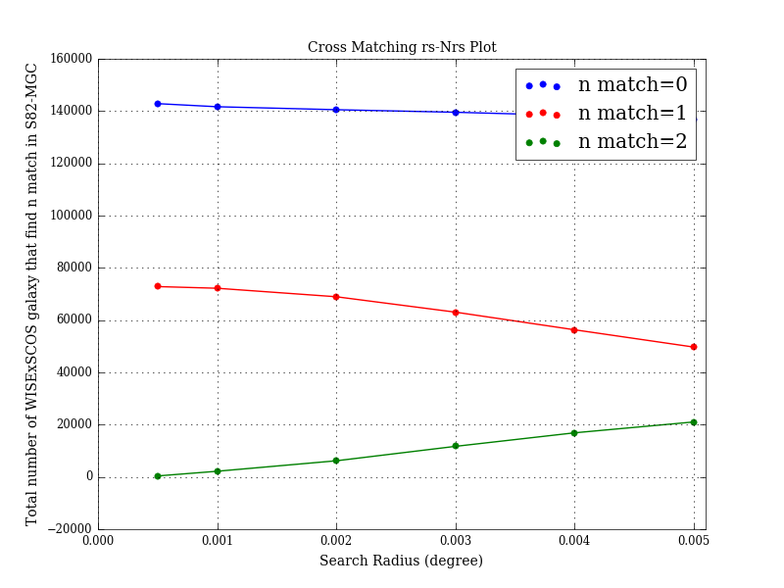
Stellar mass comparison between galaxy catalogs
Comparison between WISExSCOS (W1-W2 method) and S82-MGC
Cross-matching WISExSCOS and S82-MGC using best search radius (~0.01 deg)
Compare stellar mass of the same group of galaxies (74,403) estimated by using W1-W2 method and SED fitting method

Slide 30
Galaxy Cluster Stellar Mass Estimation
Method 1: Using galaxy richness of a cluster(Optical)
Estimate galaxy cluster mass using the stacked velocity dispersion- richness relation derived from MacBCG catalog data (Koester et al. 2007)
$Input:R_{200}, N_{200}$
-$R_{200}:the radius inside which the average density is 200∗critical density(z)$
-$N_{200 }:the number of galaxies enclosed by theR_{200} circle$
$$\ln{σ\left(N_{200}\right)}=\left(5.52±0.04\right)+\left(0.31±0.01\right)ln⁡(N_{200})$$
$M_{200}=\frac{5R_{200}∗σ{\left(N_{200}\right)}^{2}}{G}$ (Virial theorem)
-$σ\left(N_{200}\right):the stacked velocity dispersion at{ R}_{200} (dynamical cluster radius)$
$$Output:galaxy cluster mass$$

Slide 31
Metallicity Estimation
For all GLADE-2MASS galaxies, metallicities are estimated together with stellar mass using the BayeSED.
Metallicities of WISExSCOS galaxies, on the other hand, are derived from stellar mass using the empirical mass-metallicity relation:
Assumption: metallicity of a galaxy is uniform and equals to the mean metallicity of the star forming gas in the galaxy.
$$Input:galaxy mass \left(M_{gal}\right), redshift (z)$$
$$\log\left(\frac{Z_{gas}}{Z_{Sun}}\right)=0.35\left[\log\left(M_{gal}\right)−10\right]+0.93e^{−0.43z}−1.05$$
$$Output:galaxy metallicity (Z_{gas})$$
The mass-metallicity relation comes from high-resolution cosmological simulation suite FIRE , and it agrees with both gas and stellar metallicity measurements observed at low redshifts for ${10}^{4}<M_{gal}<{10}^{11}M_{⨀} ,$as well as the data at higher redshifts.

