Slide 1
VOPO Suspension Final Design
LIGO MIT Lab
Matichard, Fabrice
Fernandez Galiana, Alvaro

Slide 2
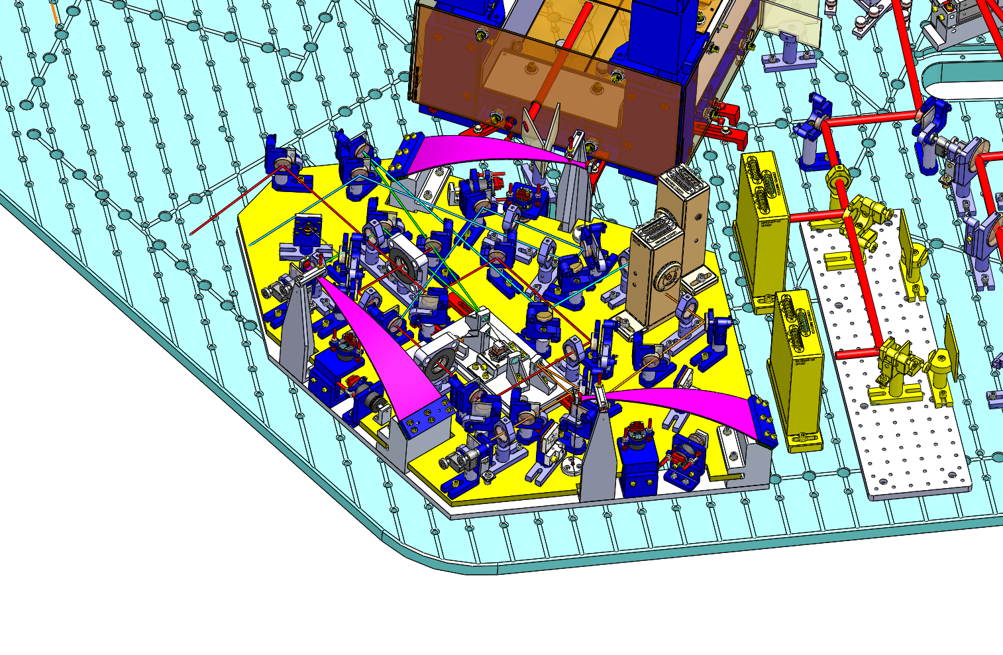
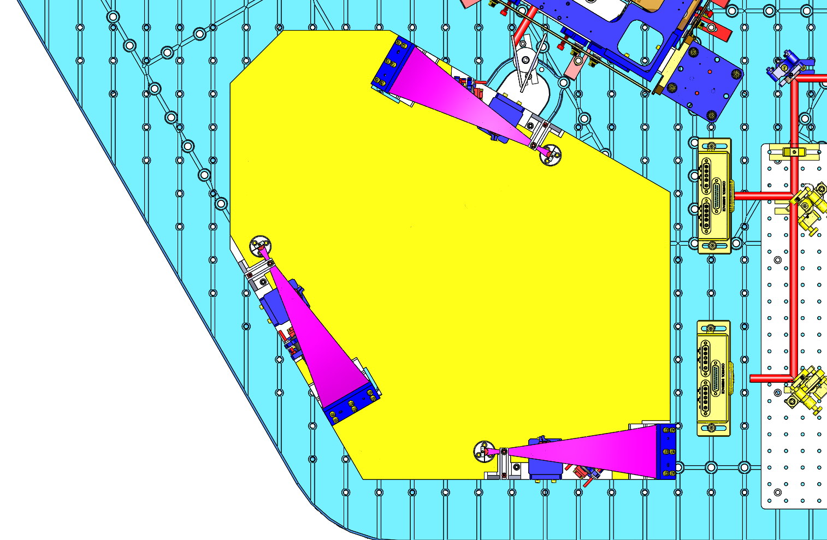
VOPO Suspension
Design based on HAM 6
Holes availability (Dog Clamps)
“Shooting” Area (for the outcome beam)
In Vacuum RFPD Area
Space for Tip Tilt
Maximizing Bench Surface: 3.64 ft²

Slide 3
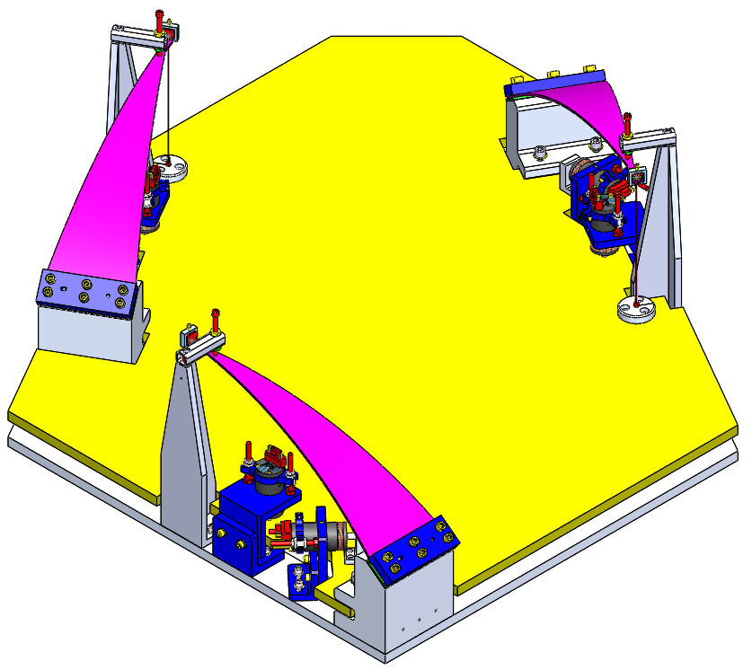
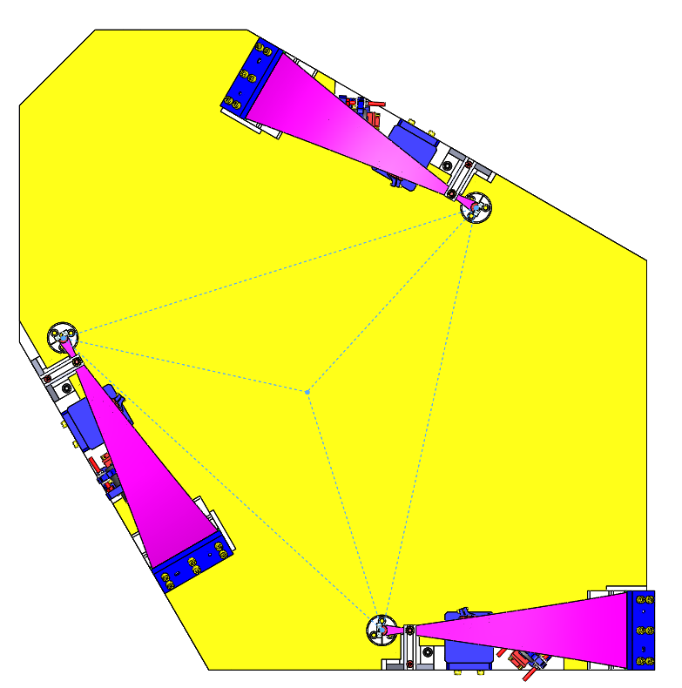
VOPO Suspension
Blade with 3-axial symmetry
Blades clamps form equilateral triangle
Triangle center close to “Geometric Center” (easy to balance)
Stops separated enough

Slide 4
VOPO Suspension
Conclusions:
Questions:
  Is it enough space for the Tip Tilt?
  Do we need a Tip Tilt?
  Is it enough shooting space?

Slide 5
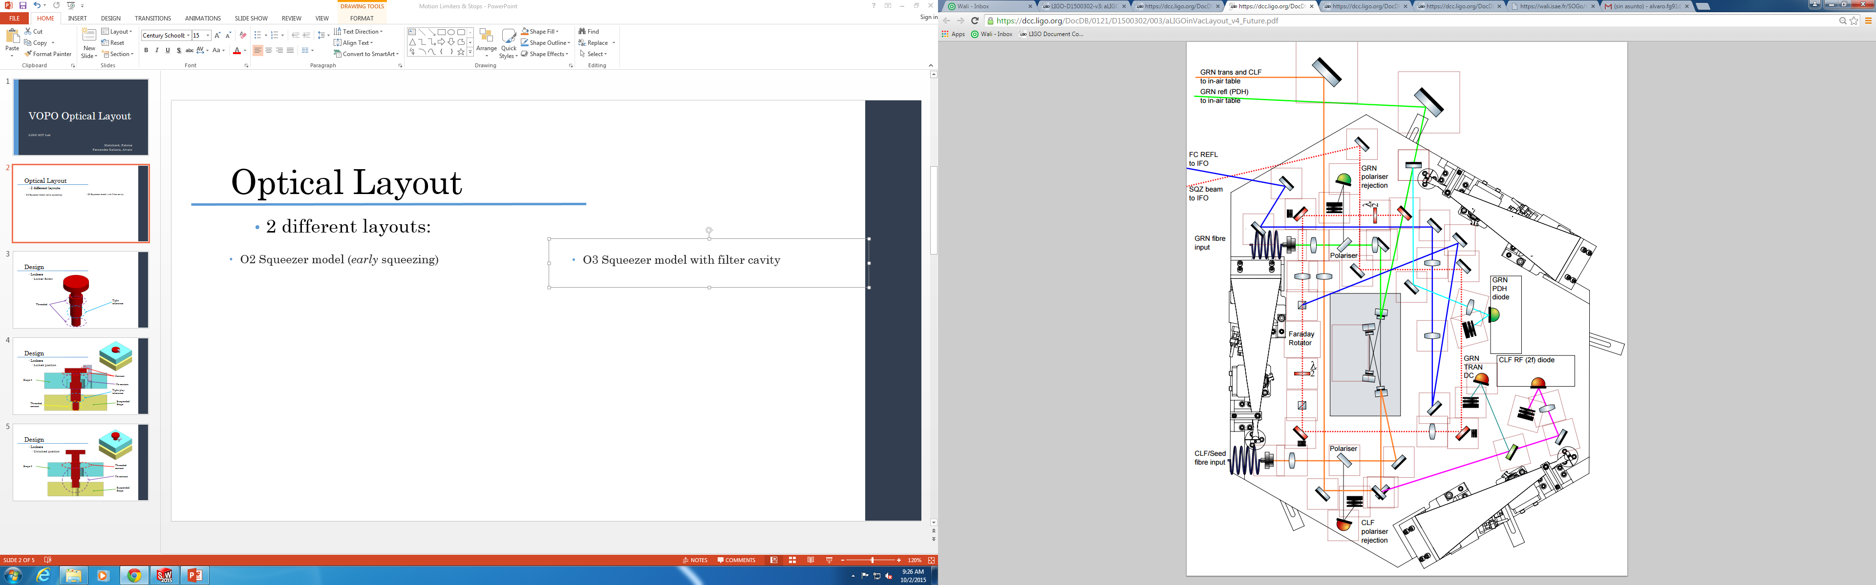
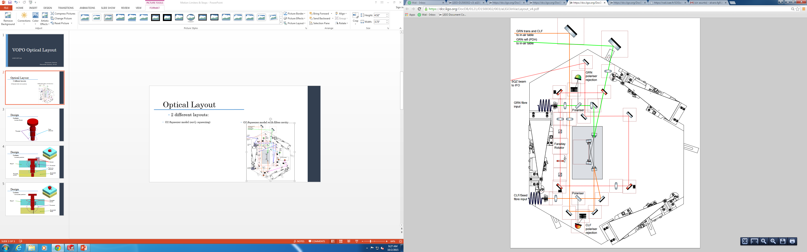
Optical Layout
2 different layouts:
  O3 Squeezer model with filter cavity + RFPD in Vacuum
  O2 Squeezer model (early squeezing)

Slide 6
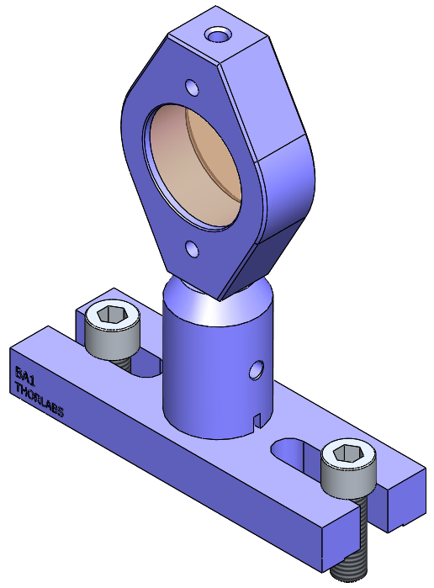
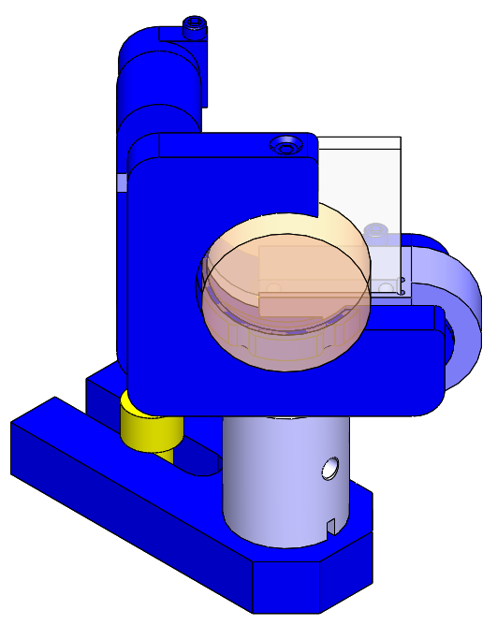
Optical Layout
Solid Works Optical Layout
Mirror:
  Mass: 205.87 g
  Quantity: 11 / 18
Lens:
  Mass: 121.375 g
  Quantity: 7 / 9

Slide 7
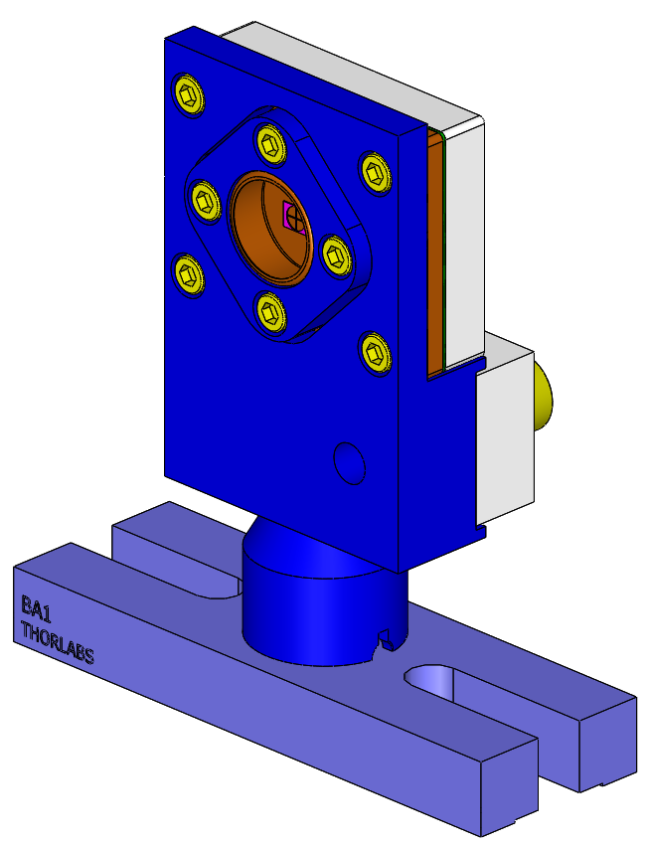
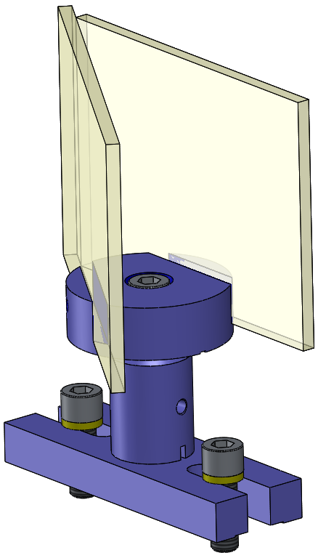
Optical Layout
Solid Works Optical Layout
QPD:
  Mass: 142.98 g
  Quantity: 2 / 3
Beam Dump:
  Mass: 164.61 g
  Quantity: 2 / 5

Slide 8
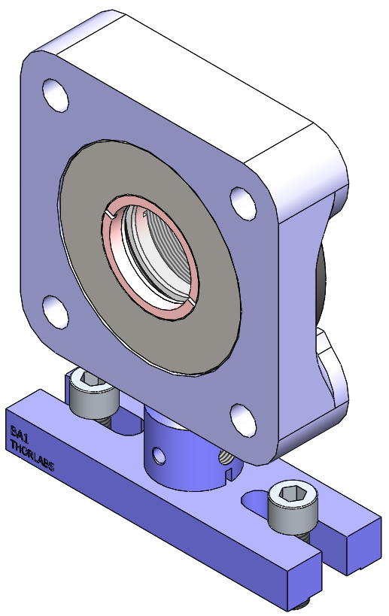
Optical Layout
Solid Works Optical Layout
Wave Plate:
  Mass: 299.69 g
  Quantity: 1 / 2
Polarizers:
  Mass: 206.71 g
  Quantity: 2+2 / 2+2
NOTE: At this point the polarizers have been modeled as mirrors. A more realistic model has to be done to the two kinds of polarizers that will be used.

Slide 9
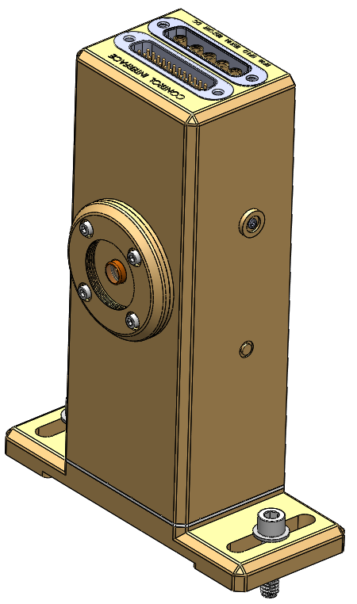
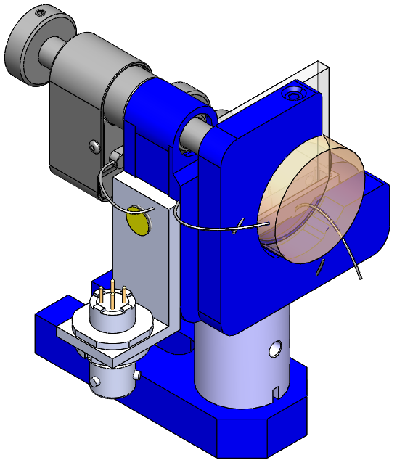
Optical Layout
Solid Works Optical Layout
RFPD in Vacuum
  Mass: 270.41 g
  Quantity: 0 / 2
Fibers In:
  Mass: 252.01 g
  Quantity: 2 / 2
NOTE: At this point the
fiber In have been modeled
as mirrors with pico motors. A
more realistic model has to be done to
the two kinds of polarizers that will be used.
NOTE: At this point the
model used is for a 4” beam
height while the real one will be at 2.5”

Slide 10
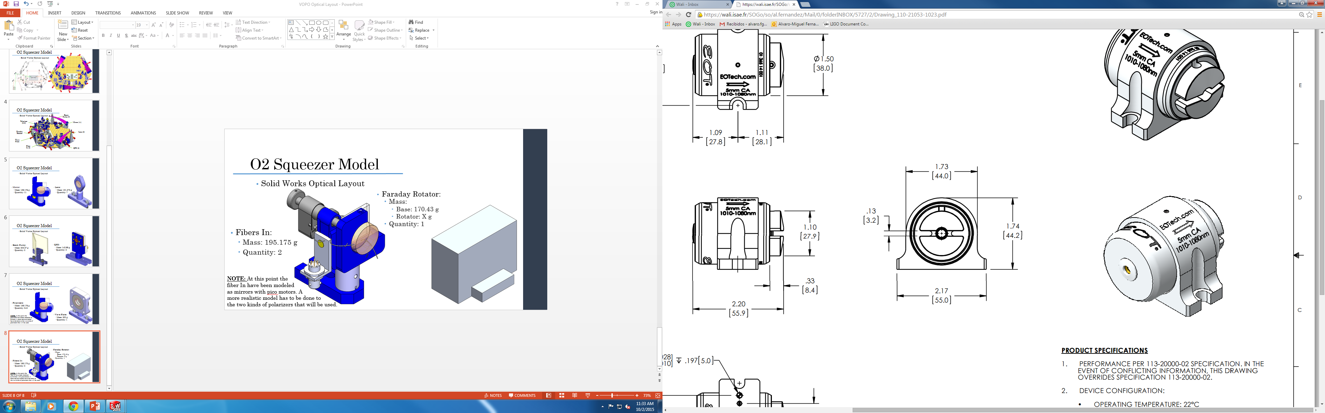
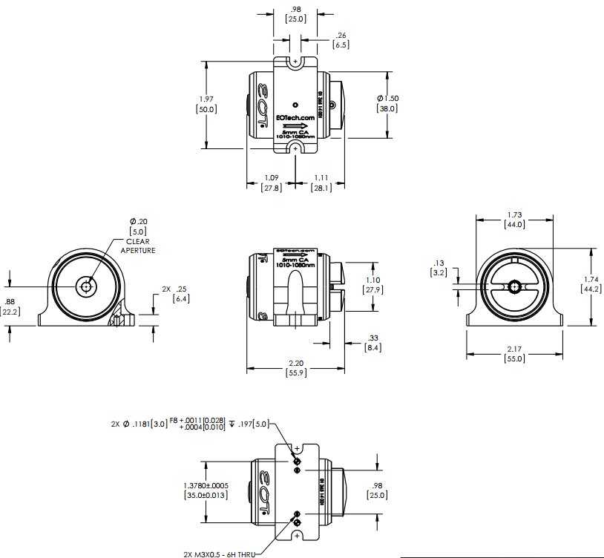
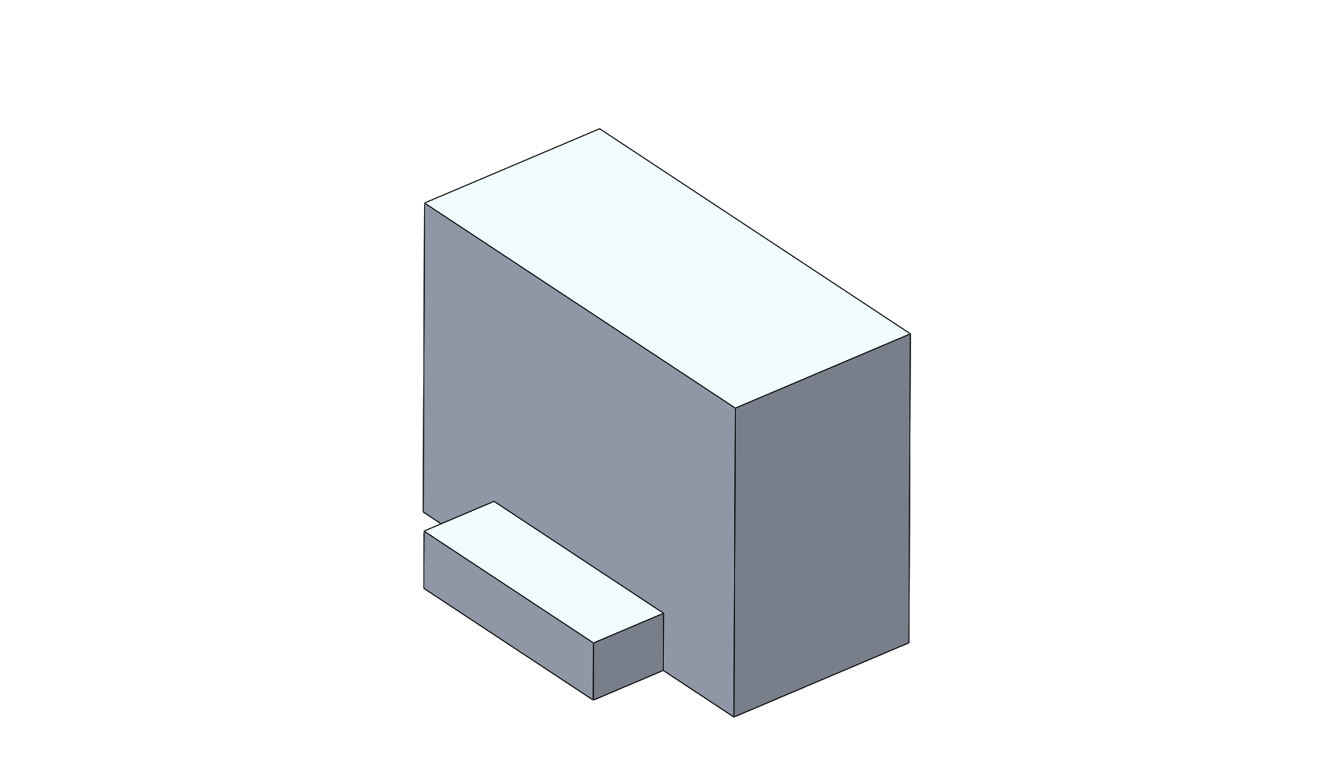
Optical Layout
Solid Works Optical Layout
EOT Faraday Rotator
Faraday Rotator:
  Mass:
    Base: 170.43 g
    Rotator: X g
  Quantity: 1 / 1
NOTE: At this point the
Faraday Rotator has been
modeled as just its base and
with a rough design that will
be improved once the Faraday
rotator model will be obtained.
Base (6061-T6 Al)

Slide 11
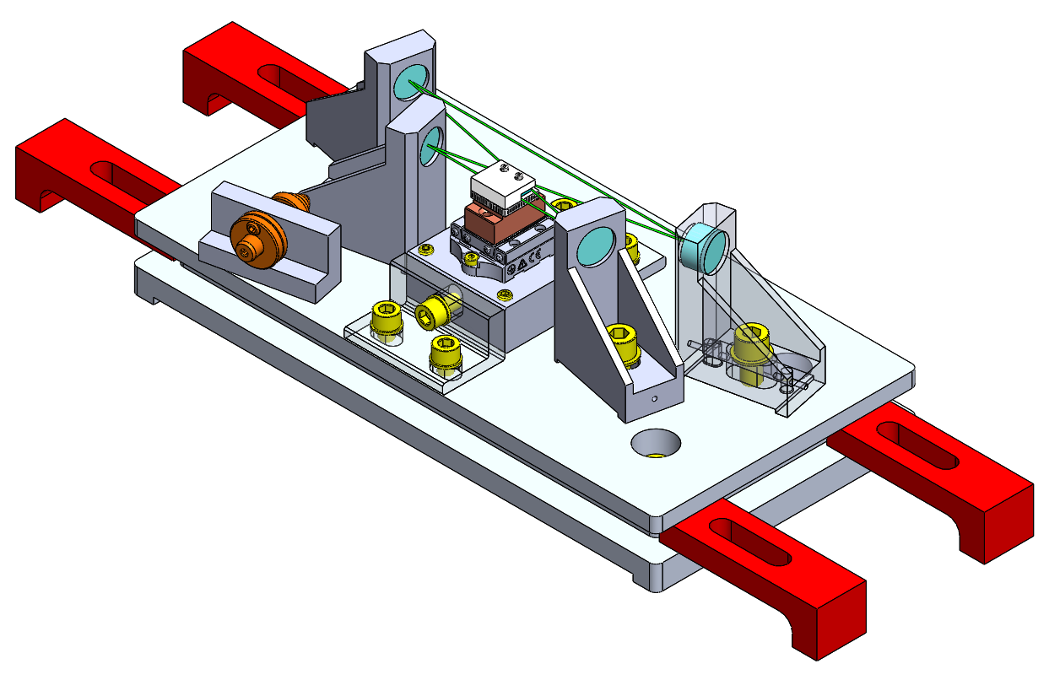
Optical Layout
Solid Works Optical Layout
VOPO Cavity:
  Mass:: 1463 g
  Quantity: 1 / 1

Slide 12
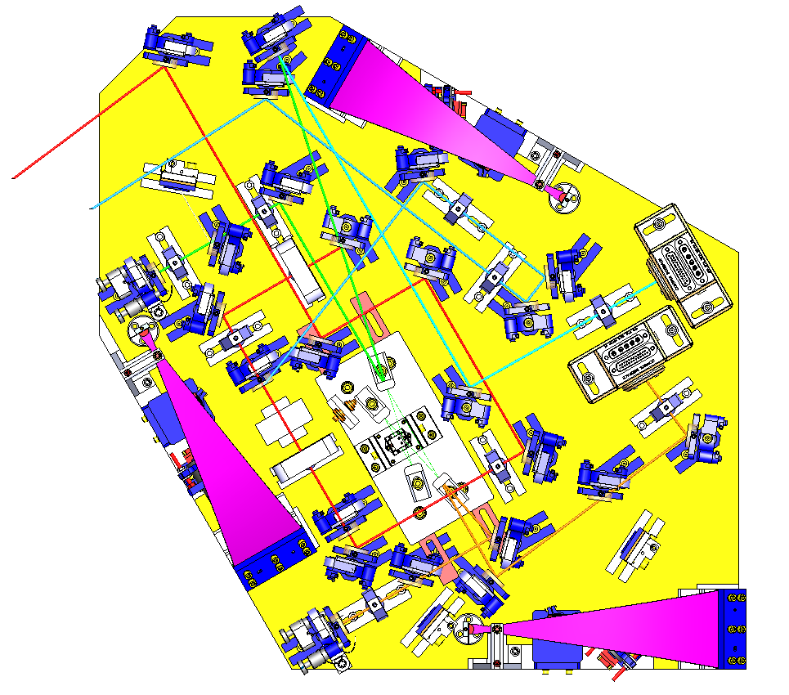
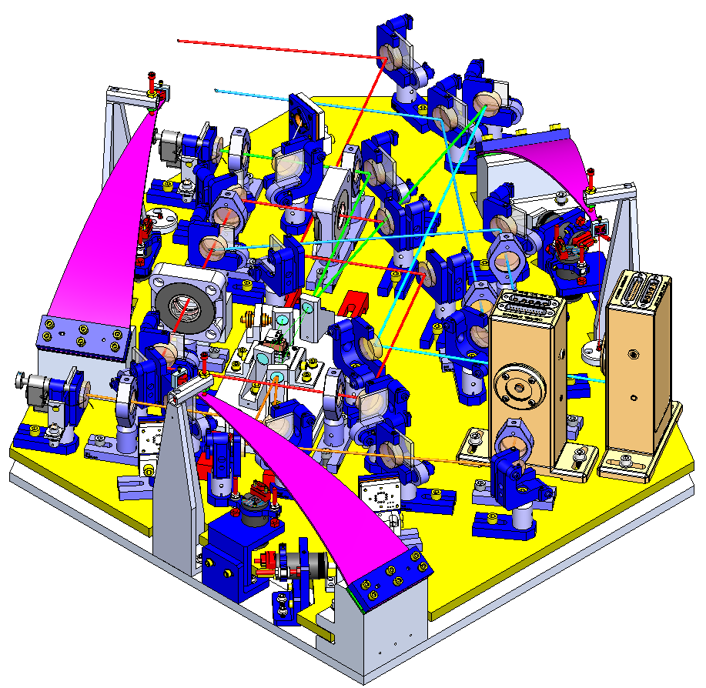
Optical Layout
O3 (Filter Cavity + In Vacuum RFPD)
  Option 1

Slide 13
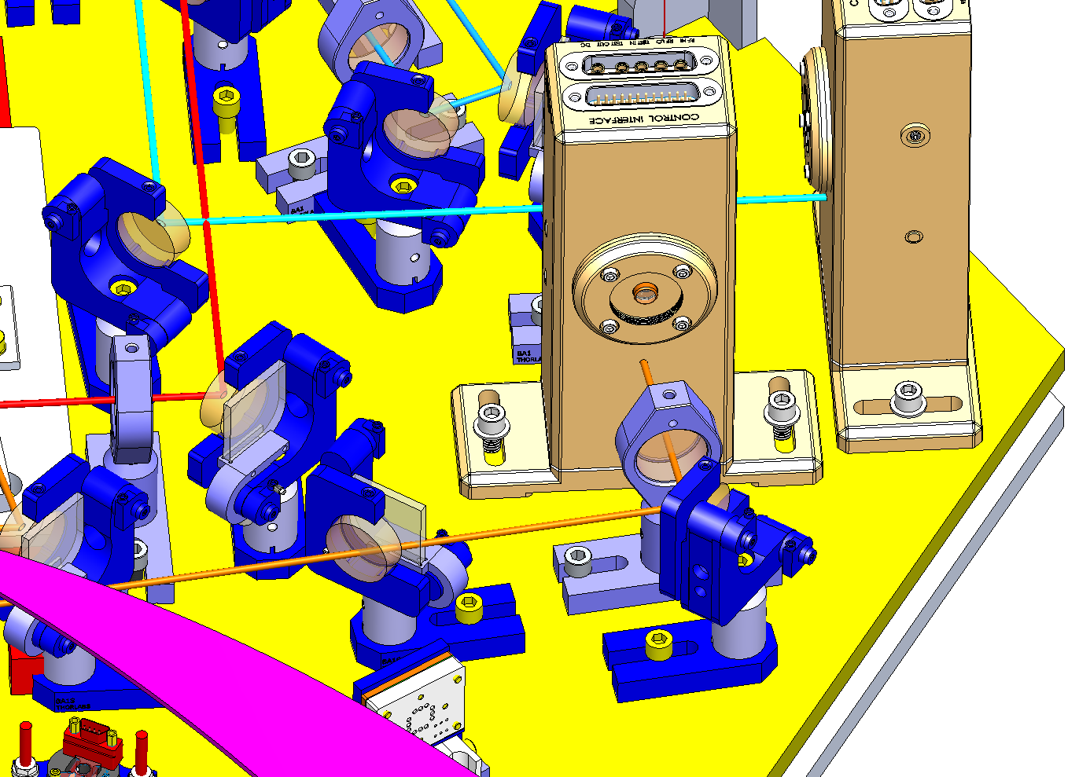
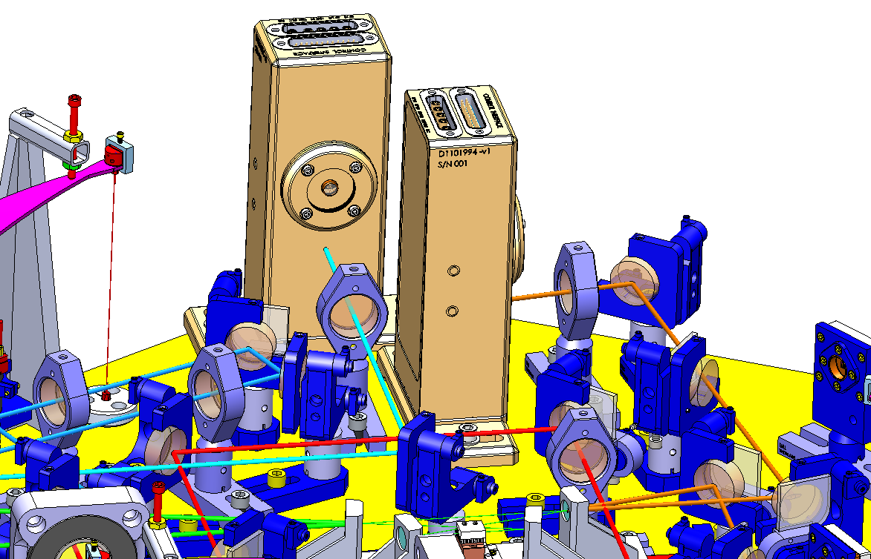
Optical Layout
O3 (Filter Cavity + In Vacuum RFPD)
  Option 1
    Problems

Slide 14
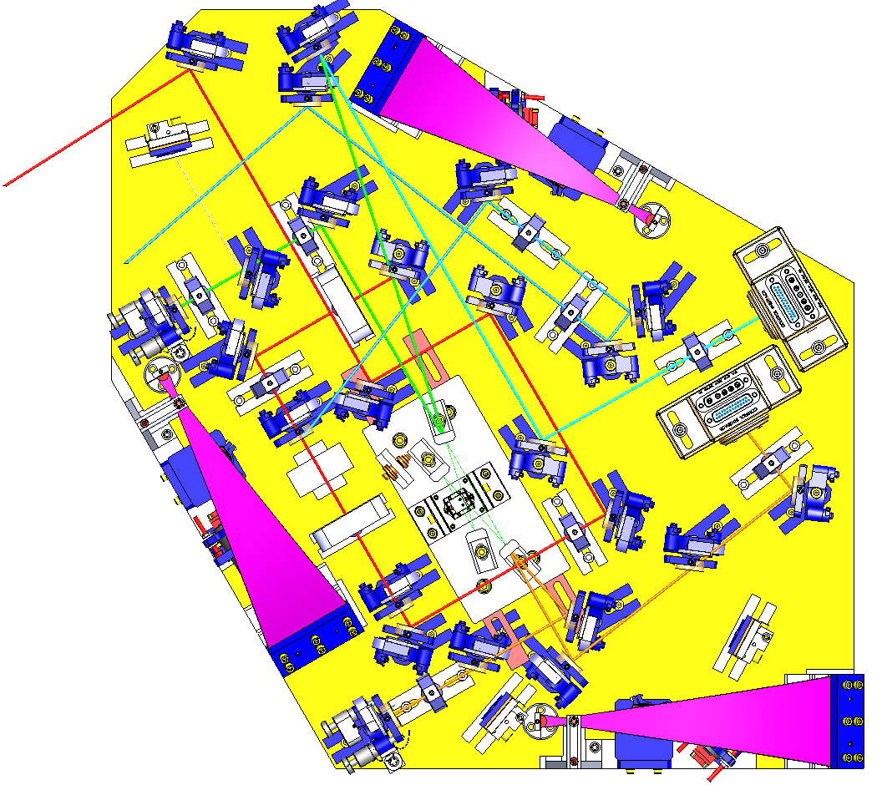
Optical Layout
O3 (Filter Cavity + In Vacuum RFPD)
  Option 1
    Problems

Slide 15
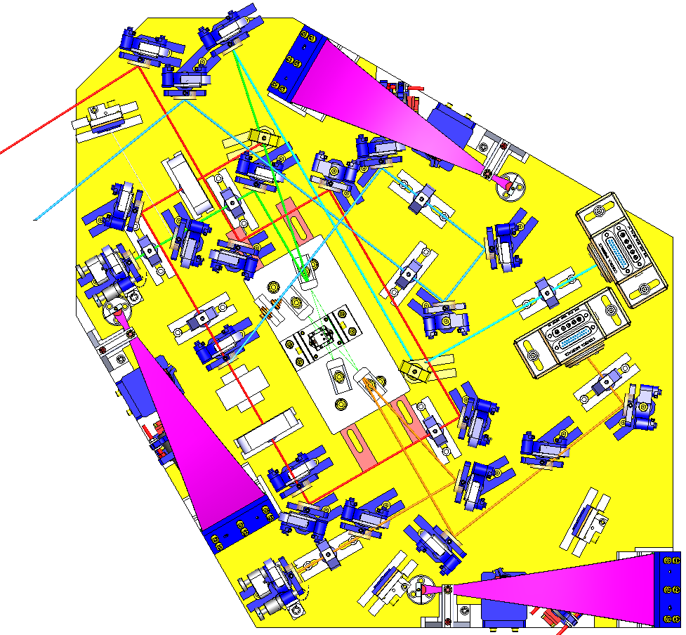
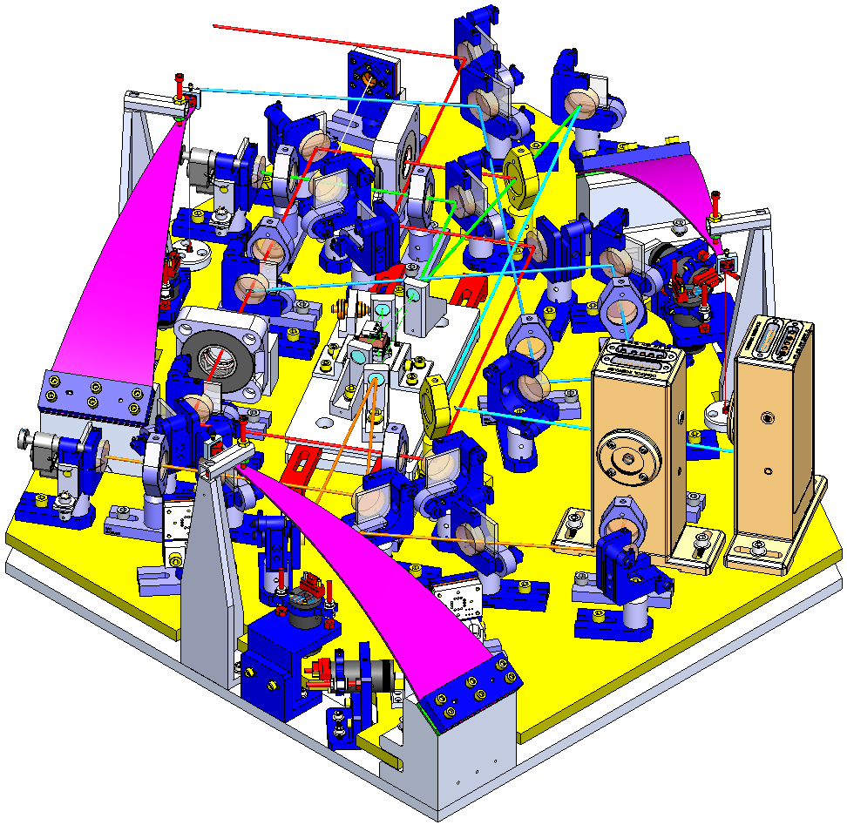
Optical Layout
O3 (Filter Cavity + In Vacuum RFPD)
  Option 2

Slide 16
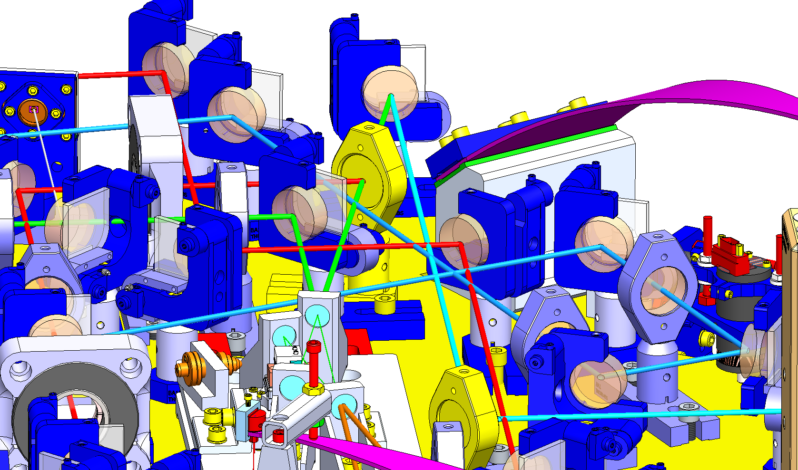
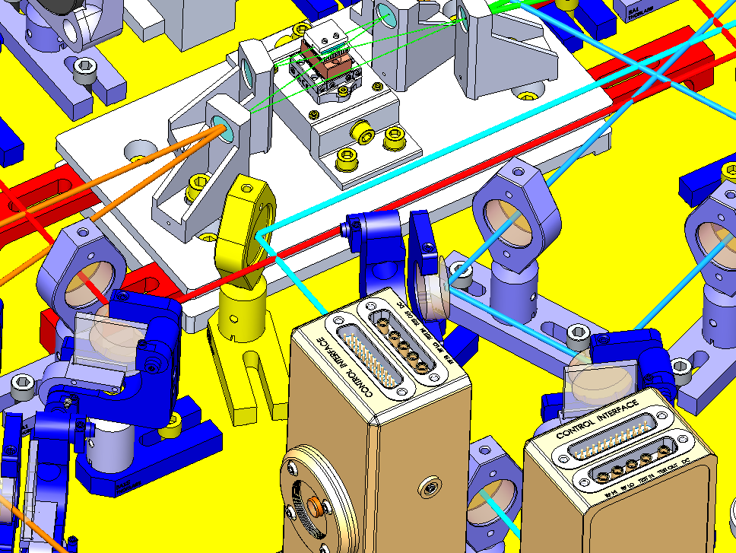
Optical Layout
O3 (Filter Cavity + In Vacuum RFPD)
  Option 2
    Problems

Slide 17
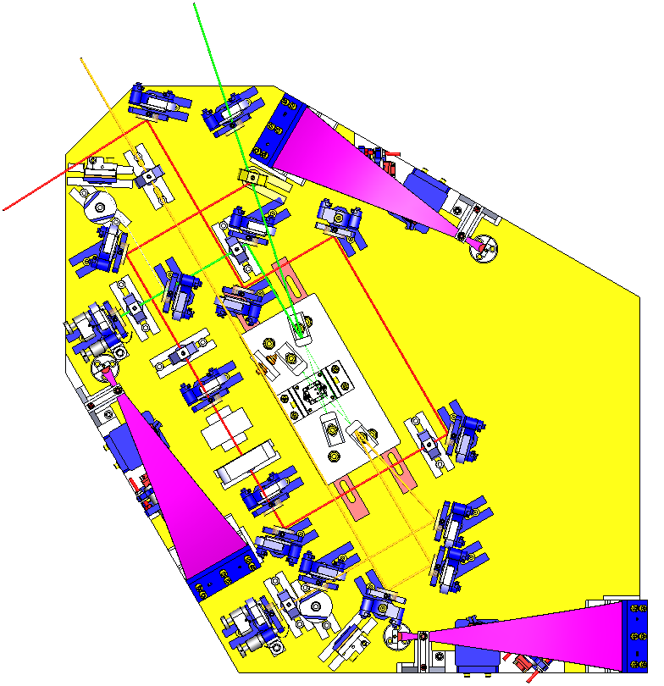
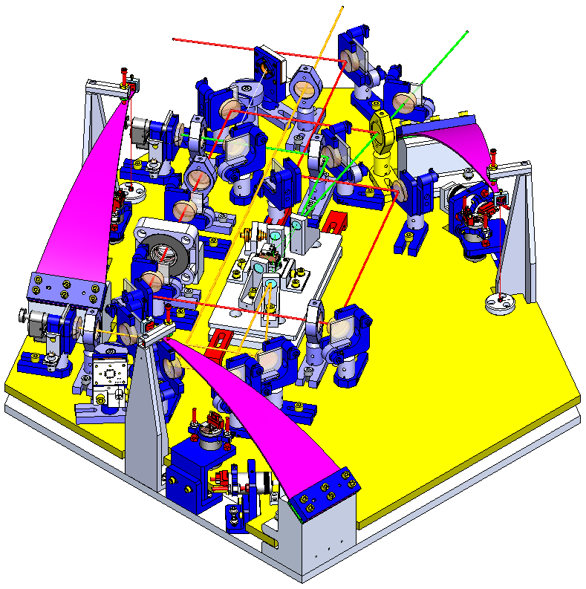
Optical Layout
O2

Slide 18
Optical Layout
CONCLUSIONS
  Injection Bench is large enough
QUESTIONS

Slide 19
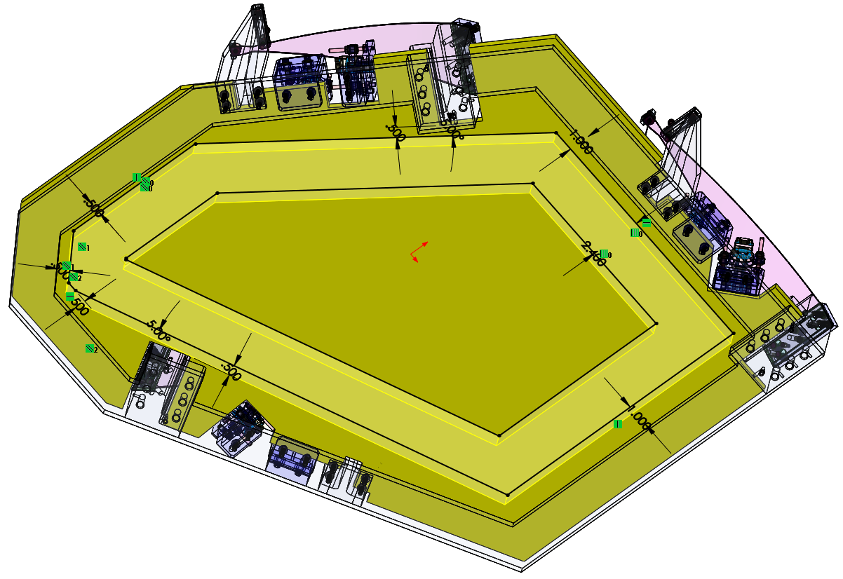
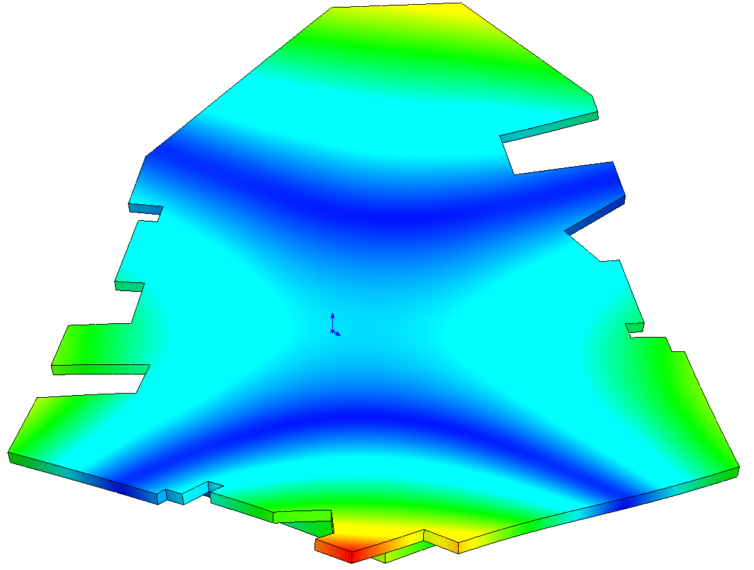
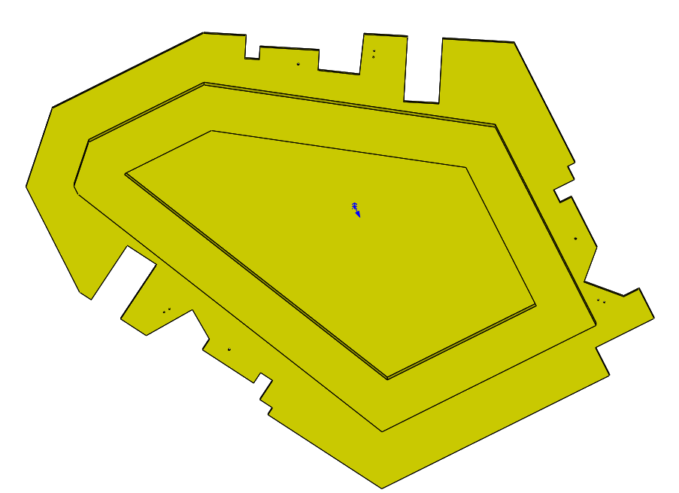
Injection Bench
Stiffener first design (dummy)
f = 267.77 Hz
Mass: 15.982 kg

Slide 20
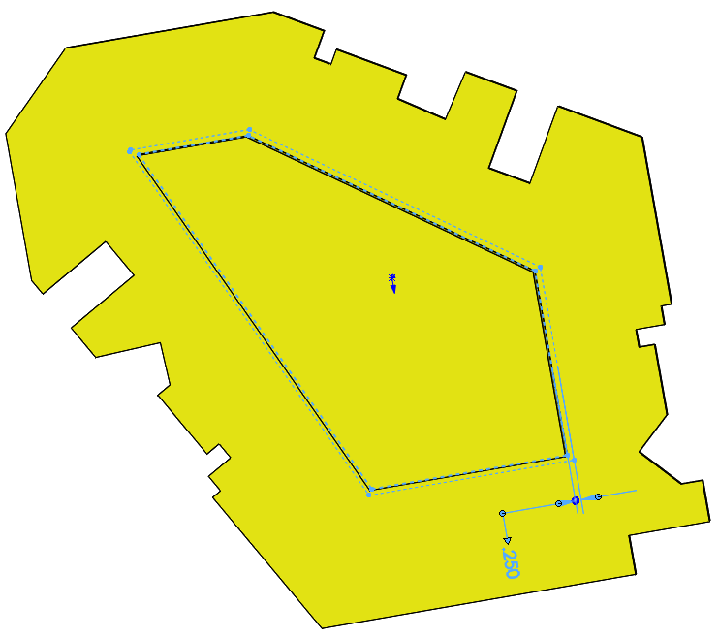
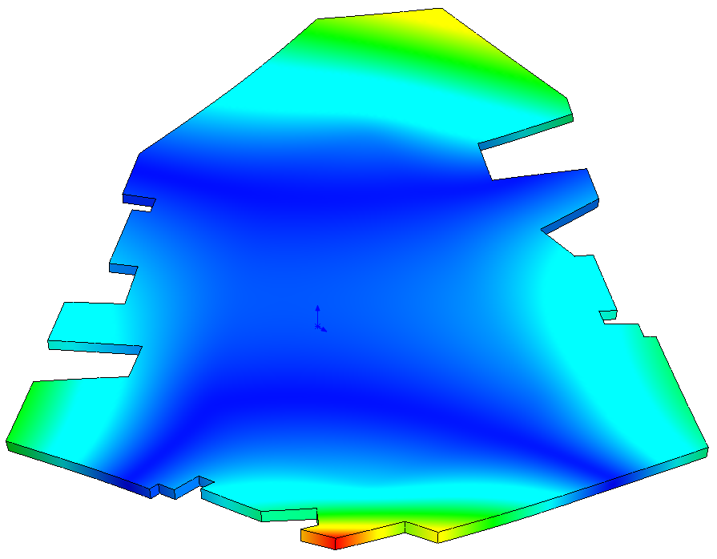
Injection Bench
Stiffener first design (dummy II)
f = 276.29 Hz
Mass: 15.977 kg

Slide 21
Injection Bench: Mass Budget
O3 (Filter Cavity + RFPD)
Optics: 12 kg (2.1kg contingency)
Bench: 18 kg
Balancing Mass: 6kg
SUSPENDED MASS: 36 kg
NOTE I: The weight of the Injection Bench has been set at 18kg but it may vary after the frequency FEA
NOTE II: In this calculation the Faraday Rotator is not considered, just its base, and the model for polarizers and fiber in is set as the one of a mirror mount

Slide 22
Injection Bench: Mass Budget
O2
Optics: 8 kg (1.2kg contingency)
Bench: 18 kg
Balancing Mass: 10kg
SUSPENDED MASS: 36 kg
NOTE I: The weight of the Injection Bench has been set at 18kg but it may vary after the frequency FEA
NOTE II: In this calculation the Faraday Rotator is not considered, just its base, and the model for polarizers and fiber in is set as the one of a mirror mount

Slide 23
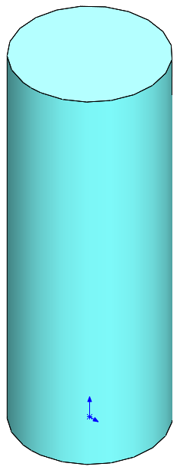
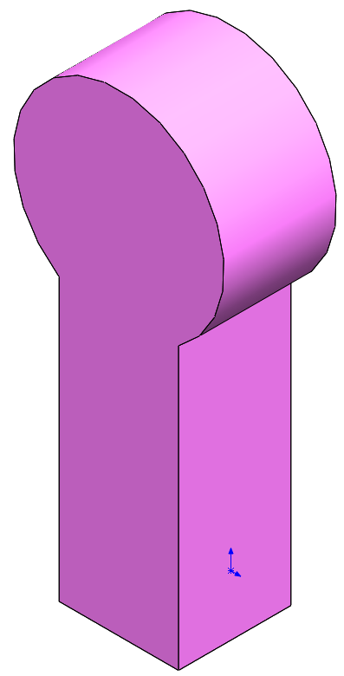
Injection Bench Assembly FEA
Optical components for FEA
Lens:
  Mass: 121.375 g
  Mass FEA: 120 g
  Quantity: 7 / 10
Mirror:
  Mass: 205.87 g
  Mass FEA: 203 g
  Quantity: 11 / 18

Slide 24
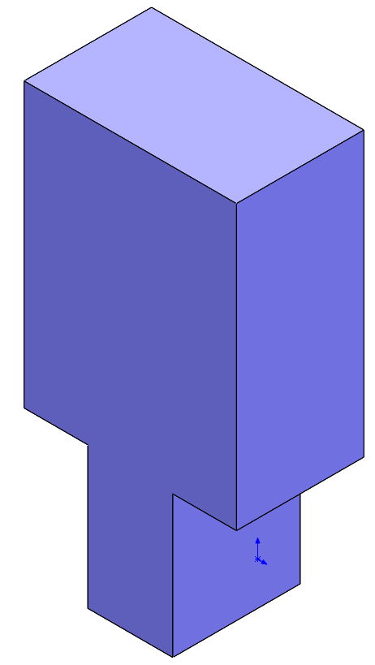
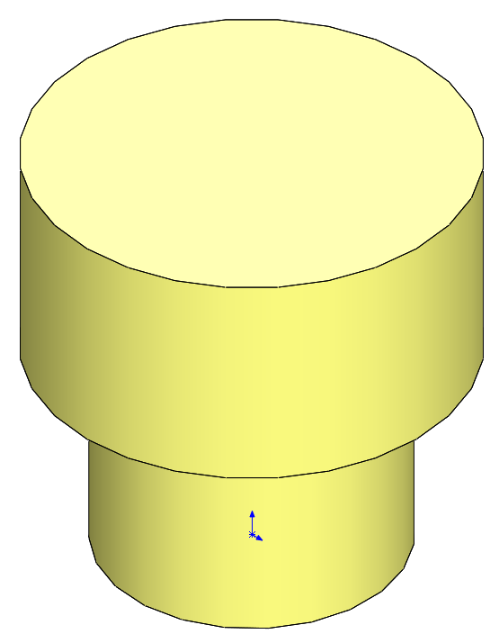
Injection Bench Assembly FEA
Optical components for FEA
QPD:
  Mass: 142.98 g
  Mass FEA: 143 g
  Quantity: 2 / 3
Beam Dump:
  Mass: 164.61 g
  Mass to FEA: 163 g
  Quantity: 2 / 5

Slide 25
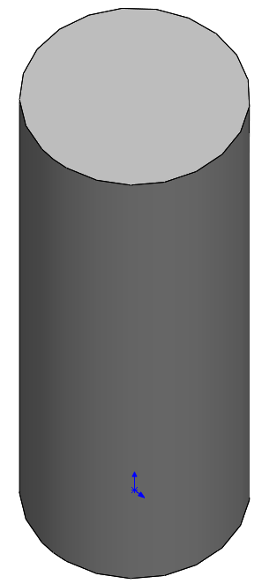
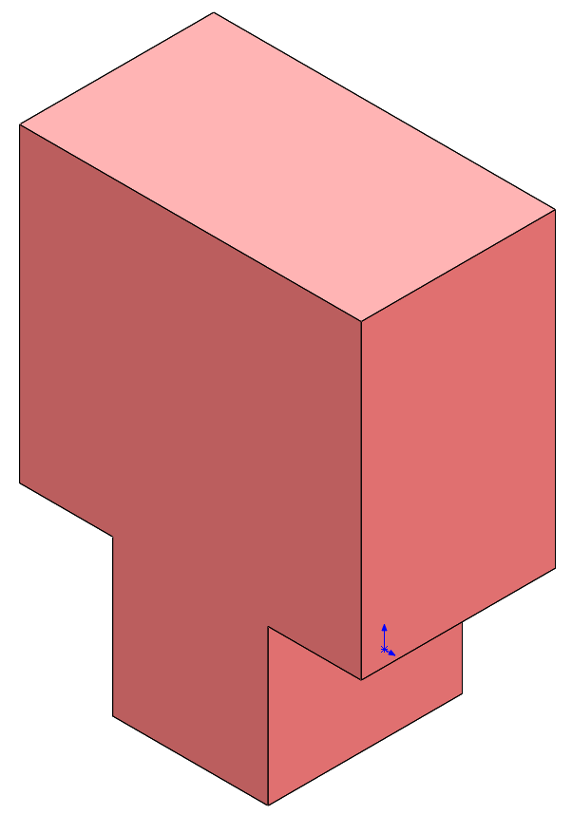
Injection Bench Assembly FEA
Optical components for FEA
Wave Plate:
  Mass: 300 g
  Mass FEA: 297 g
  Quantity: 1 / 2
Polarizer:
  Mass: 206.71 g
  Mass FEA: 203 g
  Quantity: 2+2 / 2+2

Slide 26
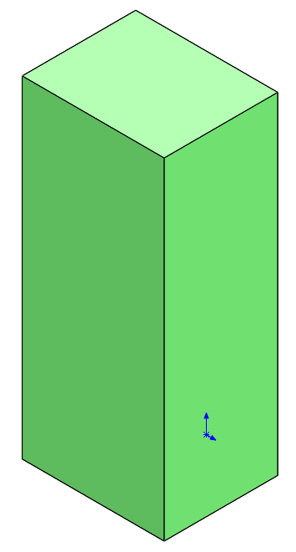
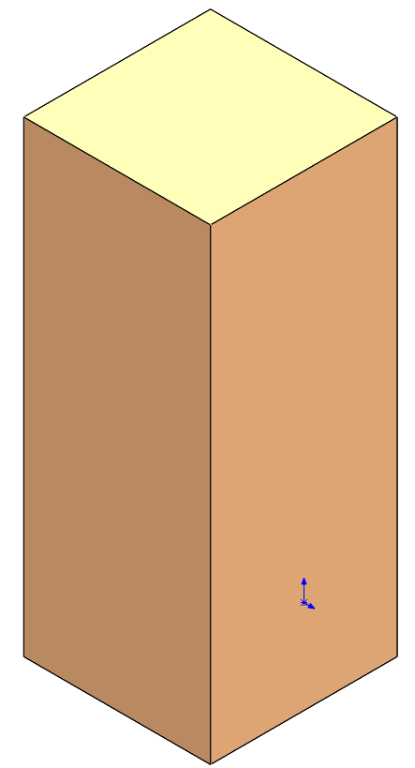
Injection Bench Assembly FEA
Optical components for FEA
RFPD in Vacuum
  Mass: 270.41 g
  Mass: 279 g
  Quantity: 0 / 2
Fiber In:
  Mass: 252.01 g
  Mass FEA: 191 g
  Quantity: 2 / 2

Slide 27
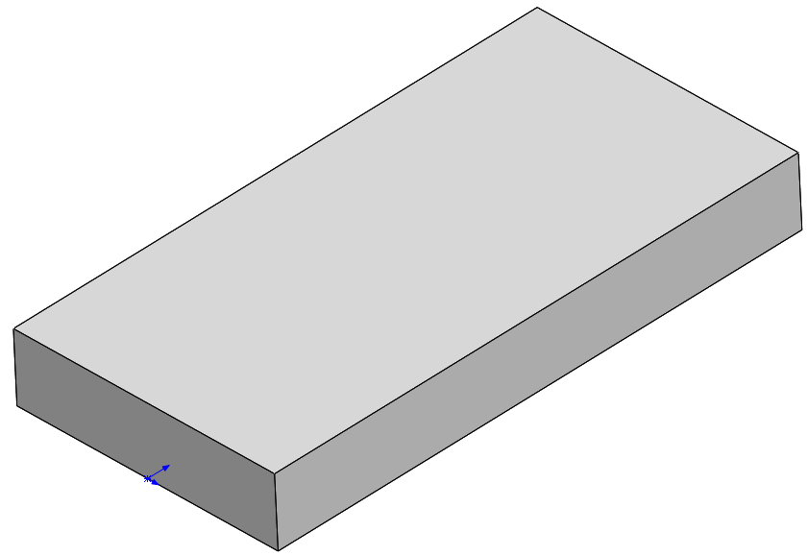
Injection Bench Assembly FEA
Optical components for FEA
Faraday Rotator:
  Mass:
    Base: 170.43 g
    Base FEA: 170 g
    Rotator: X g
  Quantity: 1 / 1
VOPO Cavity:
  Mass: 1463 g
  Mass: 1460 g
  Quantity: 1 / 1

Slide 28
Injection Bench Assembly FEA
Injection Bench Assembly for FEA
Global Contact: Bonded

Slide 29
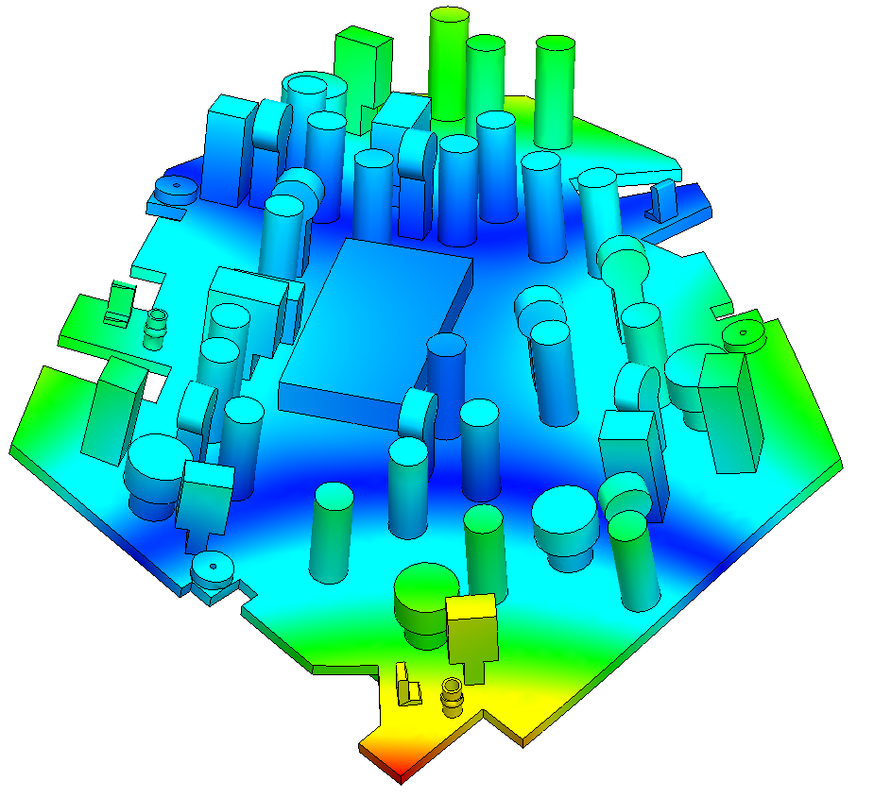
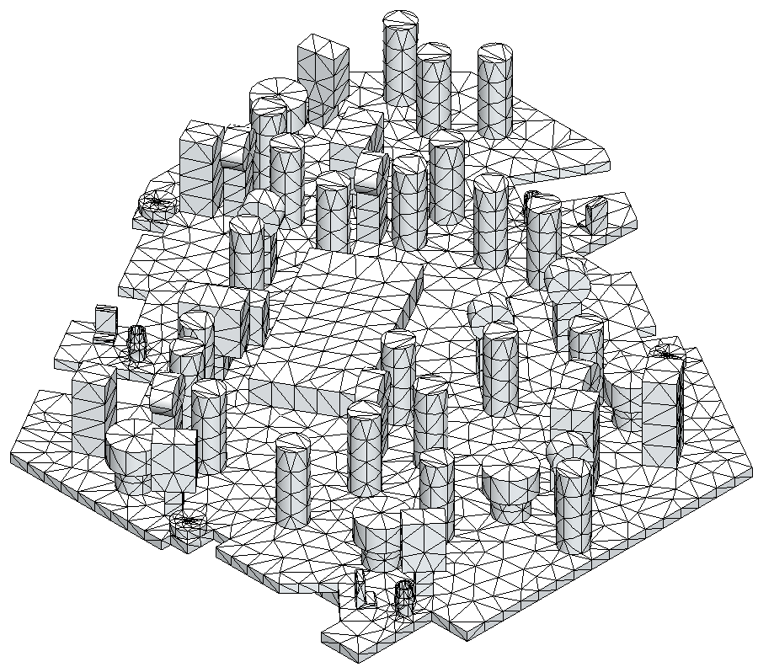
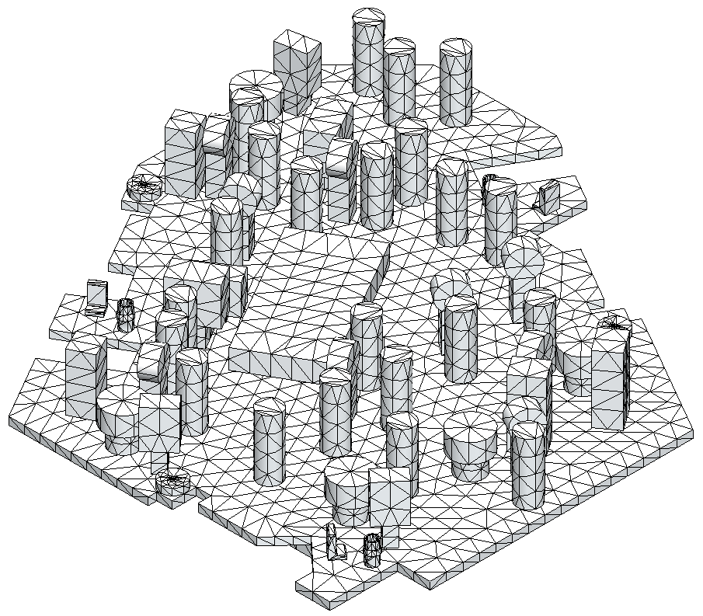


Injection Bench Assembly FEA
Injection Bench Assembly for FEA (no MASSES)
$f_{COMPATIBLE} = 238.09 Hz$
$f_{INCOMPATIBLE} = 239.76 Hz$
NOTE: No significant difference has been observed between compatible and incompatible meshing

Slide 30
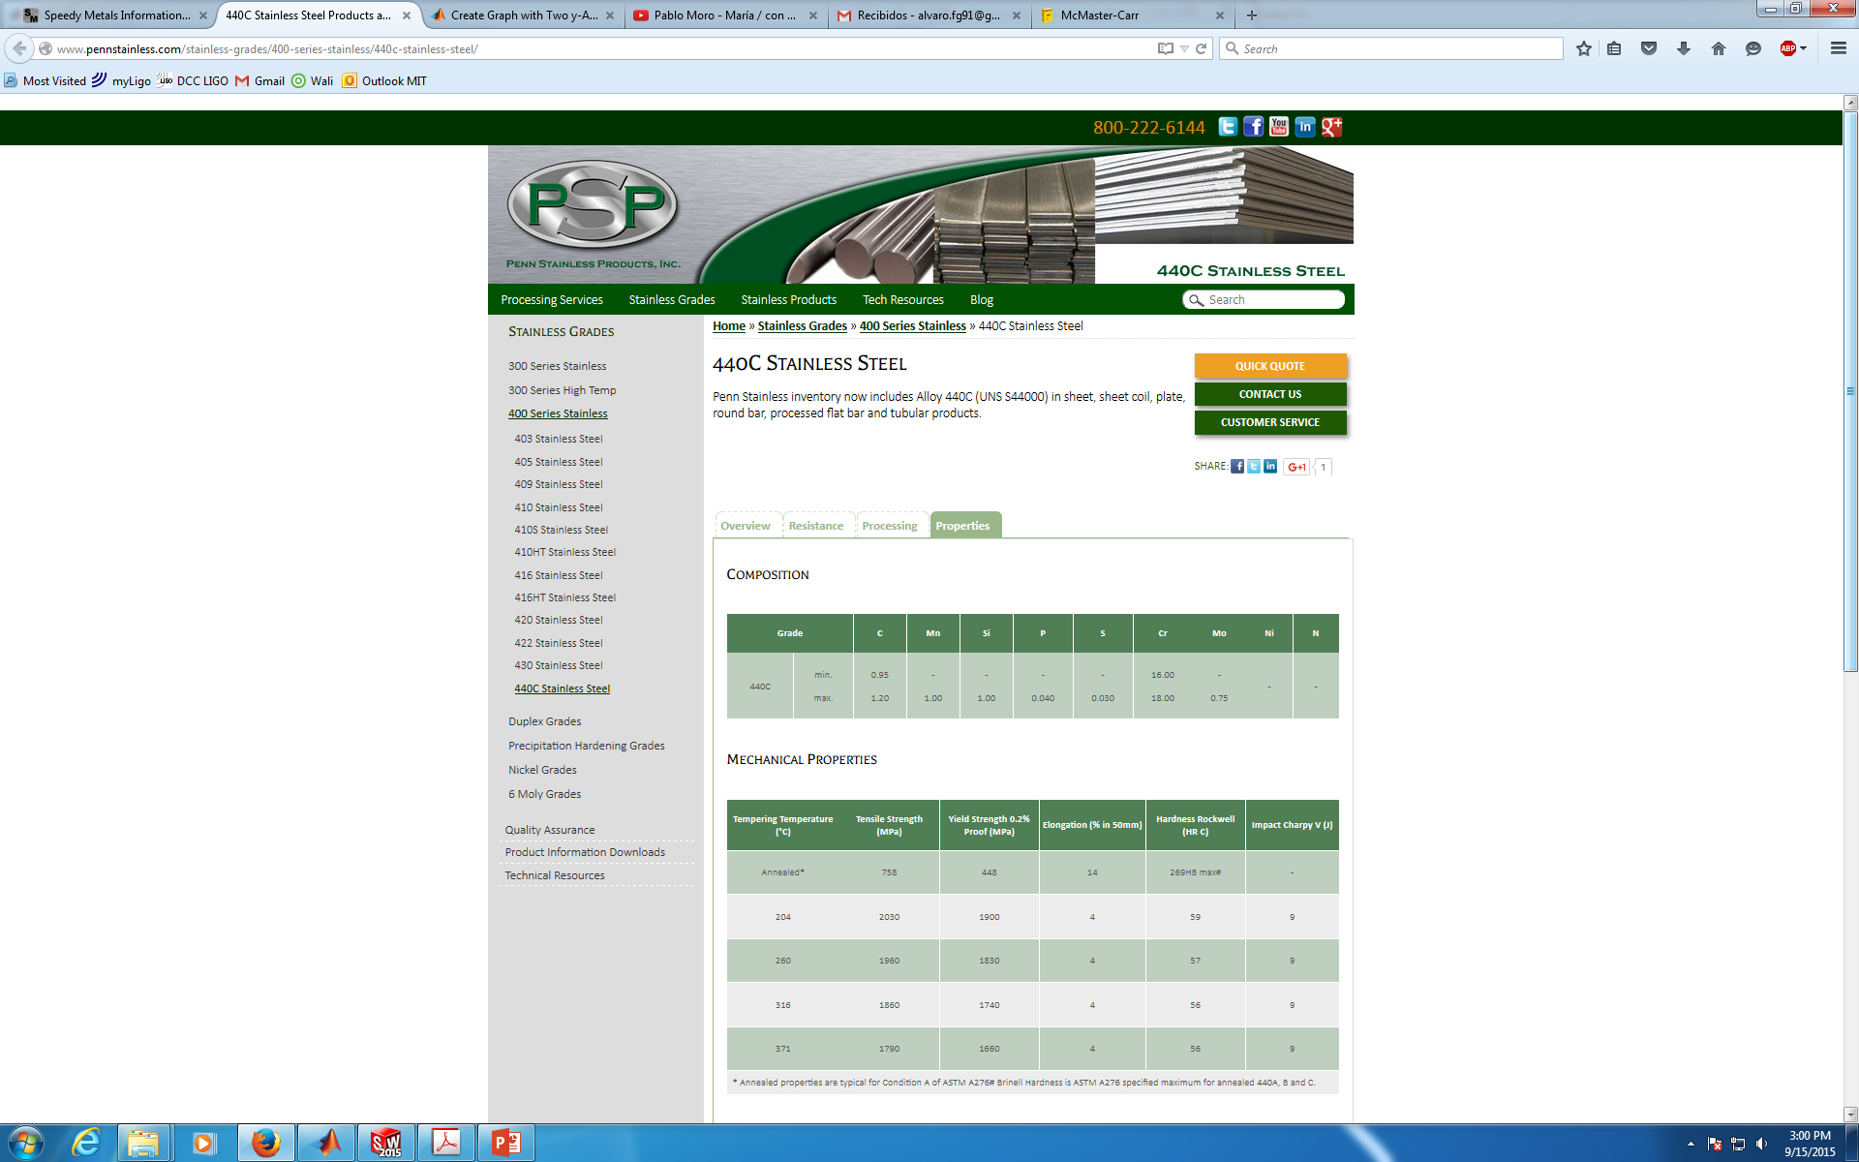
BLADE DESIGN: Material
Material: 440C SSTL (E = 210 GPa, Y = 1800 MPa, UTS = 1970 MPa, ρ = 7800 kg/m³, ν = 0.285)
Total Suspended Mass: m = 36 kg
Charge per blade: P = 117.72N (12 kg)
Constraints:
Factor of Safety: ≥ 33.3% (FoS ≥ 3)
Desired frequency: f ≈ 1.5 Hz
http://www.pennstainless.com/stainless-grades/400-series-stainless/440c-stainless-steel/
http://www.makeitfrom.com/material-properties/Hardened-440C-Stainless-Steel

Slide 31

BLADE DESIGN: Dimensions
Design Parameters:
  Blade Width: a
  Blade Length: l
  Blade thickness: h
Equations (for triangular blades):
  $K﷮zz =\frac{Eah^{3}}{4l^{3}}$
  $f=\frac{1}{2π}\sqrt{\frac{K_{zz}}{m}}=1.5 Hz$
  $σ_{max}=\frac{6Pl}{ah^{2}}$
3 Parameters
1 DOF
2 Equations
l = 280 mm
NOTE: The choice of this length has been made after checking the optical layout

Slide 32
BLADE DESIGN: Dimensions
Theoretical Results (BladeDesign.m) for m = 36kg, f = 1.5Hz and FoS = 3:
l = 280 mm
b = 80.12 mm
h = 2.0282 mm
Kzz = 1065.9 N/m
Tip deflection = 110.4 mm
NOTE: 80mm is less than what was previously used for the blade design (85 mm) so it fits widely in the designed bench.

Slide 33
BLADE DESIGN: Dimensions
Theoretical Results (BladeDesign.m) for m = 36kg, f = 1.6 Hz
l = 280 mm
b = 85 mm
h = 2.0761 mm
FoS = 3.3346 (30%)
Kzz = 1212.8 N/m
NOTE: In order to increase the FoS and knowing that 280 mm length and 85 mm wide blade fits in the design, the desired frequency has been raised to 1.6 Hz.

Slide 34
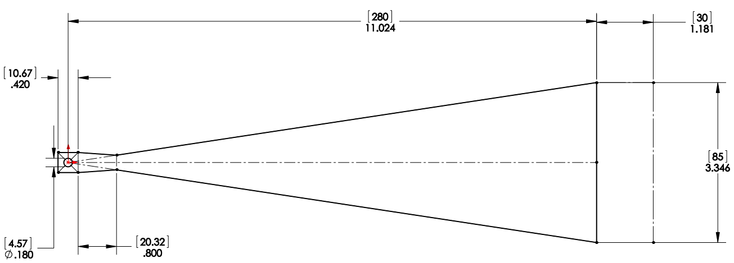
BLADE DESIGN: Dimensions
FINAL DIMENSIONS:
f = 1.5252 Hz
Kzz = 1255.1 N/m
FoS = 3
l = 280 mm
b = 85 mm
h = 2.1 mm
m = 41kg
f = 1.6277 Hz
Kzz = 1255.1 N/m
FoS = 3.5473
m = 36kg
NOTE: The expected performances are those shown for 36 kg (that already include some contingency). However, the suspended mass could be raised up to 41 kg keeping FoS ≥ 3

Slide 35
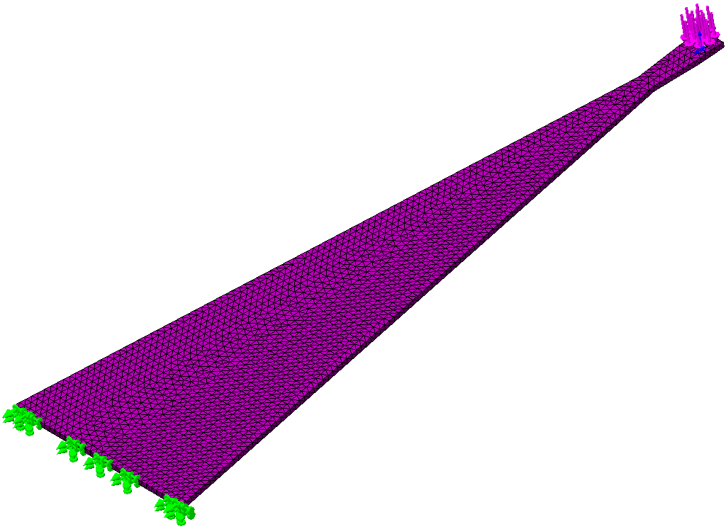
BLADE DESIGN: FEA
First Analysis using SW Simulation
Second Analysis using ANSYS
m = 36 kg
Force: Normal to Surface

Slide 36
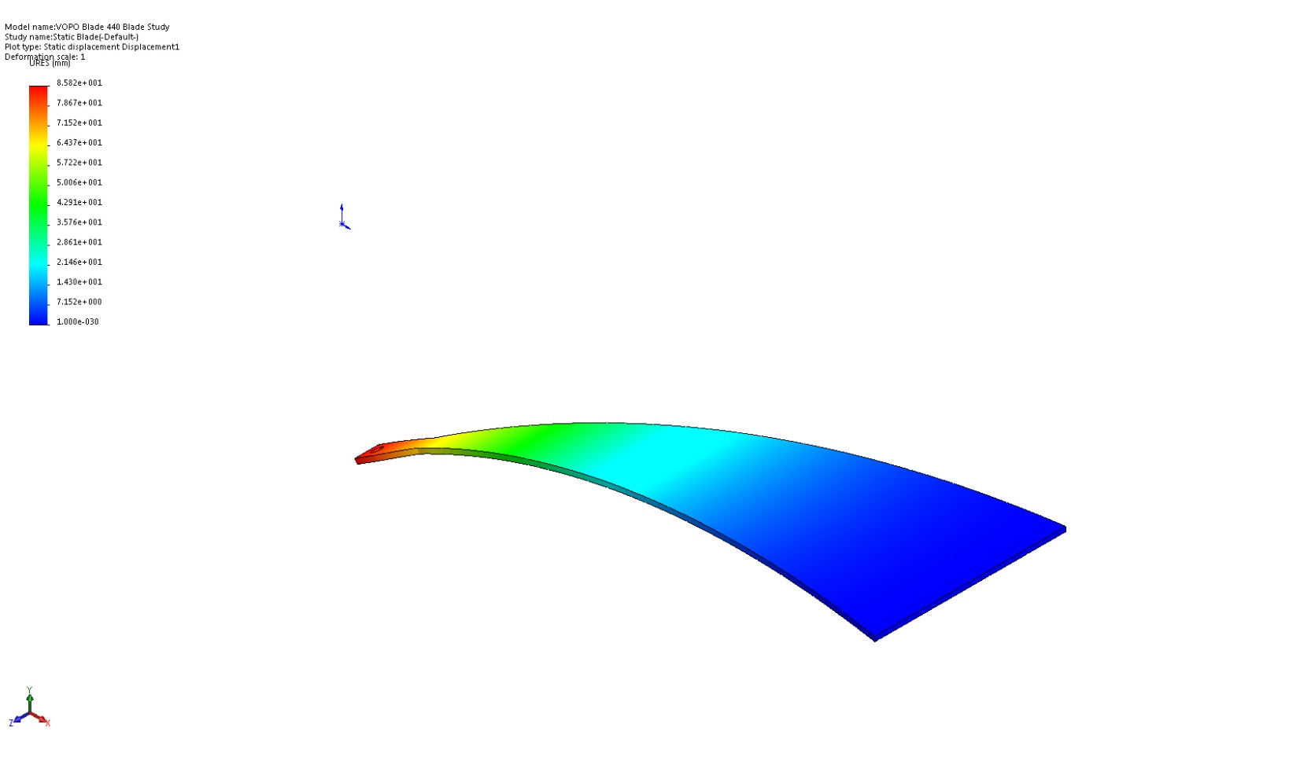
BLADE DESIGN: FEA
Deformation
Difference= 0.09%
SW SIMULATION
ANSYS

Slide 37

BLADE DESIGN: FEA
Stress (von Misses)
Difference= 0.40%
SW SIMULATION
ANSYS

Slide 38

BLADE DESIGN: FEA
Strain (Equivalent)
SW SIMULATION
ANSYS

Slide 39

BLADE DESIGN: FEA
Conclusions:
Calculated Tip Deflection Angle: 33.16°
SW and ANSYS show similar results
Possible different Strain Definition
FoS significantly lower than calculated (FoS = 3.55) [-7.32%]

Slide 40

FLEXURE DESIGN: Properties
Material: Music Wire Steel (E = 154-201 GPa, Y = 1600-2000 Mpa)
Total Suspended Mass: m = 36 kg
Charge per wire: P = 117.12 N
Minimum Tensile Strengths (E1100187)
T1500539
NOTE: T1500539 shows a 84.6% average relation between Y and UTS. Therefore, in further calculations Y is calculated as 80% of the Minimum Tensile Strength

Slide 41
FLEXURE DESIGN: Music Wire
Material: Music Wire Steel (E = 201 GPa, Y = 1710 Mpa)
Total Suspended Mass: m = 36 kg
Charge per wire: P = 117.72 N
Desired frequency: f < 1.5 Hz
FoS ≥ 33.3% (FoS ≥ 3)
Lf = 130mm
d = 0.41 mm
Calculated using
d = 0.41 mm as reference
FlexureDesign.m
f = 1.3992 Hz
Kxx = 927.5 N/m
FoS = 1.5508
NOTE: Diameter of 0.41mm enables to re-use the Faraday Isolator clamps but FoS = 1.55 is too low for our purposes

Slide 42
FLEXURE DESIGN: Music Wire
Material: Music Wire Steel (E = 201 GPa, Y = 1600 Mpa)
Total Suspended Mass: m = 36 kg
Charge per wire: P = 117.72 N
Desired frequency: f < 1.5 Hz
FoS ≥ 33.3% (FoS ≥ 3)
Lf = 130mm
d = 0.61 mm
Calculated using
d = 0.61 mm as reference
FlexureDesign.m
NOTE: Wire clamps will have to be redefined
f = 1.4203 Hz
Kxx = 955.62 N/m
FoS = 2.9148
NOTE: Diameter of 0.61mm raise FoS up to almost 3, which is considered enough as the minimal guaranteed tensile strength has been considered

Slide 43







FLEXURE DESIGN: Theory
Frequency calculation using pendulum theory
$$\ddot{α}+\frac{g}{lz}sinα=0$$
$$ω^{2}=\frac{g}{lz}$$
$lz=$123.1869 mm
$$f=\frac{1}{2π}\sqrt{\frac{g}{lz}}$$
lz
$$f_{PEND}=1.4203 Hz$$


Slide 44


CLAMP DESIGN: Material & Preload
SCREW MATERIAL
Y = 344.74 Mpa (50 ksi)
μ = 0.5
316 SSTL + HELICOILS
clampDesign.m FoS = 3
Tension = 2290.7 N
T = 8.8702 Nm (78.51 in-lb)
Note: No Socket Head Screw for this material neither Silver Plated option (McMaster & Holo-Krome)
Note II: Torque similar to the recommended for Generic Screws in T1100066 (75 in-lb)
http://www.ssina.com/download_a_file/fasteners.pdf

Slide 45

CLAMP DESIGN: Material & Preload
SCREW MATERIAL
Y = 448.16 Mpa (65 ksi)
μ = 0.5
18-8 SSTL + HELICOILS
clampDesign.m FoS = 3
Tension = 3066.9 N
T = 11.8757 Nm (105.11 in-lb)
Note I: Torque similar to the recommended for 18-8 Holo-Krome in T1100066 (100 in-lb)
http://www.nuttybolts.com/nutty-bolts/?page_id=146
http://www.mcmaster.com/#socket-head-cap-screws/=z2xdjy
https://www.boltdepot.com/fastener-information/materials-and-grades/bolt-grade-chart.aspx

Slide 46

CLAMP DESIGN: Material & Preload
SCREW MATERIAL
Y = 861.84 Mpa (125 ksi)
μ = 0.5 (conservative)
17-4 PH SSTL + HELICOILS
clampDesign.m FoS = 3
Tension = 5897.8 N
T = 22.8376 Nm (202.13 in-lb)
Note: No Socket Head Screw for this material neither Silver Plated option (McMaster & Holo-Krome)
Note II: Torque similar to the recommended for Carbon Steel 1960 Series in T1100066 (200 in-lb)
http://www.deltafastener.com/17-4%20ph.html
http://www.mcmaster.com/#=z2x9xd

Slide 47






CLAMP DESIGN: Number of Screws
Preliminary calculation using ClampDesign.m
P
316 SSTL + HELICOILS
  Bolts needed: min 2 screw per row for FoS > 3
  FoS = 5.5859 (with 2 screw per row)
$$d_{bb}=12.2 mm$$
$$d_{be}=255 mm$$
18-8 SSTL + HELICOILS
  Bolts needed: min 1 screw per row for FoS > 3
  FoS = 3.7393 (with 1 screw per row)
$$d_{p}=d−\frac{1.299038}{n}$$
$$d_{n}=d−\frac{0.649519}{n}$$
$$A_{s}=\frac{π}{4}{ \left(\frac{d_{m}+d_{p}}{2}\right)}^{2}$$
$$P_{B_{MAX}}=\frac{σ_{YIELD}}{FoS}A_{s}$$
Pb
17-4 PH SSTL + HELICOILS
  Bolts needed: min 1 screw per row for FoS > 3
  FoS = 7.1909 (with 1 screw per row)
Note: The final number of screws per row and the material election will be driven by the contact calculation between the blade and the platform
$P_{B} = 2460.5N$

Slide 48


Balancing Mass
Preliminary Mass Balancing
  First Bench Design (≈17kg)
Note: The remaining 1kg has been reserved for the Bench Optimization and final CoG adjustment
Note II: This model is the one that has been used for the injection bench optimization and will be tunned according to the results of this optimization.

Slide 49


Injection Bench Assembly FEA
Injection Bench Assembly for FEA with Masses
Global Contact: Bonded
Mesh: Compatible

Slide 50




Injection Bench Assembly FEA
Injection Bench Assembly for FEA
$f_{COMPATIBLE} = 200.58 Hz$
$Bench Mass =17. 06 kg$
NOTE: The remaining 940g will be used to position the CoG

Slide 51






Injection Bench Assembly FEA
Injection Bench Assembly for FEA (ANSYS)
$f_{ANSYS} = 200.58 Hz$
NOTE: The areas with high Strain should be reinforced using the 940g
$Equivalent Strain$

Slide 52


Injection Bench Assembly FEA
Injection Bench Assembly for FEA (no MASSES)
NOTE: The remaining 940g will be used to position the CoG and to improve the high strain areas

Slide 53


Center of Mass
Optics O3
Optics CoM
Desired Center of Mass
Note: The Center of Mass of the optics is already close to the desired CoM (the barycenter of the clamps attachment points)

Slide 54


Balancing Mass
Preliminary Mass Balancing
  First Bench Design (≈17kg)
  Lateral Masses
Note: The remaining 3.44kg (940g in the injection bench and the rest as balancing masses on the bench) should be placed near the dashed area in order to balance the assembly

Slide 55

Balancing Mass
Optics + Balancing Mass
Real CoM
Desired Center of Mass
Note: The balancing masses are more distributed in the left part of the assembly. That could be solved by “naturally” placing the CoG of the Injection Bench opposed to the Optics one.

Slide 56


Center of Mass
FEA

Slide 57


Center of Mass
Geometric Center
With balancing masses
Center of Mass

Slide 58

Center of Mass
Optics
Optics CoM
Desired Center of Mass
Note: The Center of Mass of the optics is already close to the desired CoM (the barycenter of the clamps attachment points)

Slide 59

Balancing Mass
Preliminary Mass Balancing
  First Bench Design (≈16kg)
Note: The weight of the suspension (basically the Injection Bench) is approximate and will be defined after the optimization to increase the frequency

Slide 60
Balancing Mass
Optics + Balancing Mass
Real CoM
Desired Center of Mass
Note: The balancing masses are basically placed in the lateral of the Injection Bench (5.4 kg). However, 2.6 kg are placed on the Bench as contingency for the optics weight

Slide 61


Center of Mass
FEA

Slide 62


Center of Mass
FEA
  First Frequency Study
$f_{COMPATIBLE} = 205.19 Hz$

Slide 63

Center of Mass
Optics
Optics CoM
Desired Center of Mass
Note: The Center of Mass of the optics far from the desired but there is a lot of available space to locate the balancing masses

Slide 64

Balancing Mass
Preliminary Mass Balancing
  First Bench Design (≈18kg)
Note: The weight of the suspension (basically the Injection Bench) is approximate and will be defined after the optimization to increase the frequency

Slide 65

Balancing Mass
Optics + Balancing Mass
Real CoM
Desired Center of Mass
Note: In this case there is more balancing mass placed on the bench than in the laterals as it has to compensate the lack of optics

Slide 66


Center of Mass
FEA

Slide 67


Center of Mass
FEA
  First Frequency Study
$f_{COMPATIBLE} = 211.84 Hz$

Slide 68



Optimization
FEA
  Bench Optimization for O3
$f_{COMPATIBLE} = 209.28 Hz$
Bench Mass = 17.296 kg

Slide 69



Fixer
Screw #10-24 Static Calculation
  Load = P = 117.72N
  FoS = 32.1622
Maximum Play
  Vertical: $0.5 −2\frac{0.19}{2}=0.31 in (7.874 mm)$
  Horizontal: $0.5 −2\frac{0.19}{2}=0.31 in (7.874 mm)$
  Lateral: $0.32 −2\frac{0.19}{2}=0.13 in (3.302 mm)$

