Slide 1


A Cryogenic LIGO Mirror for 3rd Generation Gravitational Wave Observatories
Brett Shapiro,
Stanford University
* Travel supported by the APS-SBF Brazil-U.S. physics PhD student & post-doc visitation program
Notes:
I’m going to talk about cryogenic LIGO mirrors for 3rd generation LIGO observatories

Slide 2

Talk Summary
How cryogenics can help us
Summary of cryogenics research going on
Stanford cryogenic test mass work
Early experimental results from Stanford

Slide 3
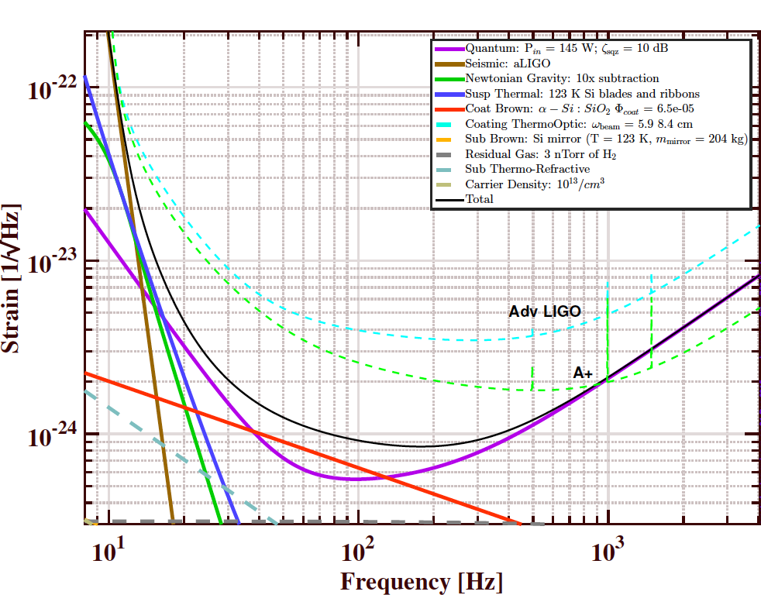
LIGO Voyager baseline noise model
from LIGO-T1400226-v7
Notes:
The proposed cryogenic upgrade to aLIGO is called LIGO Voyager. It’s baseline noise model is the black curve, about a factor of 3 below the aLIGO goal, the dashed cyan line.

Slide 4
LIGO Voyager baseline noise model
Test masses:
40 kg 300 K silica in aLIGO
becomes 200 kg 120 K silicon
from LIGO-T1400226-v7
Notes:
The best sensitivity is around 100 Hz is limited by the thermal noise of the test mass mirror coating noise in red, which is achieved, in part, by swapping out the aLIGO test masses, made of 40 kg room temp silica, for 200 kg of silicon at 120 K.

Slide 5
Why Cryogenic Si for Test Masses?
Lower temperature -> lower thermal noise
Silicon has low mechanical loss at cold temperatures, further lowering the thermal noise off-resonance
Thermal expansion goes to 0 at 124 K, eliminating thermoelastic noise and reducing thermal lensing
Silicon has high thermal conductivity at low temperatures, reducing thermal lensing, permitting higher laser powers (lower shot noise)
Notes:
So how is cryogenic silicon actually helpful? Well…

Slide 6
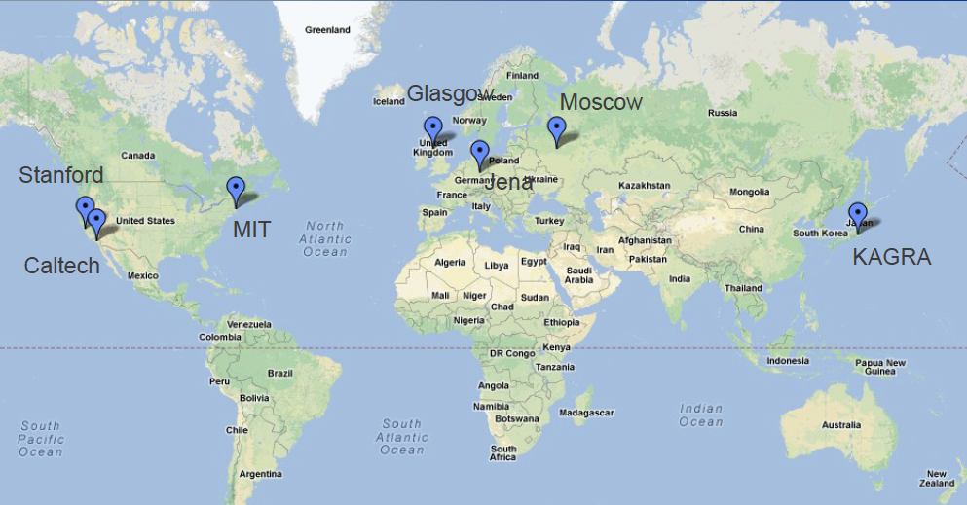
Cryo work distribution
Caltech - direct thermal noise measurements; procuring large silicon masses
Jena/Glasgow/Moscow - mechanical loss
KAGRA – 20 K sapphire suspensions
Glasgow – silicon and sapphire test mass suspensions; coatings; absorption
INPE Brazil – cryogenic multi-nested pendulum
Stanford – optical coatings (Riccardo Bassiri’s talk); cryogenic technology
Adapted from Nicolas Smith-Lefebvre
Notes:
There are a number of groups throughout the gravitational wave community doing research for cryogenic test masses.

Slide 7


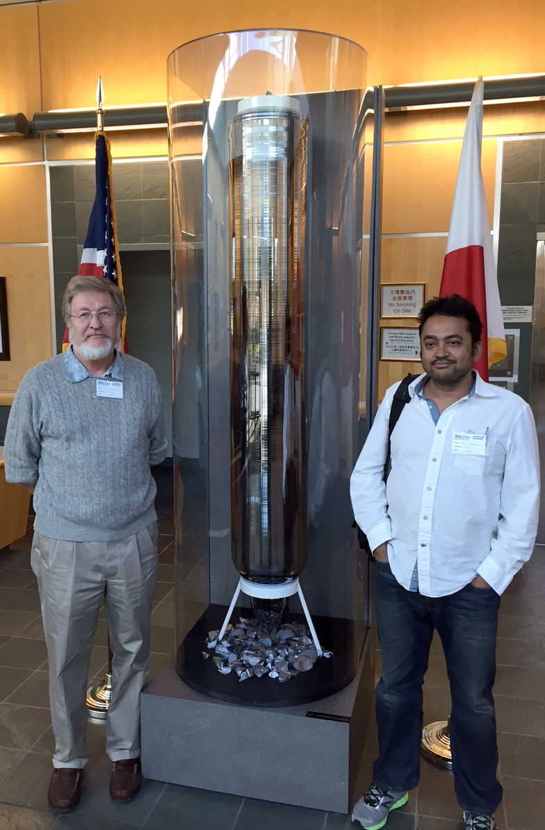
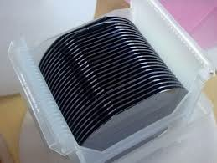
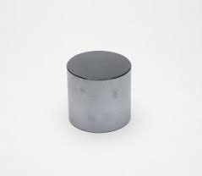
Magnetic Czochralski for 200 kg Si test masses
Normally all the ingots produced are processed into wafers
We are procuring “slugs” to determine properties of interest to us
20 cm diameter by 1 cm
Rana A & Eric G with 300 mm ingot at Shin-Etsu, WA
Notes:
The University of Glasgow and Caltech are looking into how we can actually get 200 kg of high purity single crystalline silicon for 45 cm diameter test masses. This turns out to be a non-trivial problem. The silicon industry is primarily set up for producing wafers.

Slide 8
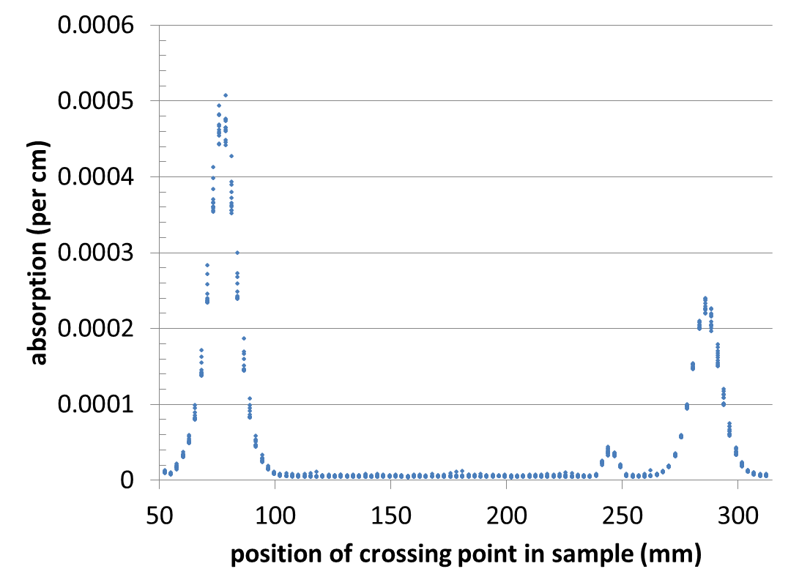
Silicon absorption measurements
Ingots polished with diamond slurry and pitch lap
Consistently gives ~0.1% absorption at the surface
Polishers uses it as it more easily gives good flatness over 4” diameter
1550 nm absorption
Notes:
Glasgow and Stanford measuring the optical absorption in Silicon. This is important so that our high power lasers don’t deposit too much heat into the cold test masses.

Slide 9

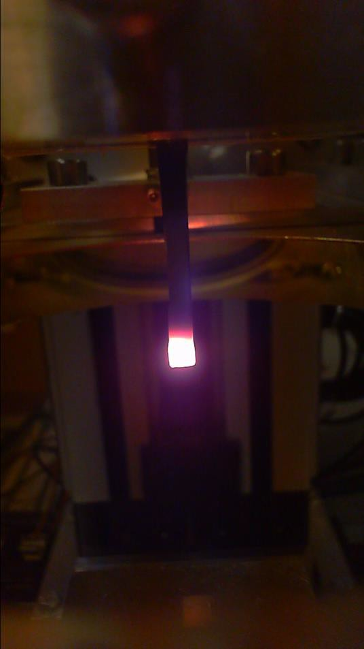
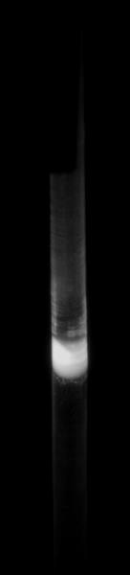
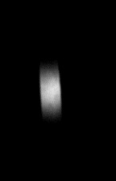
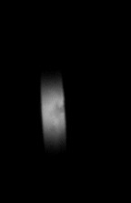
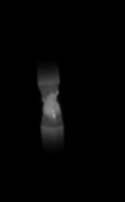
Crystalline suspension fiber development
We now have a SYNRAD 10.6um (400W laser for silicon growth/silica puller) and 1064 nm (100W) as heat sources for melting silicon/sapphire
Low viscosity, requirement of long term stability (low growth speed) and emissivity
variation (for silicon) are areas of ongoing research
Silicon heating at 10.6 um
From G1600467
Silicon
Molten sapphire
Notes:
Also at Glasgow they are looking into how to produce silicon and sapphire fibers from which to hang these test masses. This is important because it is not yet known how to make these fibers that are strong enough.

Slide 10

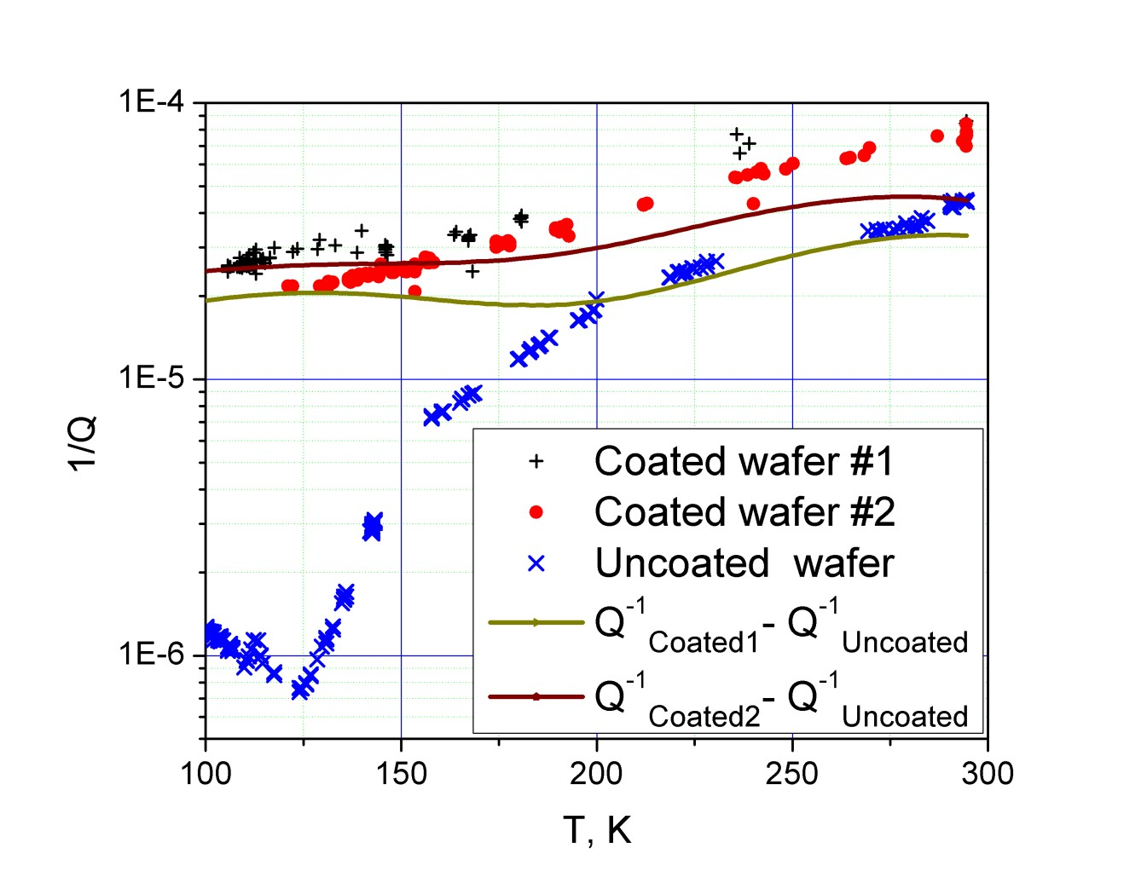
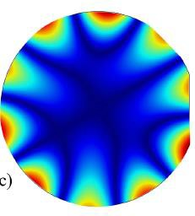
Mechanical losses of coated and uncoated Si oscillators
For the detail investigation we choose the relatively high-Q mode with frequency of 3528 Hz. This mode has five nodal diameters distorted by presence of the flats.
From G1500466
Notes:
Moscow state University is measuring the mechanical loss of silicon with various black coatings, because these test masses will need to be cooled radiatively.

Slide 11
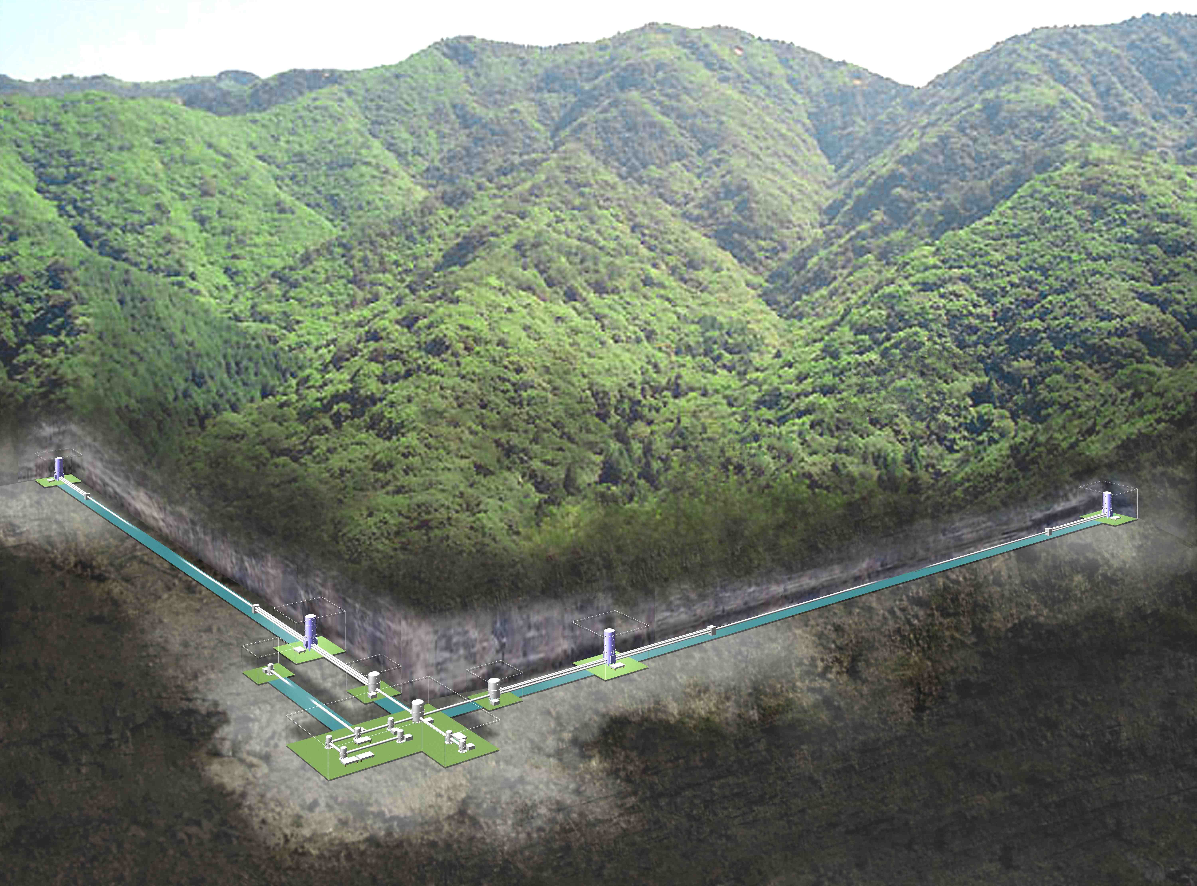
KAGRA Kamioka site
Cryogenic operations planned for March 2018
20 K, 23 kg sapphire test masses
From G1600682
Notes:
KAGRA, the Japanese observatory currently under construction plans to be operating with cryogenic Sapphire test masses 2 years from now.

Slide 12
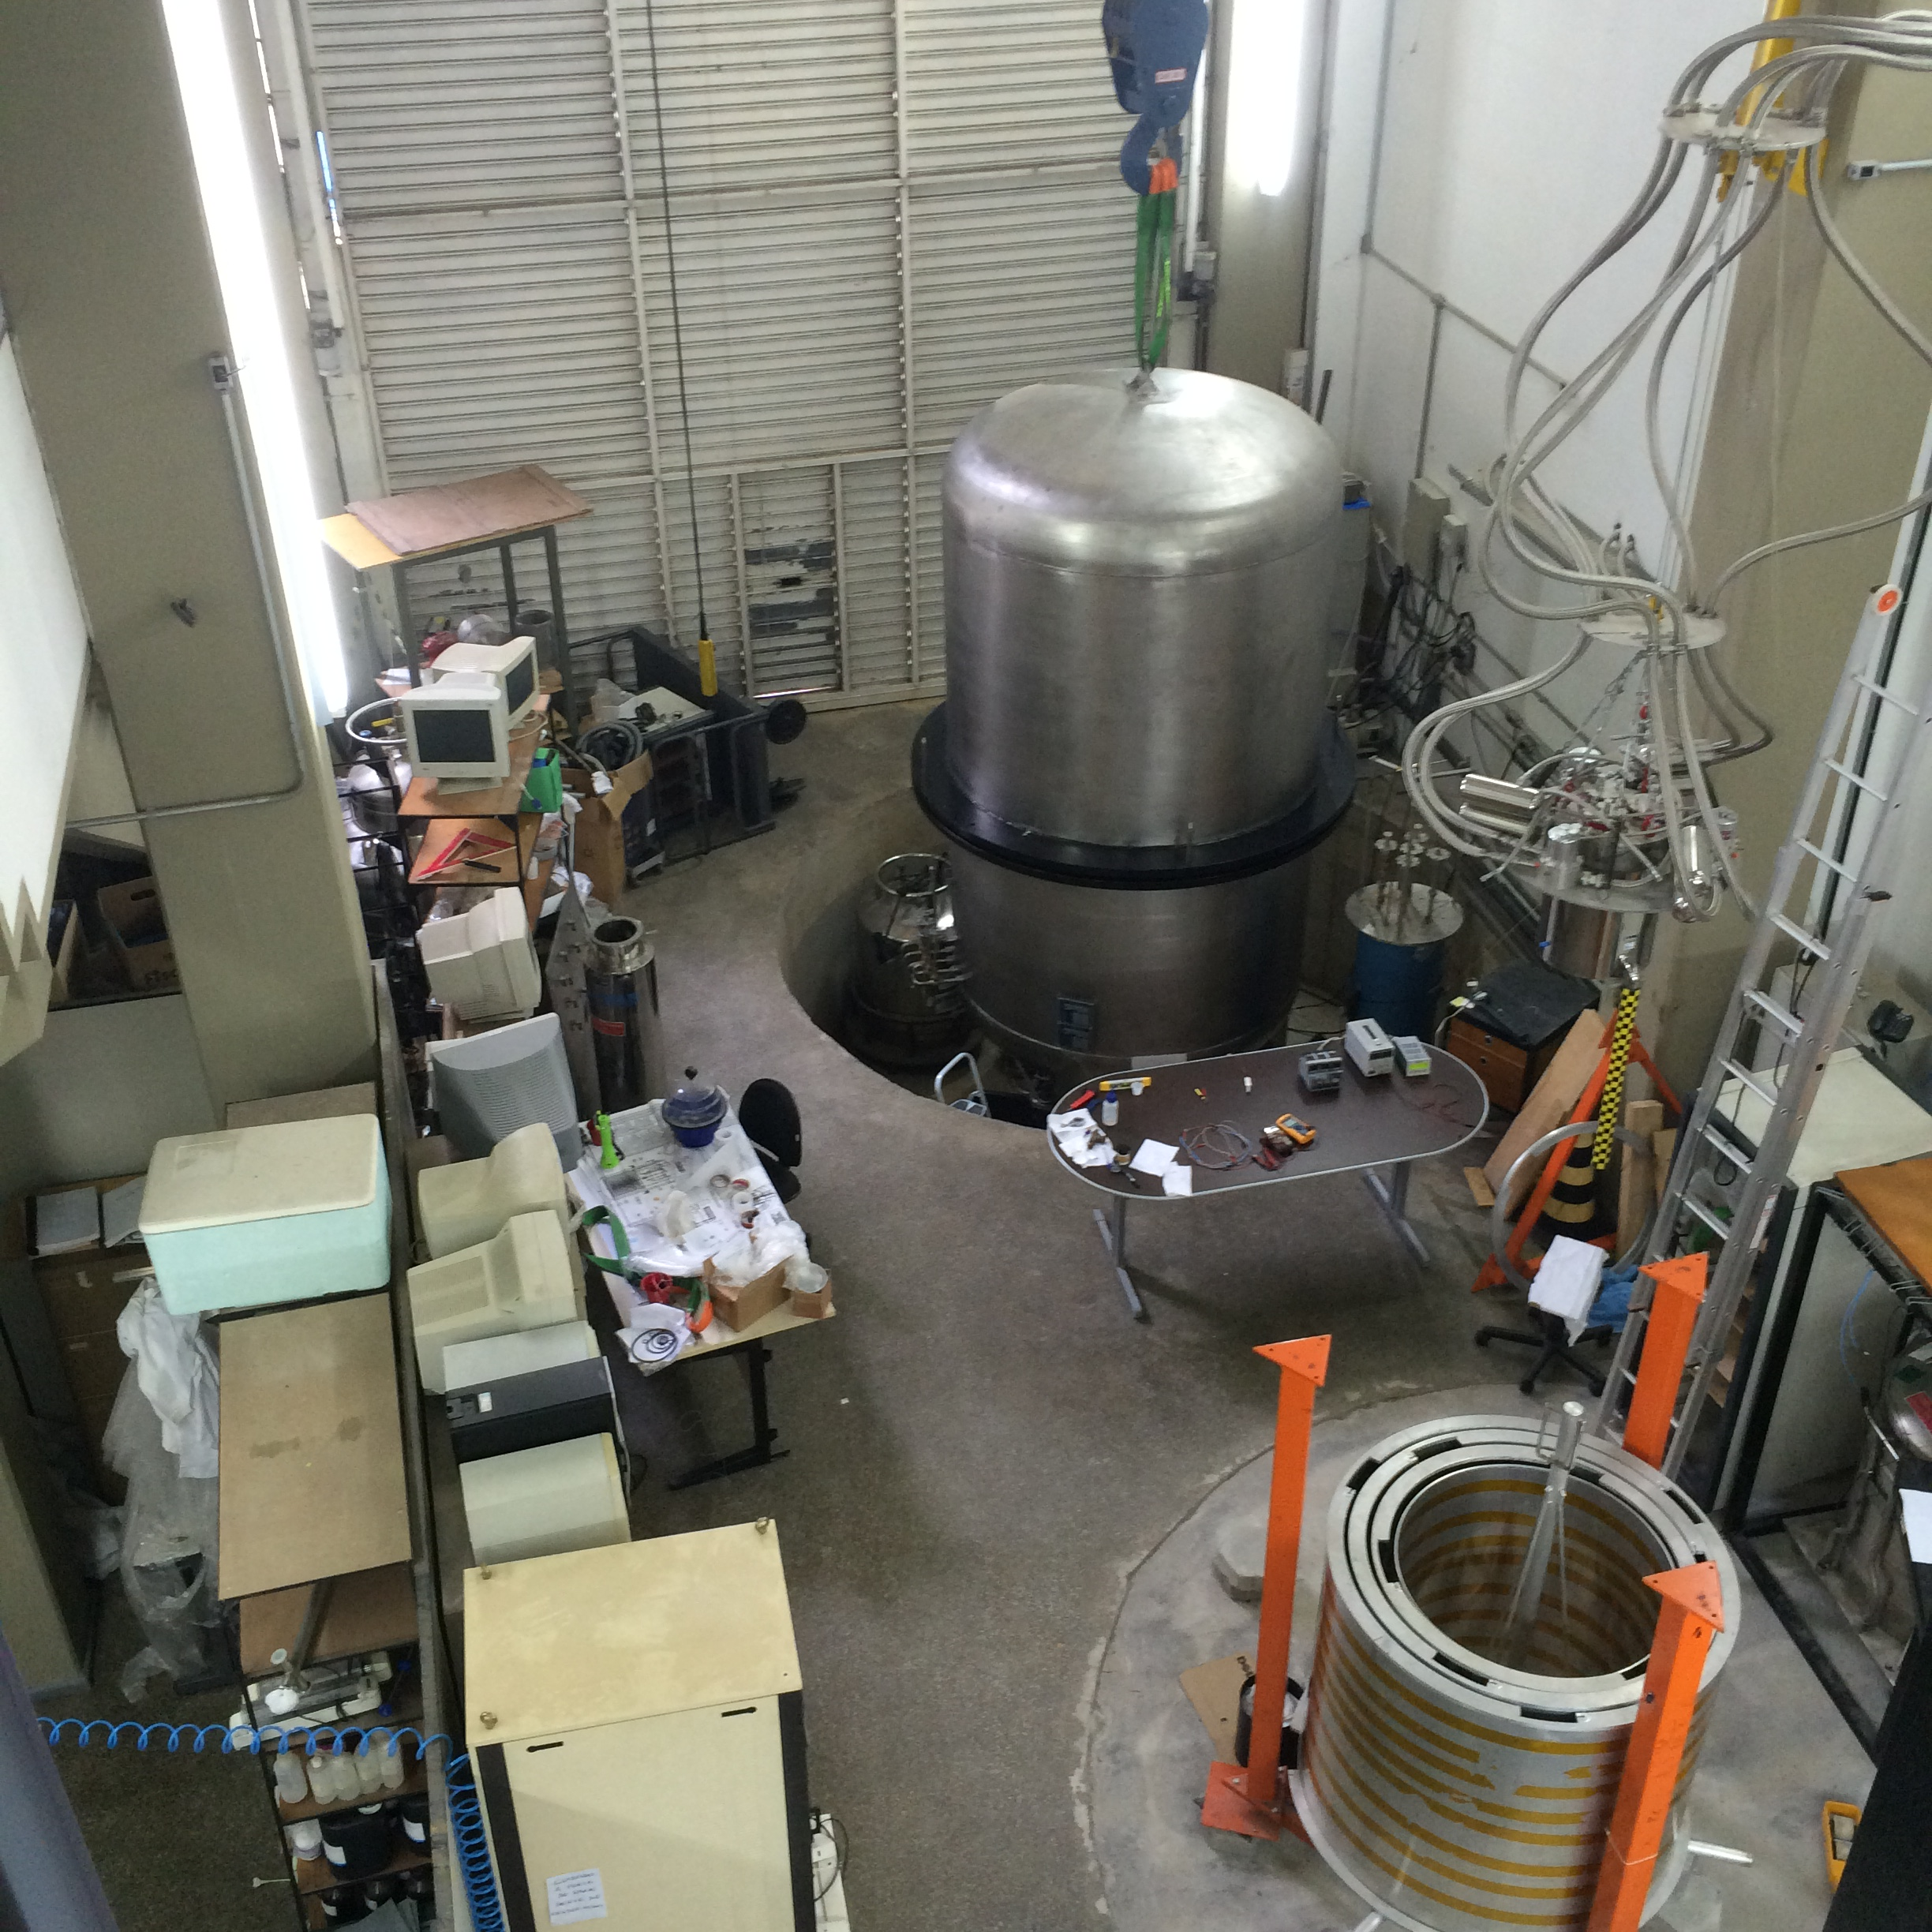
GWINPE – Multi-Nested-Pendulum
28 March 2016
Notes:
And of course here at INPE, Odylio’s group is working on a method to cool the silicon test masses without compromising their vibration isolation.
This is a picture from yesterday, and you can see their new cryogenic vacuum chamber, and a part of the MNP.

Slide 13
A model of the noise performance of LIGO Voyager
Goal of the work at Stanford:
Cool a silicon test mass to 120 K
Don’t compromise the seismic isolation performance
Plan for maintenance and repair
from LIGO-T1400226-v7
Notes:
At Stanford we are also looking into this problem of how to cool a silicon test mass without increasing its vibration.
We’re also trying to design the cryogenics for maintenance and repair scenarios, meaning that if we fully enclose the test mass with cryogenics, we can still somehow get in there to access the test mass.
One of the great things about collaborating with Odylio’s group is that they have a tremendous amount of experience with cryogenics, while at Stanford we’re still learning about all this. In fact the more I get into it, the more I realize what I don’t know. So one of the goals of my visit here is to learn everything Odylio knows.

Slide 14


Actively controlled shield (ETM)
Vacuum chamber
Vib. isolated optics table
Gnd
Gnd
Gate Valve
Gate Valve
z
10 m
124 K test mass
Notes:
The approach we’ve decided to take is shown by this cartoon of a LIGO end station.
Here’s the test mass inside the test mass chamber.

Slide 15
Actively controlled shield (ETM)
Vacuum chamber
Vib. isolated optics table
Gnd
Gnd
Gate Valve
Gate Valve
z
10 m
80 K heat shield for ≈5 W cooling
124 K test mass
Notes:
There’s an 80 K heat shield surrounding the test mass, giving us about 5 W of cooling power, just by radiation.

Slide 16
Actively controlled shield (ETM)
Vacuum chamber
Cold link
Vib. isolated optics table
Gnd
Gnd
Gate Valve
Gate Valve
z
10 m
80 K heat shield for ≈5 W cooling
124 K test mass
Notes:
The heat shield is cooled by some flexible cold link that goes off to the vacuum wall.

Slide 17
Actively controlled shield (ETM)
Vacuum chamber
Cold link
Vib. isolated optics table
80 K baffled beam tube shield
Gnd
Gnd
≈ 900 mm dia
Gate Valve
Gate Valve
z
10 m
80 K heat shield for ≈5 W cooling
124 K test mass
Notes:
And then there is also a shield inside the beam tube so that we can get the laser beam in without leaking too much heat into the shield through that large hole the laser has to pass through

Slide 18
Actively controlled shield (ETM)
Vacuum chamber
Blade springs
Cold link
Vib. isolated optics table
80 K baffled beam tube shield
Gnd
Gnd
≈ 900 mm dia
Gate Valve
Gate Valve
z
10 m
80 K heat shield for ≈5 W cooling
124 K test mass
Notes:
The shield around the test mass hangs from the ground, and it is suspended by springs to give it some vibration isolation, because the shield does require some isolation to minimize the coupling of scattered light, which we’ll talk about more later.
We could have hung it from the optics table, which is already very well isolated, but we chose not to do this just to avoid the whole issue of integrating the cryogenics with a high performance seismic isolation system.

Slide 19
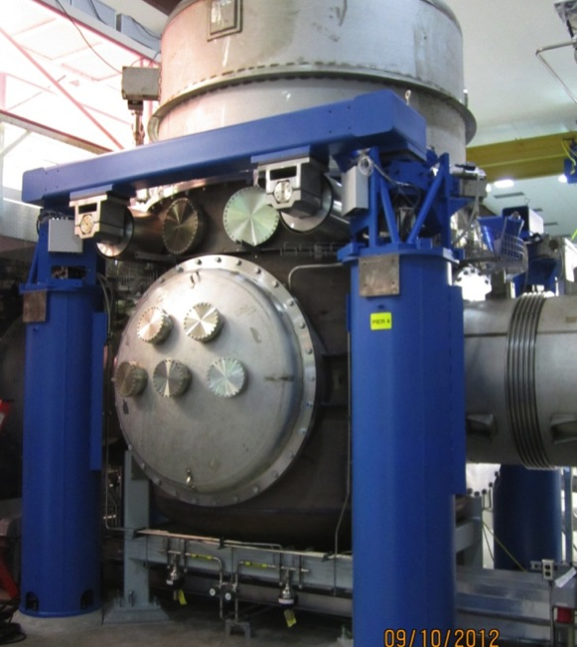
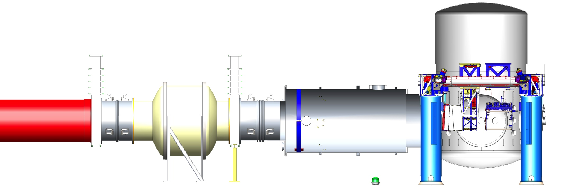
LIGO End Station Model
5 m
5 m
10 m
Notes:
To give you a better idea of what this looks like, this is a solid works model of a LIGO end station, with a photograph of the test mass chamber.

Slide 20
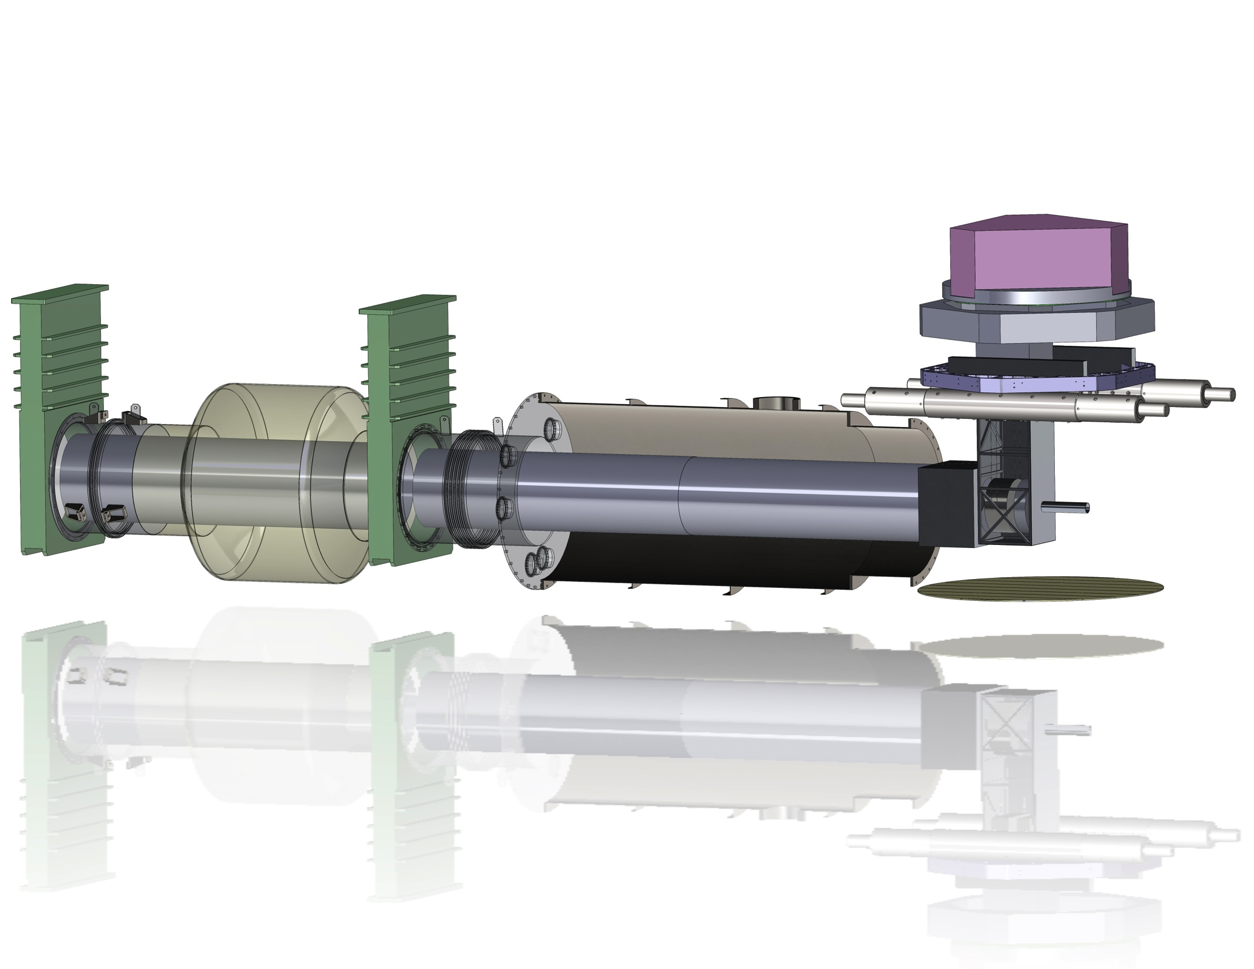
LIGO Voyager Conceptual Model
Vibration isolated
optics table
Gate valve
Gate valve
Transmitted
beam shield
Vibration isolated test mass shield, 80 K
Suspended beam tube shield, 80 K
Notes:
Here is a view with various bits cut away, and with a very preliminary conceptual model of the LIGO Voyager components, to get an idea of how everything fits together.

Slide 21
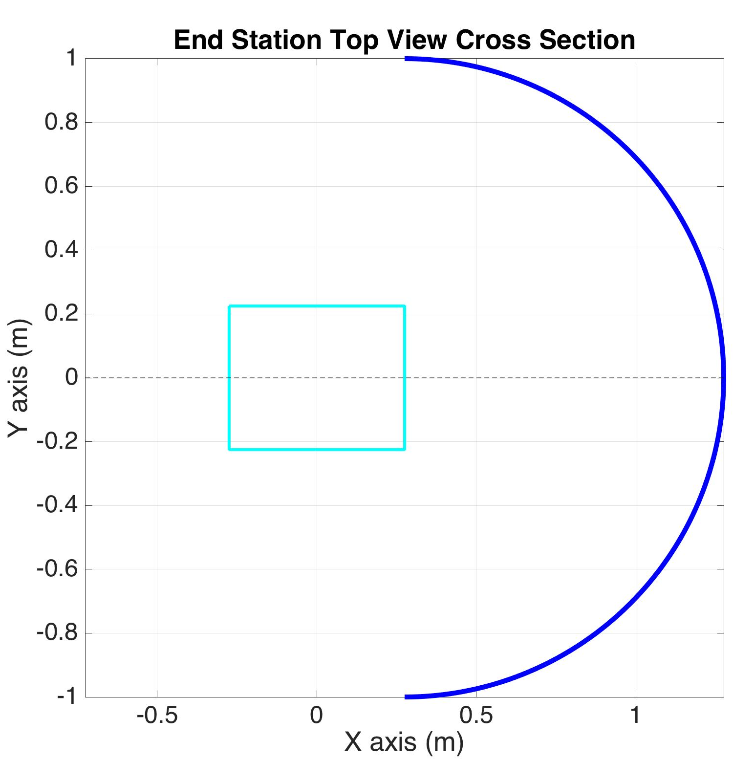
Scattered light noise simulation
10 ppm scatter
Test mass
3 MW laser
Simplified shield
1 m radius
Notes:
In order to determine how well isolated seismically the shield needs to be, we need to estimate how much noise we can expect from the scattered light. The way the scattered light works is that some small pieces of the 3 MW beam hitting the test mass scatter away, at the level of 10 ppm, hit the shield, which is moving with some displacement spectrum, and then a small piece of that comes back to the test mass and recombines into the interferometer. That recombined light carries information about the shield displacement, which will appear as noise in the interferometer. This sketch is from a Matlab simulation that models the scattered light noise. It uses a simplified shield geometry, which is a 1 m radius sphere. 1 m was chosen just because it is a round number. It is likely the real thing will be smaller since this would fill nearly the entire chamber.

Slide 22
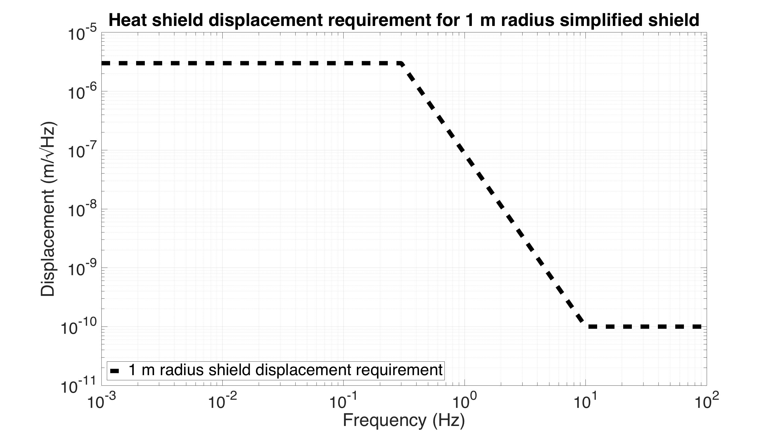
Scattered light noise simulation
3 MW laser
Test mass
Simplified shield
1 m radius
Notes:
For this simulation, I made an educated guess of how low the shield displacement spectrum needs to be, which I show here with this black dashed line in units of meters / sqrt(Hz) vs frequency.

Slide 23
Scattered light noise simulation
Magnitude proportional to shield radius
3 MW laser
Test mass
Simplified shield
1 m radius
Notes:
It turns out the scattered light noise is roughly inversely proportional to the shield radius. So if we for example divide the shield radius by 2, then we also should move this displacement requirement curve down by 2.

Slide 24
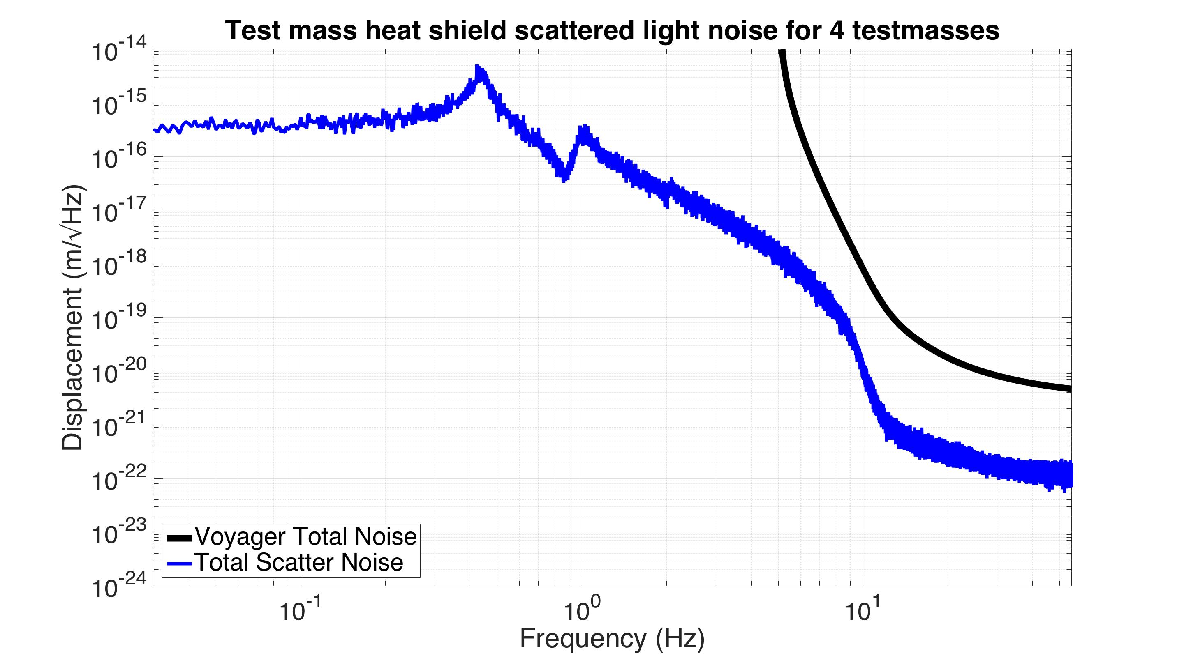
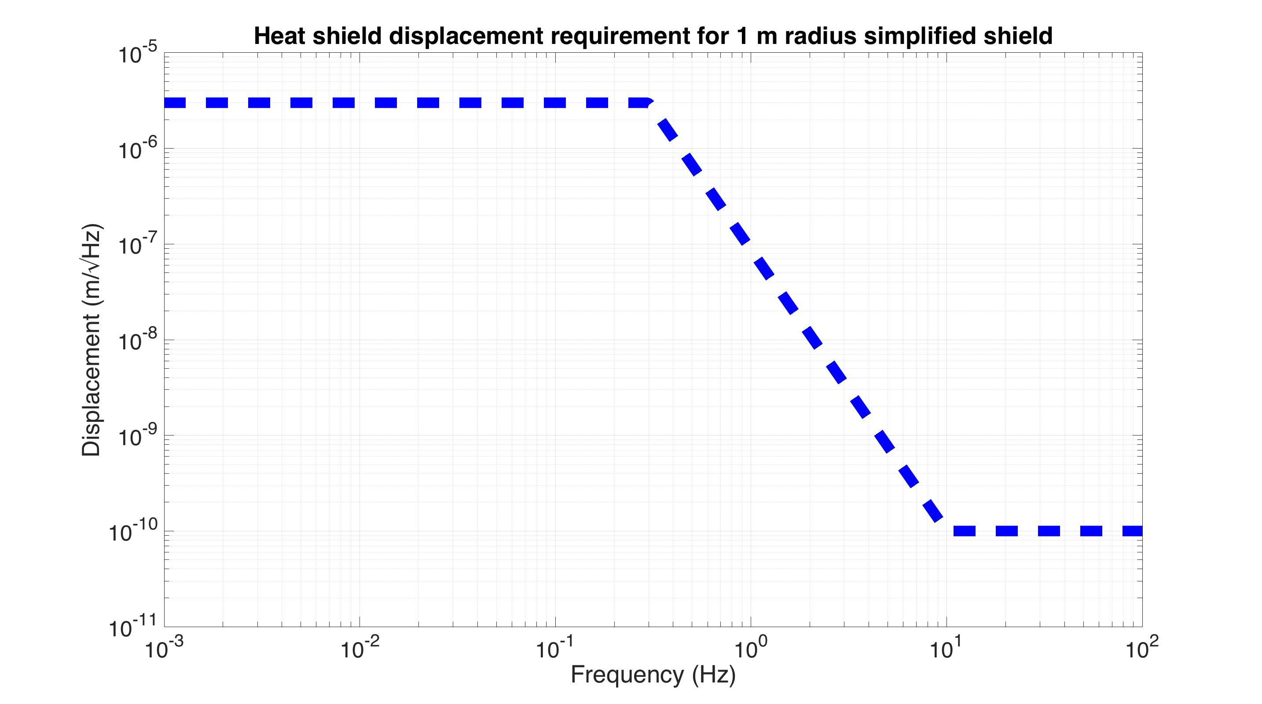
Scattered light noise simulation
Shield displacement requirement
simulation
Notes:
This fuzzy blue line, is a simulation of the effective displacement noise seen by a LIGO voyager interferometer given that displacement requirement curve. The black curve is the baseline Voyager noise performance we saw earlier. So you can see the scattered light nose is in at least 2 orders of magnitude away from our performance goal at all frequencies.
It turns out though, that this noise is highly nonlinear.

Slide 25
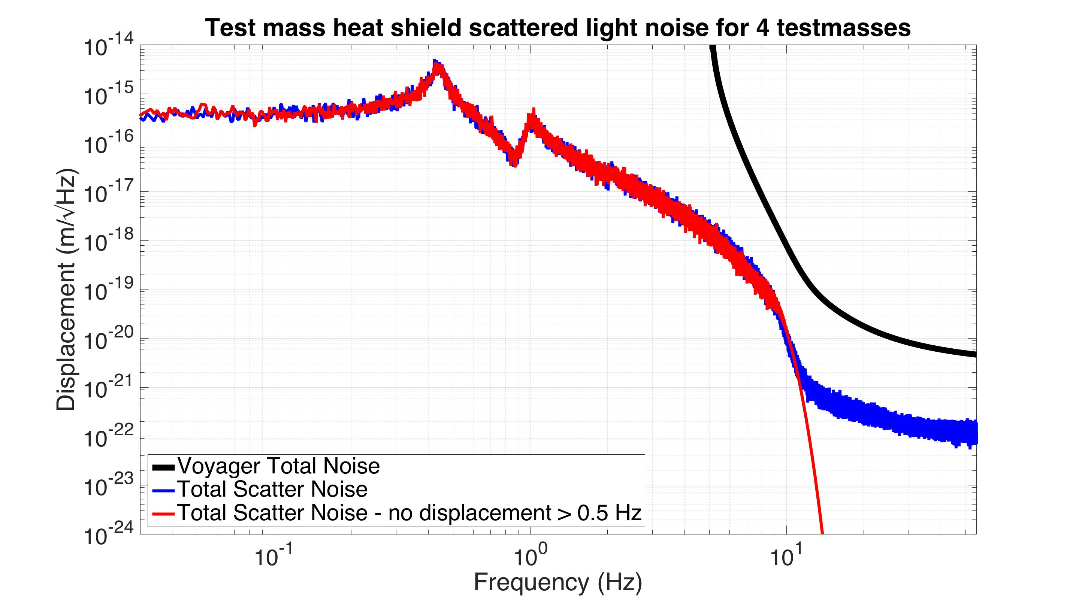
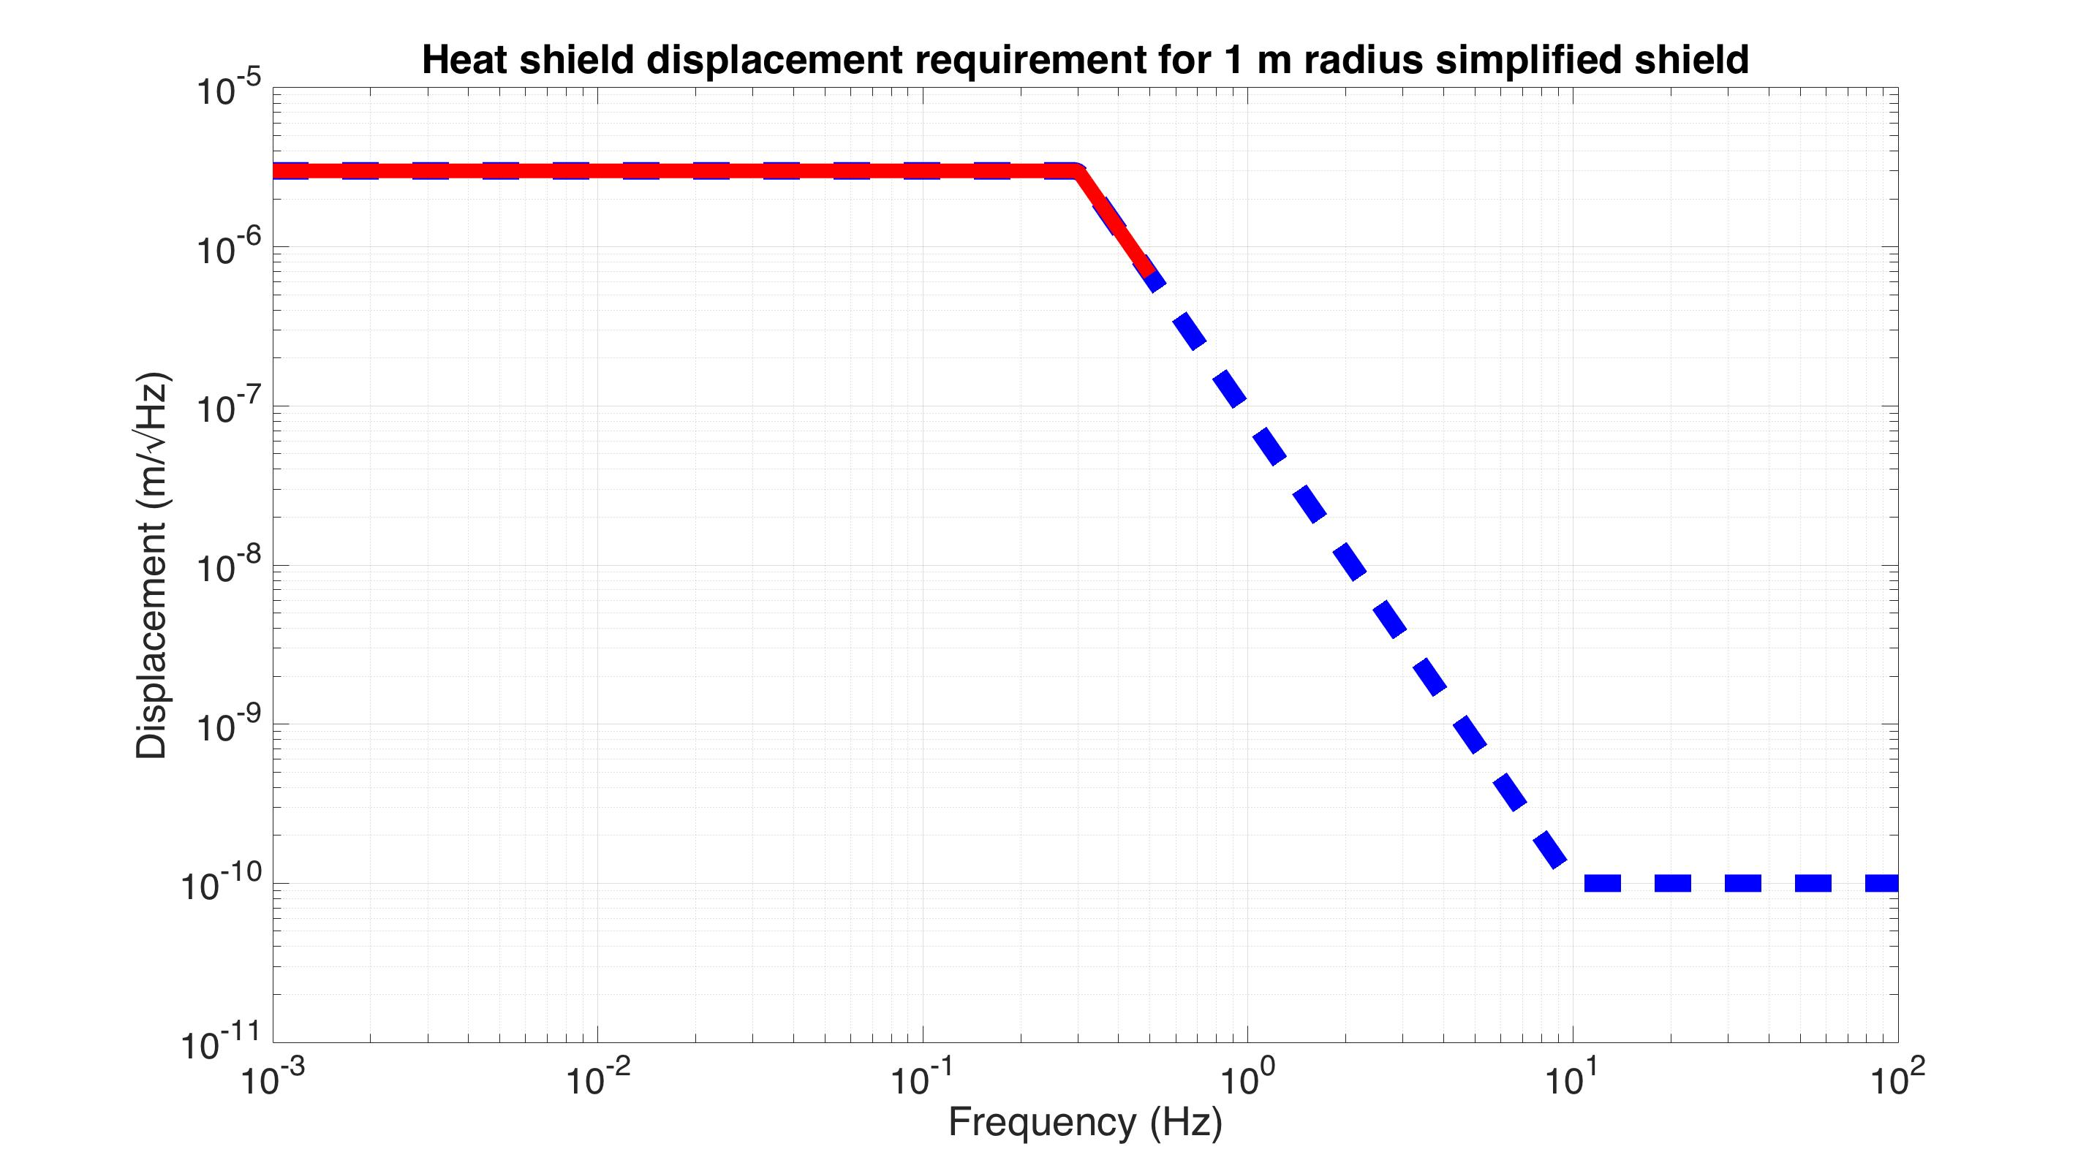
Scattered light noise simulation
- upconversion
No shield displacement
simulation
Notes:
To get a feel for this, on this next slide, I’ve eliminated all the shield’s displacement above 0.5 Hz. So all this noise you see here up to 10 Hz is coming entirely from displacement below 0.5 Hz. This suggests that most of the vibration isolation we need is at low frequencies.

Slide 26
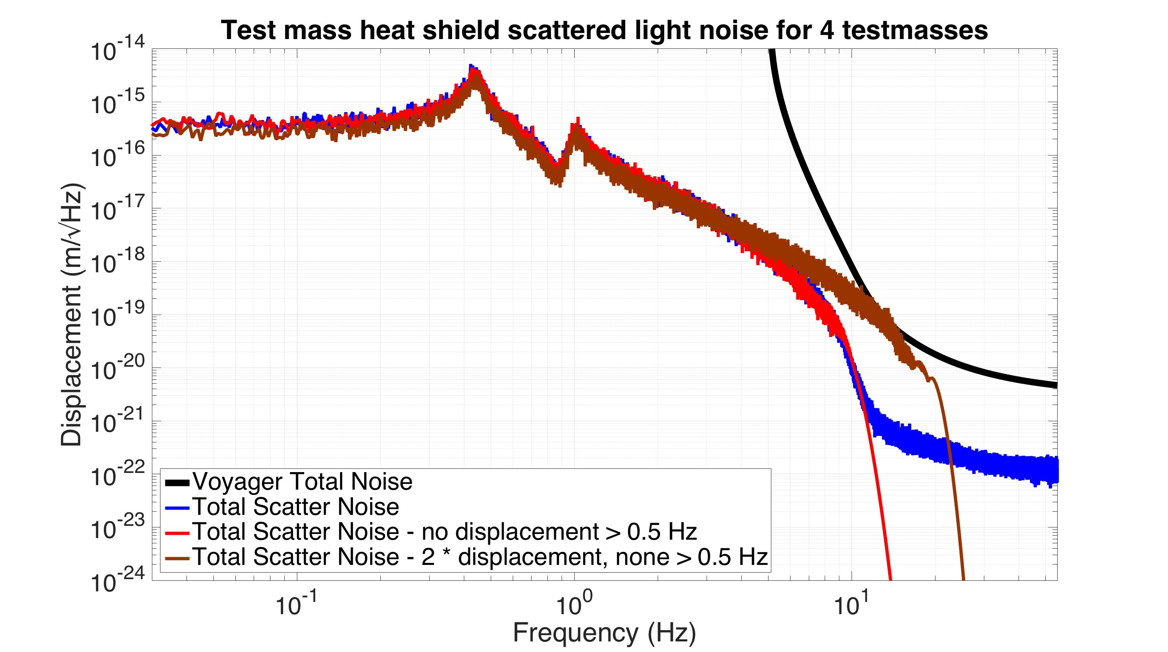
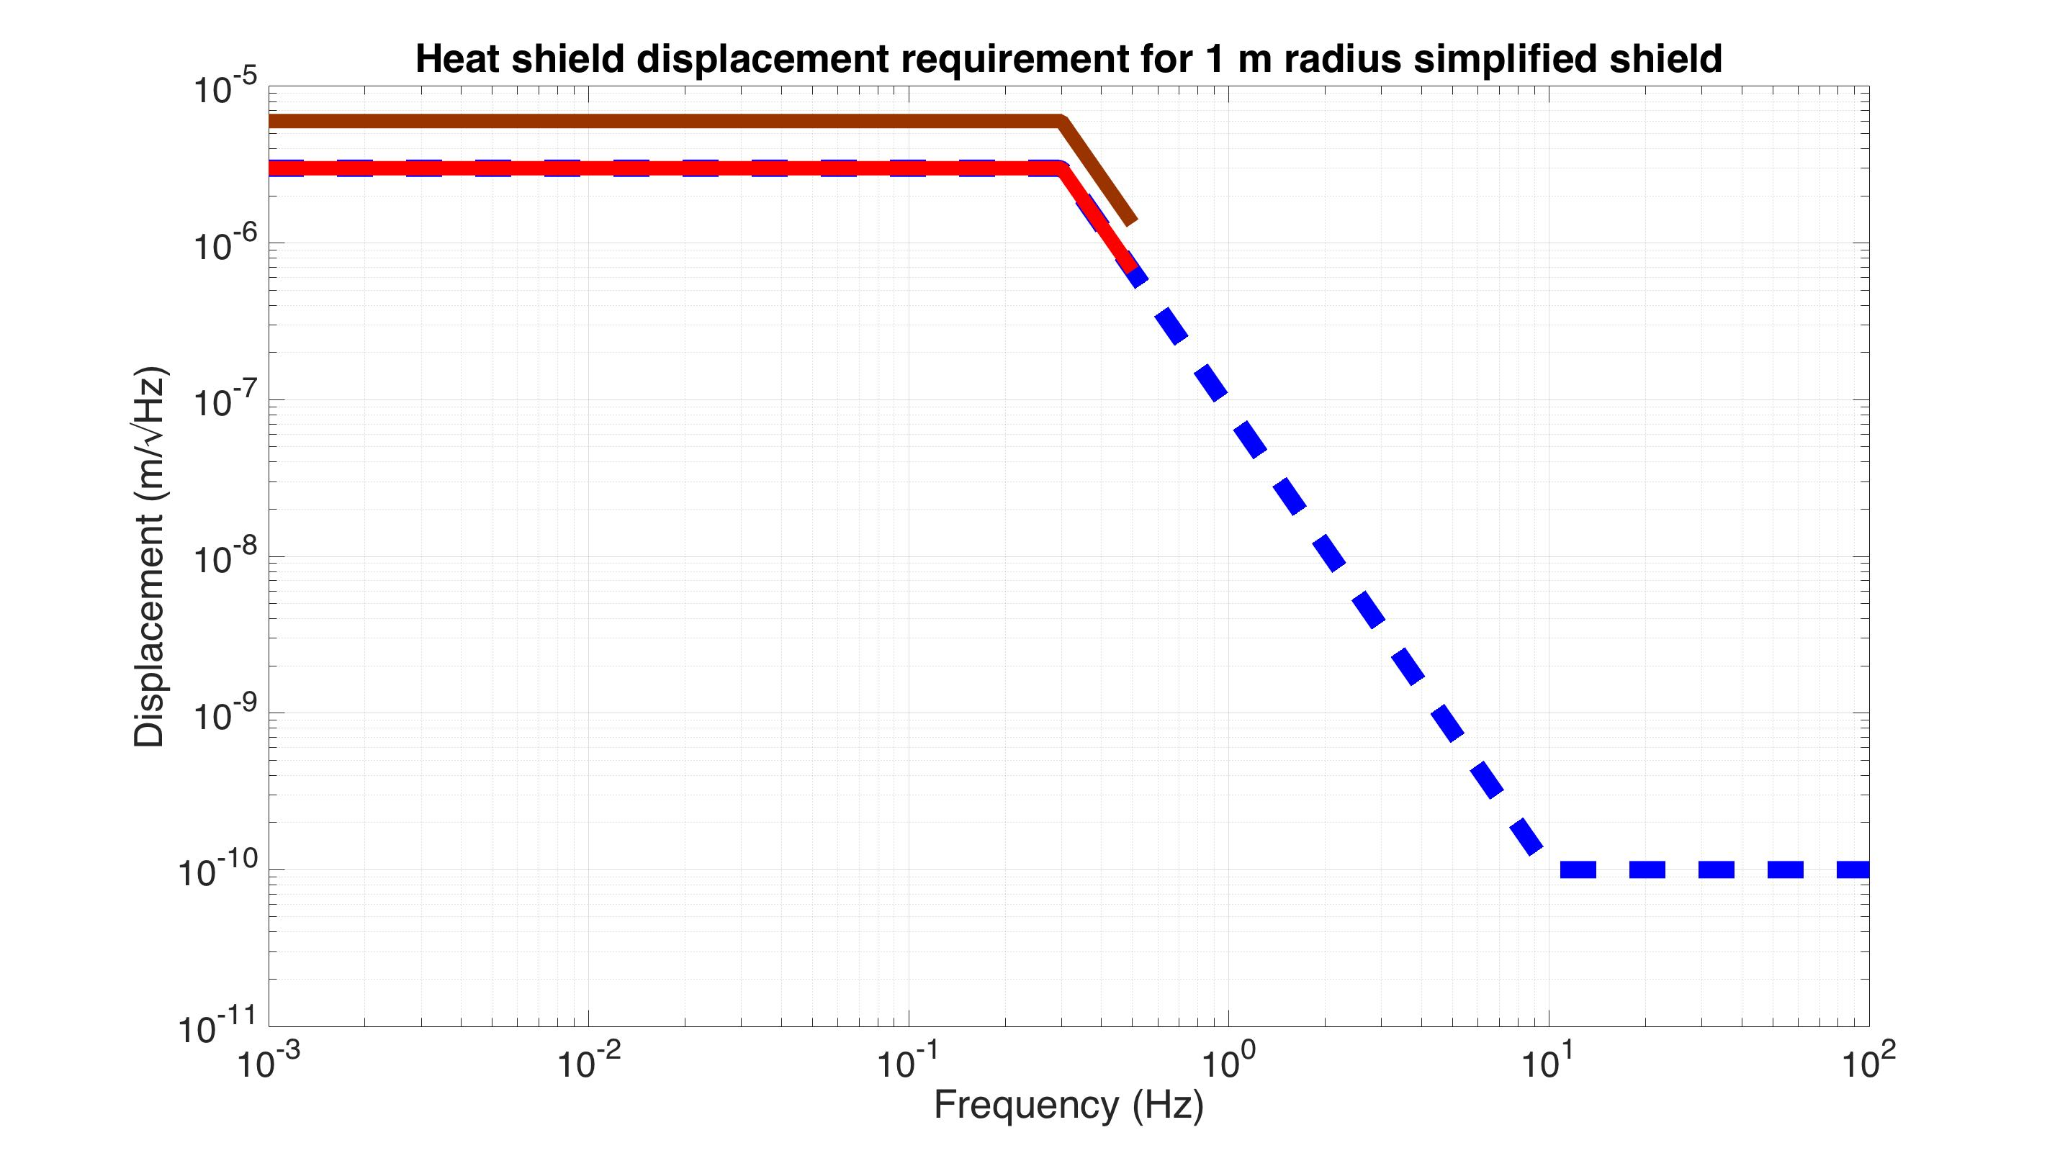
Scattered light noise simulation
- upconversion
No shield displacement
simulation
Notes:
To explore this nonlinear behavior some more, here I’ve amplified the shield’s displacement by a factor of 2. There is still 0 displacement above 0.5 Hz. You can see that this 10 Hz shoulder has moved up to about 20 Hz, even though the low frequency noise is no worse.

Slide 27
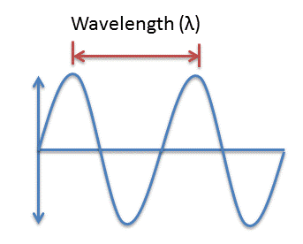
Laser wavelength (λ≈2μm)
10 ppm scatter
Shield displacement
Test mass
3 MW laser
Test mass
If the displacement is large compared to λ, the scattering upconverts to higher frequencies
Simplified shield
1 m radius
Notes:
This nonlinear behavior happens when the shield’s displacement is large compared to the wavelength of the laser. It’s only linear when it is small.

Slide 28
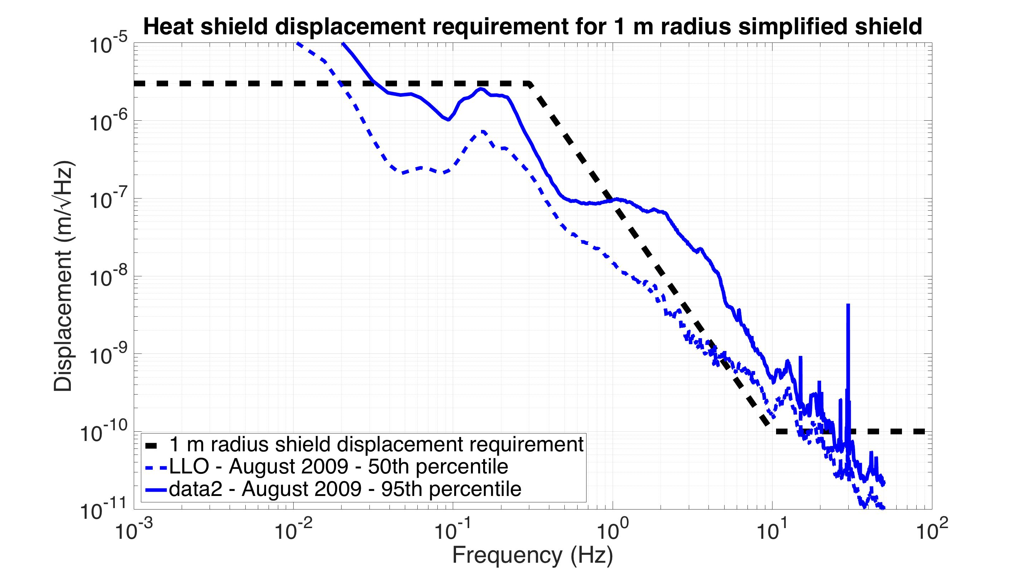
Livingston Ground Displacement
August 2009
95th percentile
50th percentile
Data from T1500224
Notes:
To see how much vibration isolation we need to actually achieve this requirement curve, I’ve plotted measured ground motion from Livingston on top of it. This is from August of 2009. The 50th percentile line indicates that 50% of the time from that month the ground moved less than this. The 95 percentile line indicates that 95% of the time that month the ground moved less than that line. Much of this motion is below the requirement curve, so perhaps this isn’t too bad.

Slide 29
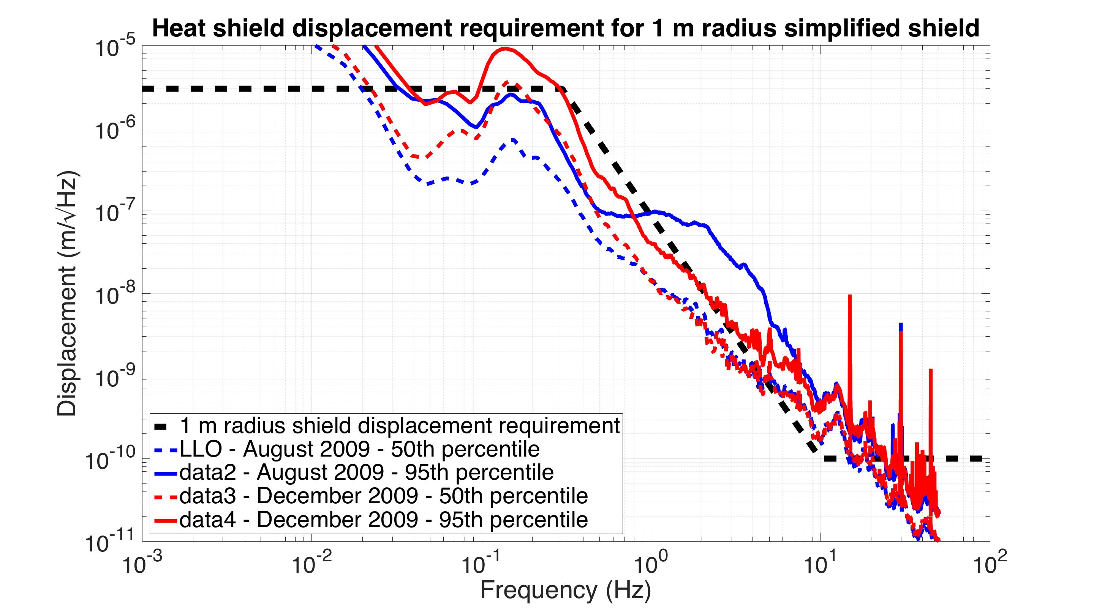
Livingston Ground Displacement
August & December 2009
Dec 95th percentile
Aug 95th percentile
Aug 50th percentile
Dec 50th percentile
Data from T1500224
Notes:
The ground moves more in the winter time however. The red lines are from December of 2009, and the peak motion increases a noticeable amount.

Slide 30
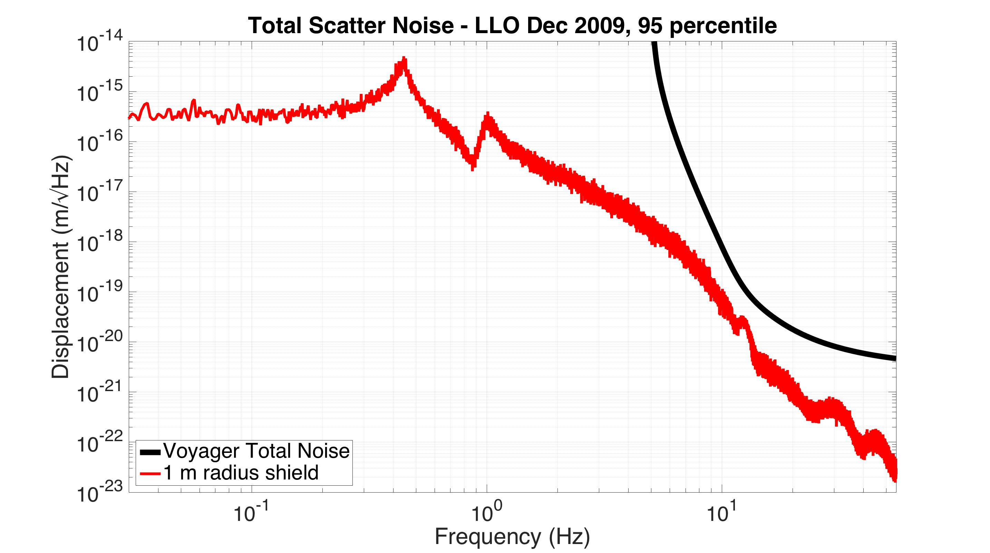
Noise with various shield sizes
simulation
Notes:
If you plug that worst case ground motion into the scattered light simulation, you get this red curve. It’s still below the Voyager goal, but not by as much.

Slide 31
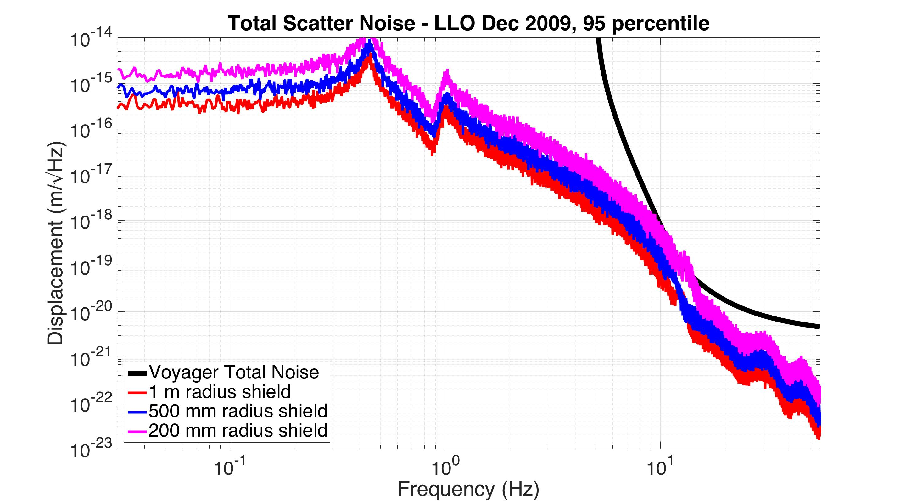
Noise with various shield sizes
simulation
Notes:
If you decrease the shield’s radius however, the noise starts becoming more significant.

Slide 32
Noise with various shield sizes
+ unknown vibration from cryogenics
simulation
Notes:
In addition to the ground noise, there is also going to be some still unknown amount of vibration from the cryogenics.

Slide 33
Actively controlled shield (ETM)
Vacuum chamber
Blade springs
Cold link
Vib. isolated optics table
80 K baffled beam tube shield
Gnd
Gnd
≈ 900 mm dia
Gate Valve
Gate Valve
z
10 m
80 K heat shield for ≈5 W cooling
124 K test mass
Notes:
So for these reasons, at Stanford we are thinking about using active control to limit the motion of the shield.
It’s perhaps not necessary to do this, but it does give us more freedom to use a more compact shield, and to be more aggressive with the cryogenics.

Slide 34
Actively controlled shield (ETM)
Relative displacement sensors
Vacuum chamber
Blade springs
Cold link
Vib. isolated optics table
80 K baffled beam tube shield
Gnd
Gnd
≈ 900 mm dia
Gate Valve
Gate Valve
z
10 m
80 K heat shield for ≈5 W cooling
124 K test mass
Notes:
To do this, you can imagine putting displacement sensors between the shield and the optics table, which is well isolated.

Slide 35
Actively controlled shield (ETM)
Relative displacement sensors
Actuators
Vacuum chamber
Blade springs
Cold link
Vib. isolated optics table
80 K baffled beam tube shield
Gnd
Gnd
≈ 900 mm dia
Gate Valve
Gate Valve
z
10 m
80 K heat shield for ≈5 W cooling
124 K test mass
Notes:
And then putting actuators between the shield and the ground, and then using active feedback to force the shield to follow the isolated optics table.
So now that we have some idea of what we need,

Slide 36
Heat shield experiment at Stanford University
Notes:
…the next thing to do is to build a prototype and see if it works. That’s what we’re working on at Stanford. This is a solidworks model of our active heat shield experiment inside of our vacuum chamber. For scale, the chamber is about 2 meters on each side. This image is a rather busy, so I won’t bother to point out all the details here.

Slide 37
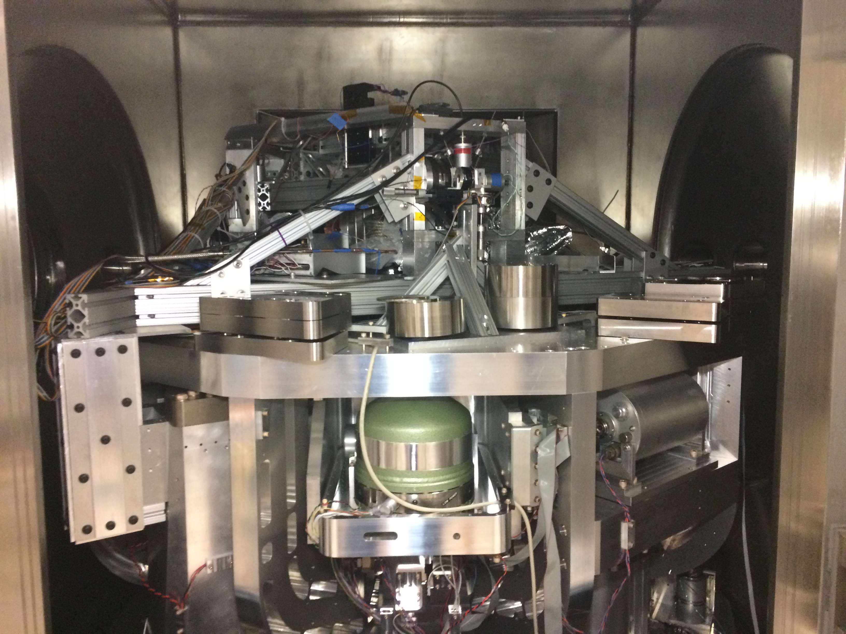
Notes:
Here’s a photo of the same thing. Again, I won’t bother to point out all the parts here.

Slide 38
Actuator
Vacuum wall
Relative displacement sensors
Cu braid
cold link
LN₂ pipes
Inertial sensors - geophones
LN₂ supply
Heat shield support structure
Heat shield
80 K
LN₂ return
Actively isolated optics table (300 K)
Exchange gas feedthrough
Intermediate stage (300 K)
Ground
Spring
Ground
Notes:
Instead, I’ll show a simplified cartoon of how it works, which is basically what we just saw earlier. So starting from the middle of the image and going out, the main difference in our system is that our optics table is below the optic instead of above. But there is still have a heat shield, with a small 1 kg test mass inside. The shield hangs from some springs mounted to a structure rigidly connected to the ground. There are sensors and actuators for the active isolation of the shield, And finally, the heat shield is cooled with some flexible copper braids between it and a liquid nitrogen pipe that comes in through the vacuum wall.

Slide 39
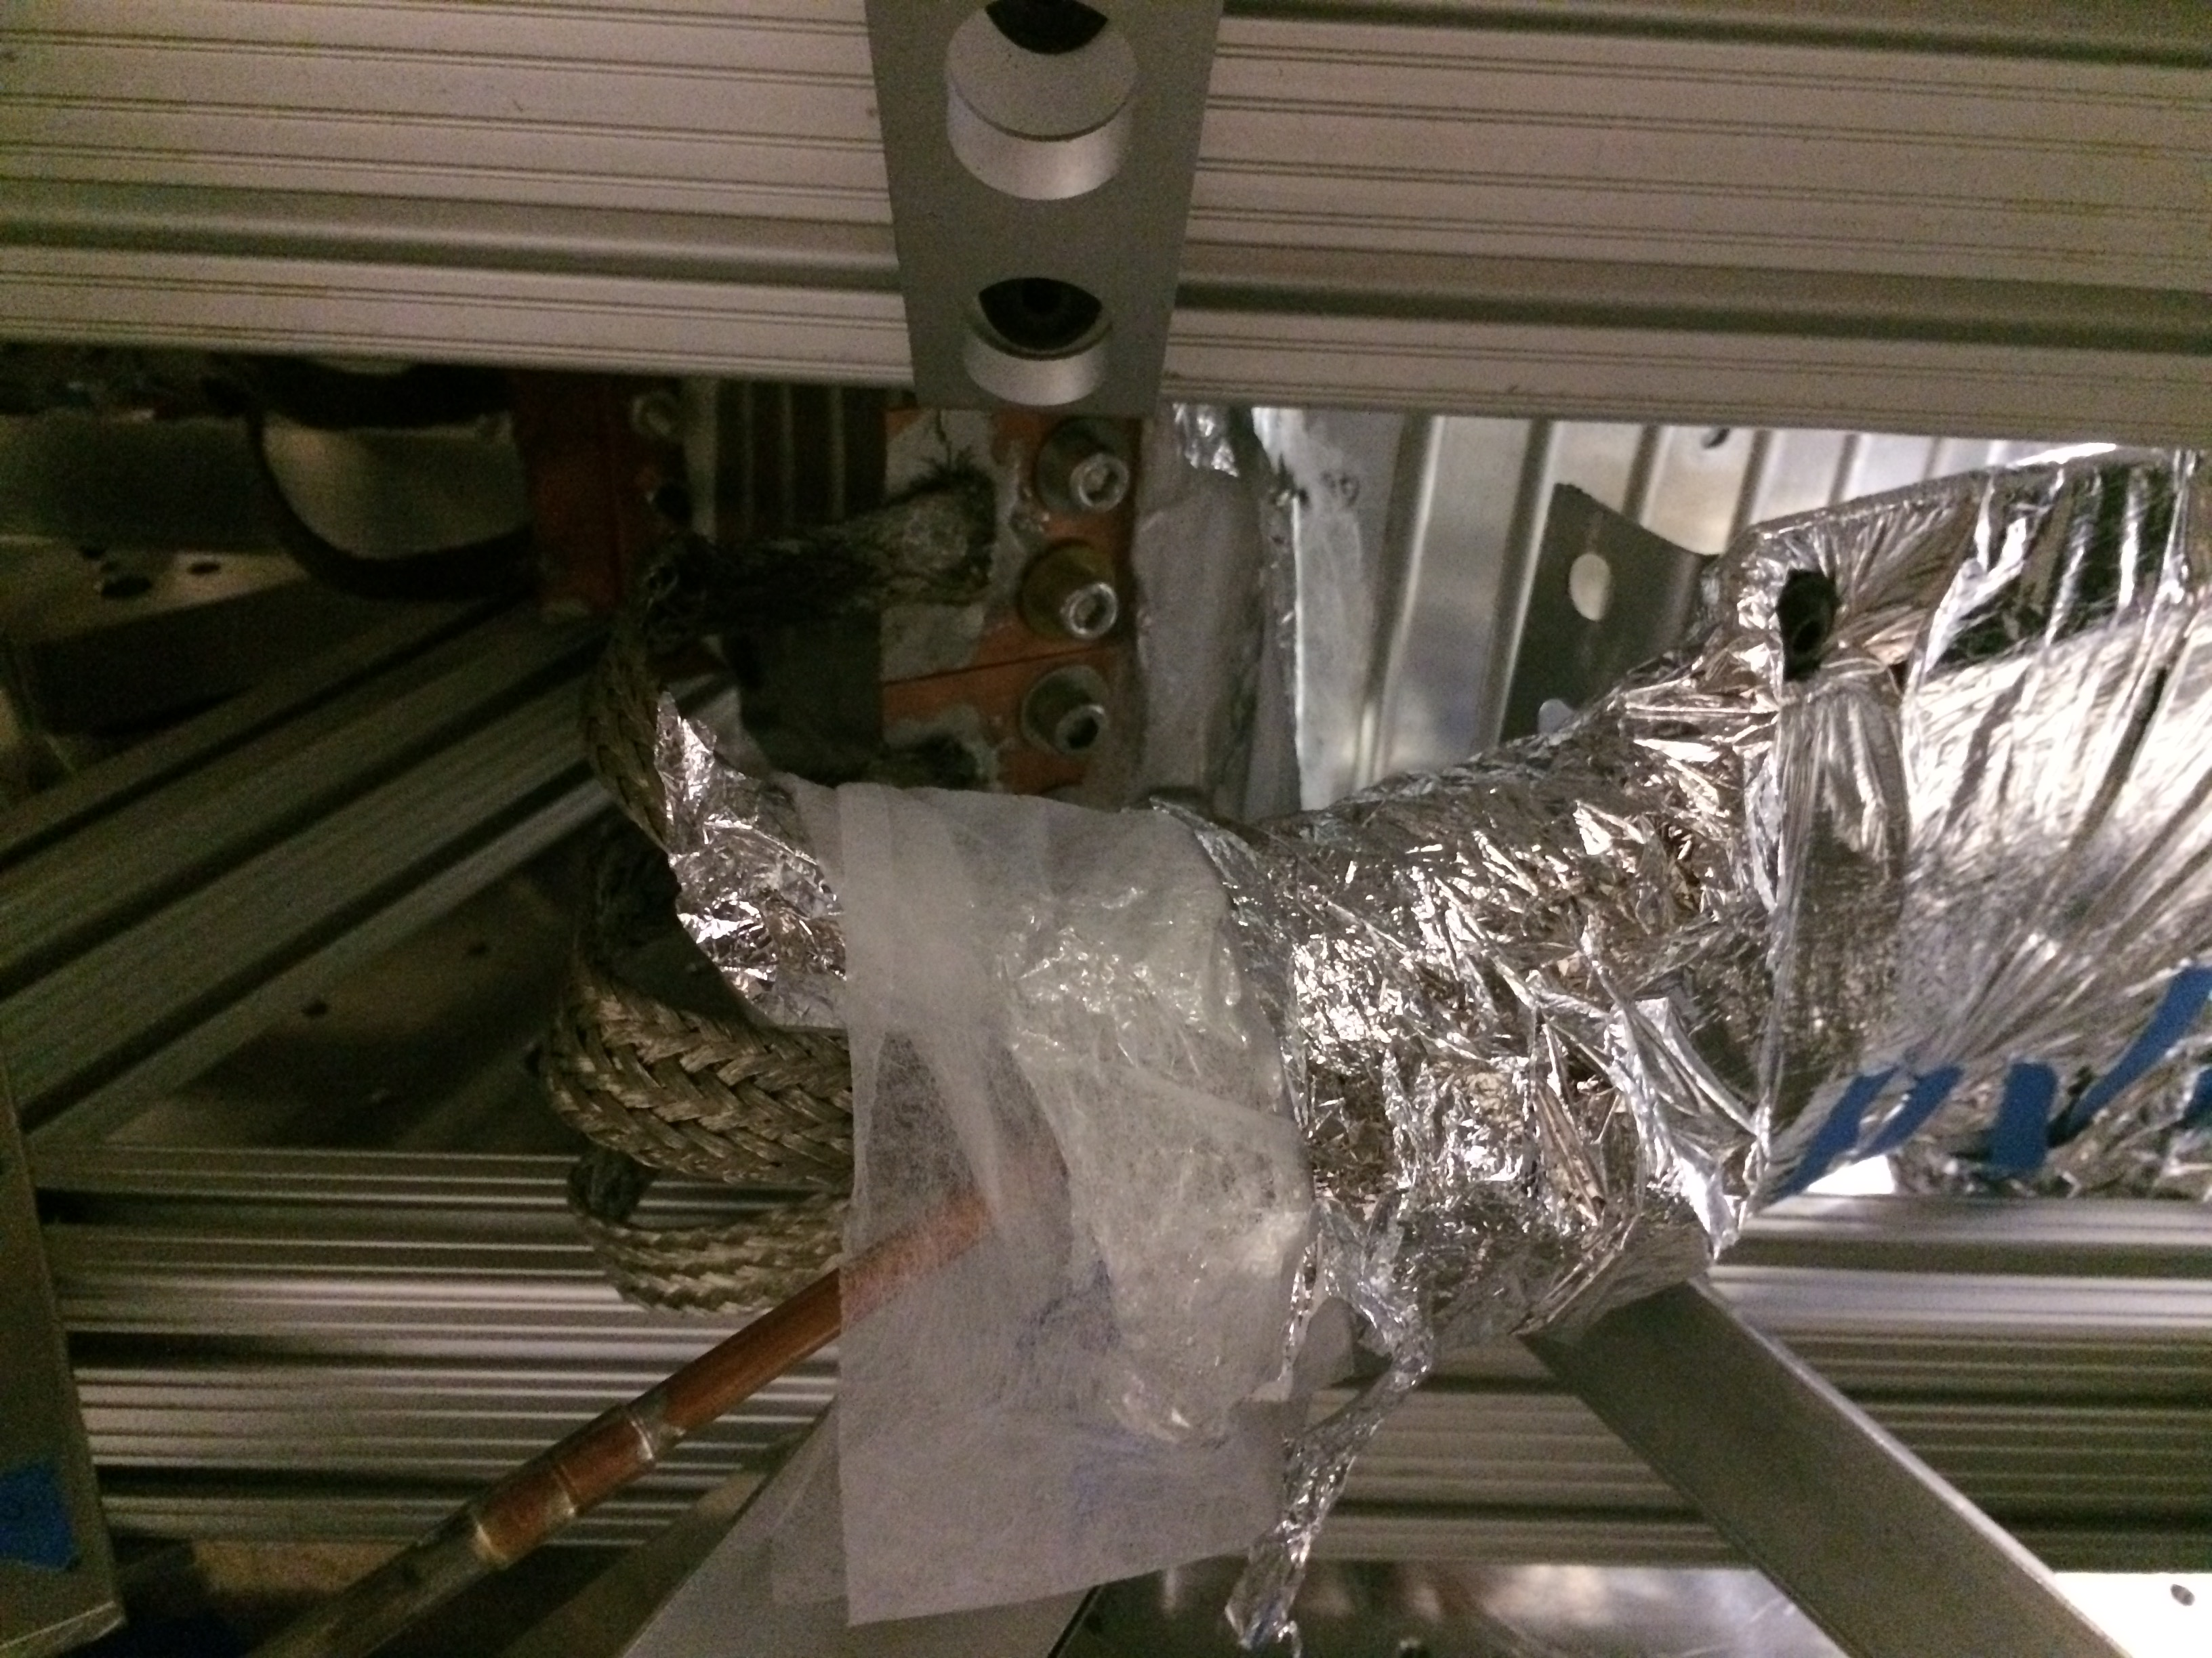
Cold plate
Heat shield
Copper braids
Nitrogen pipe
Notes:
Here is a photo showing the liquid nitrogen pipe, with the copper braids bolted onto the shield. We know bolted joints can be problematic for heat transfer, but we hope to leave an easy way of taking this to access the test mass inside. We simply chose them because they’re easy to install, and easy to remove.

Slide 40

Heat shield measurement and control
The controller forces the heat shield to follow the isolated optics table using the relative displacement sensors
The heat shield’s geophones are used to measure how well the control is doing
Ground vibrations
Isolated optics
table
Heat Shield
Cryo vibrations
Geophones
Relative
displacement sensors
Geophones
Actuator force
Controller
Notes:
This is a diagram of how our active isolation works. We feed back relative displacements sensor signals in order to force the heat shield to follow the optics table, which is already well isolated. This way we can ensure the shield also has good isolation, despite the influence of vibrations from the ground and the cryogenics. Then we measure the heat shield’s performance with some geophones that are not part of the feedback loop.

Slide 41
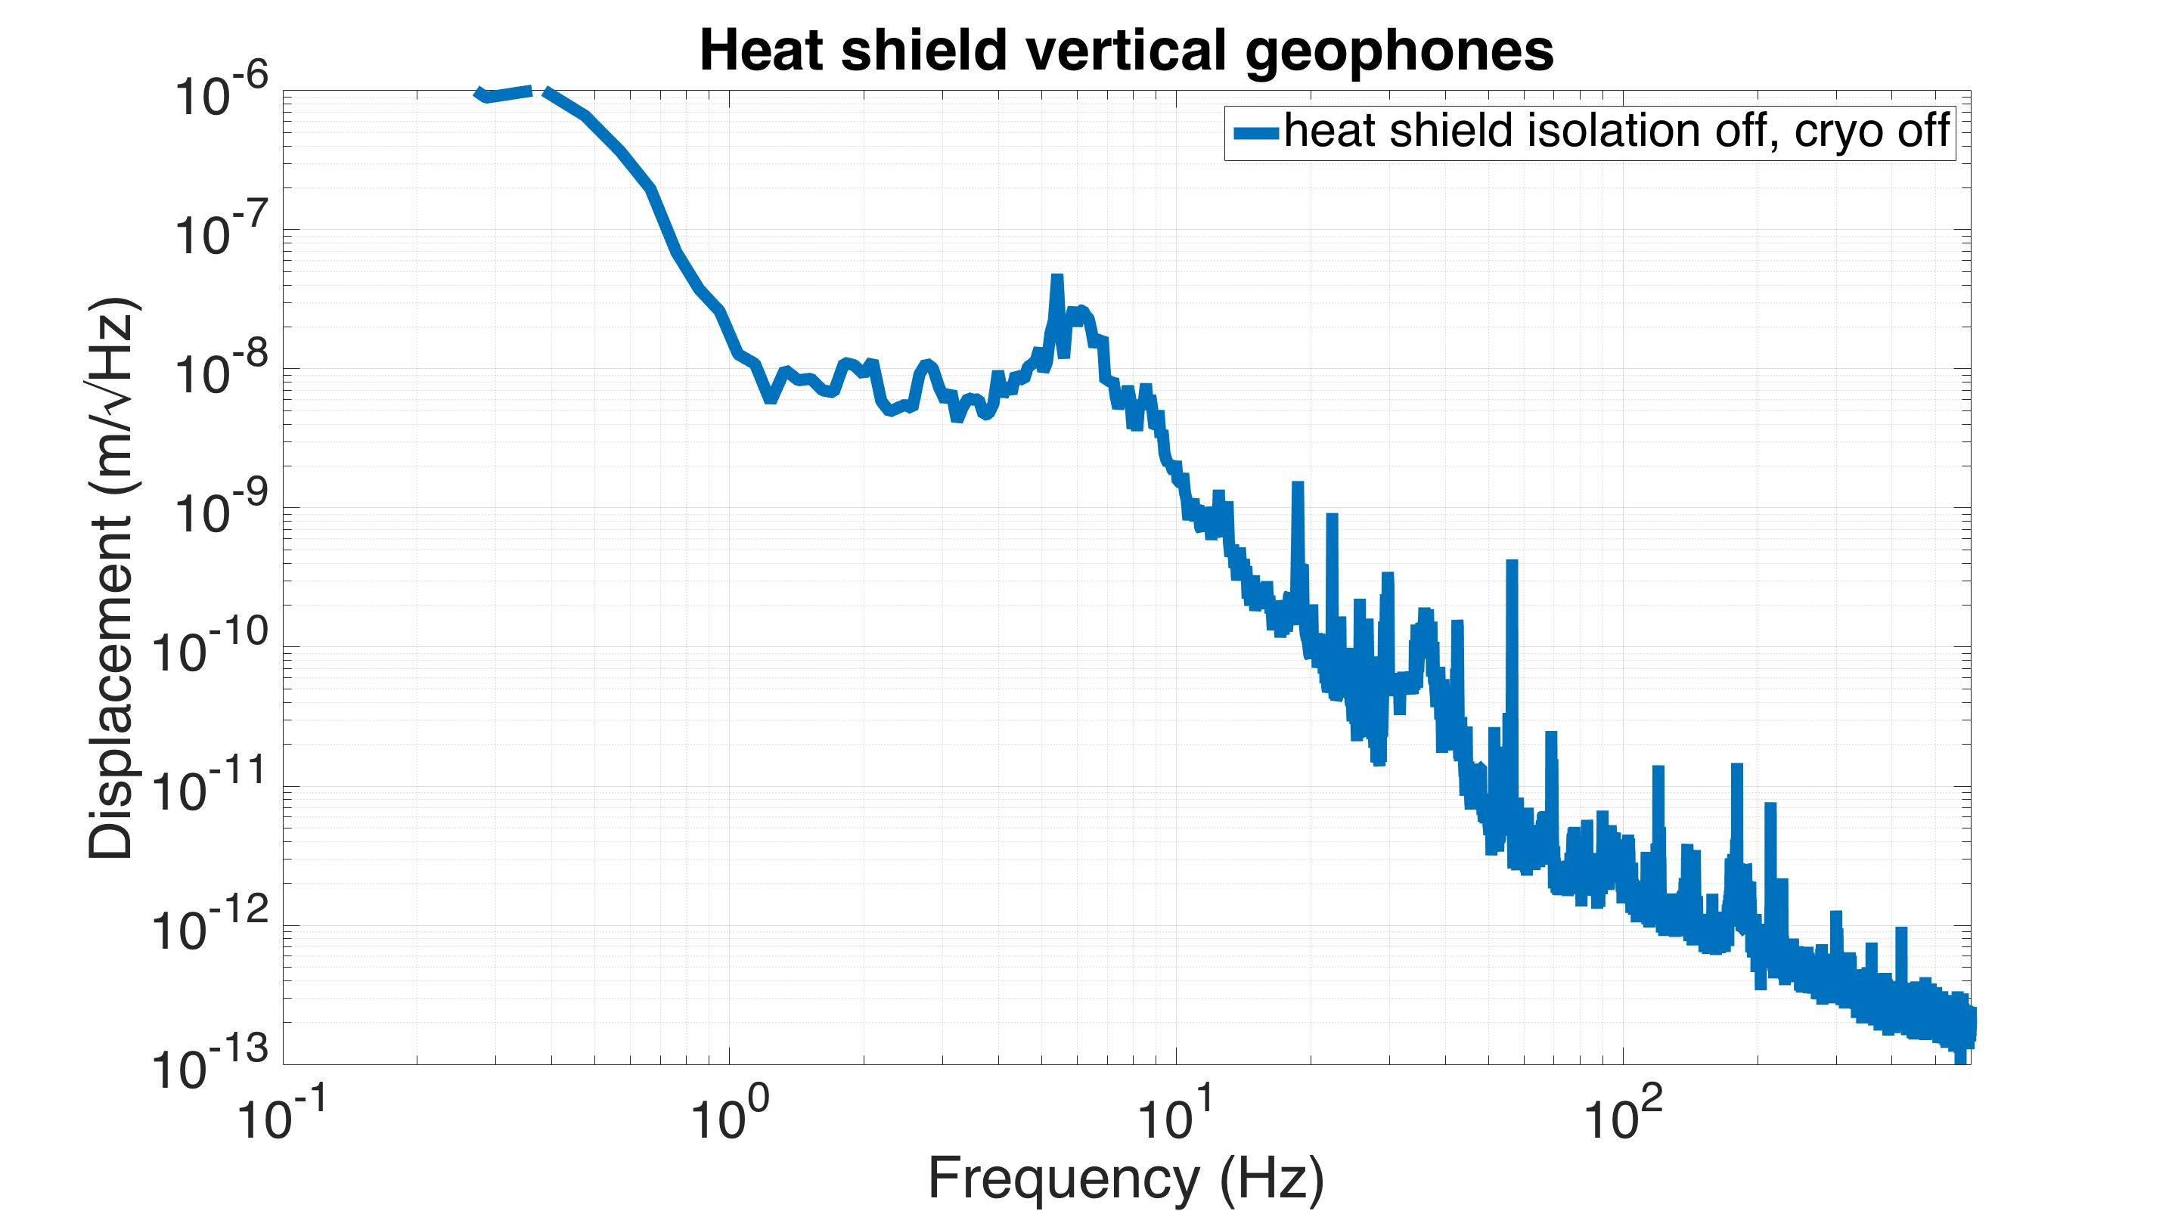
Ground vibrations
Heat Shield
Geophones
inertial displacement measurement
Notes:
Just a few weeks ago we started getting data with this system. So this plot shows the shield’s vertical displacement seen by the geophones, without any cryogenics or control.

Slide 42
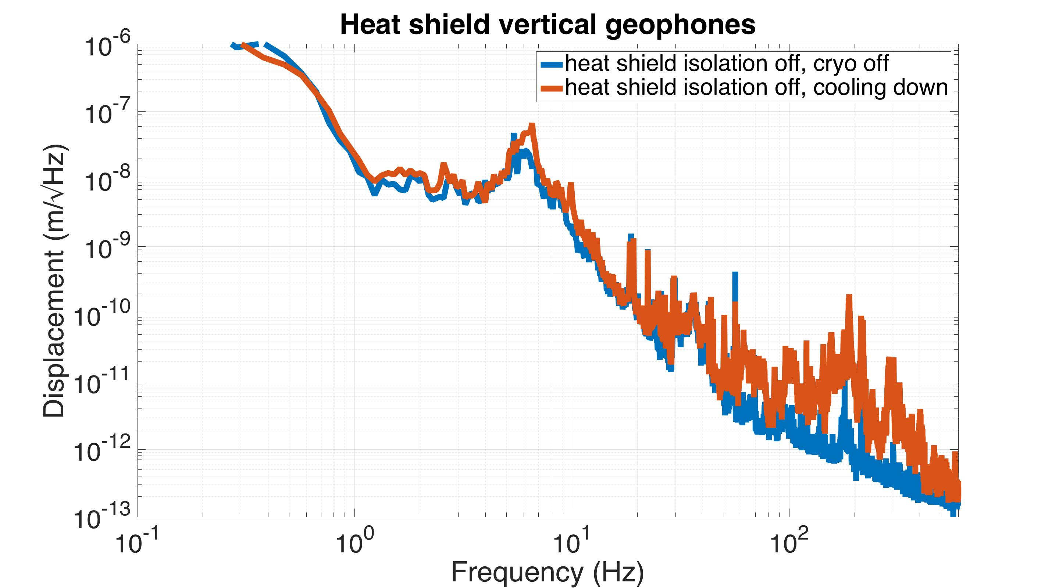
Ground vibrations
Cryo vibrations
Heat Shield
Geophones
inertial displacement measurement
Notes:
Then, when you turn the liquid nitrogen on, you do see some extra vibration. A little bit around its resonance, and some more at high frequencies.

Slide 43
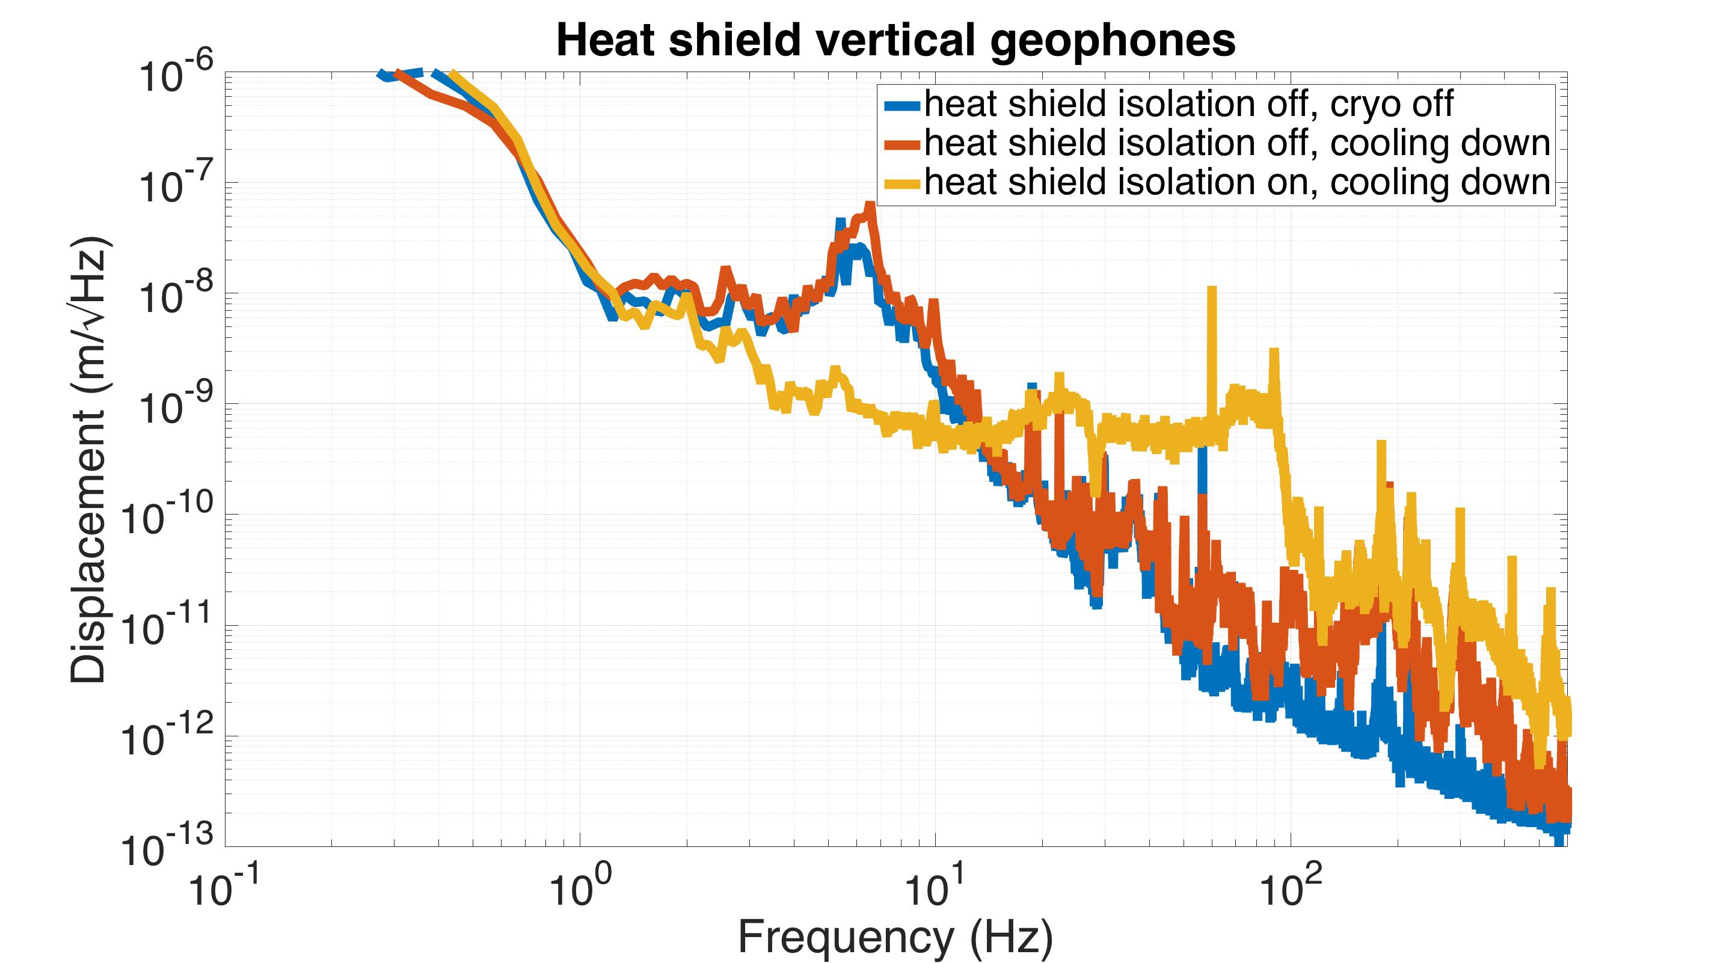
Ground vibrations
Cryo vibrations
Heat Shield
Geophones
inertial displacement measurement
Controller
Notes:
If you turn the control on, you can get good suppression of that resonance peak, at the expense of some higher frequency noise.

Slide 44
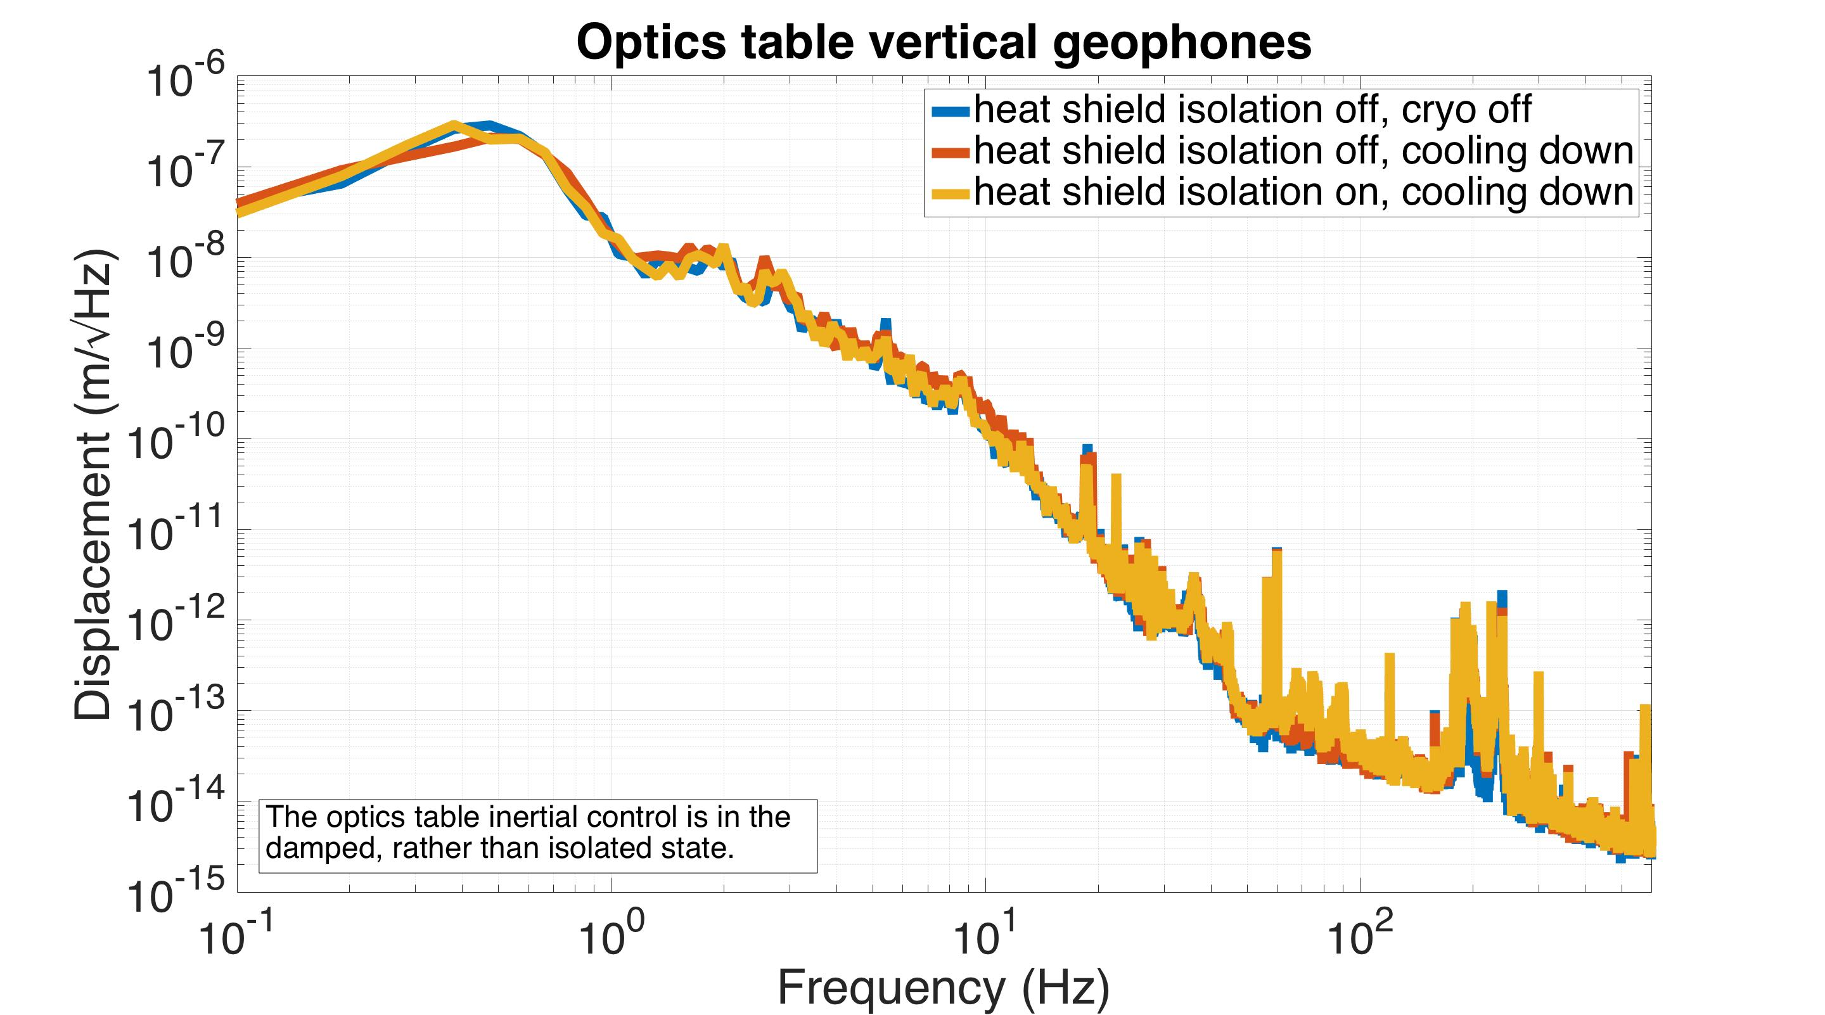
Optics
Table
Geophones
inertial displacement measurement
Notes:
Looking at the same curves for the optics table, we see there is virtually no increased noise propagating through the seismic isolation system, which is very good. That’s one of the goals of this design.

Slide 45
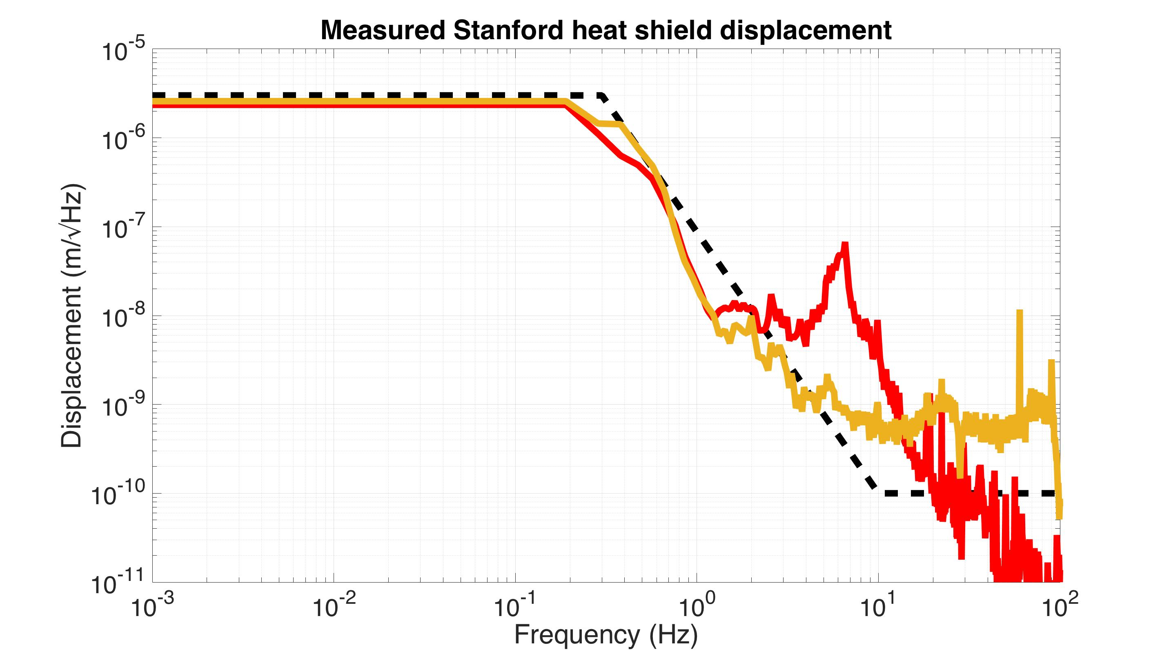
Measured Heat Shield Displacement
Control off
Control on
Requirement (1m shield)
Notes:
Comparing the shield’s displacement to our chosen requirement curve, we see some extra motion at the higher frequencies.

Slide 46
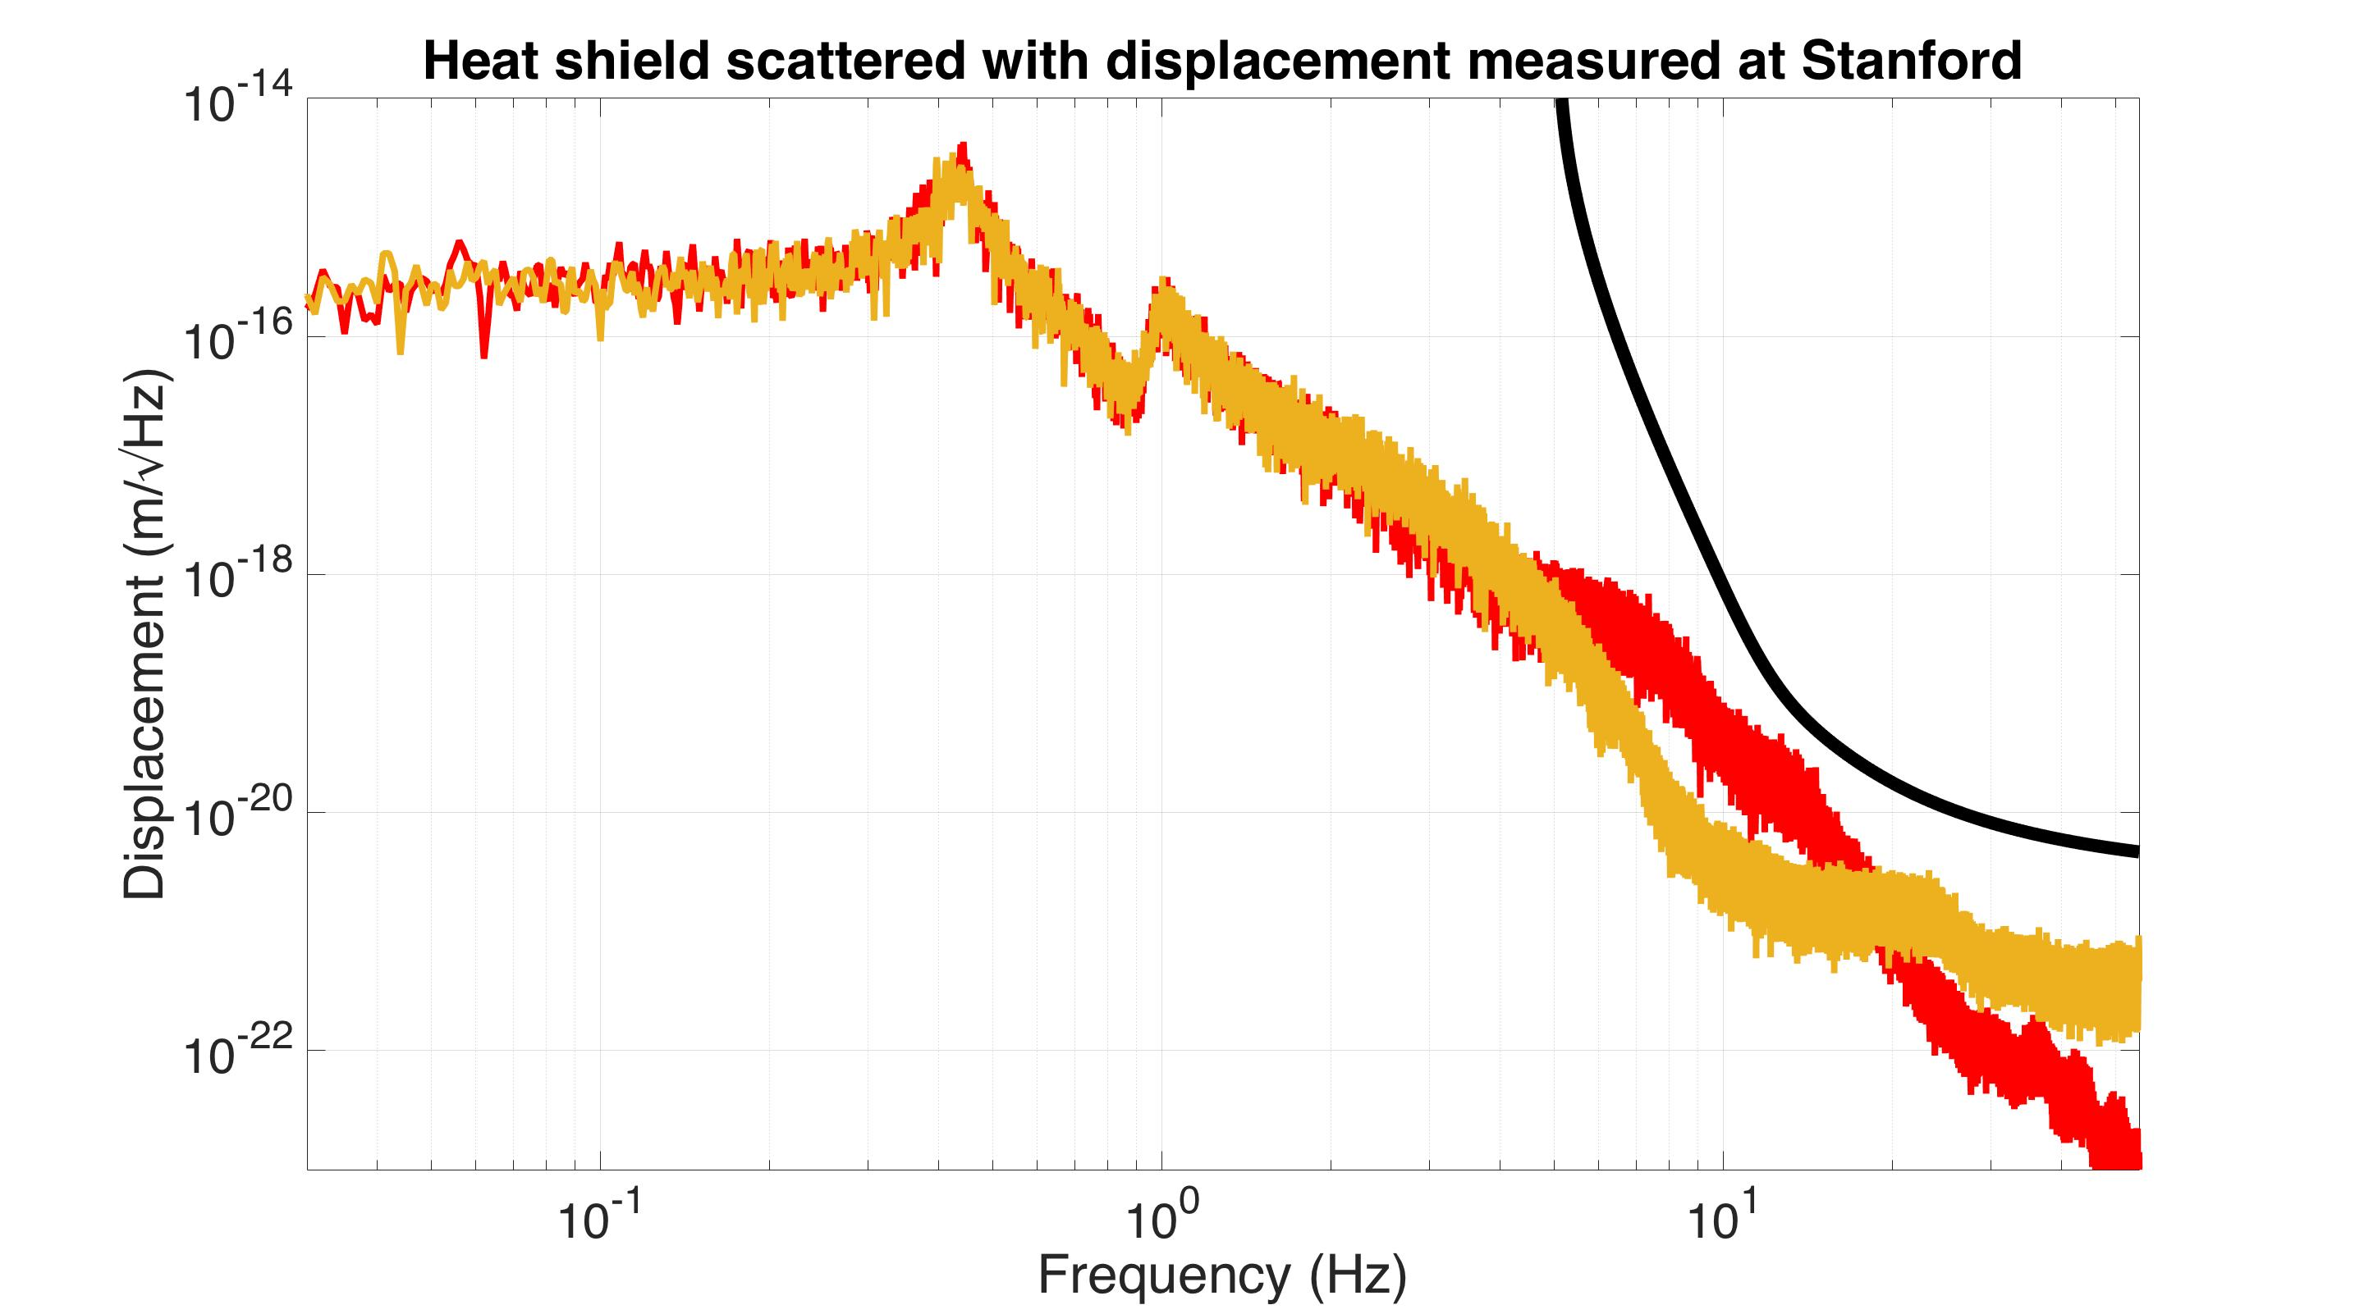
Scattered Light with Measured Displacement
Voyager noise
Control off
Control on
Simulation with 1 m shield radius
Notes:
Then we can simulate how much scattered light noise this would produce. Though both are below the voyager curve, the control does seem to help. So so far this is good news for the isolation performance.

Slide 47
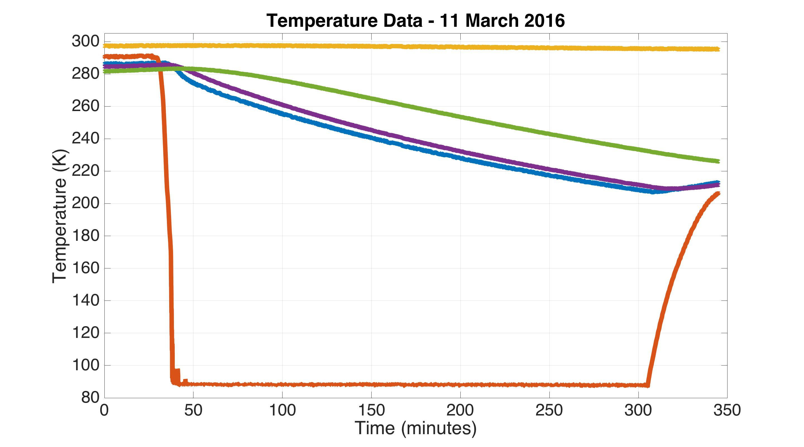
Cool Down Data
Test mass spring
Test mass
Heat shield
Braid tip at heat shield
Liquid nitrogen pipe
Vacuum pressure = 1e-5 torr
Notes:
But we also have to satisfy the thermal performance of the shield. This is data from the same period just a few weeks ago. We had temperature sensors on the liquid nitrogen pipe, at the end of one of the copper braids near its bolted joint with the heat shield, one on the heat shield itself, one on the test mass inside the shield, and finally one on the suspension spring that the test mass hangs from.
The pipe cooled down very quickly. After about 5 hours we ran out of liquid nitrogen before everything else finished cooling off.

Slide 48
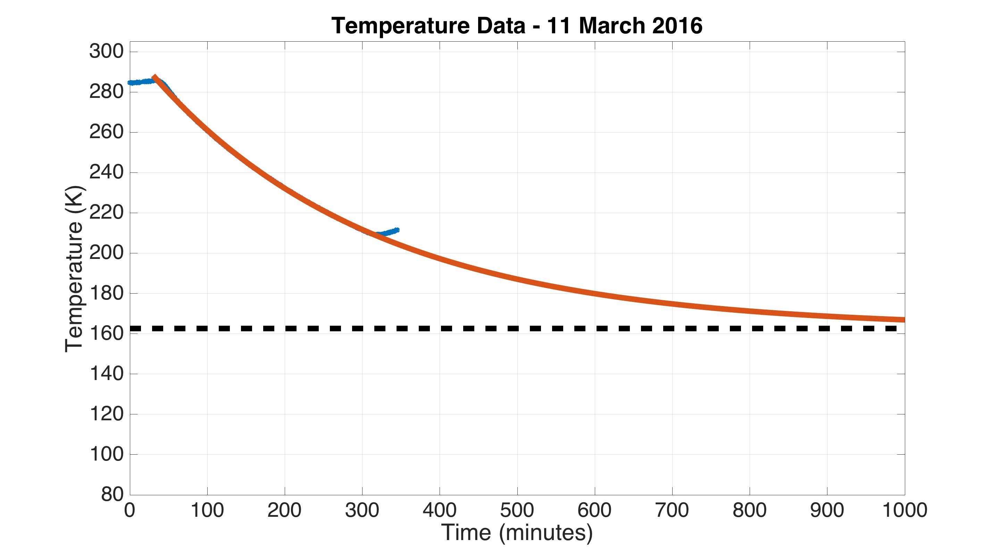
Cool Down Data
Heat shield measurement
Fit to heat shield measurement
Estimated final temperature
Vacuum pressure = 1e-5 torr
Notes:
But, you can extrapolate the final temperature of the shield by fitting an exponential decay curve to it, which turns out to be about 160 K. This is quite far from our goal of 80 K.

Slide 49
Cool Down Data
Heat shield measurement
Fit to heat shield measurement
Estimated final temperature
Estimated thermal conductivity of braids at 45% of maximum
Estimated heat load on shield at 40 W
Vacuum pressure = 1e-5 torr
Notes:
From the fit, you can estimate that our shield has an ambient heat load of about 40 W, and also the copper braids are only about half the conductivity they could be. So we have some work to do in the future to improve this.

Slide 50
Actively controlled shield (ETM)
Relative displacement sensors
Actuators
Vacuum chamber
Blade springs
Cold link
Vib. isolated optics table
80 K baffled beam tube shield
Gnd
Gnd
≈ 900 mm dia
Gate Valve
Gate Valve
z
10 m
80 K heat shield for ≈5 W cooling
124 K test mass
Notes:
Reworking our conceptual design, what we think we should do, is to take some of Odylio’s advice, …

Slide 51
Actively controlled shield (ETM)
Relative displacement sensors
Actuators
Vacuum chamber
Blade springs
LN₂ pipe
Vib. isolated optics table
80 K baffled beam tube shield
Gnd
Gnd
≈ 900 mm dia
Gate Valve
Gate Valve
z
Cu braid
10 m
80 K inner shield
77 K outer shield
124 K test mass
Notes:
…and add a second heat shield outside the first one. The outside shield doesn’t need to have any isolation, because the test mass only sees the inner shield. So we can do a really good job of cooling the outer shield with liquid nitrogen pipes, which prevent the inner shield from seeing the warm outside environment. Likely, the inner shield will still need a copper braid connection to the outer one because the scattered light will create too much of a heat load to cool the inner shield by radiation alone.

Slide 52
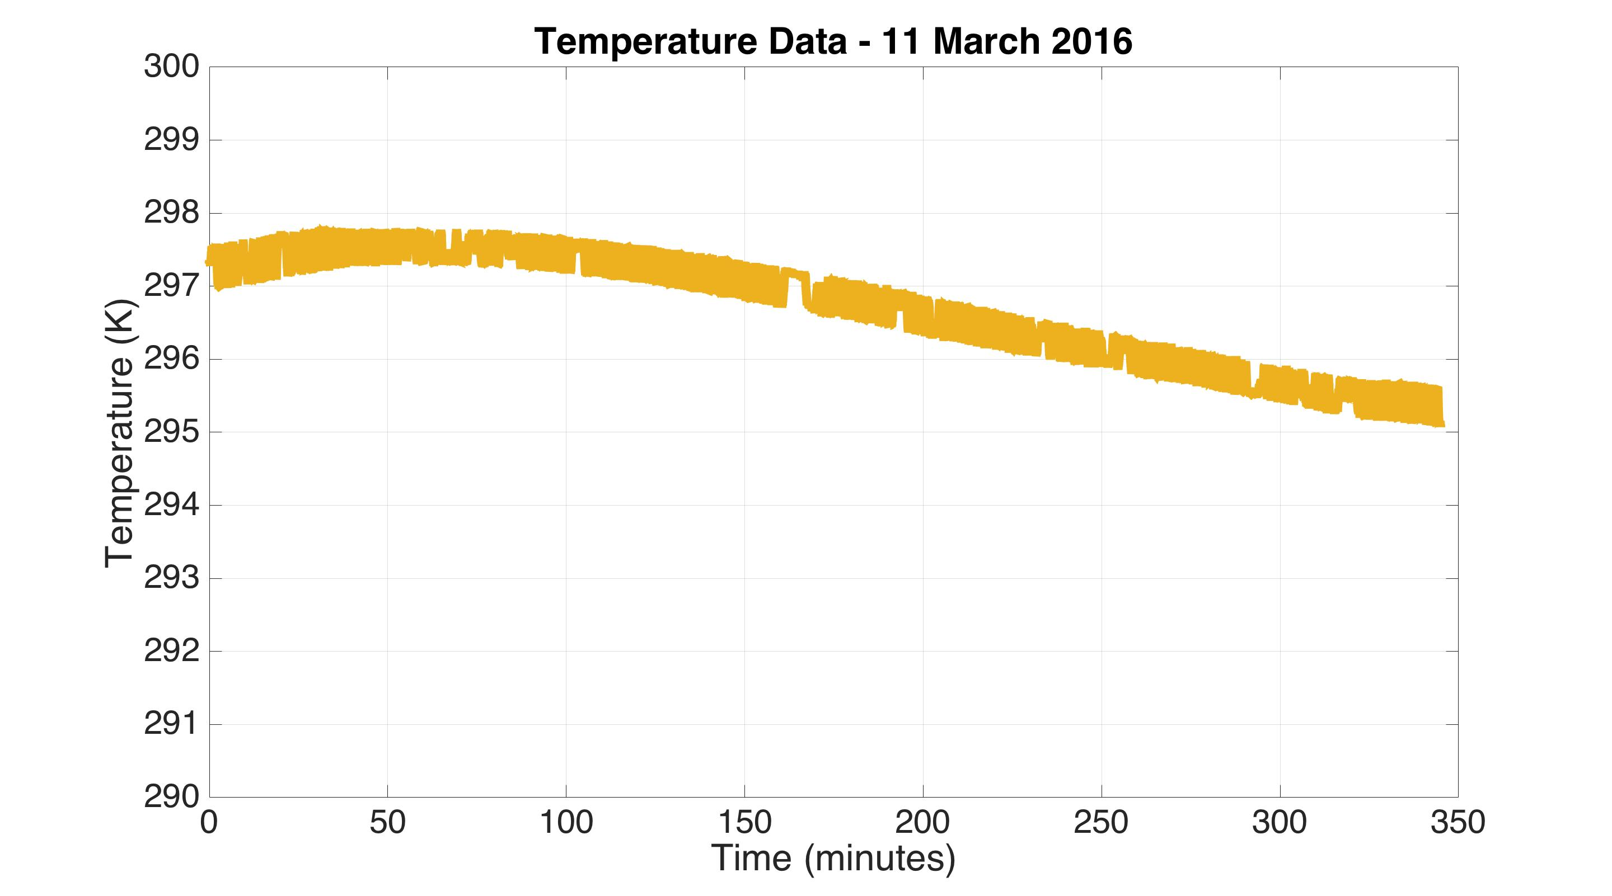
Cool Down Data
Test mass spring
Drifts of 1 degree are problematic for optical alignment
Drifts of a few degrees will shut LIGO down
Notes:
One last thing we haven’t talked about, is that we’ve seen the temperature of the test mass spring is effected by the cryogenics. In advanced LIGO the interferometer alignment is highly dependent on the temperature of these springs, and we expect the same problem in LIGO Voyager. So something we might do going forward is to heat, and actively control the temperature of some of these springs.

Slide 53
Conclusions
Shield displacement maybe a problem
  Active control is one approach to mitigate this
  Or avoid control with a careful shield design
Plan to add a second shield outside first
Might want to heat the test mass springs

Slide 54
Special thanks to the APS-SBF Brazil-U.S. physics PhD student & post-doc visitation program for supporting this visit!

Slide 55
Questions?

Slide 56
Sources for scattered light simulations
P1100117 – The impact of upconverted scattered light on advanced interferometric Gravitational Wave Detectors
T070089 – Wide-angle scatter from LIGO arm cavities
T1300354 – Scattered light noise due to the ETM coating ripple

Slide 57

Advanced LIGO Noise
(2010)
Design
Notes:
Blue and red are recently measured aLIGO noise curves. It’s already doing much better than the first generation of LIGO in green. Despite the fact we haven’t yet reached the aLIGO design in gray, we’re already thinking about how to improve LIGO for 3rd generation GW detectors.

Slide 58
Predicted thermal noise of a 123 K Si mirror α-Si:SiO₂ HR coating and a 6 cm beam spot radius.
LIGO-T1400226

Slide 59
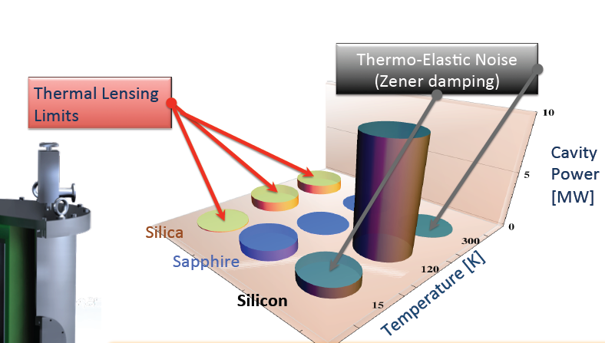
Materials vs max power
From G1300330

Slide 60
Thermal Expansion coefficient of silicon as a function of temperature
From NIST / CODATA Swenson (1983)
LIGO-T1400226

Slide 61
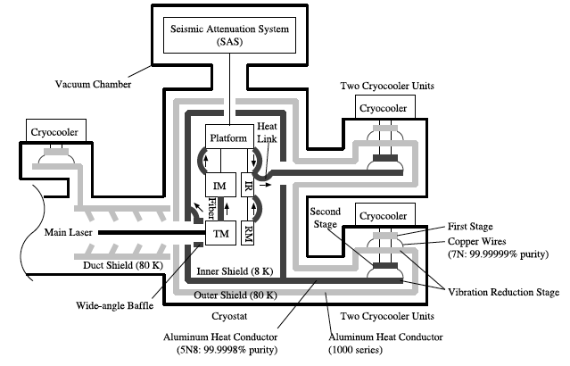
KAGRA End Station Layout
20 K, 23 kg sapphire test masses
CQG 31 (2014) 224003 – Progress on the cryogenic system fir the KAGRA cryogenic interferometric gravitational wave telescope

Slide 62
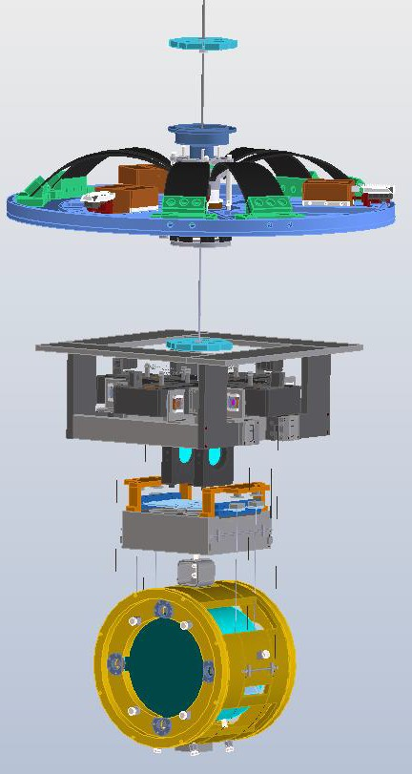
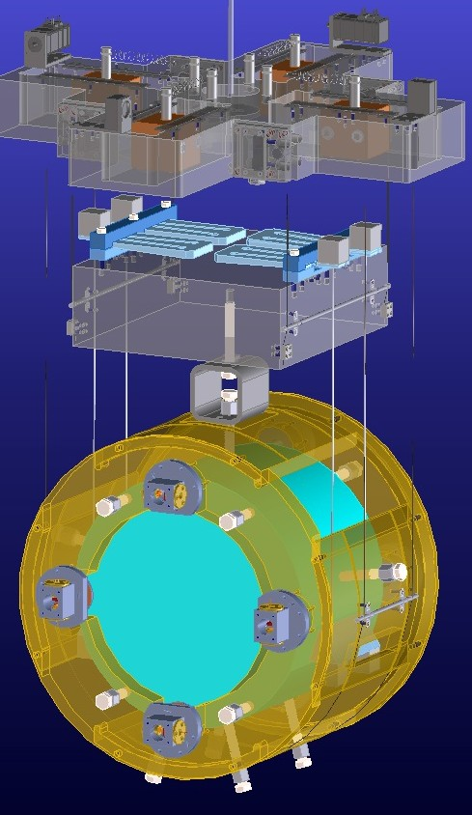
Fabrication (other than the platform) w/ a dummy mirror will be done at end of this Mar.
Marionette
Bottom IM
Sapphire fibers
Recoil mass
Sapphire mirror
IM recoil mass and heat link are not shown
From G1600682

Slide 63


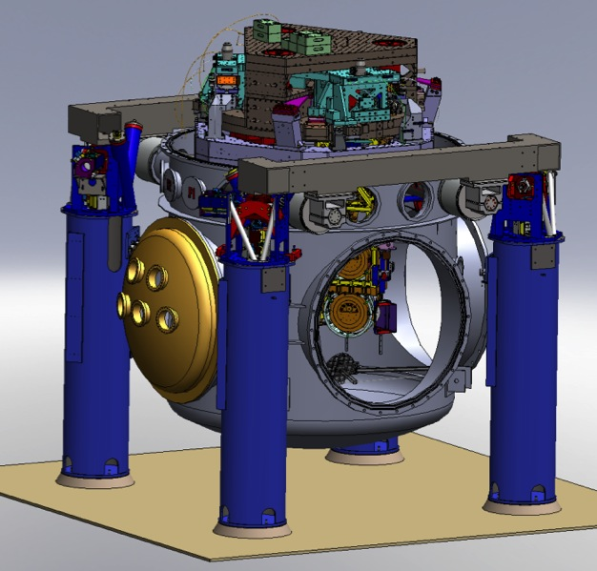
aLIGO test mass chambers
hydraulic external pre-isolator (HEPI) (one stage of isolation)
active isolation platform (2 stages of isolation)
quadruple pendulum (four stages of isolation) with monolithic silica final stage

Slide 64
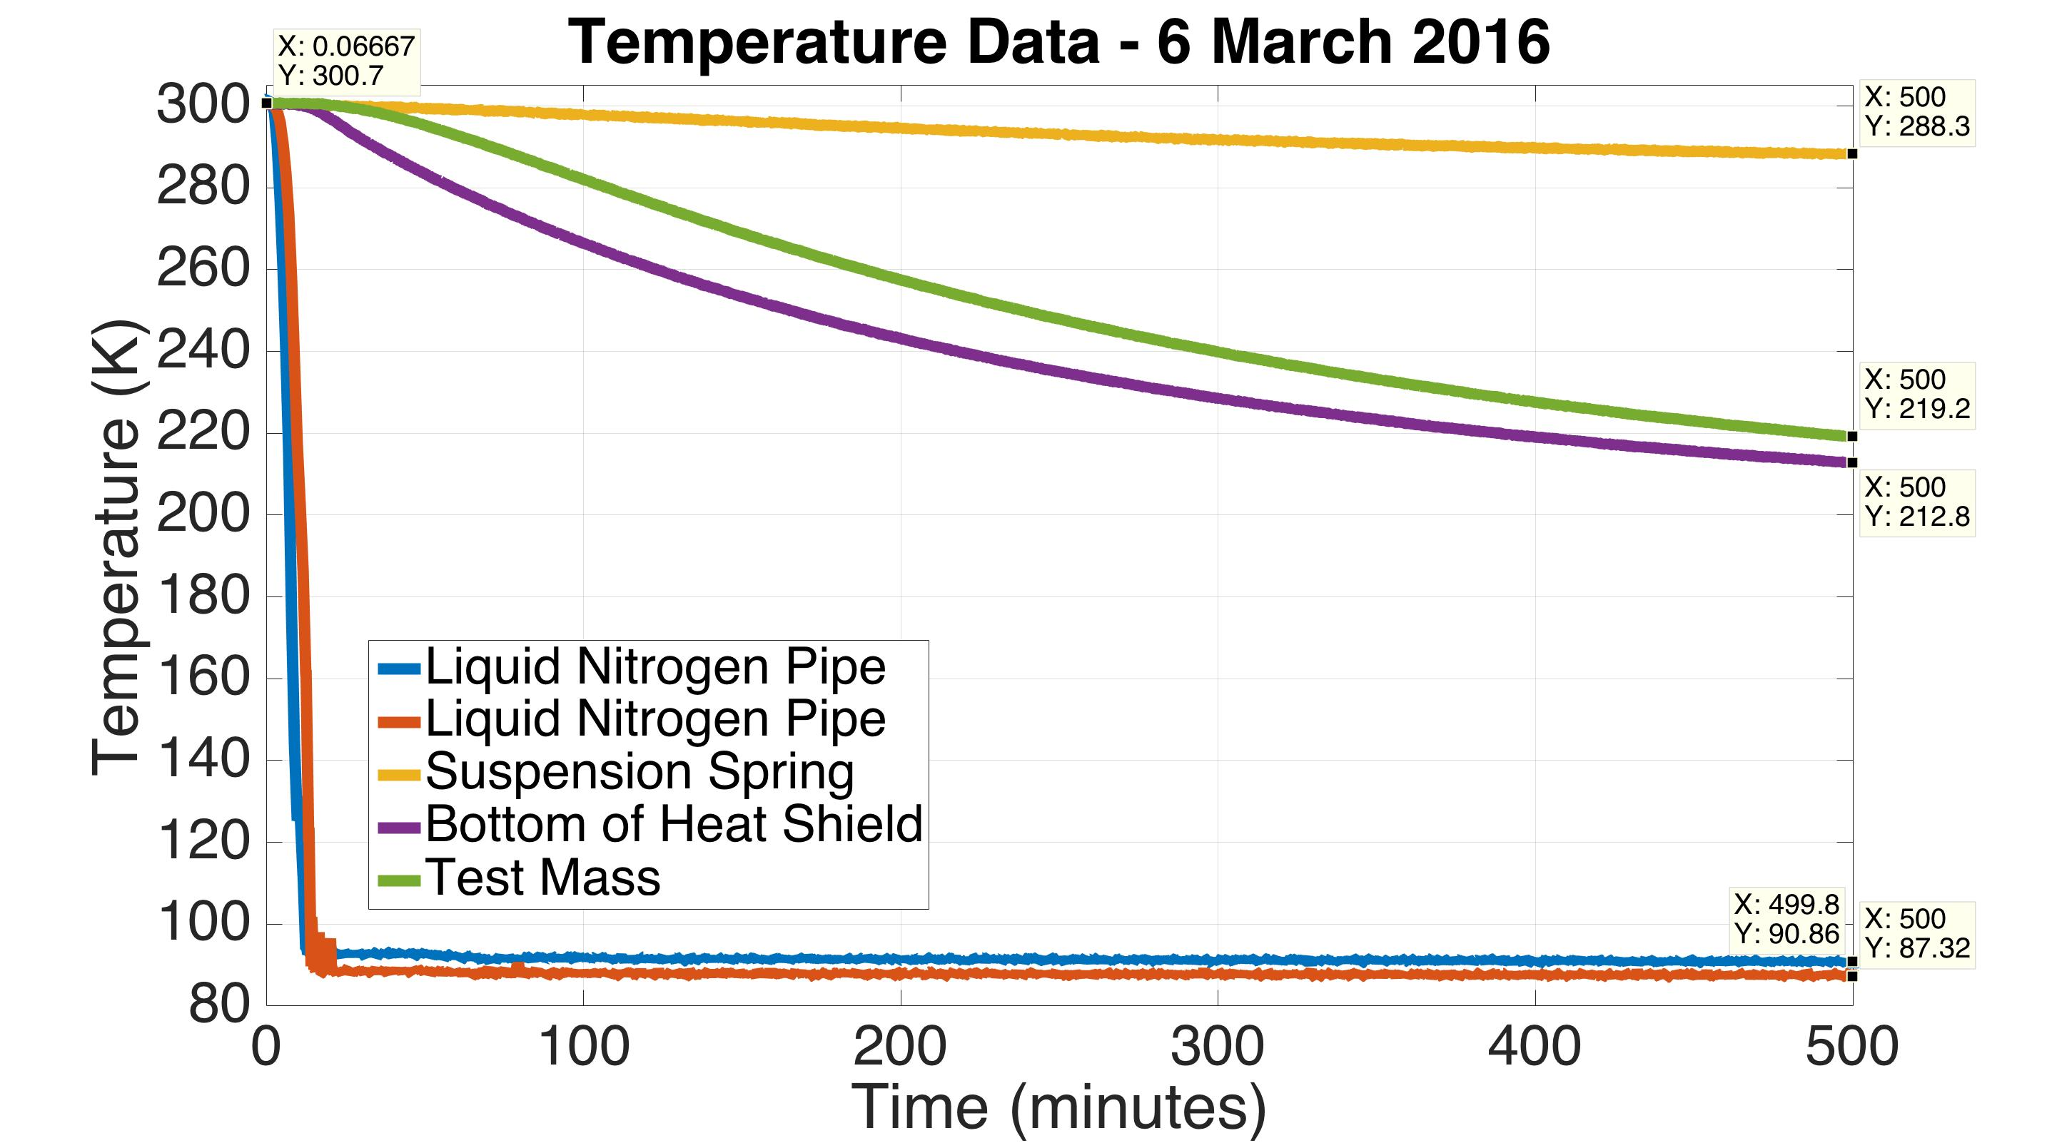
Cool Down Data
Khuri-Yakub
Vacuum pressure = 1e-1 torr
Notes:
The final part of this presentation shows the thermal response of the shield. This data is from the first very first test we did just a week ago. Red and blue show the temperature of the liquid nitrogen pipes. Purple is the heat shield and green is the test mass. Yellow is the blade spring the test mass hangs from. So you can see the test mass follows the heat shield pretty well, which is good. It suggests the shield is doing a good job of being a shield. However it only got down to about 213 K. You can extrapolate with an exponential fit that it would eventually bottom out at 205 K. But we need it to go all the way to 80 K. Also, the suspension spring has dropped 12 degrees, which is quite bad for suspension alignment.

Slide 65
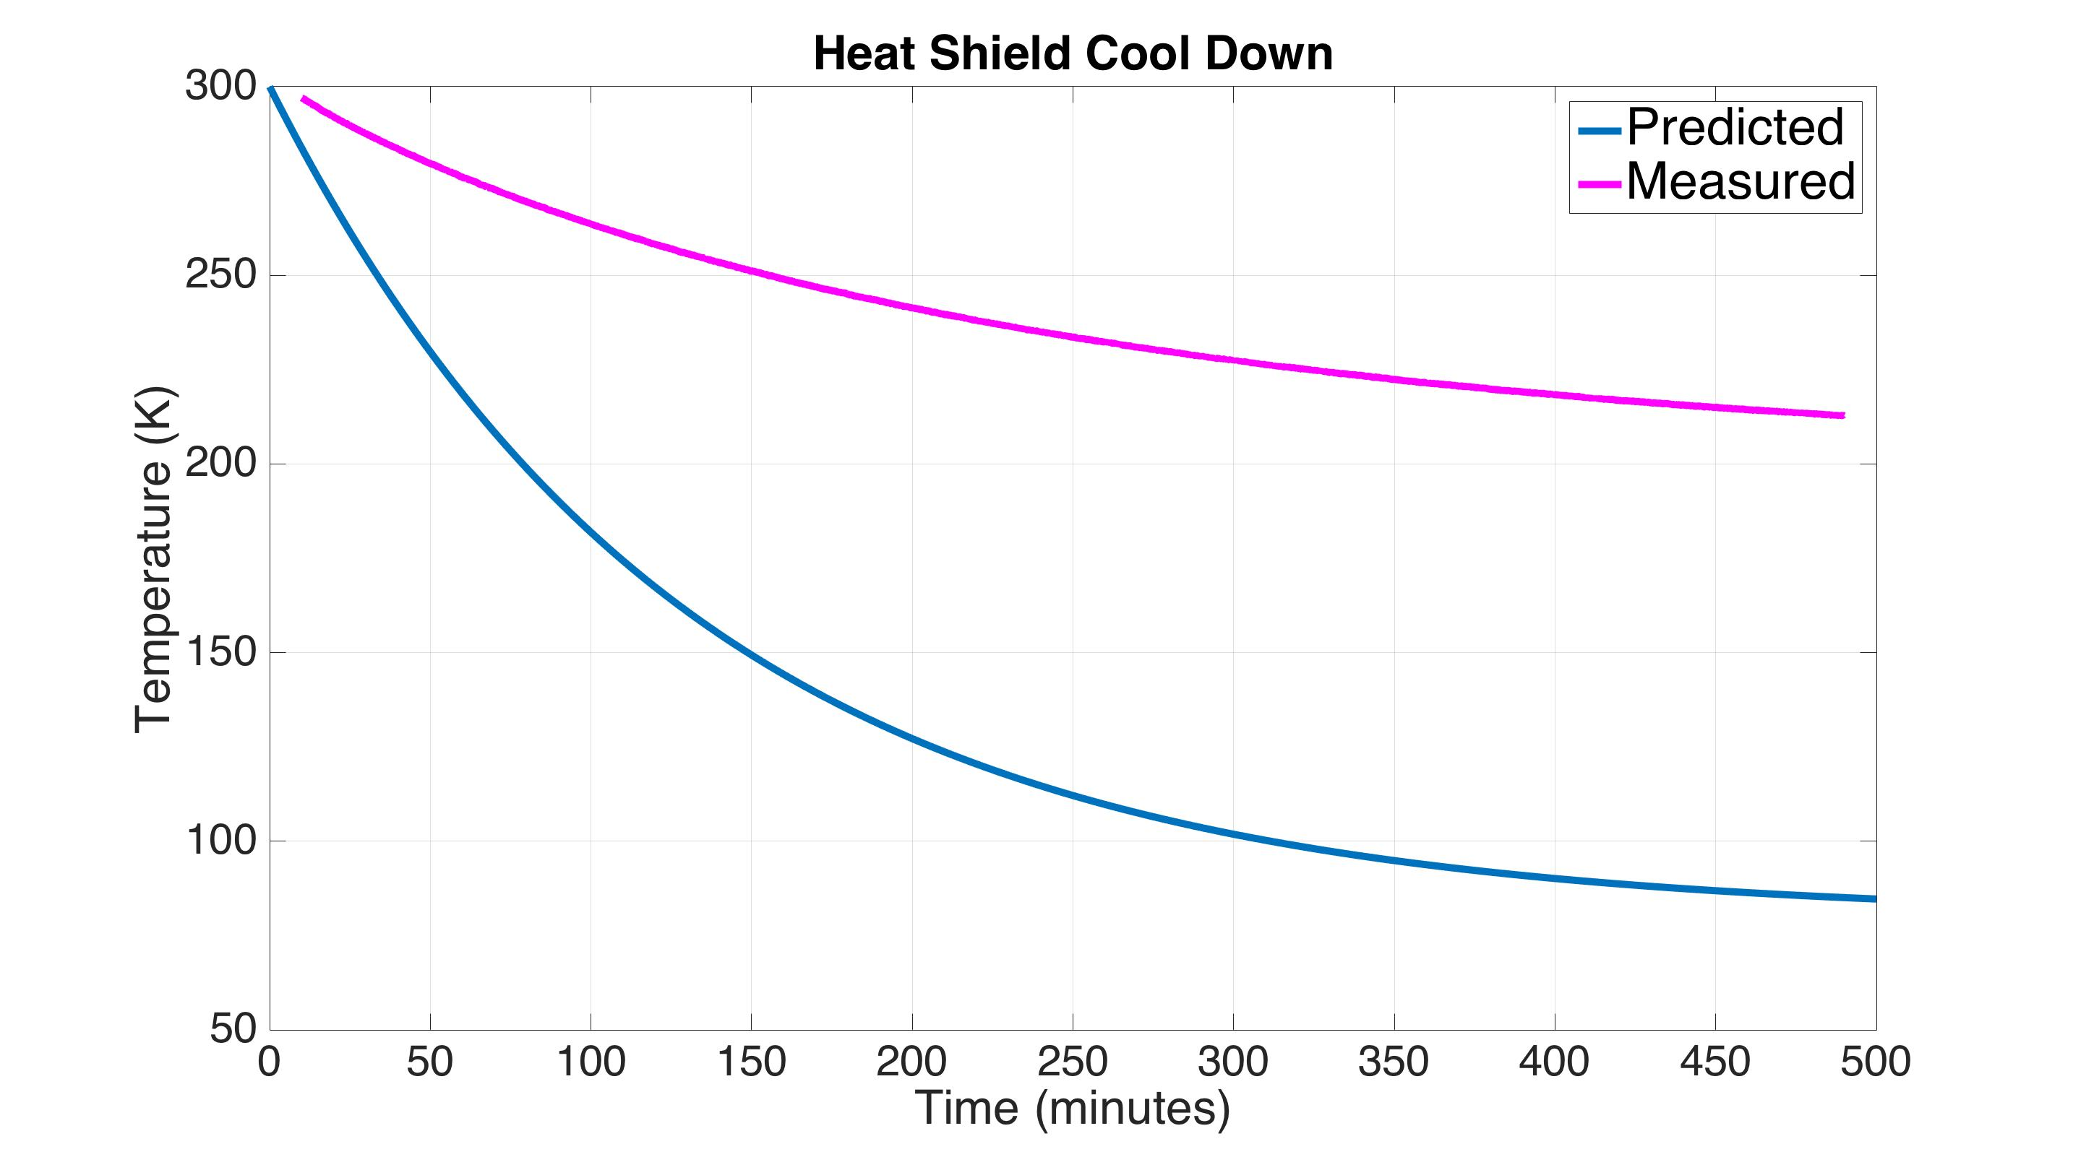
Cool Down Analysis
0.1 torr N₂ exchange gas
Estimated conductivity of braids is 60% of the ideal value
Estimated heat load on shield is 85 W (150 W net incident radiation)
Notes:
Some of this could be because we have 0.1 torr N₂ exchange gas in the chamber, in order to help the cool down of the test mass. Maybe its transferring heat from the warm parts of the chamber.

Slide 66
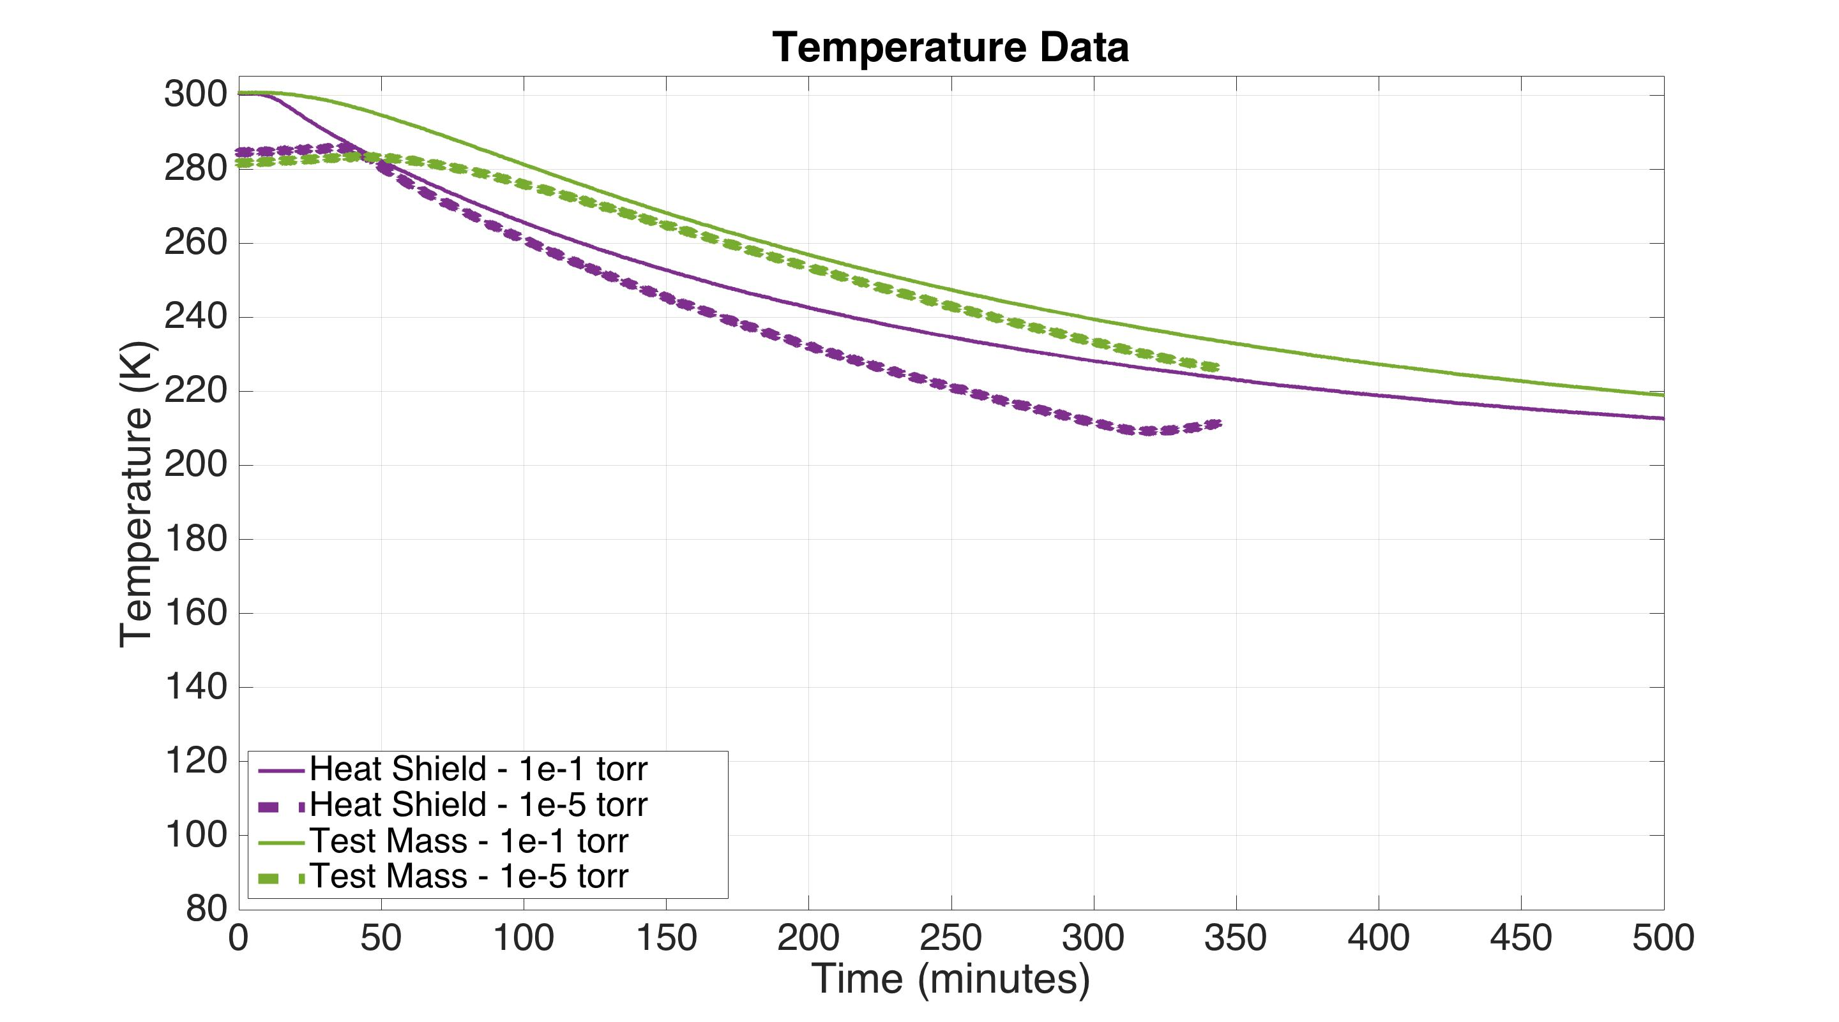
Cool Down Data

Slide 67

Optics
Table
Heat Shield
Geophones
displacement
sensors
Geophones
Controller
Notes:
Which, if we look closer, is coming all from sensor noise. So if we had better sensors, we could do better. To see if we need to do better, we can take this performance data

Slide 68

Optics
Table
Heat Shield
relative
displacement sensor

Slide 69


Slide 70



Optical Sensor ElectroMagnet (OSEM)
Birmingham OSEM (BOSEM)
Advanced LIGO OSEM (AOSEM)
- modified iLIGO OSEM
Magnet Types (M0900034)
BOSEM – 10 X 10 mm, NdFeB , SmCo
10 X 5 mm, NdFeB, SmCo
AOSEM – 2 X 3 mm, SmCo
    2 X 6 mm, SmCo
    2 X 0.5 mm, SmCo
BOSEM Schematic

Slide 71


HS1 Geophone
Geophone Schematic
http://newsline.linearcollider.org/readmore_20070809_ftr1.html
http://www.geospace.com/hs-1-industrial-geophone/

Slide 72

Test mass inside heat shield
Heat shield 80 K
Holes for suspension wires
Cold link for initial cool down
Test mass 124 K

Slide 73

Cu brackets for Cu braids between heat shield and stage 0 cold plates

Slide 74

Aluminum low emissivity plates (ribs boost vibrational frequencies)

Slide 75

g10
Flexible stainless strips attach the heat shield to its (warm) suspended stage

Slide 76

suspension top mass
suspension spring

Slide 77

Vertical suspension OSEMs
Suspension spring mounted to vertical translation stage
The OSEMs monitor vertical drift of the suspension due to temperature changes in the spring
The translation stage engages the test mass with the cold link for the initial cool down

Slide 78

The complete heat shield stage
Geophones
OSEM flag post
Actuator magnets

Slide 79

Suspended heat shield platform
Actuator
HS1 geophone
OSEM
stage 0
ISI stage 2

Slide 80

Suspended heat shield stage over Stanford ISI

Slide 81

2 stage HAM-like ISI
Stage 2
Stage 1
Stage 0

Slide 82
ISI with stage 0 mounting structure for heat shield over stage 2
Mounting Structure
Stage 2
Stage 1
Stage 0

Slide 83

Mounting structure with cryogenic cold plates
Cold plates (80 K)

Slide 84

Suspended heat shield stage hanging from mounting structure
Heat shield stage
Heat shield
Geophone witness sensors measure heat shield inertial motion
Coil/magnet actuators between stage 0 mounting structure and the suspended heat shield stage

Slide 85
OSEM feedback forces the heat shield to follow stage 2
OSEM
mount
OSEMs measure relative displacement between heat shield and stage 2

Slide 86

Future cryogenic beam tube shield

