Slide 1
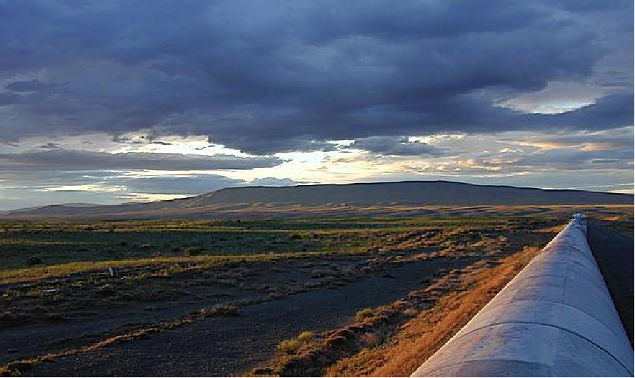
Listening to the universe: detecting gravitational waves with laser interferometry
Sheila Dwyer for the
LIGO Scientific Collaboration
Photo G Moreno

Slide 2
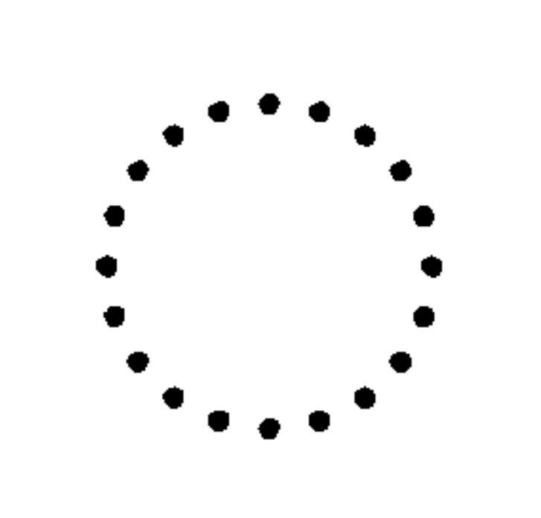




Direct detection of gravitational waves
$$h= {2∆L}/L={10}^{−22}$$
$$h= {2∆L}/L$$
$$h= {2∆L}/L=2$$
Wikimedia commons
Notes:
10^-18m/rtHz

Slide 3
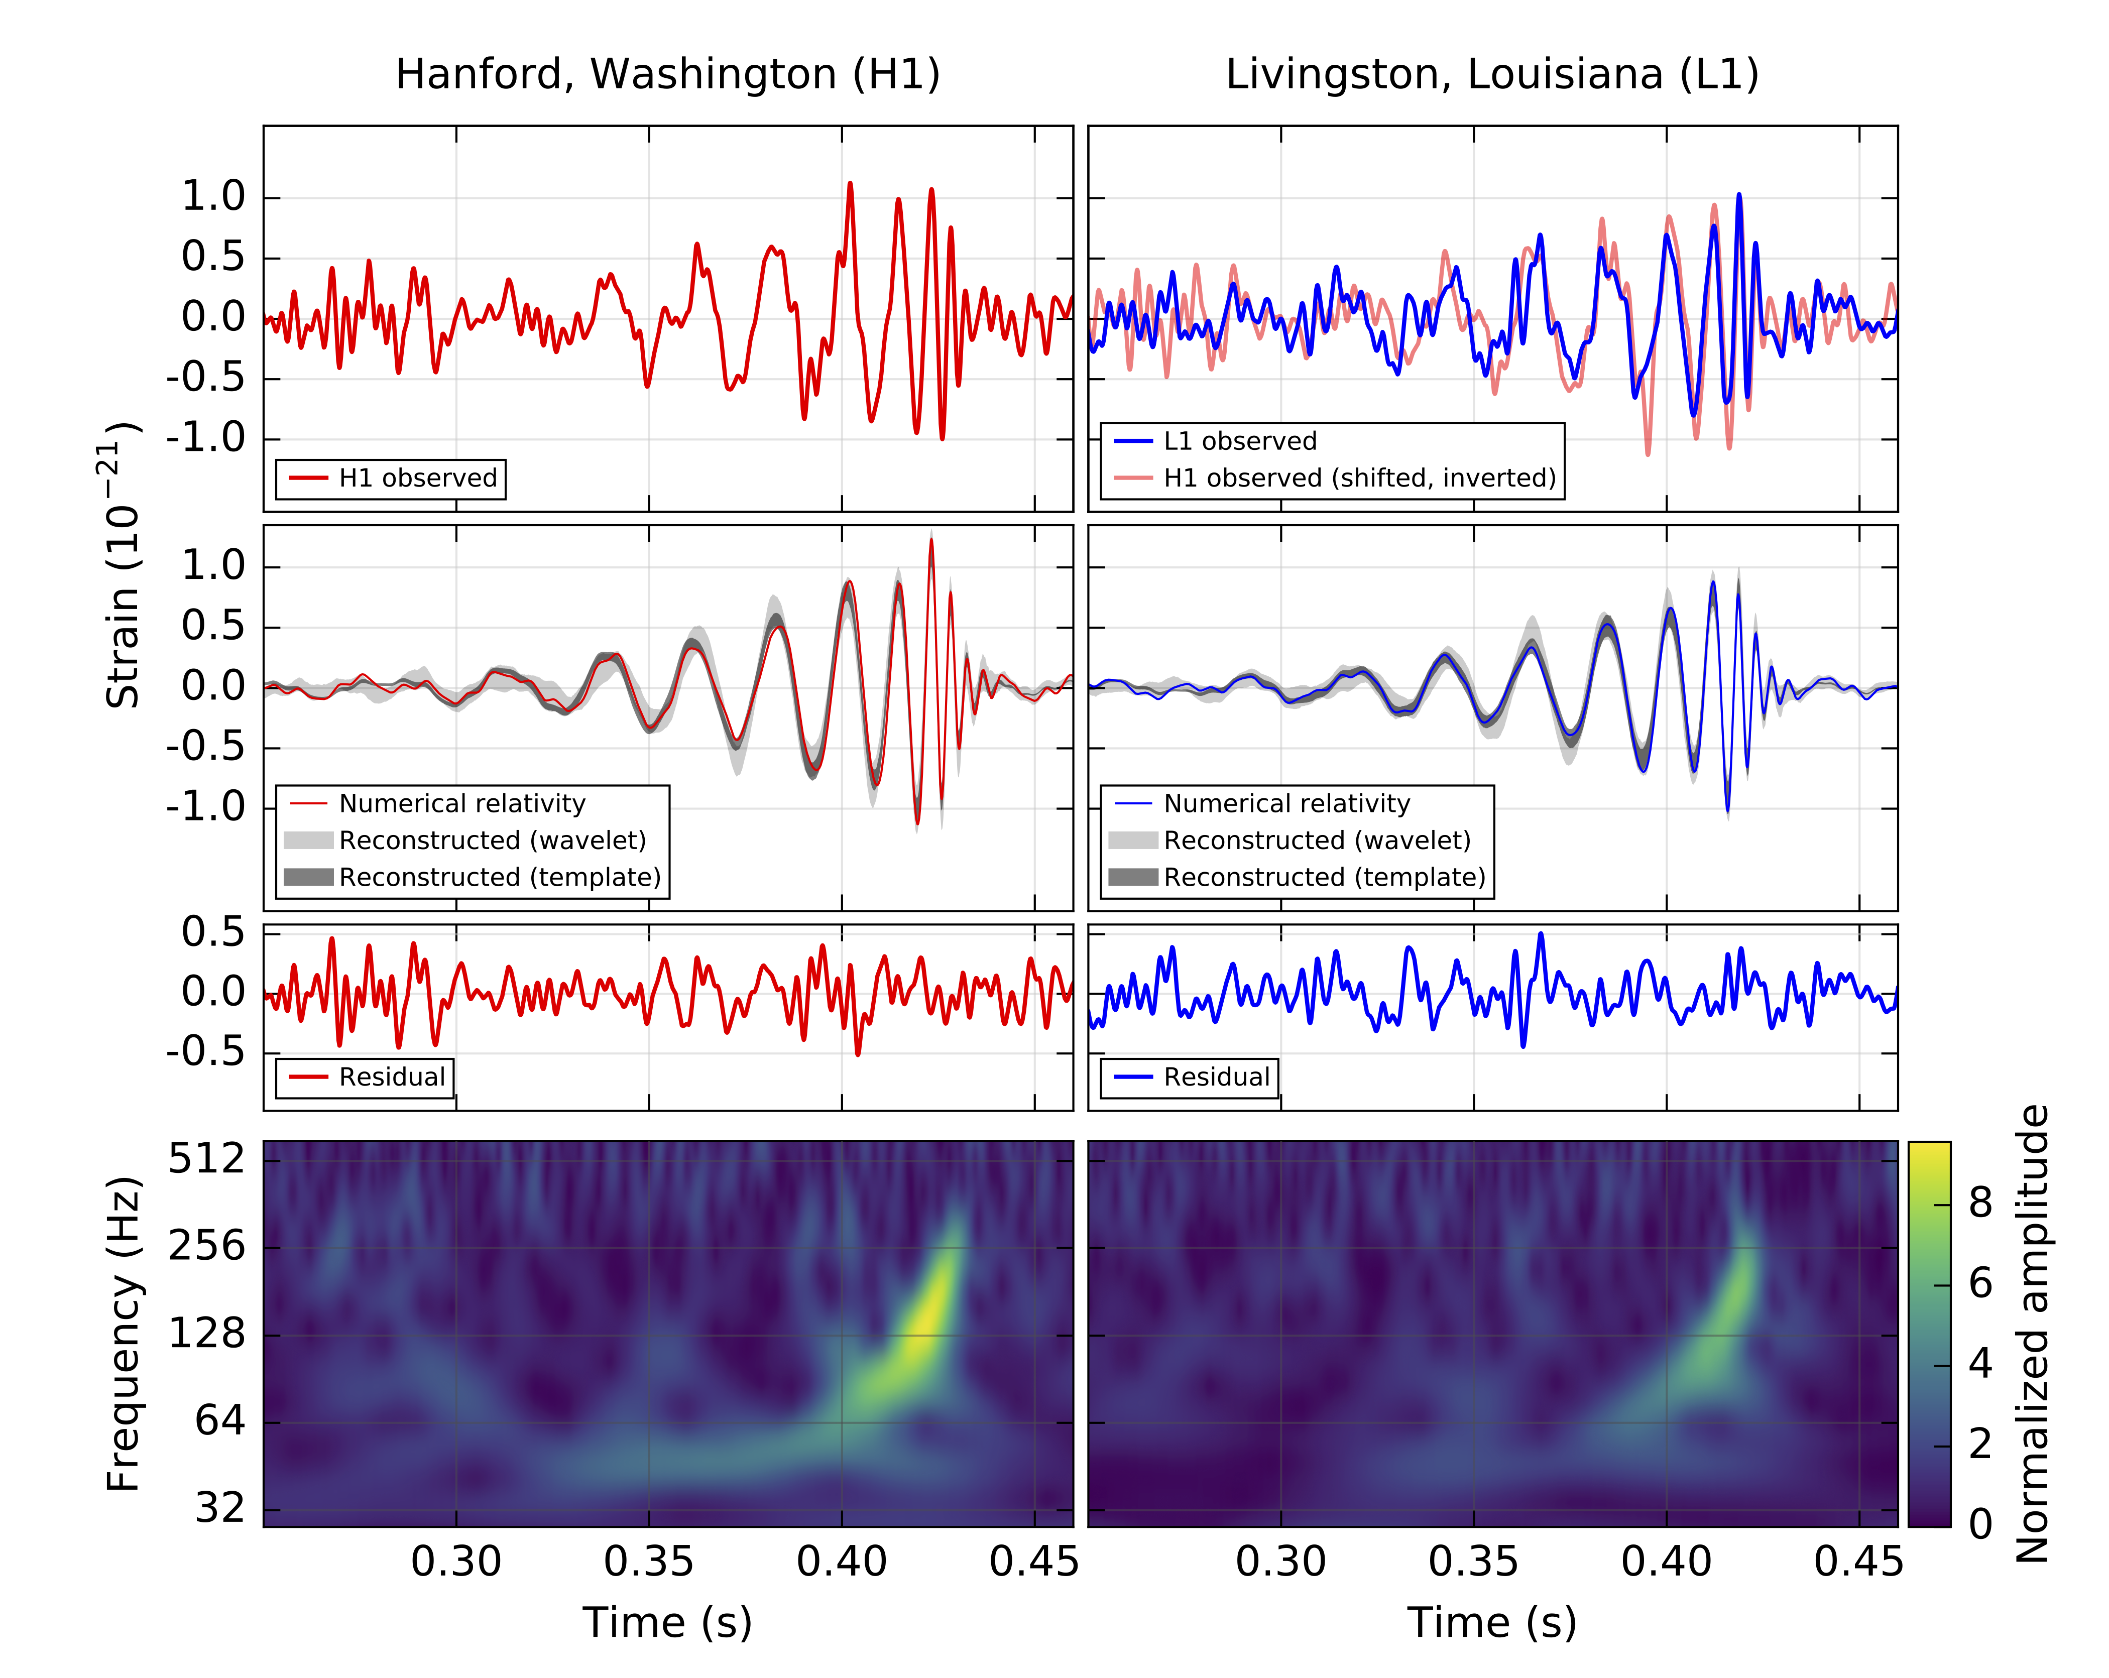
We got one!
September 14th at 2:50 am
LIGO scientific collaboration, PRL 116 061102
http://dx.doi.org/10.1103/PhysRevLett.116.061102

Slide 4
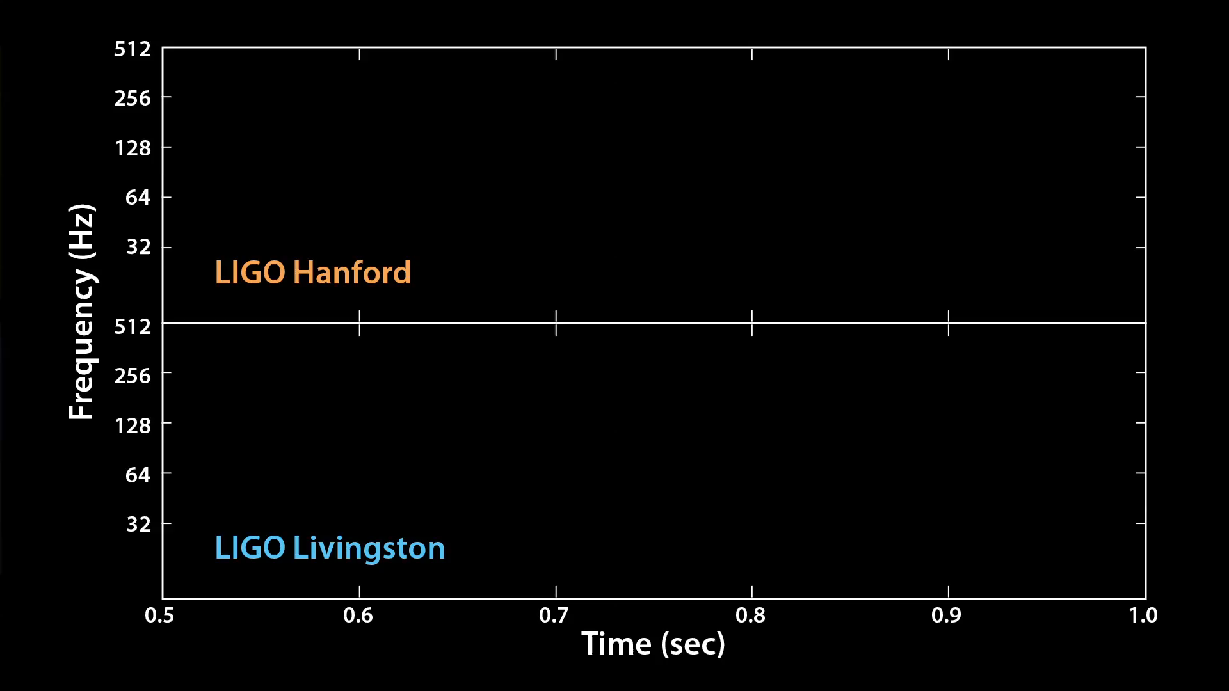

Slide 5
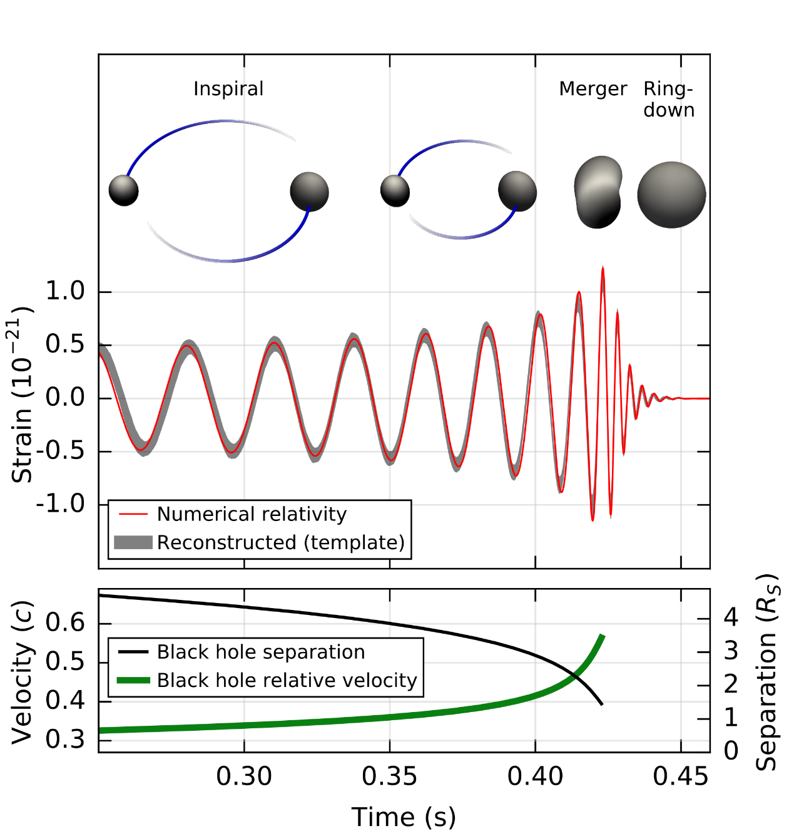
The source:
First observation of binary black holes
First observation of stellar black holes larger than 14 solar masses
First test of general relativity in strong field, dynamic regime
First observation of a merger of 2 black holes
PRL 116 061102
http://dx.doi.org/10.1103/PhysRevLett.116.061102

Slide 6
How can LIGO measure such small strains?
Laser
$$h= {2∆L}/L={10}^{−22}$$
Wikimedia commons
Notes:
10^-18m/rtHz

Slide 7
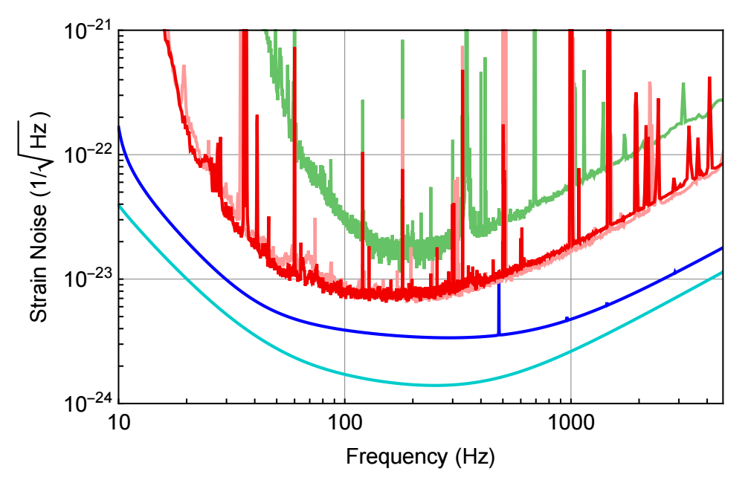
Strain sensitivity
Advanced LIGO (2015)
Initial LIGO (2010)
Advanced LIGO
fundamental noises
Advanced LIGO with
near term upgrades
(including squeezing)
http://arxiv.org/pdf/1602.03838v1.pdf

Slide 8
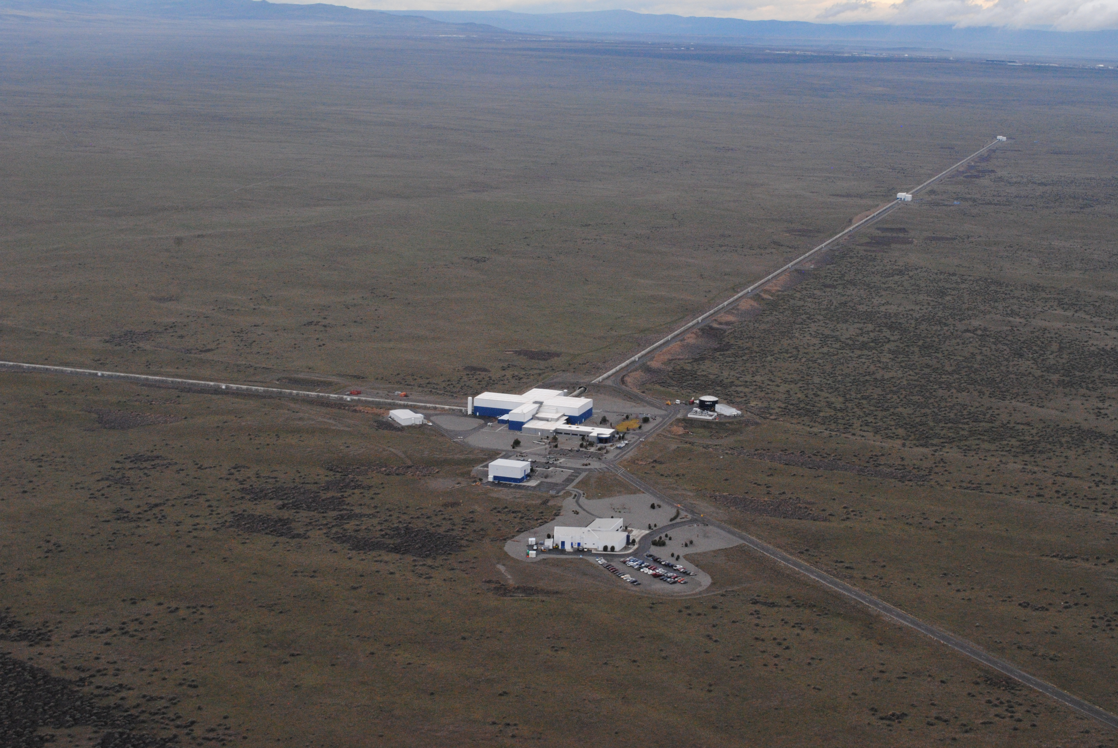
How can LIGO measure such small strains?
First, separate the test masses as much as possible
4km arm length, displacement sensitivity requirement is 10⁻¹⁹ meters
Photo: R Ward S Ballmer

Slide 9
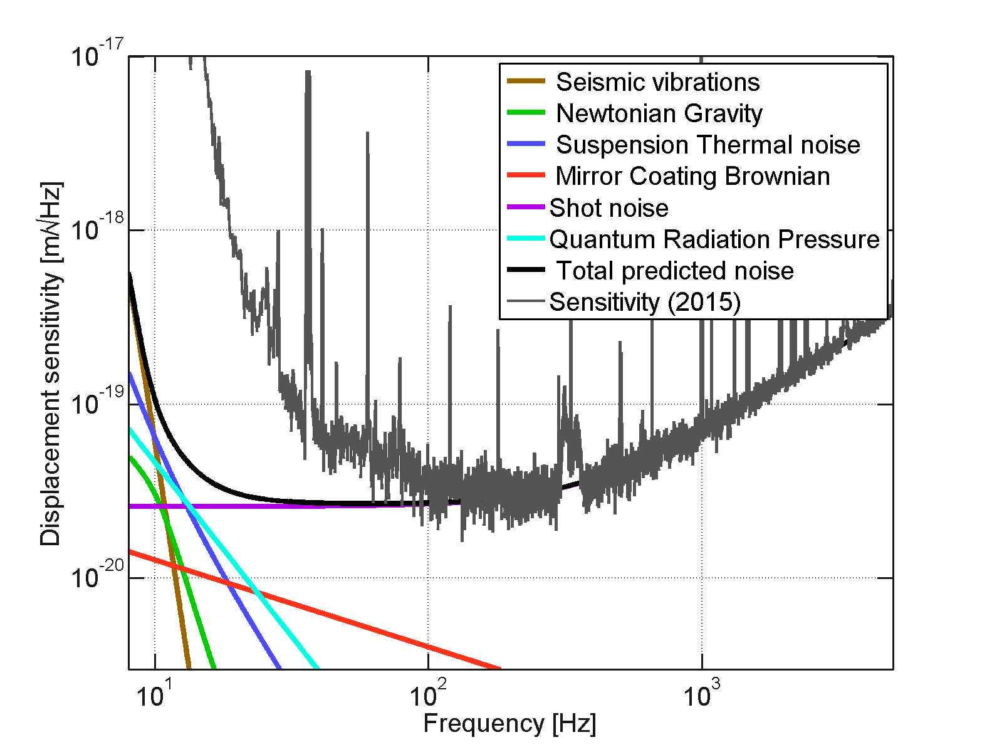
Advanced LIGO noises

Slide 10
Current displacement sensitivity:
Limited by many types of technical noise
Noise budget courtesy of Evan Hall, Caltech

Slide 11
Advanced LIGO fundamental noises

Slide 12
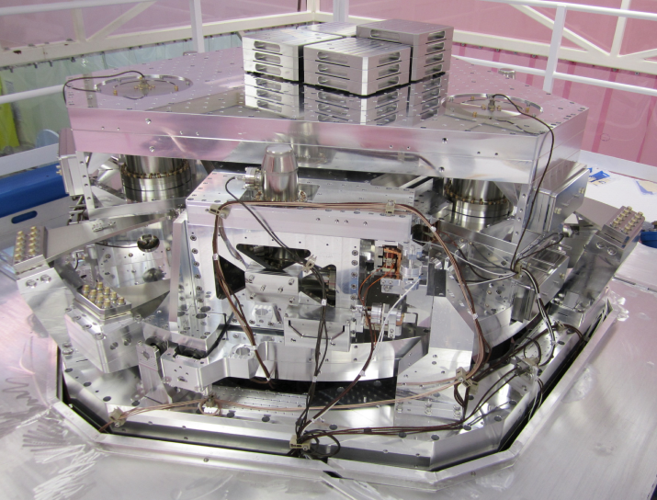
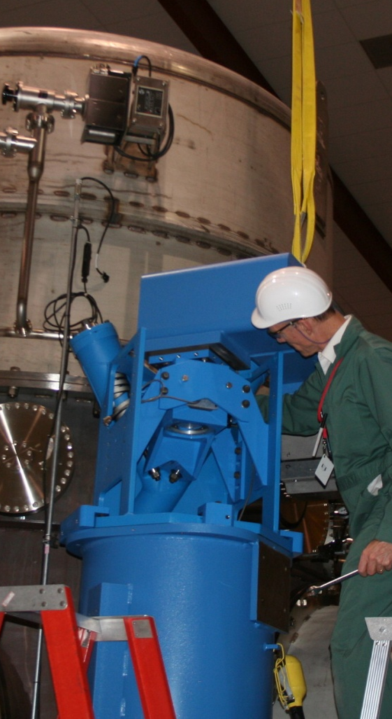
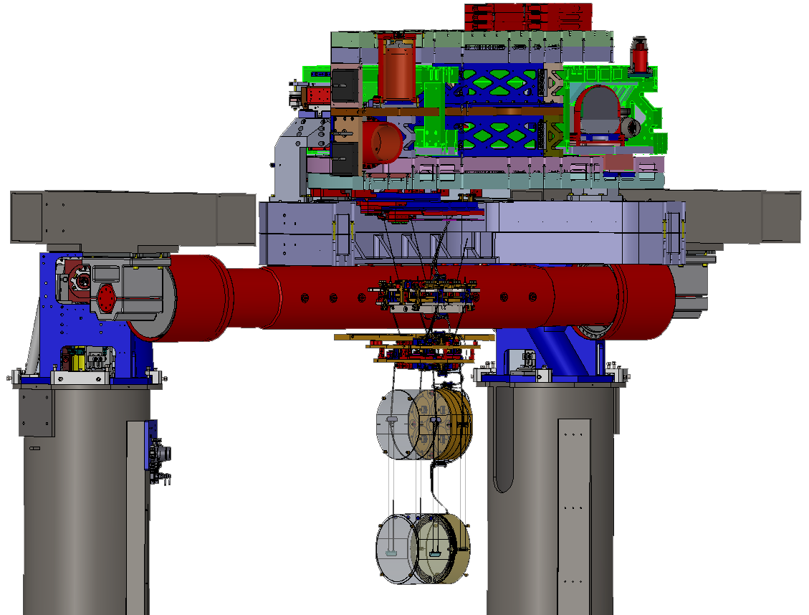
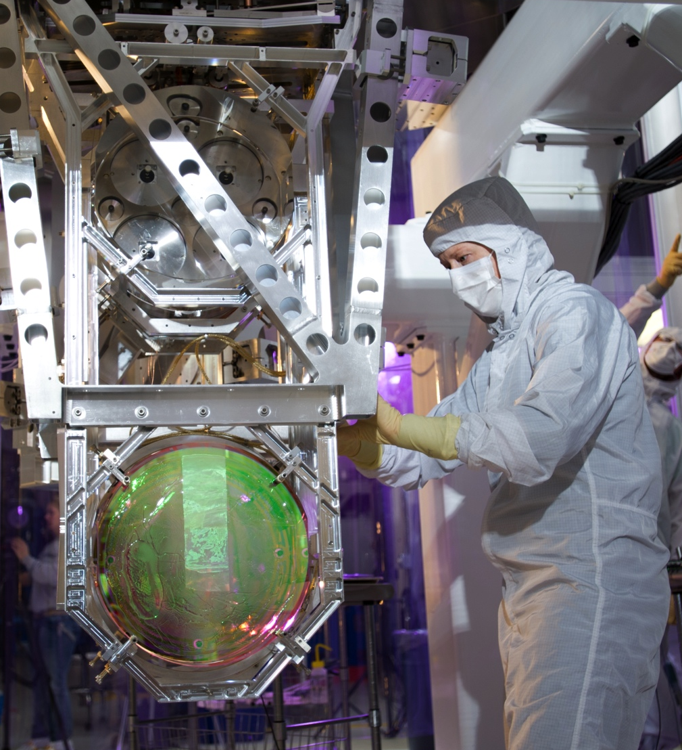
Isolating test masses from the environment
Ground Motion at 10 Hz ~ 10⁻⁹ [m/rtHz]
Test mass motion should be < 10⁻¹⁹ [m/rtHz] at 10 Hz
10 orders of magnitude of isolation needed for test masses!
2
3
4
5
5
1
6
6
7
7

Slide 13
Advanced LIGO fundamental noises

Slide 14
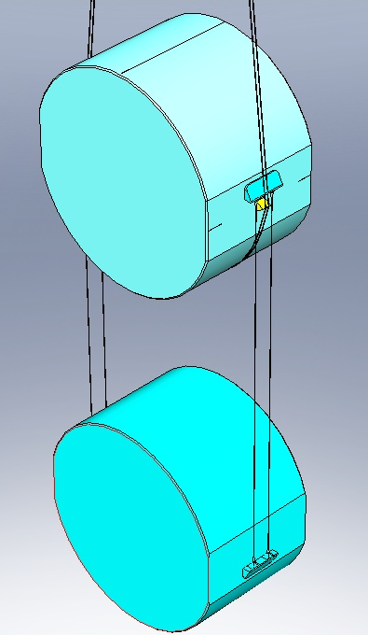
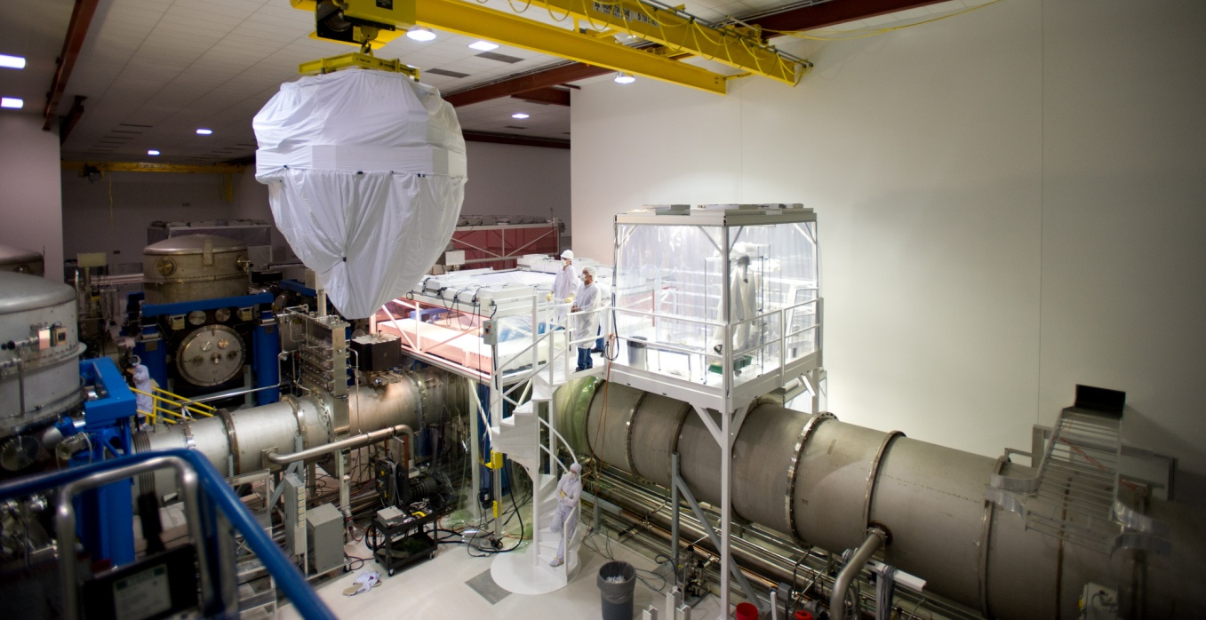
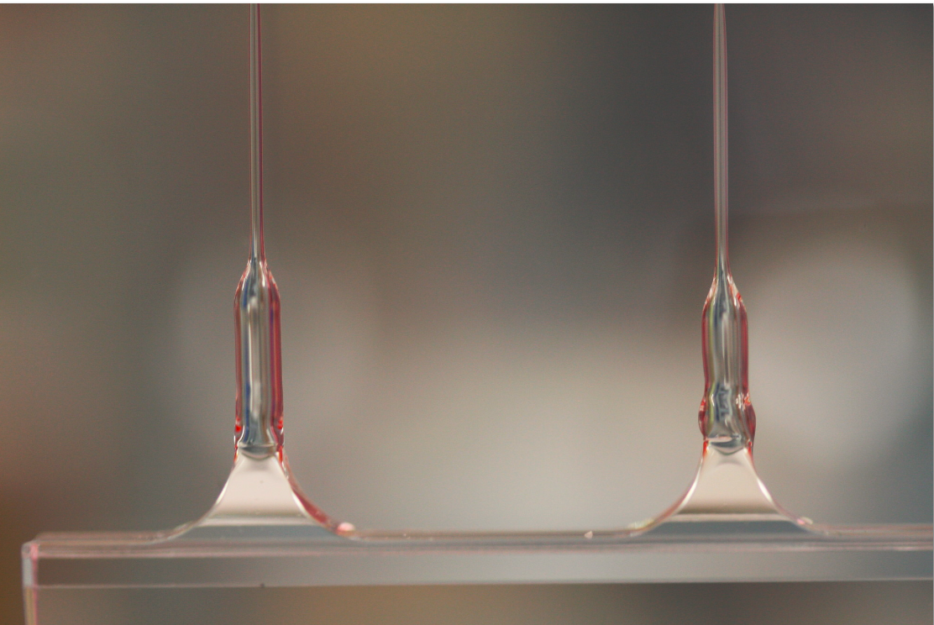
Suspension thermal noise
Equipartition theorem sets total thermal energy in a oscillator (kx²= k_{B}T/2)
Away from the resonance frequency, level of noise is set by quality factor of the oscillator
Reducing mechanical dissipation reduces thermal fluctuations
4
4
Photos: LIGO Lab
Notes:
As with any mechanical system, the dissipation of energy in the suspensions introduces interaction with the environment and therefore fluctuations of the force on the suspensions. The final stage of the Advanced LIGO suspensions are fused silica, which is bonded to the test mass to form one continuous piece of glass. This makes the suspensions into very high quality factor oscillators, and is also a potentially fragile system. These are test masses that weigh as much as a small person, held by glass fibers that I can’t see easily with my face a few inches away.

Slide 15
Advanced LIGO fundamental noises

Slide 16
Advanced LIGO fundamental noises

Slide 17
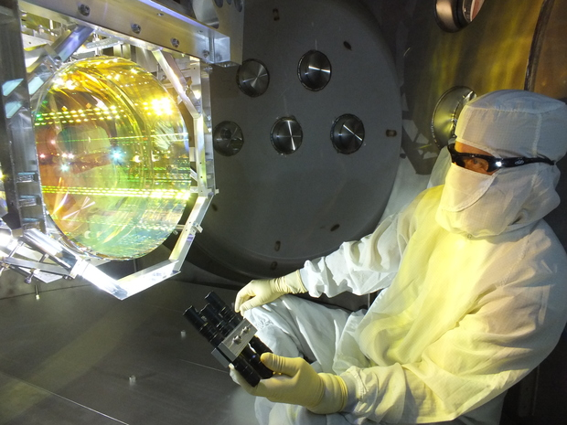
Coating thermal noise
Dielectric coatings used in mirror coatings have high mechanical losses compared to substrate
Brownian motion changes thickness of the coating
Photo: M Heitze LIGO Lab

Slide 18
Advanced LIGO fundamental noises

Slide 19
Interferometer configuration is chosen to mitigate quantum noise
Fabry Perot arm cavities amplify
signal relative to shot noise
40 kg test masses reduce radiation pressure noise
Laser
Power recycling increases effective laser power: currently using 100kW of circulating power
Signal extraction cavity
efficiently extracts signal sidebands

Slide 20
Next month: Increasing power to 50 Watts
Increasing circulating
power from 100 kW
to 250 kW

Slide 21
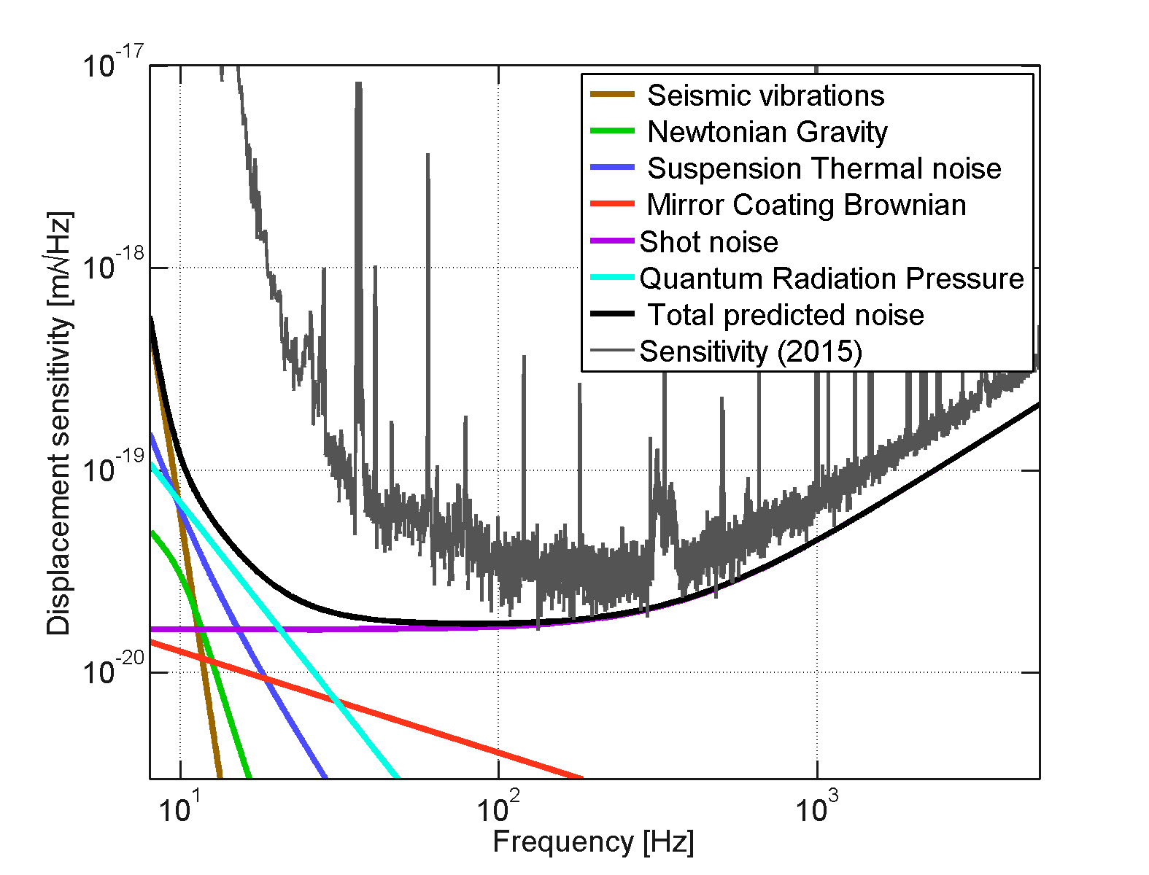
Next month: Increasing power to 50 Watts
Increasing circulating
power from 100 kW
to 250 kW

Slide 22
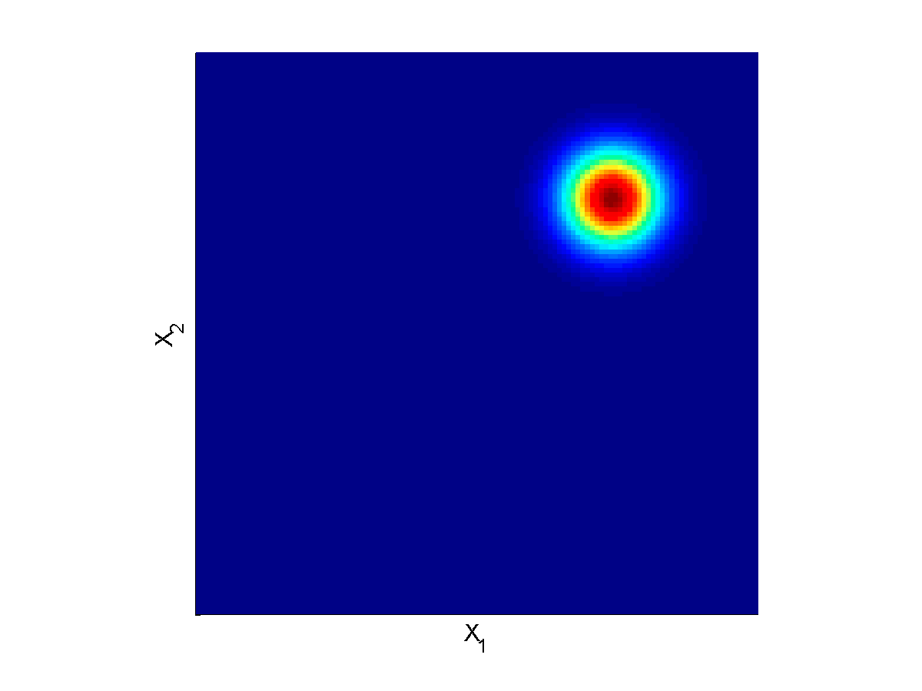
An alternative explanation for quantum noise: vacuum fluctuations
X₂
X₂
∆X₂
A
∆X₁
θ
X₁
X₁
The uncertainty principle
Vacuum fluctuations
∆X₁ ∆X₂ ≥1
22

Slide 23
An alternative explanation for quantum noise: vacuum fluctuations
Laser
Alternative solution: Squeezing

Slide 24
Squeezed light and squeezed vacuum
X₂
X₂
X₁
X₁
The uncertainty principle
Squeezed vacuum
∆X₁ ∆X₂ ≥1
24

Slide 25
Squeezing in an interferometer
Laser

Slide 26
Squeezing in Enhanced LIGO
2.1dB
19% improvement in SNR at high frequencies
LIGO Scientific Collaboration, Nature Photonics 7 613-619 (2013)

Slide 27
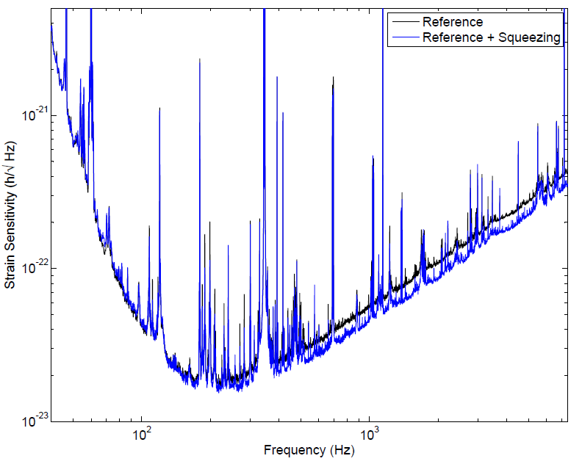
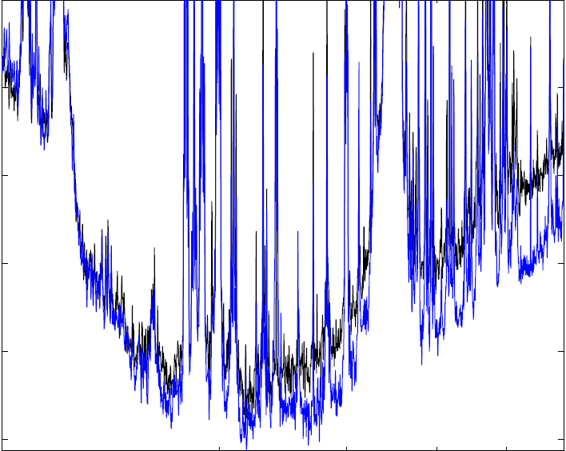
No additional noise introduced
1Mpc range added to neutron star
binary inspiral range,
24% increase in detection rate

Slide 28
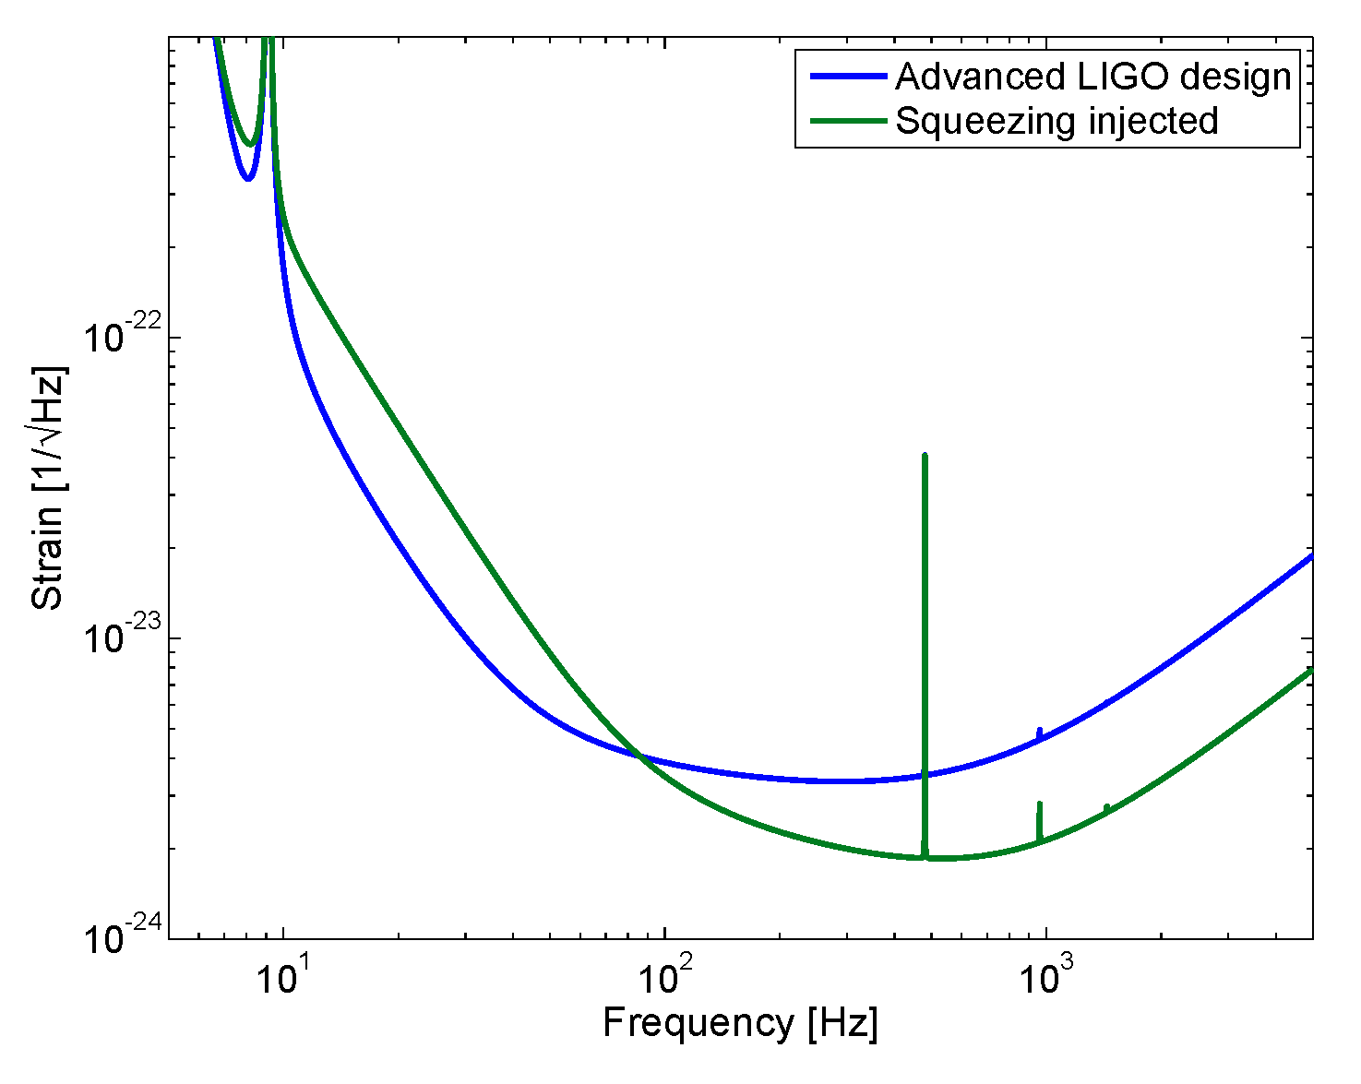
Squeezing with a radiation pressure noise limited interferometer

Slide 29
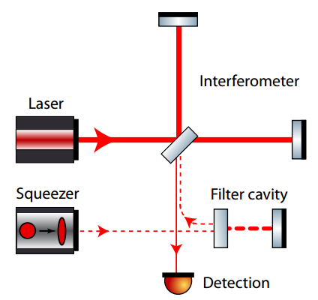
Frequency Dependent Squeezing
Evans et al, PRD 88 022002 (2013)

Slide 30
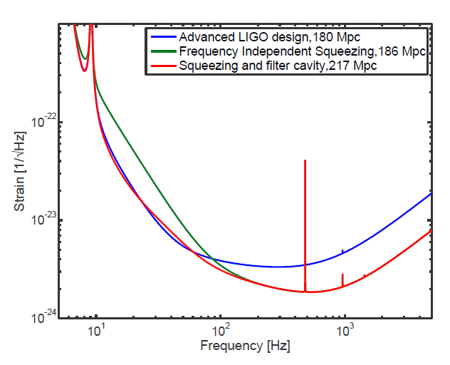
Frequency Dependent Squeezing
10 meter Filter Cavity
60 ppm round trip losses

Slide 31
Strain sensitivity should evolve over the next 5-10 years
Advanced LIGO (2015)
Initial LIGO (2010)
Advanced LIGO
fundamental noises
Advanced LIGO with
near term upgrades
(including squeezing)
http://arxiv.org/pdf/1602.03838v1.pdf

Slide 32
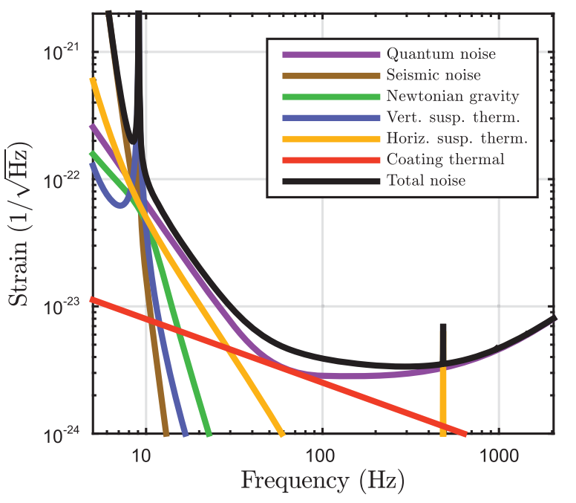
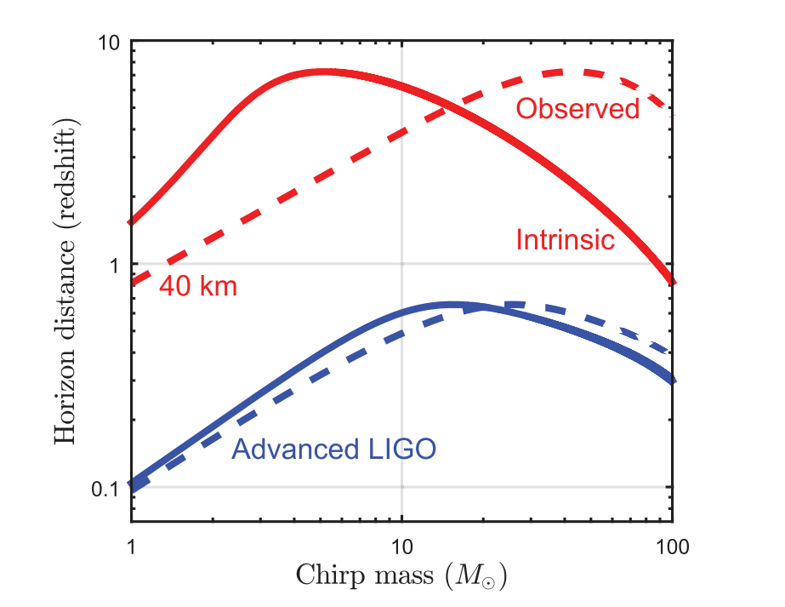
Extending our reach to cosmological distances
Dwyer et al
http://dx.doi.org/10.1103/PhysRevD.91.082001

Slide 33
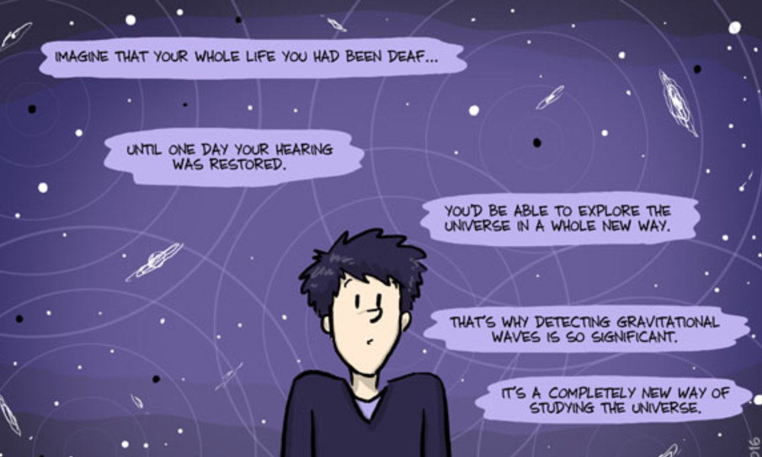
Thanks for your attention!
LIGO has detected gravitational waves from a binary black hole merger
This required making the most precise displacement measurements ever made
Several techniques, including squeezing, are available to improve the sensitivity further
Jorge Cham @ PhD comics

Slide 34
Extra Slides

Slide 35
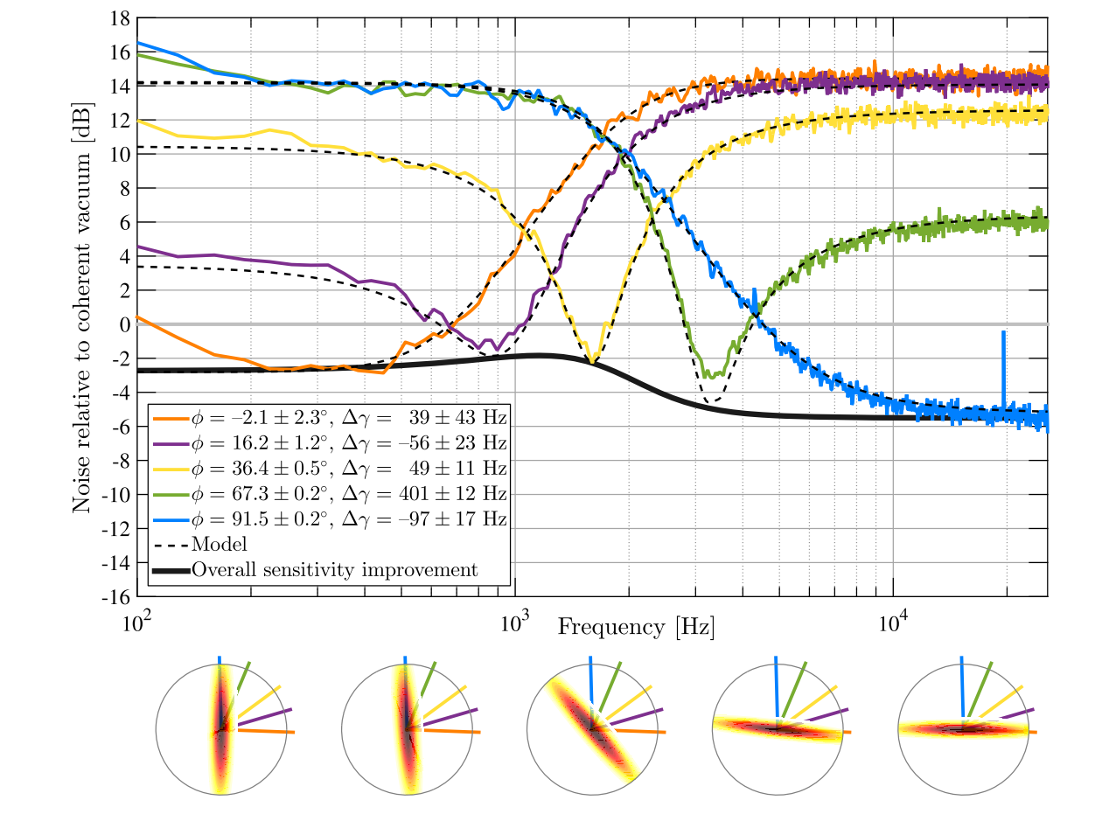
Frequency dependent squeezing recently demonstrated in the audio band
Oekler et al PRL Jan 2016
http://dx.doi.org/10.1103/PhysRevLett.116.041102

Slide 37
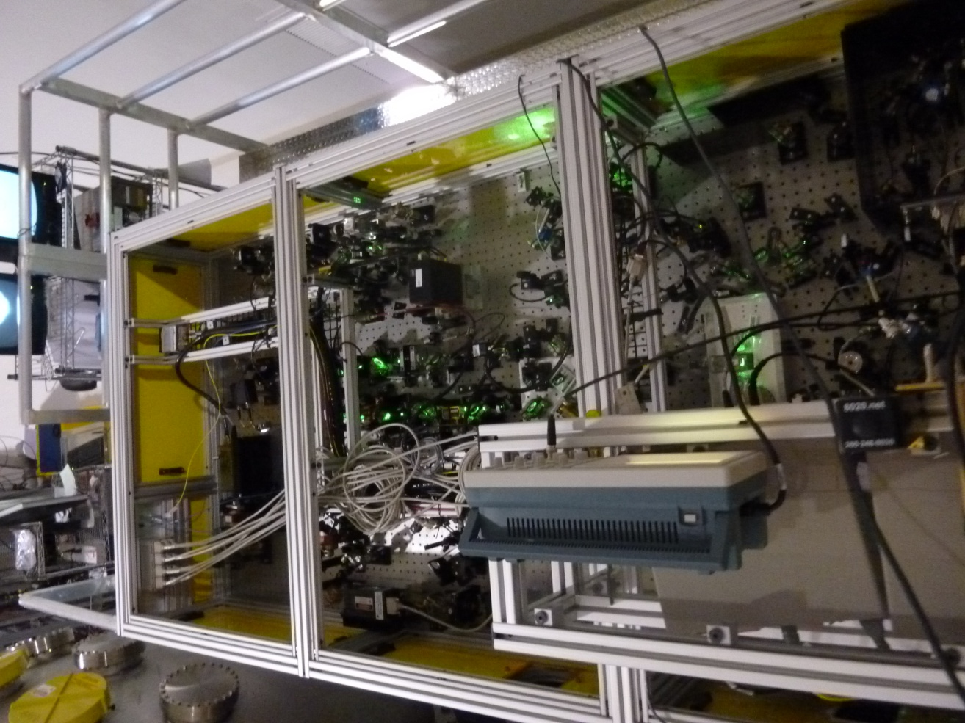
A squeezer table
Homodyne
Detector
Second Harmonic Generator
Optical Parametric Oscillator
Laser
Interferometer
AS Port

Slide 38
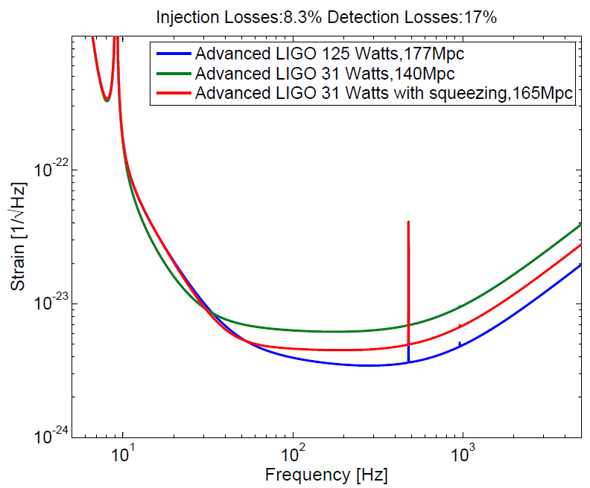
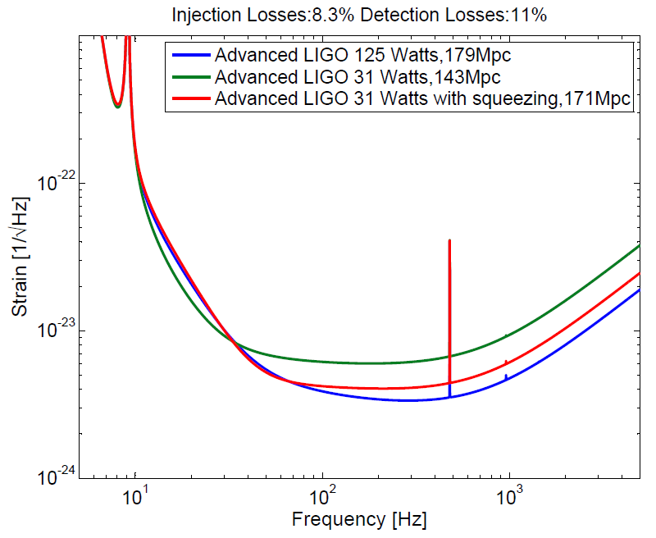
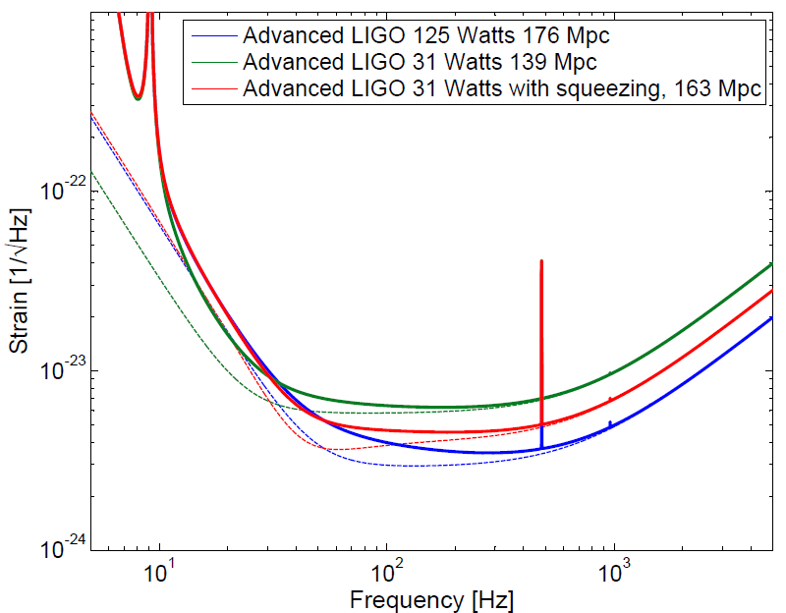
An alternative to high power operation in Advanced LIGO

Slide 39

Squeezer: Optical parametric oscillator
Classical OPO:
Phase sensitive amplifier
Quantum OPO:
Turns a vacuum state into
squeezed vacuum

Slide 40
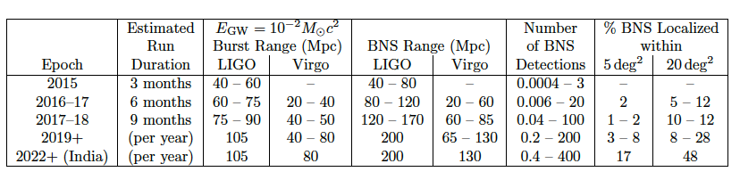
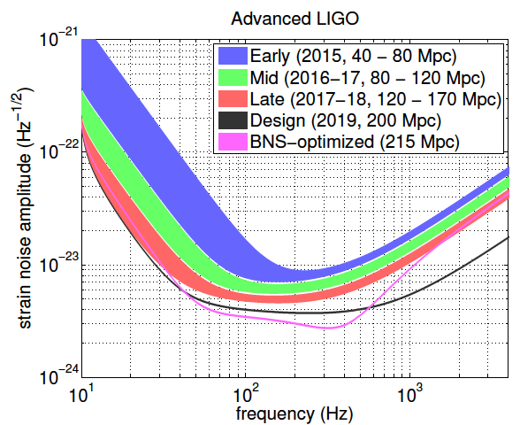
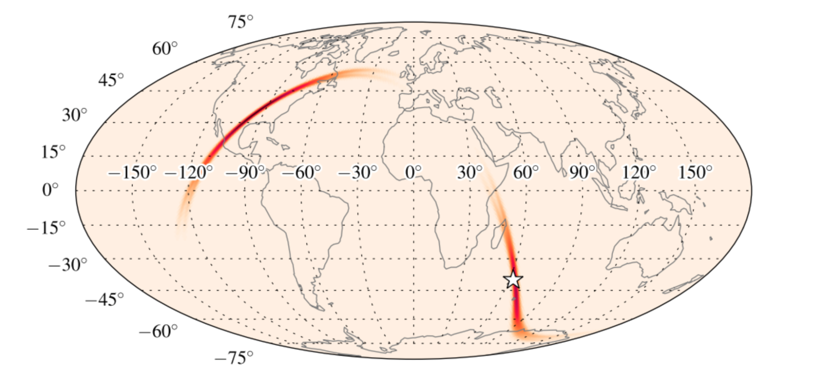
Observing Scenario
http://arxiv.org/abs/1304.0670
Localization of source,
Hanford and Livingston LIGO detectors,
First science run at end 2015

Slide 41
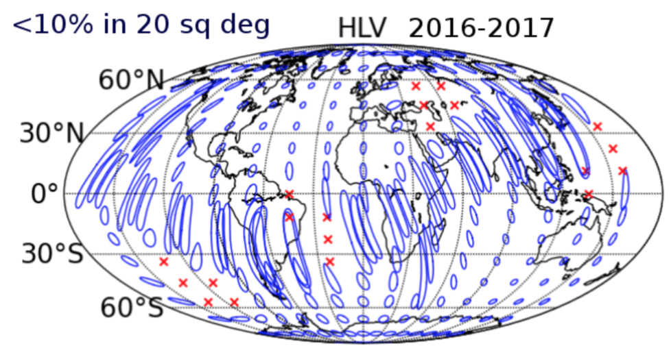
Localization of source,
Hanford, Livingston and Virgo detectors,
Observing 2016-17

Slide 42
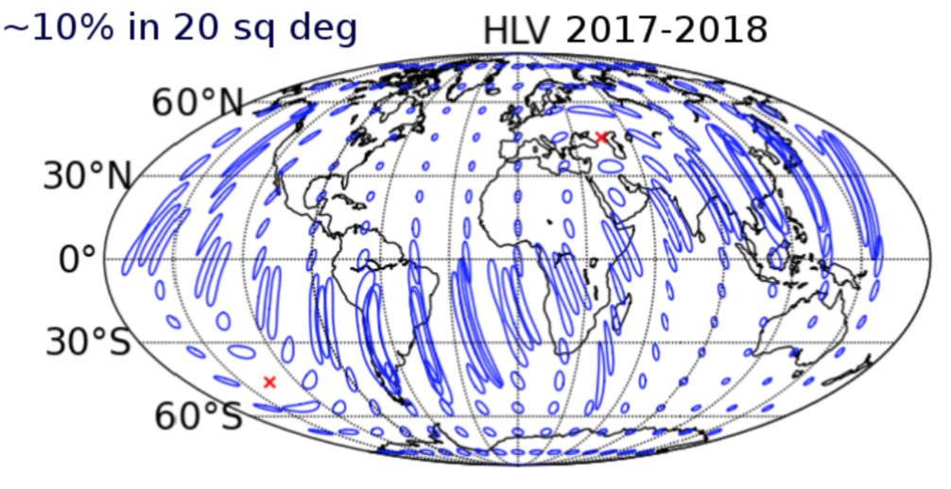
Localization of source,
Hanford, Livingston and Virgo detectors,
Observing 2017-18

Slide 43
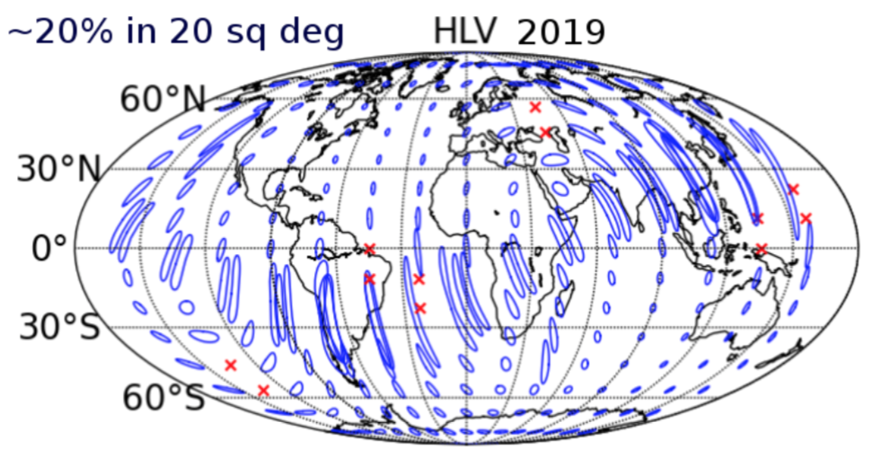
Localization of source,
Hanford, Livingston and Virgo detectors,
Observing 2019

Slide 44
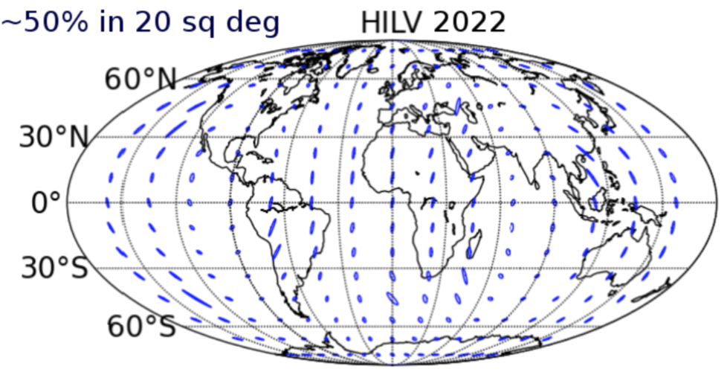
Localization of source,
Hanford, Livingston, Virgo, India detectors,
Observing 2022

Slide 45
Future Plans: Next few months
Increase input power from 20Watts to 50 Watts
  Increase circulating power from ~100kW to ~250 kW
Work on reducing low frequency noise
  Important for sensitivity to binary black holes
Prepare for next observing run in later part of the year

Slide 46
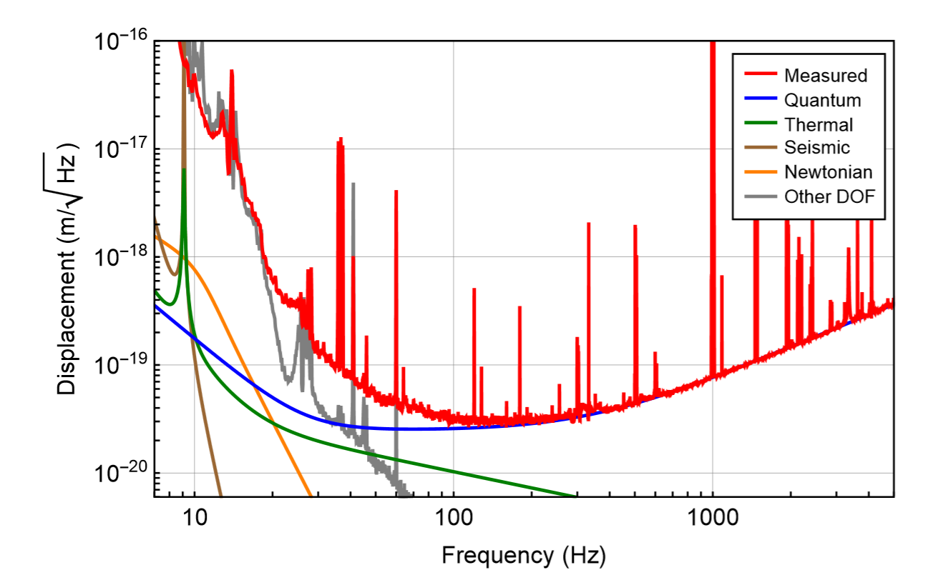
Displacement sensitivity
http://arxiv.org/abs/1602.03838

