Slide 1
Progress Towards a Cryogenic LIGO mirror
Brett Shapiro,
Litawn Gan, Dan Fan, Sanditi Khandelwal,
Brian Lantz
Stanford University
Notes:
I’m going to talk about the work at Stanford towards achieving a cryogenic LIGO mirror

Slide 2
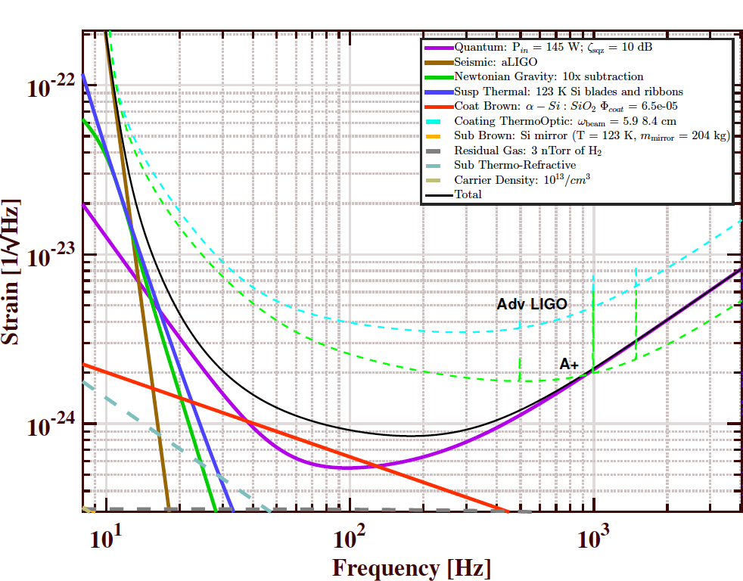
LIGO Voyager baseline noise model
reference T1400226-v7
Notes:
This shows the baseline noise model for LIGO voyager in black, about a factor of 3 below the aLIGO goal, the dashed cyan line. The limit around 100 Hz is set by the coating brownian noise in red, which is achieved, in part, by cooling silicon test mass to 124 K.

Slide 3
A model of the noise performance of LIGO Voyager
Goal of the work in these slides:
Show we can cool a silicon test mass to 120 K
Don’t compromise the seismic isolation performance
LIGO-T1400226-v7
Notes:
The goal of the work in these slides is to show we can…

Slide 4
A model of the noise performance of LIGO Voyager
Goal of the work in these slides:
Show we can cool a silicon test mass to 120 K
Don’t compromise the seismic isolation performance
Plan for maintenance and repair
LIGO-T1400226-v7
Notes:
Also, we need to design for maintenance and repair scenarios, meaning if we fully enclose the test mass with cryogenics, we must be able to get in somehow to do maintenance and repair work.

Slide 5
Actively controlled shield (ETM)
Vacuum chamber
Vib. isolated optics table
Gnd
Gnd
Gate Valve
Gate Valve
z
10 m
Cryo pump
124 K test mass
Notes:
This is a cartoon of an end station with the approach we have in mind to achieve this.
Here’s the test mass inside the BSC.

Slide 6
Actively controlled shield (ETM)
Vacuum chamber
Vib. isolated optics table
Gnd
Gnd
Gate Valve
Gate Valve
z
10 m
80 K heat shield for ≈5 W cooling
Cryo pump
124 K test mass
Notes:
There’s an 80 K heat shield surrounding the the test mass, giving us about 5 W of cooling power. Here it’s shown around the PUM as well, but we could choose just to enclose just the test mass if we want a simpler approach.

Slide 7
Actively controlled shield (ETM)
Vacuum chamber
Cold link
Vib. isolated optics table
Gnd
Gnd
Gate Valve
Gate Valve
z
10 m
80 K heat shield for ≈5 W cooling
Cryo pump
124 K test mass
Notes:
The heat shield is cooled by a flexible cold link that goes to the vacuum wall.

Slide 8
Actively controlled shield (ETM)
Vacuum chamber
Blade springs
Cold link
Vib. isolated optics table
Gnd
Gnd
Gate Valve
Gate Valve
z
10 m
80 K heat shield for ≈5 W cooling
Cryo pump
124 K test mass
Notes:
The shield then hangs from stage 0, and it is suspended from springs to give it some seismic isolation, because the shield does require some isolation to minimize the coupling of scattered light.
We’ve chosen not to hang it from the isolated optics table just to avoid the whole issue of integrating the cryogenics with the seismic isolation system.

Slide 9
Actively controlled shield (ETM)
Relative displacement sensors
Vacuum chamber
Blade springs
Cold link
Vib. isolated optics table
Gnd
Gnd
Gate Valve
Gate Valve
z
10 m
80 K heat shield for ≈5 W cooling
Cryo pump
124 K test mass
Notes:
So maybe hanging it from stage 0 is just good enough, but if your pessimistic you might want to do a little better. So one thing you could do is put displacement sensors between the shield and stage 2, which is well isolated.

Slide 10
Actively controlled shield (ETM)
Relative displacement sensors
Actuators
Vacuum chamber
Blade springs
Cold link
Vib. isolated optics table
Gnd
Gnd
Gate Valve
Gate Valve
z
10 m
80 K heat shield for ≈5 W cooling
Cryo pump
124 K test mass
Notes:
and then have actuators between the heat shield stage 0.
And actively control the shield to follow stage 2.

Slide 11
Actively controlled shield (ETM)
Relative displacement sensors
Actuators
Vacuum chamber
Blade springs
Cold link
Vib. isolated optics table
80 K baffled beam tube shield
Gnd
Gnd
≈ 900 mm dia
Gate Valve
Gate Valve
z
10 m
80 K heat shield for ≈5 W cooling
Cryo pump
124 K test mass
Notes:
And then the last thing here is an 80 K beam tube shield, which gives you a way to cut a large hole in the test mass shield so that the laser can get in without making a huge heat leak on the test mass.

Slide 12
Heat shield experiment at Stanford University
Notes:
So the next thing to do is to build a prototype of this system and see if it works. That’s what we’re working on at Stanford. This is a solidworks model of our heat shield experiment inside of our vacuum chamber. For scale, the chamber is about the size of a HAM chamber. This image is a bit too busy to point out all the bits, so I won’t even try.

Slide 13
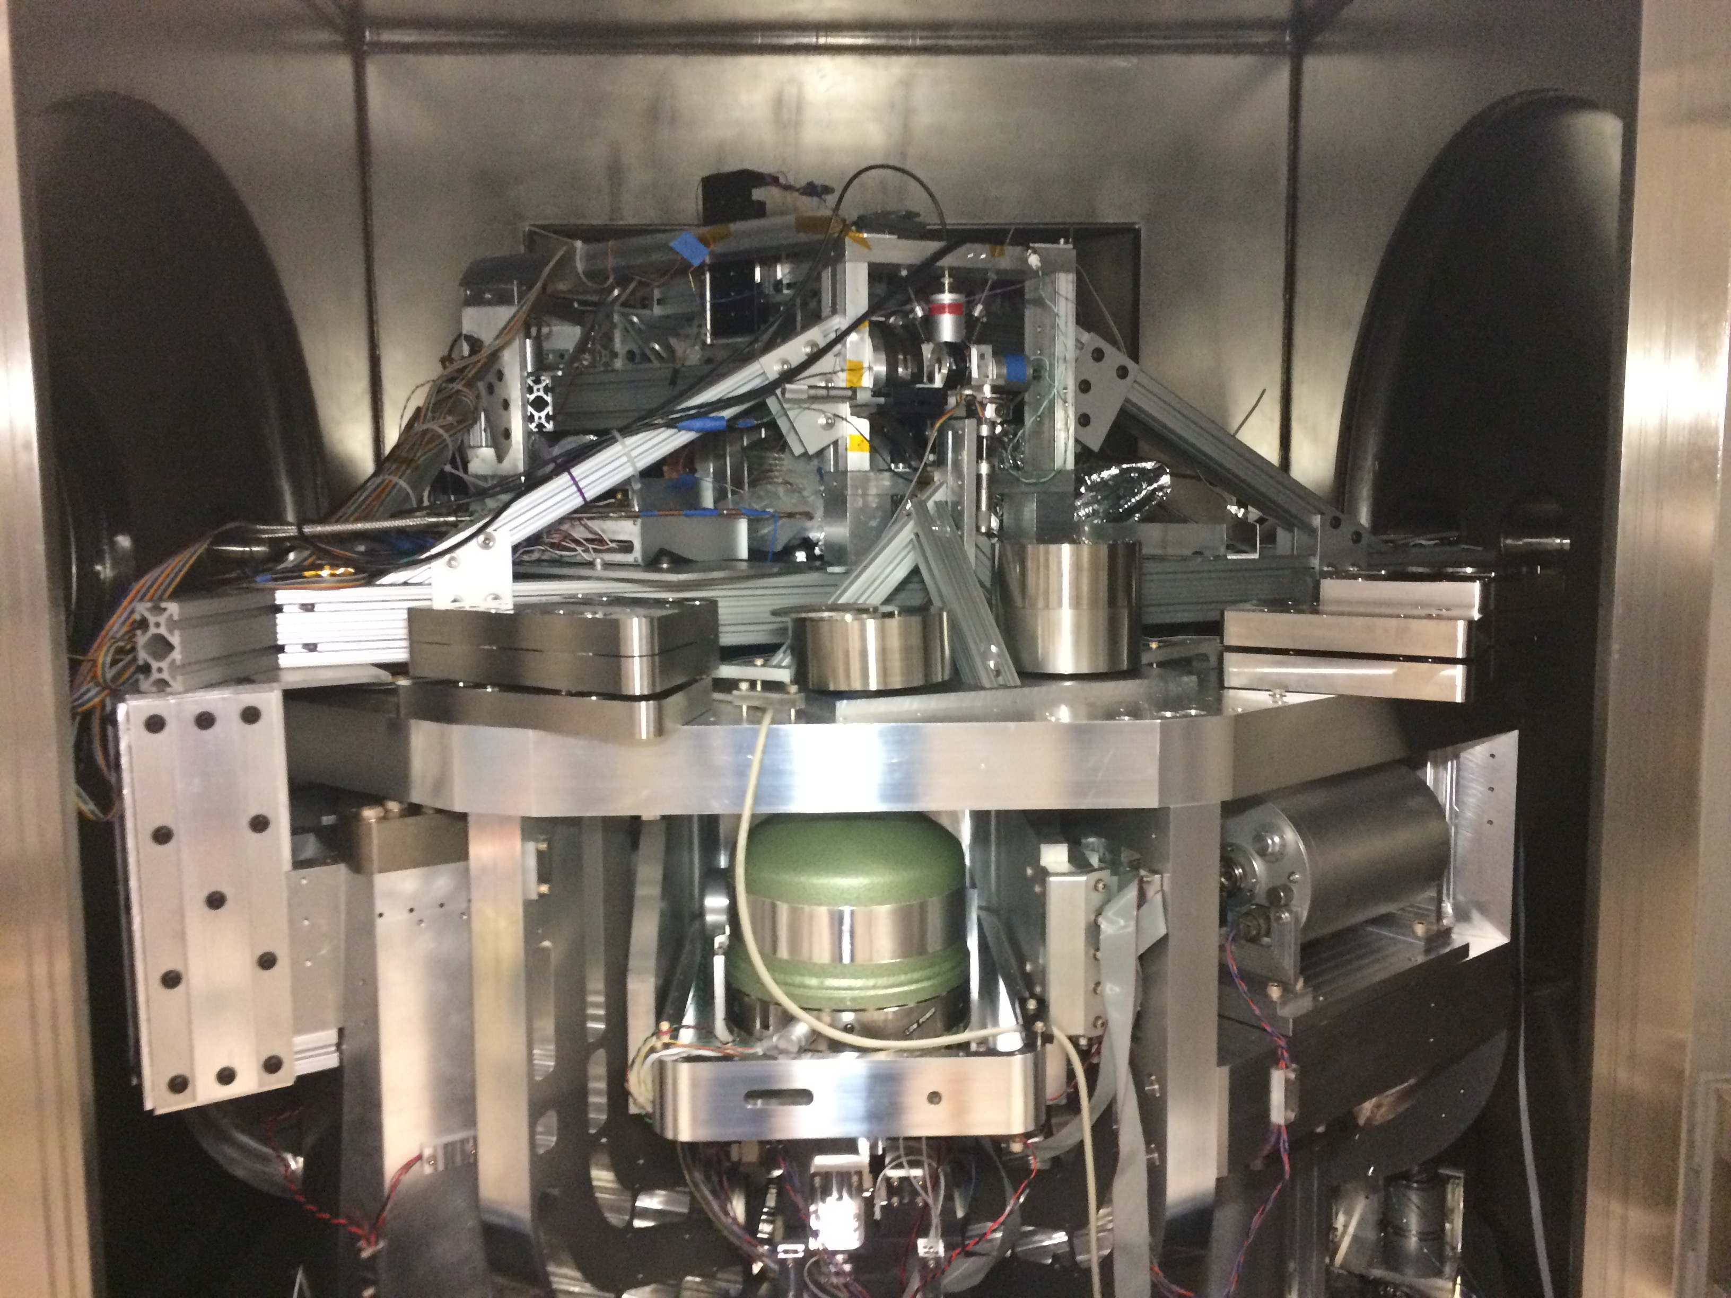
Notes:
Here’s a photo of the same thing. Again, I won’t bother to point out all the parts here.

Slide 14
Actuator
Vacuum wall
Relative displacement sensors
Cu braid
cold link
LN₂ pipes
Inertial sensors - geophones
LN₂ supply
Heat shield support structure
Heat shield
80 K
LN₂ return
Actively isolated optics table (300 K)
GN₂ feedthrough
Intermediate stage (300 K)
Ground
Spring
Ground
Notes:
Instead, I’ll show a simplified cartoon of how it works, which is basically what we just saw earlier. The main difference is that our ISI sits below the optic instead of above. But you still have a heat shield hanging from some springs mounted to stage 0. It’s then cooled with some flexible copper braids between it and a liquid nitrogen pipe. We’ve taken the conservative approach of installing sensors and actuators for isolation control, just in case we need them.

Slide 15
Heat shield measurement and control
The controller forces the heat shield to follow the isolated optics table using the relative displacement sensors
The heat shield’s geophones are used to measure how well the control is doing
Ground vibrations
Isolated optics
table
Heat Shield
Cryo vibrations
Geophones
Relative
displacement sensors
Geophones
Actuator force
Controller
Notes:
And just to highlight how the isolation control works, we feeding back the relative displacements sensor signals in order to force the heat shield to follow the ISI, which is already isolated, despite the influence of vibrations from the ground and the cryogenics. Then we measure the heat shield’s performance with some geophones that are not part of the feedback loop.

Slide 16
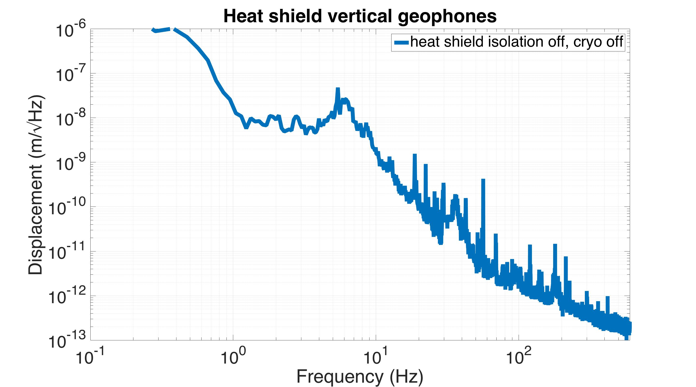
Ground vibrations
Heat Shield
Geophones
inertial displacement measurement
Notes:
Just a week ago we started getting data with this system. So this plot shows the shield’s vertical displacement seen by the geophones, without any cryogenics or control.

Slide 17
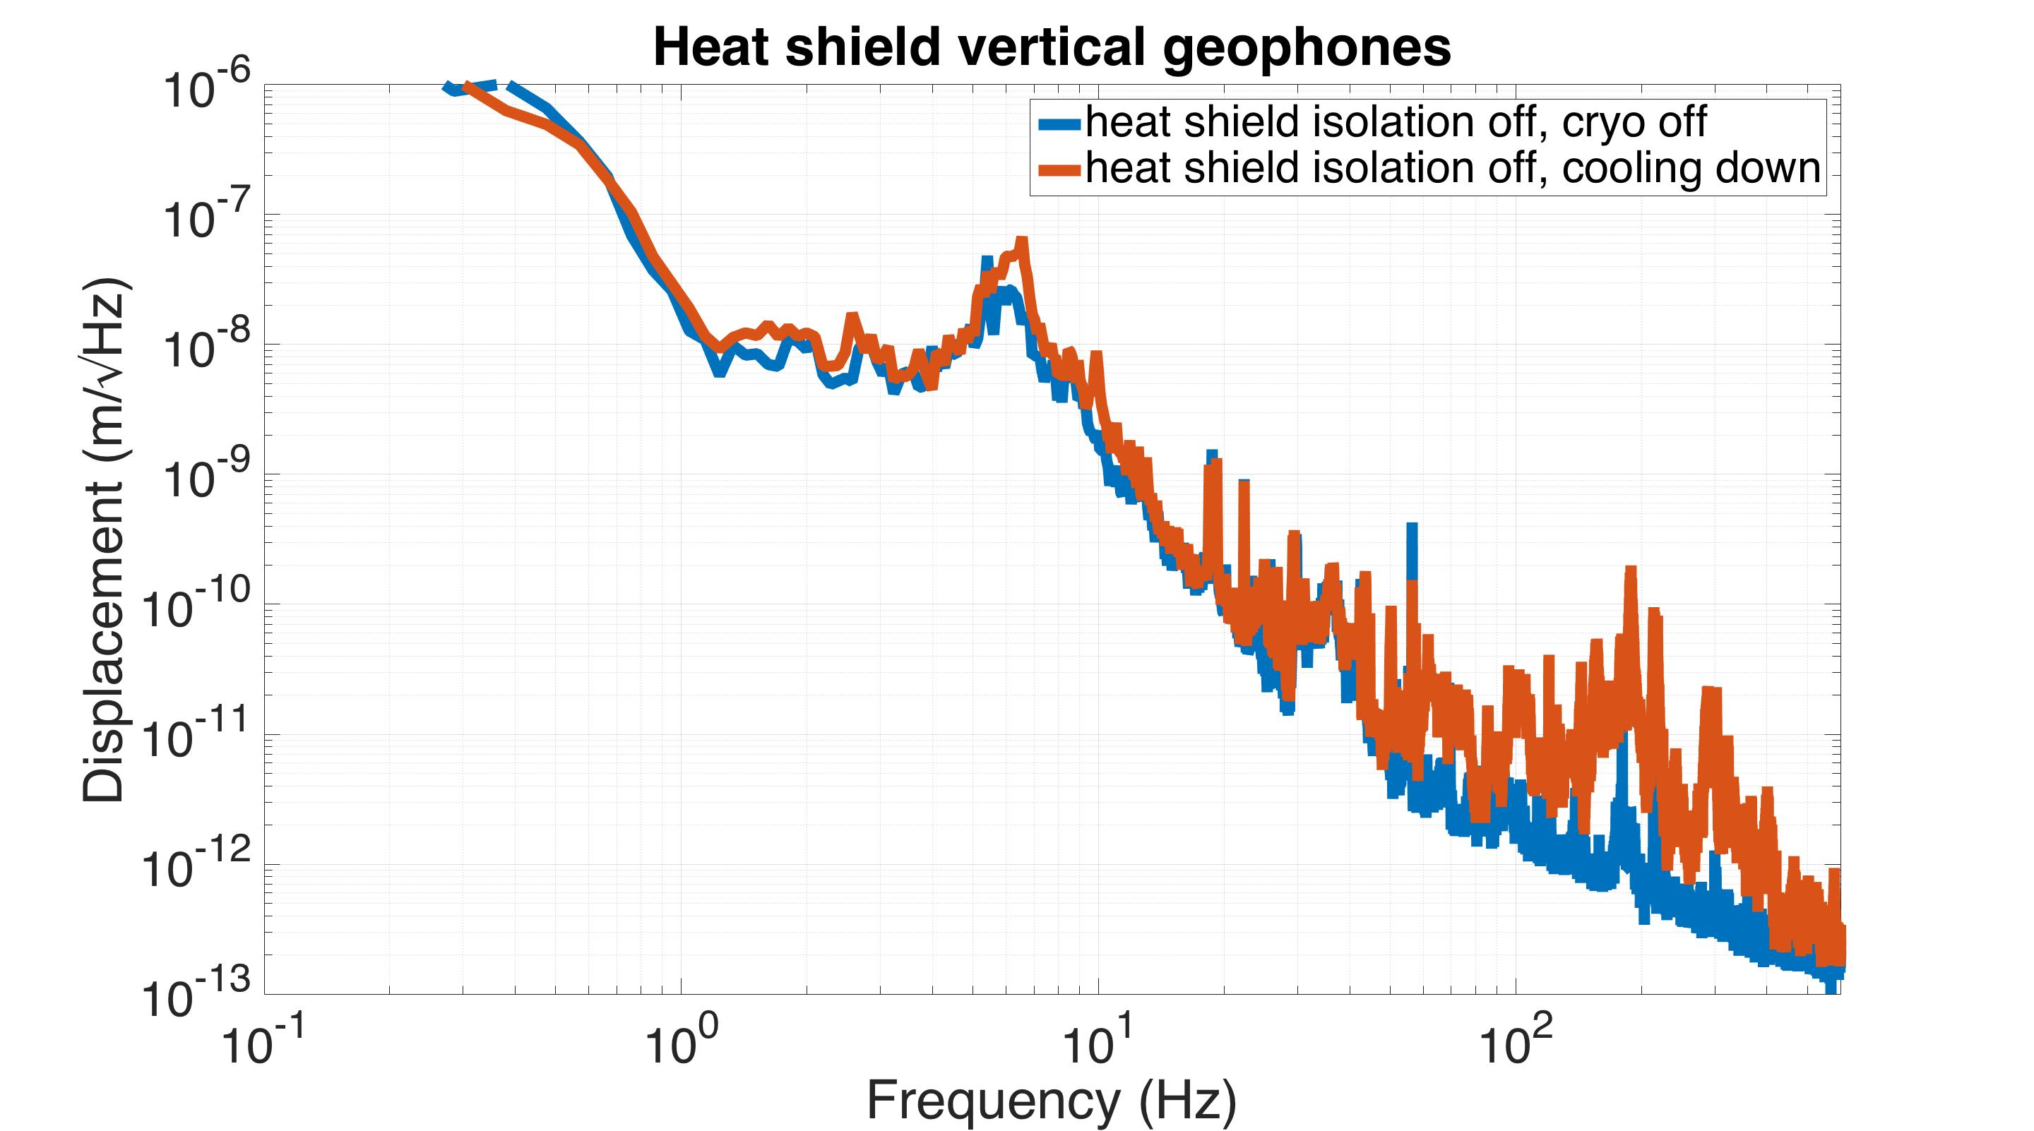
Ground vibrations
Cryo vibrations
Heat Shield
Geophones
inertial displacement measurement
Notes:
Then, when you turn the liquid nitrogen on, you do see some enhanced vibration. A little bit around its resonance, and some more at high frequencies.

Slide 18
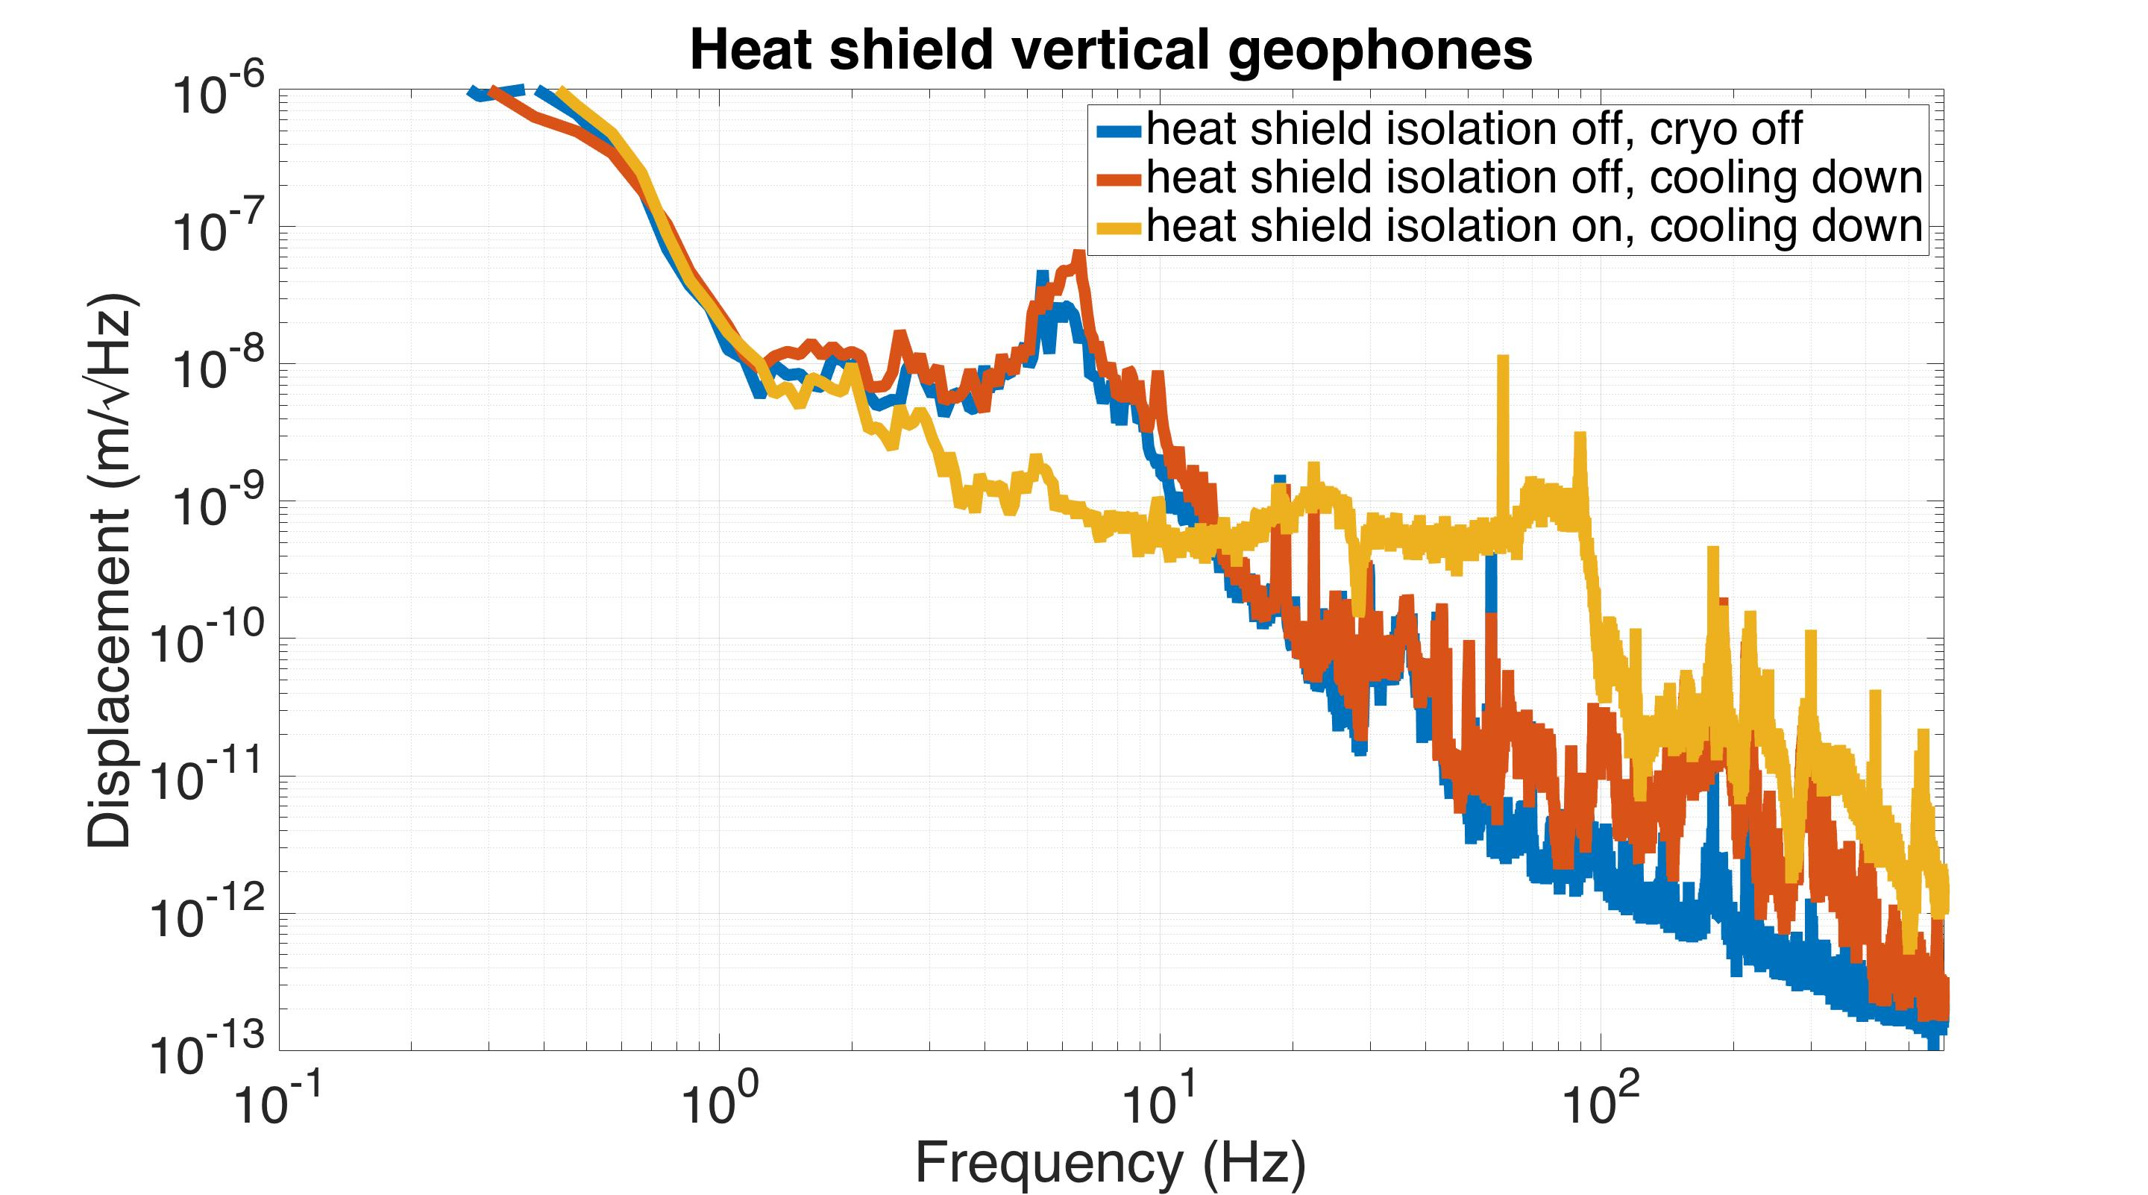
Ground vibrations
Cryo vibrations
Heat Shield
Geophones
inertial displacement measurement
Controller
Notes:
If you turn the control on, you can suppress that resonance peak, at the expense of higher frequency noise. We’ll see later if this is good enough.

Slide 19
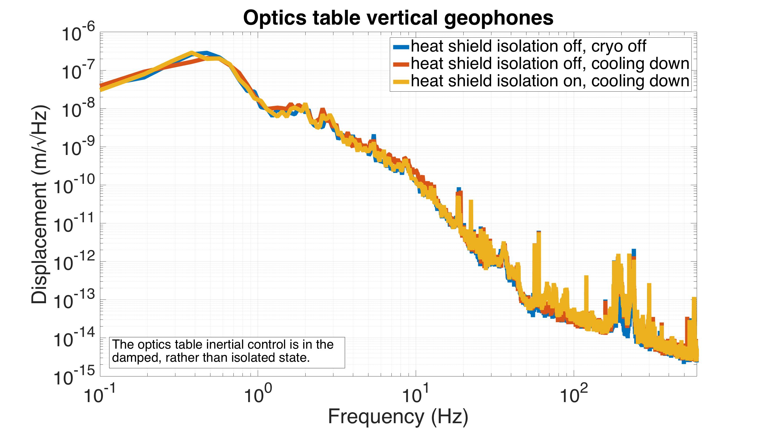
Optics
Table
Geophones
inertial displacement measurement
Notes:
Looking at the same curves for the ISI, we see there is virtually no increased noise propagating through the seismic system, which is good. That’s what we want to see.

Slide 20
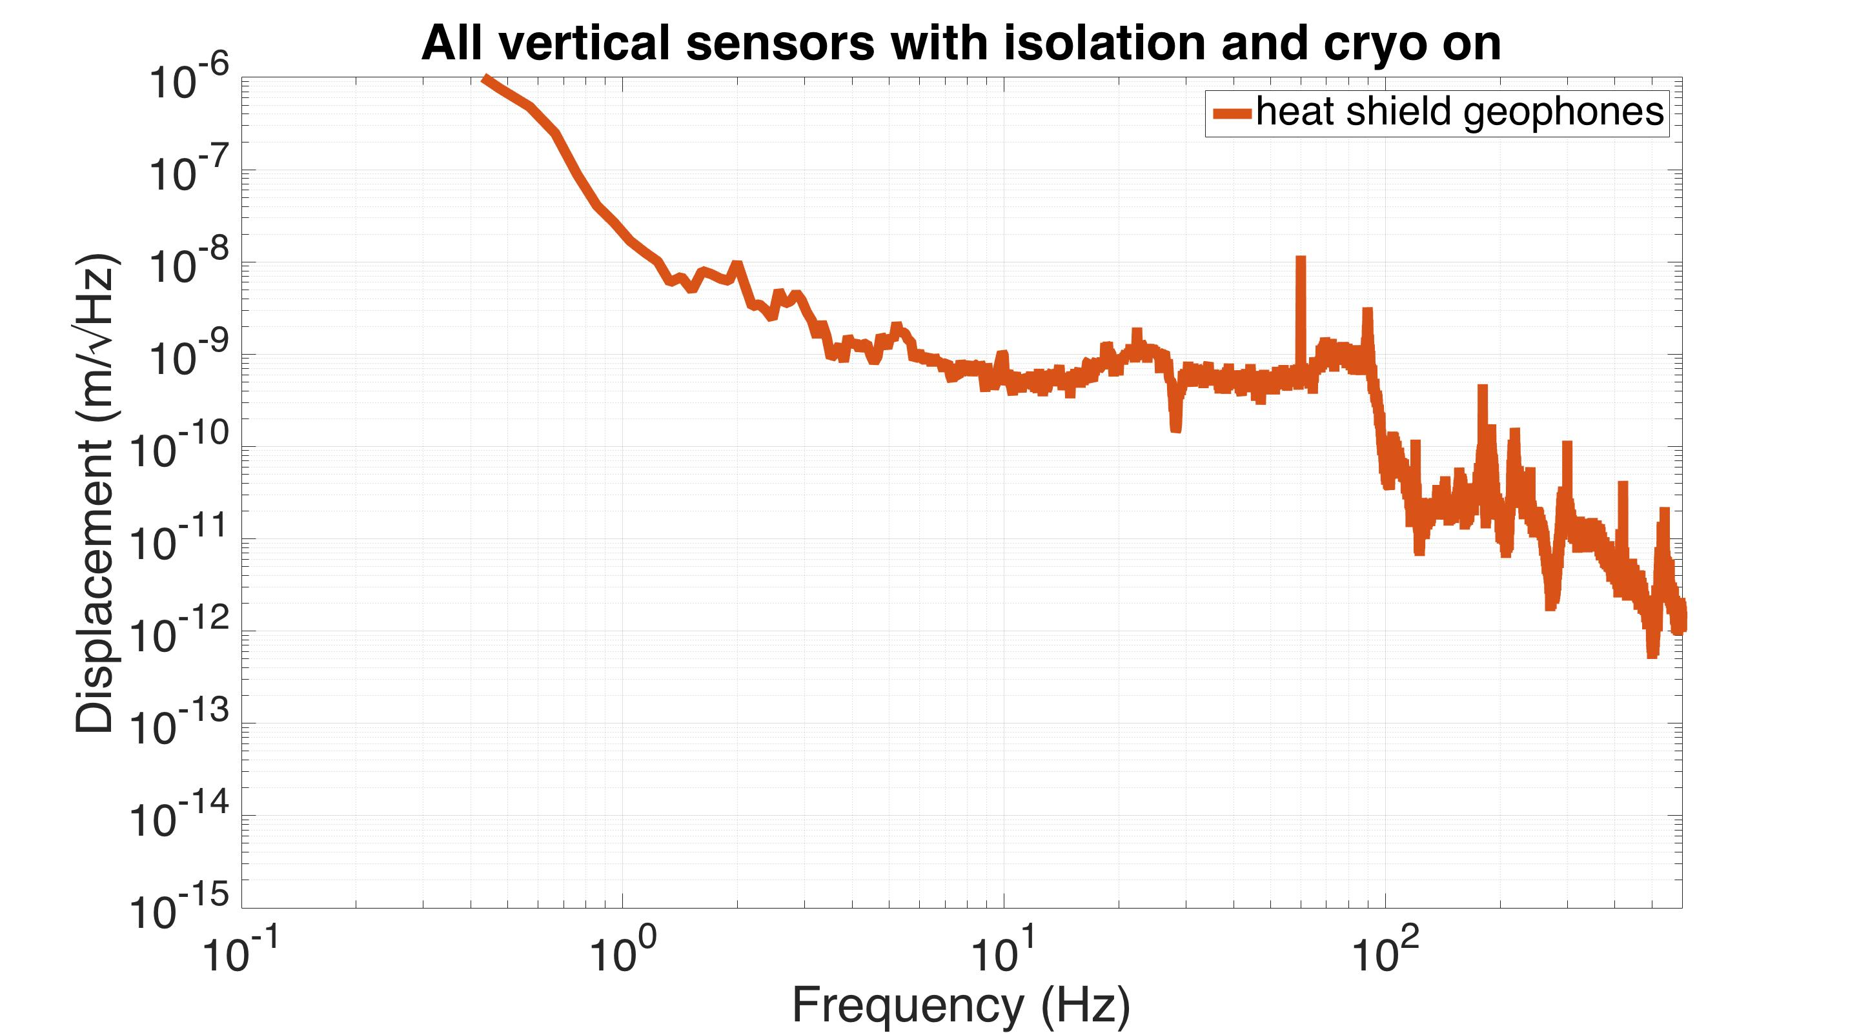
Optics
Table
Heat Shield
Geophones
displacement
sensors
Geophones
Controller
Notes:
Going back to the heat shield noise, this is the same curve we saw a moment ago with the control on. To get an idea of what contributes to this performance, we can compare it to the ISI motion.

Slide 21
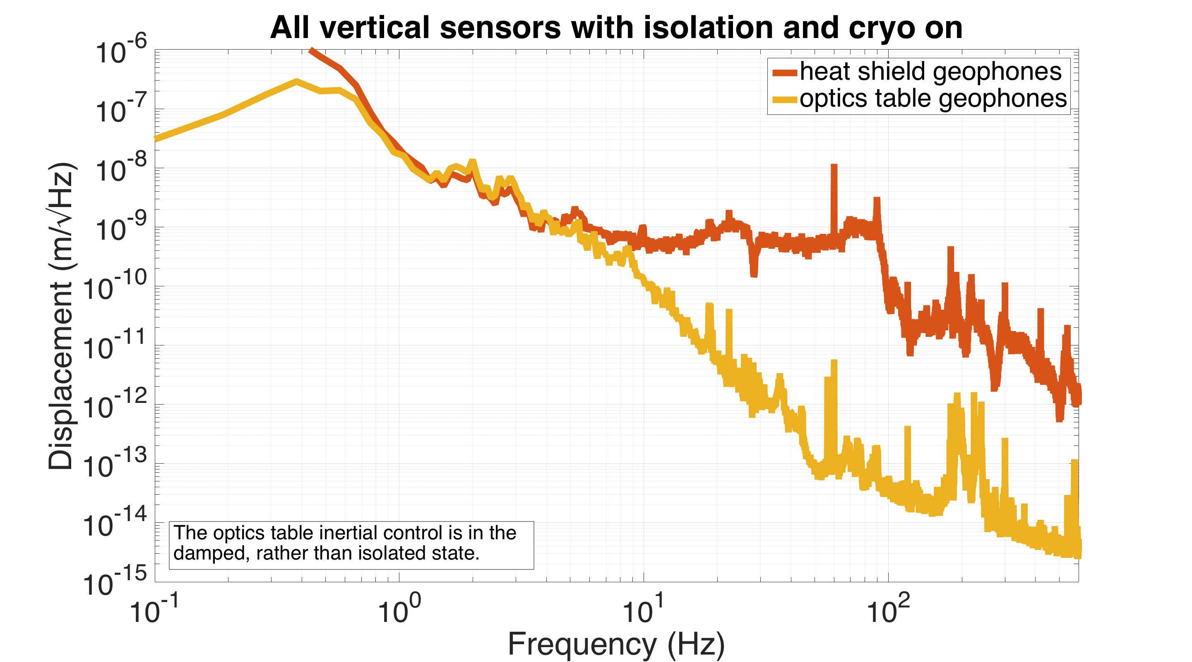
Optics
Table
Heat Shield
Geophones
displacement
sensors
Geophones
Controller
Notes:
The low frequencies match well, which is what we’re trying to achieve with the control.

Slide 22
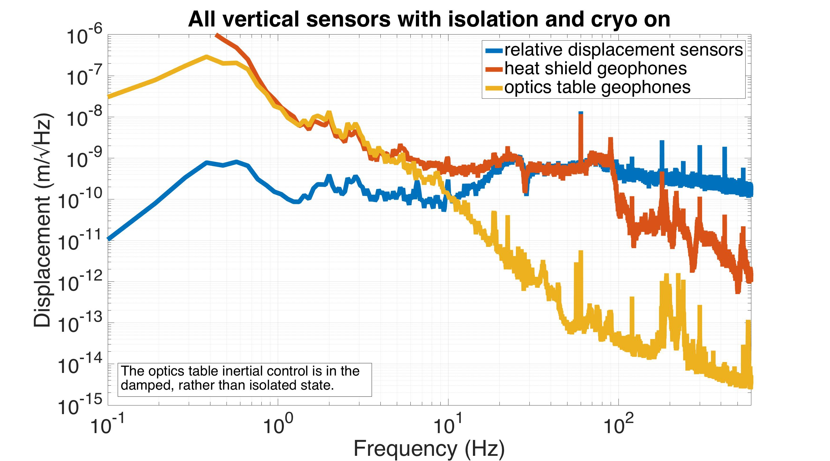
Optics
Table
Heat Shield
Geophones
displacement
sensors
Geophones
Controller
Notes:
The high frequencies follow the displacement sensors.

Slide 23
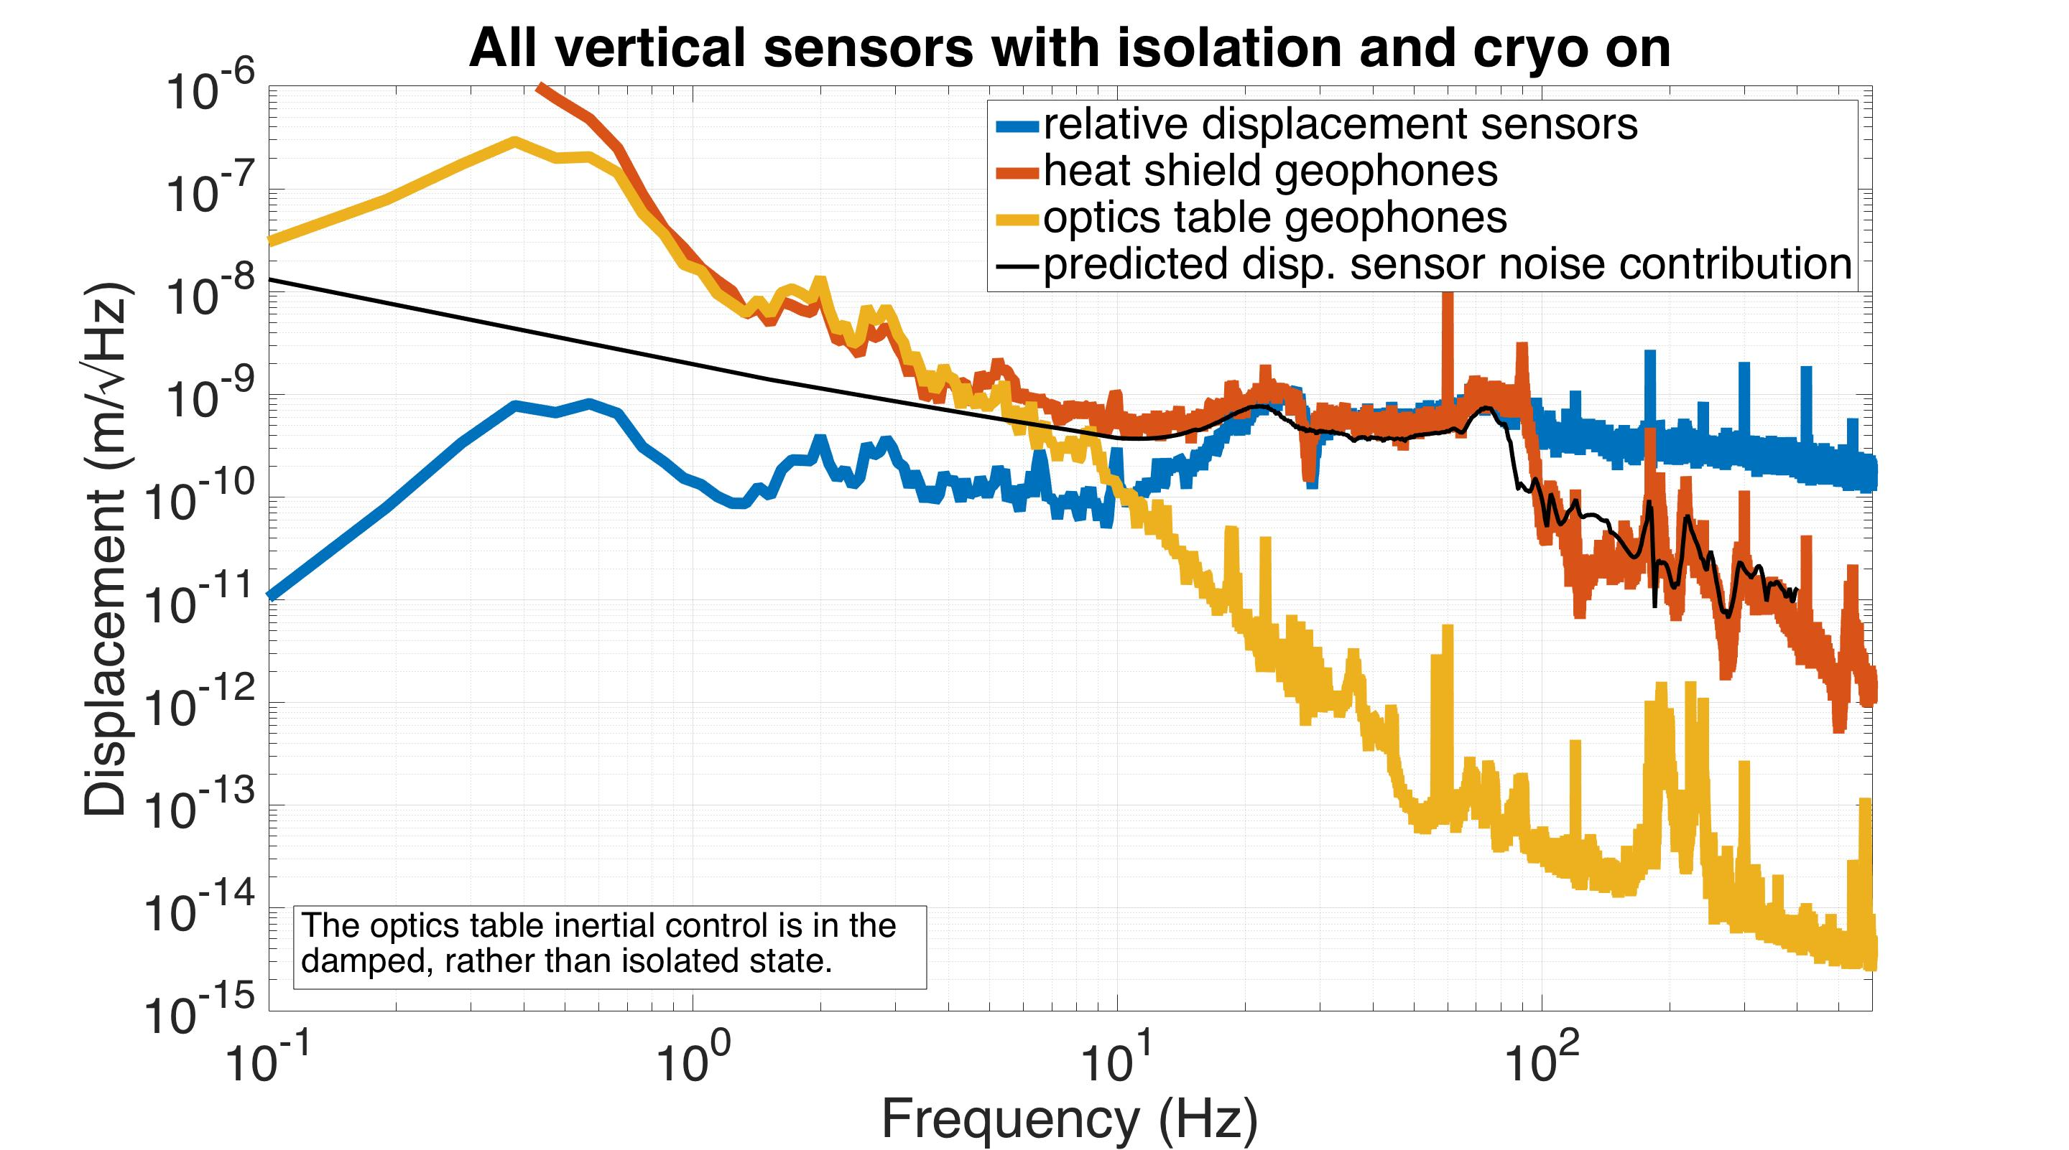
Optics
Table
Heat Shield
Geophones
displacement
sensors
Geophones
Controller
Notes:
Which, if we look closer, is coming all from sensor noise. So if we had better sensors, we could do better. To see if we need to do better, we can take this performance data

Slide 24
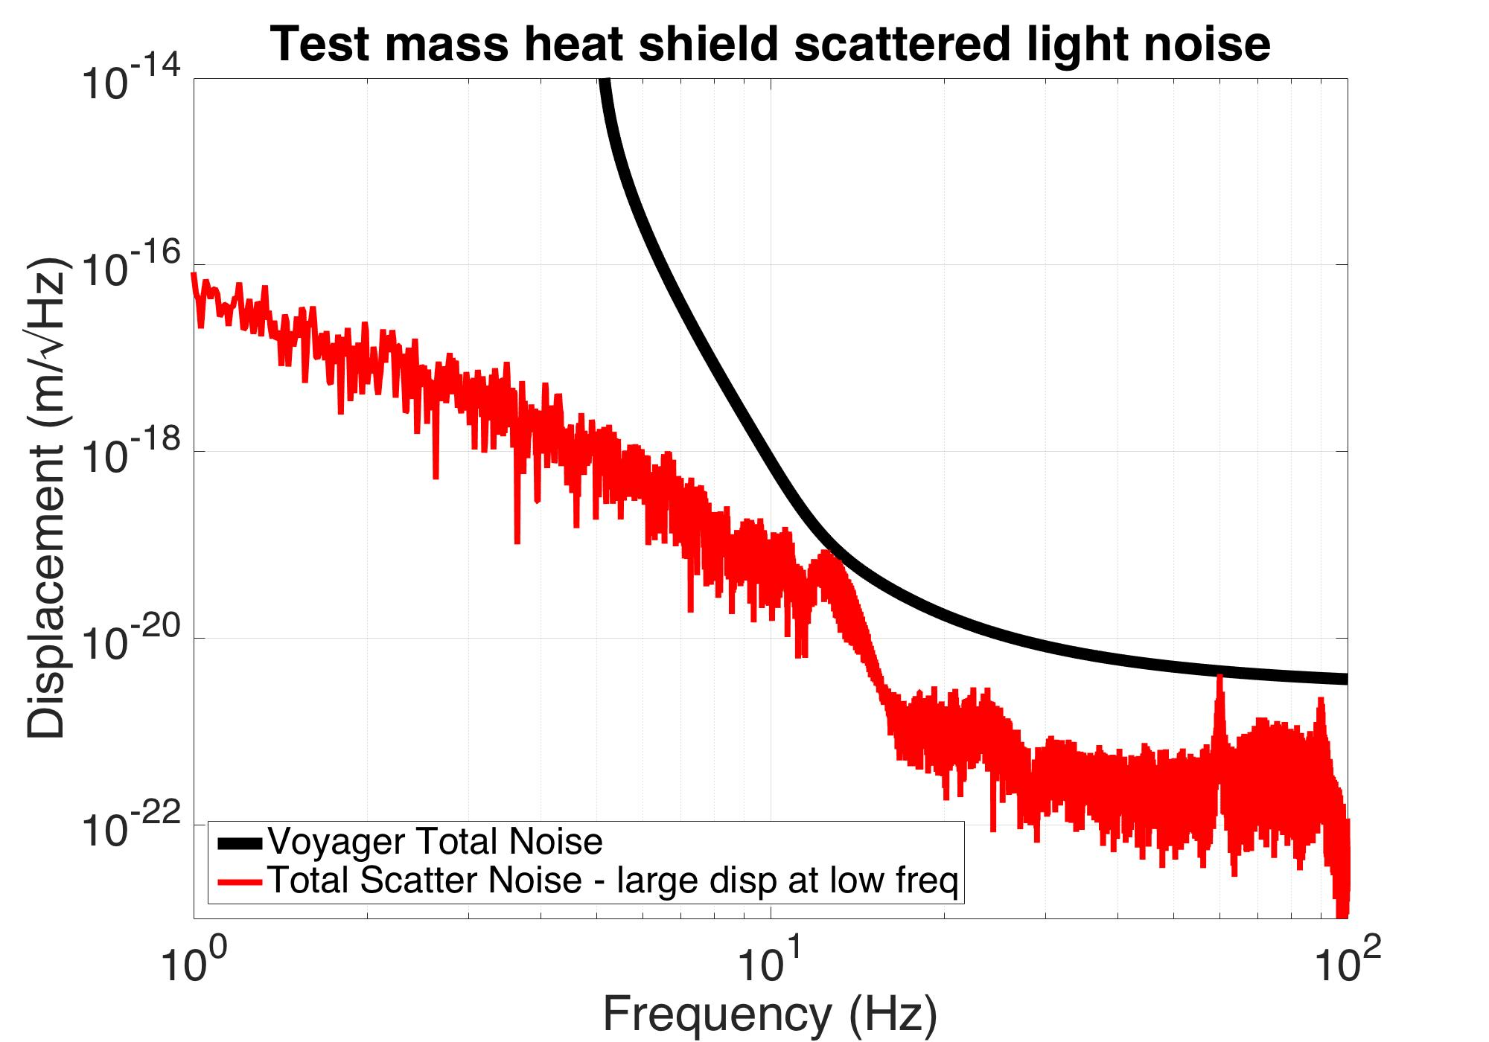
simulation
Notes:
and simulate the scattered light noise it would contribute to a LIGO Voyager interferometer. Here the black curve is the Voyager noise model, red is the simulated scattered light noise based on the previous data. You can see that it’s not too bad. It’s pretty much below at all frequencies except maybe that feature right at 15 Hz. And in fact, you can turn off the heat’s control, and you pretty much get the same thing.

Slide 25
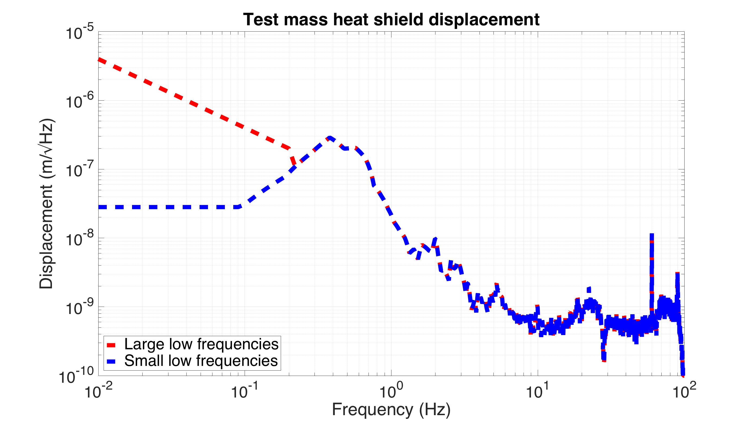
simulation
Notes:
To get an idea of where that 15 Hz feature comes from, I took the measured heat shield data, in red, and just reduced it’s low frequencies down to the blue curve.

Slide 26
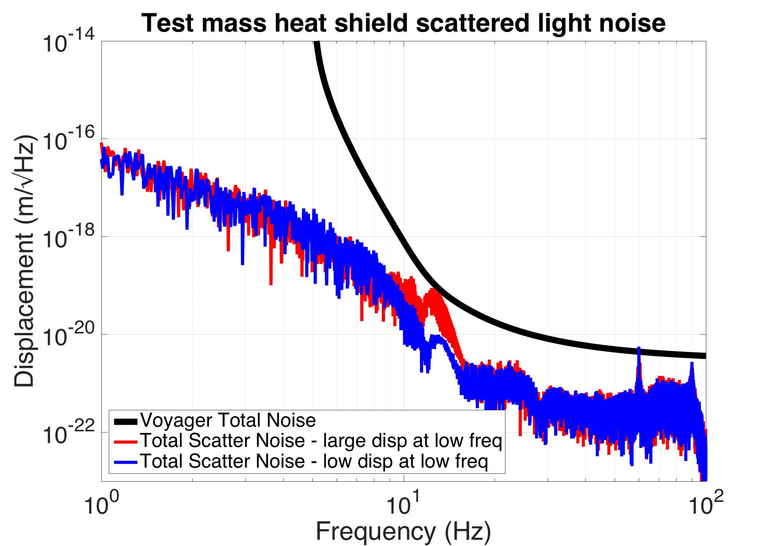
simulation
Notes:
And then that 15 Hz feature goes away. So this suggests, in this setup, if we want to improve the performance, we only need some active isolation at low frequencies. Around the microseism and below.

Slide 27
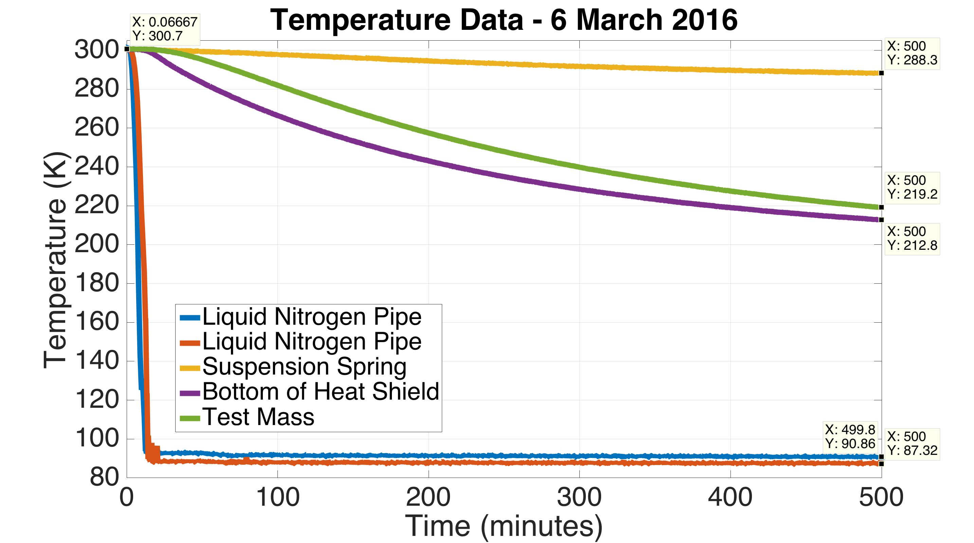
Cool Down Data
Khuri-Yakub
Notes:
The final part of this presentation shows the thermal response of the shield. This data is from the first very first test we did just a week ago. Red and blue show the temperature of the liquid nitrogen pipes. Purple is the heat shield and green is the test mass. Yellow is the blade spring the test mass hangs from. So you can see the test mass follows the heat shield pretty well, which is good. It suggests the shield is doing a good job of being a shield. However it only got down to about 213 K. You can extrapolate with an exponential fit that it would eventually bottom out at 205 K. But we need it to go all the way to 80 K. Also, the suspension spring has dropped 12 degrees, which is quite bad for suspension alignment.

Slide 28
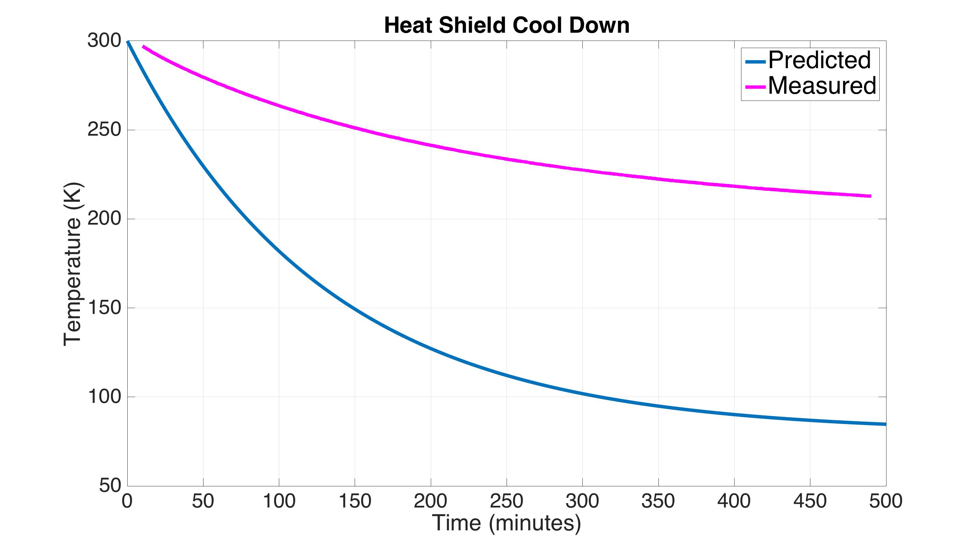
Cool Down Analysis
Notes:
To get an idea of what is happening, you can simulate how what it would look like if there were no heat leaks, and if the thermal conductivity through the copper braids was ideal. This is what is shown in the blue curve. Purple is the measurement from the previous slide. By fitting an exponential to the measurement and comparing these two, you can estimate that the braid conductivity is only about 60% of what it could be, and the heat leak is about 85 W.

Slide 29
Cool Down Analysis
0.1 torr N₂ exchange gas
Estimated conductivity of braids is 60% of the ideal value
Estimated heat load on shield is 85 W (150 W net incident radiation)
Notes:
Some of this could be because we have 0.1 torr N₂ exchange gas in the chamber, in order to help the cool down of the test mass. Maybe its transferring heat from the warm parts of the chamber.

Slide 30
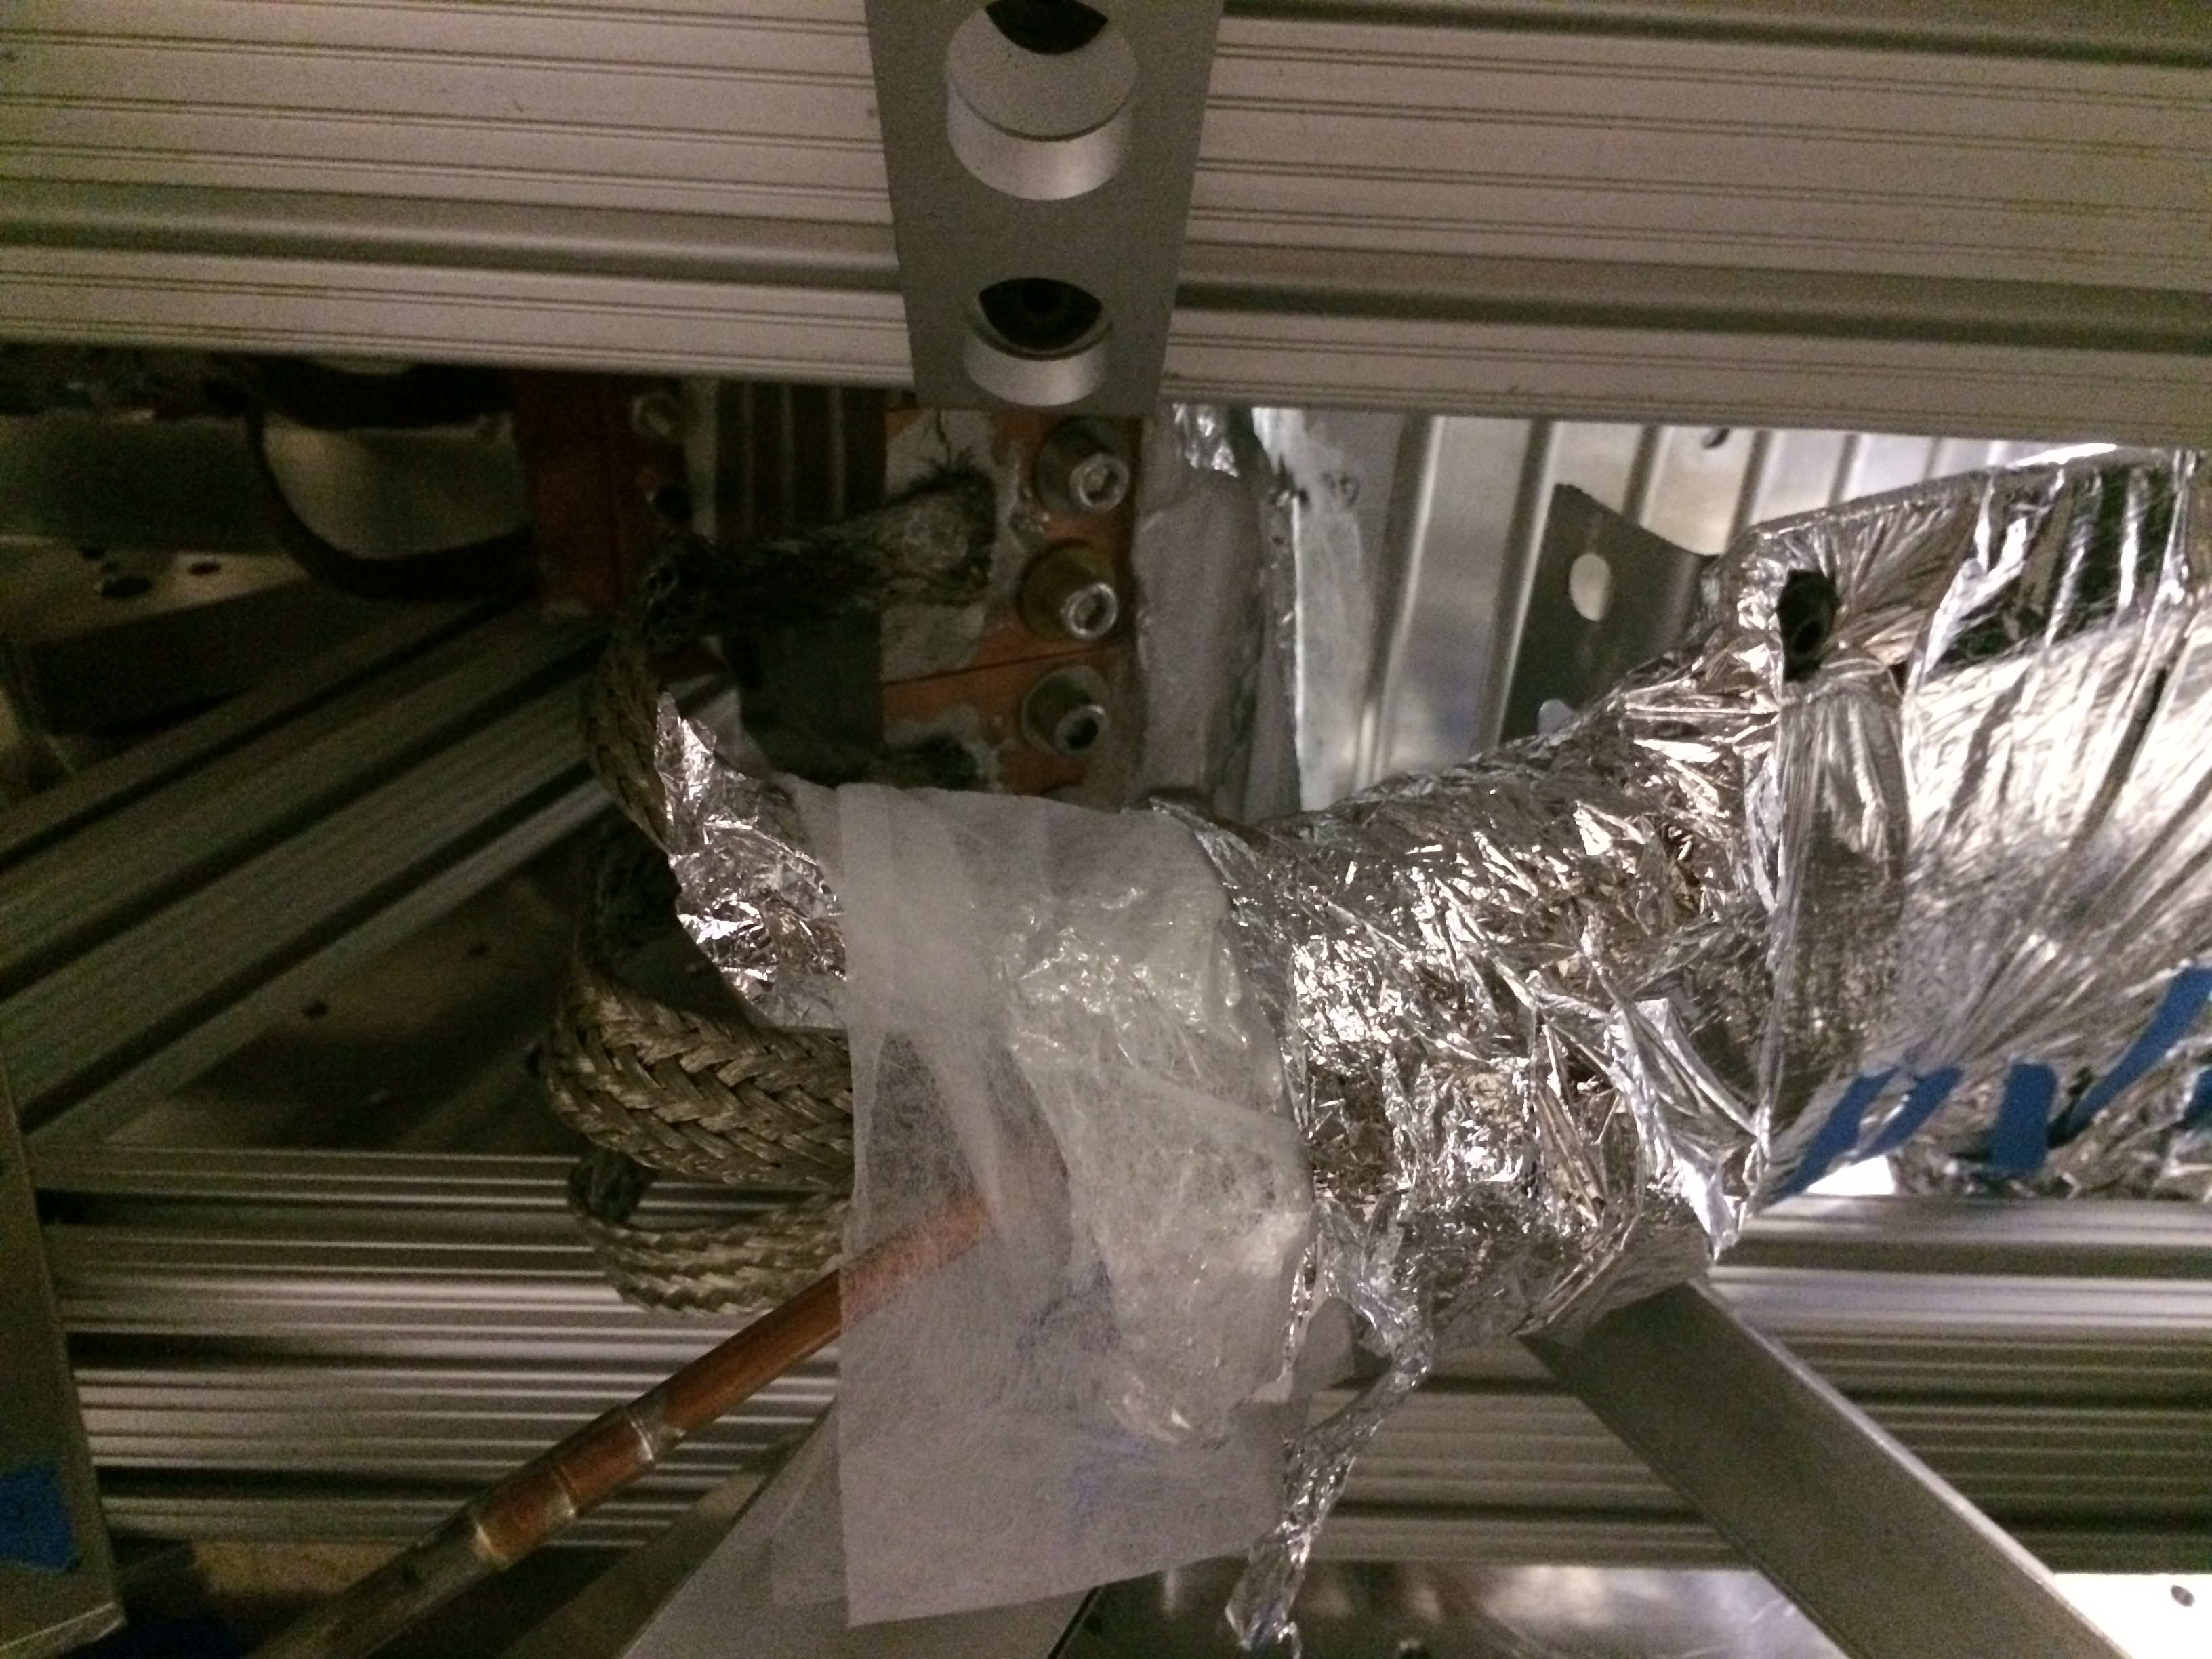
Cold plate
Heat shield
Copper braids
Nitrogen pipe
Notes:
It could also be the connection of the braids to the shield. Here is a photo showing the liquid nitrogen pipe, with the copper braids bolted onto the shield. Bolted joints are known to be problematic for heat transfer. We simply chose them because they’re easy to install, and easy to remove.

Slide 31
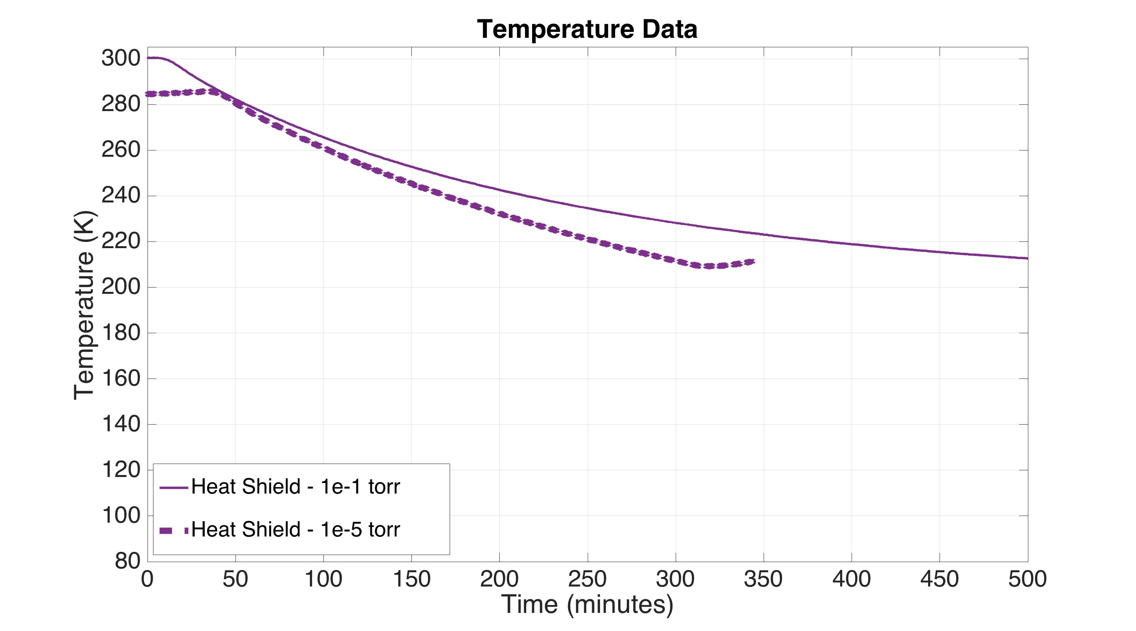
Cool Down Data
Notes:
So I repeated the test at 10^-5 torr, shown by the dashed line, instead of 10^-1, shown by the solid line. I ran out of liquid nitrogen a few hours in, but you can see the heat shield was coming down faster this time.

Slide 32
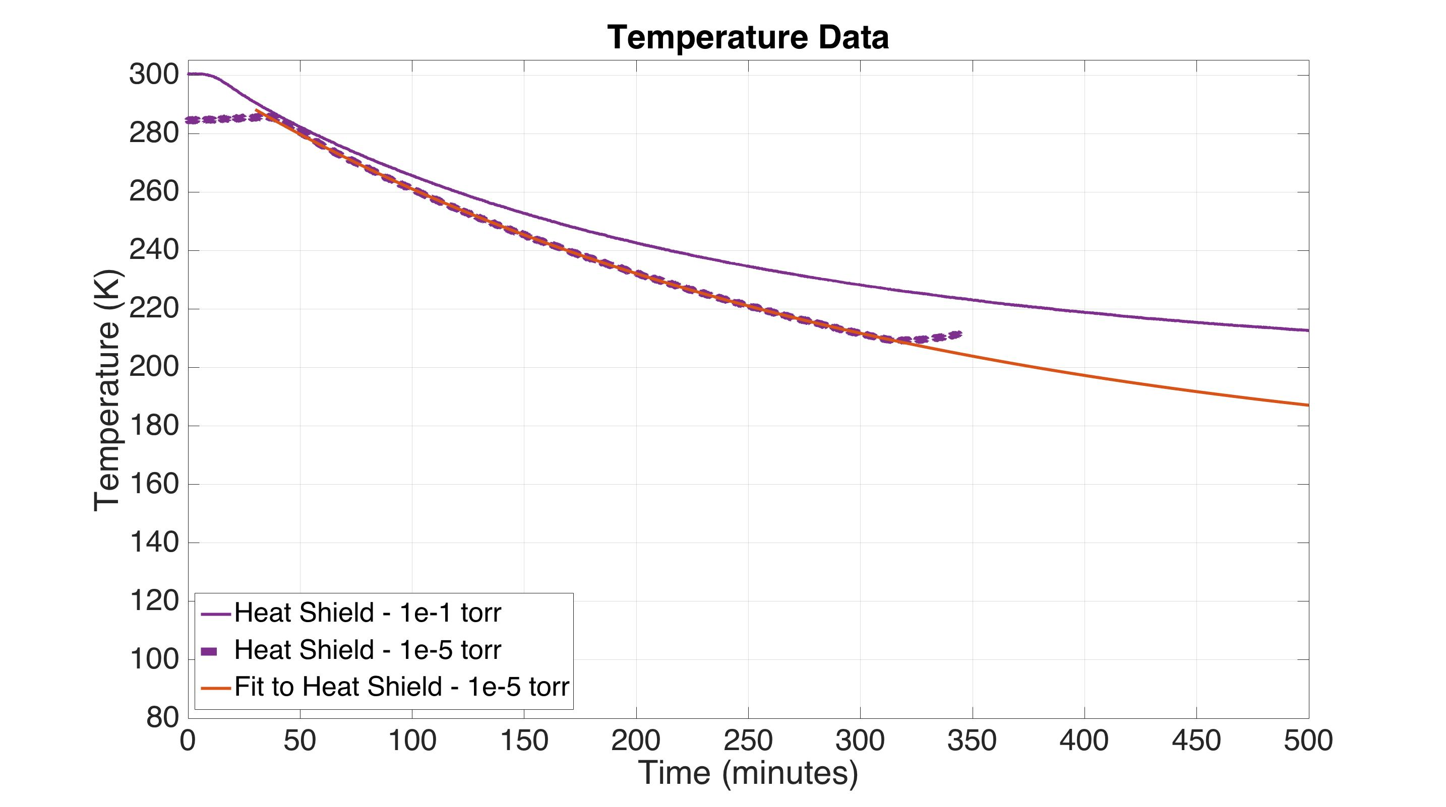
Cool Down Data
Notes:
Then, like before you can fit an exponential to the heat shield measurement, and predict that it would bottom out at about 160 K, which is 40 degrees better than before.

Slide 33
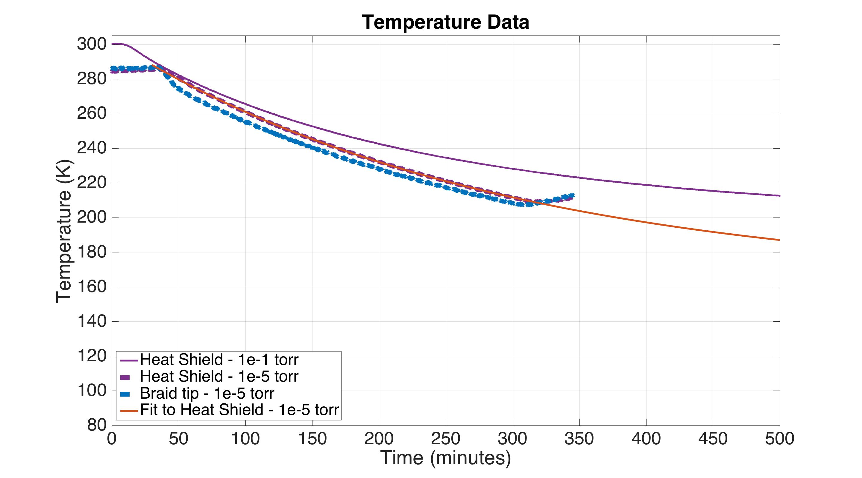
Cool Down Data
Notes:
We also moved one of the temperate sensors to the end of the braid right at the heat shield to see if the bolted joint was contributing a lot of thermal resistance. It turns out it’s not so bad, the temperature is within a few degrees of the shield itself.

Slide 34
Cool Down Data
With less exchange gas
Estimated thermal conductivity falls from 60% to 45%
Estimated heat load falls from 85 W to 40 W
Notes:
We can estimate from this that the heat load has fallen from 85 W to 40 W. Also, the conductivity has fallen a bit, likely because exchange gas helps the conductivity of bolted joints. But overall there is a net win. However, we still have some work to do before we reach 80 K.

Slide 35
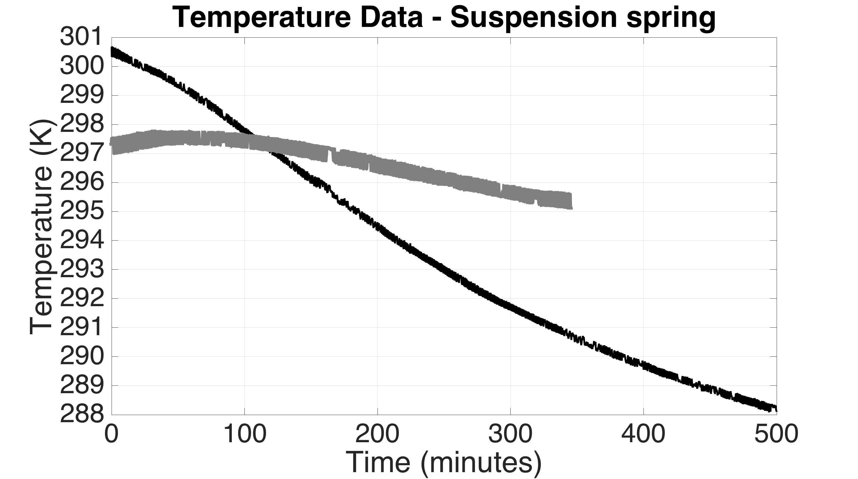
Cool Down Data
Blade spring at 10⁻⁵ torr
Blade spring at 10⁻¹ torr
Notes:
Also, improved by removing the exchange gas, is the suspension spring. It still started dropping in temperature, but now nearly as fast as before.

Slide 36
Conclusions
Learning a lot about how to cool a test mass in a LIGO compatible way.
Still more work to do.
Vibration from the liquid nitrogen is not so bad. These measurements suggest
Maybe only need control at low frequencies
Or, we could be a lot more aggressive with the cryogenics.
Might want to heat the blade springs

Slide 37
Questions?

Slide 38
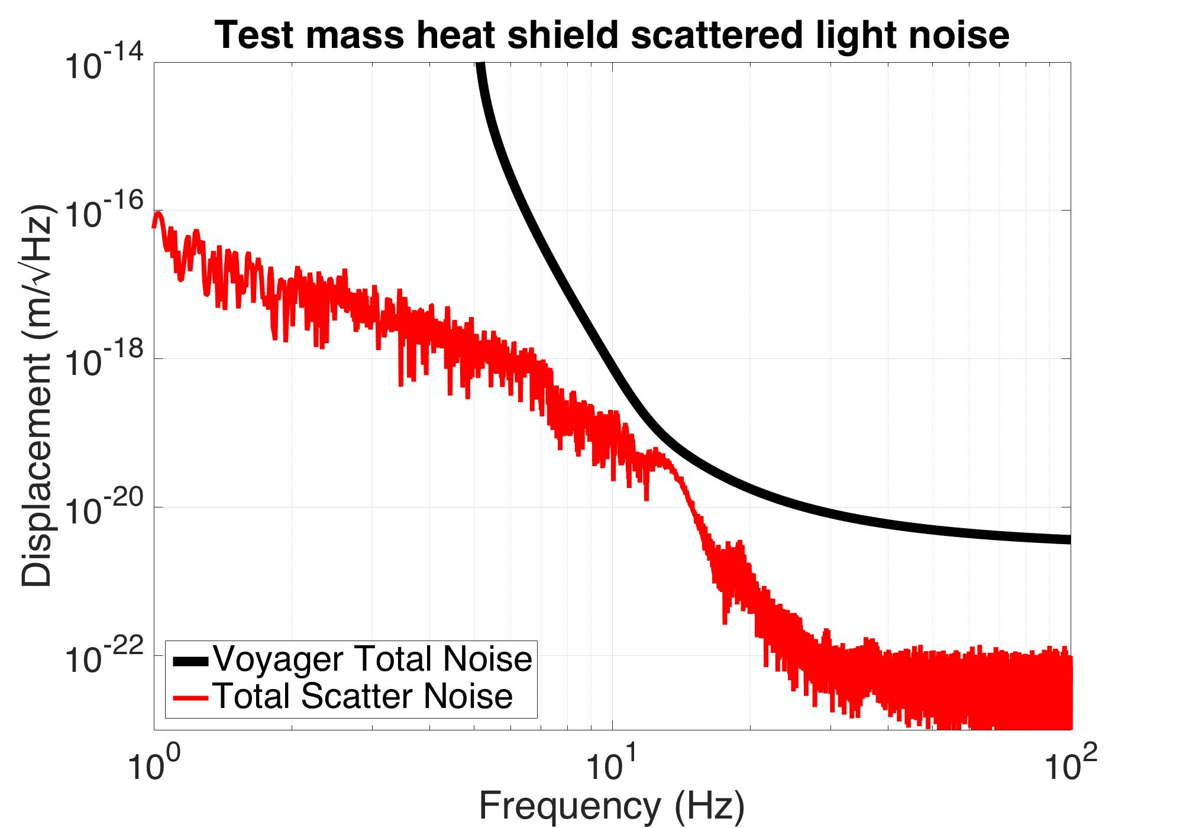
simulation – no isolation control

Slide 39
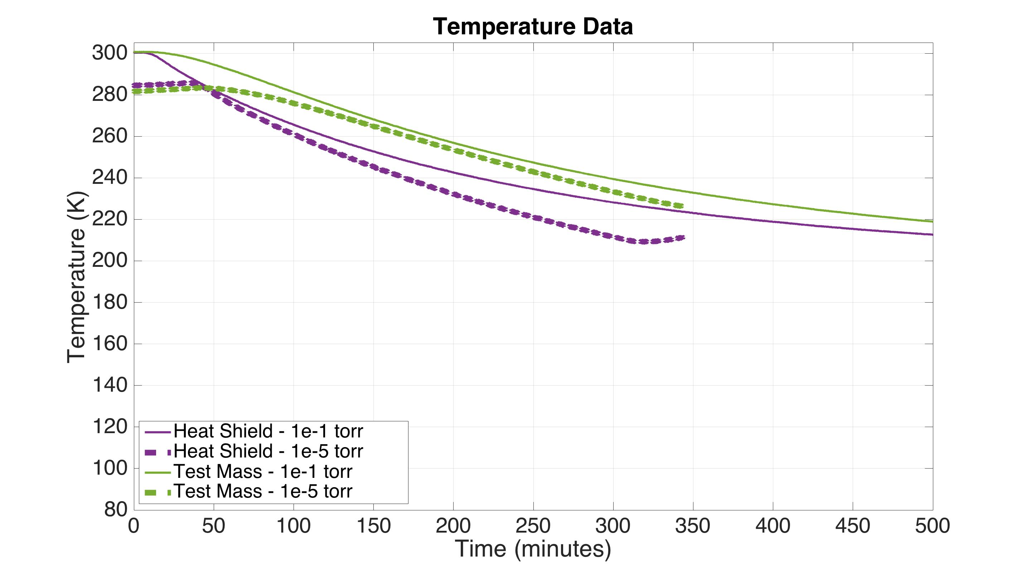
Cool Down Data

Slide 40
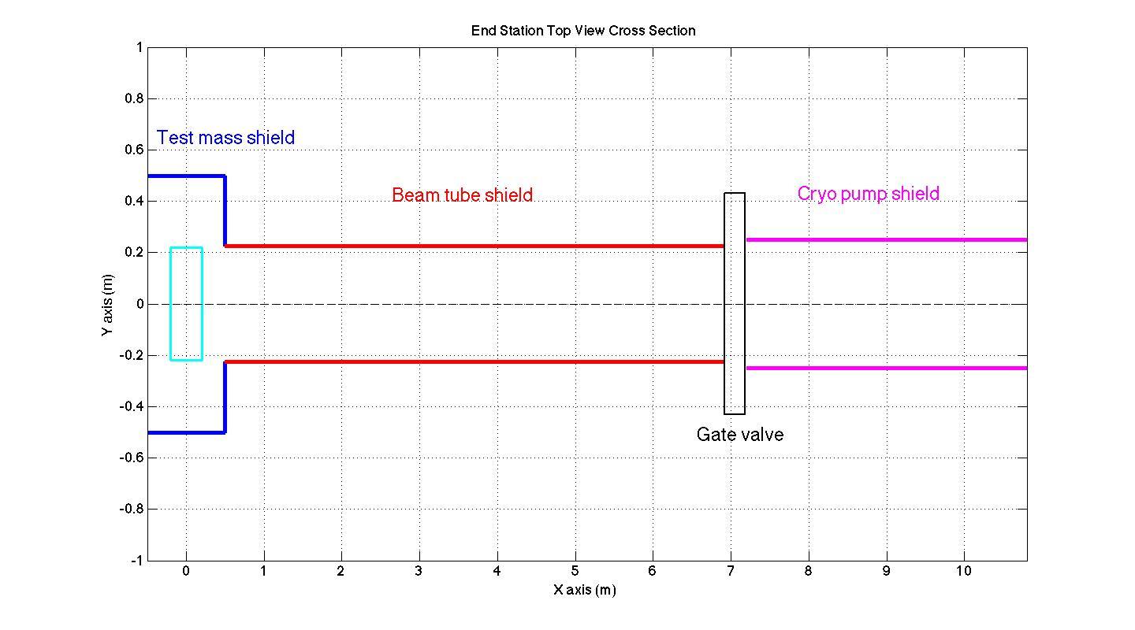
Geometry of heat shields in scattered light simulation

Slide 41
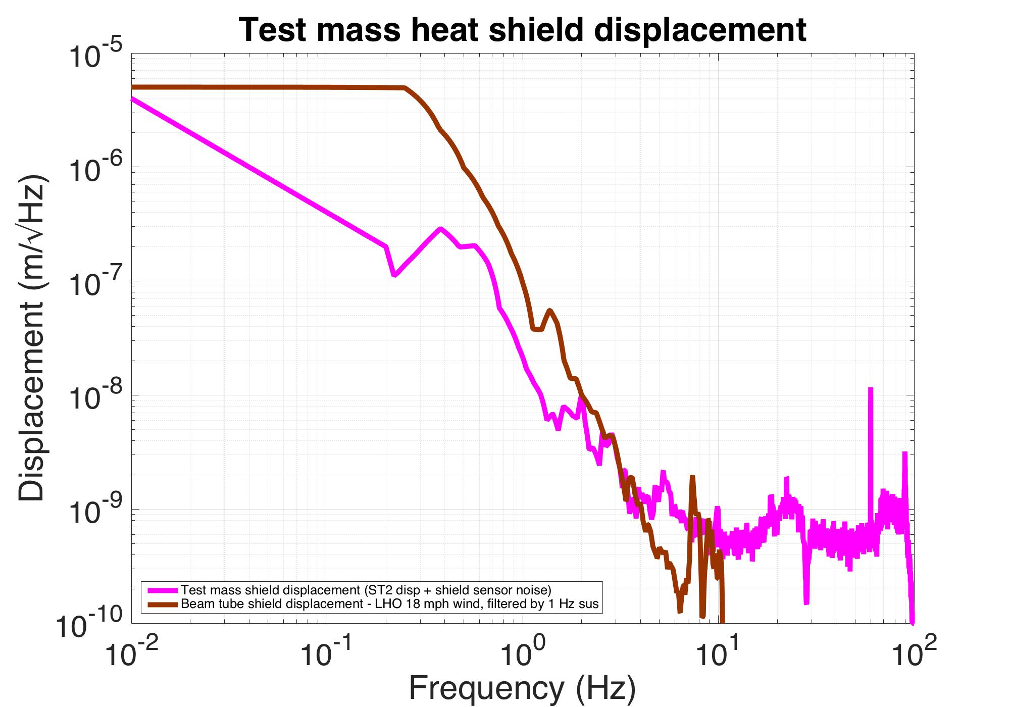

Slide 42
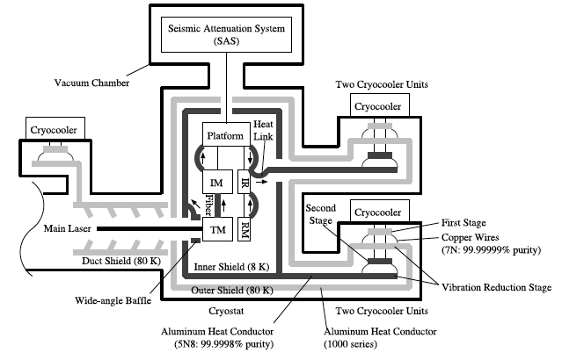
KAGRA Layout
CQG 31 (2014) 224003 – Progress on the cryogenic system fir the KAGRA cryogenic interferometric gravitational wave telescope

Slide 43
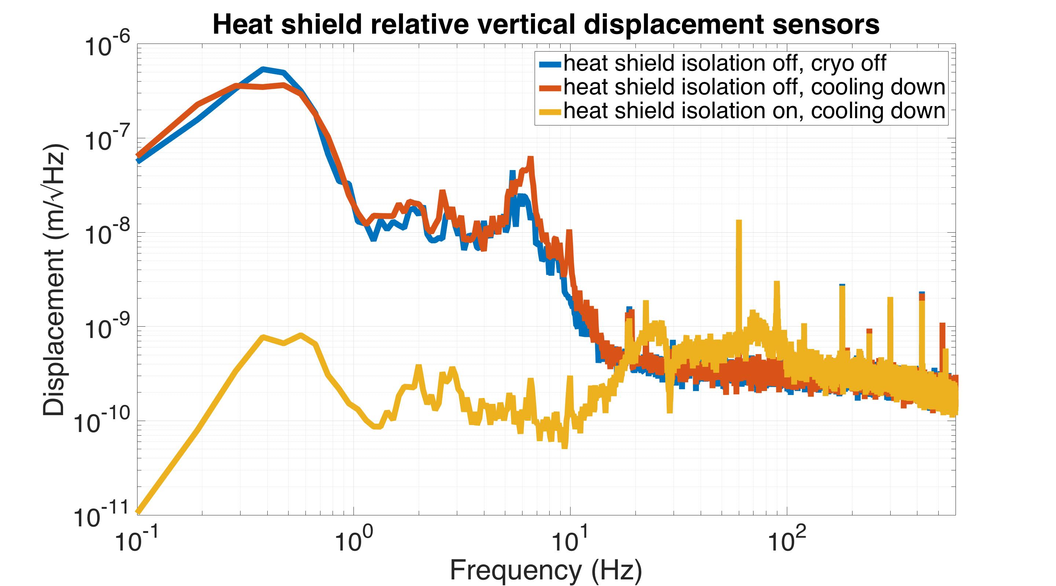
Optics
Table
Heat Shield
relative
displacement sensor

Slide 44
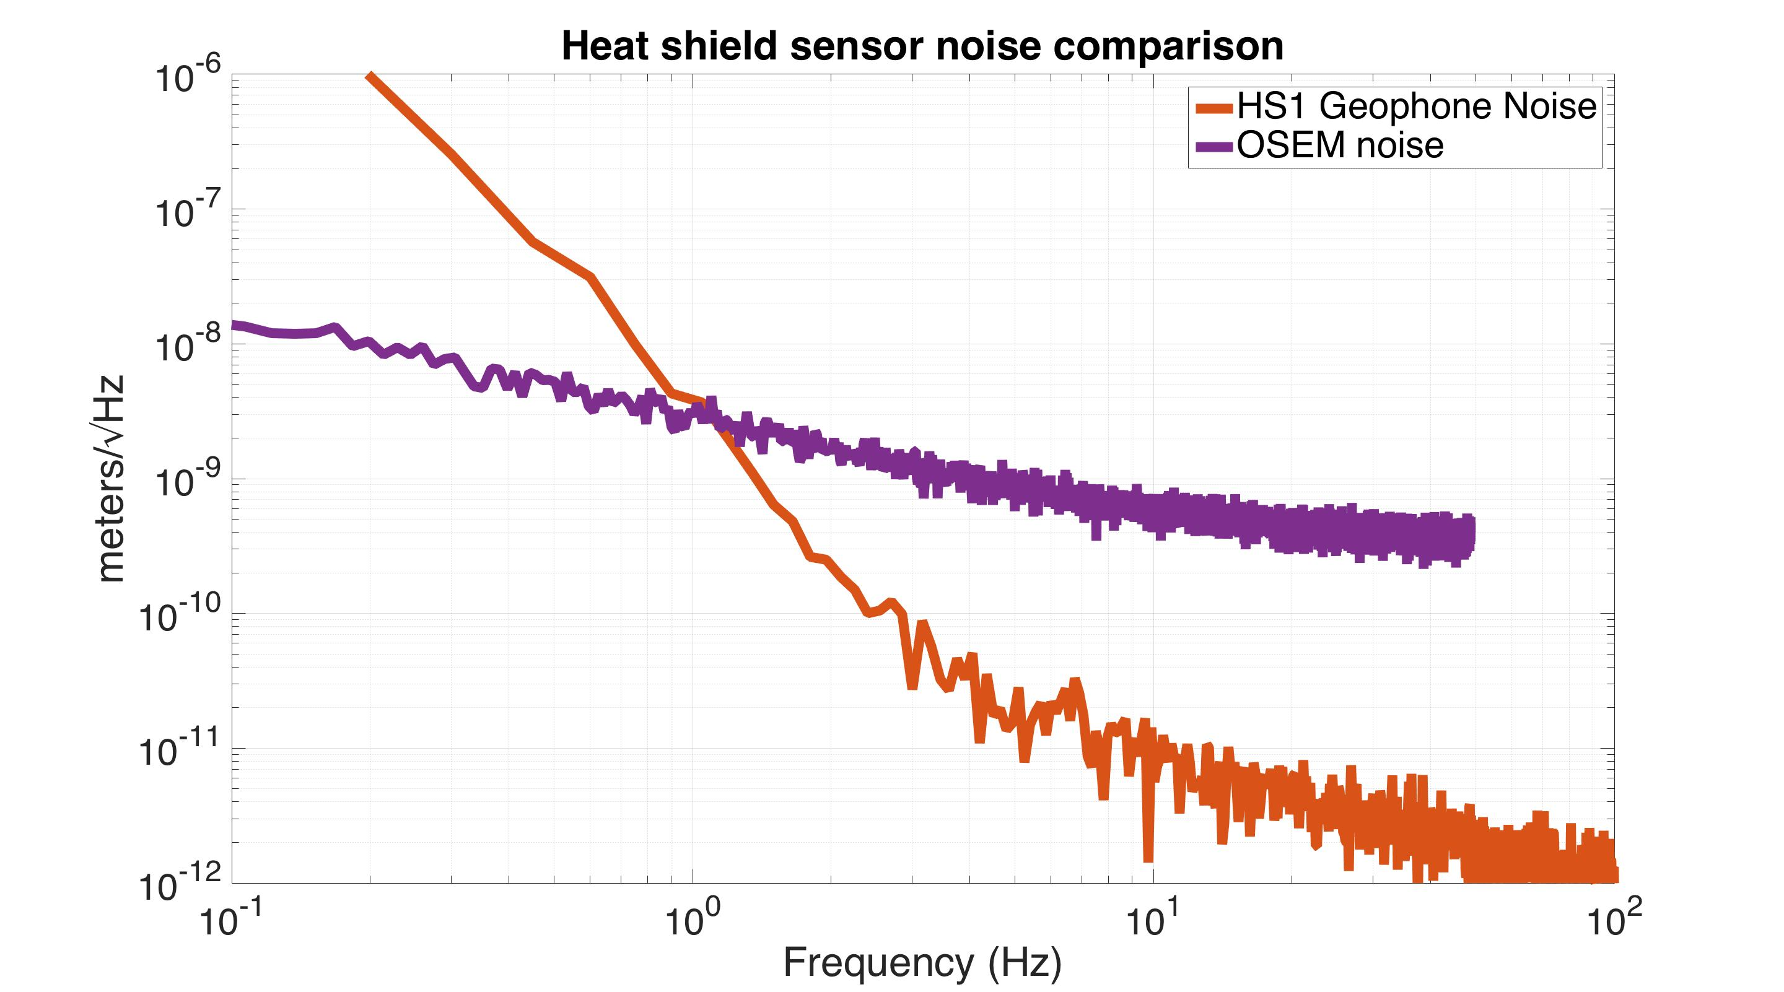

Slide 45
Test mass inside heat shield
Heat shield 80 K
Holes for suspension wires
Cold link for initial cool down
Test mass 124 K

Slide 46
Cu brackets for Cu braids between heat shield and stage 0 cold plates

Slide 47
Aluminum low emissivity plates (ribs boost vibrational frequencies)

Slide 48
Flexible stainless strips attach the heat shield to its (warm) suspended stage

Slide 49
suspension top mass
suspension spring

Slide 50
Vertical suspension OSEMs
Suspension spring mounted to vertical translation stage
The OSEMs monitor vertical drift of the suspension due to temperature changes in the spring
The translation stage engages the test mass with the cold link for the initial cool down

Slide 51
The complete heat shield stage
Geophones
OSEM flag post
Actuator magnets

Slide 52
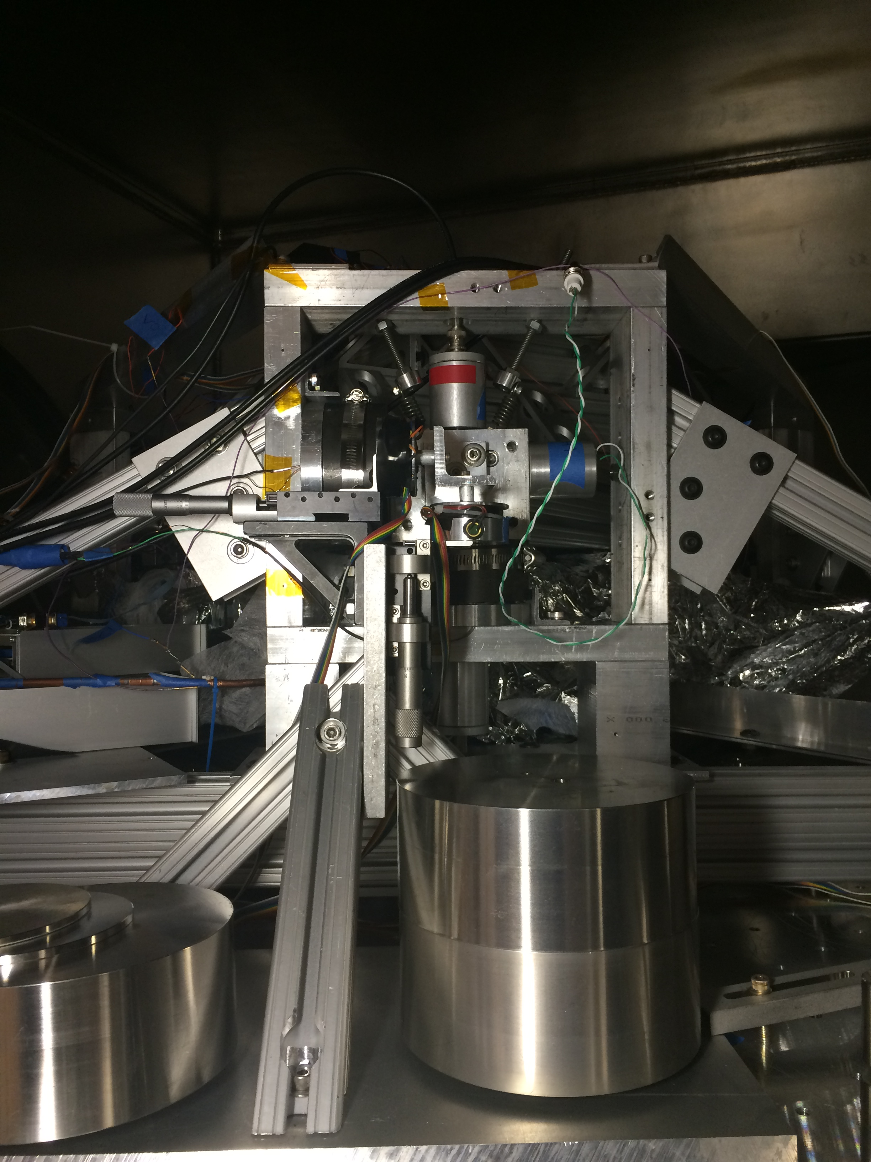
Suspended heat shield platform
Actuator
HS1 geophone
OSEM
stage 0
ISI stage 2

Slide 53
Suspended heat shield stage over Stanford ISI

Slide 54
2 stage HAM-like ISI
Stage 2
Stage 1
Stage 0

Slide 55
ISI with stage 0 mounting structure for heat shield over stage 2
Mounting Structure
Stage 2
Stage 1
Stage 0

Slide 56
Mounting structure with cryogenic cold plates
Cold plates (80 K)

Slide 57
Suspended heat shield stage hanging from mounting structure
Heat shield stage
Heat shield
Geophone witness sensors measure heat shield inertial motion
Coil/magnet actuators between stage 0 mounting structure and the suspended heat shield stage

Slide 58
OSEM feedback forces the heat shield to follow stage 2
OSEM
mount
OSEMs measure relative displacement between heat shield and stage 2

Slide 59
Future cryogenic beam tube shield

