Slide 1
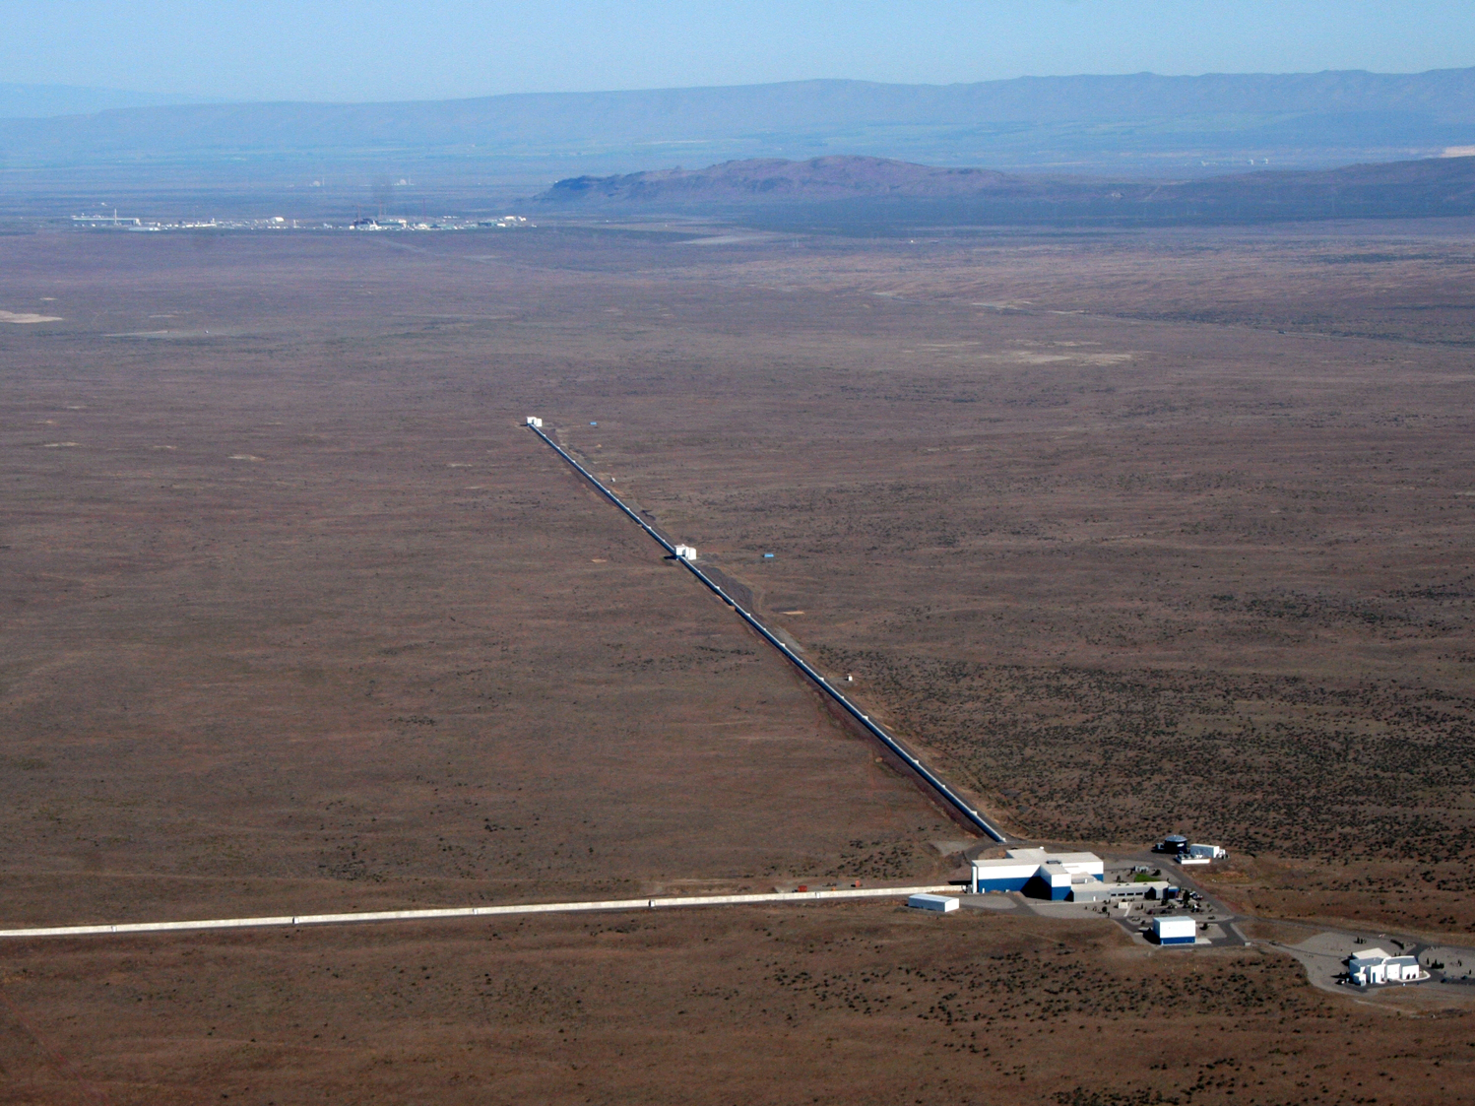

LIGO Roadmap Musing
David Shoemaker, MIT LIGO Laboratory
For Joint ET/LIGO future
Meeting, February 2016
1
LIGO G1600194-v1

Slide 2
Questions
a) What are the current instrument timelines for initial operation and incremental upgrades
b) What plausible timelines do we see for major observatories in the US and in Europe
c) What are the key questions that need to be pursued to firm up timelines
d) what are the next actions in this domain?

Slide 3
Credits and Caveats
Thoughts on roadmaps for LIGO detectors have been discussed many times in many places
Draws from work by many; Mike Zucker just talked to this issue in the Lab; Dennis Coyne and Erik Gustafson have worked some on ‘Voyager’ cost and schedule; Paper by Miller et alia; cover slide stolen from Dave
No consensus represented by my slides! Just things I thought useful for discussion.
  (i.e., expect a lively set of critiques and questions from LIGO folk!)

Slide 4
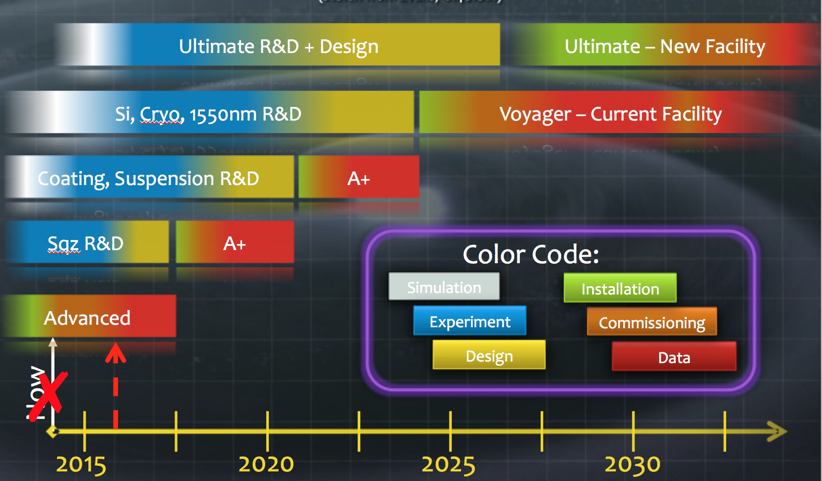
Recycling (of slides, that is):
A rough timeline to critique
(stolen from Evans, G1401081)

Slide 5
aLIGO Timeline – an existence proof
1990’s: very active R&D and table-top demonstrations
1999: white paper with a conceptual design, a few important open questions (test mass material, laser technology); Lab cost and schedule estimate
1999: NSF acknowledges that this is a feasible plan and they support it being developed into a proposal
2000-2005: larger scale prototypes, ‘v0.8’ style prototypes
2003: Proposal formally submitted to the NSF (final approval in 2007)
2005-2010: preliminary designs, some final designs
Meet NSB start criteria: Initial LIGO at design sensitivity, one year run
2008: funding starts for Advanced LIGO Project
2014: Project complete
2015: Two detectors functioning at 1/3 final sensitivity, ~50% joint uptime
From 1995 to 2015: 20 years
If we are e.g., at the ‘1995’ level of maturity for 3rd gen….could guess 2036.

Slide 6
(new) NSF process for Projects
Has become more complex than it was for aLIGO
Much more NSF participation
E.g., management of
reviews
Can expect to continue to see milestones presented as prerequisites to moving forward

Slide 7
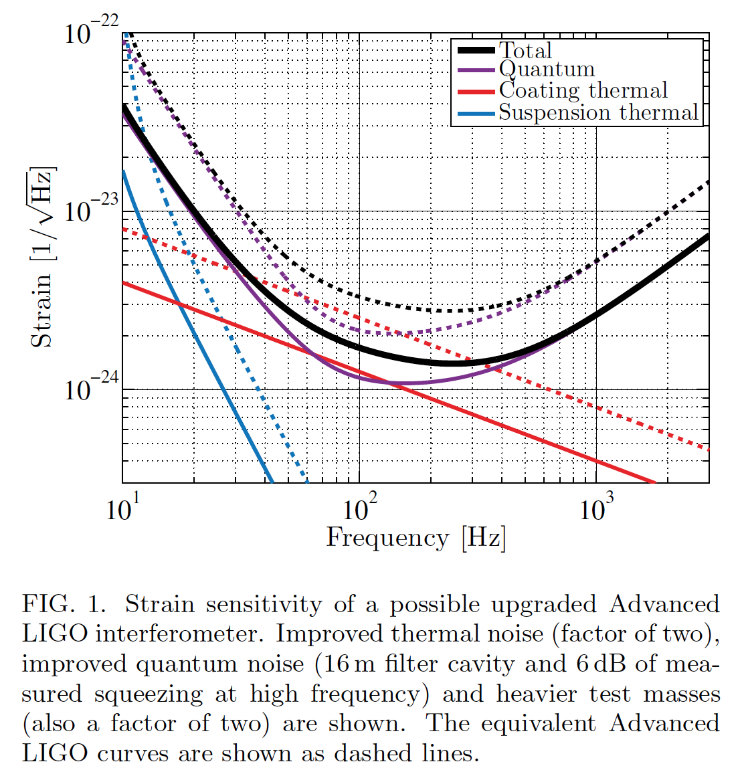
aLIGO Upgrades: +, ++, +++…
‘modest’ cost, ‘modest’ downtime
Fixing whatever is limiting the sensitivity at this time!
Use of squeezed Light
  Frequency independent ~now
  Frequency dependent – possibly between O2-O3
Tiltmeters; NN/seismic feed-forward array
Vertical/roll damping; additional vertical springs here and there
Installation of ‘better’ mirrors
  Lower loss, scatter
  Lower thermal noise
Increasing mirror mass,
Extending suspension length
(ok, not so modest…)
…clearly can keep busy till 2025

Slide 8
Voyager scale Upgrade
Some approach to another step up; several concepts in discussion
Dennis Coyne and Eric Gustafson made an educated guess for the cost and time required for a Cryogenic, Silicon, Voyager-style instrument for the current LIGO facilities, and re-using what one can
Extrapolated from the aLIGO experience for both cost and time.
Costs: ~$100M, using US accounting
Timing with hopes for start dates and resignation for the later pace:
  End-2016 NSF review of Concept, NSF go-ahead mid-2017
  Design through PDR, Construction proposal to NSF end 2019
  Construction award end of 2021 (if …)
  3 years Fabrication,
  2 years installation ~4 years with
  1 year integration no observation
  Commissioning begins at the end of 2027
What’s the science lifetime of this upgrade? 10 years? That determines…:
  When do we want to see an ET/LUNGO operating?

Slide 9
Tensions in the Cold Voyager path
Time down for a given observatory
  Have to assume we do a staged upgrade of the instruments, with the other partners in the network continuing observations
  What scale of upgrade in the ‘Voyager’ epoch will be well motivated in terms of the science and the downtime?
Time to first observation
  First guess for a cryogenic Voyager Observing Run is ~2028
  Will the ‘Advanced+++’ detectors be interesting until then?
Quasi-parallel or slightly time-shifted request for ~$10⁸ and ~$10⁹
  Is there a community to support this pair of investments?
  Is there an optimization of draws from the bank in terms of timing?
  Is a $10% ‘prototype’ a good investment to control final costs?
Can it be better to skip the ‘cold Voyager’ phase?
  Can we find more ‘modest’ upgrades with ‘modest’ downtime?
  Science Objective: Bring in the earliest readiness date for an ET/LUNGO scale observatory, reduce downtime
  Funding Objective: Decrease sum of draws from funding agencies

Slide 10
LIGO Lab thoughts on 3rd gen
Starting to talk (Mike Z) about how to make real substantive progress
  The ET study really brought the European effort forward; emulate this
  Can’t be done in ‘spare time’ with ‘spare people’
May apply to the NSF for supplemental funding for this domain
Proposal elements of a ~3 year plan might be this sort of mix:
  Voyager design study
  LUNGO design study
  Amorphous Si coatings, Crystal coatings
  40m conversion → 2 µm, Si
  LASTI cryo test
  Si optics & lasers
Proposal Objectives:
  Science motivation, conceptual designs, engineering & cost frameworks for aLIGO+, Voyager and CX/LUNGO/ET
  Directed R&D to resolve strategic issues and inform designs
  Systems-level integrated design and trade studies
  Systems-level integrated testing of critical technologies

Slide 11
Timeline for a US great observatory, with a Voyager-scale upgrade in series
Can’t do much better at this time than copy-and-paste the timeline for Voyager, pushed out some number of years and stretched to account for:
  Civil construction
  Overall scale and need to establish the project in the funding process
Need to have a compelling argument; N.B.: our scientific results, and #(astronomy customers), grow with time to motivate a ~$bn expense
Guess we need to show success with a Voyager-class upgrade, so no construction before ~2030, but everything can be ready including designs
  I have confidence R&D can deliver by then
So, Timing:
  End-2026 NSF review of Concept, NSF go-ahead mid-2027
  Design through PDR, Construction proposal to NSF end 2028
  Construction award end of 2030 (if )
  3 years Fabrication – here in parallel with Civil Construction
  2 years installation
  1 year integration
  Commissioning begins at the end of 2037 – 10 years after a Voyager

Slide 12
Timeline for a US great observatory, no Voyager-scale upgrade in series
Same point of departure for Great Observatory project duration
Again, Need to have a compelling argument – our data, and astronomy customers, grow with time to motivate a ~$bn expense; can we achieve that without a Voyager-scale instrument and resulting data?
Timing w/out Voyager may be limited by our instrument R&D bearing fruit, full-scale prototype tests, and the like; guess 6 years from ~ now
So, Timing, pulled in without a Cold Voyager in series:
  End-2022 NSF review of Concept, NSF go-ahead mid-2023
  Commissioning of new Observatory begins at the end of 2033
  ~4 years earlier without a Cold Voyager, but so much guesswork….
The naïve aLIGO extrapolation suggested 2036 if we start now
  The uncertainty in the dates is greater than the difference with/without Voyager; probably is sooner without the change in wavelength and cryogenics if funding is adequately motivated by the science to date

Slide 13
Questions, answers, questions…
a) What are the current instrument timelines for initial operation and incremental upgrades
  No new information – we believe we can improve the aLIGO (and AdV) performance substantially (x2) with modest funds
b) What plausible timelines do we see for major observatories in the US and in Europe
  Some guesses offered in these slides
c) What are the key questions that need to be pursued to firm up timelines
  Do we pursue a cold-Voyager-class upgrade? Can we satisfy our science customers until 2034 with only modest improvements ($10-$30M) and small down-time per ifo?

Slide 14
Questions, answers, questions…
d) What are the next actions in this domain?
  Resolve the intermediate-upgrade scenario from a science perspective – not urgent, but ultimately important
  Seek feedback from funding agencies and non-GW community: What results from the field will be required to make a ~$bn investment compelling?
  (I think we can make the technology in time)
  Ask ourselves: When can we deliver those results?
  Sets date for start of bulk funding
  Start working as a global team with near-term deadlines; whether we make 1,2, or 3 Great observatories, and if they are identical or not, we’ll get more support from the community and the funding agencies this way

Slide 15
Recycling (of slides, that is):
A rough timeline to critique
(stolen from Evans, G1401081)

