Slide 1



White Light Cavity Ideas and
General Sensitivity Limits
G1500730
Haixing Miao
University of Birmingham
Summarizing researches by several LSC groups
GWADW 2015, Alaska

Slide 2
Outline
Mizuno Limit
Shot-noise-limited sensitivity and signal recycling
A limit on peak sensitivity and bandwidth
Approaches for Surpassing Mizuno Limit
Peak-sensitivity-oriented: external/internal squeezing
Bandwidth-oriented: white-light-cavity ideas
An overview of key issues for future upgrades
Fundamental Quantum Limit
A limit beyond the Standard Quantum Limit and Mizuno Limit
Some implications for configuration studies in future
GWADW 2015, Alaska
0

Slide 3
Outline
Mizuno Limit
Shot-noise-limited sensitivity and signal recycling
A limit on peak sensitivity and bandwidth
Approaches for Surpassing Mizuno Limit
Peak-sensitivity-oriented: external/internal squeezing
Bandwidth-oriented: white-light-cavity ideas
An overview of key issues for future upgrades
Fundamental Quantum Limit
A limit beyond the Standard Quantum Limit and Mizuno Limit
Some implications for configuration studies in future
GWADW 2015, Alaska
1

Slide 4
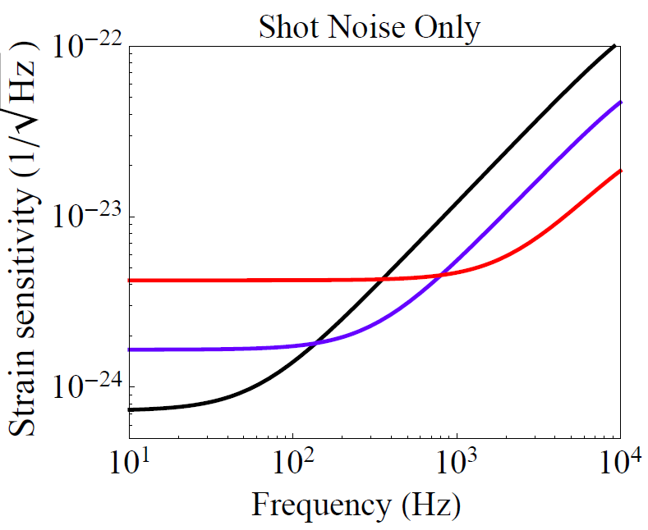
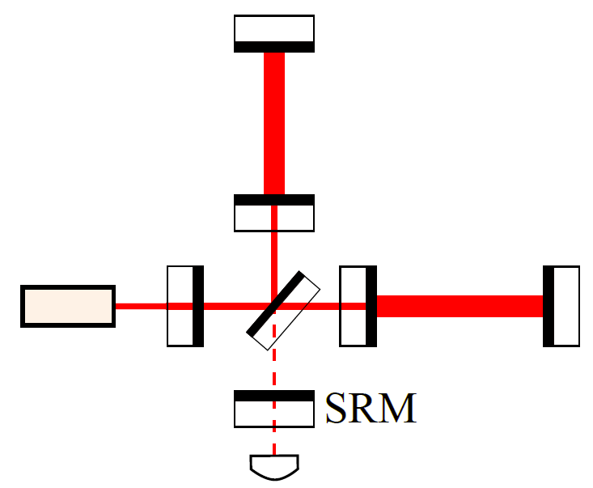
Mizuno Limit
Shot-noise-limited sensitivity and signal recycling:
Given different
SRM
reflectivity
GWADW 2015, Alaska
2

Slide 5

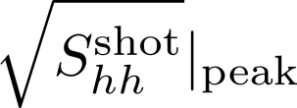

Mizuno Limit
Shot-noise-limited sensitivity and signal recycling:
Given different
SRM
reflectivity
A limit on peak sensitivity and bandwidth product:
Order-of-magnitude:
GWADW 2015, Alaska
2

Slide 6
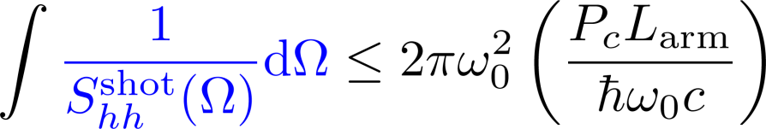
Mizuno Limit
Shot-noise-limited sensitivity and signal recycling:
Given different
SRM
reflectivity
A limit on peak sensitivity and bandwidth product:
Order-of-magnitude:
Only depends
on power and
arm length.
More precisely:
GWADW 2015, Alaska
2

Slide 7
Outline
Mizuno Limit
Shot-noise-limited sensitivity and signal recycling
A limit on peak sensitivity and bandwidth
Approaches for Surpassing Mizuno Limit
Peak-sensitivity-oriented: external/internal squeezing
Bandwidth-oriented: white-light-cavity ideas
An overview of key issues for future upgrades
Fundamental Quantum Limit
A limit beyond the Standard Quantum Limit and Mizuno Limit
Some implications for configuration studies in future
GWADW 2015, Alaska
3

Slide 8
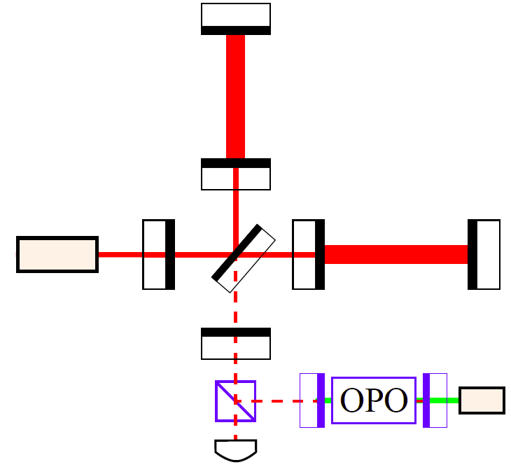
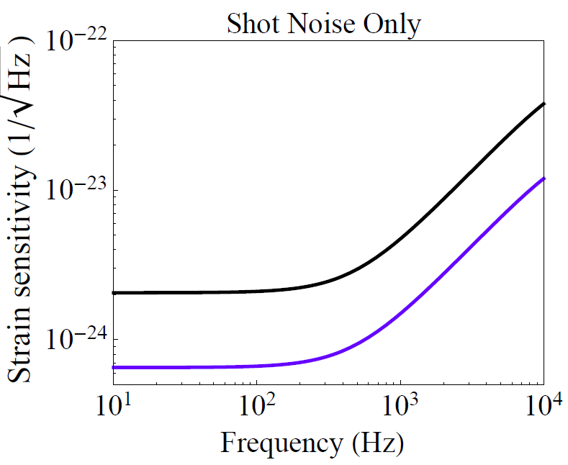

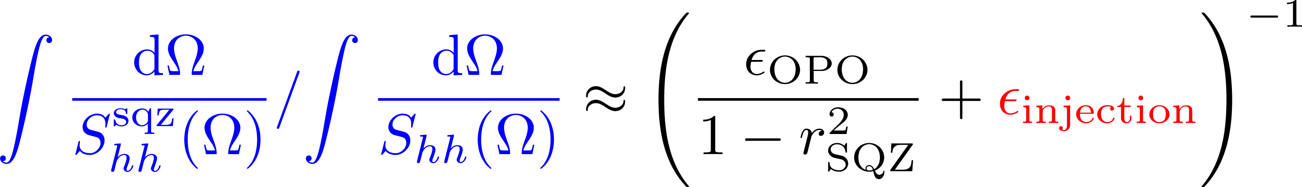
Approaches for Surpassing Mizuno Limit
Peak-sensitivity oriented: external squeezing
Faraday
Challenge: optical loss of injection path
Max Mizuno
beating factor:
GWADW 2015, Alaska
4

Slide 9
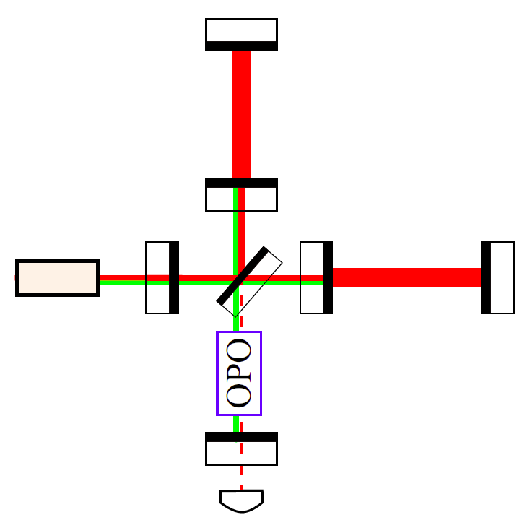
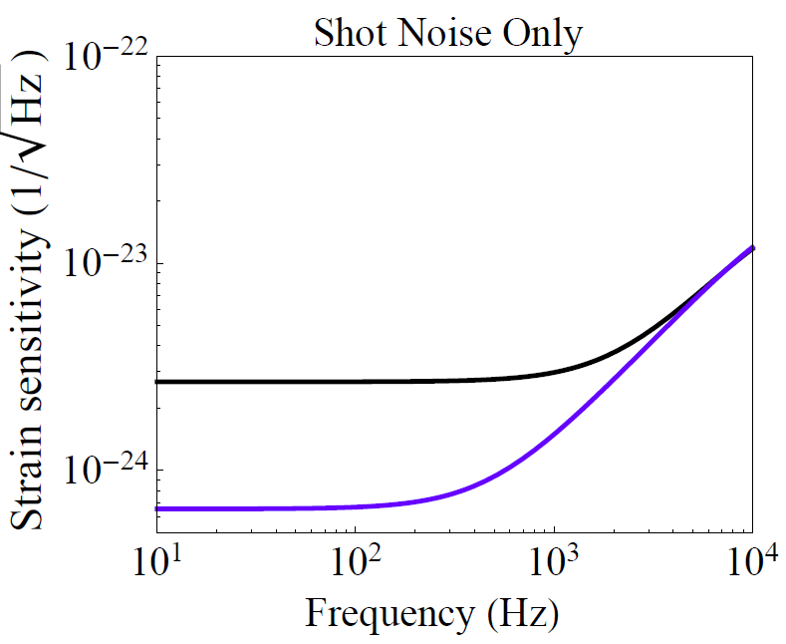


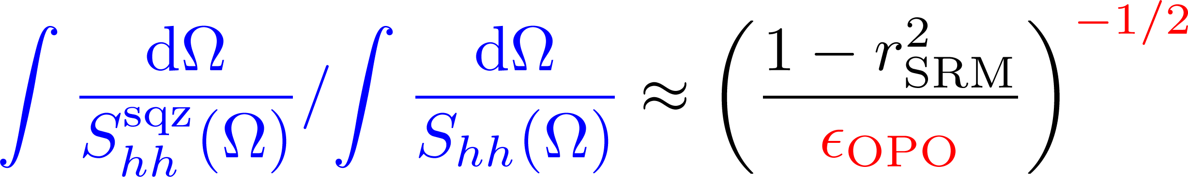
Approaches for Surpassing Mizuno Limit
Peak-sensitivity oriented: internal squeezing
Challenge : optical loss of the nonlinear crystal
Max Mizuno
beating factor:
Reference: Mikhail Korobko & Roman Schnabel et al., in preparation
GWADW 2015, Alaska
5

Slide 10
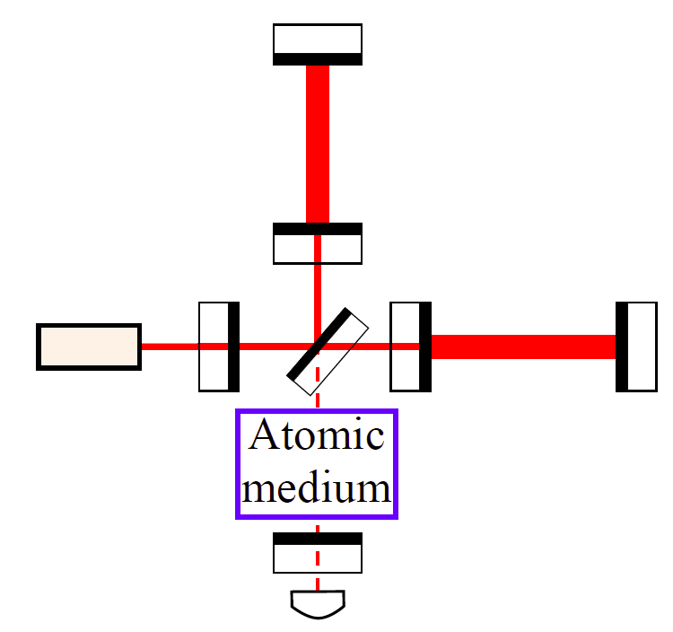
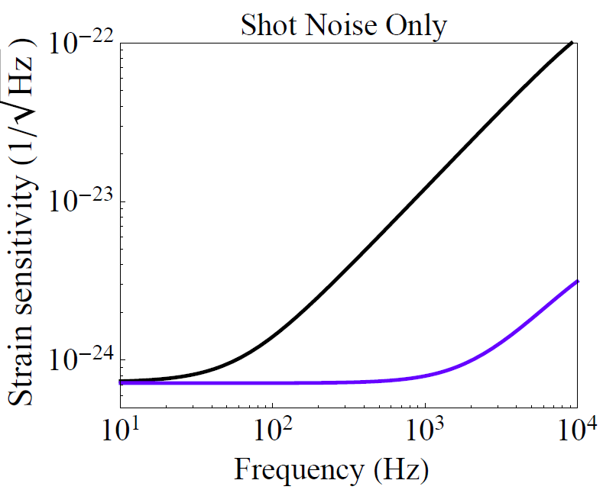
Approaches for Surpassing Mizuno Limit
Bandwidth-oriented: white-light-cavity ideas
Case I:
Principle: Negative dispersion to compensate propagation phase
Advantage: Long coherence time and tunable
Challenges: (1) Wavelength compatibility (frequency conversion)
(2) Additional quantum noise (currently under study)
Reference: Zhou et al., arXiv:1410.6877; Yiqiu Ma et al. arXiv:1501.01349
GWADW 2015, Alaska
6

Slide 11
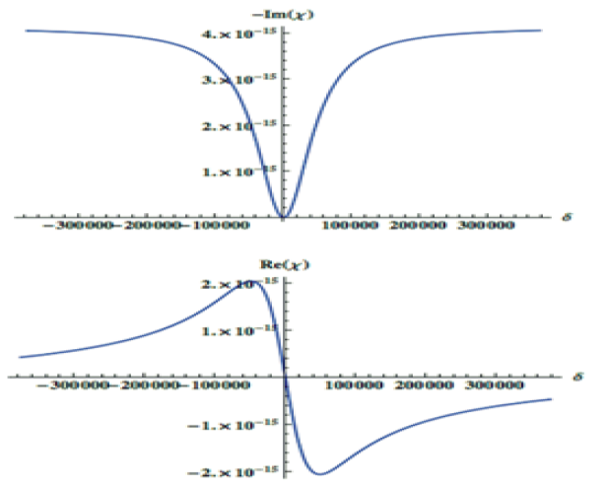
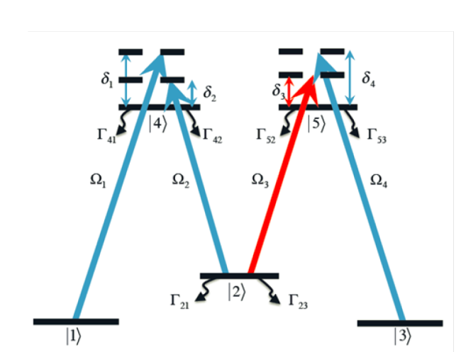

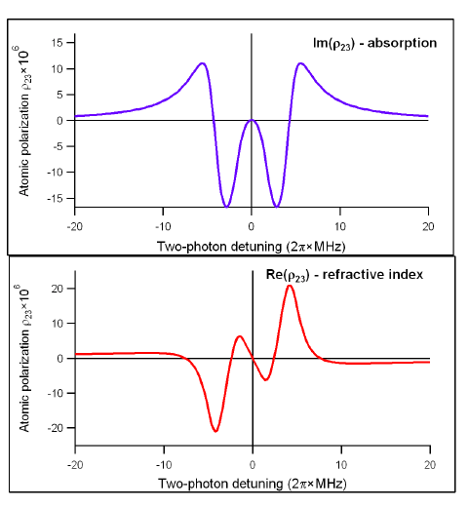
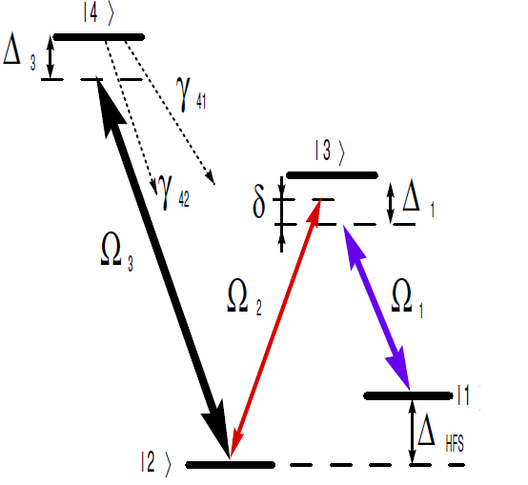
Approaches for Surpassing Mizuno Limit
Bandwidth-oriented: white-light-cavity ideas
Shahriar’s group
Phase
Mikhailov’s group
Phase
GWADW 2015, Alaska
7

Slide 12
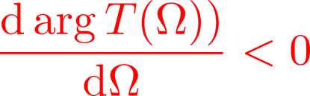
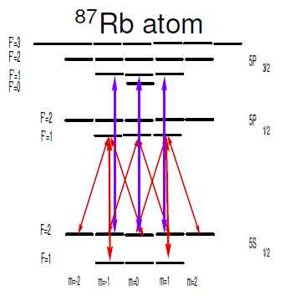
Approaches for Surpassing Mizuno Limit
Bandwidth-oriented: white-light-cavity ideas
Shahriar’s group
Working
wavelengths
transitions in
alkali atom
(780, 795, 590,
852, 895 nm)
Phase
Mikhailov’s group
Phase
GWADW 2015, Alaska
8

Slide 13
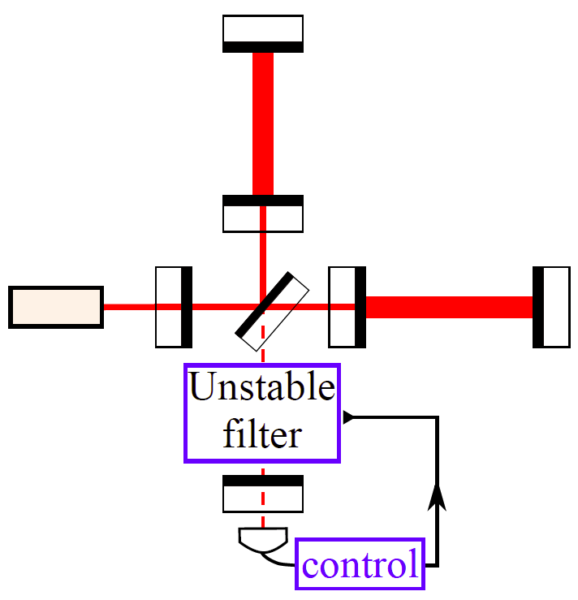
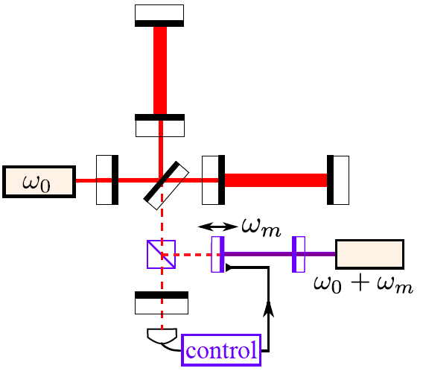
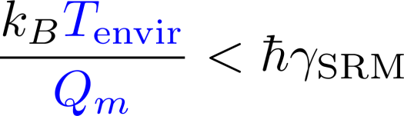
Approaches for Surpassing Mizuno Limit
Bandwidth-oriented: white-light-cavity ideas
Case II:
An example using optomechanics:
Challenge:
thermal noise from mechanical oscillator (optomechanics)
GWADW 2015, Alaska
9

Slide 14
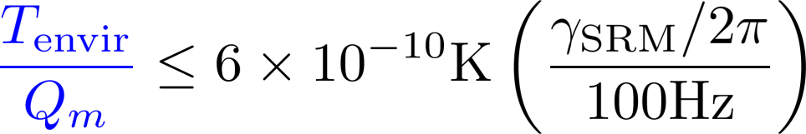
Approaches for Surpassing Mizuno Limit
Bandwidth-oriented: white-light-cavity ideas
Case II:
An example using optomechanics:
Challenge:
thermal noise from mechanical oscillator (optomechanics)
Reference: Miao et al., LIGO DCC: P1400255
GWADW 2015, Alaska
9

Slide 15
Overview of key challenges for upgrades
Peak-sensitivity-oriented: external/internal squeezing
Advantage: fully understood and ready to implement
Challenge:
optical loss in injection path (external squeezing) or
in nonlinear crystal (internal squeezing).
Bandwidth-oriented: white-light-cavity ideas
Advantage: long coherence time and tunable
Challenges and readiness:
Atomic-based:
(1) Compatibility of wavelength (using frequency conversion).
(2) A complete quantum noise analysis (currently under way).
Readiness: around 5-10 years according to Shahriar and Mikhailov.
Optomechanics-based:
(1) Thermal noise in the optomechanical oscillator.
(2) Additional feedback control scheme.
Readiness: conditional on progress in optomechanics.
GWADW 2015, Alaska
10

Slide 16
Outline
Mizuno Limit
Shot-noise-limited sensitivity and signal recycling
A limit on peak sensitivity and bandwidth
Approaches for Surpassing Mizuno Limit
Peak-sensitivity-oriented: external/internal squeezing
Bandwidth-oriented: white-light-cavity ideas
An overview of key issues for future upgrades
Fundamental Quantum Limit
A limit beyond the Standard Quantum Limit and Mizuno Limit
Some implications for configuration studies in future
GWADW 2015, Alaska
11

Slide 17
Fundamental Quantum limit
Tuned signal recycling: Standard Quantum Limit
A tradeoff between the radiation pressure noise and shot noise
Cancelling radiation pressure noise: Mizuno Limit
A tradeoff between the peak sensitivity and detector bandwidth
Using squeezing or white-light cavities: Next Limit?
GWADW 2015, Alaska
12

Slide 18




Fundamental Quantum limit
Tuned signal recycling: Standard Quantum Limit
A tradeoff between the radiation pressure noise and shot noise
Cancelling radiation pressure noise: Mizuno Limit
A tradeoff between the peak sensitivity and detector bandwidth
Using squeezing or white-light cavities: Next Limit?
(Initial quantum
state of detector)
(Final state to
be measured)
(Interaction)
GWADW 2015, Alaska
12

Slide 19
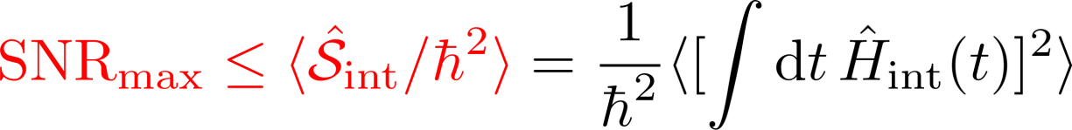
Fundamental Quantum limit
GW detectors as force measurement devices:
GWADW 2015, Alaska
13

Slide 20
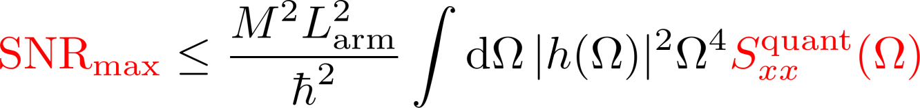
Fundamental Quantum limit
GW detectors as force measurement devices:
For any interferometer configuration:
(Displacement spectrum)
GWADW 2015, Alaska
13

Slide 21
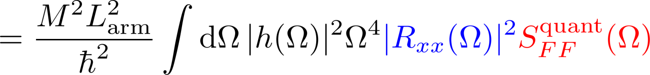
Fundamental Quantum limit
GW detectors as force measurement devices:
For any interferometer configuration:
(Displacement spectrum)
(Force)
Strong back action force (high energy) is necessary for high SNR.
Energetic Quantum Limit
References: [1] Braginsky et al., arXiv: 9907057 (gr-qc);
[2]Tsang et al. PRL 106, 090401 (2011); [3] Yiqiu Ma et al. (in preparation)
GWADW 2015, Alaska
13

Slide 22

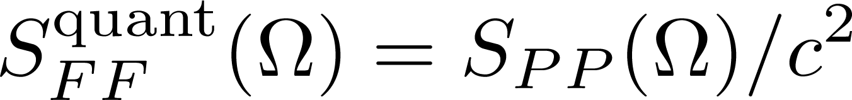
Fundamental Quantum limit
Applied to tuned configurations (no optical spring):
GWADW 2015, Alaska
14

Slide 23
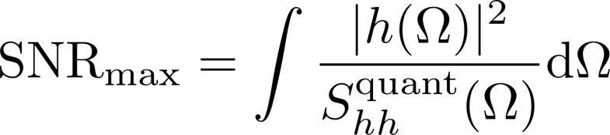
Fundamental Quantum limit
Applied to tuned configurations (no optical spring):
With matching filtering:
GWADW 2015, Alaska
14

Slide 24
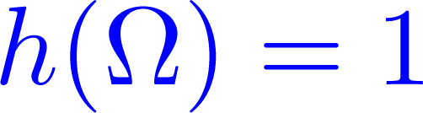
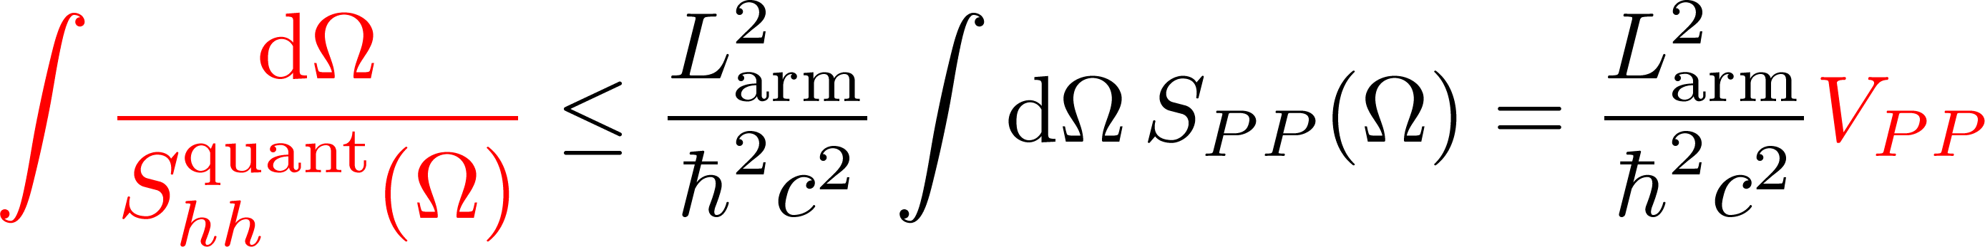
Fundamental Quantum limit
Applied to tuned configurations (no optical spring):
With matching filtering:
Leading to a generalized Mizuno limit [ ]:
(variance of power
fluctuation)
Upper sensitivity bound for all schemes with squeezing and WLC.
GWADW 2015, Alaska
14

Slide 25
Fundamental Quantum limit
For any interferometer configuration:
Implications:
Approach 1: increasing the back action
Higher power and more squeezing (external/internal)
Approach 2: increasing mechanical response
Modifying test-mass dynamics using optical spring (optical bar)
Note: proper filtering schemes are needed to approach such SNR
(Speedmeter, frequency-dependent readout, intra-cavity filtering)
GWADW 2015, Alaska
15

Slide 26
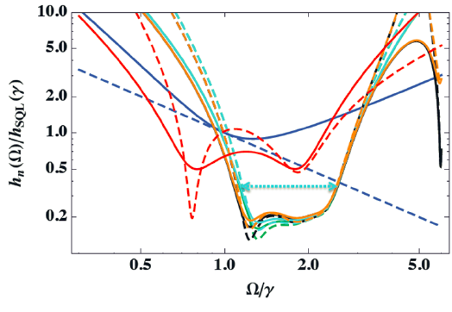
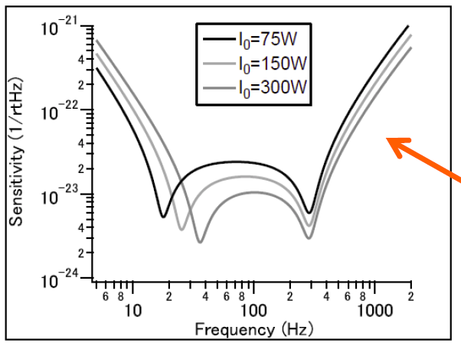
Fundamental Quantum limit
For any interferometer configuration:
Implications:
increasing the back action & mechanical response
Two interesting examples combining these two aspects:
Mingchuan Zhou & Shahriar et al.
arXiv:1410.6877
Farid Khalili & Kentaro et al.
GWADW 2015, Alaska
16

Slide 27
The End
Mizuno Limit
Shot-noise-limited sensitivity and signal recycling
A limit on peak sensitivity and bandwidth
Approaches for Surpassing Mizuno Limit
Peak-sensitivity-oriented: external/internal squeezing
Bandwidth-oriented: white-light-cavity ideas
An overview of key issues for future upgrades
Fundamental Quantum Limit
A limit beyond the Standard Quantum Limit and Mizuno Limit
Some implications for configuration studies in future
GWADW 2015, Alaska
17

