Slide 1
System Identification Overview & Session Goals
GWADW 2015
Controls Session A: System Identification
Dennis Coyne

Slide 2
What is System Identification (SID)?
SID is the process of developing or improving a mathematical representation of a physical system using experimental data
Black box or grey box (Physical insight must be used to develop the underlying model structure)
Time domain and frequency domain
Model reduction
Plant, or plant + controller
Open loop, closed loop
Experiment design
SID for structural dynamics
Modal parameter identification (the focus of this talk)
Structural-model parameter identification (motivation given in this talk)
Control-model identification

Slide 3
What does SID offer?
Does adaptive control negate the need for SID?
No; Adaptive techniques are essentially recursive identification algorithms applied to a specific model structure
Does robust control design render SID obsolete?
No; Robust control design requires a description of the model/plant uncertainty that SID can provide.

Slide 4
SID Process
Basic steps:
Build a physics-based model
Design the experiment
Collect the data
Select, filter, de-trend the data, as appropriate
Fit the model
Validate the model (compare prediction to data)
Iterate until converged on a validated model
Software tools:
Matlab Sys ID Toolbox (Ljung)
Matlab Frequency-Domain Identification (Kollar)
Matlab System/Observer/Controller Identification Toolbox (SOCIT)
…

Slide 5
SID for structural dynamics
Modal parameter identification
the focus of this talk
Structural-model parameter identification
motivation given in this talk
Control-model identification

Slide 6
Structural Modeling & SID

Slide 7
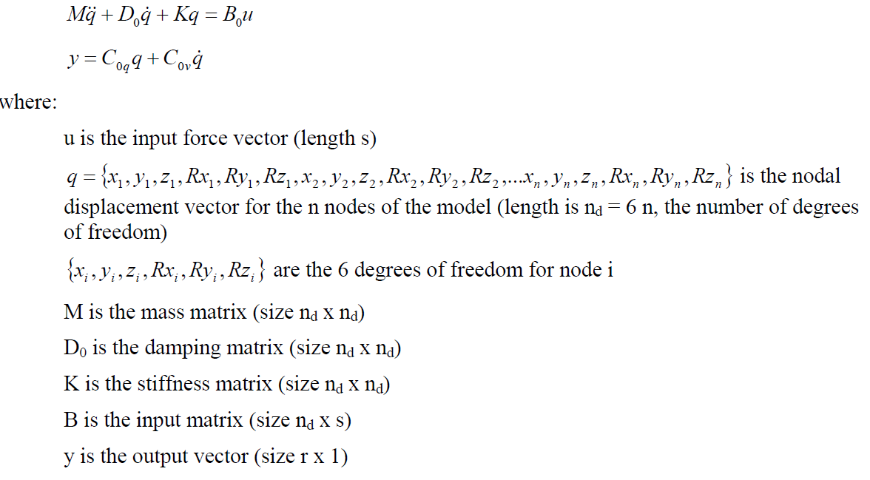
Continuous-Time, Finite Dimensional, Linear Dynamic System Model

Slide 8
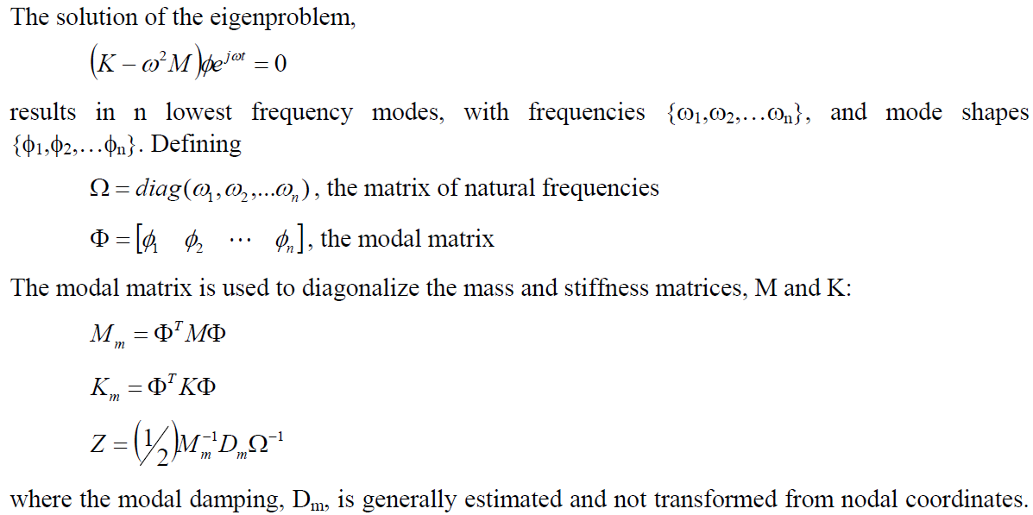
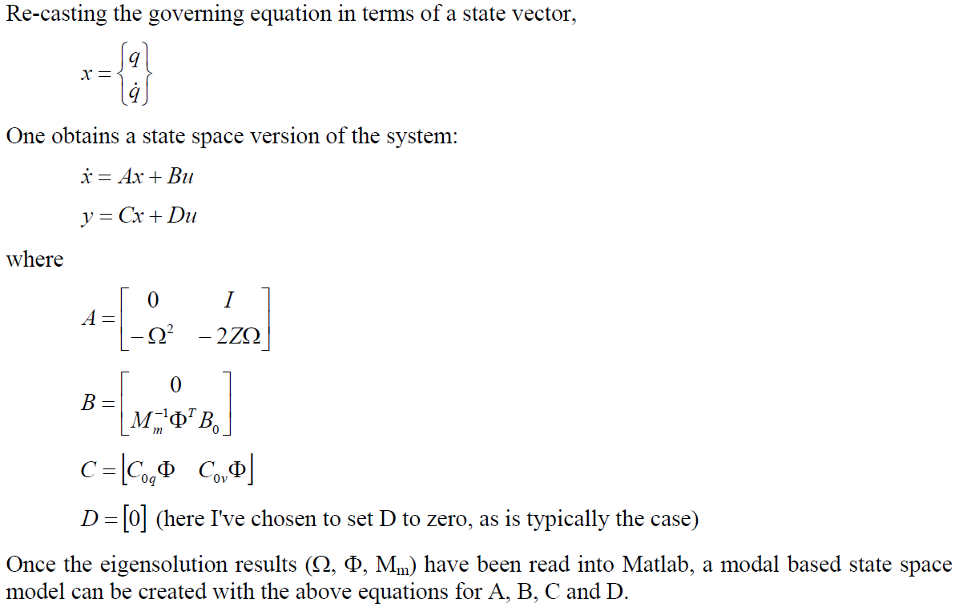
Continuous-Time State-Space Model

Slide 9
Discrete-Time, State-Space, Observer Model
Discrete-time:
$$x\left(k+1\right)=A x\left(k\right)+B u(k)$$
$$y\left(k\right)=C x\left(k\right)+D u(k)$$
k = 0, 1, 2, …
where
$$A= e^{A_{c} ∆t}$$
$$B= \int_{0}^{∆t}{e^{A_{c} τ} ∂τ B_{c}}$$
A_{c}, B_{c} are the continuous versions
Since the state vector is (generally) not accessible, a state estimator (observer) is added:
$$x\left(k+1\right)= \overline{A }x\left(k\right)+\overline{B}v(k)$$
$$y\left(k\right)=C x\left(k\right)+D u(k)$$
where
$$\overline{A}=A+GC$$
$$\overline{B}=[B+GD−G] \\ v\left(k\right)=\left[\begin{matrix}u(k) \\ y(k)\end{matrix}\right]$$

Slide 10
System Realization Theory
Construct a model with controllability & observability
Seek a minimum realization (smallest state space dimensions)
Time domain models for modal parameter identification are based on the transfer function matrix, which yields Markov parameters (i.e. pulse response)
$$x\left(k+1\right)=A x\left(k\right)+B u(k)$$
$$y\left(k\right)=C x\left(k\right)+D u(k)$$
Let $u_{i}\left(0\right)=1 \left(i=1, 2, …,r\right) a$nd $u_{i}\left(k\right)=0 \left(k=1, 2, …\right)$
Pulse response matrix Y (m x r):
$$Y_{0}=D; Y_{1}=CB; Y_{2}=CAB;…; Y_{k}=CA^{k−1}B$$
where Y are the Markov parameters
A realization is the computation of the triplet [A, B, C] (D = Y₀)

Slide 11
System Realization Theory
The triplet [A, B, C] can be transformed into modal parameters by computing the eigenvectors, ${φ=\{φ}_{1}, φ_{2}$, …, $φ_{n}\}$, with the corresponding eigenvalues, ${γ=\{γ}_{1}, γ_{2}$, …, $γ_{n}\}$, of matrix A
Transform to realization $\left[\begin{matrix}γ & φ^{−1}B & Cφ\end{matrix}\right]$
Diagonal Matrix $γ$ contains the modal damping rates and damped natural frequencies
Re & Im parts of $γ_{c}=\ln\left(γ\right)/∆t$
Mode Shapes at the sensor locations
Initial Modal Amplitudes

Slide 12
Eigensystem Realization Algorithm (ERA)
The Hankel matrix is formed from the Markov parameters
$$H\left(k−1\right)=\left[\begin{matrix}Y_{k} & Y_{k+1}… & Y_{k+β−1} \\ \begin{aligned}Y_{k+1} \\ …\end{aligned} & Y_{k+2} & … \\ Y_{k+α−1} & … & Y_{k+α+β−2}\end{matrix}\right]$$
ERA is a least squares fit to the pulse response measurements
Variant ERA/DC
with Data Correlations
Fit to the output auto-correlations and cross-correlations over a finite number of lag values
Juang, J. et. al., “An eigensystem realization algorithm using data correlations (ERA/DC) for modal parameter identification”, Control Theory and Advanced Technology, v4,n1,1988.

Slide 13
Other SID Techniques
Ultimately we seek a recursive, real-time parameter identification of our MIMO systems (at their operating states)
Many techniques are available; Potential candidates include:
Generalized Least Squares and Maximum Likelihood Estimators (e.g. the Prediction Error Method) are computationally simple
Observer/Kalman Filter ldentification (OKID) -- time domain based, can be extended to identification of closed loop effective controller/observer combination (Observer Controller ldentification, OCID)
State-Space Frequency Domain (SSFD) identification techniques

Slide 14
How and what to measure – modal testing
Frequency Response Function (FRF) is the Fourier transform of an impulse or pulse response sequence (Markov parameters)
Typically the FRFs are computed before application of a SID technique
However many SID tools can analyze the free or forced response time histories directly

Slide 15
SID Session Goals
Compare techniques
Share experiences
Exchange tools and ideas
Define a “road map” for application to our systems and further research
Explore the state of the art, new tools …
Define suitable problems/applications
Define upgrades & next generation system targets (early stages of testing and commissioning)
A new GW working group?
Host a wiki page?
Meet virtually on some cadence?

