Slide 1
LIGO and the network of terrestrial gravitational wave detectors
APS April Meeting, Baltimore
11 April 2015
David Shoemaker
For the LIGO Scientific Collaboration

Slide 2
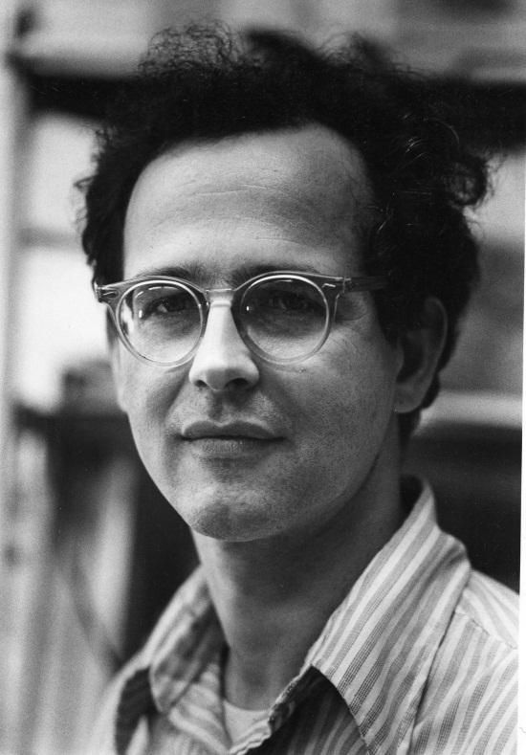

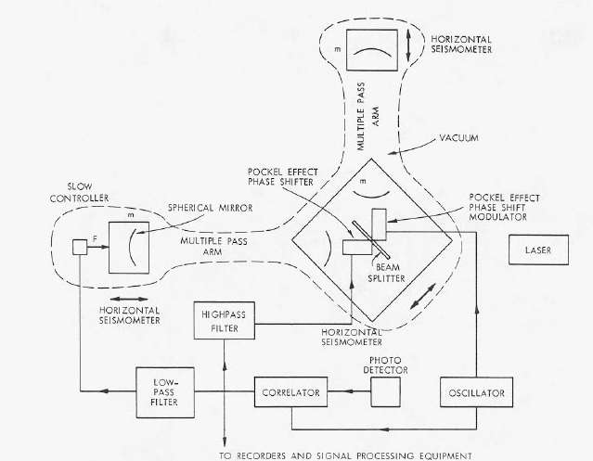

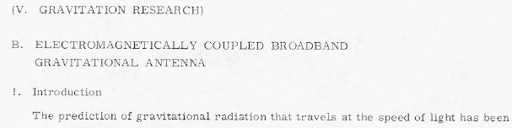
The starting point for GW detection via Interferometry
Rai Weiss of MIT was teaching a course on GR
in the late ‘60s
Wanted a good homework problem for the students
Why not ask them to work out how to use
laser interferometry to detect gravitational waves?
Weiss wrote the instruction book we have been following
ever since

Slide 3
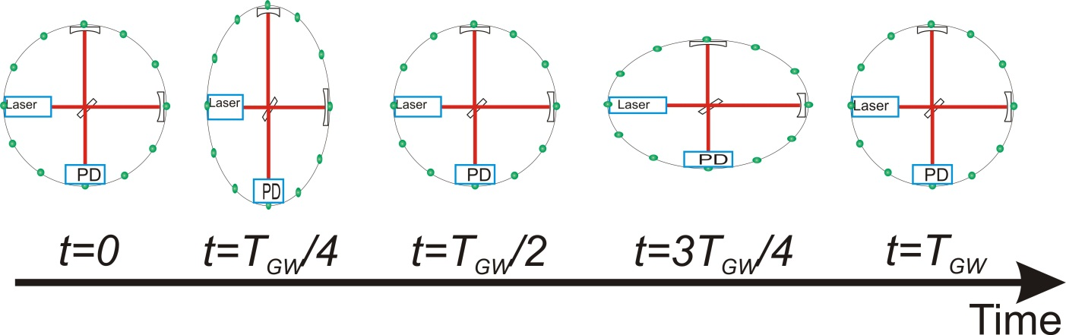
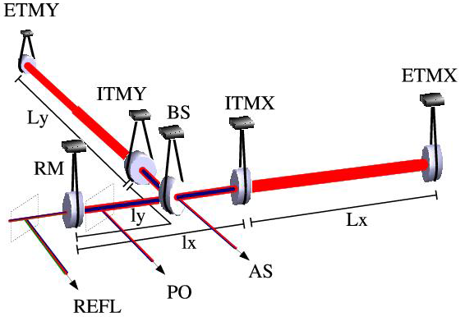
Interferometric Gravitational-wave Detectors
Enhanced Michelson interferometers
  LIGO, Virgo, and GEO600 use variations
Passing GWs modulate the distance between the end test mass and the beam splitter
The interferometer acts as a transducer, turning GWs into photocurrent proportional to the strain amplitude
Arms are short compared to our GW wavelengths, so longer arms make bigger signals
→ multi-km installations
Arm length limited by
taxpayer noise….
Magnitude of h at Earth:
  Largest signals h ~ 10⁻²⁰
  For L = 1 m, ΔL= 10⁻²⁰ m
  For L = 4km, ΔL= 4*10⁻¹⁶ m
←4km→
←4km→
Laser →
Photo
diode

Slide 4
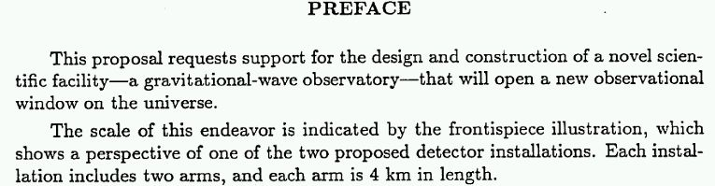
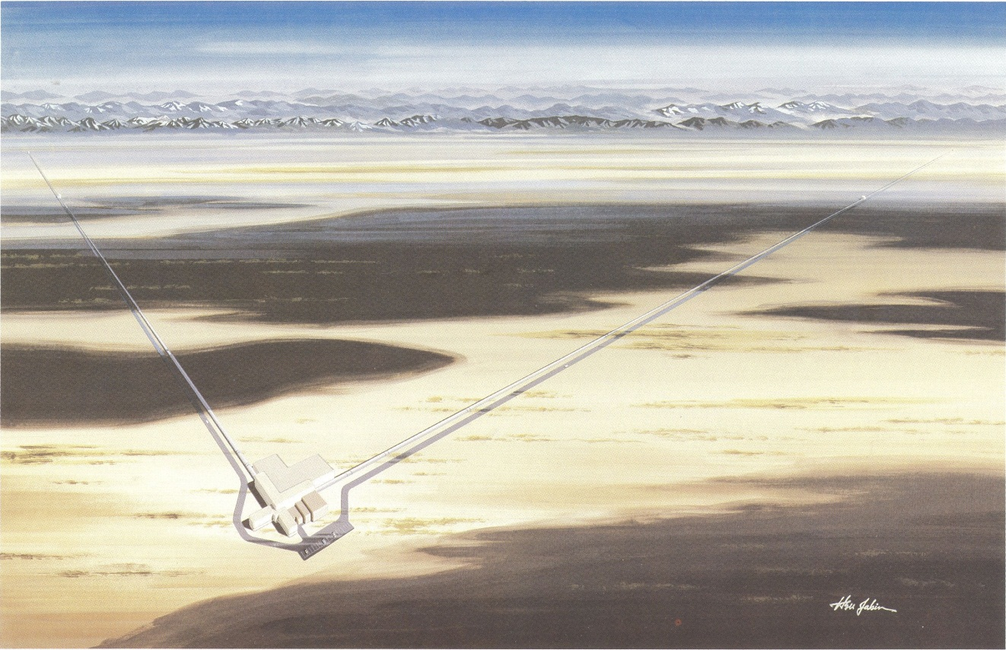
Weiss’ groundwork and a worldwide development effort led to a 1989 Proposal to the US NSF

Slide 5
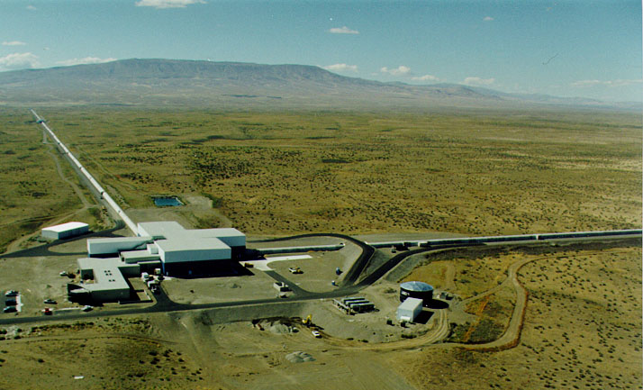
LIGO:
Today, Washington state…

Slide 6

…LIGO in Louisiana

Slide 7

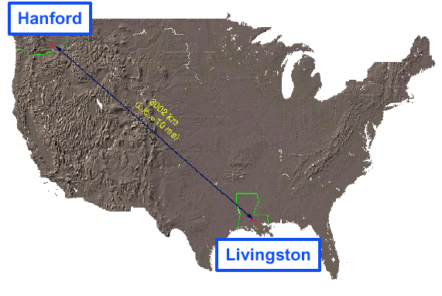
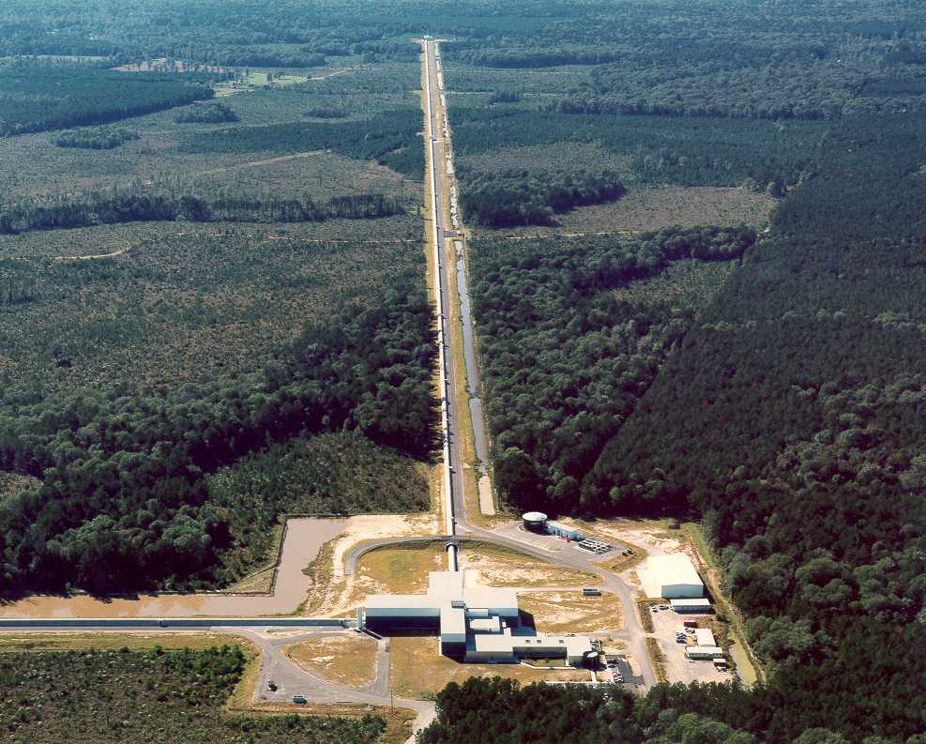
LIGO Laboratory: two Observatories and Caltech, MIT campuses
Mission: to develop gravitational-wave detectors, and to operate them as astrophysical observatories
Jointly managed by Caltech and MIT;
LIGO Hanford and Livingston Observatories
Requires instrument science at the frontiers of physics fundamental limits
MIT
Caltech
LIGO Livingston
Notes:
LIGO is actually two observatories.
Describe parameters
Emphasize that the arms are in ultra high vacuum. 8 km of steel 1.2 m dia beam tubes at each site
Separate observatories allow for coincidence detection – since the detectors see uncorrelated noise, only a true gravitational wave would appear on all the interferometers with the correct amplitude.
Emphasize that the LIGO Observatories were designed and are operated by Caltech and MIT

Slide 8
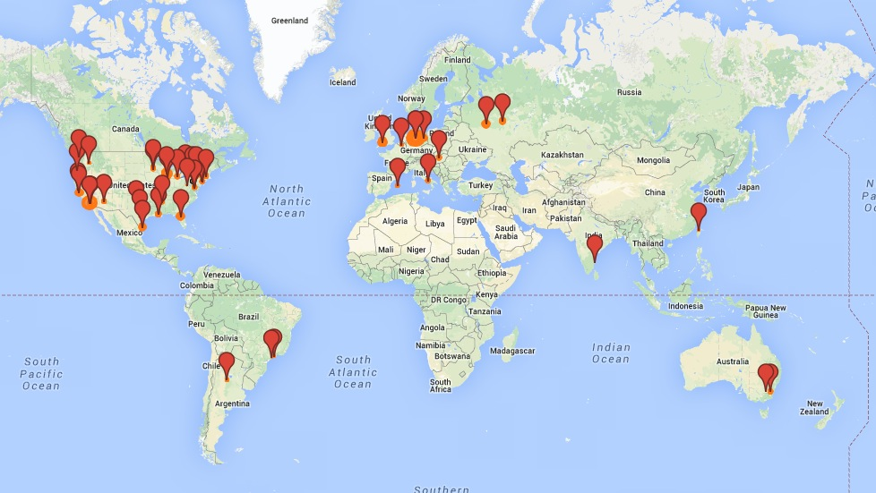
LIGO Scientific Collaboration
The LSC is the organization the conducts the science of LIGO
www.ligo.org
900+ members, 80+ institutions, 16 countries
Slide: Gabriela González

Slide 9


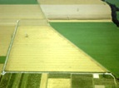

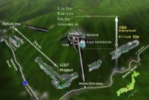



The advanced GW detector network
GEO600 (HF)
2011
Advanced LIGO
Hanford,
Livingston
2015
Advanced
Virgo
2016
KAGRA
2018
LIGO-India
2022
(Planned)
9
9

Slide 10
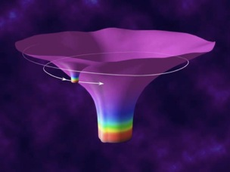
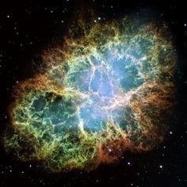
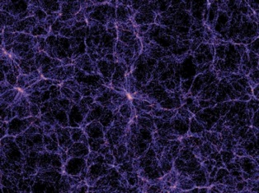
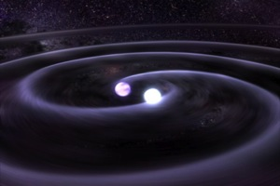
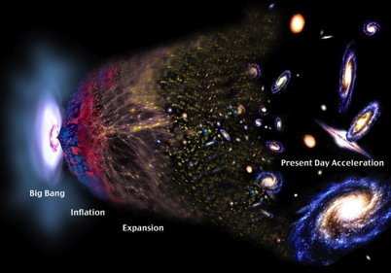
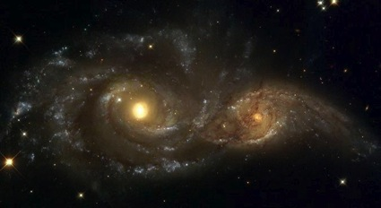

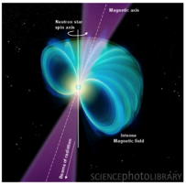
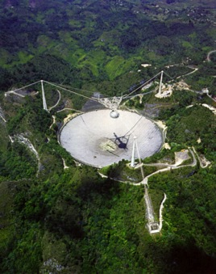
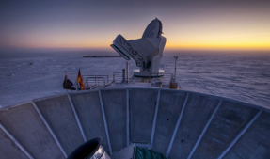
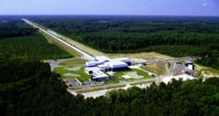
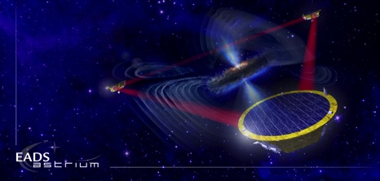
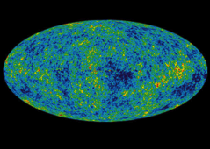
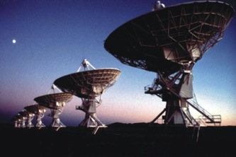
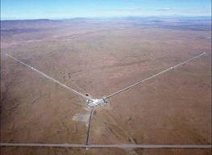
The Gravitational Wave Spectrum
Supernovae
Cosmic Strings
BH and NS
Binaries
Relic radiation
Extreme Mass
Ratio Inspirals
Supermassive
BH Binaries
Binary coalescence
Spinning NS
10⁻¹⁶ Hz
10⁻⁹ Hz
10⁻⁴ Hz
10⁰ Hz
10³ Hz
Inflation Probes
Pulsar timing
Space detectors
Ground interferometers
Laser Interferometer
Gravitational Wave
Observatory

Slide 11

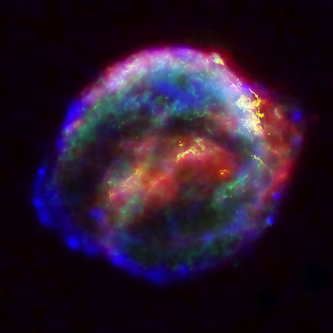

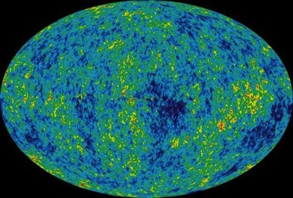
Ground-based
Astrophysical Targets
for Ground-based Detectors
Coalescing Binary Systems
Well-modelled
Neutron stars, low mass black holes, and NS/BS systems
‘Bursts’
Unmodelled
galactic asymmetric core collapse supernovae
cosmic strings
???
Credit: AEI, CCT, LSU
Stochastic GWs
Noise
Incoherent background from primordial GWs or an ensemble of unphased sources
primordial GWs unlikely to detect, but can bound in the 10-10000 Hz range
Continuous Sources
Essentially Monotone
Spinning neutron stars
probe crustal deformations, equation of state, ‘quarki-ness’
NASA/WMAP Science Team
Casey Reed, Penn State
Notes:
Quickly walk through sources/characteristics

Slide 12
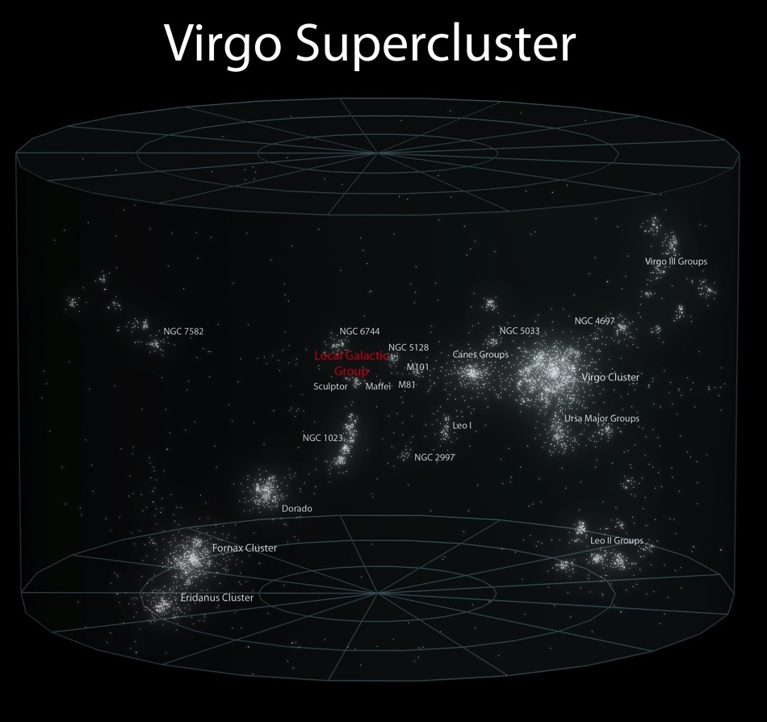
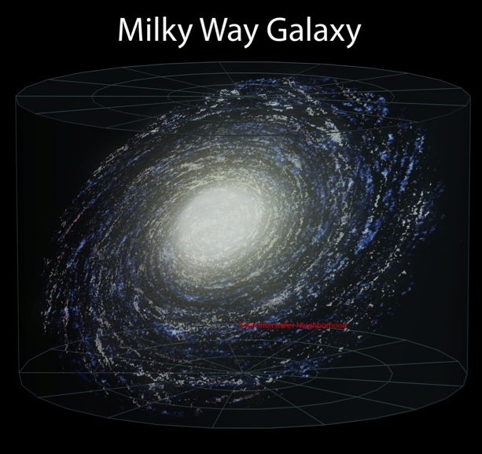

First generation detectors
First generation detectors and infrastructure built from mid-’90s to mid-2000; commissioned to design sensitivity; and observed for several years
Sensitivity sufficient to reach about 100 galaxies; however…
NS-NS coalescence events happen once every 10,000 years per galaxy…
Need to reach more galaxies to see
at least one signal per lifetime
Notes:
at 20 minutes here.

Slide 13
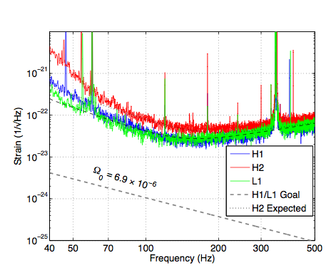
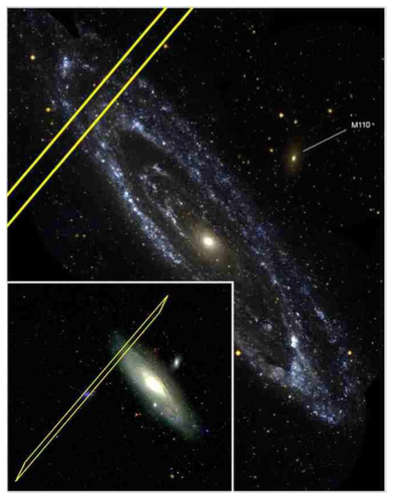
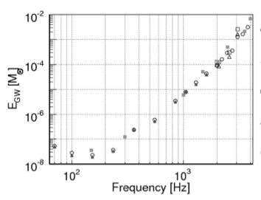
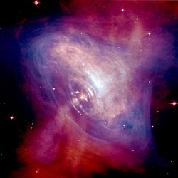
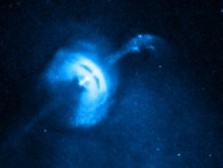
Results from 2005-2010 Initial LIGO Data
Upper limit of <6.7 x 10⁻⁶ on stochastic background
energy density in GW (below nucleosynthesis limit)
Exclusion of GRB070201 from Andromeda
if GRB due to inspiral coalescence
Nature 460 (2009) 990
Astrophys. J. 681 (2008) 1419
Upper limit on GW energy emitted
by generic sources at 10 kpc
Upper limits on GW emissions from
Crab and Vela pulsars - ε < 1.8 x 10⁻⁴
Phys. Rev. D 81 (2010) 102001
(X-ray: NASA/CXC/Univ of Toronto/M.Durant et al;
Optical: DSS/Davide De Martin)
NASA/CXC/ASU/J Hester et al. (Chandra);
NASA/HST/ASU/J Hester et al. (Hubble)
Astrophys. J. 722 (2010) 1504; 737 (2011) 93

Slide 14
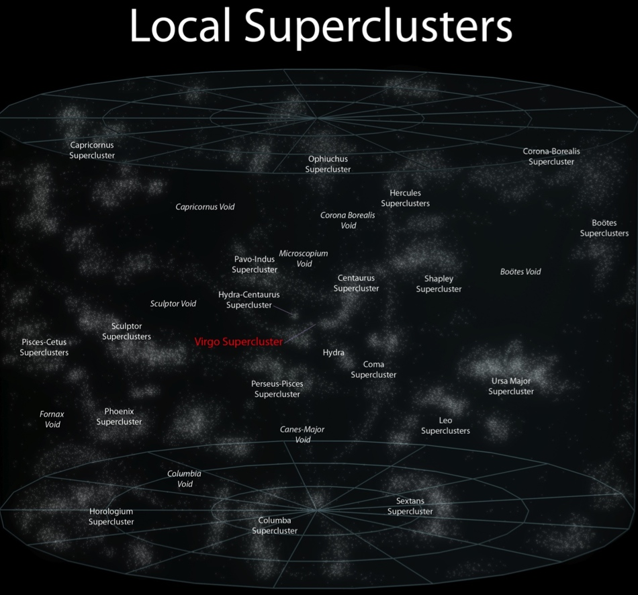
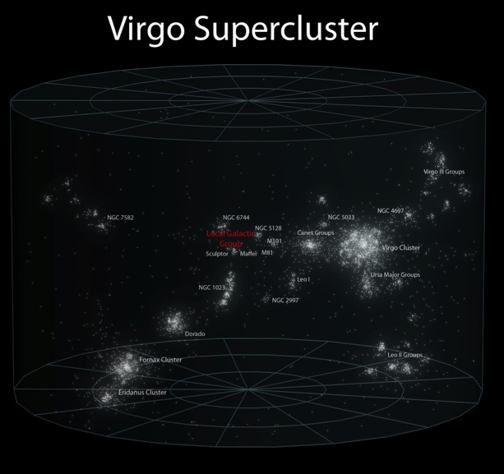
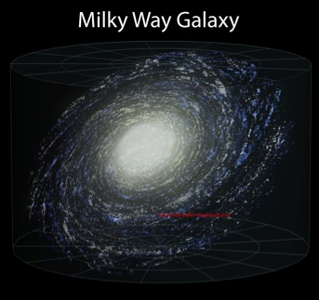
Advanced LIGO Sensitivity: a qualitative difference
While observing with initial detectors, parallel R&D led to better concepts
‘Advanced detectors’ now coming on line are ~10x more sensitive, will reach about 100,000 galaxies
Events happen once every 10,000 years per galaxy…
NS-NS detection rate order of 1 per month
Advanced LIGO concept ~1999
Project start 2008, $205M NSF
Completed 2015, tuning underway
Initial Reach
Advanced Reach

Slide 15
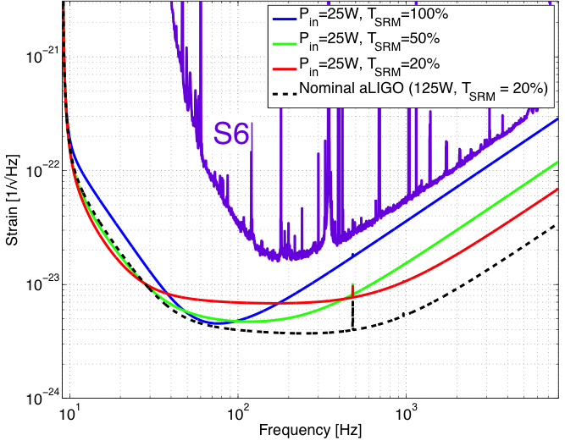
How to get there:
Addressing limits to performance
Shot noise – ability to resolve a fringe shift due to a GW (counting statistics)
Zum gegenwärtigen Stand des Strahlungsproblems, A. Einstein, 1909
Fringe Resolution at high frequencies improves as as
(laser power)^{1/2}
Point of diminishing returns when buffeting of test mass
by photons increases
low-frequency noise –
use heavy test masses!
‘Standard Quantum Limit’
Advanced LIGO reaches this limit with its 200W laser,
40 kg test masses
photodiode

Slide 16
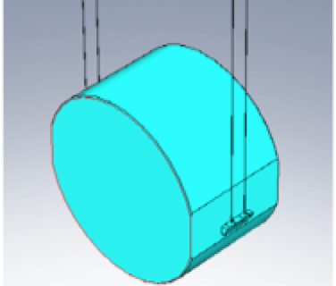
Addressing limits to performance
Thermal noise – kT of energy
per mechanical mode
Über die von der molekularkinetischen Theorie
der Wärmegeforderte Bewegung von in ruhenden Flüssigkeiten suspendierten Teilchen, A. Einstein, 1905
Motion of components due to thermal energy masks GW
Low mechanical loss materials gather this motion into a narrow peak at resonant frequencies
Realized in aLIGO with an all fused-silica test mass
suspension – Q of order 10⁹
Test mass internal modes,
Mirror coatings engineered for
low mechanical loss

Slide 17
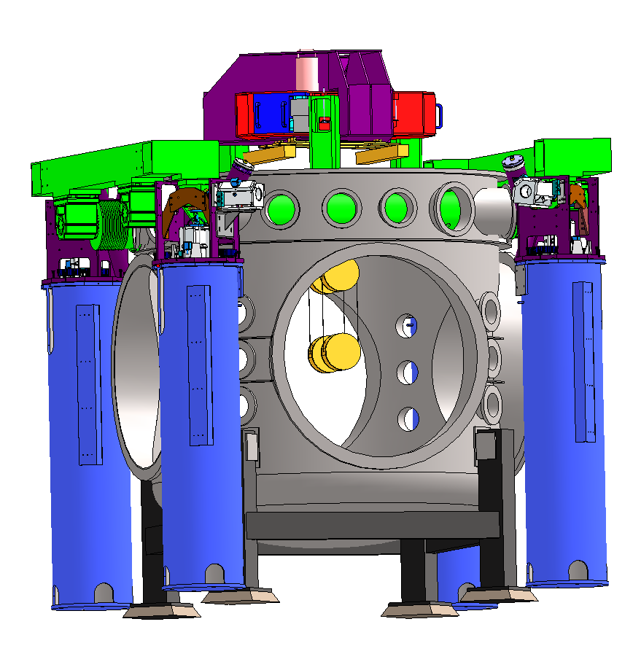
Addressing limits to performance
Seismic noise – must prevent masking of GWs, enable practical control systems
Motion from waves on coasts…and people moving around
GW band: 10 Hz and above – direct effect of masking
Control Band: below 10 Hz – forces needed to hold optics
on resonance and aligned
aLIGO uses active servo-controlled platforms, multiple pendulums
Ultimate limit on the ground: Newtownian background – wandering net gravity vector; a limit in the 10-20 Hz band

Slide 18
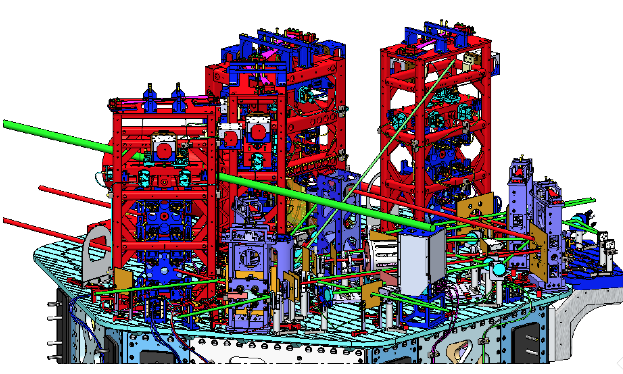

The real instrument is far more complex…
Reality axis
photodiode

Slide 19
The Design: Optical Configuration

Slide 20

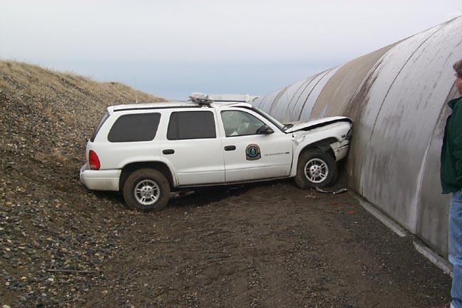
Infrastructure:
4km Beam Tubes
Light must travel in an excellent vacuum
  Just a few molecules traversing the optical path makes a detectable change in path length, masking GWs!
  1.2 m diameter – avoid scattering against walls
Cover over the tube – stops hunters’ bullets and the stray car
Tube is straight to a fraction of a cm…not like the earth’s curved surface
Notes:
Walk through slide

Slide 21
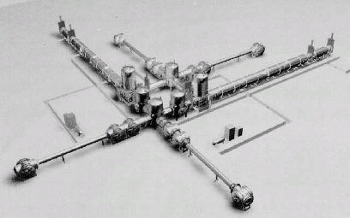
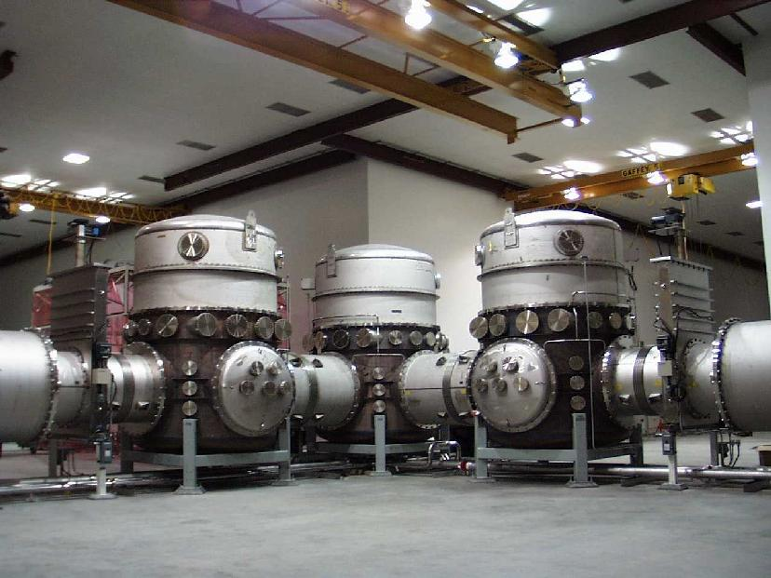
LIGO Vacuum Equipment – designed for several generations of instruments

Slide 22
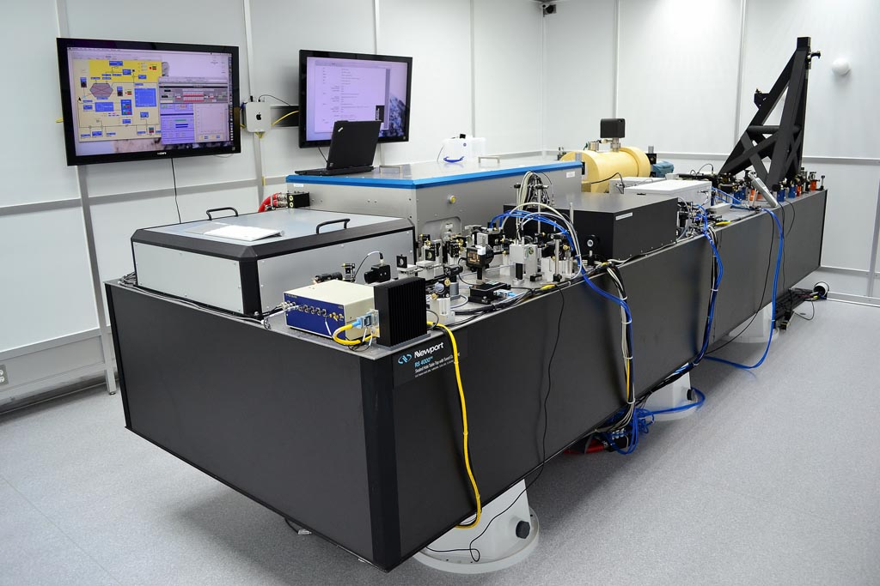
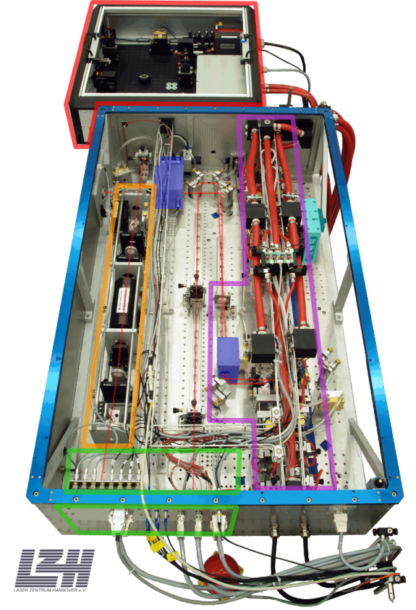
200W Nd:YAG laser
Designed and contributed by Max Planck Albert Einstein Institute
Stabilized in power and frequency
Uses a monolithic master oscillator followed by injection-locked rod amplifier

Slide 23
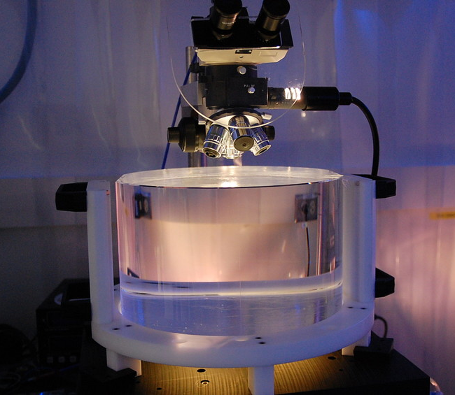
Test Masses
Requires the state of the art in substrates and polishing
Pushes the art for coating!
Sum-nm flatness over 300mm
Test Masses:
34cm φ x 20cm
40 kg
Round-trip optical loss: 75 ppm max
40 kg
Both the physical test mass – a free point in space-time – and a crucial optical element
Mechanical requirements: bulk and coating thermal noise, high resonant frequency
Optical requirements: figure, scatter, homogeneity, bulk and coating absorption
Compensation plates:
34cm φ x 10cm
BS:
37cm φ x 6cm
ITM
T = 1.4%

Slide 24
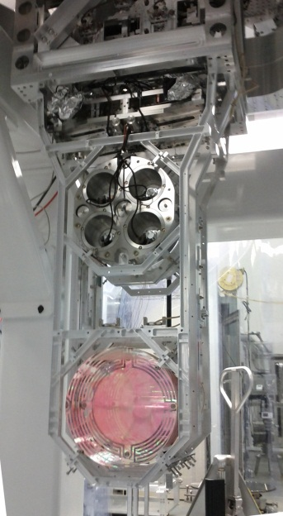

Test Mass Quadruple Pendulum suspension designed jointly by the UK (led by Glasgow) and LIGO lab, with capital contribution funded by PPARC/STFC
Quadruple pendulum suspensions for the main optics; second ‘reaction’ mass to give quiet point from which to push
Create quasi-monolithic pendulums using
fused silica fibers to suspend 40 kg test mass
  VERY Low thermal noise!
Another element in hierarchical control system
Optics Table Interface
(Seismic Isolation System)
Damping Controls
Hierarchical Global
Controls
Final elements
All Fused silica
Electrostatic
Actuation

Slide 25

Seismic Isolation:
Multi-Stage Solution
Objectives:
  Render seismic noise a negligible limitation to GW searches
  Reduce actuation forces on test masses
Both suspension and seismic isolation systems contribute to attenuation
Choose an active isolation approach, 3 stages of 6 degrees-of-freedom :
  1) Two Active Stages of Internal
  Seismic Isolation
  2) Hydraulic External Pre-Isolation
Low noise sensors (position, velocity, acceleration) are combined, passed
through a servo amplifier, and delivered
to the optimal actuator as a function of
frequency to hold platform still in inertial
space

Slide 26
Where are we?
What astrophysics can be accomplished with Advanced LIGO once commissioned?
What is the status of the instrument?
When do we have a chance of making a detection?

Slide 27


Observing Scenario, focus on NS-NS Binaries http://arxiv.org/abs/1304.0670
Binary Neutron Star Range :
  Advanced LIGO: ~ 200 Mpc
  “Realistic rate” ~ 40/year
  CQG, 27, 173001 (2010)
  Initial LIGO: ~15 Mpc
  Rate ~1/50years
27
Notes:
P0900125-v8

Slide 28

Very rapid progress –
Current sensitivity acceptable for Fall run!

Slide 29





Enabling multi-messenger astronomy with gravitational waves
Swift
About 60 Partners from 19 countries
About 150 instruments covering the full spectrum from radio to very high-energy gamma-rays
Swift
X-ray, γ-ray
follow-up
Optical
follow-up
Palomar Transient
Factory
t₁
Coherent
Detector
Network
Virgo
t₃
LIGO
Hanford
t₂
LIGO
Livingston
Abadie, et al, (LSC & Virgo Collaborations)
Astron. Astrophys. 541 (2012) A155.
Nissanke, Kalsiwal, Georgieva,
Astrophysical J. 767 (2013) 124.
Singer, Price, et al., Astrophysical J., 795 (2014) 105.
Image:
http://earthobservatory.nasa.gov/

Slide 30


Future Improvements
Need to have some detections – both to convince
ourselves and others that it is worthwhile, and to
help focus future astrophysics goals
R&D continuing; see sensible paths in near and
far time scales
Factor ~1.7 in sensitivity: possible as early as 2018
  Would give increase in event rate of ~5
Use of squeezed light expected (and demonstrated)
Larger test masses to control radiation pressure noise,
and for lower thermal noise
Factor 10: perhaps by 2035
  Maybe a longer baseline –
  40km instead of 4km
  Almost all noise sources stay constant –
  but signal grows a factor of 10
  Models indicate feasibility

Slide 31






Next-to-last page Acknowledgments
Thanks to:
www.ligo.org
Support: National Science Foundation

Slide 32


The last page: A Familiar Story
Often experimentalists find that they prove some even very fine theorists wrong
In this case, it is a theorist – one A. Einstein – who helped enormously with the fundamentals of the experimental technique we use
We are seeking to show that a paper published in 1916 was in error –
  Einstein, A.: Näherungsweise Integration der Feldgleichungen der Gravitation, 1916 – in which he stated that gravitational waves do not exist!
Believe we have a good chance to make a direct detection of Gravitational Waves 100 years after the publication of this paper
  (and 98 years after the author’s own correction
  of the error, in Über Gravitationswellen, 1918)
  Here’s hoping for a first detection in 2016!

