Slide 1
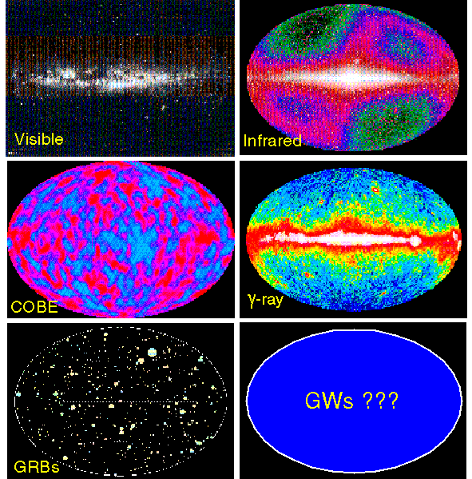
Advanced LIGO :
Aiming for the detection of the gravitational wave signal, and beyond
Hiro Yamamoto LIGO lab/Caltech
New Astronomy by gravitational wave signal at
the 100th memorial year of general relativity
  In the beginning…
2nd generation detector - advanced LIGO
Targeting the first observations
Aiming for the future
Some slides are copied from talks in 2015 March LVC meeting and from the talk by D. Reitze G1500139

Slide 2
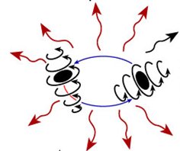
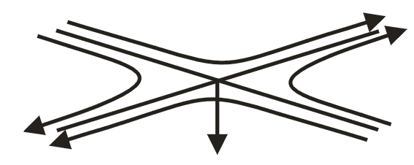
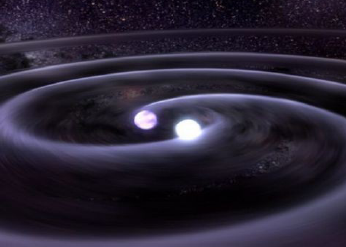
Gravitational waves
Gravitational waves are propagating dynamic fluctuations in the curvature of space-time (‘ripples’ in space-time)
Emissions from rapidly accelerating non-spherical mass distributions
  Quadrupolar radiation

Slide 3
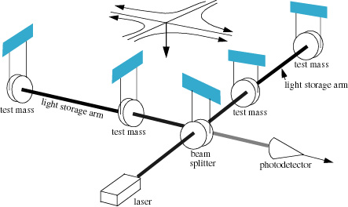
Interferometer for
Gravitational Wave detection
L₁
E₁
E₂
L₂
E₁- E₂ ∝ L₁-L₂
h~10⁻²³
L₁-L₂~10⁻¹⁹m

Slide 4
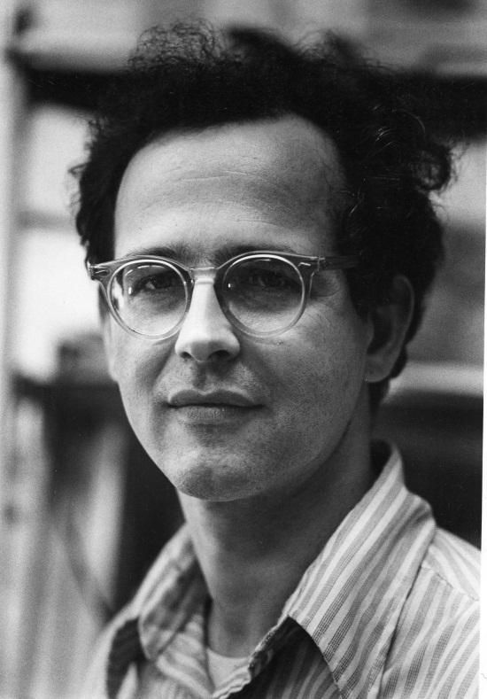
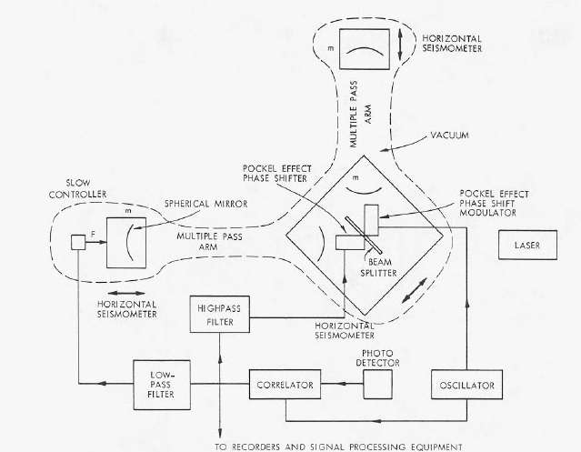
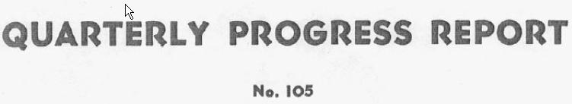

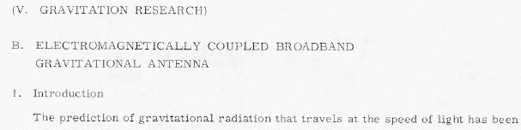
In the beginning
From G1101133 by D.H.Shoemaker
Rai Weiss of MIT was teaching a course on GR
in the late ‘60s
Wanted a good homework problem for the students
Why not ask them to work out how to use
laser interferometry to detect gravitational waves?
…led to the instruction book we have been following
ever since

Slide 5
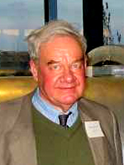
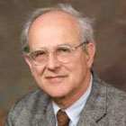
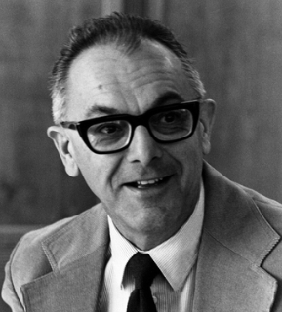
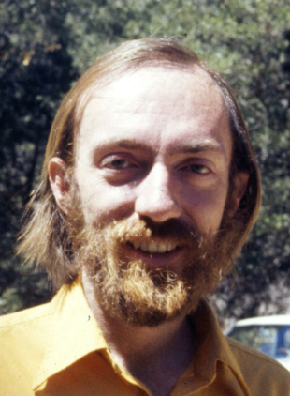
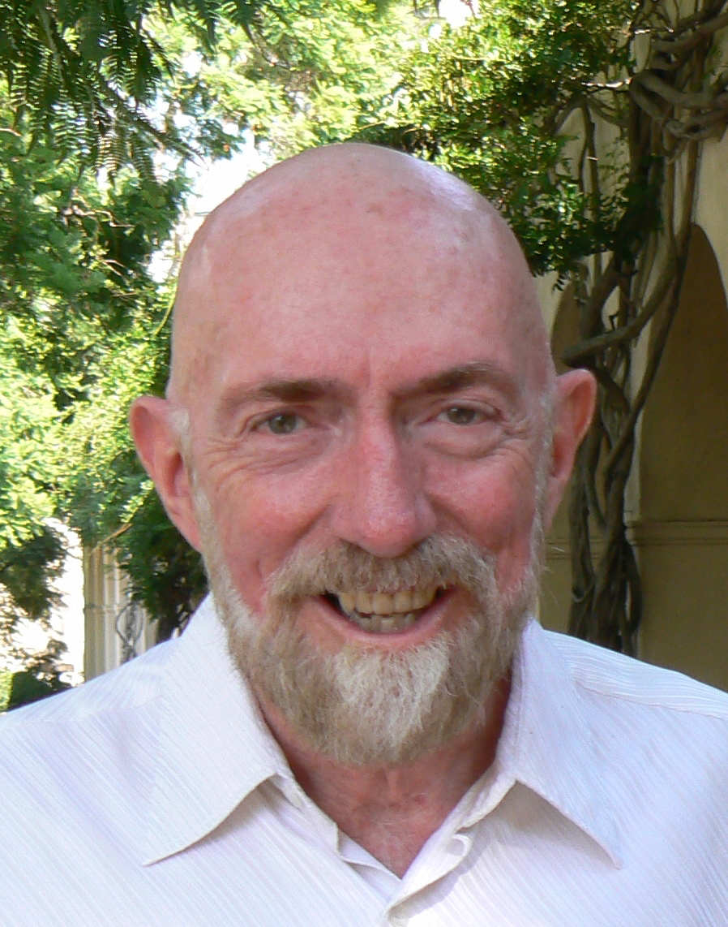
LIGO Chronology idea to realization ~ 15 years
Drever
Weiss
1970s Feasibility studies and early work on laser interferometer gravitational-wave detectors
1979 National Science Foundation (NSF) funds Caltech and MIT for laser interferometer R&D
1984 Development of multiple pendulum Advanced LIGO Concept
1989 December Construction proposal for LIGO submitted to the NSF ($365M as of 2002)
1990 May National Science Board approves LIGO construction proposal
1994 July Groundbreaking at Hanford site
1999 LIGO Scientific Collaboration White Paper on a Advanced LIGO interferometer concept
2000 October Achieved “first lock” on Hanford 2-km interferometer in power-recycled configuration
2002 August First scientific operation of all three interferometers in S1 run
2003 Proposal for Advanced LIGO to the NSF ($205 NSF + $30 UK+Germany)
2004 October Approval by NSB of Advanced LIGO
2005 November Start of initial LIGO Science run, S5, with design sensitivity
2008 April Advanced LIGO Project start
2009 July Science run (“S6”) starts with enhanced initial detectors
2014 May Advanced LIGO Livingston first two-hour lock
2015 March Advanced LIGO all interferometers accepted
September Advanced LIGO observation run 1 scheduled
Initial LIGO events
Advanced LIGO events
R&D of aLIGO using iLIGO facility
Real size R&D for the real detection
Journey for the new astronomy
Vogt
Executive producer & consultant of movie “Intersteller”
Thorn

Slide 6
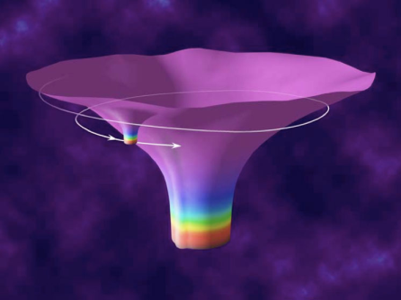

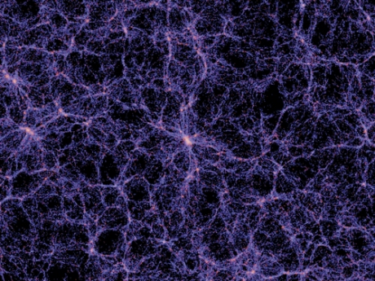
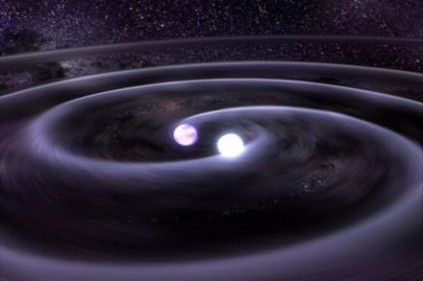

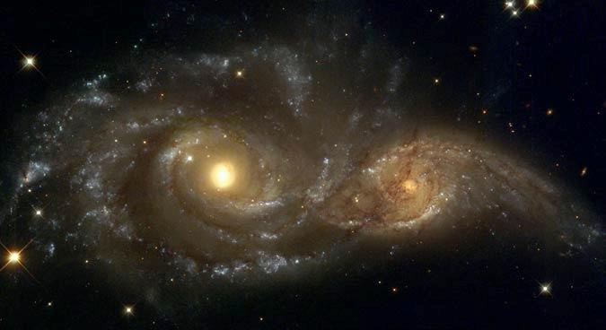

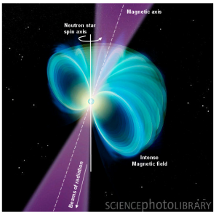
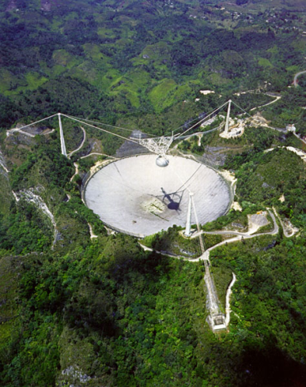
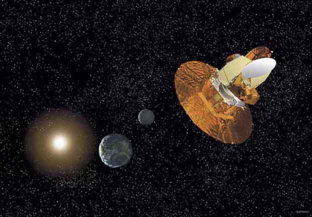

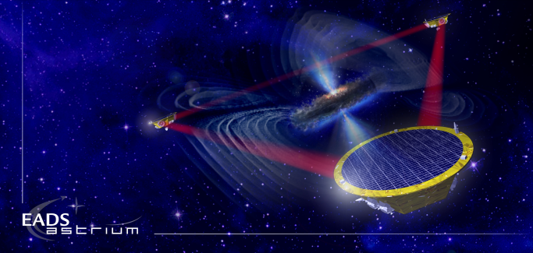
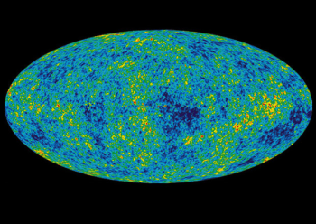
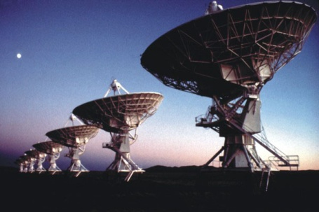
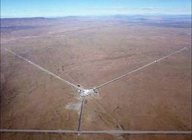
The Gravitational Wave Spectrum
Supernovae
Cosmic Strings
Relic radiation
BH and NS
Binaries
Extreme Mass Ratio
Inspirals
Supermassive BH Binaries
Binaries coalescences
Spinning NS
10⁻¹⁶ Hz
10⁻⁹ Hz
10⁻⁴ Hz
10⁰ Hz
10³ Hz
Inflation Probe
Pulsar timing
Space detectors
Ground interferometers
Laser Interferometer
Gravitational Wave
Observatory

Slide 7
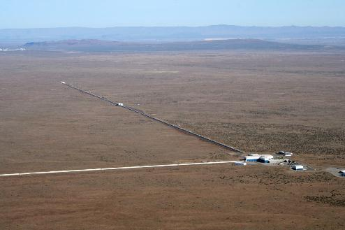
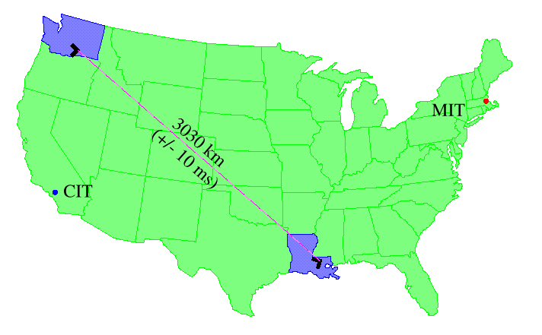
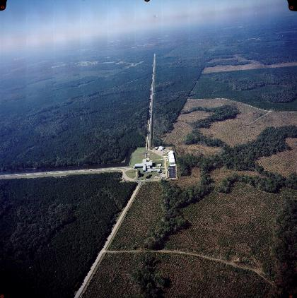
LIGO sites
Hanford
Observatory
(H2K and H4K)
4 km
+ 2 km
Hanford, WA (LHO)
located on DOE reservation
treeless, semi-arid high desert
25 km from Richland, WA
iLIGO : H2K and H4K ⇒
aLIGO : 4k LHO + 4k LIGO-India
Livingston, LA (LLO)
located in forested, rural area
commercial logging, wet climate
50km from Baton Rouge, LA
One L4K IFO
Livingston
Observatory
(L4K)
4 km

Slide 8
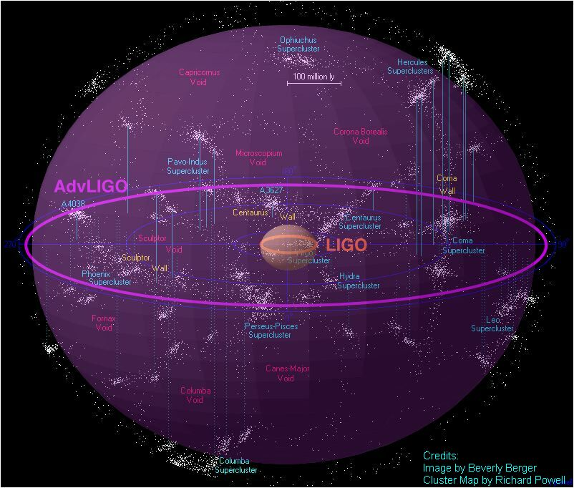
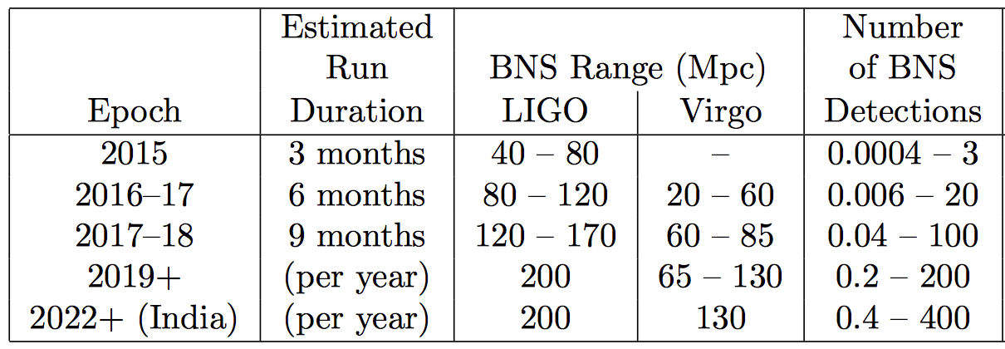
Advanced LIGO
~ event rates
#events by advanced LIGO ~
1000 x #events by initial LIGO
Assumes NS-NS rate between 10⁻⁸ Mpc⁻³yr⁻¹ and 10⁻⁵ Mpc⁻³yr⁻¹
Observation run
1
2
3

Slide 9
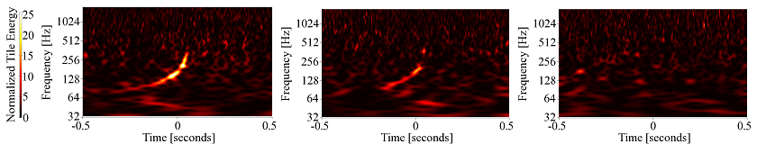
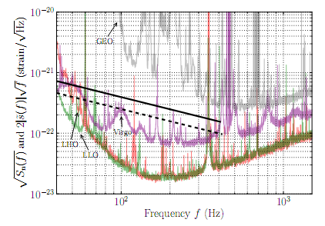
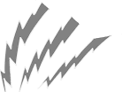


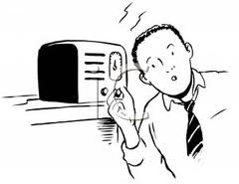
Event GW100916: blind injection http://www.ligo.org/science/GW100916/
Hanford
Livingston
Virgo
LHO SNR=15
LLO SNR=10
Notes:
One event in S6 – shows up clearly in H1,L1, less clear in Virgo, data quality good, no instrumental artifacts
Well above background – 1/7000 year event
Was a secretly injected signal

Slide 10
Fundamental Sensitivity Limits in Advanced LIGO
no more major noise
Radiation pressure noise : #photons recoiling against the test mass mirror is discrete
Shot noise : #photons going into PD is discrete
Coating Brownian noise : Mirror coating layers are thermally fluctuating

Slide 11
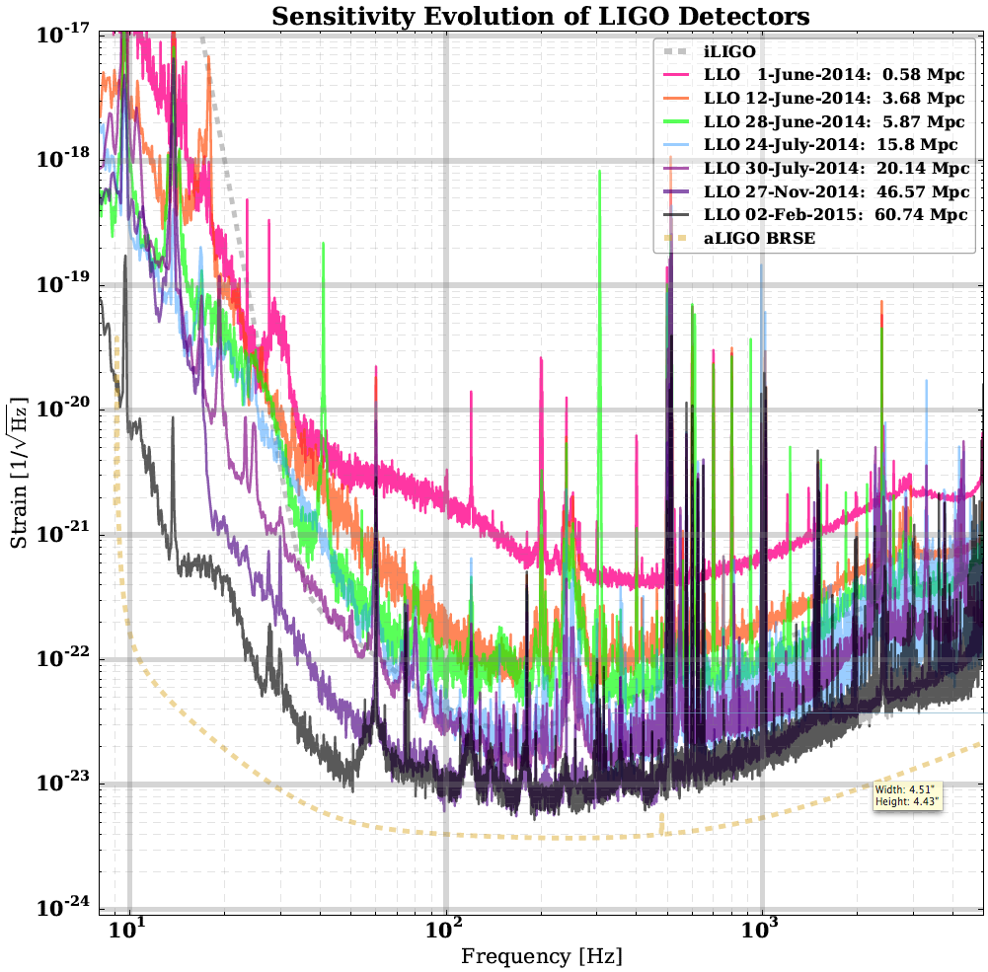
LIGO Livingston Sensitivity Progression
initial LIGO
seismic, control,
charge in TM, etc
advanced LIGO

Slide 12
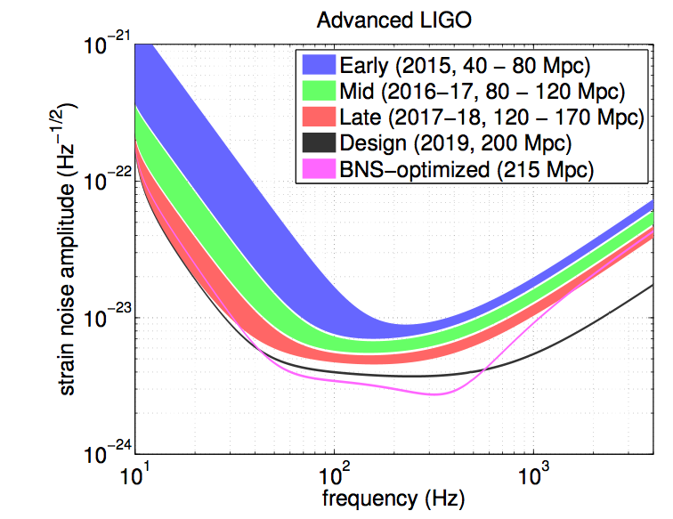
Planning for Advanced LIGO Science
Detections Possible
Detections Likely

Slide 13
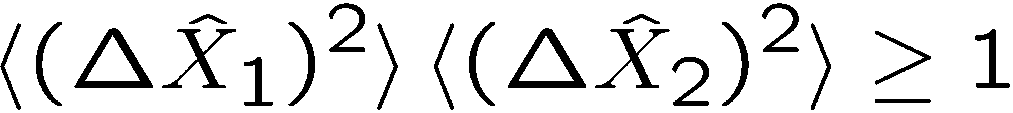
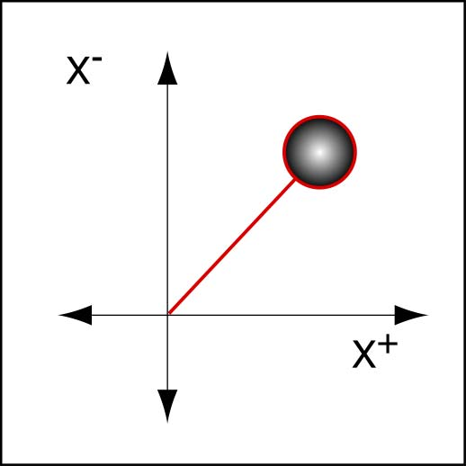
Squeezed Light in LIGO suppressing quantum noise without increasing power
Heisenberg Uncertainty Principle
Squeezed state
  Reduce noise in one quadrature at the expense of the other
  Shot noise - phase,
  radiation pressure - amplitude
X₁ and X₂ associated
with amplitude and phase
X₂
Aasi, et al., (LIGO Scientific Collaboration), Nature Physics, 7, 962 (2011); Nature Photonics 7 613 (2013).
X₁

Slide 14
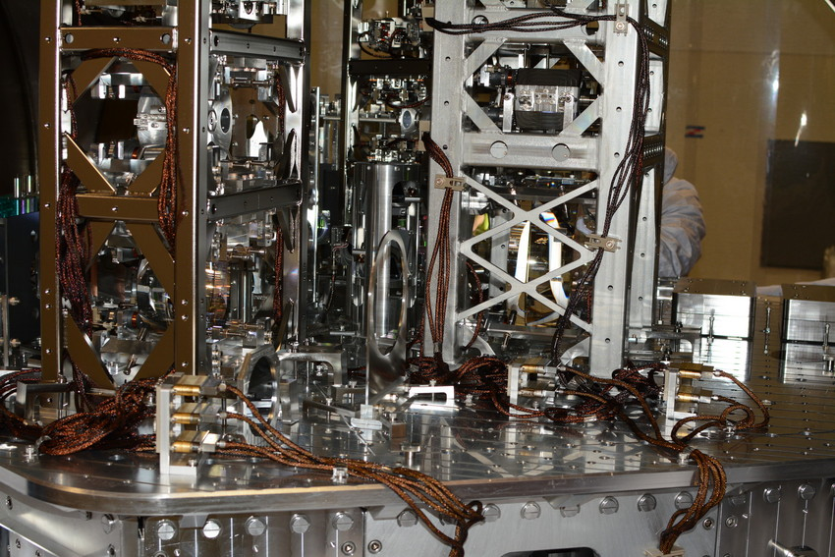

The real instrument is far more complex…
Reality axis

Slide 15
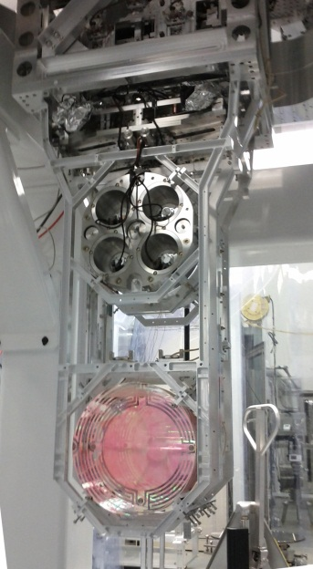
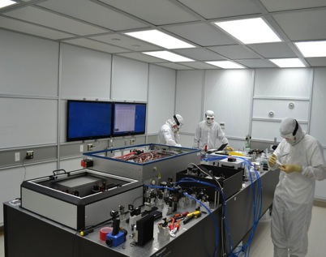
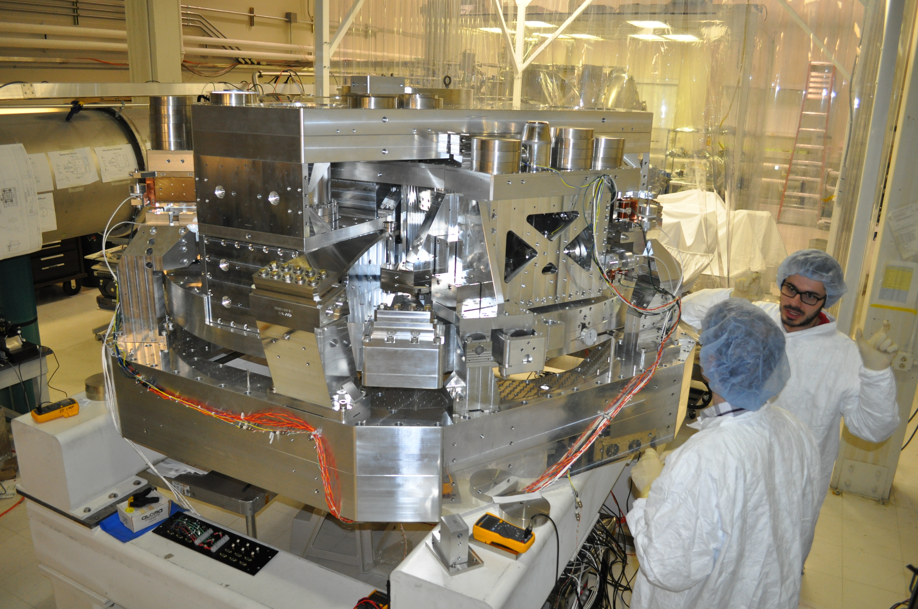
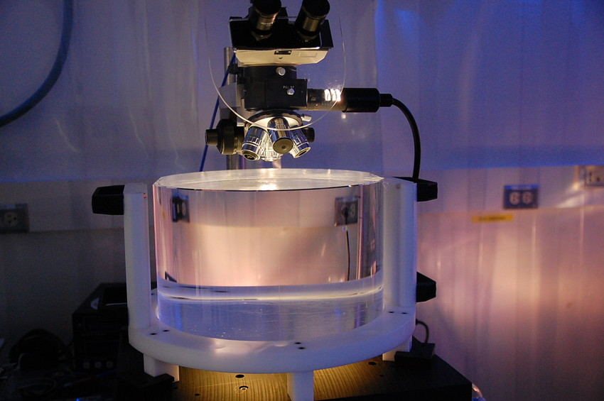
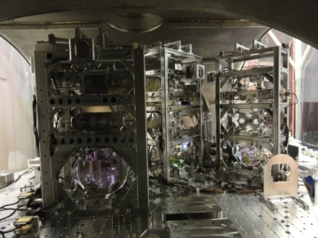
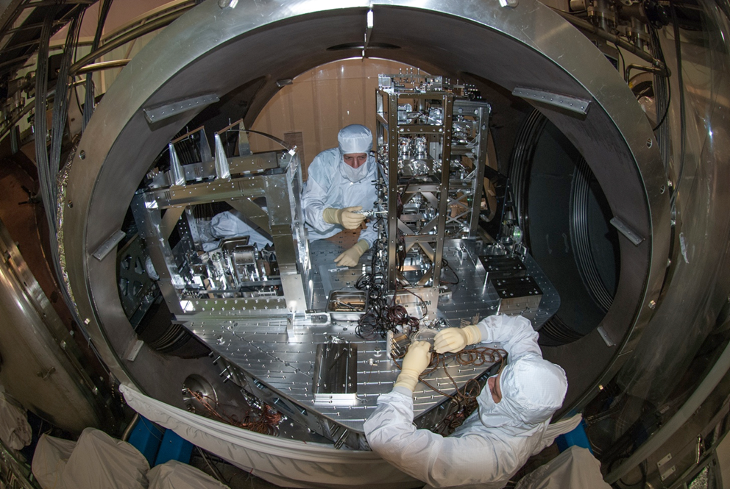
Advanced LIGO in Pictures
Quadruple
suspension
Pre-stabilized Laser
Active Seismic Isolation
40kg test mass
34cm ϕ x 20cm
Input Optics
Output Mode Cleaner
Auxiliary Laser

Slide 16
Test Masses with thermal compensation system
Requires the state of the art in substrates, polishing and coating
  Fabri-Perot cavity is used to measure arm length or space distortion
Half-nm flatness over 300mm diameter
0.2 ppm absorption at 1064nm
Coating specs for 1064 and 532 nm
Mechanical requirements: bulk and coating thermal noise, high resonant frequency
40 kg
Test Masses:
34cm ϕ x 20cm
Round-trip optical loss: 75 ppm max
Ring
heater
Compensation plates:
34cm ϕ x 10cm
BS:
37cm ϕ x 6cm
ITM
T = 1.4%

Slide 17
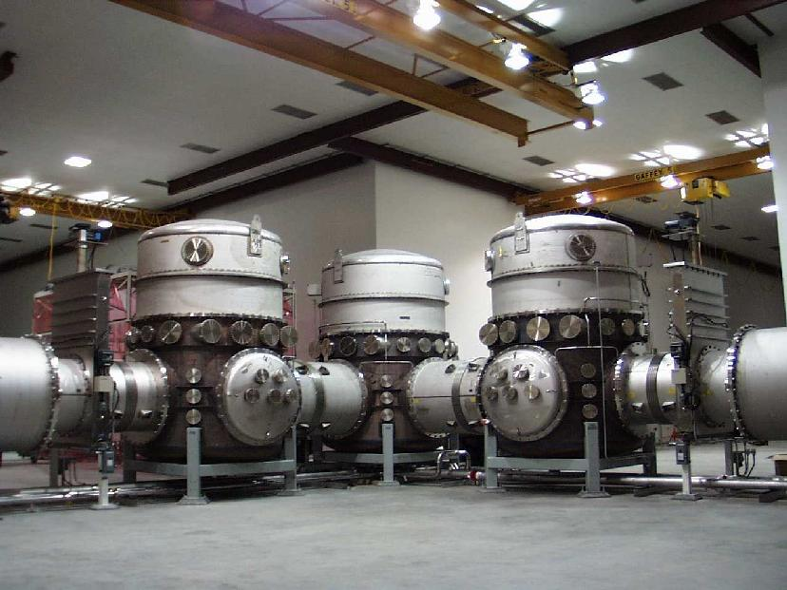

LIGO vacuums
Beam light path must be high vacuum to minimize “phase noise”. The 4km arm is the world’s biggest UHV vacuum system, and is straighter than earth’s curvature
All optical components must be in high vacuum, so mirrors are not “knocked around” by gas pressure

Slide 18
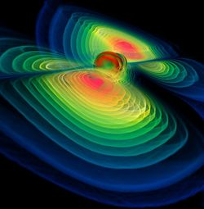
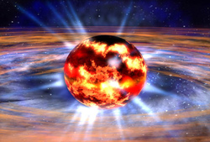
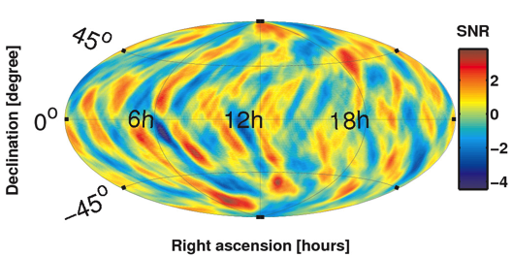
Some Questions Gravitational Waves May Be Able to Answer
Black Hole Merger and Ringdown
Fundamental Physics
  Is General Relativity the correct theory of gravity?
  How does matter behave under extreme conditions?
  What equation of state describes a neutron star?
Astrophysics, Astronomy, Cosmology
  Do compact binary mergers cause GRBs?
  What is the supernova mechanism in core-collapse of massive stars?
  How many low mass black holes are there in the universe?
  Do intermediate mass black holes exist?
  How bumpy are neutron stars?
  Is there a primordial gravitational-wave residue?
Image credit: W. Benger
Neutron Star Formation
Image credit: NASA
GW Upper limit map
Credit: LIGO Scientific Collaboration

Slide 19
Advanced LIGO Data analysis
Burst
  All-sky search for generic GW transients, in low latency for EM follow up and deep, offline for 4σ detection confidence
Compact Binary Coalescence
  Low latency, all-sky search for BNS and NS-BH systems
  Search for binary neutron-star and black-hole systems (BNS, BHNS, BBH)
Continuous Wave
  All-sky deep/broad search for isolated starts
  Targeted search for high value, known pulsars
Stochastic Gravitational Wave background
  Directional and isotropic search for stochastic gravitational wave background
  Constraints of a detected background of astrophysical origin with long transients
Search for GW signals using alerts by other signals
Parameter estimation for the astrophysical interpretation of detected events

Slide 20
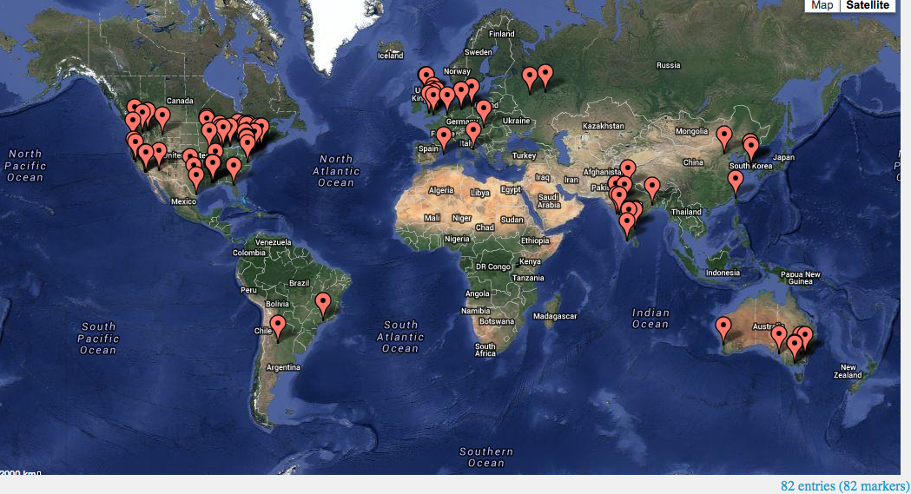
LIGO = LIGO Lab (CIT,MIT,UFL) +
LSC (LIGO Science Collaboration)
900+ members, 82 institutions, 16 countries, 52 MOUs.
https://my.ligo.org/census.php
https://roster.ligo.org/roster.php

Slide 21


Welcome! The LIGO Open Science Center (LOSC, https://losc.ligo.org) provides access to a variety of LIGO data products, as well as documentation, tutorials, and online tools for finding and viewing data.
The S5 Data Release
S5 Time Range: Nov. 4, 2005 ~ Oct. 1, 2007
Detectors: H1, H2, and L1
The S6 Data Release
S6 Time Range: Jul.7, 2009 ~ Oct 20, 2010
Detectors: H1 and L1
All Science Mode Times for LIGO/Virgo/GEO Network
Time Range: 2004 ~2014
Detectors: H1, H2, L1, G1, V1
IP addresses who downloaded data

Slide 22






International network
LIGO
GEO
detection confidence
locate the sources
verify light speed propagation
decompose the polarization of gravitational waves
Open up a new field of astrophysics!
Virgo
KAGRA
LIGO
LIGO-India

Slide 23


Improvement of Binary Neutron Star Merger Localization by Adding LIGO-India
Hanford+Livingston+Virgo
no LIGO-India
Hanford+Livingston+Virgo
And LIGO-India
x denotes blind spots
S. Fairhurst, “Improved source localization with
LIGO India”, J. Phys.: Conf. Ser. 484 012007

Slide 24




Multi-messenger astronomy collaborations with Groups
Detecting other signals
Discussions going toward the new astrophysical era
Complementary alert system
Complementary and supplemental information about the source
Many MOUs exchanged with EM partners, covering the whole EM spectrum.

Slide 25


Aiming for the future beyond advanced LIGO
Range z > 1 ( 10 x aLIGO)
New facility ⇒ Major cost
40km arm, bigger mass, better coating, reduction of losses
Range ~ 2x A+ (700 MPc)
Cost O( $50M~$100M )
Cryogenic (120K), 1550nm laser, Silicon, better coating
Range ~ 2x aLIGO (340Mpc)
Cost O( $10M )
Squeezing, bigger mass, better coating, reduced thermal noise

Slide 26

Slide prepared for
2016 announcement

