Slide 1

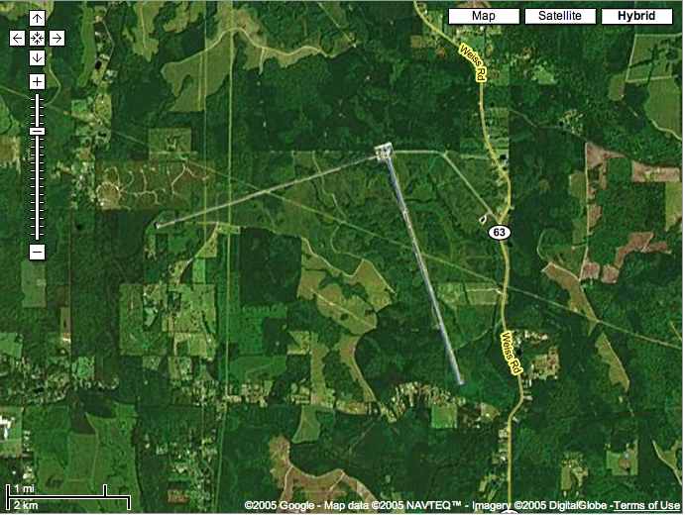
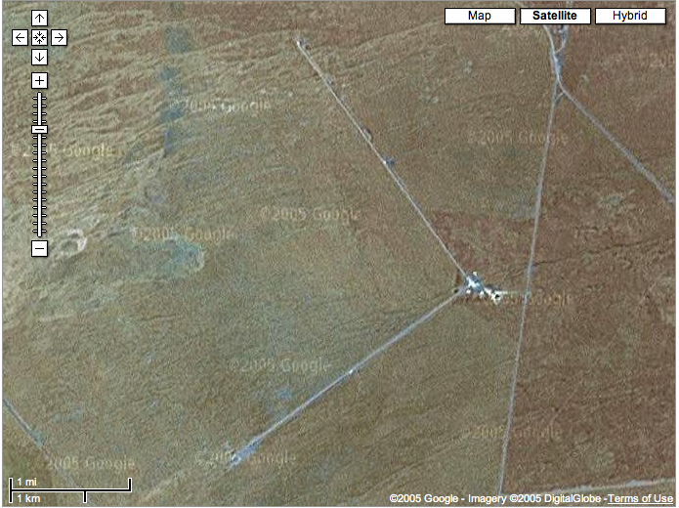
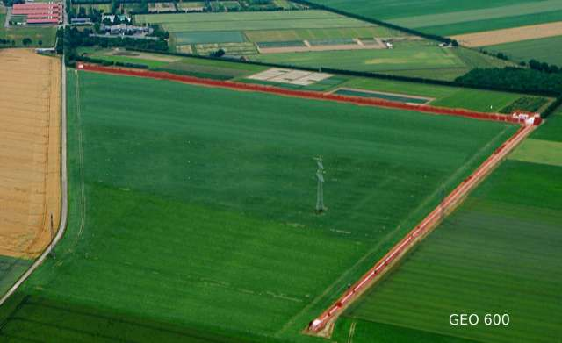
The LIGO Scientific Collaboration
Gabriela González,
Louisiana State University
For the LIGO Scientific Collaboration
LIGO Livingston Observatory
LIGO Hanford Observatory

Slide 2
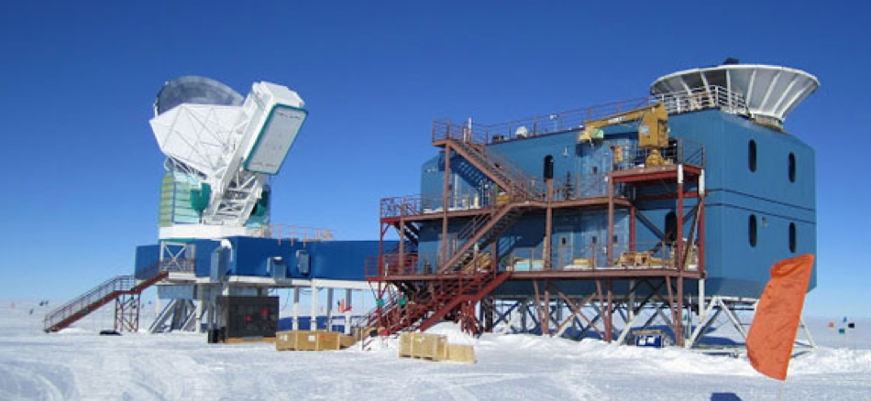
Gravitational waves: sources and detectors
Credit: Nanograv

Slide 3
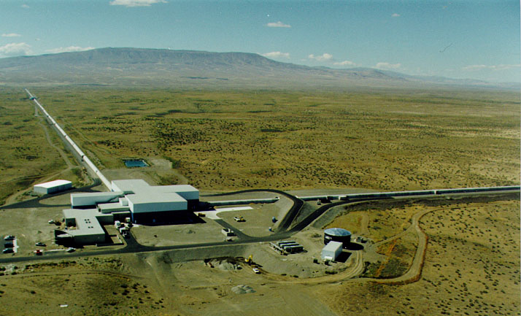
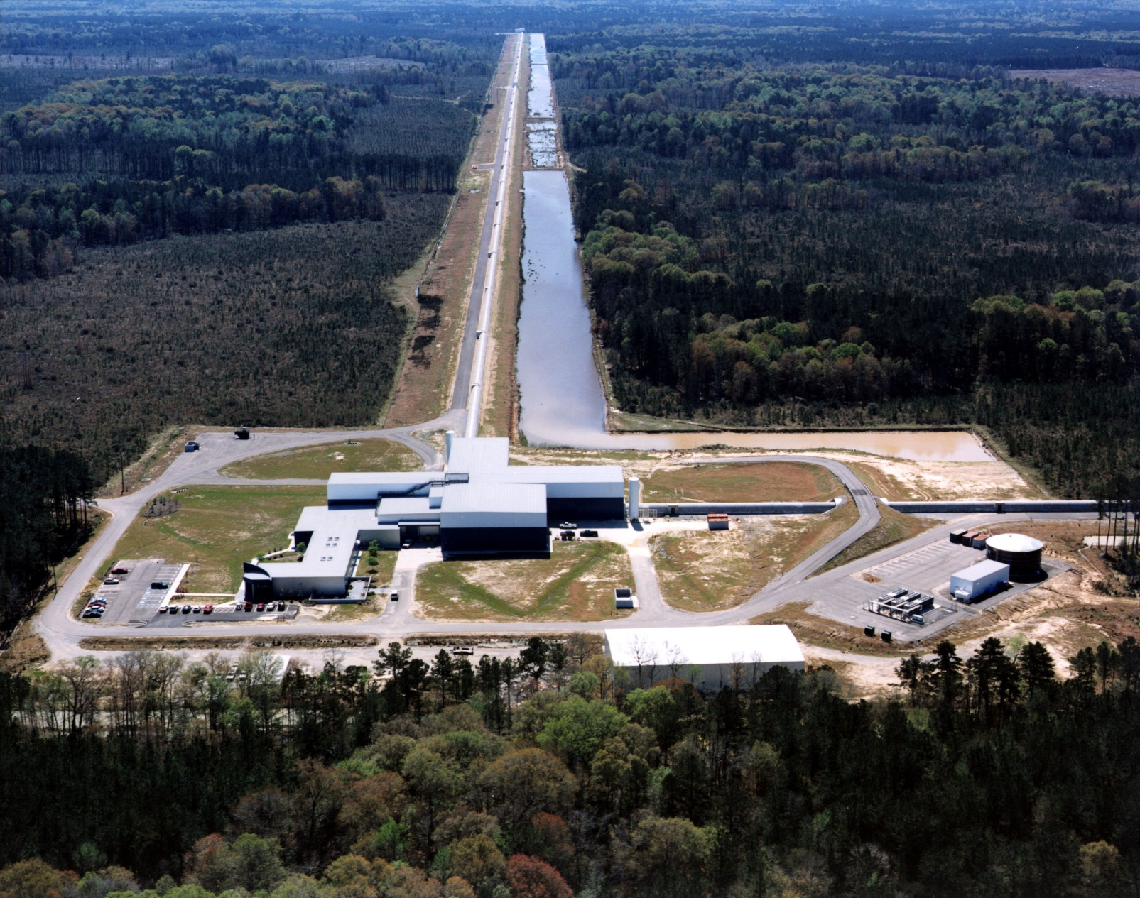

LIGO detectors
Livingston, LA
Hanford, WA

Slide 4
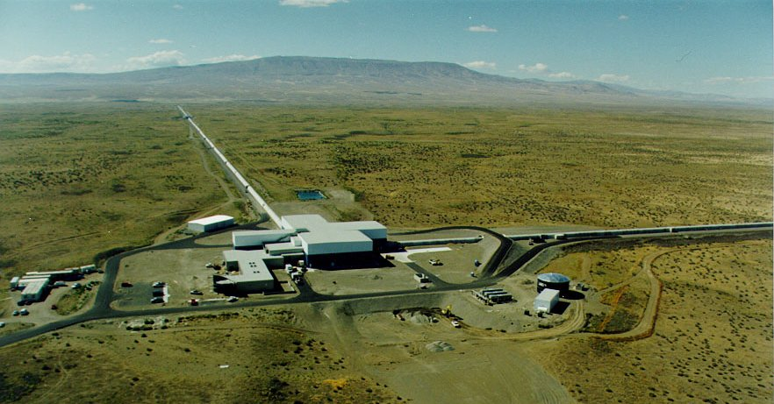
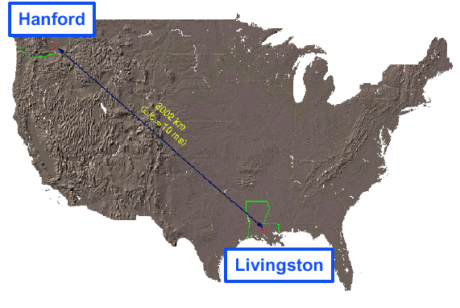
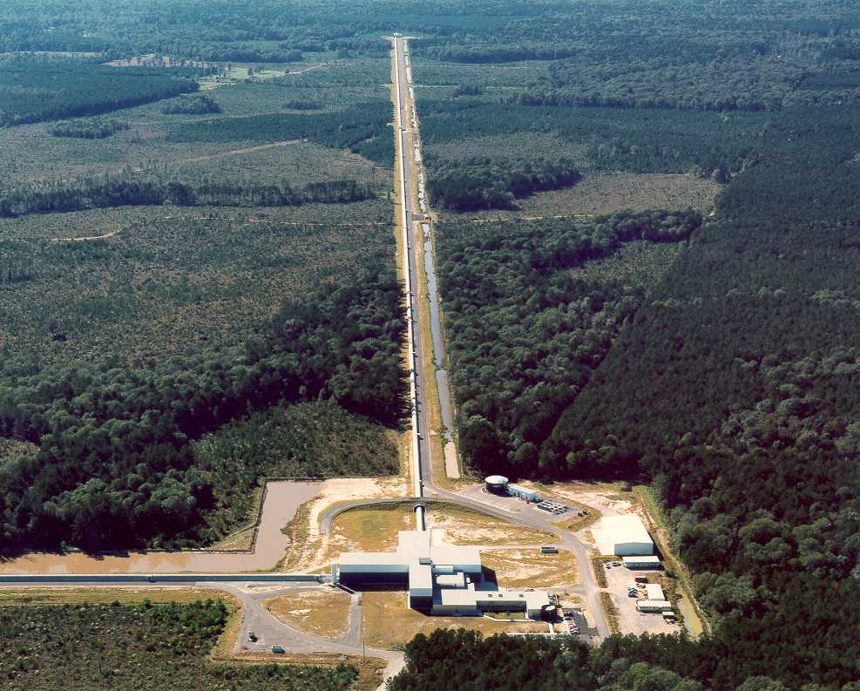
LIGO Laboratory
Mission: Observe gravitational wave sources; operate the LIGO facilities; develop the instrument science and technology; scientific education and public outreach.
NSF Major Research Facilities Construction LIGO grant in 1992 and in 2008; cooperative agreements since 1992, jointly managed by Caltech and MIT; develop the instrument science and technology; education and public outreach.
~200 scientists, engineer and staff; includes physicists working on instrument science and data analysis.
MIT
Caltech
LIGO Livingston
Notes:
LIGO is actually two observatories.
Describe parameters
Emphasize that the arms are in ultra high vacuum. 8 km of steel 1.2 m dia beam tubes at each site
Separate observatories allow for coincidence detection – since the detectors see uncorrelated noise, only a true gravitational wave would appear on all the interferometers with the correct amplitude.
Emphasize that the LIGO Observatories were designed and are operated by Caltech and MIT

Slide 5
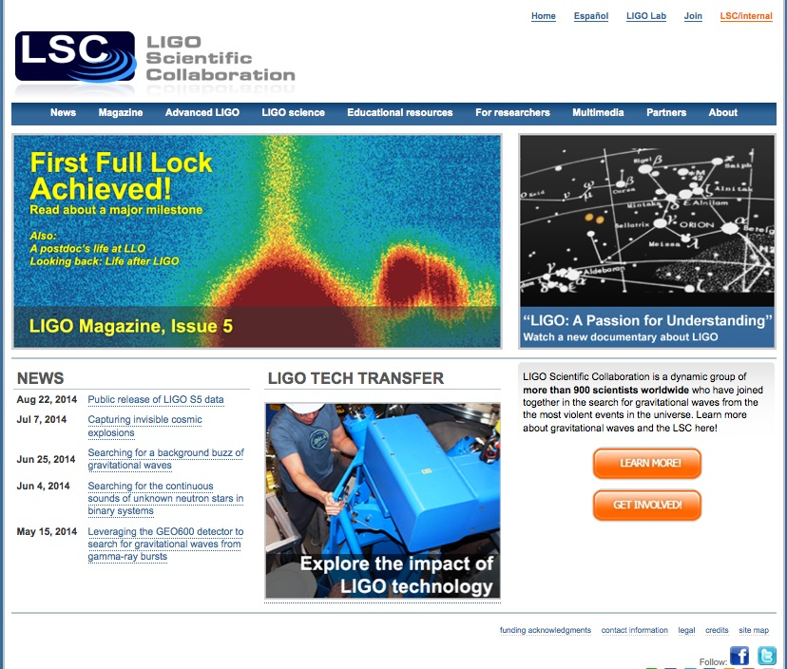
LIGO and LSC
The LSC and the LIGO Laboratory together make up “LIGO”.
LSC Mission: The LIGO Scientific Collaboration (LSC) is a self-governing collaboration seeking to detect gravitational waves, use them to explore the fundamental physics of gravity, and develop gravitational wave observations as a tool of astronomical discovery.
LSC Responsibilities:
  data analysis strategy, goals, and timeline, and carry out the data analysis program;
  identify priorities for research and development, and carry out the R&D program;
  carry out a public outreach, and provide educational opportunities for young people;
  disseminate the results of the data analysis program and the R&D program;
  participate in the scientific operations of the LIGO detectors;
  perform internal evaluation of progress in data analysis and R&D.
www.ligo.org

Slide 6
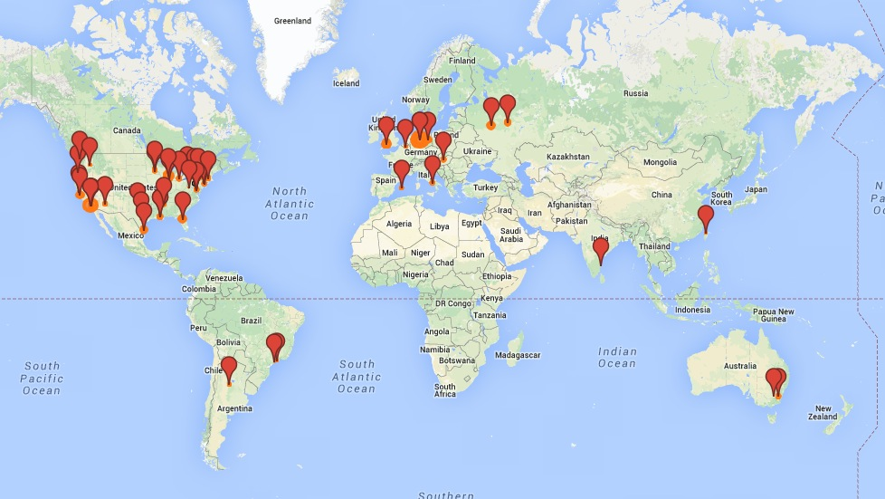
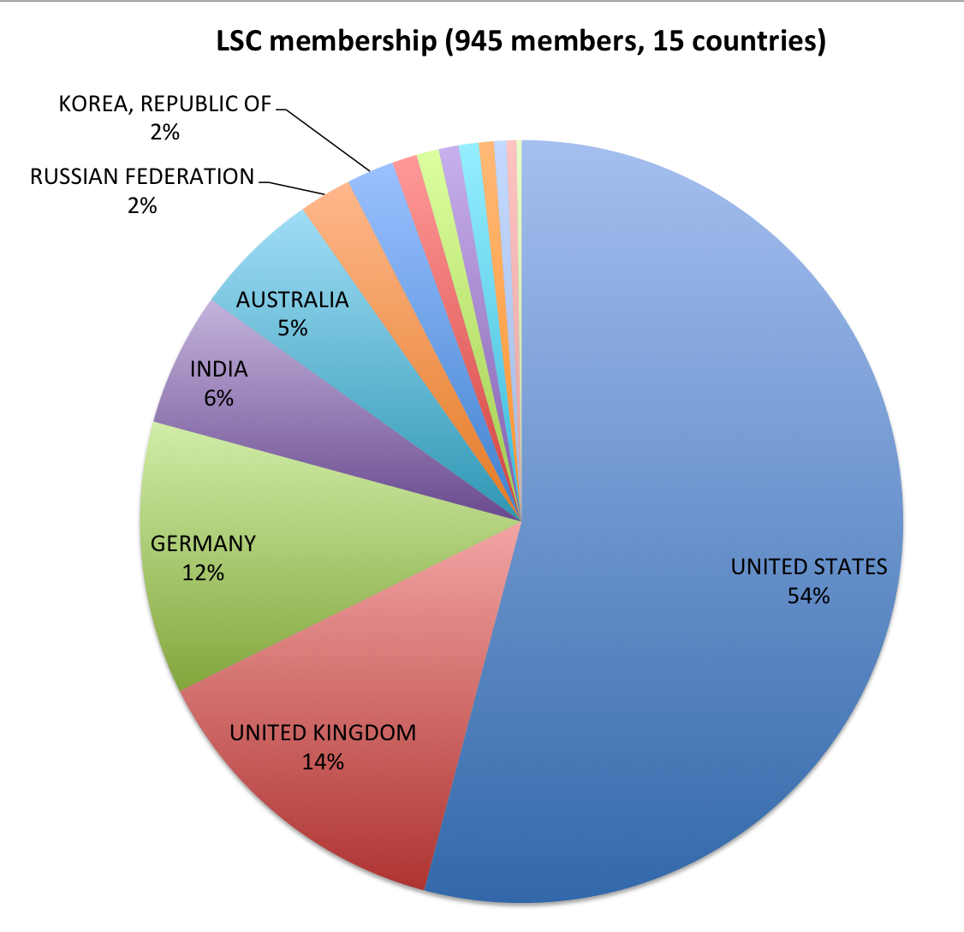
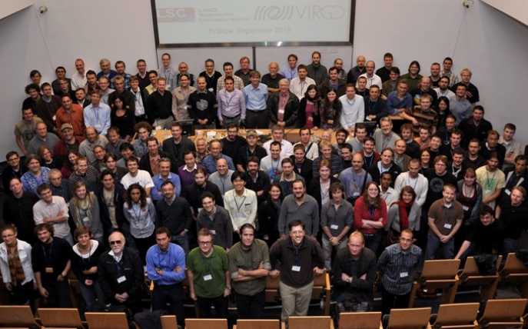
LIGO Scientific Collaboration
ITALY
HUNGARY
BRAZIL
SPAIN
CHINA
TAIWAN
CANADA
BELGIUM
www.ligo.org

Slide 7
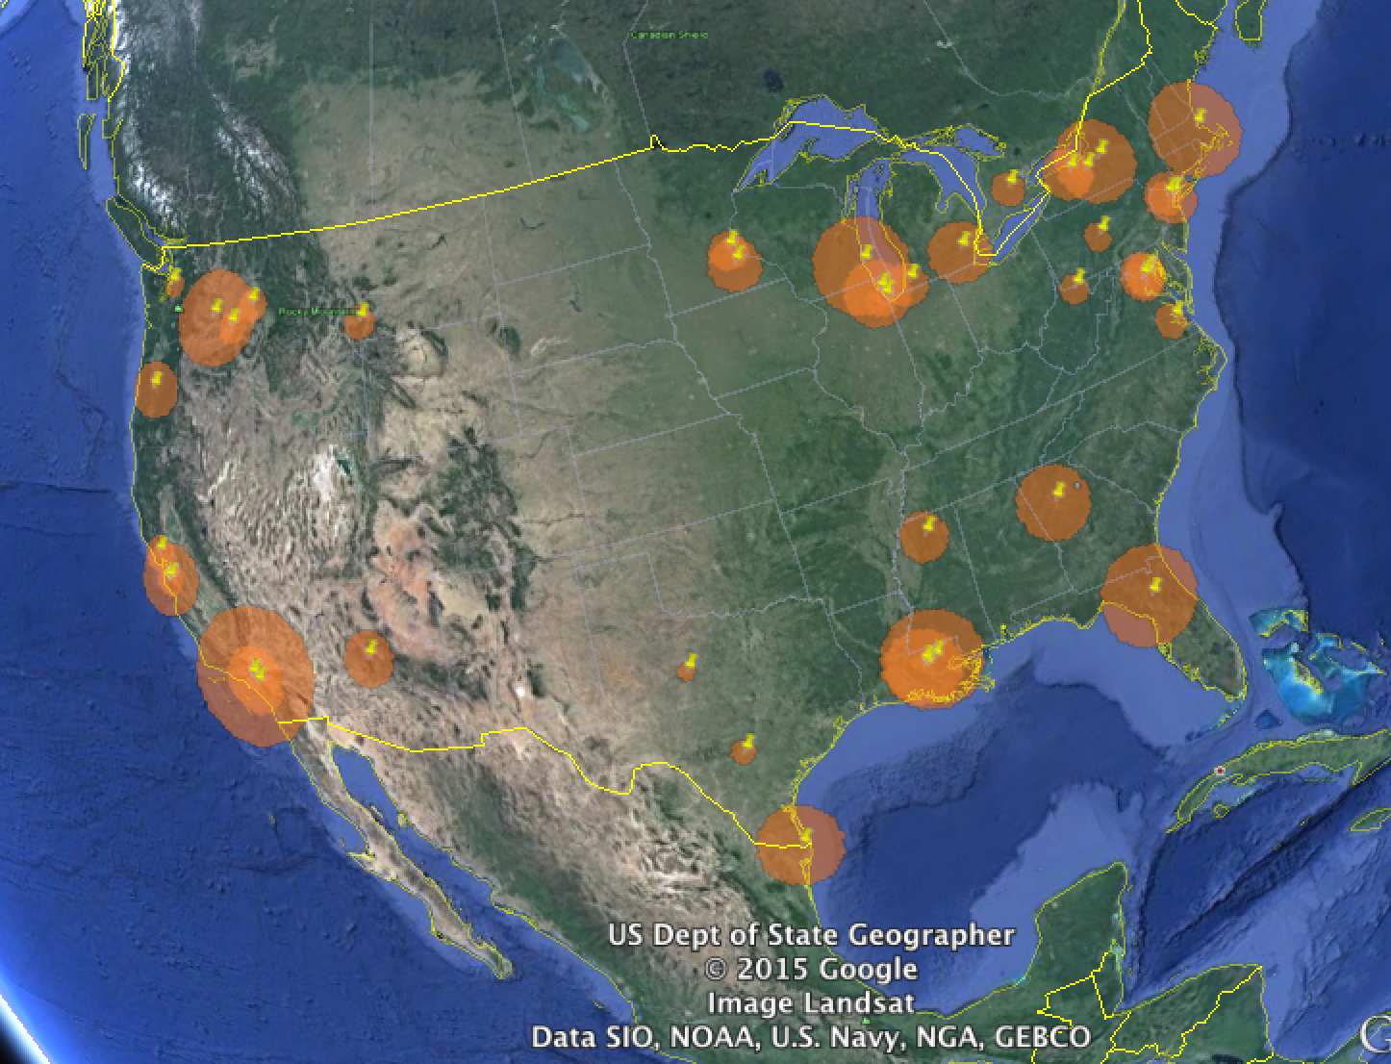
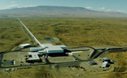

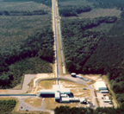
LSC-USA
Large institutional diversity: large and small departments, graduate and undergraduate institutions, several serving large under-represented groups.
Most US groups are supported by NSF with competitive, single investigator NSF grants. LIGO Laboratory (~30% of LSC) is supported by CA NSF grant to Caltech and MIT.
Many LSC “graduates” now working in STEM industries (Intel, Synaptics, Google, SpaceX, Apple, Facebook,…), national facilities (Lincoln Labs, NASA, …) and academia.

Slide 8
LIGO Scientific Collaboration
Some LSC Principles:
  Open: “No individual or group will be denied membership on any basis except scientific merit and the willingness to participate and contribute as described in this Charter.”
  Member agreements (MOUs) describe scientific, not financial, commitments.
  Democratic: Spokesperson and working group leaders elected (w/2 yr terms).
  Formal LSC/LIGO Lab interaction: “LIGO directorate” consists of the LSC spokesperson, and the Executive and Deputy Directors of the LIGO Laboratory. The LIGO Directorate will be ex officio members of all planning and evaluative bodies of the LSC. (On the ground, there are no differences between LIGO Lab LSC members and other group members, other than funding.)
Some history:
  Created in 1997, already international (Germany, UK, Australia, Russia).
  Initially ~25 groups, 200 people, Rai Weiss spokesperson 1997-2003
  Peter Saulson elected spokesperson 2003-2007, David Reitze 2007-2011, GG 2011-2017.

Slide 9
The LIGO Scientific Collaboration
LSC Council
LSC Executive Committee
(LSC Spokesperson)
LSC Spokesperson
(G. González)
Assistant Spokesperson (M. Cavaglià)
LSC-Virgo Committees
LSC Service Committees
Data Analysis
(L. Cadonati)
Instrument Science
(D. McClelland)
Education and Public Outreach
(S. Marka)
Burst Sources
(I.S. Heng, J. Kanner)
Data Analysis and Software
(P. Brady)
Quantum Noise
(R. Schnabel)
Formal Education
(L. Cominsky, D. Ingram, W. Katzmann)
Compact Binary Sources
(C. Hanna, J. Veitch)
Computing Committee
(B. Allen, S. Anderson)
Lasers and Auxiliary Optics
(V. Quetschke)
Informal Ed./Public Outreach
(M. Hendry)
Optimization
(P. Couvares)
Continuous Wave Sources
(K. Riles, G. Woan)
Detector Characterization
(J. Smith)
Optics
(I. Martin)
Stochastic Background
(N. Christensen, E. Thrane)
Calibration
(J. Betzwieser, X. Siemens)
Seismic Isolation and Suspensions
(B. Lantz)
Adv. Interferometer Configurations
(M. Evans)

Slide 10

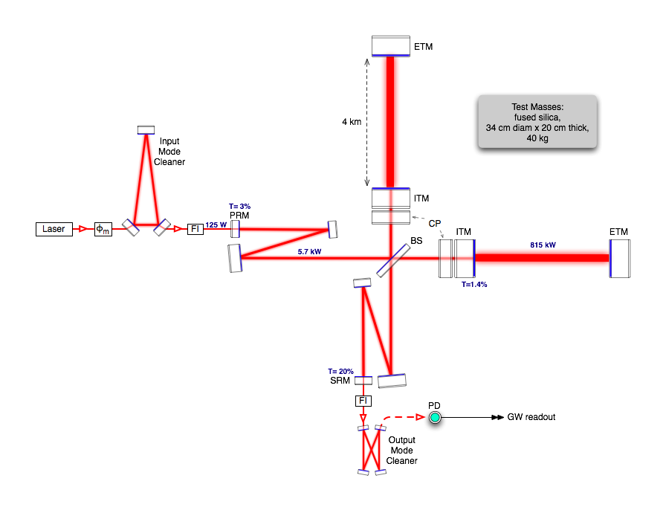
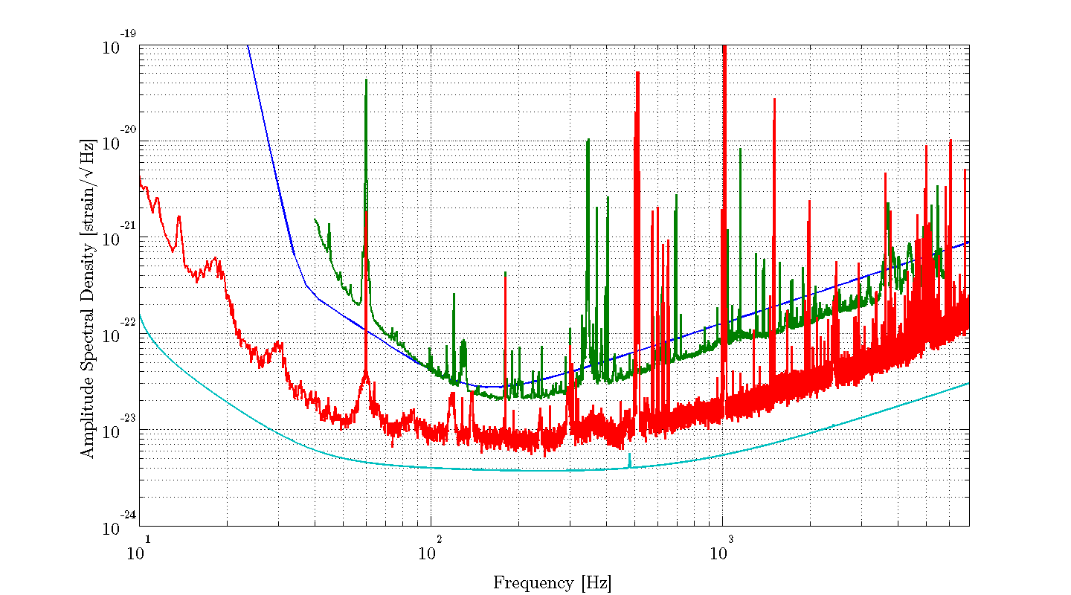
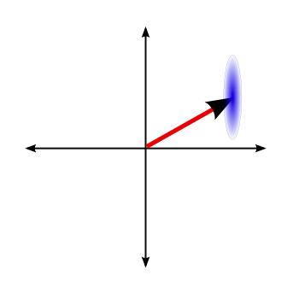
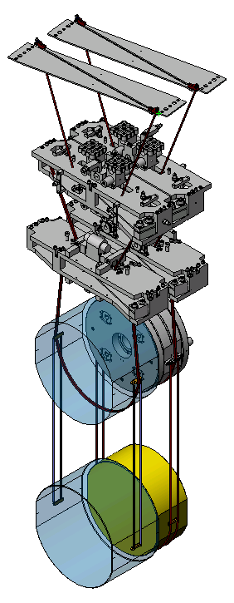
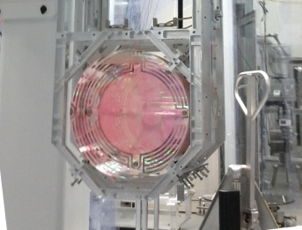
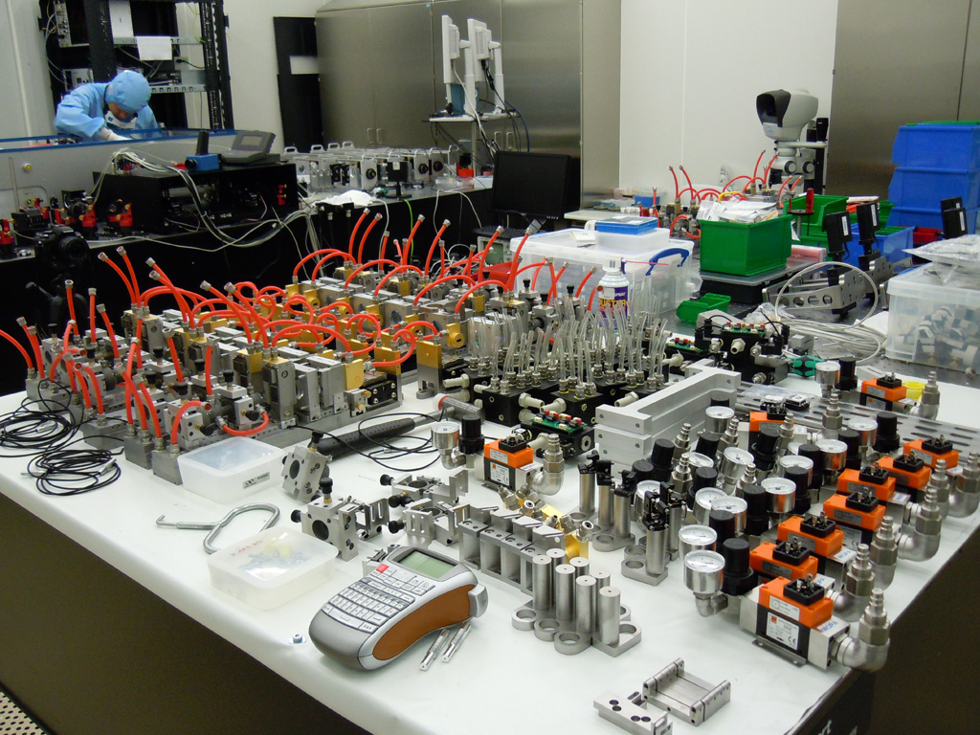
LIGO Detector Technology
Initial LIGO design; ~15 Mpc BNS avg range
S6 L1 sensitivity ~ 15 Mpc
April L1 sensitivyt ~ 65 Mpc sensitvity
Advanced LIGO sensitivity ~ 200 Mpc
Latest: https://dcc.ligo.org/LIGO-G1401390/public
Five instrumental working groups – white paper LIGO-T1400316 (dcc.ligo.org)
about R&D for future detectors with improved sensitivities

Slide 11
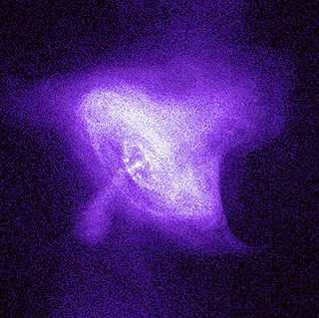
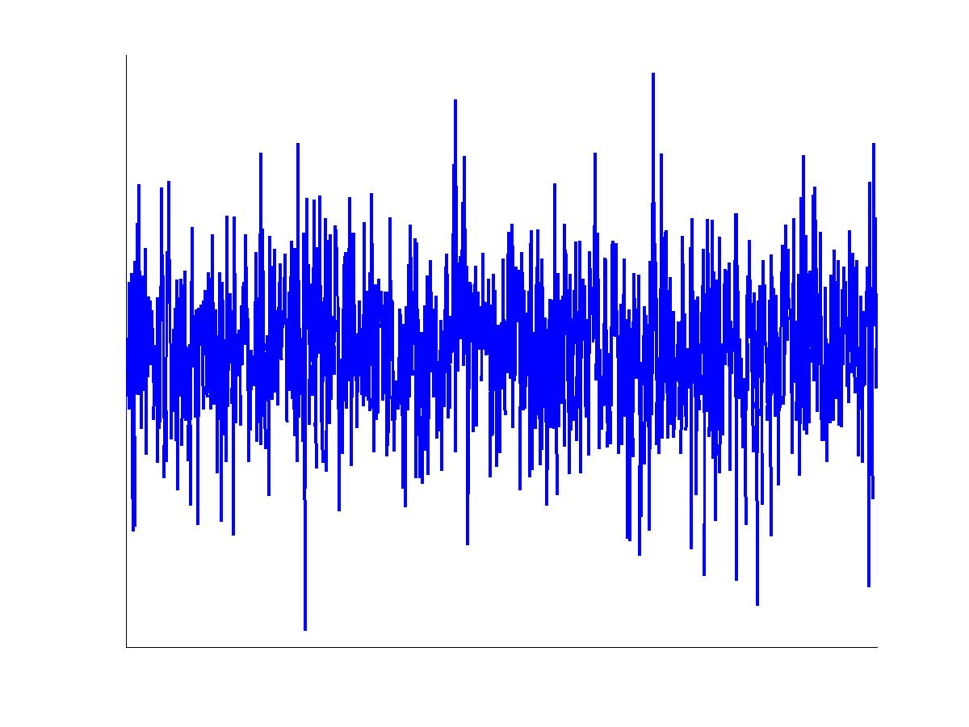
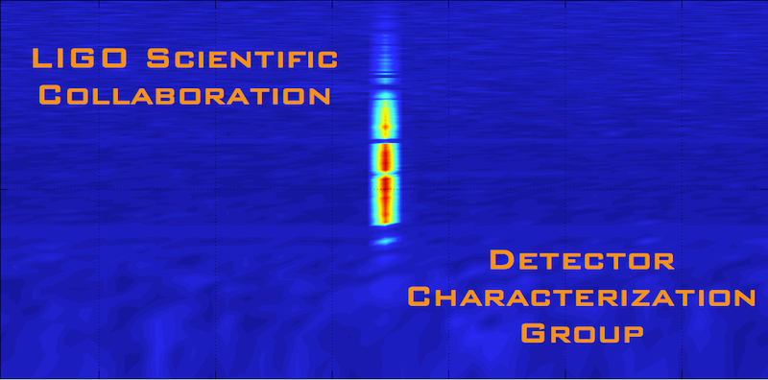
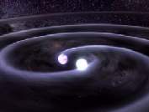
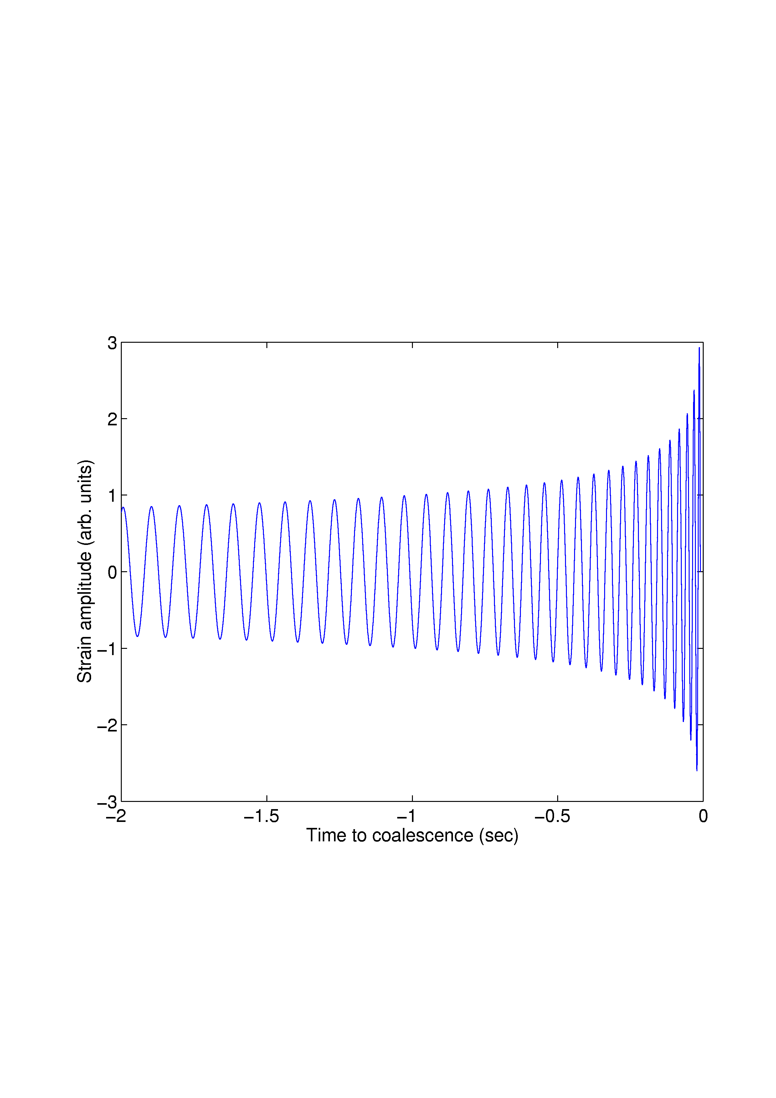
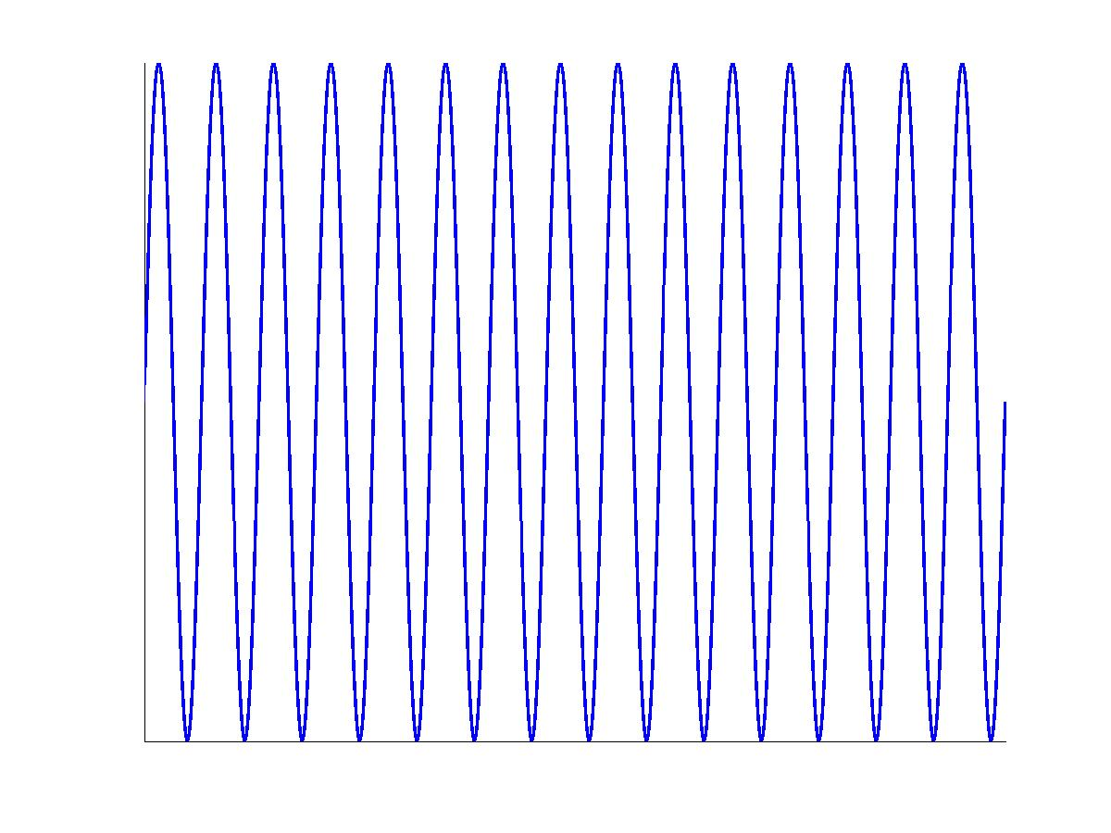
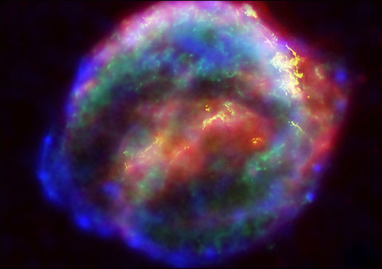
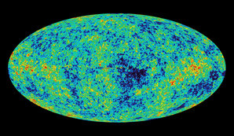
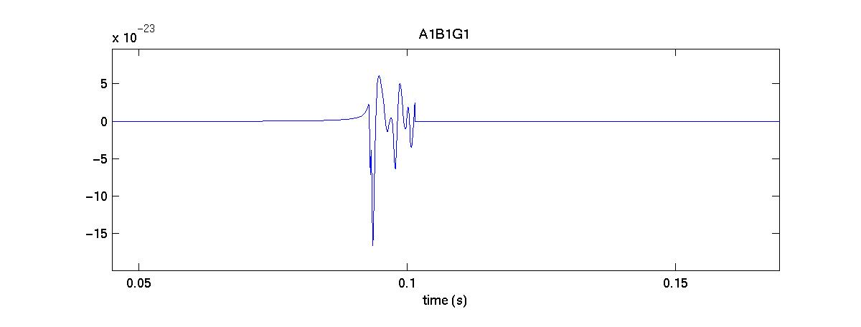
LIGO Data Analysis
Crab pulsar (NASA, Chandra Observatory)
Latest: https://dcc.ligo.org/LIGO-G1401390/public
?
NASA, WMAP
Four analysis working groups (plus detector characterization, software and computing)
white paper LIGO-T1400054 (dcc.ligo.org)
about search plans for Adv LIGO and Virgo dete

Slide 12
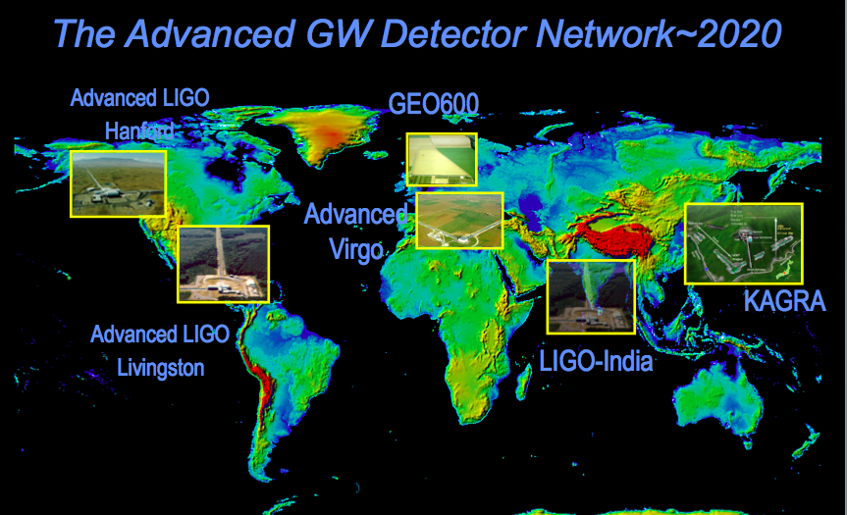
LIGO leads but it’s not alone: gravitational wave network

Slide 13
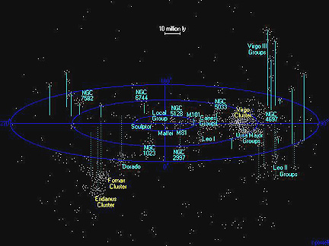
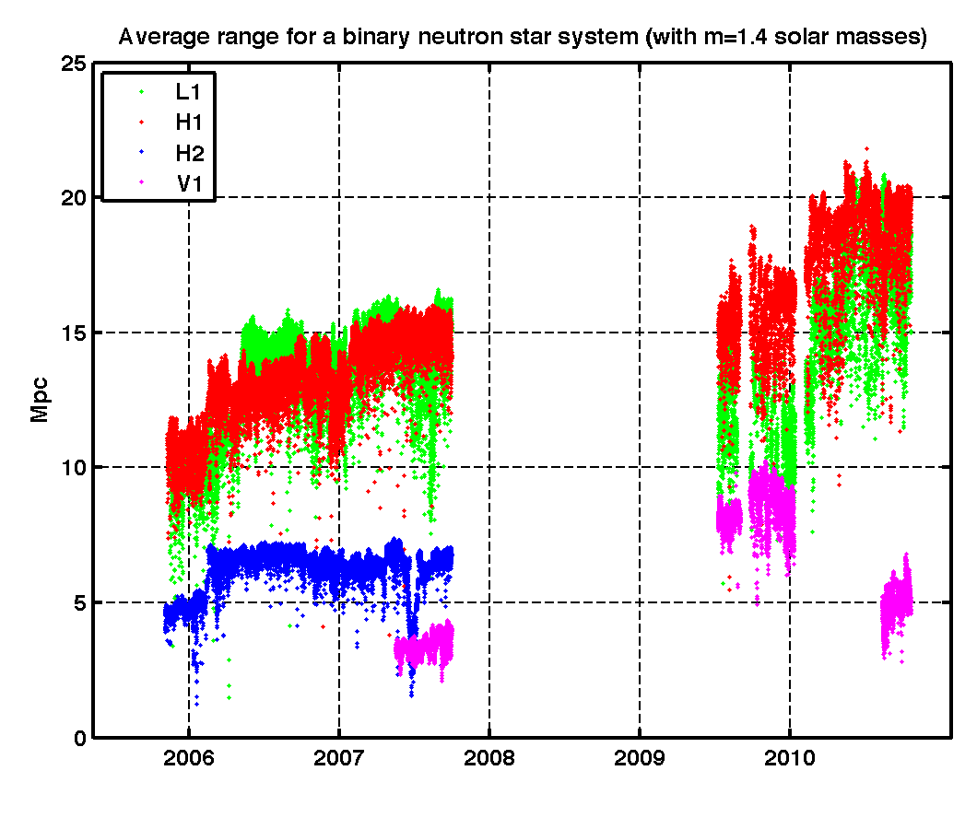
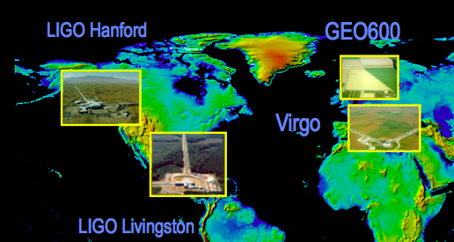
LIGO-Virgo detectors 2005-2010
atlasofthe universe.com

Slide 14
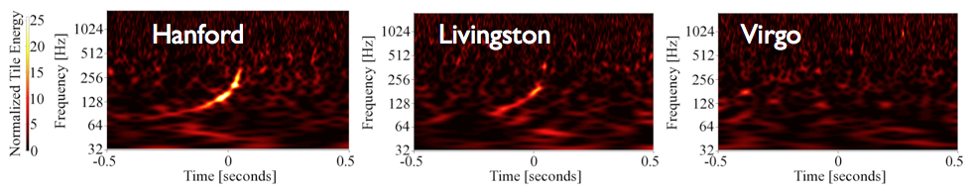
Some S5/S6 LSC results
Best experimental limits to cosmic GW background around 100 Hz (Nature 460 (2009) 990)
Limits on GW radiation from known pulsars: “mountains” on Crab are less than 1m high (Astrophys. J. 785 (2014) 119)
Multi-messenger searches for GW transients in coincidence with neutrinos, gamma ray bursts, soft gamma repeaters, pulsar glitches, magnetars, …
We can detect GWs! Phys. Rev D85 (2012) 082002
All publications in www.ligo.org

Slide 15
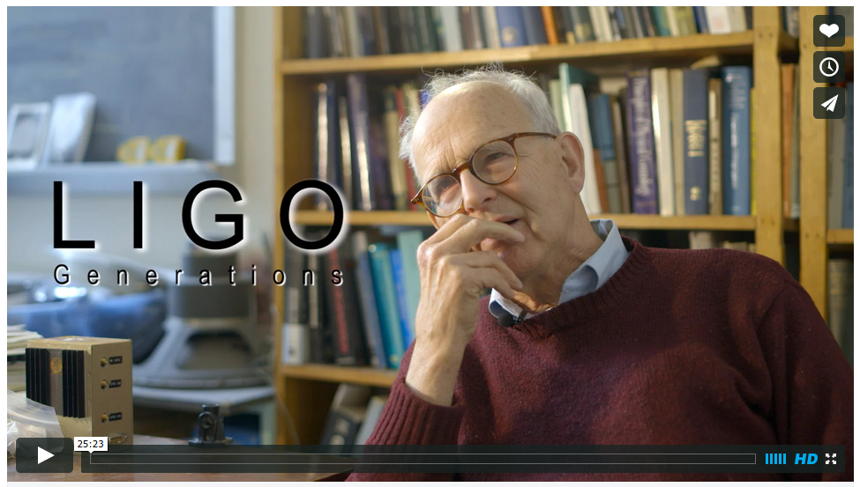
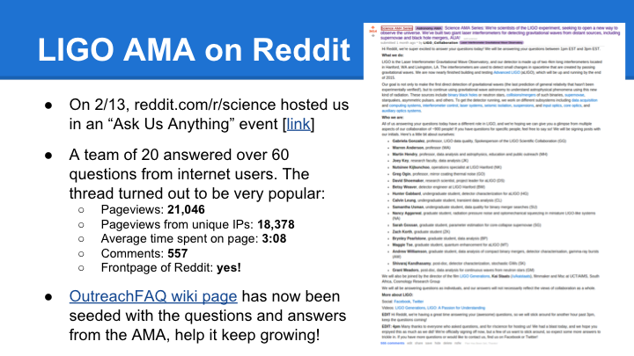
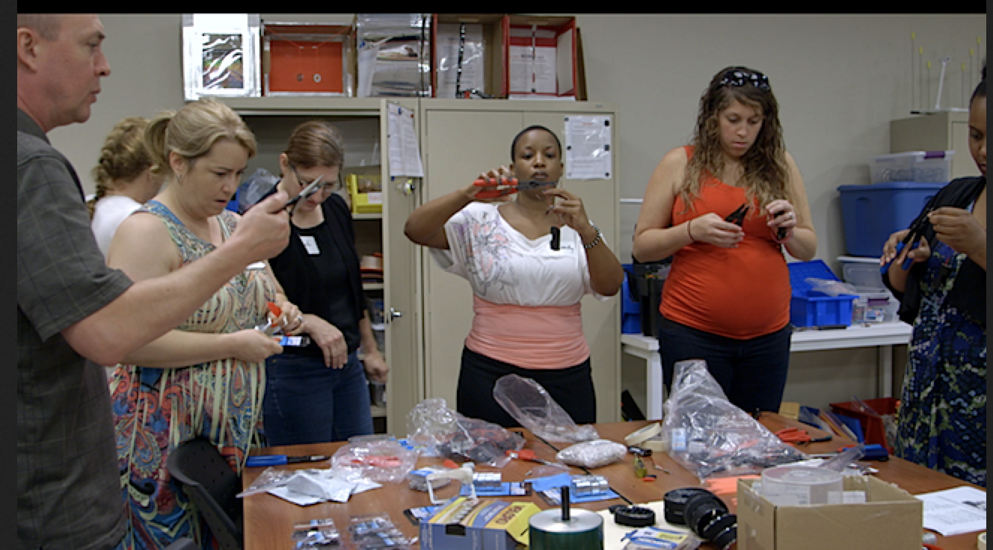
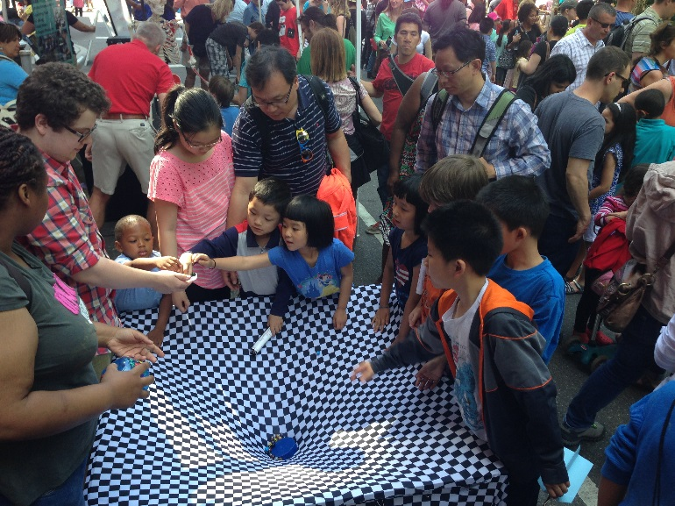
Education and Public Outreach
http://facebook.com/ligofilm
Multimedia
Social media
Science teachers’ education
Science fairs, exhibits, Science Education Center

Slide 16

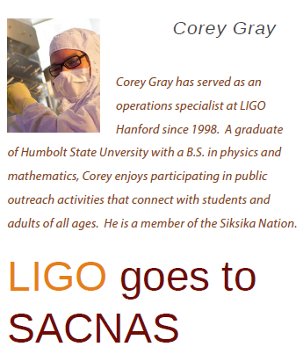
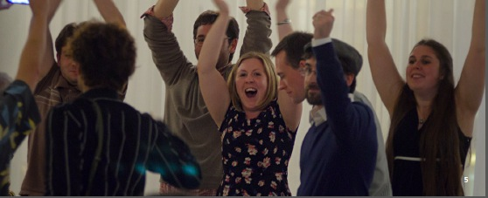
Other important LSC activities
Diversity
  LSC has a “Diversity Committee. Some initiatives:
    LSC Diversity statement; anti-harassment policy, LSC “best practices”
    LSC “Ombudsperson” (former NSF program officer!)
    LIGO summer undergraduate fellowships sponsored by NSBP and NSHP
    “Family grants” to attend LSC meetings
    Set up a booth and organize sessions in scientific meetings of women and minorities
Academic mentoring
  The LSC has an “Academic Advisory Committee” to care about mentoring of young members. Some recent activities:
    Student and postdoc events and useful tutorials.
    “Industry panels” with colleagues working now in industry.
    Mentoring program: a platform for members of the LSC to form and maintain mentoring relationships.

Slide 17
LSC Service Committees
Operations
(F. Raab)
Publications and Presentations
(S. Fairhurst, S. Klimenko)
Bylaws Committees
LIGO Document M050172
Detection
(P. Saulson)
Election and Membership
(D. Tanner)
MOU Review
(LSC Spokesperson)
LSC Academic Advisory Committee
(J. Read, A. Stuver)
Auth Project
(W. Anderson)
Beginners Guide
(L. Nuttall)
Diversity
(M. Cavaglià)
Other Committees
LIGO Magazine
(A. Freise)
LSC Fellows
(M. Landry, B. O’ Reilly)
Meeting
(E. Gustafson)
Remote Participation
(N. Christensen)

Slide 18
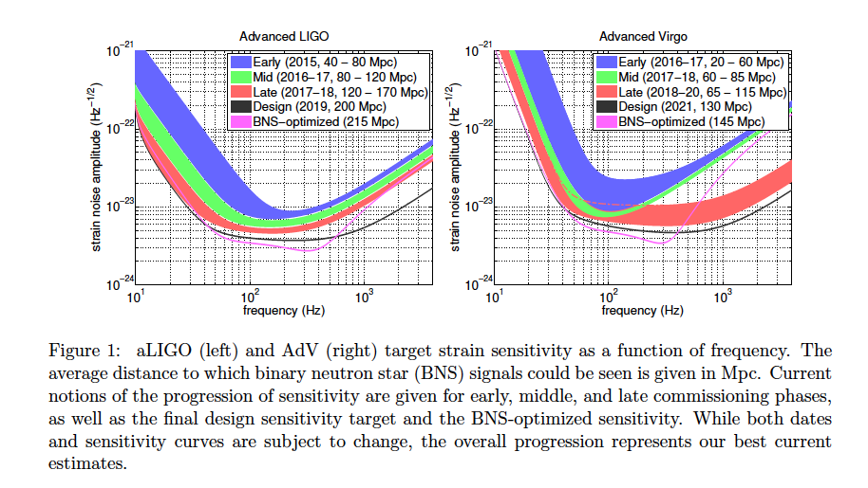
The future is coming – very soon!
Prospects for Localization of Gravitational Wave Transients by the Advanced LIGO and Advanced Virgo Observatories, The LIGO Scientific Collaboration and The Virgo Collaboration, arXiv:1304.0670

Slide 19
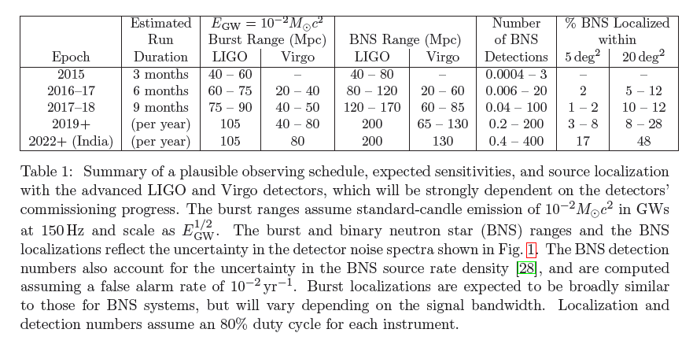
Observing Scenario

Slide 20
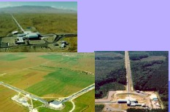

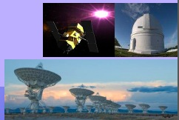
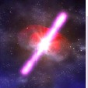
Multi-messenger astronomy:
GW/EM observations
We will obtain rich astrophysics combining gravitational-wave and electromagnetic information.
LSC and Virgo opened a call to sign agreements for the identification of EM counterparts to GW triggers in Advanced detectors starting in 2015: http://www.ligo.org/scientists/GWEMalerts.php
We received and approved more than 60 applications from 19 countries, with about 150 instruments covering the full spectrum, from radio to high-energy gamma-rays.
Shortly after a few detections, LSC/Virgo will publicly release GW triggers for follow up: dcc.ligo.org, LIGO-M1200055,

Slide 21
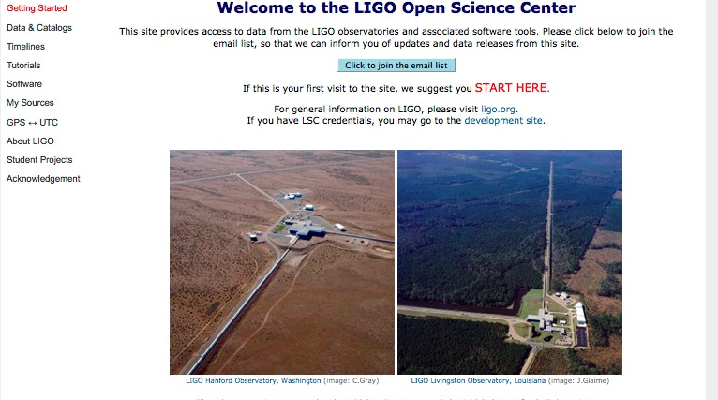
LIGO open data
LIGO is committed to open data and prompt release of GW observations.
Much development is needed for releasing LIGO data - prototyping with initial LIGO data: S5 is now public, S6 data will be soon.
https://losc.ligo.org/

Slide 22
Conclusions
Although atypical, the LSC model with an open collaboration created around a “LIGO Laboratory” has worked well.
Large size has already many challenges. More challenges lie ahead: collaboration model will evolve in the presence of detections and open data, funding for future detectors, …
The field will always need a large collaborative team working on operations, timely science analysis, and R&D ready for installation in new detectors, plus innovative methods for analysis and research on new technologies.

