Slide 1

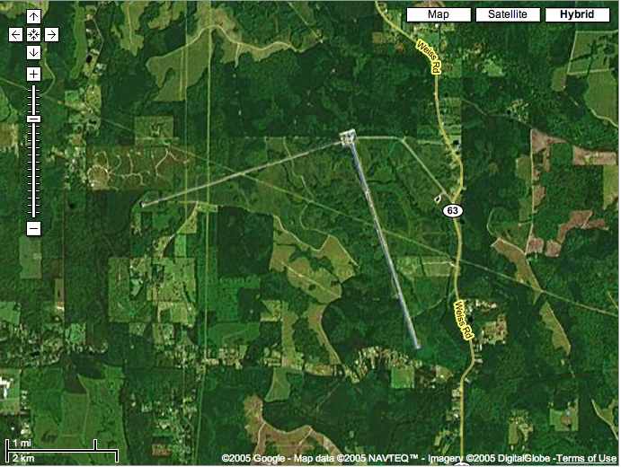
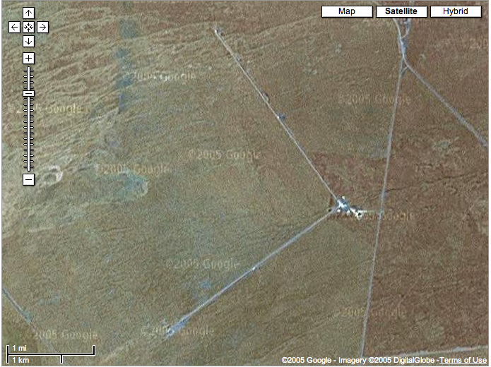
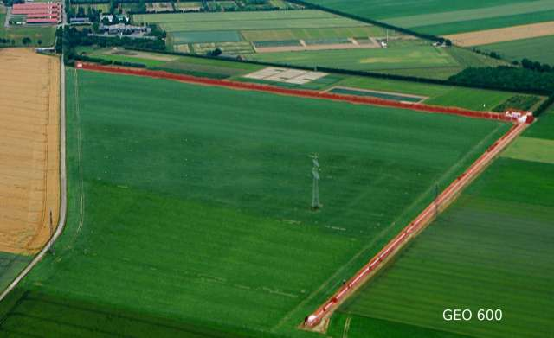
LIGO and its Scientific Collaboration
Gabriela González,
Louisiana State University
LIGO Scientific Collaboration
spokesperson
LIGO Livingston Observatory
LIGO Hanford Observatory

Slide 2
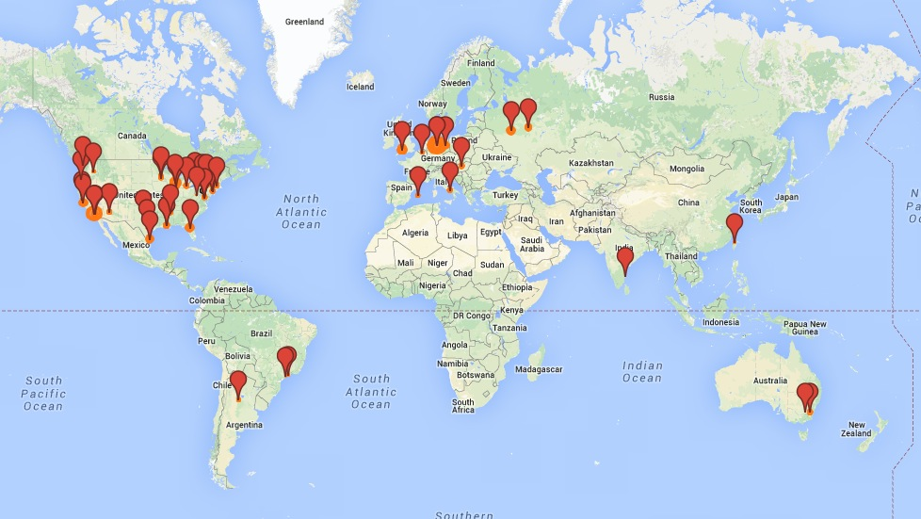
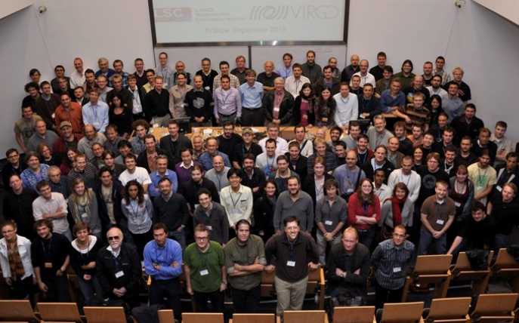
LIGO Scientific Collaboration
900+ members, 80+ institutions, 16 countries

Slide 3
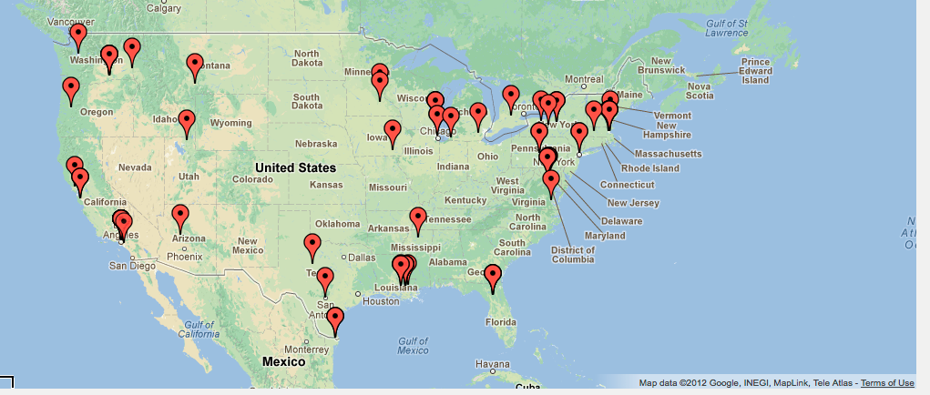



LSC-USA
Of LSC 900+ members, 500+ are in the USA.
Large institutional diversity: large and small departments, graduate and undergraduate institutions, several serving large under-represented groups.
Most US groups are supported by NSF by competitive, single investigator NSF grants. LIGO Laboratory (~25% of LSC) is supported by MRFC NSF grant to Caltech and MIT.
Many LSC “graduates” now working in STEM industry (Intel, Synaptics, Google, SpaceX, Apple, Facebook,…), national facilities (Lincoln Labs, NASA, …) and academia.

Slide 4
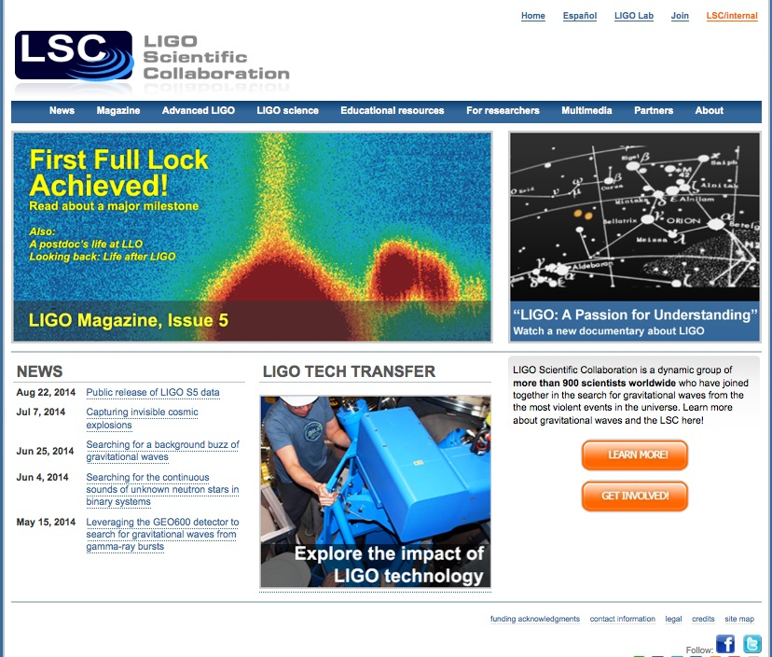
LIGO and LSC
The LSC and the LIGO Laboratory together make up “LIGO”.
LSC Mission: The LIGO Scientific Collaboration (LSC) is a self-governing collaboration seeking to detect gravitational waves, use them to explore the fundamental physics of gravity, and develop gravitational wave observations as a tool of astronomical discovery.
LSC Responsibilities:
  data analysis strategy, goals, and timeline, and carry out the data analysis program;
  identify priorities for research and development, and carry out the R&D program;
  carry out a public outreach, and provide educational opportunities for young people;
  disseminate the results of the data analysis program and the R&D program;
  participate in the scientific operations of the LIGO detectors;
  perform internal evaluation of progress in data analysis and R&D.
www.ligo.org

Slide 5
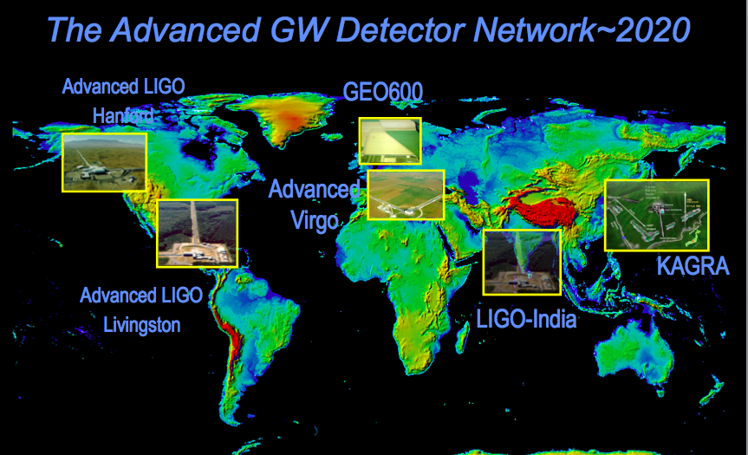
LIGO leads but it’s not alone: gravitational wave network

Slide 6


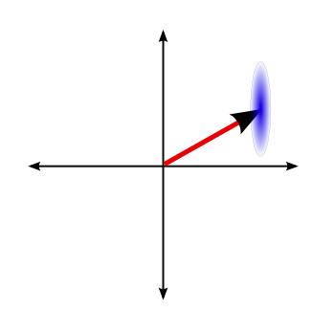

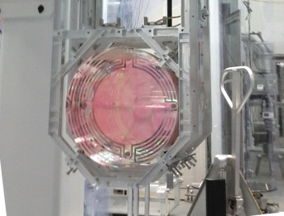
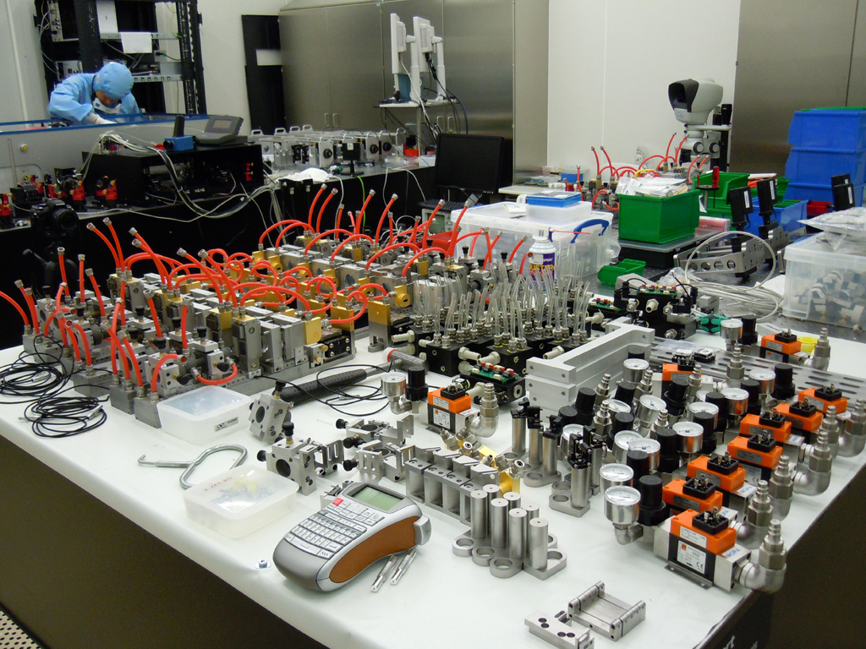
LIGO Detectors Technology
Strain (1/√Hz)
Five instrumental working groups – white paper LIGO-T1400316 (dcc.ligo.org).

Slide 7
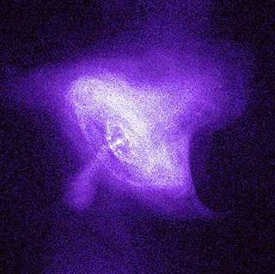
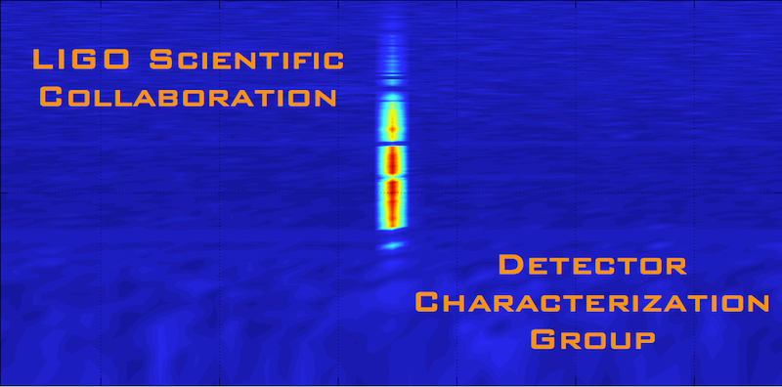
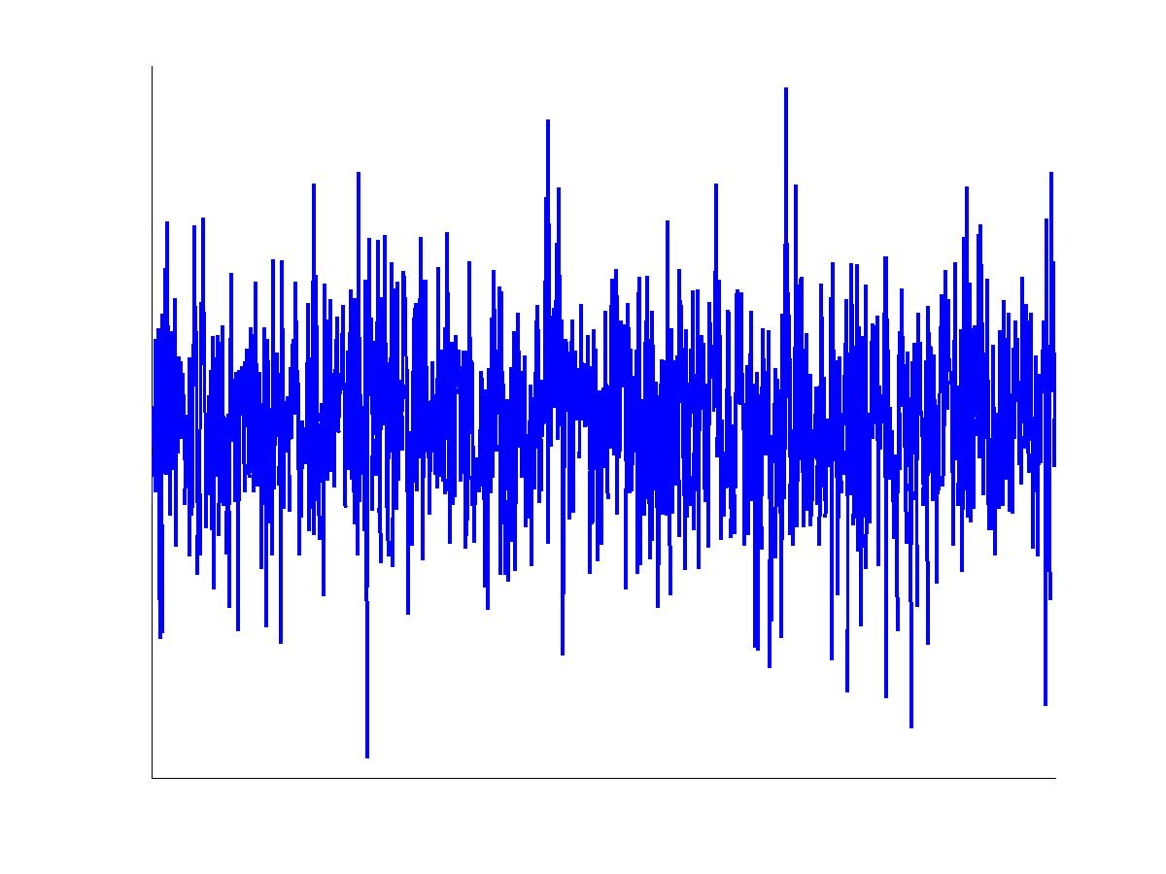
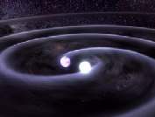
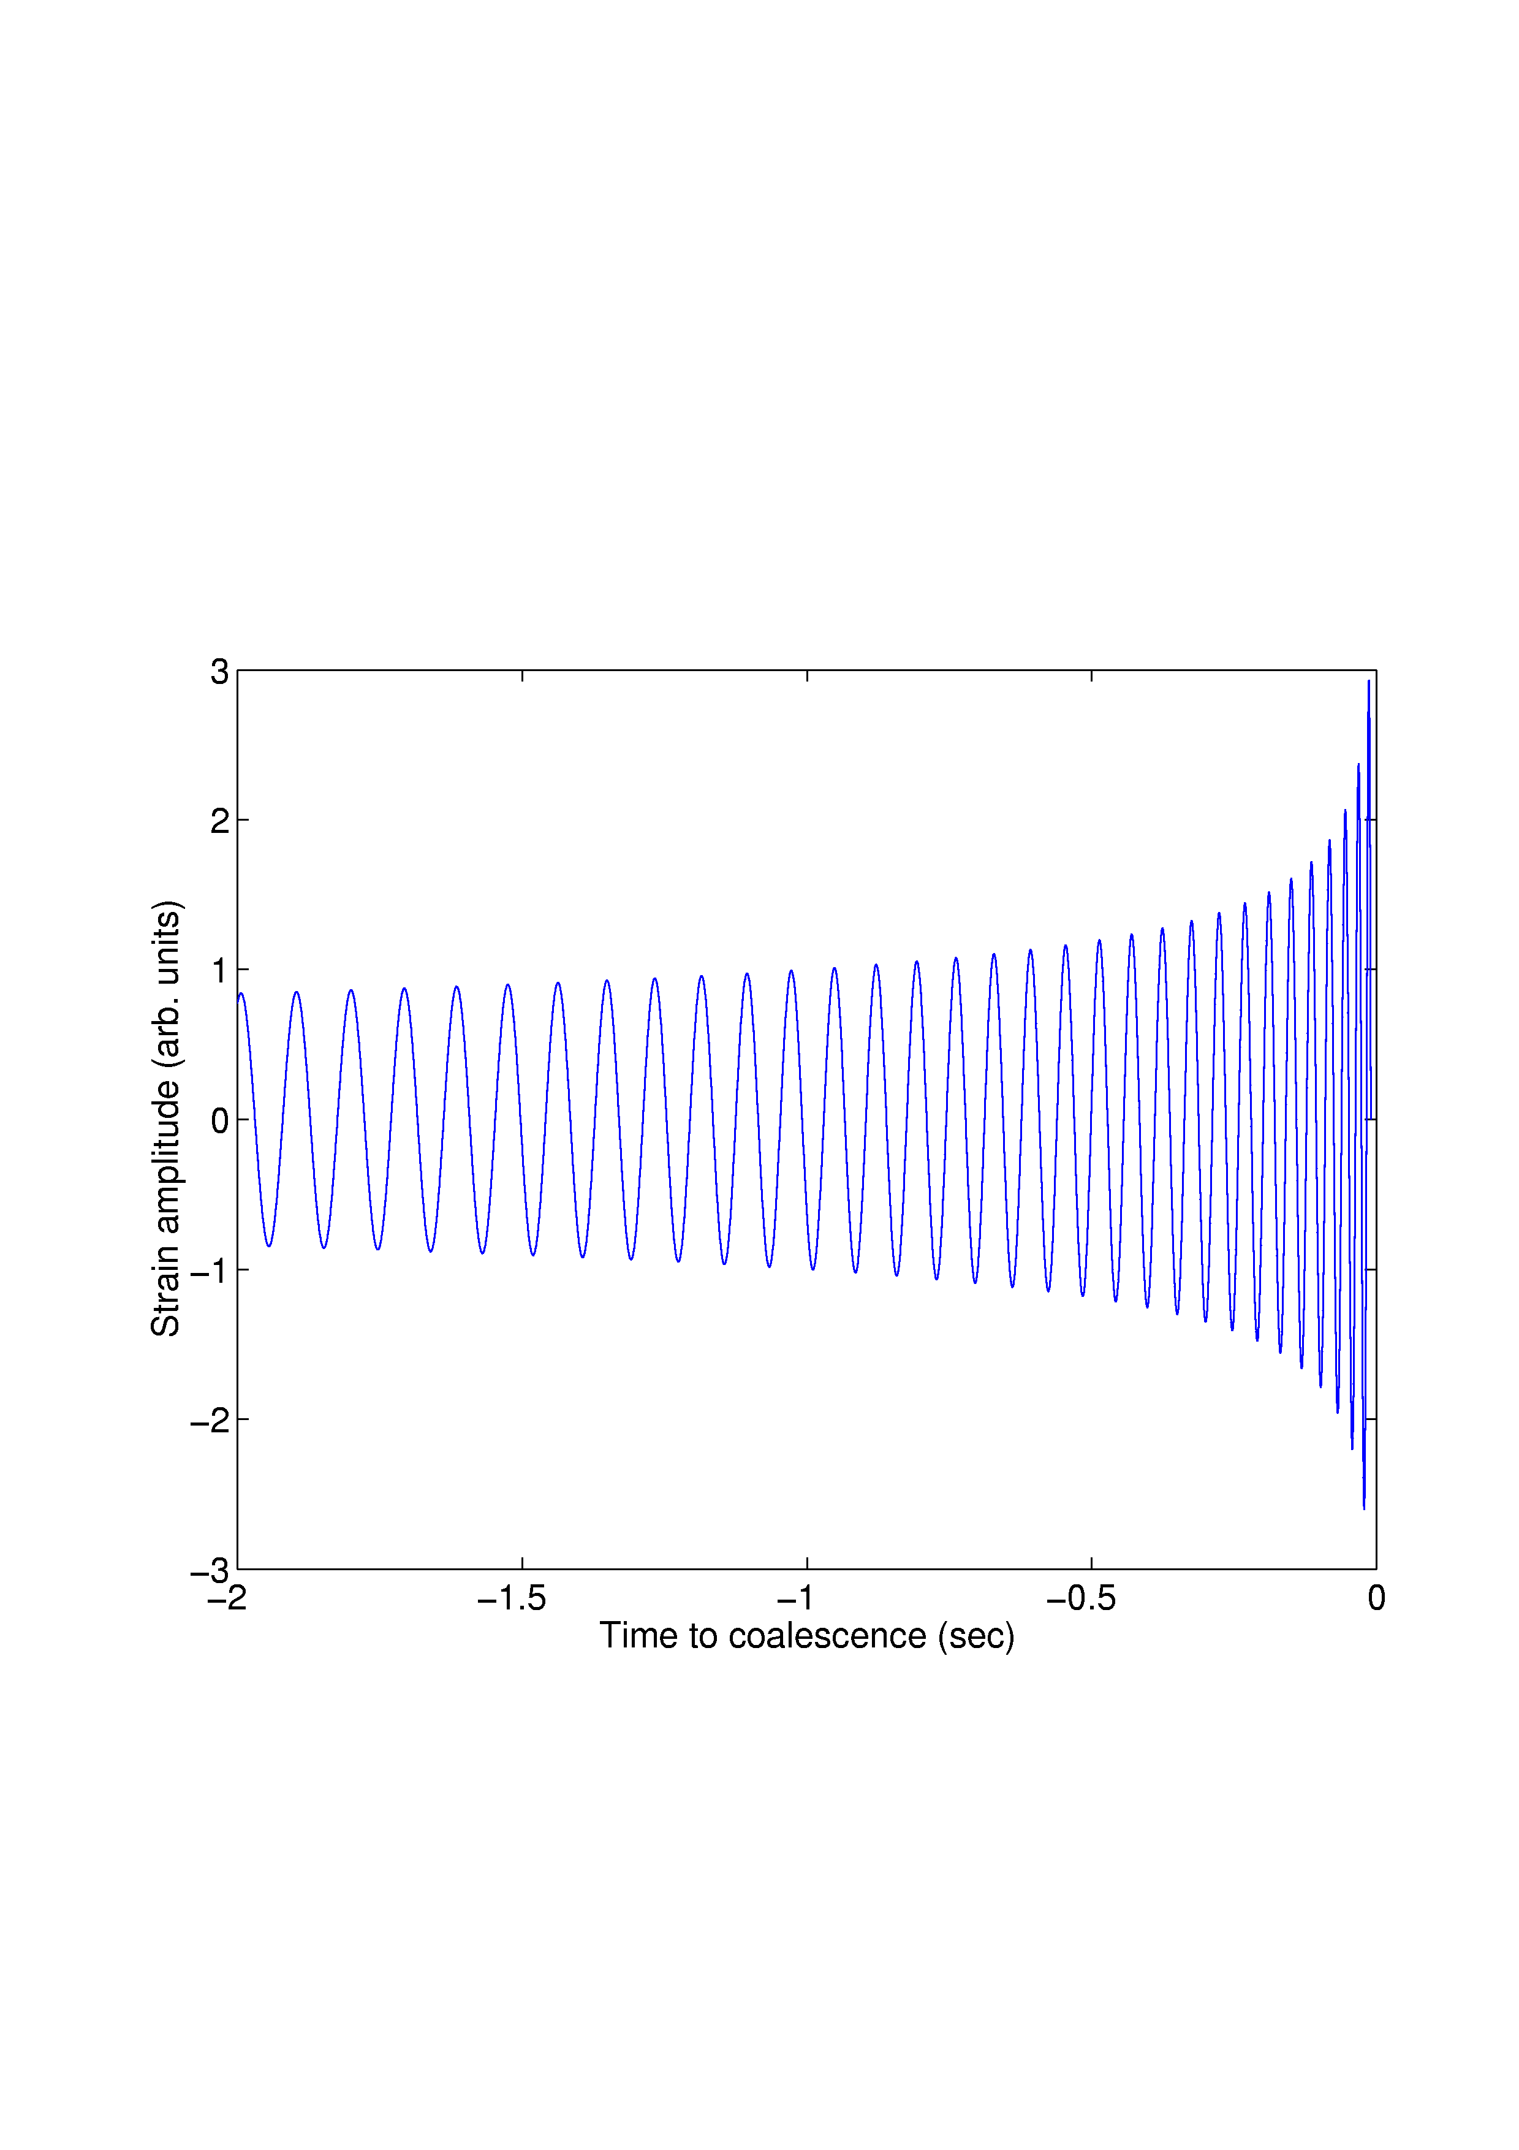
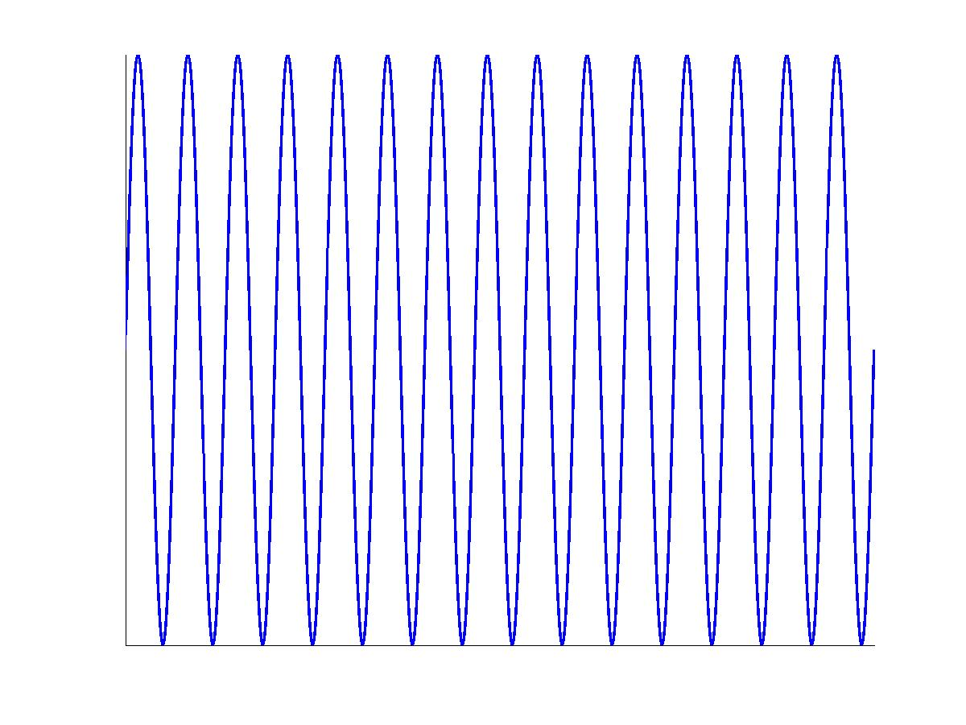
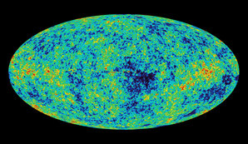
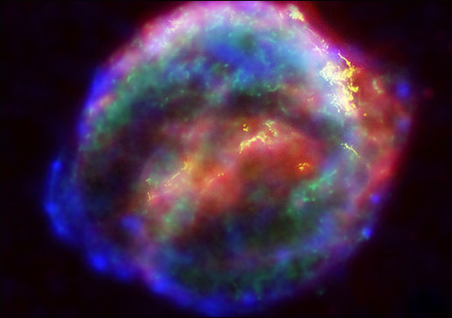
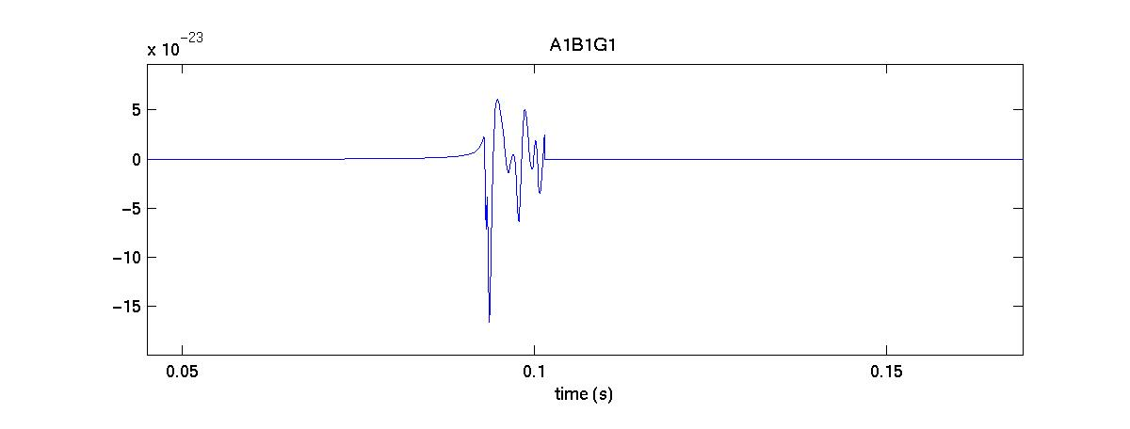
LIGO Data Analysis
Crab pulsar (NASA, Chandra Observatory)
Strain (1/√Hz)
NASA, WMAP
?
Four analysis working groups (plus detector characterization, software and computing)
white paper LIGO-T1400054 (dcc.ligo.org).

Slide 8
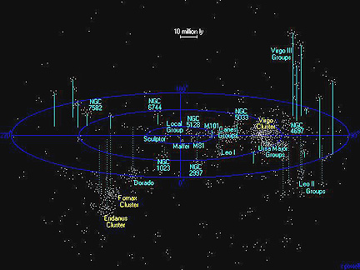
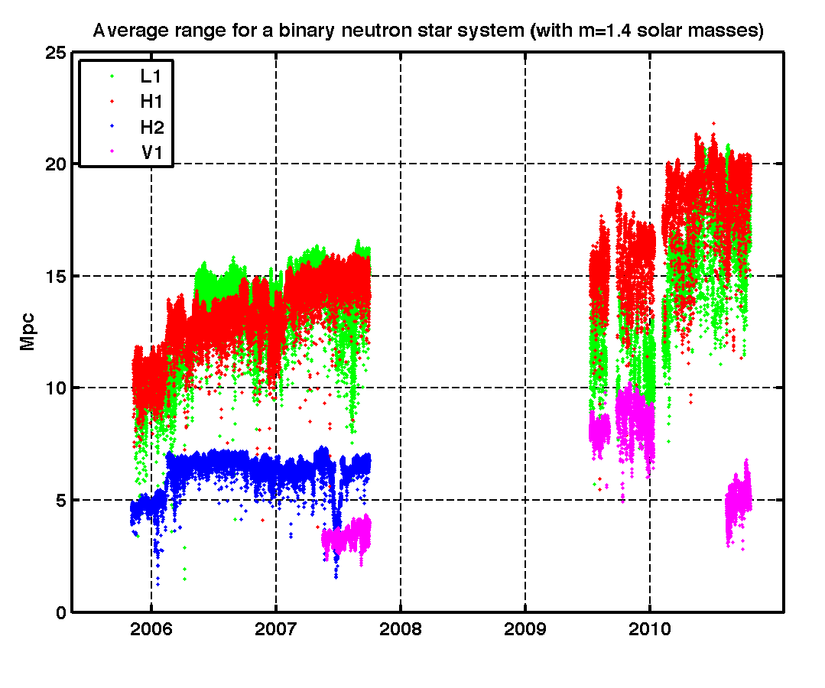
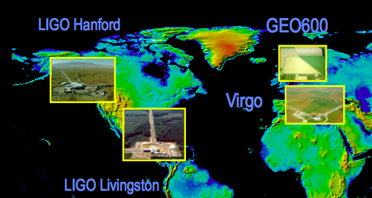
LIGO-Virgo detectors 2005-2010
atlasofthe universe.com

Slide 9
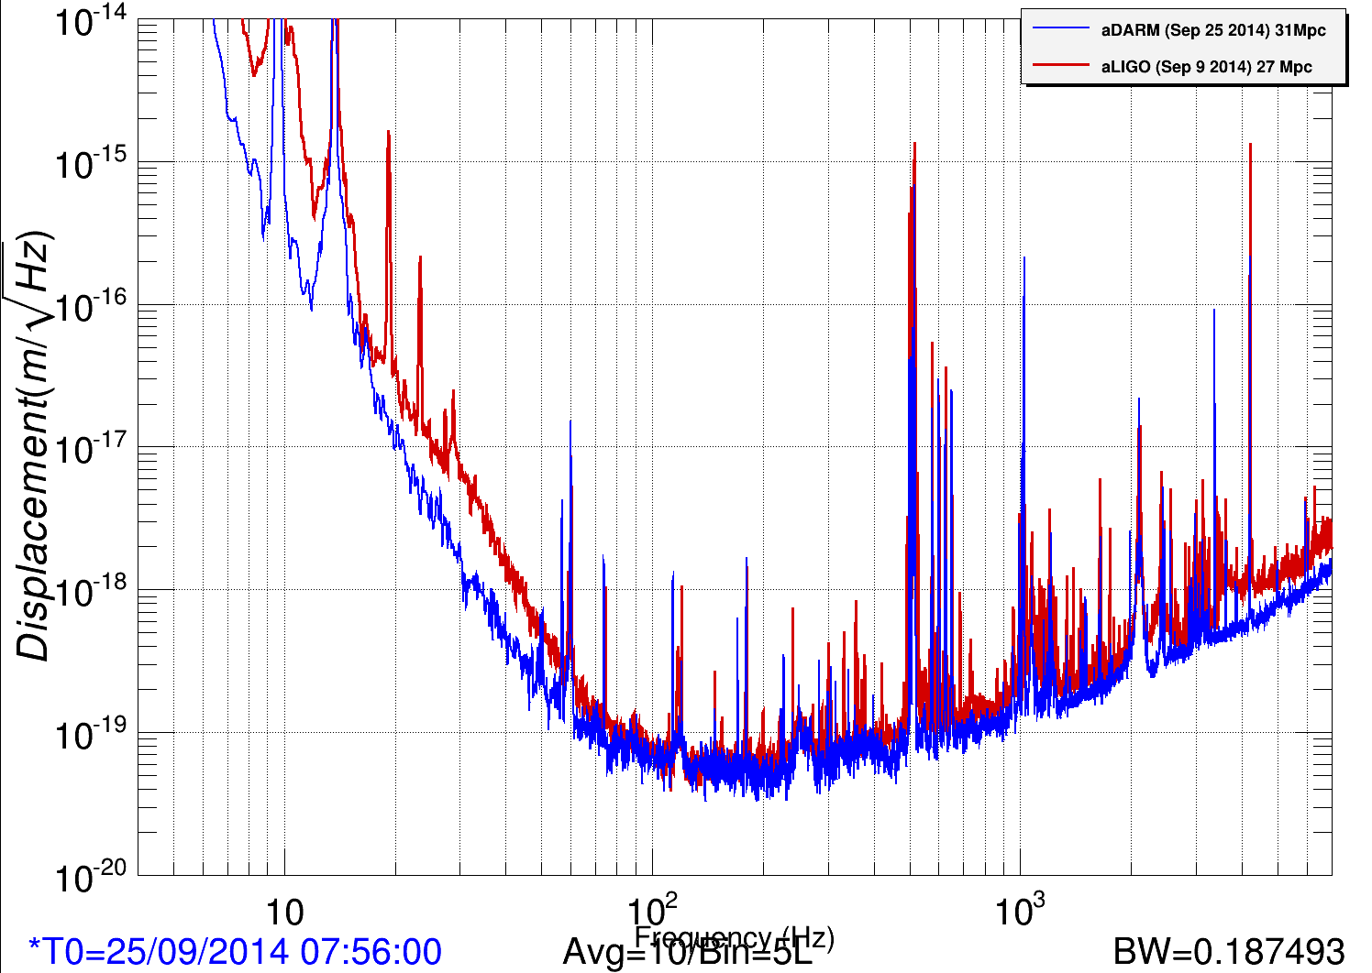
Advanced LIGO current status
Is already better than S6! L1 detector, Sept 25: 30+ Mpc!
Preliminary calibration

Slide 10
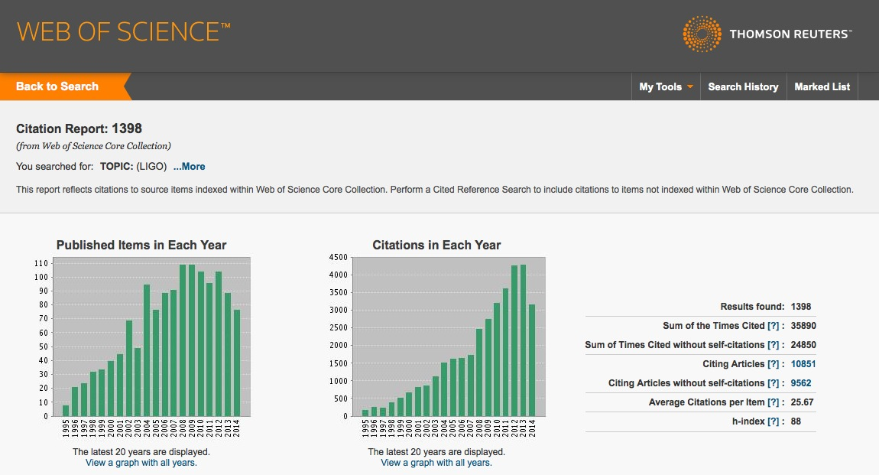
Academic interest in LIGO
1000+ papers, increasing citations/year
September 2014

Slide 11
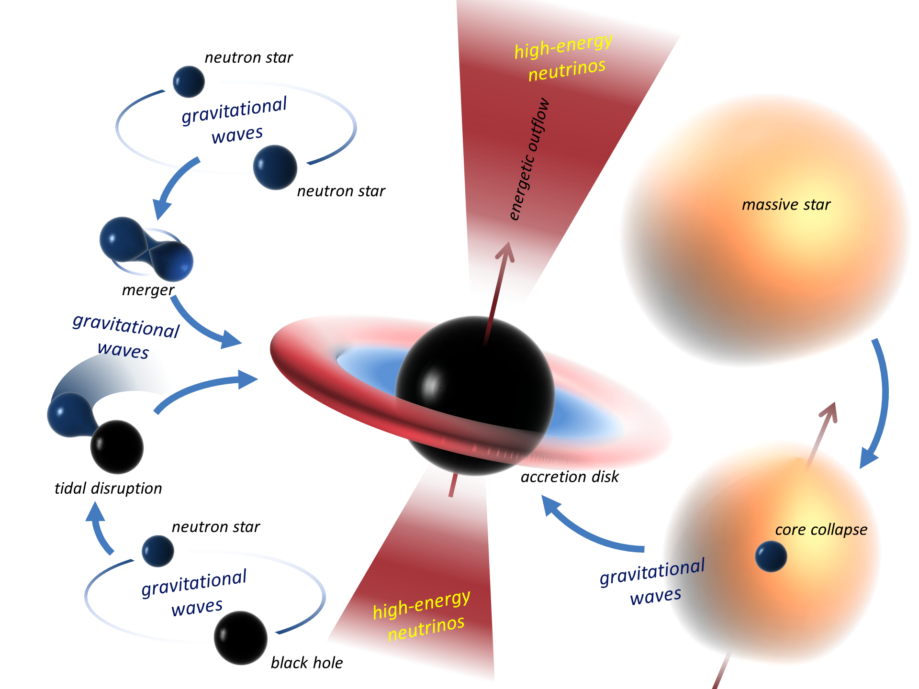
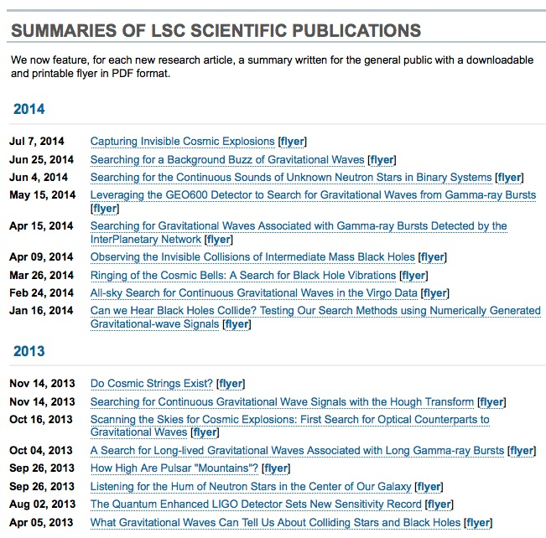
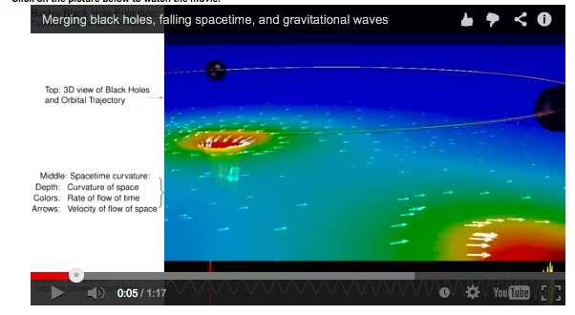
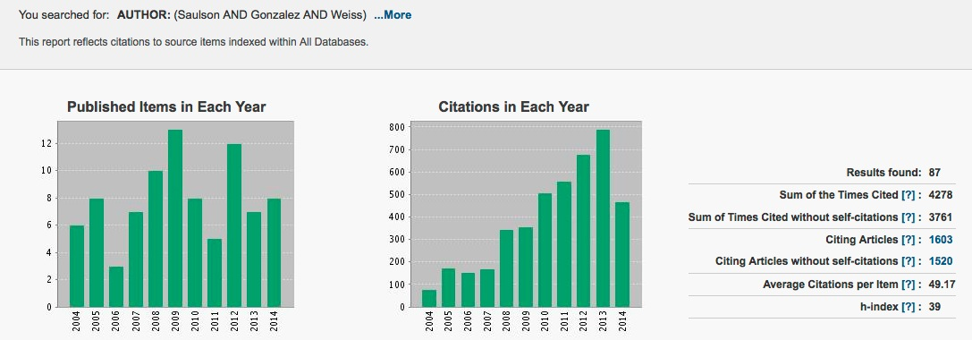
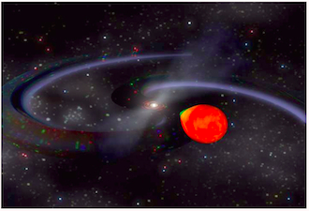
Latest LSC papers
Credit: I. Bartos/Based on arXiv:1212.2289
S5
S6
Courtesy of NASA Goddard
Find all LSC results and publications in www.ligo.org - science tab

Slide 12
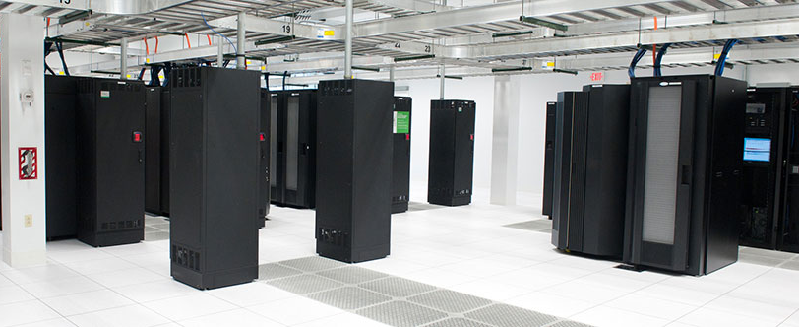
LIGO and the National Cyberinfrastructure
Gravitational-wave science is Big Science on Big Data - petascale data sets through massive workflows
LIGO has driven development in
  Computing clusters (e.g. exploration of consumer-grade GPUs for science)
  Crowd-sourced computing (e.g. Einstein at Home)
  Scientific workflow management (e.g. Condor and Pegasus)
  Federated identity management (e.g. Co-manage and Shibboleth)
Gravitational-wave science trains people with real world computing skills that are applicable to many scientific domains and to industry

Slide 13
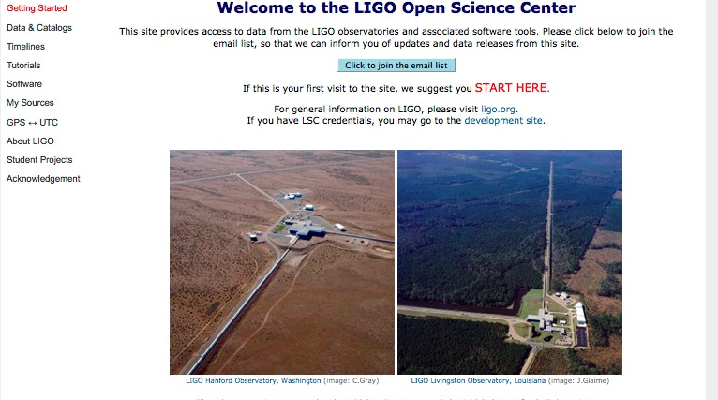
LIGO open data
LIGO is committed to open data and prompt release of GW observations.
Much development is needed for releasing LIGO data - prototyping with initial LIGO data: S5 is now public.
https://losc.ligo.org/

Slide 14
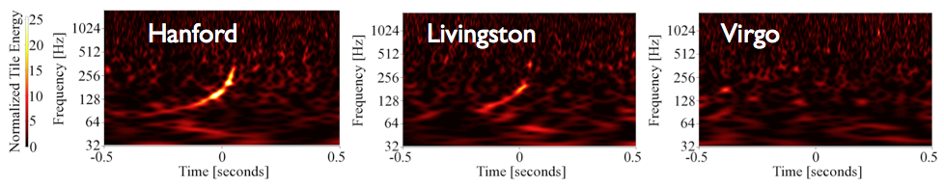
Some S5/S6 LSC results
Best experimental limits to cosmic GW background around 100 Hz (Nature 460 (2009) 990)
Limits on GW radiation from known pulsars: “mountains” on Crab are less than 1m high (Astrophys. J. 785 (2014) 119)
Multi-messenger searches for GW transients in coincidence with neutrinos, gamma ray bursts, soft gamma repeaters, pulsar glitches, magnetars, …
We can detect GWs! Phys. Rev D85 (2012) 082002
All publications in www.ligo.org

Slide 15
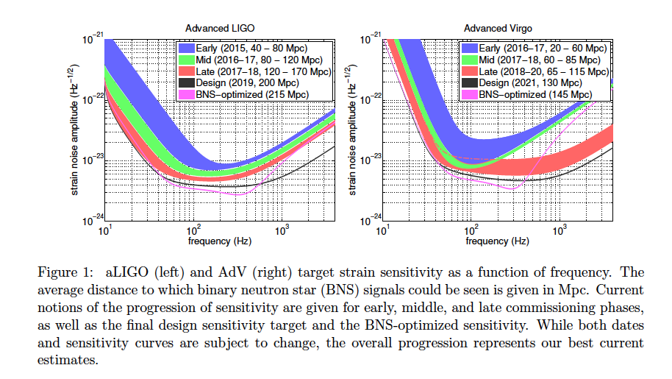
The future is coming – soon!
Prospects for Localization of Gravitational Wave Transients by the Advanced LIGO and Advanced Virgo Observatories, The LIGO Scientific Collaboration and The Virgo Collaboration, arXiv:1304.0670
LLO, Sept 25

Slide 16
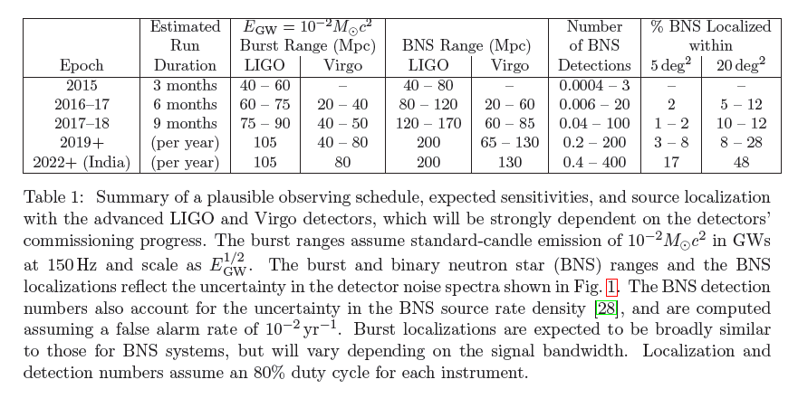
Observing Scenario

Slide 17
Planned O1 searches
Described in public white paper LIGO–T1400054
All-sky burst search
Binary neutron star coalescences
Stellar-mass binary black holes coalescences
Neutron star-black hole coalescences
Intermediate mass black hole binary coalescences
GRB sources of transient gravitational waves
All-sky searches for isolated spinning neutron stars
Targeted searches for gravitational waves from known pulsars
Isotropic stochastic gravitational wave background
Directional search for persistent gravitational waves
… other plans in preparation

Slide 18
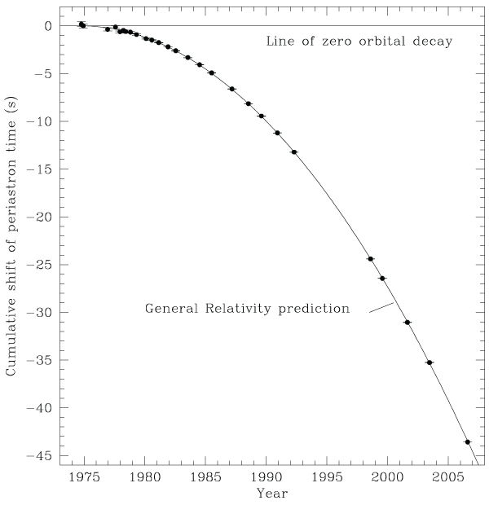
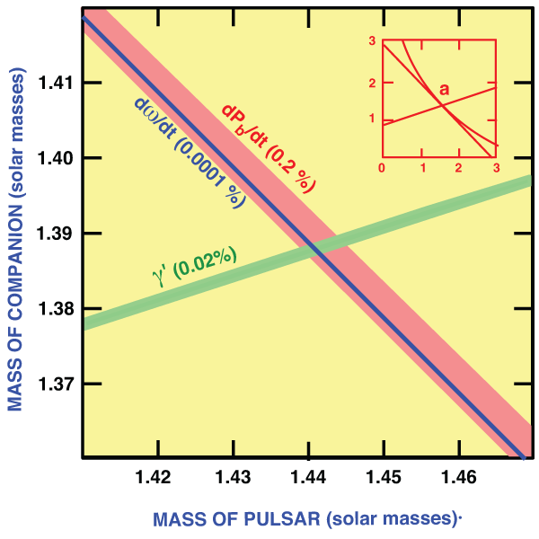
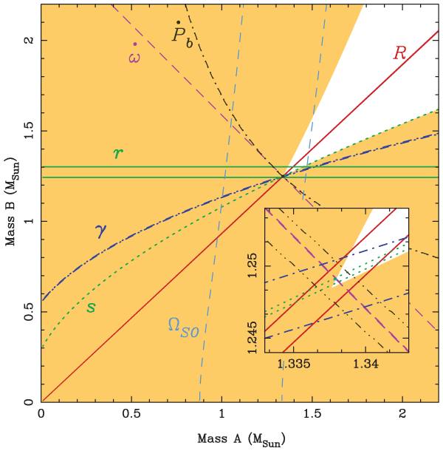
Detection and GR tests
Pulsar tests measure leading orders in orbit decay.
Waveforms in GW detectors will measure the coalescence, millions of years later, in the extreme strong gravity regime: birth of black holes!
Living Rev. Relativity, 17 (2014), 4

Slide 19

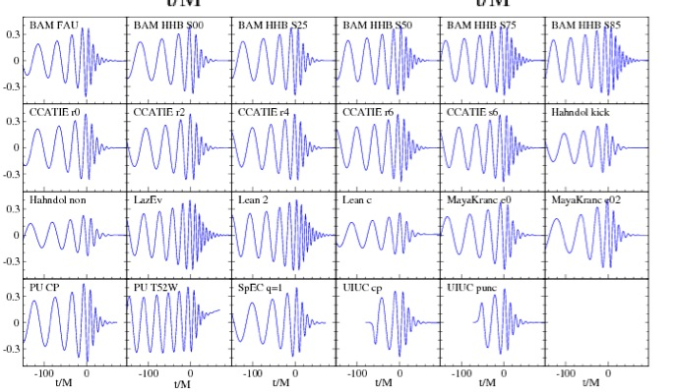
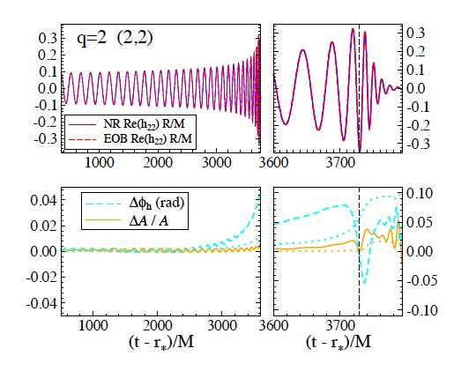
Numerical relativity
There are good numerical results for a given system – computationally expensive, but they are doable! (not true before ~2005)
There are parameterized approximations that fit numerical results, and a collaboration to produce these: “NRAR” collaboration, numerical and analytical relativity communities.
Efficiency of analysis methods with PN or phenomenological approximations can be tested against numerical models: “NINJA collaboration”: LVC and NR communities. Most useful for post-detection parameter estimation.
Phys.Rev. D84 124052
Class.Quant.Grav. 26 (2009) 165008

Slide 20
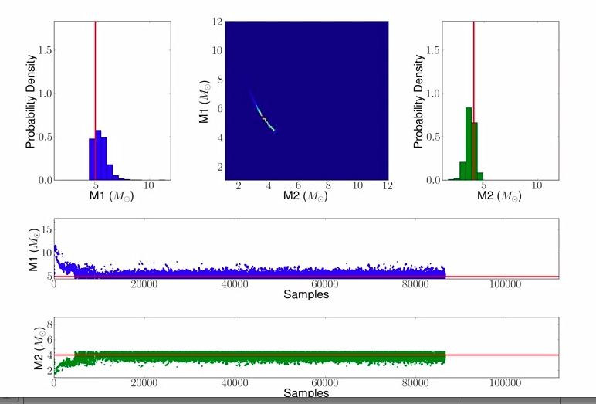
Astrophysics with GW detections: parameter estimation
After a search algorithm finds a candidate with some confidence, we can run (computationally expensive) parameter estimation studies, using many different models of waveforms with many possible parameters.
http://www.ligo.org/science/Publication-S6PE/

Slide 21
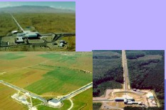

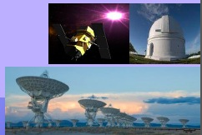
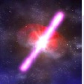
Multi-messenger astronomy:
GW/EM observations
We will obtain rich astrophysics combining gravitational-wave and electromagnetic information.
LSC and Virgo opened a call to sign agreements for the identification of EM counterparts to GW triggers in Advanced detectors starting in 2015.
We received and approved more than 60 applications from 19 countries, with about 150 instruments covering the full spectrum, from radio to high-energy gamma-rays!
Shortly after a few detections, LSC/Virgo will publicly release GW triggers for follow up.

Slide 22

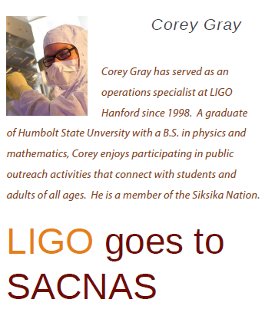
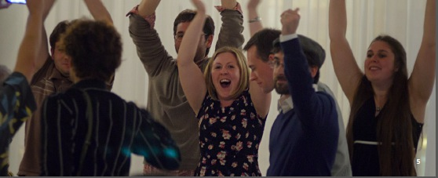
Other important LSC activities
Diversity
  LSC has a “Diversity Committee. Some initiatives:
    LSC Diversity statement; anti-harassment policy, LSC “best practices”
    LSC “Ombudsperson” (former NSF program officer!)
    LIGO summer undergraduate fellowships sponsored by NSBP and NSHP
    “Family grants” to attend LSC meetings
    Set up a booth and organize sessions in scientific meetings of women and minorities
Academic mentoring
  The LSC has an “Academic Advisory Committee” to care about mentoring of young members. Some recent activities:
    Student and postdoc events and useful tutorials.
    “Industry panels” with colleagues working now in industry.
    Mentoring program: a platform for members of the LSC to form and maintain mentoring relationships.

Slide 23
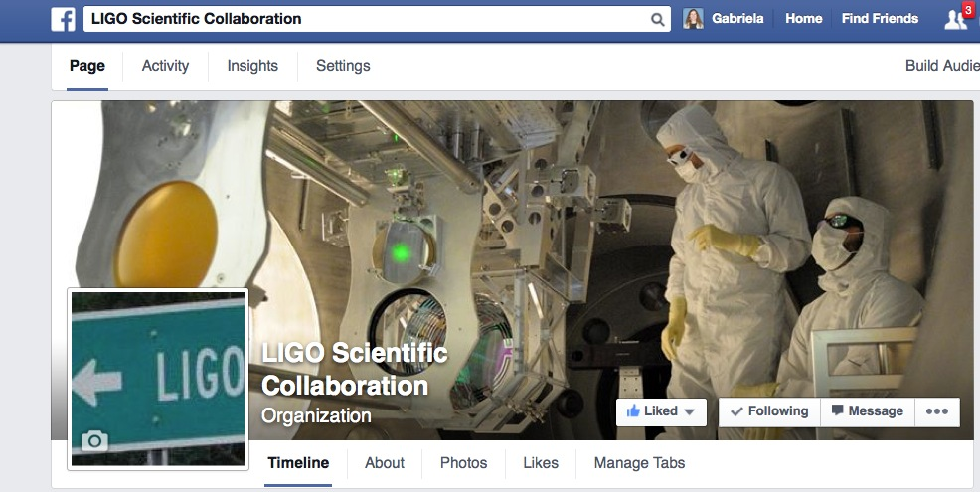
Telling our story
Education and Public Outreach is a very active LSC working group
www.ligo.org, LIGO magazine, science summaries, documentaries, Facebook, Twitter, and much more!

Slide 24
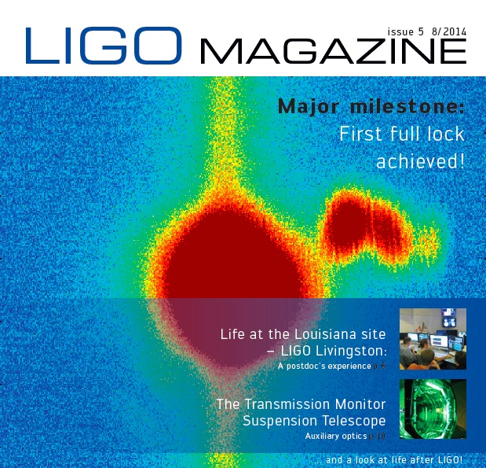
www.ligo.org/magazine

Slide 25
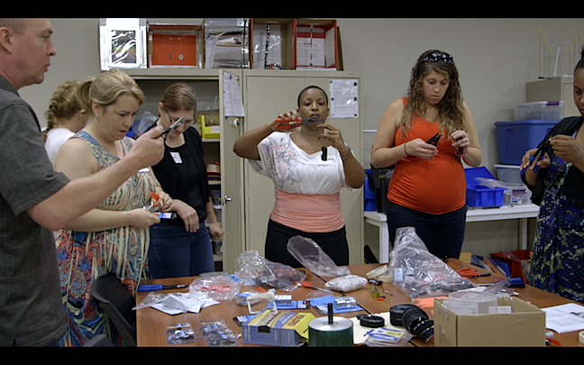
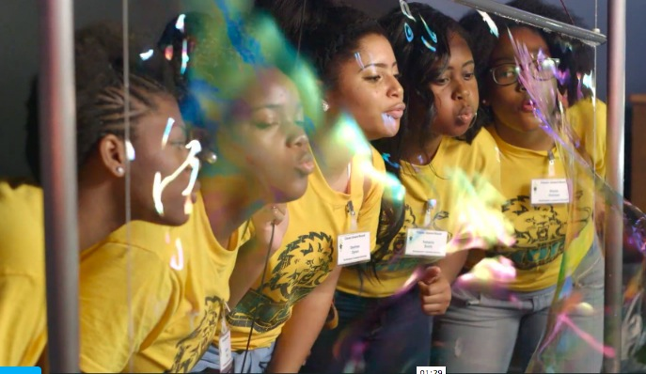




LIGO Science Education Center

Slide 26






Recent LIGO documentaries

Slide 27



Some LSC outreach activities
New York, May 29-Jun 2, 2013

Slide 28





Slide 29

AstroDance
(Rochester Institute of Technology initiative)

Slide 30

LIGO traveling exhibit
(University of Mississippi)

Slide 31

The future is now, and is very bright!
Decades of NSF investment in LIGO and hundreds of scientists’ efforts are about to pay off.
The convergence of gravitational-wave experiments, numerical and analytical relativity, modeling of electromagnetic counterparts, wide-field optical telescopes will revolutionize our astrophysical knowledge of the universe : “transformative science”!
The benefits to the country will be broad, and not just in the scientific arena: also in K-12 education, public outreach, STEM resources, worldwide leadership,…

