Slide 1
Noises in Gravitational Wave Detectors
LIGO-G1401145-v2
Koji Arai – LIGO Laboratory / Caltech

Slide 2
Introduction ~ Noise?
GW detection
Data stream of differential arm strain
Once recorded:
Signals and noises are indistinguishable
What we can do is to catch “likely” features
Reduce any kind of noises!

Slide 3
Introduction ~ Noise?
Time domain vs frequency domain
Noise
Reduction
Time domain: transient noises
Frequency domain: stationary noises

Slide 4
Introduction ~ Noise?
Power Spectral Density (PSD)
Double sided PSD (-Infinity < f < Infinity)
Single sided PSD (0 <= f < Infinity)
[x_{unit}² / Hz]
Linearized PSD:
[x_{unit}/ sqrtHz]

Slide 5
Introduction ~ Noise?
Parseval’s Theorem for signal RMS and PSD
Root Mean of x(t):
average signal power density (per sec)
(cf. variance, std deviation)
PSD Sx(f):
power density per frequency (per sec)

Slide 6
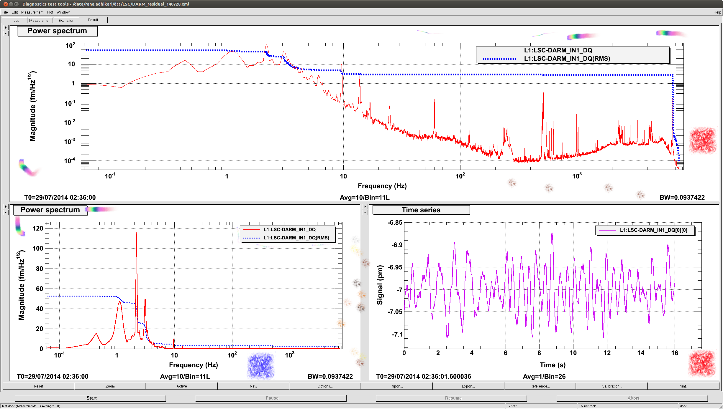
Introduction ~ Noise?
Example
PSD [fm/sqrtHz] in log-log scale, RMS [fm] ~ 50fm = 0.05pm
PSD [fm/sqrtHz] in log-lin scale
RMS [fm]
Time series [pm]

Slide 7
Components of the interferometer
3 fundamentals of the GW detector
Mechanics
Optics
Electronics

Slide 8
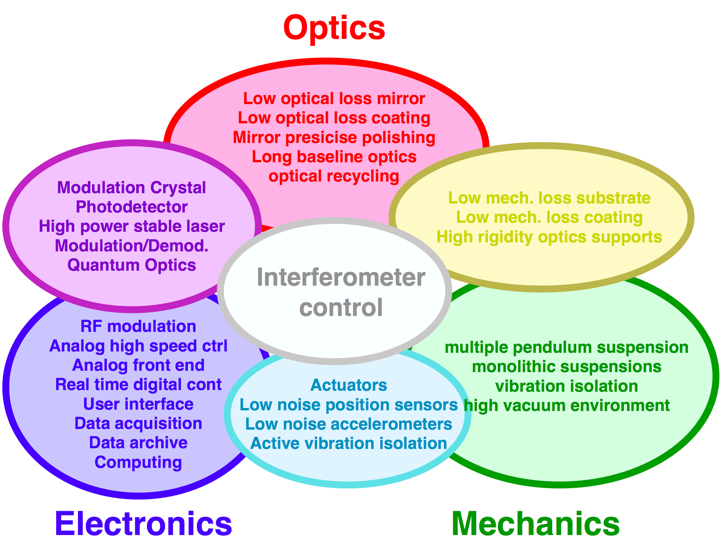
Components of the interferometer
3 fundamentals of the GW detector
Mechanics
Optics
Electronics

Slide 9
Noise categories
3 fundamentals of the GW detector
Mechanics -> Displacement noises
Optics -> Optical noises
Electronics -> Electrical noises
Displacement
Optical
Optical
Displacement
Electrical
Electrical
Electrical

Slide 10
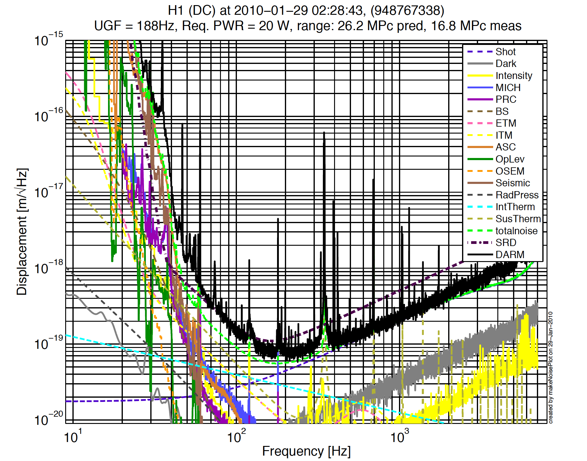
Noise budget
Laser shot noise
Laser radiation
pressure noise
thermal noise
seismic noise
Laser intensity
/frequency noise
electronics noise
digitization noise
angular control noise
......

Slide 11
Displacement noises

Slide 12
Displacement noise
Mechanical displacement sensed
by a laser interferometer
The longer the arm length,
the smaller the strain noise
  Seismic noise
  Thermal noise
  Newtonian Gravity noise

Slide 13
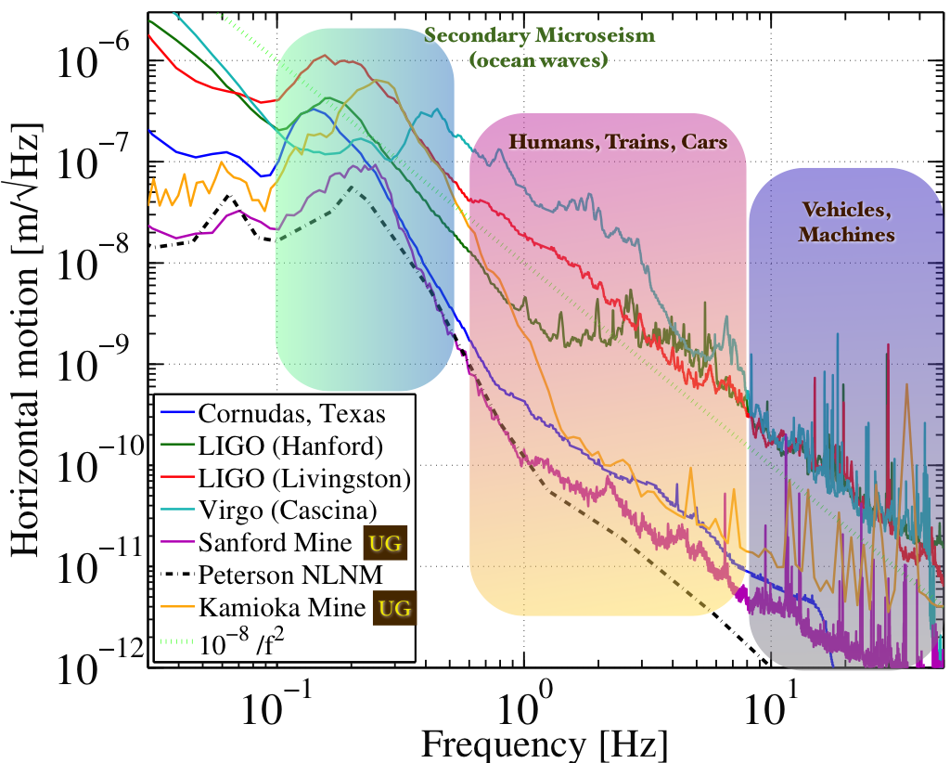
Displacement noise
Seismic noise
  Even when there is no noticeable earth quake…
Target
disp. noise
10⁻²⁰m/rtHz
http://link.aps.org/doi/10.1103/RevModPhys.86.121 (http://arxiv.org/abs/1305.5188)

Slide 14
Displacement noise
Vibration isolation ~ utilize a harmonic oscillator
  A harmonic oscillator provides vibration isolation
  above its resonant frequency
w0=1Hz
|x/X|~1/1000@30Hz

Slide 15
Displacement noise
How to get more isolation?
Damping
Lower the peak height
Multi stage
Steeper isolation curve
Lower resonant freq
Better isolation
f ⁻⁴
f ⁻²
Worse isolation
More peaks
Complex to realize
In practice: employ combination of these measures

Slide 16
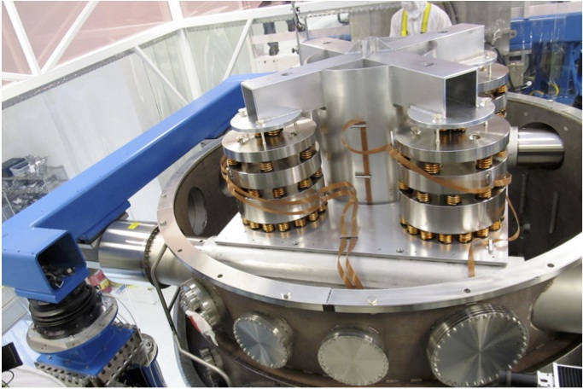
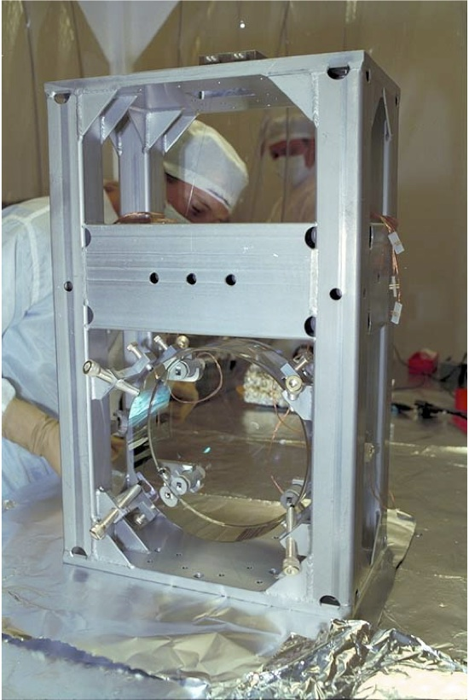
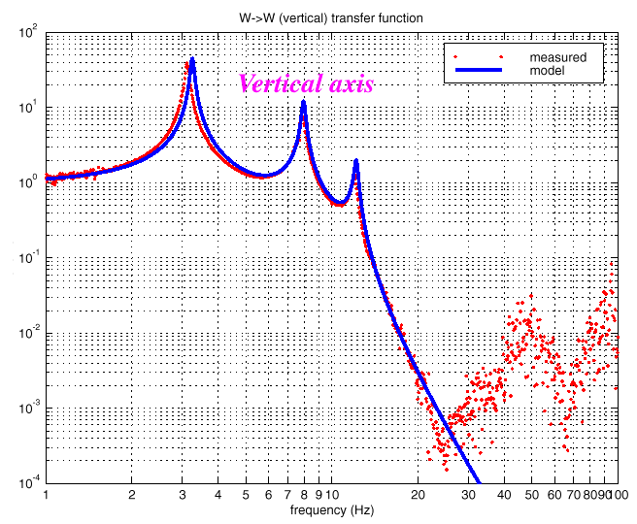
Displacement noise
iLIGO vibration isolation
Hydraulic active isolation / Isolation stack / Single Pendulum

Slide 17
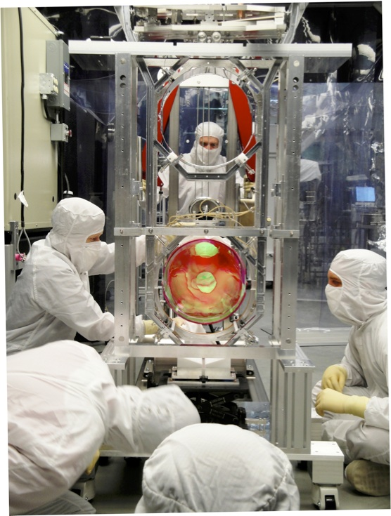
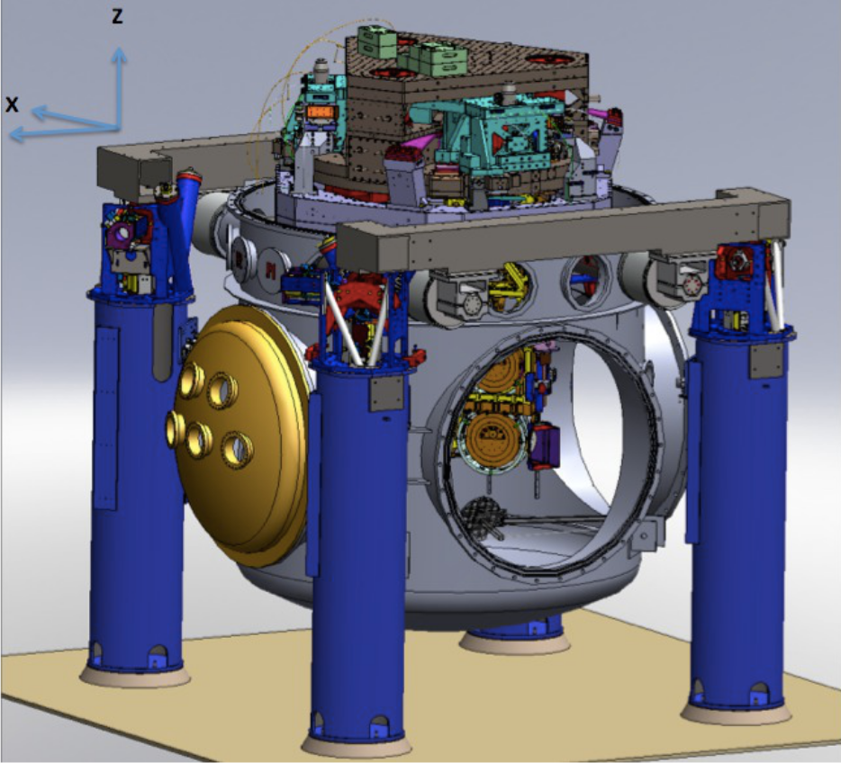
Displacement noise
aLIGO vibration isolation
Hydraulic active isolation / Invacuum Active Isolation Platforms / Multiple Pendulum

Slide 18
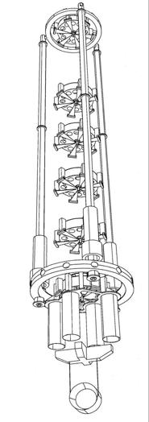
Displacement noise
Virgo: super attenuator
  8m high
  9 stages in horizontal
  6 stages in vertical
8m

Slide 19
Displacement noise
http://link.aps.org/doi/10.1103/RevModPhys.86.121 (http://arxiv.org/abs/1305.5188)

Slide 20
Displacement noise
Question:
n-stage multiple pendulum with fixed height of H
How many stages n do we need to realize
the vibration isolation of A at frequency of f?
For a given A what is the minimum f, we can
realize by increasing n?
(Mass distribution)
  For equal m for each stage
  or
  For arbitrary mass m_{i} and length h_{i}

Slide 21
Displacement noise
Thermal noise:
System in thermal equilibrium
  the system can dissipate its energy to the heat bath
  the system is thermally excited by thermal fluctuation
Mechanical thermal noises
  suspension thermal noise
  mirror substrate thermal noise
  mirror coating thermal noise

Slide 22


Displacement noise
Fluctuation Dissipation Theorem
Friction: interaction with “bath” = huge number of d.o.f.
Fluctuation force: produced by huge number of d.o.f.
Dissipation and fluctuation have certain relationship
system description (Langevin equation)
q: generalized coordinate m: generalized mass
R: friction (dissipation)
F: internal force (restoring force, etc)
F’(t): fluctuating force from heat bath
Power spectrum density (PSD) of the fluctuation force

Slide 23

Displacement noise
Transfer function approach
Equivalently, the fluctuation of the system can be obtained from the response of the system
where Z(w) and H(w) are the impedance and
force-to-displacement transfer function of the system

Slide 24
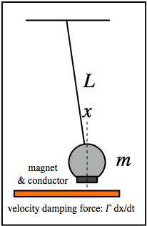


Displacement noise
Question:
- Velocity damping of a pendulum
- Structure damping
loss angle: 0 < 𝜙 ≪ 1
- How anti-spring changes the thermal noise spectrum?
anti-spring parameter: 0<𝛼<1

Slide 25

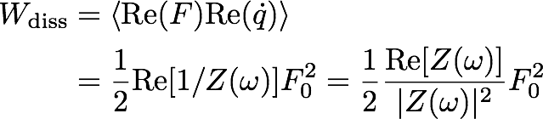
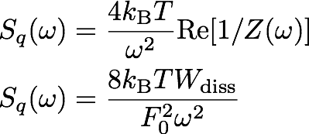
Displacement noise
In some cases, calculating the system response is complicated (e.g. deformation of an elastic body)
Systems response (impedance) at a certain freq:
Average rate of energy disspation
We don’t need to
know Z(w)!

Slide 26
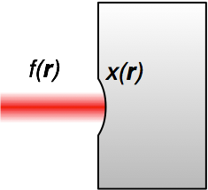


Displacement noise
Sensing of the mirror surface deformation with a laser beam (with intensity profile of f(r))
Apply periodic pressure with profile of f(r)
This induces deformation of x(r) which is different
from our sensing profile of f(r), but that’s OK
Calculate the rate of dissipation Wdiss
analytically, using FEA, or etc
Put this into the formula
We don’t need to
know Z(w)!
Y. Levin PRD 57, 659-663 (1998)

Slide 27
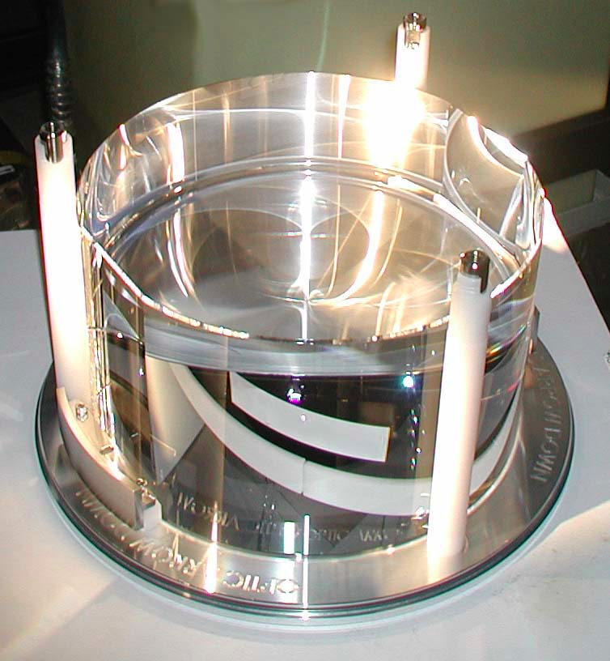
Displacement noise
Mirror substrate thermal noise
  Brownian motion
  Mechanical loss associated
  with the internal friction
  ⬄Thermally excited body modes
  Optical coating (high mechanical loss)
  will be limiting noise source in aLIGO
  Thermo elastic noise
  Elastic strain & thermal expansion coefficient
  => cause heat distribution & flow in the substrate
  ⬄Temperature fluctuation causes mirror displacement
  Thermo-refractive noise
  ⬄Temp. fluctuation causes fluctuation of refractive index
We don’t need to
know Z(w)!

Slide 28
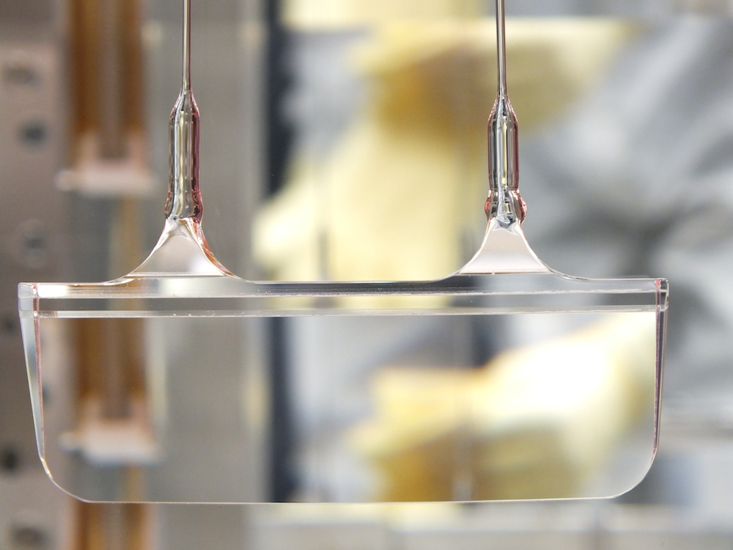
Displacement noise
Suspension thermal noise
  Brownian motion
  Mechanical loss of the suspension fiber
  ⬄Thermally excited pendulum modes
  Thermo elastic noise
  Elastic strain of the fiber & thermal expansion coefficient
  => cause heat distribution & flow in the fiber
  ⬄Temperature fluctuation causes mirror motion
<- Monolithic suspension
for high pendulum Q
We don’t need to
know Z(w)!

Slide 29
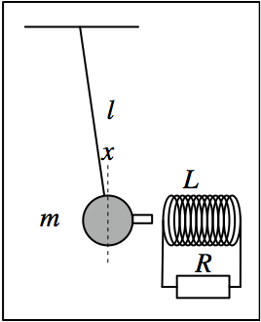
Displacement noise
Question
  Induced current damping (electro-mechanical system)
  1. How does the Q factor of the system depend on R?
  2. How much is the thermal noise displacement of the mass?
  3. How does the thermal noise of the resister shakes the mass?
  4. How are the above questions with a capacitive coupling
  instead of the coil?
  Cold damping
  1. If the resister is cooled, how does
  the thermal noise motion change?
  2. Is the pendulum actually cooled?
  Down to what temperature?
  3. How fast the pendulum recovers the
  original temperature once R is returned
  to the room temp.?
We don’t need to
know Z(w)!

Slide 30
Displacement noise
Newtonian Gravity noise
  Mass density fluctuations around the test masses
  => test mass motion via gravitational coupling
  Dominant source of Newtonian noise
  = Seismic surface wave
  Mitigation
  1) Going to quiet place (underground)
  2) Feedforward subtraction
  3) Passive reduction by shaping
  local topography
NN
aLIGO
sensitivity
J Driggers, et al, PRD 86, 102001 (2012)
J Harms, et al, Class. Quantum Grav. 31 185011 (2014)

Slide 31
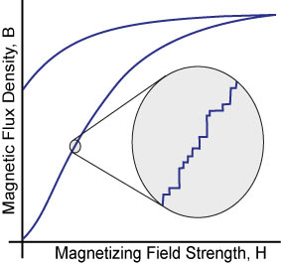
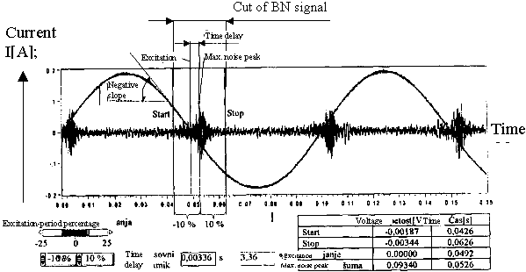
Displacement noise
Mechanical upconversion noise
  Large low frequency (f < 1Hz) motion
  => upconverted to 10~100Hz motion via nonliner processes
  Barkhausen noise
  => low freq mirror actuation cause BH noise and upconversion
  Select better magnet materials (e.g. SmCo)
https://www.nde-ed.org/

Slide 32
Optical noises

Slide 33
Optical noises
Noises that contaminate the readout signal
  Quantum noises (shot noise, radiation pressure noise)
  Laser technical noises (frequency/intensity noise)
  Modulation noises
  Scattered light noise
Optical
Optical

Slide 34
Optical noises
Quantum noises: Shot noise
  Noise due to photon counting statistics
  N detected photon => standard deviation √N
  Increasing the incident power P_{in},
  => The shot noise is increased by √P_{in}
  => The signal amplitude is increased by P_{in}
  In total, the signal-to-noise ratio is improved by

Slide 35
Optical noises
Quantum noises: Shot noise
  Photon shot noise associated with photodetection
  Michelson interferometer
  Michelson response (@DC)
  i_{DC} : DC Photocurrent
  η : PD Quantum Efficiency
  ν : Optical Frequency
at the limit of d𝜙->0
Michelson
Strain Sensitivity
Shot-noise limit of the Michelson phase sensitivity
  1.3x10⁻²⁰ 1/sqrtHz
  @1W, 1064nm, 4km

Slide 36
Optical noises
Supplemental slide ~ Shot noise derivation

Slide 37
Optical noises
Quantum noises ~ Radiation pressure noise
  Photon number fluctuation in the arm cavity
  => Fluctuation of the back action force
  Quantum noise of the input laser
  => Common noise for two arms
  => cancelled and does not appear in the signal
  Vacuum fluctuation injected
  from the dark port
  => Differentially power fluctuation
  => Cause the noise in the GW signal

Slide 38
Optical noises
Quantum noises
  Standard Quantum Limit (SQL)
- Trade-off Between Shot Noise and Radiation-Pressure Noise
- Uncertainty of the test mass position due to observation

Slide 39
Optical noises
Laser frequency noise
  Laser wavelength (λ = c / ν)
  = reference for the displacement measurement
  Optical phase 𝜙 = 2 pi ν L / c
  d𝜙 = 2 pi / c (L dν + ν dL) <= indistinguishable
  dL/L target 10⁻²⁴
  => dν = 10⁻²⁴ x 300 THz (1064nmYAG laser)
  = 3 x 10⁻¹⁰ Hz/rtHz

Slide 40
Optical noises
Laser frequency noise
  Target: dν_{eff} = 3 x 10⁻¹⁰ Hz/rtHz
  Laser stability
  dν = 10~100 Hz/rtHz @100Hz
iLIGO
3-stage cascaded
laser frequency stabilization
  Michelson’s differential sensitivity provides
  Frequency noise cancellation of 1/100~1/1000
  “Common Mode Rejection”

Slide 41
Optical noises
Laser intensity noise
  Relative Intensity Noise (RIN): dP/P
  Sensor output V = P x
  => dV = P dx + x dP <= indistinguishable
  Requirement: RIN = 10⁻⁹ 1/√Hz
  x_{ofs}=10e-12 (DC Readout)
  => dx=1e-20 m/√Hz

Slide 42
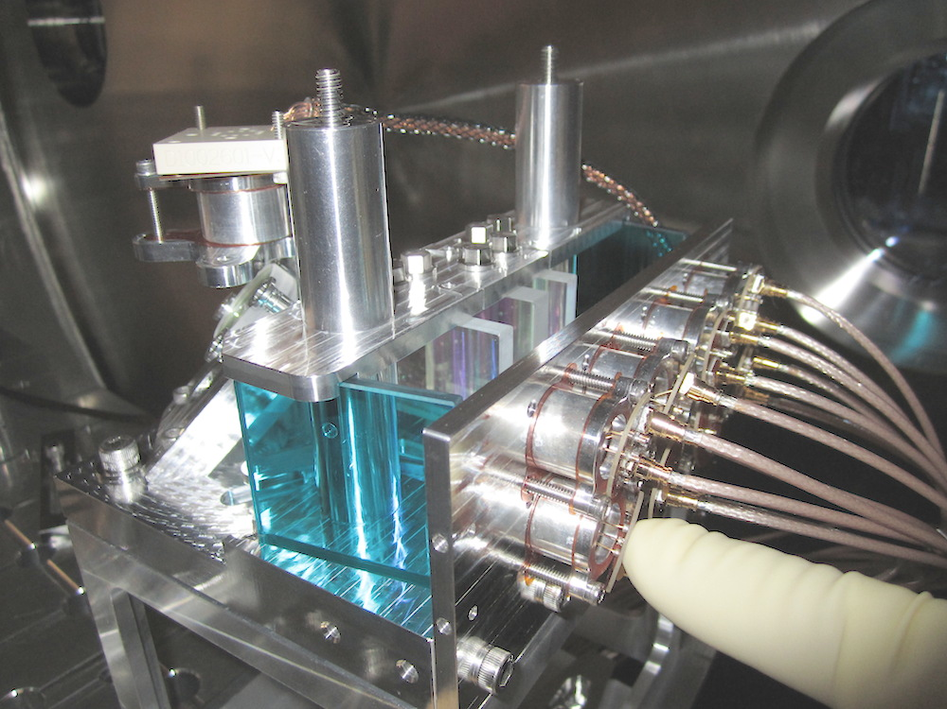
Optical noises
Laser intensity noise ~ intensity stabiliaztion
  Requirement: RIN = 10⁻⁹ 1/√Hz
  2-stage cascaded intensity stabilization control
  Challenge: requires 300mA of photodetection
  Shot noise limited RIN
  In-vacuum 8-branch
  Photodiode array
P. Kwee et al,
Optics Express 20 10617-10634 (2012)

Slide 43
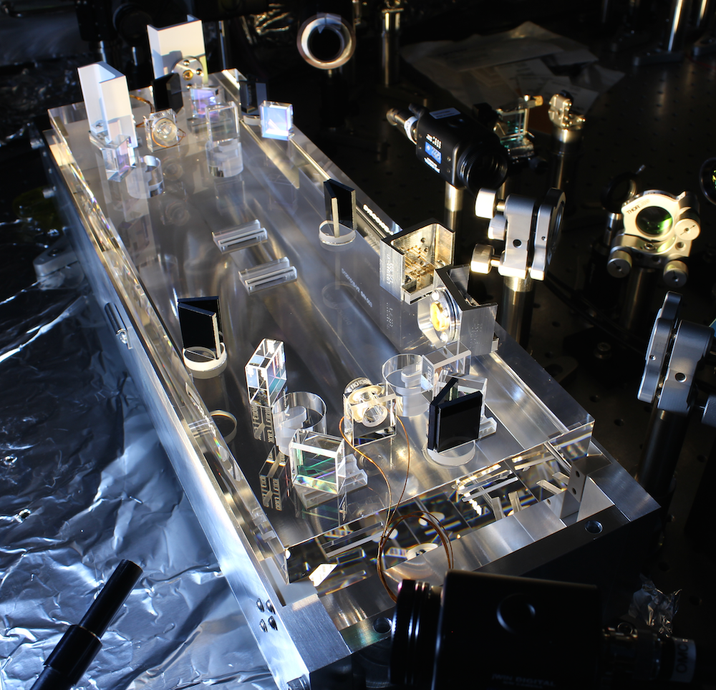
Optical noises
Modulation noises
  RF Residual Amplitude Modulation
  Modulation Oscillator Phase Noise
  Modulation Oscillator Amplitude Noise
Produce noise sidebands on the modulation sidebands
Mitigation
  For the GW signal:
  Use DC readout and eliminate them
  by an “output mode cleaner cavity”
J. Camp et al JOSA A 17 120-128 (2000)

Slide 44
Optical noises
Scattered light noise
  Scattered light recouples to the interferometer beam
  with an arbitrary phase
  => causes amplitude and phase fluctuation
  Two effects:
  1. Small motion regime: linear coupling of the phase fluctuation
  2. Large motion regime: low freq large motion of the scattering object => upconversion via fringe wrapping
  Mitigation
    Reduce scattered light
    Vibration isolation
    of the scattering object

Slide 45
Electrical noises

Slide 46
Electrical noises
General rules for electrical noises
  Electrical noise in photo detection
  Digitization noise (ADC/DAC) / Aliasing
Control noise
Actuator noise

Slide 47
General rules for electrical noises
Low noise amplification at the beginning
Give necessary gain as early as possible
Don’t attenuate (and amplify again)
input noise: v1
input noise: v2
output noise Vout:
Sqrt[(v1 G1 G2)²+(V2 G2) ²]
Signal
Gain G1
Gain G2
Input equivalent noise
Vout / (G1 G2)
= Sqrt[v1²+(v2/G1) ²]
output noise: v1 G1
Lessons
  The input referred noise is determined by v1
  It won’t become better by the later stages
  If G1 is big enough, we can ignore the noise of later stages

Slide 48
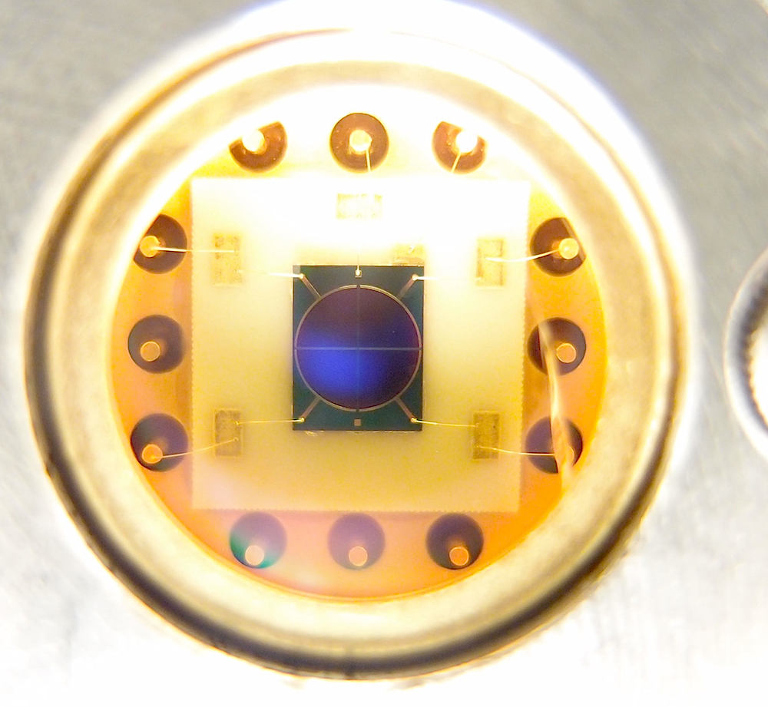
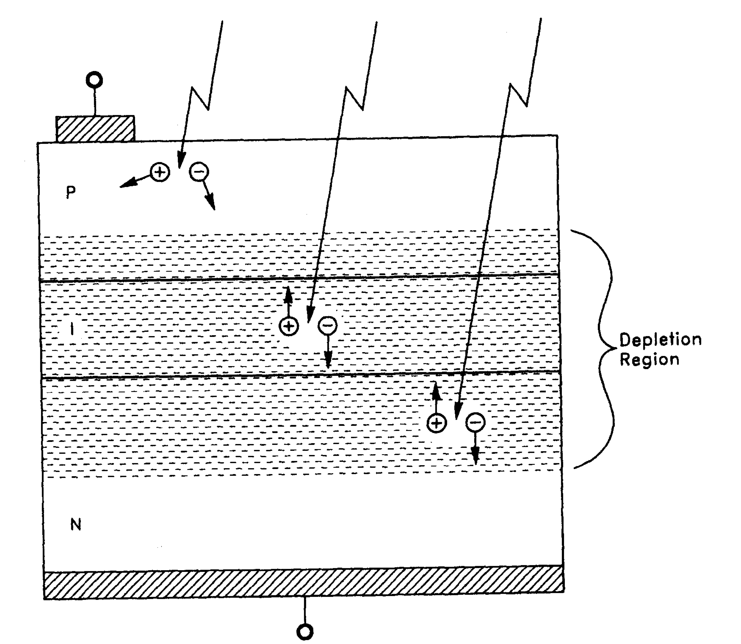
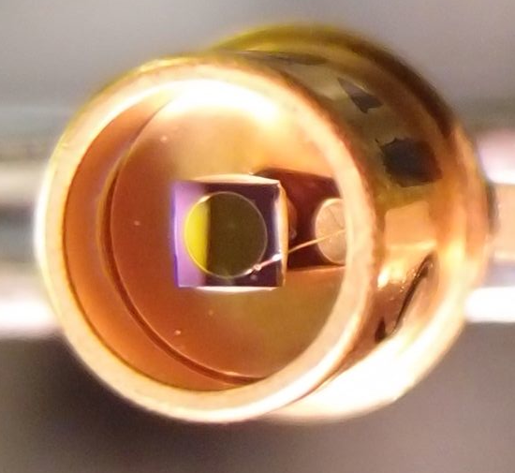
Noise in photodetectors
Photodiodes
  PIN photodiodes
  (InGaAs for near IR, Si for visible)
    Good linearity
    Low noise
    High Quantum Efficiency (>90%)
InGaAs Quadrant PD
(𝜙3mm)
Anode
InGaAs PD (𝜙1mm)
P-layer
I-layer
N-layer
Photocurrent
Cathode
“Photodiode Amplifiers”, J. Graeme (McGrawHill 1995)

Slide 49
Noise in photodetectors
Photodetectors are the first electrical block
of the control chains
  It is important to have
  low input-referred current noise
Photo detection
  AF (Audio Frequency 0~100kHz)
    Prenty of light (photocurrent ~mA)
    Not a big electrical issue
  RF (Radio Frequency 10~200MHz)
    Large diode aperture -> high RF noise
    Need careful consideration

Slide 50
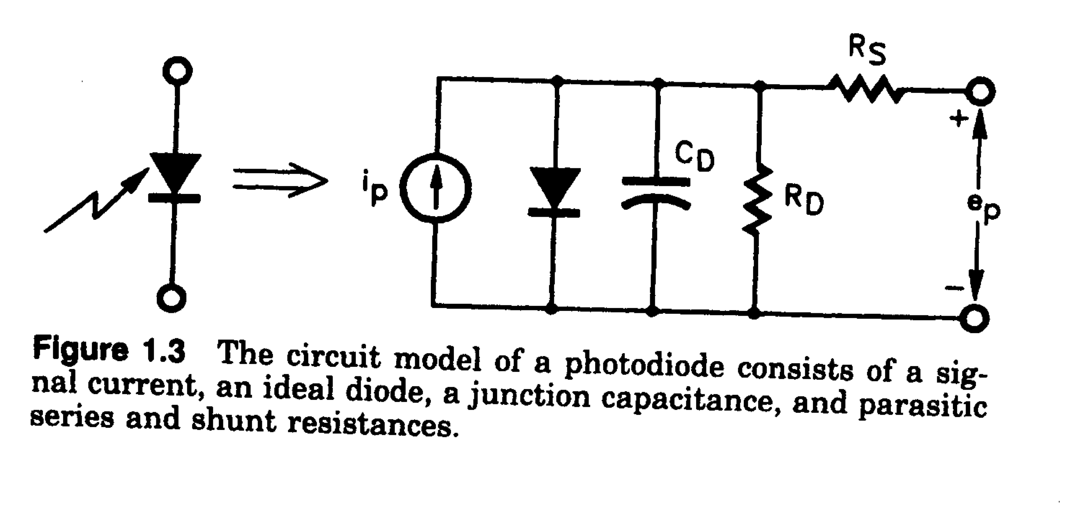
Noise in photodetectors
Noise in photodiodes
  Photodiode equivalent circuit
    Shunt Capacitance R_{D} (~100MΩ) Usually not a problem
    Junction Capacitance C_{D} (1pF~1nF)
    Series Resistance R_{S} (1Ω~100Ω)
input referred noise current
  The diode aperture size needs to be ~mm => Cd tends to be big.
  2mm InGaAs PD: Rs~10Ω, Cd~100pF
  => i_Rs = 20 pA/sqrtHz @100MHz
  (equivalent to the shot noise of 1mA light ~ 1.3mW@1064nm)

Slide 51
Analog/Digital interface
Restriction of signal digitization
  Voltage quantization: quantization noise
  => limited dynamic range
  => Requires whitening/dewhitening filters
  Temporally discrete sampling: aliasing problem
  => limited signal bandwidth
  => Requires anti-aliasing (AA) / anti-imaging (AI) filters
  Typical signal chain

Slide 52
Digitization (Quantization) noise
Analog signals (~+/-10V) -> Digital signal
  Digitized to a discrete N bit integer number
  Quantization causes a white noise
  e.g. +/-10V 16bit => Δ = 0.3mV => Vn ~ 100 μV/sqrtHz
  cf. Input noise of a typical analog circuit 10nV/sqrtHz
quantization error
quantization
http://www.analog.com/static/imported-files/tutorials/MT-229.pdf

Slide 53
Digitization (Quantization) noise
Whitening
  Amplify a signal in the freq band where the signal is weak
Dewhitening
  Amplify a signal in the freq band where the signal is weak

Slide 54
Control induced noise
Noise couplings from auxiliary loops
  e.g. Angle control feedback
  -> noise injection to the GW channel
  Mitigation
  1) Make the coupling smaller
  2) Make the noise itself smaller
  3) Limit the control bandwidth of the aux loop

Slide 55
Actuator noise
Actuator noise appears in the GW signal
as an external disturbance
  Mitigation
  1) Make the noise itself smaller
  2) Make the actuator response smaller
  We need to keep sufficient actuator strength
  for lock acquisition
  => Transition to a low-noise mode after achieving lock

Slide 56
Summary

Slide 57
Summary
Summary
  There are such large number of noises
  They are quite omnidisciplinary
  Even only one noise can ruin our GW detection
  GW detection will be achieved by
    Careful design / knowledge / experience
    Logical, but inspirational trouble shooting
  Noise “hunting”

