Slide 1
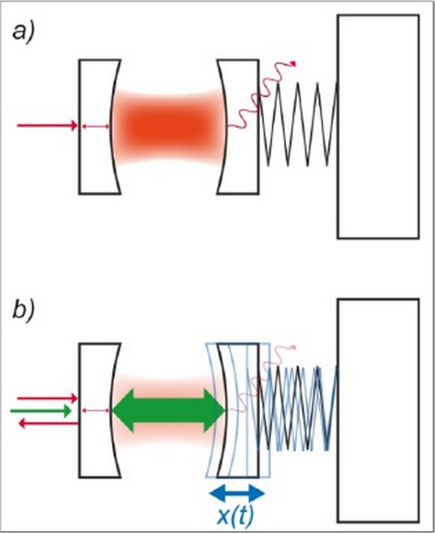
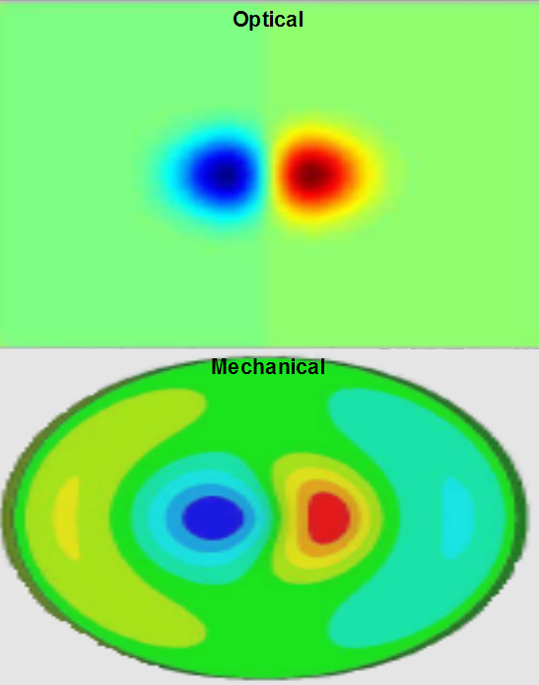
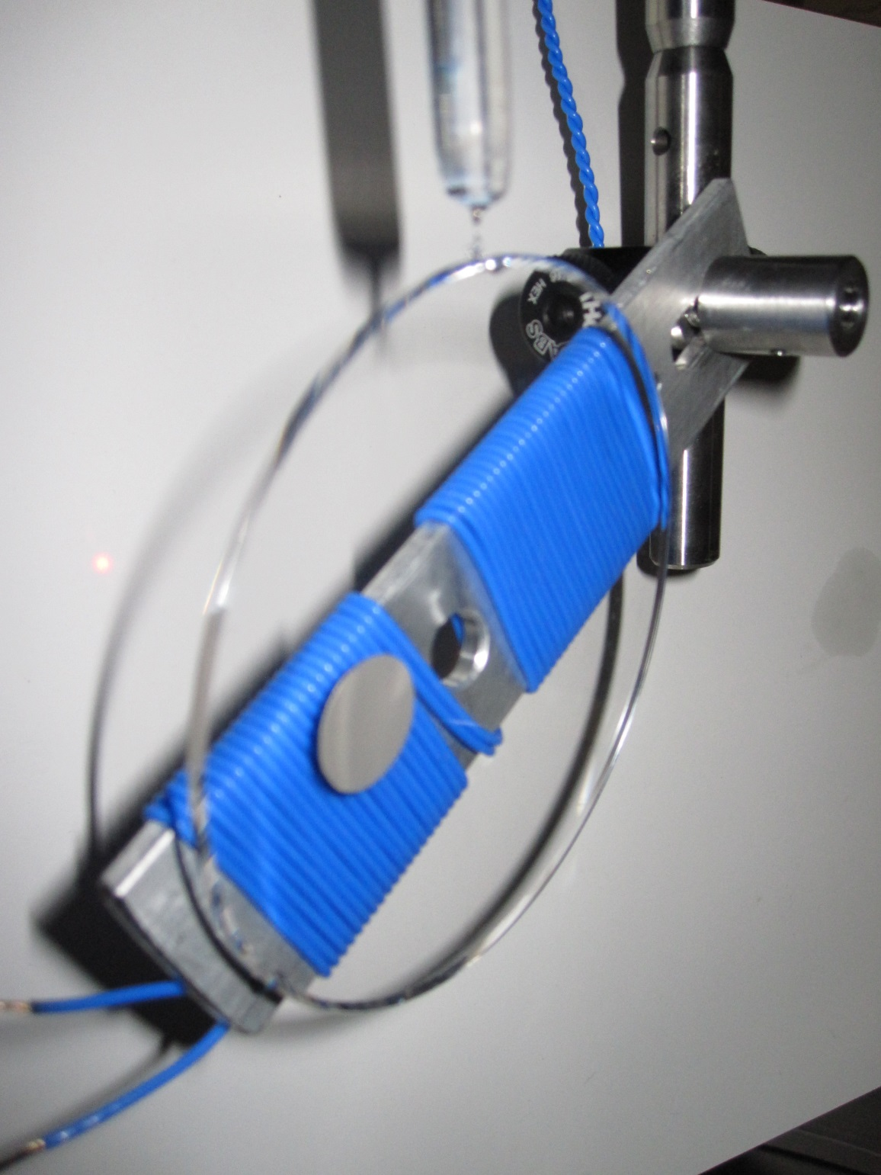
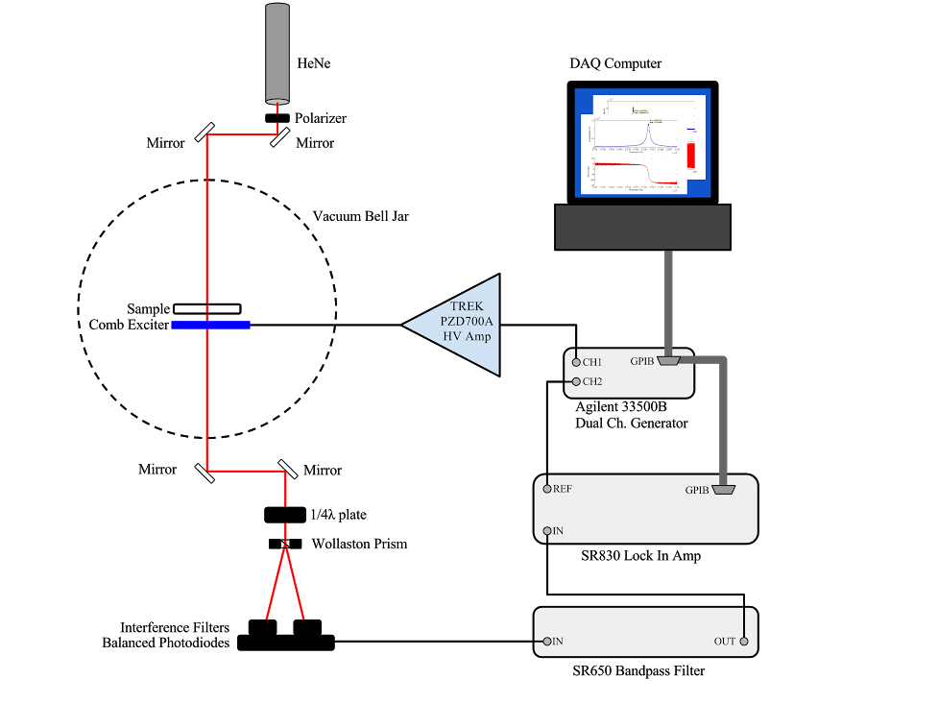
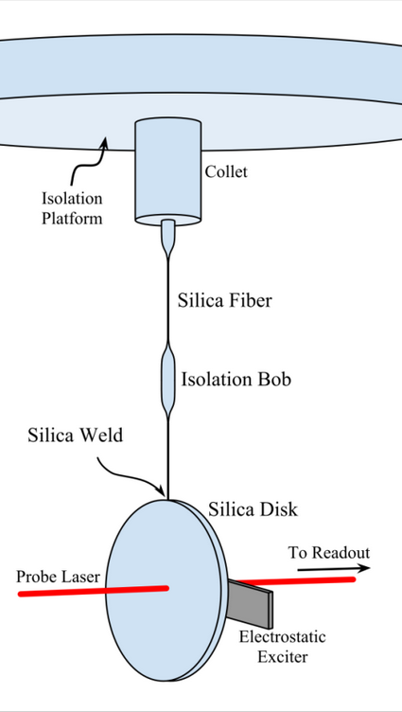
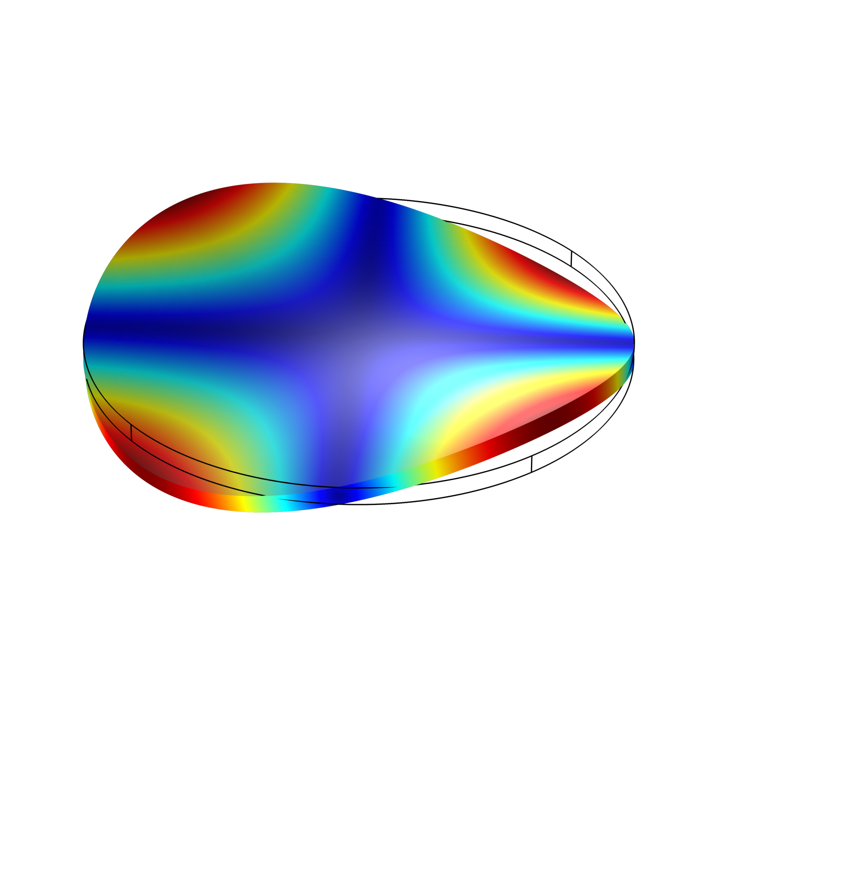
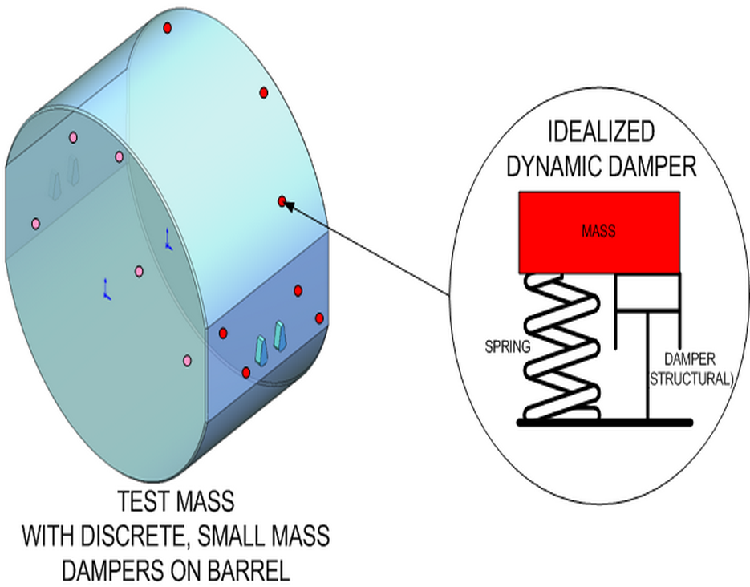
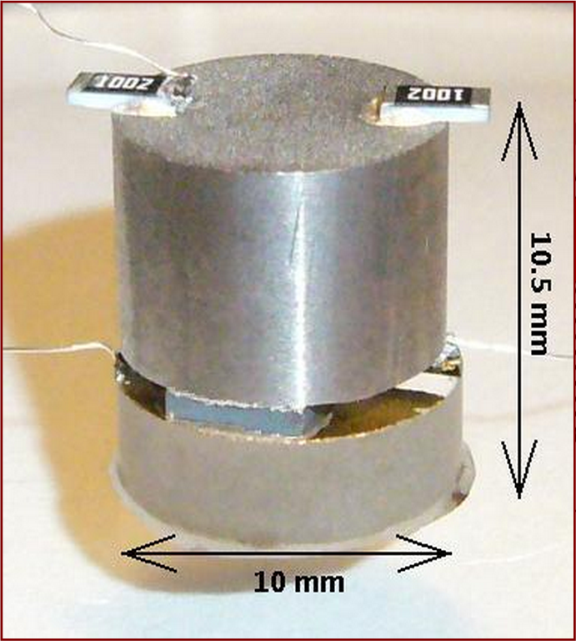
Mechanical Loss of Vacuum Compatible Epoxies for Tuned Mass Dampers
Hannah Fair, Gregory Harry, Jonathan Newport,
Sam Hickey from American University
Parametric Instability
Interpretation into Mechanical Loss
Slawek Gras, Peter Fritschel from MIT,
Bill Kells from Caltech
LIGO-G1400938
The higher optical power in the Fabry Perot cavities of Advanced LIGO potentially introduces the issue of parametric instability; the exchange of energy between the optical modes of the cavity and the acoustic modes of the mirrors. Energy transfer from the optical cavities to the mirrors could ring up the mirror’s elastic modes, increase the rms motion, and potentially lead to control problems and lock loss.
After obtaining the Qs of the silica disk with epoxy on them, we use the FEA program COMSOL to obtain our mechanical loss phis. The program takes into account the properties of the silica disk and wafer, the Young’s modulus of the epoxy, the Qs of the different frequencies, and the bulk and shear properties to determine the phi. This is an ongoing progress, as we still need to find the thicknesses, Young’s moduli and related parameters to some of the epoxies.
Technique
We find the modal Qs of different silica disks with different epoxies between the disks and a thin top wafer of silica. The position of the epoxies on the silica disks is determined via Finite Element Modeling (FEA).
Epoxy Solution
One possible solution is to damp the test mass modes with tuned mass dampers. There is a concern that damping the system would increase mechanical loss and result in higher thermal noise. However, the test mass modes are above 50kHz, while thermal noise is a concern around 100Hz. Parametric instability can be mitigated if a damping device that damps higher frequencies more than lower frequencies can be created. Because these dampers must be retrofitted onto the aLIGO mirrors, silicate bonding is not possible. At American University, we are measuring the mechanical loss of different epoxies in order to find a suitable candidate for attaching these dampers to the test masses.
Epoxies in Progress
Epoxies analyzed with FEA
Name | Frequency | Quality Factor
Hysol EA 9313 | 2692 Hz | 4.5x10⁵
(centered) | 6114 Hz | 1.2x10⁶
 | 6115 Hz | 1.1x10⁶
 | 9370 Hz | 1.2x10⁶
EP1730 | 2683 Hz | 35,000
(off center) | 4077 Hz | 300
 | 9367 Hz | 14,000
Name | Thickness | Young’s Modulus | Viscosity | φ
Hysol Tra-Duct 2902 | 47 µm | 4.8 Gpa | 20 Pa s | 0.05 ≤ φ ≤ 0.1
EMI Optocast 3553LV | 10 µm | 3.4 Gpa | .5 Pa s | 0.01 ≤ φ ≤ 0.05
Masterbond EP30 | 10 µm | 2.9 Gpa | .02 Pa s | 0.02 ≤ φ ≤ 0.14
Epotek 353ND | 10 µm | 3.7 Gpa | 12.5 Pa s | φ ≈ 0.03
Current Status
Future plans with Epotek 353ND
An epoxy has not been chosen yet. With relatively high φs, Hysol Tra-Duct and Masterbond will likely be ruled out. Optocast and Epotek potentially have low enough thermal noise to be used.
We are adding carbon to EpoTek in an attempt to make it conductive, and then re-test the new mixture for mechanical loss.

