Slide 1
Automated Photodetector Frequency Response Measurement System for the Caltech 40m Interferometer
Nichin Sreekantaswamy
BITS,Pilani – Goa Campus
LIGO SURF 2014
Mentors: Eric Gustafson and Jameson Rollins
LIGO Laboratory

Slide 2
Outline
Introduction
Photodiode Transimpedance
Transimpedance measurement technique
Overview of the Photodiode Frequency Response (PDFR) system
Other factors affecting measurements (RF cable delay, demodulator boards)
Results
Conclusion

Slide 3
Introduction
Several photorecievers are used to provide feedback signals to position the mirrors for correct operation of the interferometer and ensure that the optical cavity resonances are acquired and maintained (Pound-Drever-Hall technique).
This system will enable the lab personnel to check if a photoreciever is functioning properly or not, remotely.
GUI interface to run the frequency sweep test and then bring up its current transimpedance frequency response plots.
Notes:
EPICS is a set of Open Source software tools, libraries and applications developed collaboratively and used worldwide to create distributed soft real-time control systems
MEDM is a Motif graphical user interface for designing and implementing control screens, called displays, that consist of a collection of graphical objects that display and/or change the values of EPICS process variables.

Slide 4
Photodetector Model
A representative model:
Notes:
The significance of transimpedance.

Slide 5
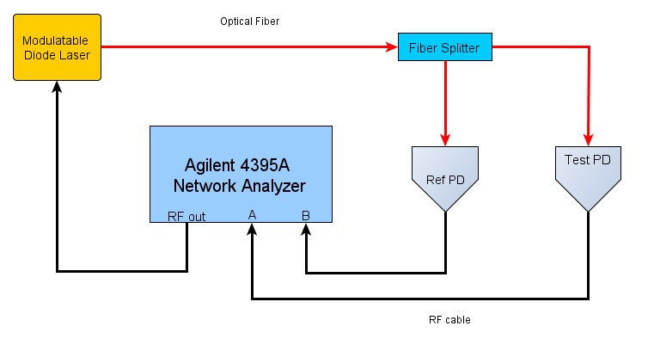
Single PD Transimpedance Measurement

Slide 6
Single PD Transimpedance Measurement
$$T_{RF,Test}=\frac{V_{RF,Test}}{V_{RF,Ref}}∗\frac{V_{DC,Ref}}{V_{DC,Test}}∗\frac{T_{DC,Test}}{T_{DC,Ref}}∗T_{RF,Ref}$$
$\frac{V_{RF,Test}}{V_{RF,Ref}}$ is measured with the network analyzer.
$V_{DC,Ref}$ and $V_{DC,Test}$values are measured with a multimeter and stored in a database.
The values are plugged in and the RF transimpedence for the test PD is calculated at different frequencies.

Slide 7
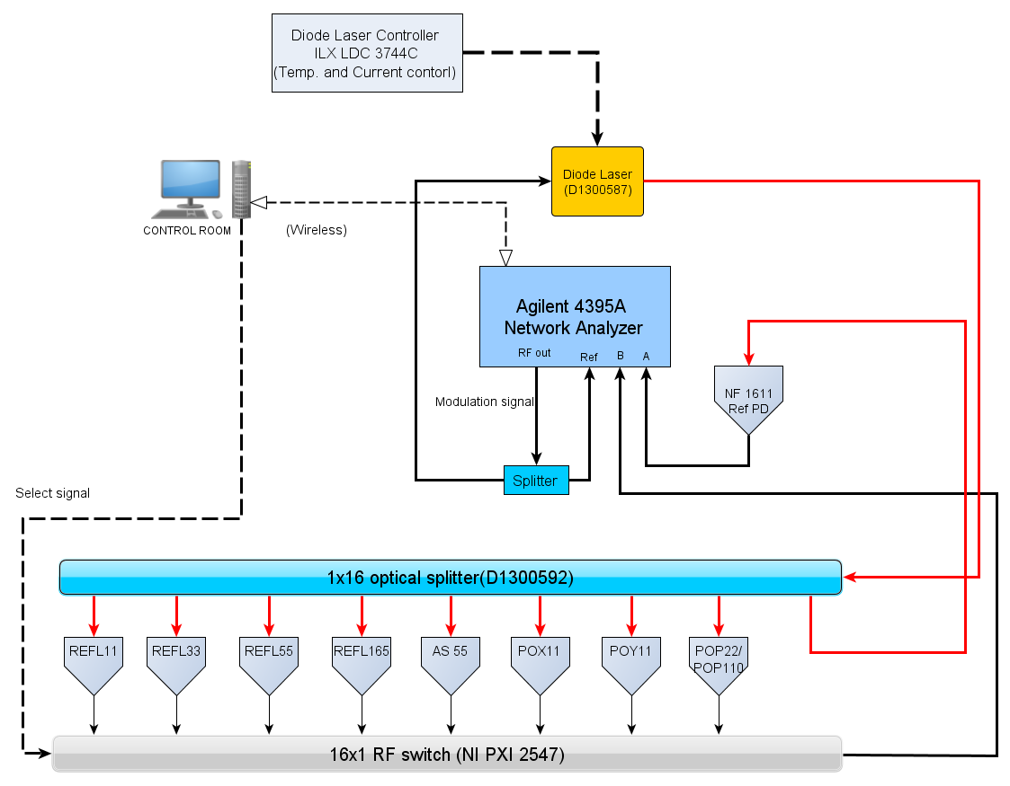
The PDFR system

Slide 8
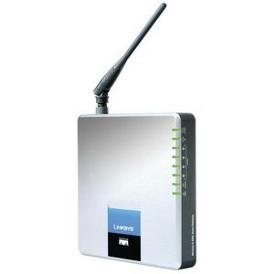
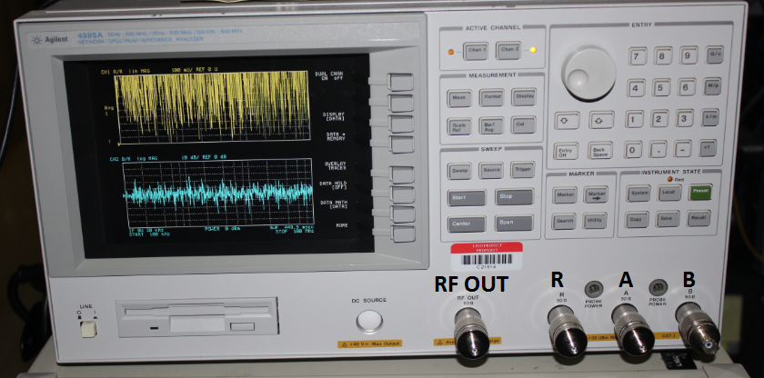
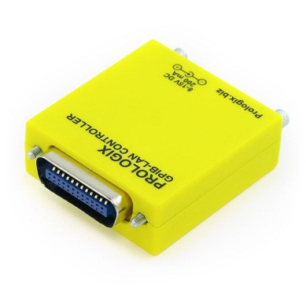
Agilent Network Analyzer
Lab’s closed LAN Network
GPIB (General Purpose Interface Bus)
Notes:
HP-IB (Hewlett-Packard Interface Bus), and is commonly called GPIB(General Purpose Interface Bus)
short-range digital communications bus specification. It has its own keywords and commands

Slide 9
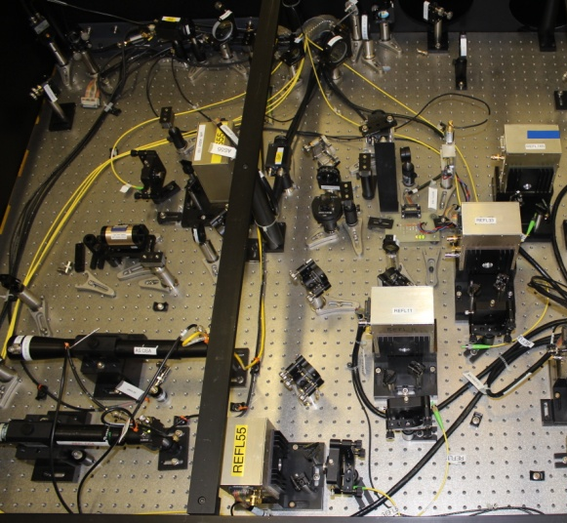
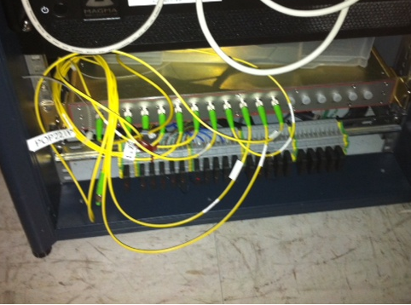
Optical Fiber Distribution

Slide 10
RF Multiplexer
Channel selection using a simple TCP/IP script.
Connected to the LAN network
Notes:
Python import socket

Slide 11
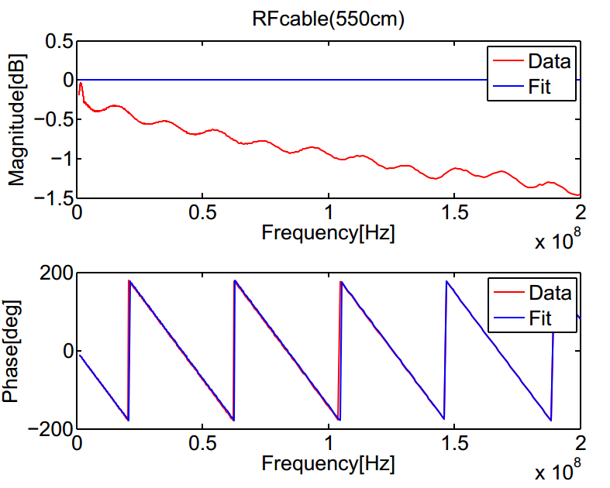
Delay in RF cables
Transfer function for an ideal delay function : e^{(-sT}_{d}⁾
The slope of the phase gives the time delay.
Notes:
Laplace transform: f(t-a) -> exp(-as) F(s)

Slide 12
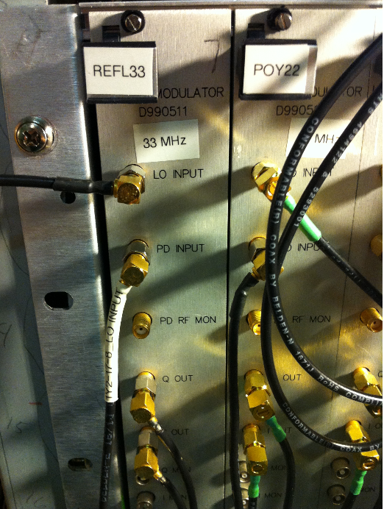
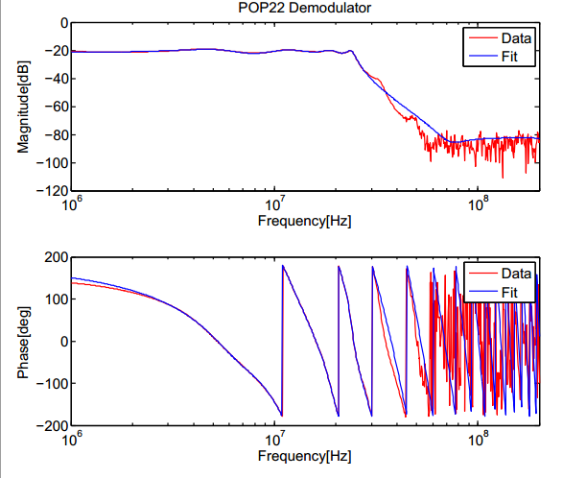
Demodulator Boards
Demodulator board’s transfer function between PD Input and PD RF MON
Vector Fitting: Fit the frequency response into a model / transfer function or simply an equation.
Notes:
This demodualtor board is
used in the Pound-Drever-Hall technique to lock Fabry-Perot cavities of the interferometer and is out of scope of this project. However the board has an output named PD RF MON (Radio Frequency Monitor) that just follows the input and is to be used for checking the PD. The PD RF MON output is attenuated compared to the actual output of the PD and our system needs to take this into account
just using the input pick off from the demod boards, so you're signal is not being demodulated at all.

Slide 13
The PDFR system, Again

Slide 14
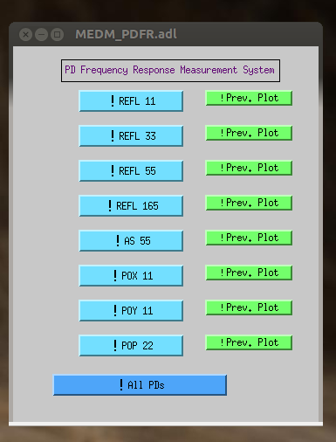
The PDFR GUI
GUI window to run scripts.
Has extra buttons for running tests on all PDs and to bring up previous measurement plots for each PD.

Slide 15
Data Presentation
Compare the transimpedance with a canonical measurement.
Vector Fitting
The transimpedance curves can be fit into a transfer function that is defined with its poles and zeros. This makes our system more robust.
The PDFR system has an option to call the standard vector fitting script on Matlab and get the transfer function.
Notes:
A resonant peak at the desired frequency can be instantly recognised.

Slide 16
Conclusion
The PDFR system is very flexible and can be used to accommodate any new PD
Vector fitting of transimpedance is being improved to be more accurate.
Future work:
More accurate curve fitting
A way to detect and exclude regions of bad coherence.

Slide 17
Acknowledgements
Eric Gustafson, Jamie Rollins
40 meter folks: Rana, Koji, EricQ, Jenne, Manasa, Steve
Akhil, Andres, Harry
National Science Foundation

