Slide 1
L1 TMSY Telescope focal tuning results
Adam Mullavey, Chris Guido
31 Oct 2013
LIGO-G1400170

Slide 2
Source Parameters (MM results)
IR beam retro reflected using flipper mirror on periscope. The RED marked values are used for the model.
[EXTERNAL RESULTS]
Min Max Mean Std Dev Dim
-------------------------------------------------------------------------------------------------
M≤x 0.96 0.97 0.96 0.004 -
M≤y 1.18 1.20 1.19 0.006 -
M≤r 1.09 1.10 1.10 0.003 -
2Wox 1.605 1.667 1.632 0.0264 mm
2Woy 2.164 2.226 2.192 0.0245 mm
2Wor 1.906 1.966 1.932 0.0250 mm
2Wex 4.142 4.167 4.152 0.0095 mm
2Wey 4.095 4.139 4.122 0.0165 mm
2Wer 4.121 4.153 4.137 0.0113 mm
Zox -4.737 -4.833 -4.776 -0.0401 m
Zoy -4.680 -4.795 -4.737 -0.0468 m
Zor -4.711 -4.796 -4.758 -0.0403 m
Zrx 1.988 2.121 2.041 0.0587 mm
Zry 2.895 3.078 2.974 0.0784 mm
Zrr 2.449 2.604 2.514 0.0670 mm
Divergencex 0.79 0.81 0.80 0.010 mr
Divergencey 0.72 0.75 0.74 0.011 mr
Divergencer 0.76 0.78 0.77 0.011 mr
Astigmatism(Zoy-Zox)/Zrr -0.0 3.1 1.5 1.25 %
Waist Asymmetry(2Woy/2Wox) 1.335 1.351 1.343 0.0073
Divergence Asymmetry Thetay/Thetax 0.919 0.926 0.922 0.0035

Slide 3
Tele Measurement - 1 (Single Lens)
IR beam into the Tele, retro-reflected by the 8” flat ETM, back to the MM.
The RED marked values are used in the model are return values.
[EXTERNAL RESULTS]
Min Max Mean Std Dev Dim
----------------------------------------------------------------------------------------------------
M≤x 0.91 1.11 0.98 0.082 -
M≤y 0.98 1.06 1.02 0.032 -
M≤r 1.08 1.19 1.13 0.042 -
2Wox 0.788 0.957 0.836 0.0711 mm
2Woy 0.841 0.871 0.861 0.0120 mm
2Wor 0.909 1.015 0.965 0.0387 mm
2Wex 1.305 1.569 1.459 0.1102 mm
2Wey 2.225 2.373 2.295 0.0665 mm
2Wer 1.877 1.992 1.925 0.0442 mm
Zox -0.666 -0.802 -0.754 -0.0560 m
Zoy -1.304 -1.350 -1.327 -0.0188 m
Zor -1.006 -1.078 -1.045 -0.0264 m
Zrx 0.482 0.610 0.529 0.0486 mm
Zry 0.530 0.551 0.537 0.0083 mm
Zrr 0.566 0.639 0.606 0.0265 mm
Divergencex 1.54 1.63 1.58 0.039 mr
Divergencey 1.56 1.64 1.60 0.033 mr
Divergencer 1.59 1.61 1.59 0.008 mr
Astigmatism(Zoy-Zox)/Zrr -106.7 -87.2 -94.5 8.54 %
Waist Asymmetry(2Woy/2Wox) 0.907 1.098 1.035 0.0768
Divergence Asymmetry Thetay/Thetax 0.967 1.069 1.014 0.0444

Slide 4
Tele Measurement – 2 (Single Lens)
Same as ‘Tele Measurement – 1’, but with the ModeMaster rotated (roll) by 45 degrees, to sample the beam differently.
The RED marked values are used as the return values.
[EXTERNAL RESULTS]
Min Max Mean Std Dev Dim
---------------------------------------------------------------------------------------------
M≤x 1.05 1.14 1.11 0.036 -
M≤y 1.10 1.17 1.12 0.031 -
M≤r 1.09 1.17 1.14 0.033 -
2Wox 0.975 1.045 1.019 0.0264 mm
2Woy 0.848 0.892 0.864 0.0170 mm
2Wor 0.924 0.966 0.950 0.0168 mm
2Wex 1.762 1.974 1.861 0.0842 mm
2Wey 1.908 2.245 2.046 0.1309 mm
2Wer 1.912 2.055 1.958 0.0580 mm
Zox -0.995 -1.141 -1.052 -0.0628 m
Zoy -0.976 -1.158 -1.053 -0.0775 m
Zor -1.028 -1.103 -1.052 -0.0312 m
Zrx 0.668 0.712 0.688 0.0162 mm
Zry 0.475 0.502 0.491 0.0118 mm
Zrr 0.577 0.587 0.584 0.0048 mm
Divergencex 1.46 1.50 1.48 0.016 mr
Divergencey 1.73 1.80 1.76 0.030 mr
Divergencer 1.60 1.64 1.63 0.019 mr
Astigmatism(Zoy-Zox)/Zrr -22.7 28.1 -0.3 22.43 %
Waist Asymmetry(2Woy/2Wox) 0.818 0.886 0.848 0.0303
Divergence Asymmetry Thetay/Thetax 1.169 1.228 1.189 0.0226

Slide 5
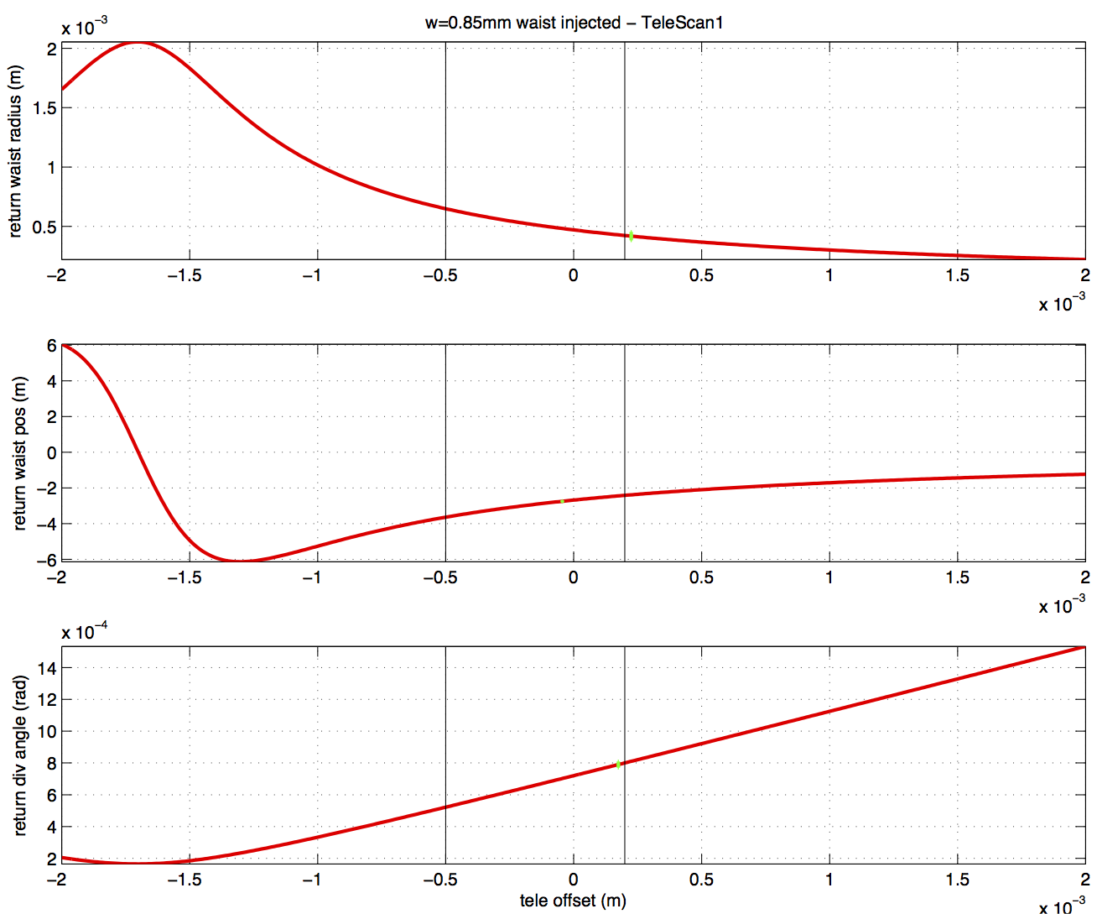
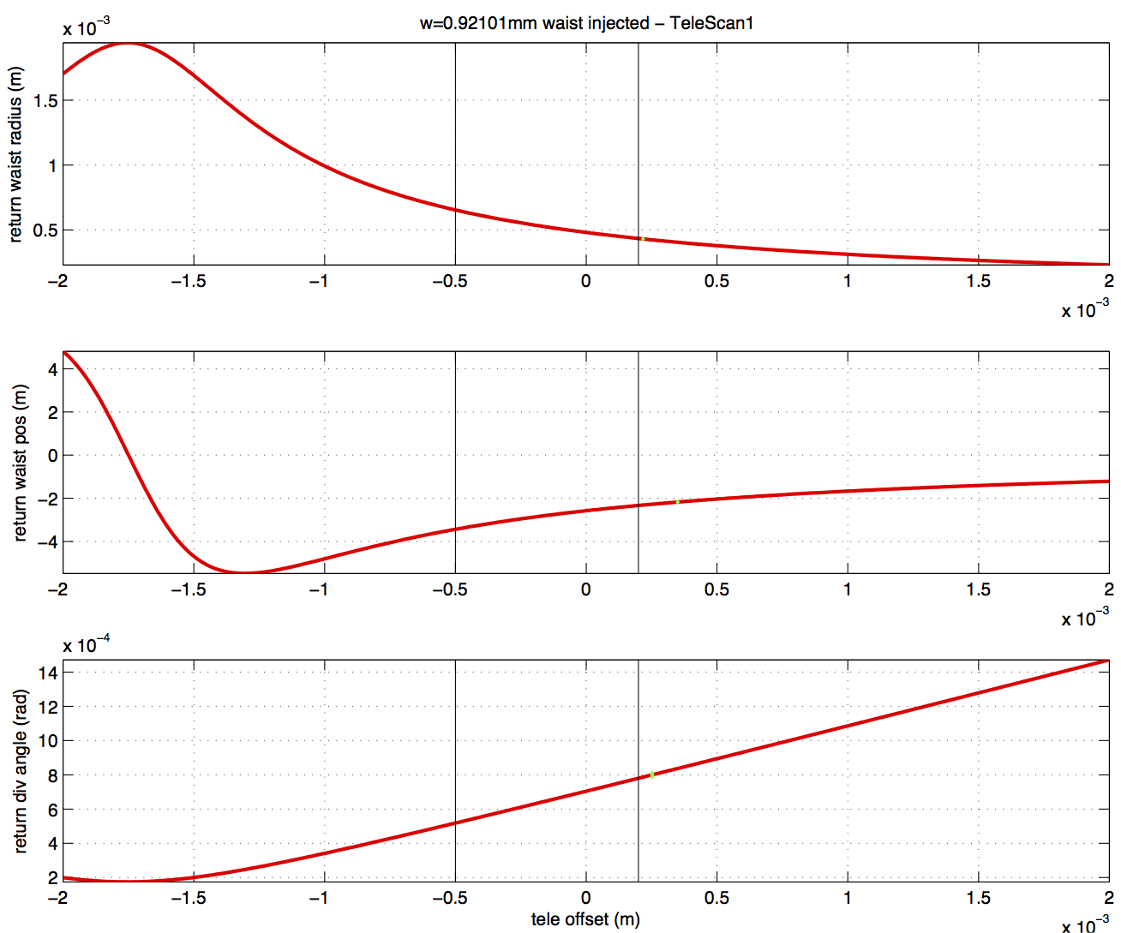
Telescope de-tuning Results (using TeleScan1 measurements)
Input into the TeleModel are the measured Source Parameters from the ModeMaster.
The GREEN markers are from the measured ModeMaster results from ‘Tele Measurement 1’ (they should be crossing the red calculated line).
The vertical lines indicate the tolerance.
X-axis
Y-axis

Slide 6
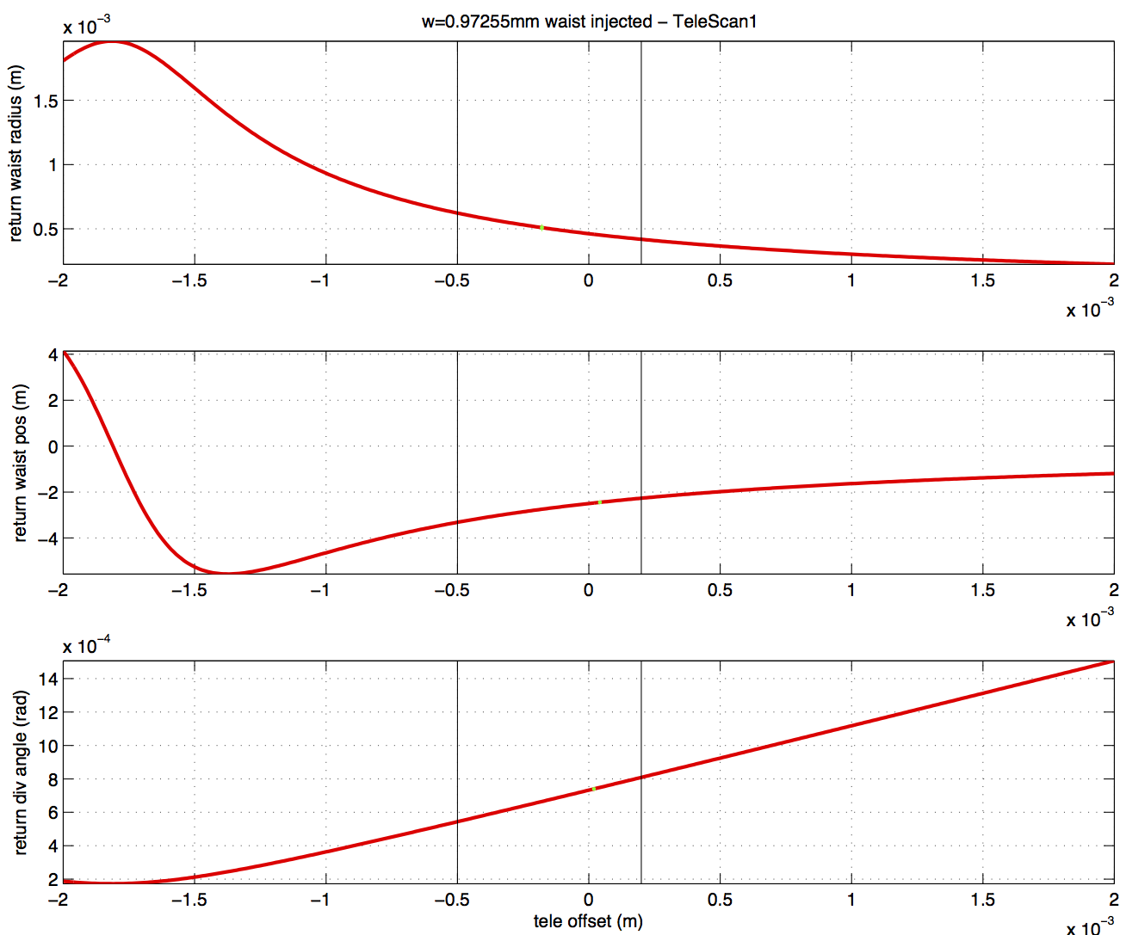
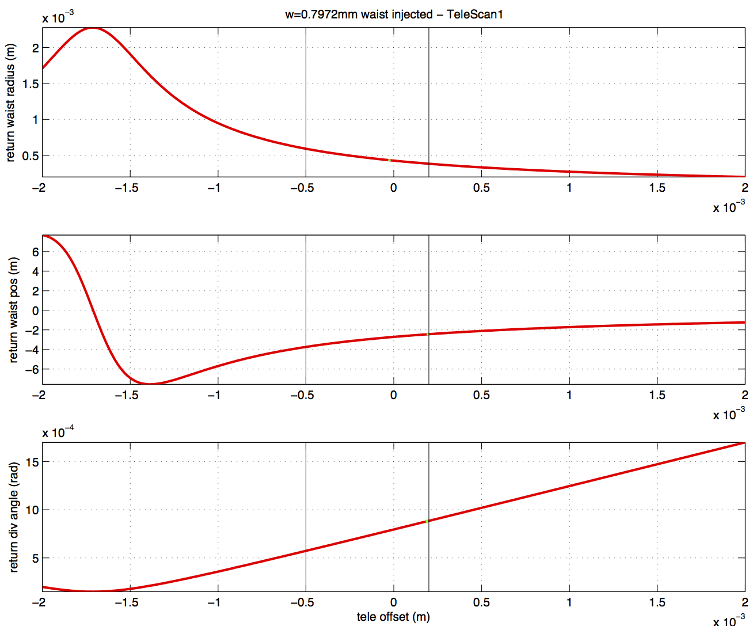
Telescope de-tuning Results (using TeleScan2 measurements)
Input into the TeleModel are the measured Source Parameters from the ModeMaster.
The GREEN markers are from the measured ModeMaster results from ‘Tele Measurement 2’ (they should be crossing the red calculated line).
The vertical lines indicate the tolerance.
X-axis
Y-axis

