Slide 1
Data Acquisition, Diagnostics & Controls (DAQ)
System Acceptance Testing
Annual NSF Review of Advanced LIGO Project
June 24 – June 26, 2014
Rolf Bork, CIT
LIGO-G1400671-v1
2014 June 16

Slide 2
DAQ Scope
Provide core software for real-time control and data acquisition
  Standard application development environment
  Common software to perform real-time scheduling and I/O functions
Provide a Timing Distribution System (TDS) to synchronize all control and DAQ systems to GPS
Provide real-time data acquisition software/hardware for Physical Environment Monitoring (PEM) sensors.
Provide system to acquire, store and distribute data from real-time control systems

Slide 3
DAQ System
Design Overview
Timing Distribution System (TDS), slaved to GPS, provides clocks to PCI Express (PCIe) modules in I/O chassis.
PCIe modules interface to control computer via PCIe fiber link.
Control computer acquires data and transmits to DAQ data concentrator (DC) via network.
DC assembles data from all controllers and broadcasts full data blocks every 1/16 second.
FrameWriter computers format data and write to disk (64sec. data frame)
Network Data Server (NDS) provides data on demand either live or from disk.

Slide 4
DAQ Test Facilities
Dedicated DAQ Test Stands (DTS)
  Scaled versions of production systems
    Caltech, LHO, LLO
    Testing performed using automated regression test software
      Described in LIGO-T1300721
      Testing includes both hardware and software
Employed in various interferometer R&D systems
    Caltech 40m lab
    MIT LASTI
    AEI (Hannover, Germany) laser and 10m labs

Slide 5
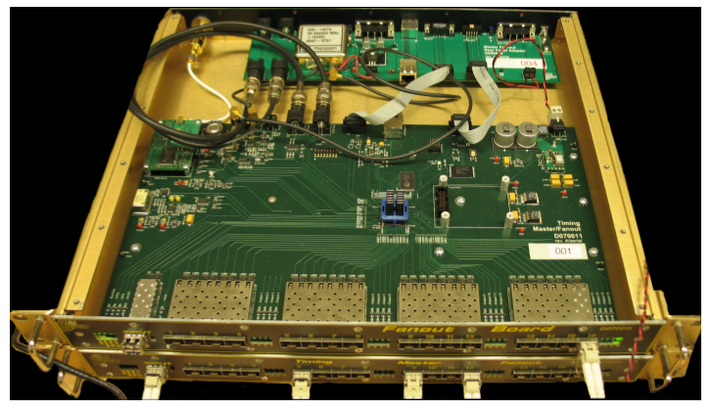
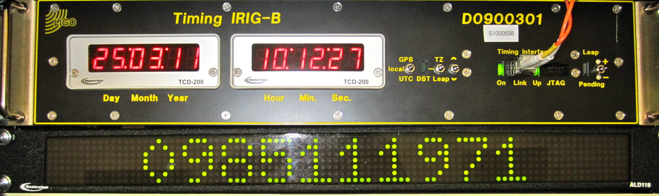
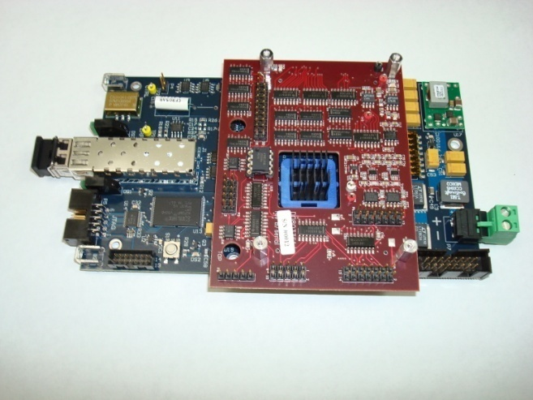
Timing Distribution System (TDS)
Contracted to Columbia Univ. for manufacture and test after a joint development effort. Design described in the journal "Classical and Quantum Gravity” under Imre Bartos et al., 2010 Class. Quantum Grav. Vol. 27, No. 8, 084025
IRIG-B Timing Fanout
Provides accurate time information to computers.
Timing Slave provides accurate clocks
At 65536Hz to ADC/DAC modules.

Slide 6
TDS Testing
Individual TDS chassis tested prior to delivery, each in accordance with its own test procedure.
  Overview contained in LIGO-T0900050
  List of all documentation linked from LIGO-E090003
Continuous on-line verification
  Each real-time control computer verifies timing via TDS duotone and IRIG-B signals.
  TDS comparators report diagnostics as compared to atomic clock.

Slide 7
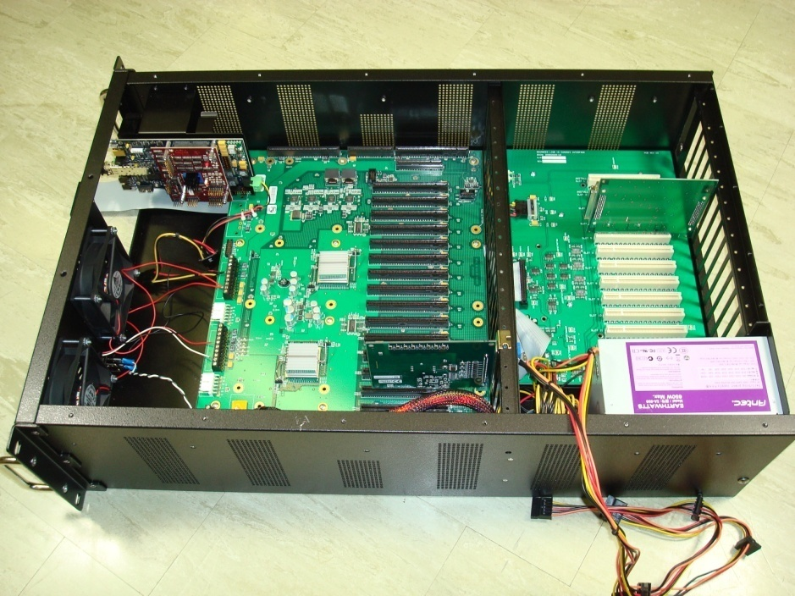
PEM Equipment
For PEM, DAQ only provides the interface to the DAQ system ie does not provide any of the sensing instruments.
For each IFO, DAQ provides:
  3 Standard I/O chassis
  4 ADC modules and associated Anti-Aliasing (AA) chassis
All AA chassis tested in accordance with test plan T1000673.
  Reports attached to equipment traveler documentation.
All I/O chassis tested in Caltech DAQ test system using automated script.
  Reports auto generated and attached to equipment traveler documentation. (linked to LIGO-E1200651).
17 Slot
PCIe Bus with
PCIe Uplink
I/O Timing Bus
Timing Slave
I/O Interface Module
24V DC Supply

Slide 8
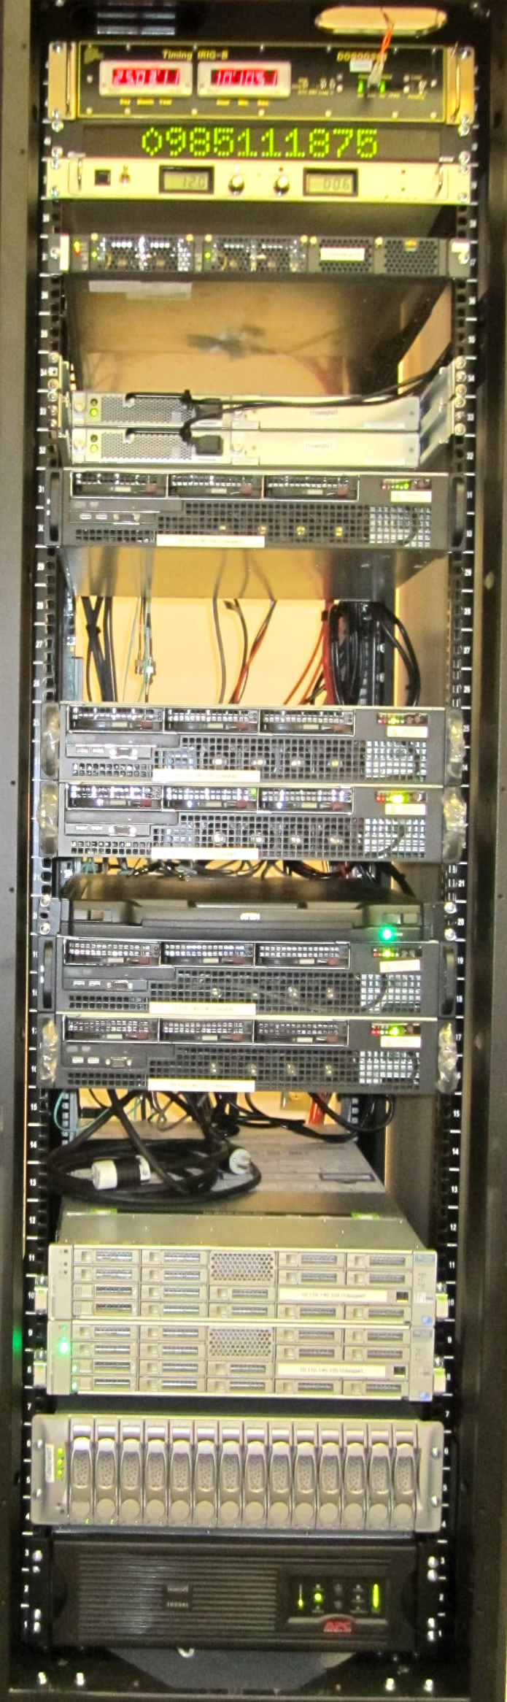
DAQ Computing / Storage Equipment
Design Overview
Data Concentrator (DC) (2)
  Collects data from all real-time control computers via 1GigE to 10GigE Ethernet switch and broadcasts data to separate 10GigE network.
  One unit on-line, second hot backup
FrameWriter (2)
  Receives data from DC
  Formats data into LVC standard Frame format
  Writes data to disk
    Local
    Data Analysis group disk farm
Network Data Server (NDS) (2)
  Provides real-time or stored data on request to various control room software tools
    NDS clients also developed for Perl, Python and Matlab
Two computers running Solaris operating system to connect disk systems via QFS.
24 TByte Local Disk

Slide 9
DAQ Primary Requirements
Support the following continuous data acquisition rates:
  4MByte/sec from each real-time control application, up to 20MByte/sec from each real-time control computer.
    Verified in both off-line and on-line testing
  Aggregate data rate of up to 30MByte/sec from all real-time control computers.
    Total of data to be archived plus user selected test point data.
    LHO system presently running at 62MByte/sec
  Write data to disk at 10MByte/sec (compressed)
    LHO system presently running at 26MByte/sec
      16 Mbyte/sec commissioning frame
      10 Mbyte/sec science frame
Provide capability to access data, live and archived, from various control room operations support tools.

Slide 10
Software Testing
Primary development project for DAQ is software.
Software test progression:
  Off-line test system
  R&D lab installation
  Production system installation
Off-line test systems employ the Jenkins continuous integration tool for test management.
  Code checked out nightly from SVN repository
  All user applications recompiled.
  Representative set of user applications and test applications started on the real-time control computers.
  Test programs run to verify proper operation.
  Test reports auto-generated using doxygen tool.

Slide 11
Continuous On Line Testing
Real-time control and acquisition systems continuously run various diagnostics as described in LIGO-T1100625
DAQ performs various data integrity checks.
  CRC checksum sent with all data at each interface, with receiving code performing CRC checksum calculation and verifying match.
  Each DAQ application performs a CRC checksum on the data channel list to verify channel to data ordering is correct.
  CRC checksums of frame files written by both frame writers compared to verify that they are identical.

Slide 12
DAQ Status
Installation complete
In continuous operation at both sites for several years
Formal fabrication acceptance review complete
  Documentation linked from LIGO-E1200645
All 3rd Interferometer equipment inventoried and committed to long term storage.

