Slide 1
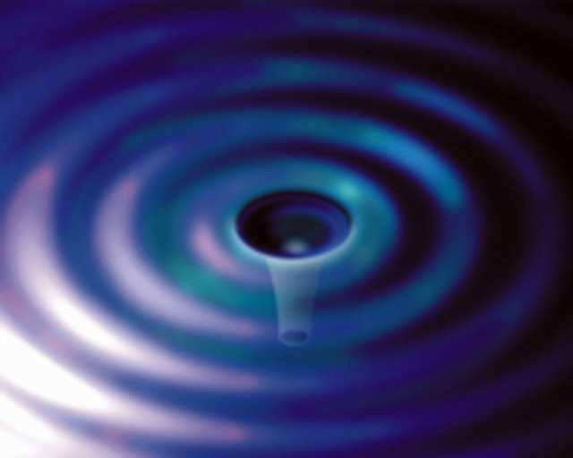
LIGO Status Report:
Initial and Advanced
Gregory Harry
Department of Physics, American University
May 16, 2014
LIGO-G1400511

Slide 2

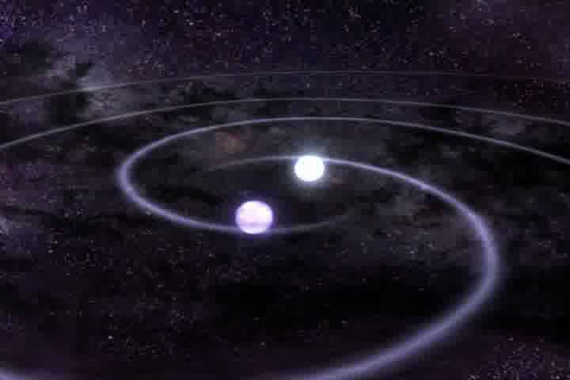
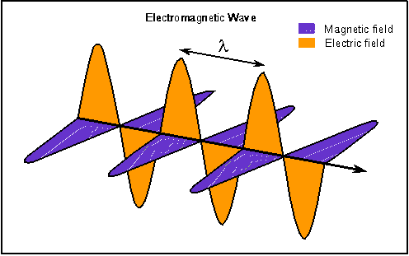

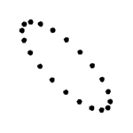
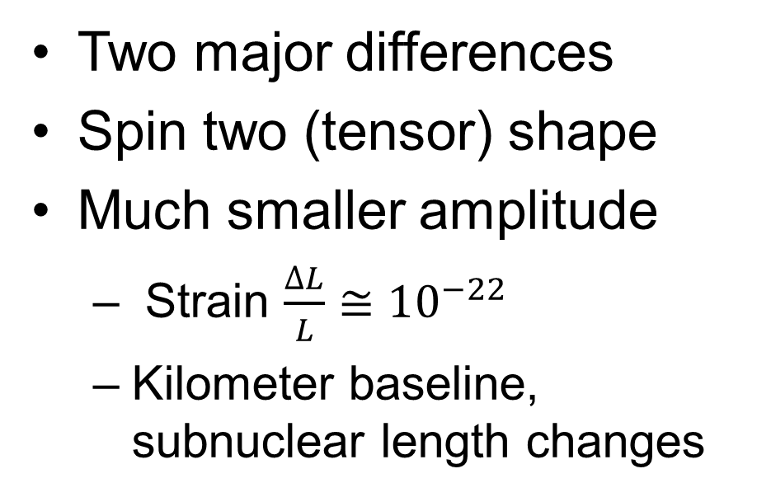
Gravitational Waves
Gravitational waves are a prediction of Einstein’s theory of gravity
Similar to electromagnetic waves (light) from Maxwell’s equations
Two major differences
Spin two (tensor) shape
Much smaller amplitude
  Strain $\frac{∆L}{L}≅10^{−22}$
  Kilometer baseline, subnuclear length changes

Slide 3
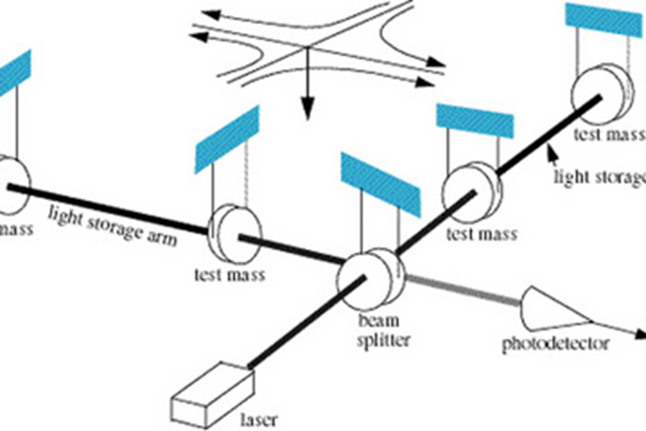

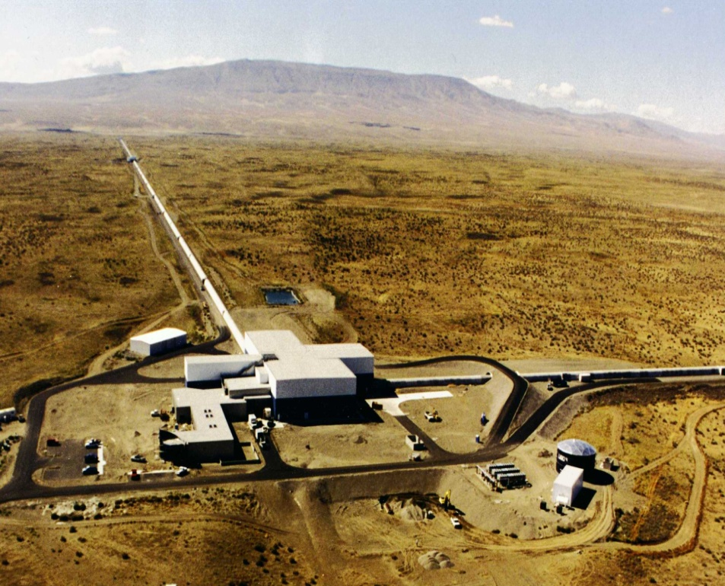
LIGO Interferometers
Modern ground based detectors use interferometers
Sense tiny motion of mirrors
L shape for tensor waves
US has two sites
  Livingston, Louisiana (LLO) and Hanford, Washington (LHO)
4 kilometer-long beam tubes
  Entire 8 km length in vacuum
  Low seismic noise environment

Slide 4
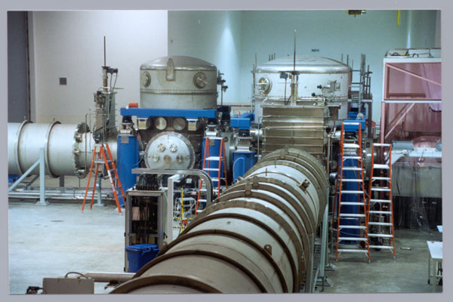
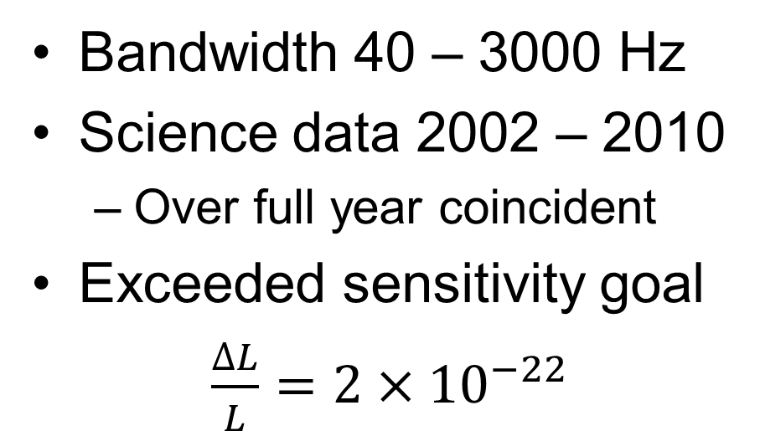
Initial LIGO
Bandwidth 40 – 3000 Hz
Science data 2002 – 2010
  Over full year coincident
Exceeded sensitivity goal
$\frac{∆L}{L}=2×10^{−22}$
3 detectors. 2×4 km/1×2 km
20 W Nd:YAG laser
10 kg silica optics
Steel wire suspensions

Slide 5
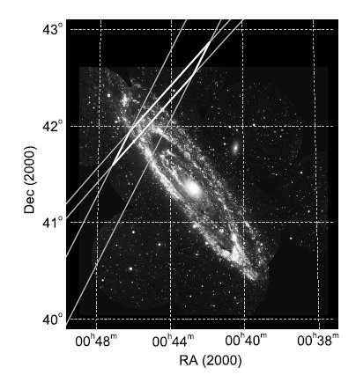
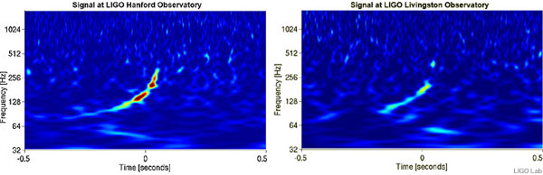
Initial LIGO Astrophysics: Burst and Inspiral Sources
Gama ray bursts (GRBs) may be compact body inspirals
Short GRBs 050311 and 070201
  Locations in galaxies M81 and M31
  Inspiral excluded at >98%
M31, GRB 070201
GW100916
  Consistent with neutron star/black hole inspiral
  Blind injection done to test analysis process

Slide 6
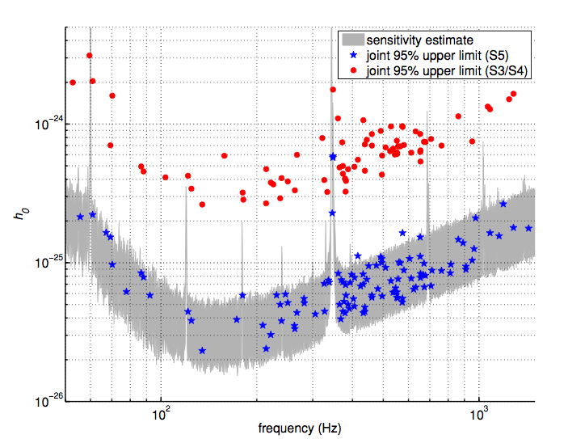
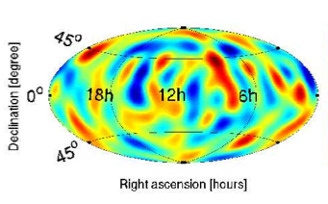
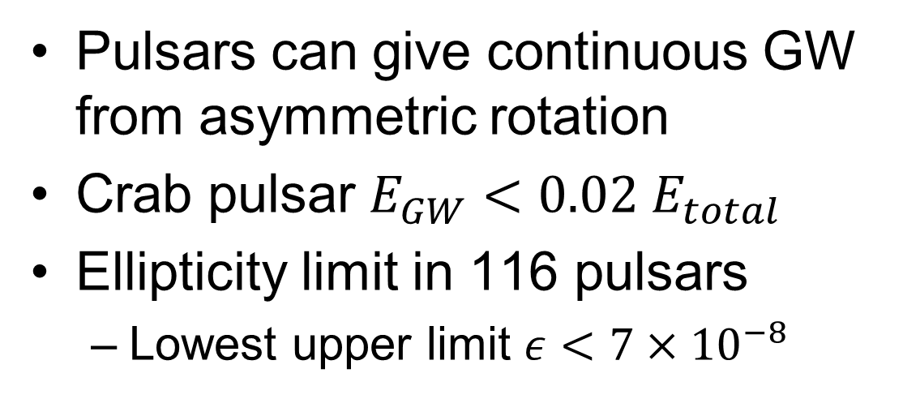
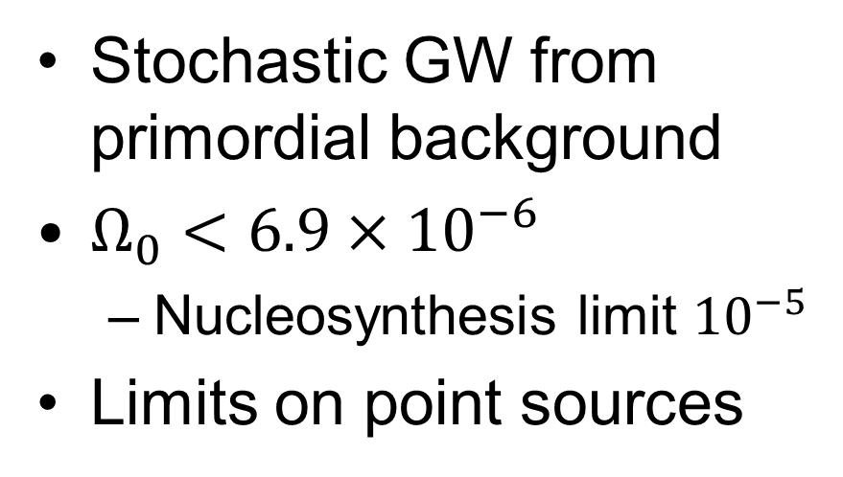
Initial LIGO Astrophysics: Pulsars and Stochastic
Pulsars can give continuous GW from asymmetric rotation
Crab pulsar $E_{GW}<0.02 E_{total}$
Ellipticity limit in 116 pulsars
  Lowest upper limit $ε<7×10^{−8}$
Stochastic GW from primordial background
$Ω_{0}<6.9×10^{−6}$
  Nucleosynthesis limit $10^{−5}$
Limits on point sources

Slide 7
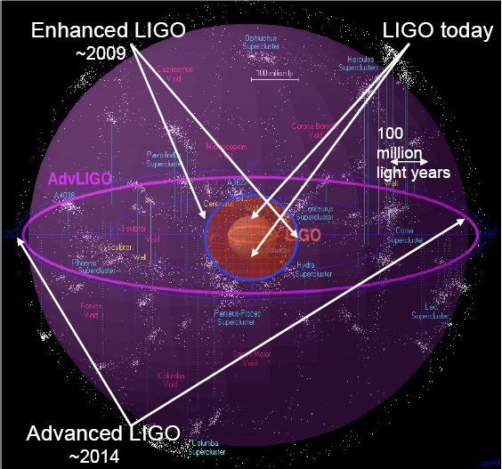
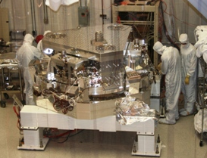
Advanced LIGO
Goal: 10X sensitivity
  10 – 5000 Hz
  200 Mpc NS inspiral range
  Inspirals possible ~ 1/month
  One day with Adv LIGO = a few years with initial LIGO
Initial LIGO
Image courtesy of Beverly Berger
Cluster map by Richard Powell
Project began 2008
  Installation started 2010
  Building three interferometers
  Installation finishing this year

Slide 8
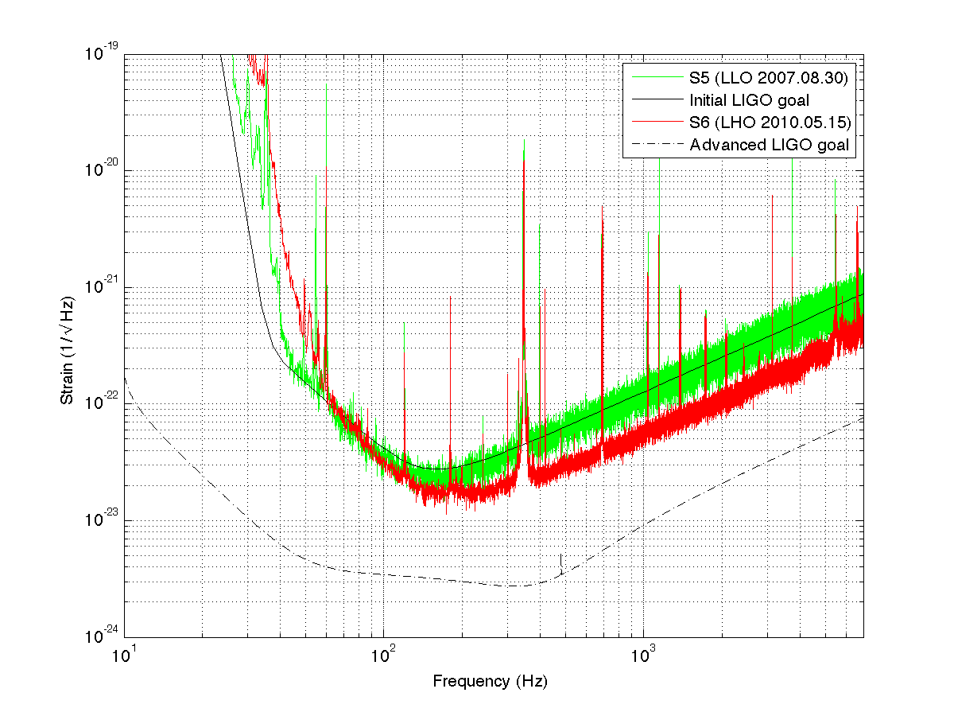
Advanced LIGO Sensitivity
Limited by Earth motion, thermodynamics, and quantum mechanics
Higher
power
laser
Better
seismic
isolation
Better
test masses

Slide 9
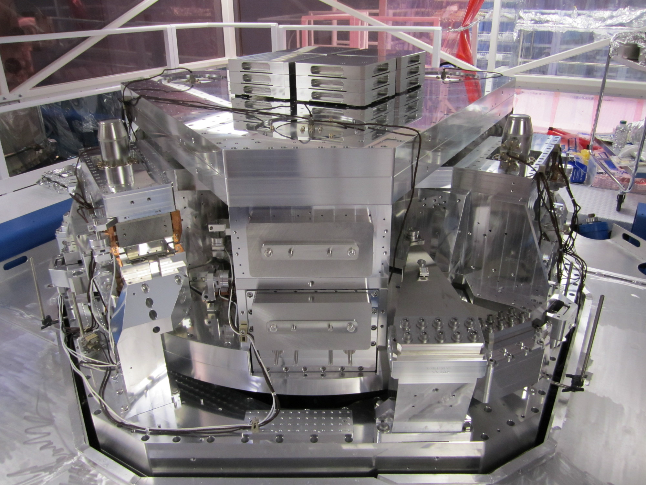
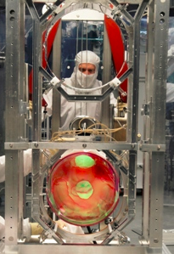
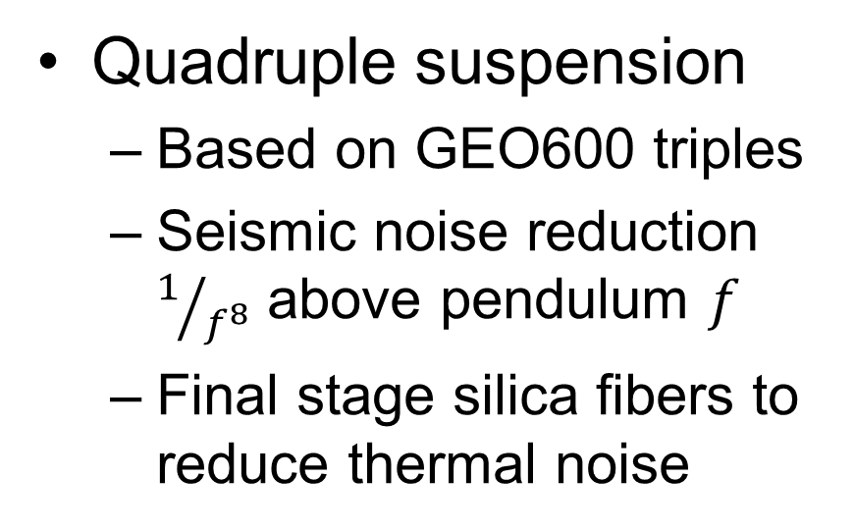
Advanced LIGO Seismic Isolation and Suspension
Seismic isolation
  Hydraulic preisolator external to vacuum
  In vacuum, two stage, 6 DOF active mass/spring system
Quadruple suspension
  Based on GEO600 triples
  Seismic noise reduction $1/{f^{8}}$ above pendulum $f$
  Final stage silica fibers to reduce thermal noise

Slide 10
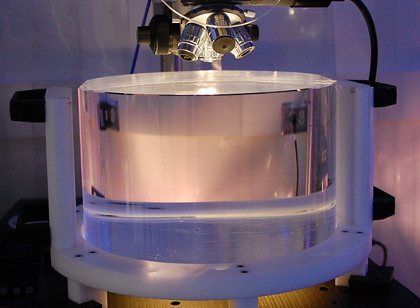
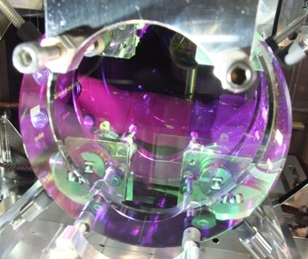
Advanced LIGO Mirrors and Coatings
Fused silica optics
  40 kilograms
  Very low absorption
  Monolithic connection to suspension
Optical coatings
  34 centimeter diameter
  5-6 cm beam spot
  Very low absorption
  Low thermal noise

Slide 11
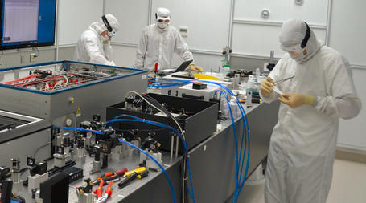
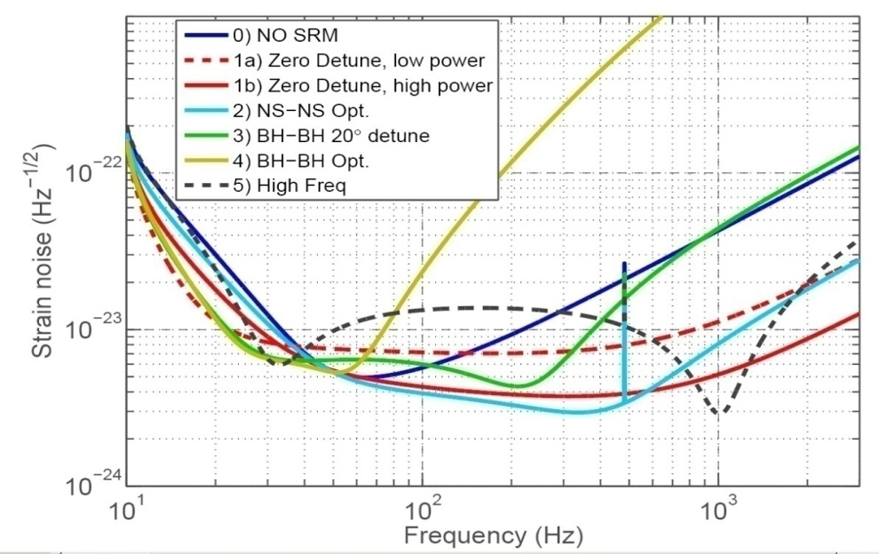
Advanced LIGO Laser and Interferometry
Laser
  Nd:YAG 1064 nm
  Three stage NPRO
  180 Watts
  Shot noise limited
Interferometer
  Power recycling increases arm power to 800 kW
  Signal recycling to tune sensitivity curve
Coating Thermal

Slide 12
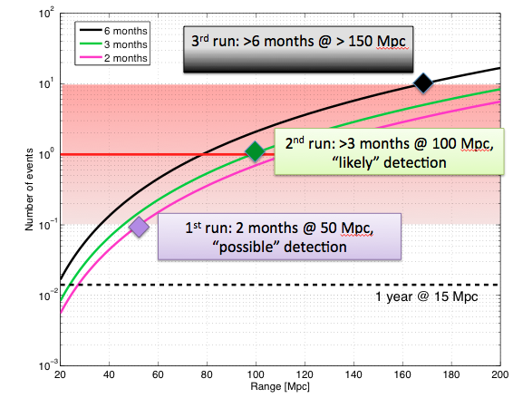
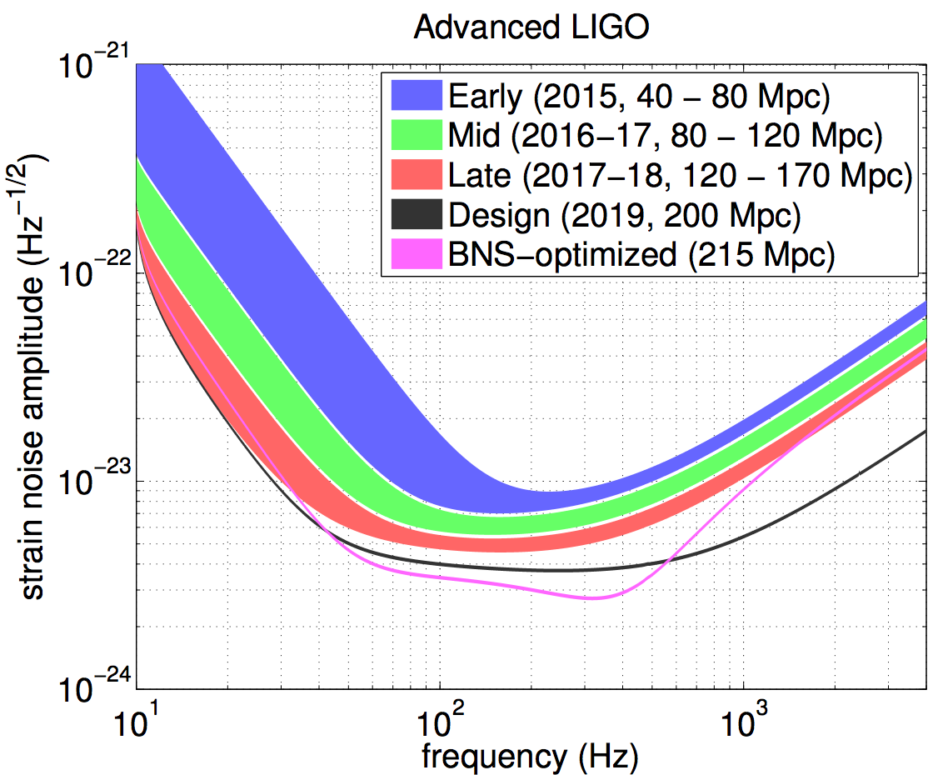
Status and Science Plans
90% complete by budget
Remaining activities
  Finish installation at LHO
  Testing at both LLO and LHO
  Computer procurement
Goal: Direct detection century after Einstein’s 1916 GW paper
Date | Length | Sensitivity
Late 2015 | 3 months | 40-80 Mpc
2016/2017 | 6 months | 80-120 Mpc
2017/2018 | 9 months | 120-170 Mpc
2019 | Full year | 200 Mpc

Slide 13
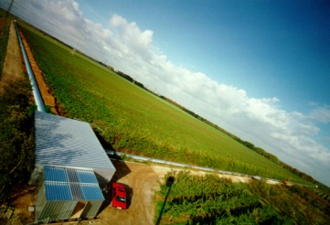
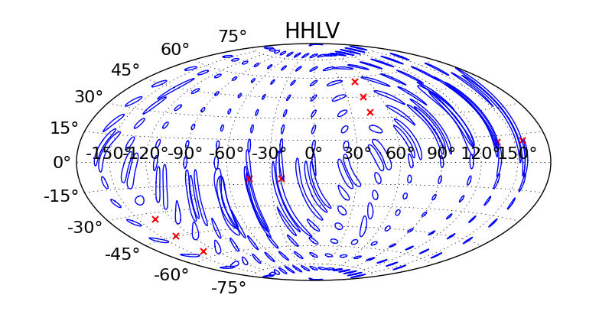
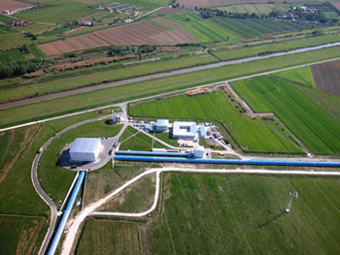
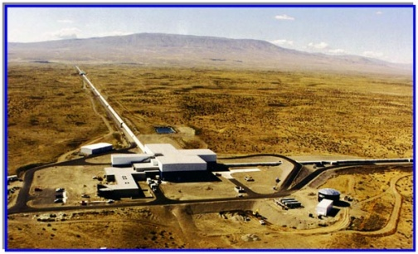
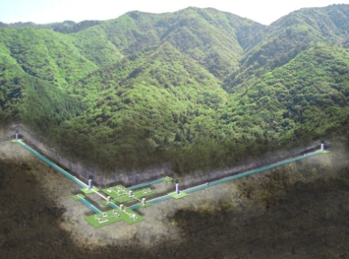
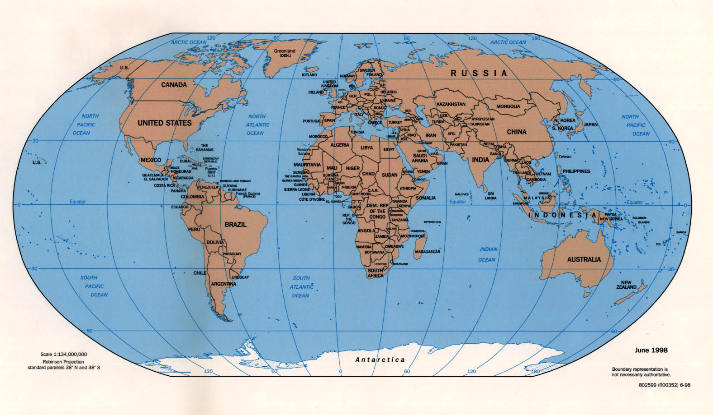
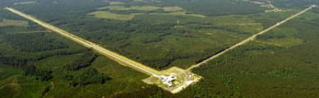
Worldwide Network
Adv LIGO:
Hanford
GEOHF:
Germany
Adv Virgo:
Italy
KAGRA: Japan
Adv LIGO:
Livingston

Slide 14
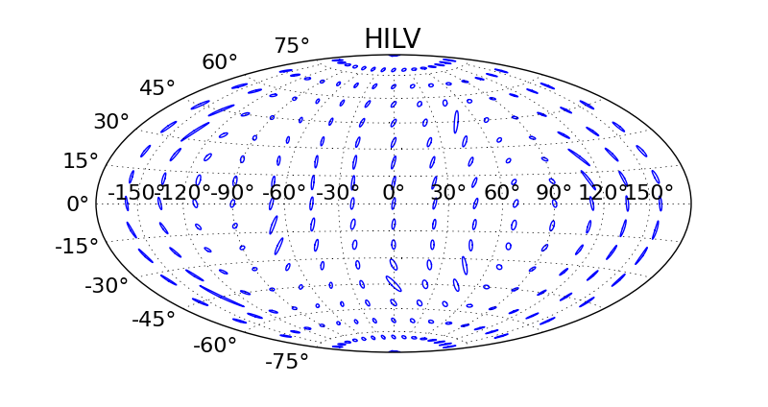
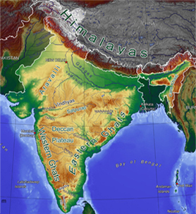
LIGO India
Third Advanced LIGO detector in India
Site selection committee set up
Interferometer hardware stored
Join network 2022
Training and collaboration now

Slide 15
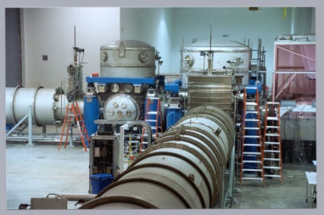

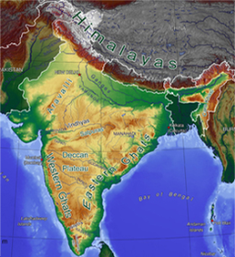
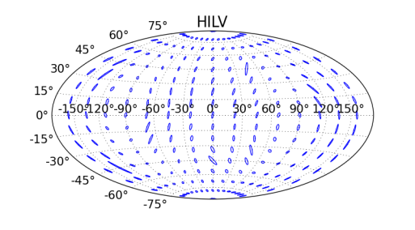
Conclusion
Initial LIGO complete
  Validated technology
  Contributed to astrophysics but no detections
Advanced LIGO
  Installation in US nearly complete
  Lower noise technology→10X sensitivity
  Science runs begin 2015, detections likely
LIGO India
  Expect approval soon
  Increase sky positioning of sources

