Slide 1
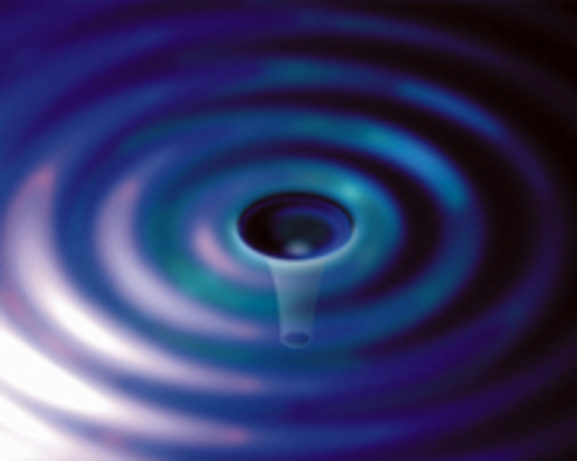
Gravitational Waves, Inflation, and the Big Bang: BICEP-2 Result and LIGO
Gregory Harry
(with support from Artur Tsobanjan)
Department of Physics, American University
April 5, 2014
LIGO-G1400418

Slide 2
Outline
Gravity Theory and Gravitational Waves
Early Universe Cosmology
Big Bang Theory
Cosmic Microwave Background
Inflation
Measurements of the Early Universe
BICEP-2 Result, Implications, and Follow-up
High Frequency Interferometric Gravitational Wave Detection

Slide 3
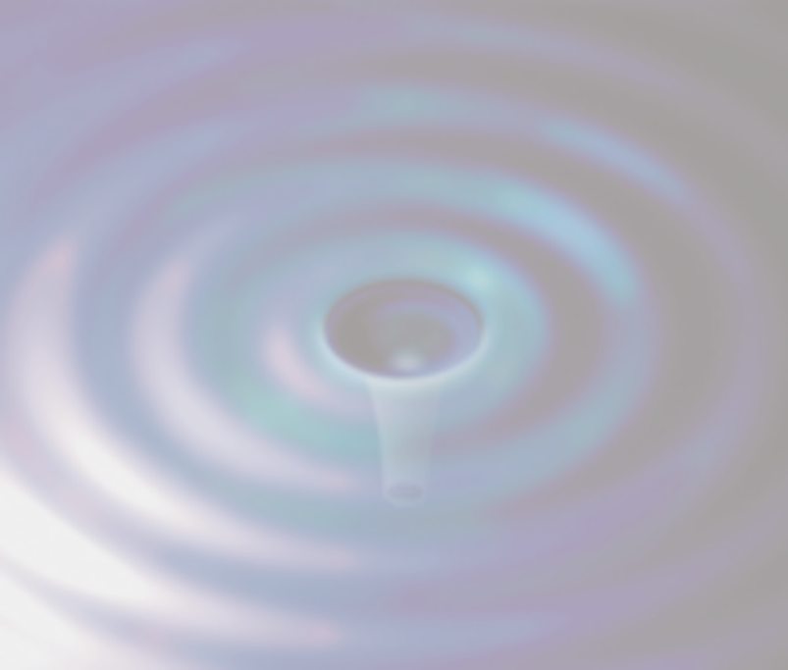
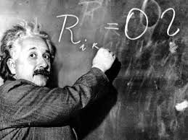
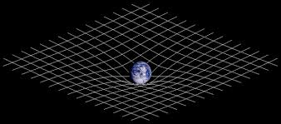
Gravity
First mathematical theory of gravity, Isaac Newton in 1687
Static, gravity everywhere
$$F=\frac{GM_{1}M_{2}}{r^{2}}$$
Einstein developed modern theory of gravity in 1915
General Theory of Relativity
Model of gravity as curvature of space-time
$G_{μν}=\frac{8πG}{c^{4}}T_{μν}$

Slide 4
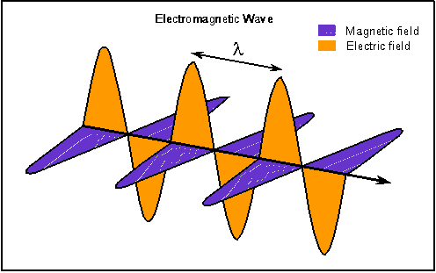
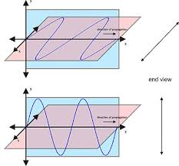
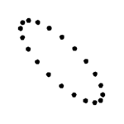
Gravitational Waves
Propagation of gravity at speed of light called gravitational wave
Similar to light wave with important differences
Gravitational wave effect much smaller
Each have two polarizations, but different shapes
Distinctive pattern from gravitational waves

Slide 5
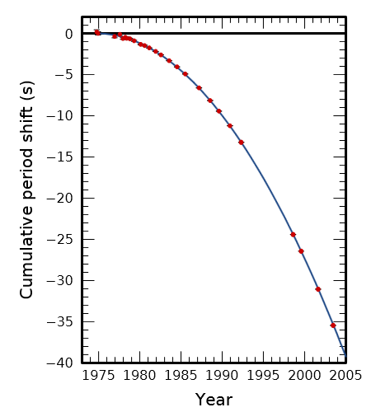
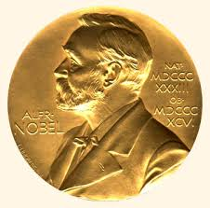
Evidence of Gravitational Waves
Confident gravitational waves exist, have seen their effects
Taylor/Hulse observed Binary Pulsar System PSR B 1913+16 from 1970s
See change in orbit from gravitational waves
Nobel Prize 1993
Similarly in neutron star/white dwarf pair PSR J0348+0432 in 2013

Slide 6
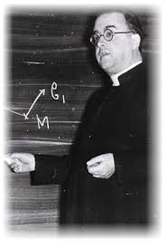
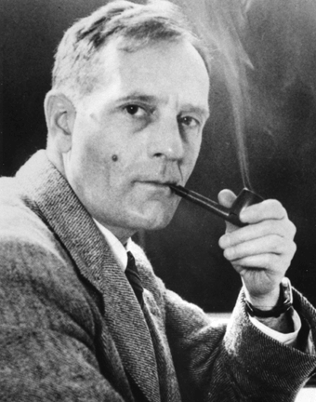
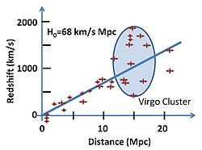
The Big Bang
14 billion years ago the universe began from a compact, hot, dense state
All of space-time compressed
Proposed by LeMaitre in 1927
Evidence from Hubble in 1929
Hubbell’s Law $v=H_{0}D$
Alternative to Steady State Cosmology
Competitor until 1964

Slide 7
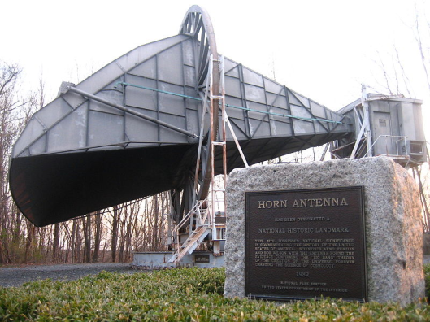
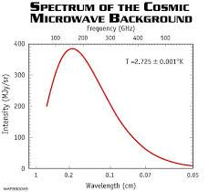
Cosmic Microwave Background (CMB)
Light that has not interacted with matter since near the Big Bang called the Cosmic Microwave Background
Theoretically predicted
Discovered (by accident) in 1964
Nobel prize 1978, Penzias and Wilson
$380,000$ years after Big Bang atoms form, no more free charge
Recombination, last scattering
Frequency distribution same as from a 2.7 K hot object

Slide 8
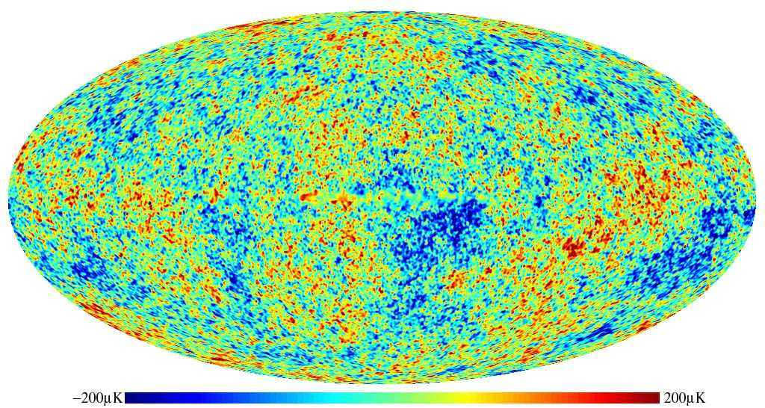
Uniformity of CMB
CMB temperature $±18 μ$K across whole sky
Points 180º across the sky outside of each other’s “light cone”
Not enough time for light to go from one to other

Slide 9
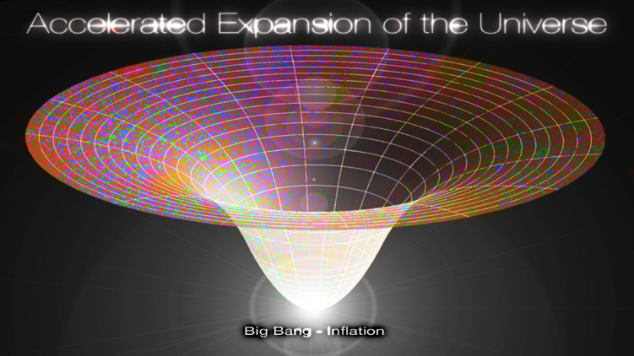
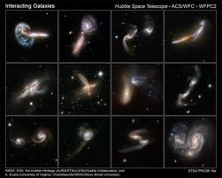
Inflation
Inflation, faster than $c$ expansion of the very early universe
Proposed by Guth in 1980
$10^{90}$ increase in volume
$10^{−36}$ seconds to $10^{−32}$ seconds
Explains why universe same in all directions
Temperature uniformity
Curvature uniformity
Quantum particle fluctuations inflated into the seeds of galaxies

Slide 10
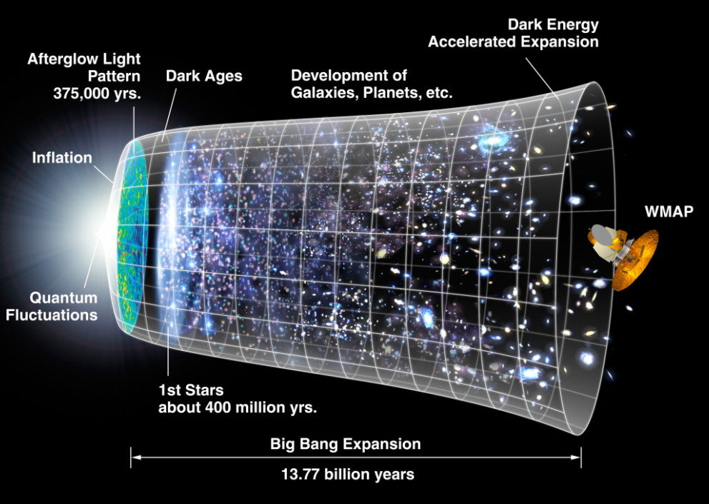
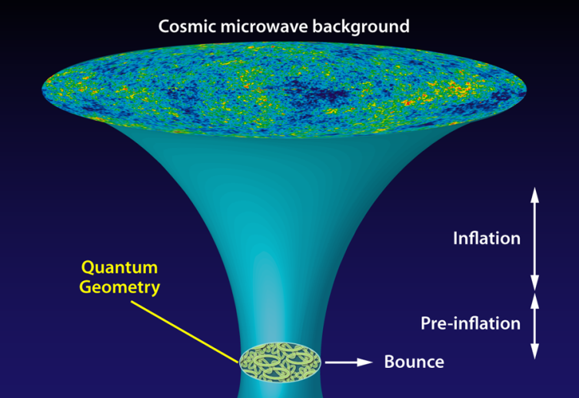
Gravitational Waves from the Big Bang
Gravitational waves created nearly at the beginning of time
Gravitational waves not influenced by recombination
Energy scale of inflation important and unknown
Quantum nature of gravity
Important at very beginning
Major missing piece of physics

Slide 11
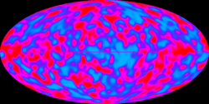
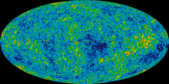
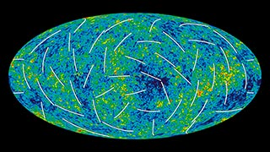
COBE and WMAP
Cosmic Background Explorer (COBE)
Satellite launched in 1989
Anisotropy in CMB
Nobel Prize 2006
Wilkinson Microwave Anisotropy Probe (WMAP)
Satellite launched in 2001
Better measurement of CMB anisotropy $δT=5×10^{−4}$ K
Measure polarization of CMB

Slide 12
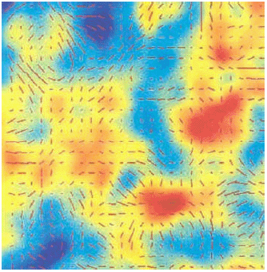
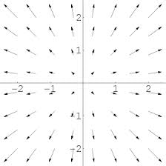
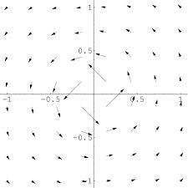
Polarization and Gravitational Waves
Sources of polarization
Density fluctuations
Gravitational waves
Polarization vector pattern
E mode spreads from a point
B mode circles around a point
Pattern depends on source
Density causes E
Gravitational waves cause E and B
Ratio $r$ of gravitational waves/density
E Mode
B Mode

Slide 13
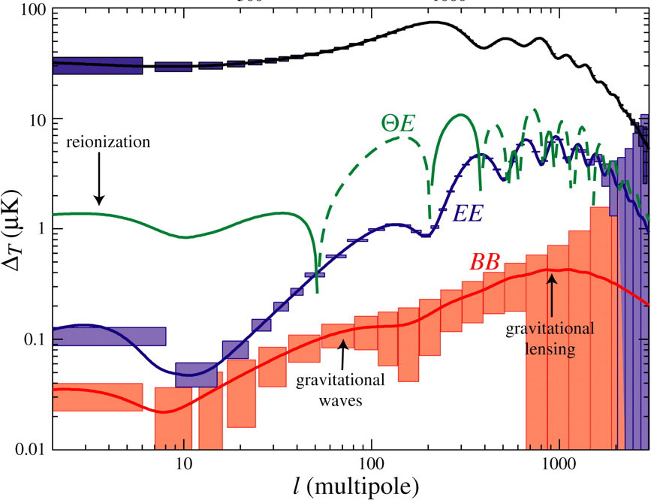
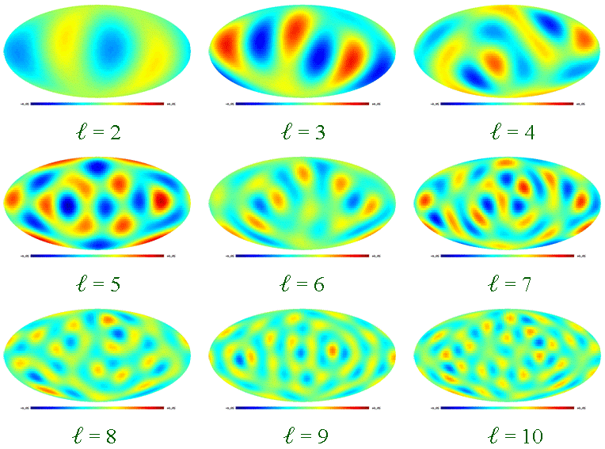
Expected CMB Spectra
Compare E mode and B mode across sky
Quantify using $ℓ$
Roughly $∆θ≈{180°}/ℓ$
B mode spectrum
Gravitational Waves $50≲ℓ≲100$
Height determines $r$

Slide 14
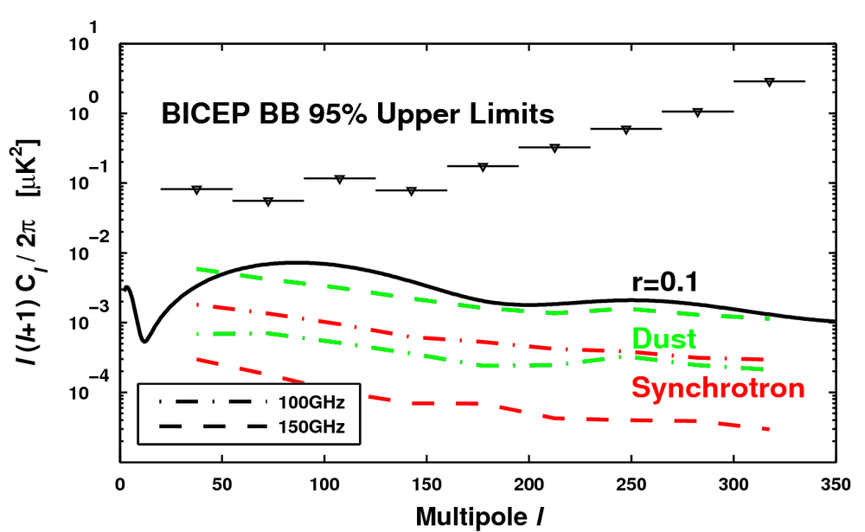
BICEP-2 Telescope
Located at South Pole
Avoid water in atmosphere
3 year observation of a few degree patch
Measures CMB polarization
Follows BICEP-1
South Pole
2006-2008
B mode polarization
$r<0.7$

Slide 15
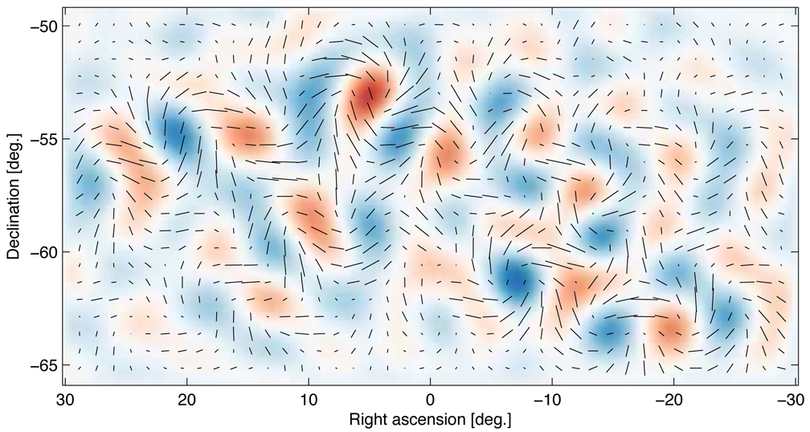
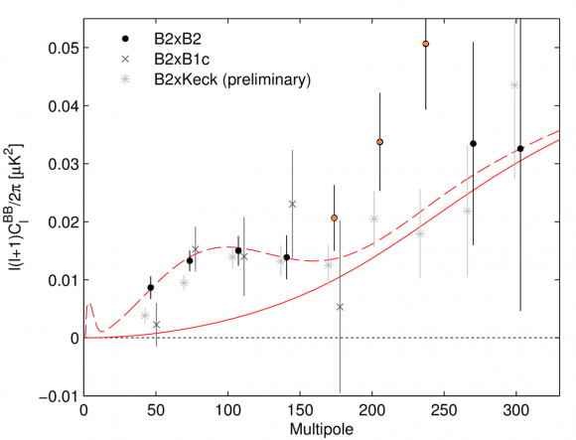
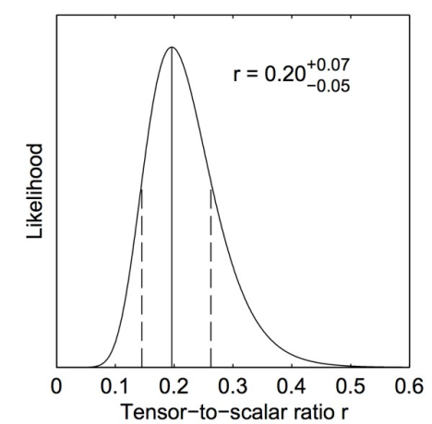
BICEP-2 Result
B Mode polarization map
B Mode spectrum against angular scale $ℓ$
Gravitational wave to density ratio $r=0.20_{−0.05}^{+0.07}$

Slide 16
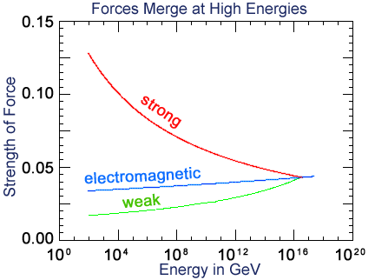
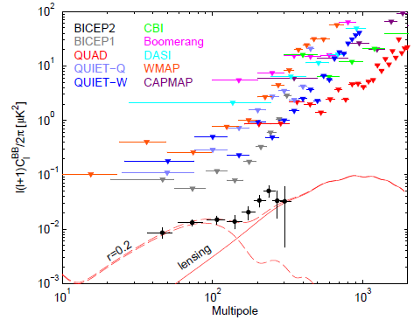
Implication and Confusion
$r$ fixes energy scale of inflation
$r=0.2$ → Grand Unified energy
$10^{13}$ higher than accelerators
Quantum nature of gravity
BICEP-2 result $r=0.20$
Previous result $r<0.11$
Planck Satellite/South Pole Telescope(SPT)/WMAP
Other dust models might make BICEP-2 $r=0.16$

Slide 17
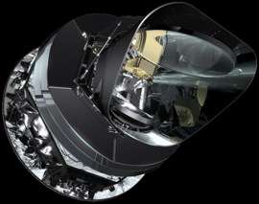
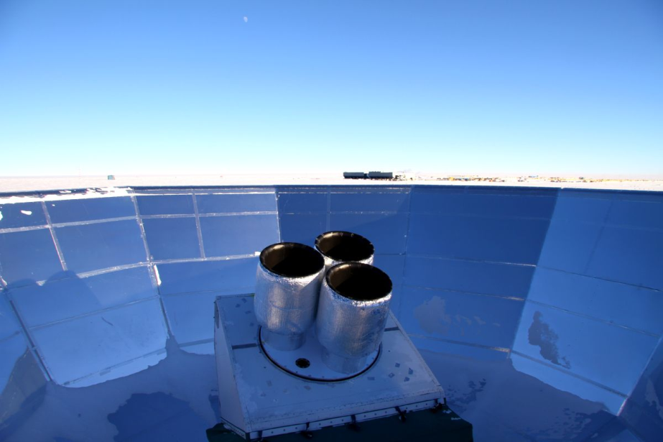
Near Future Results
Planck Satellite
Data release late 2014
Should see clear evidence
SPT, POLARBEAR etc. should also see evidence
Keck array is follow up to BICEP-2
Multiple receivers
Preliminary results used in BICEP-2 results

Slide 18
Higher Frequency Gravitational Wave Detection
Gravitational wave interferometers on Earth
Different gravitational waves than BICEP-2
Much shorter wavelength and higher frequency
Astronomical rather than cosmological
Black holes, neutron stars, pulsars, etc.
LIGO detectors in the United States

Slide 19
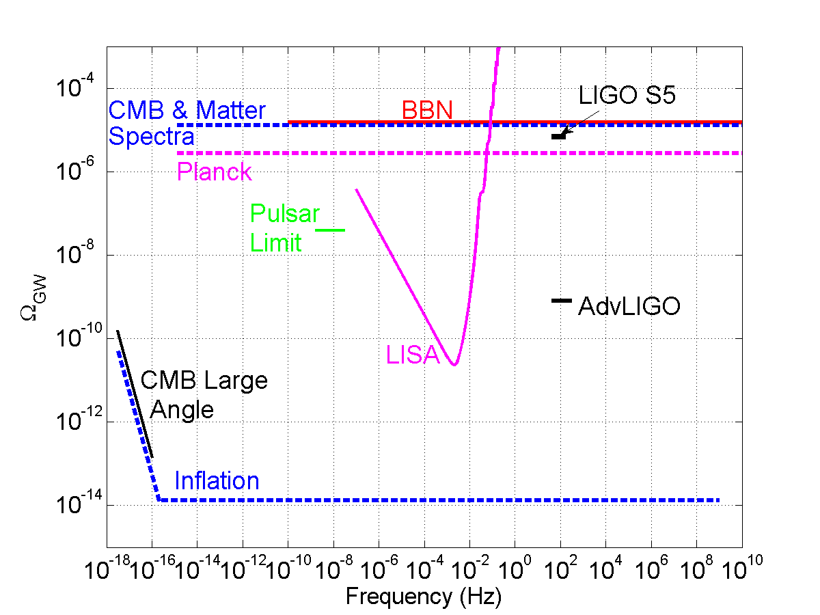
Stochastic Background
Before BICEP-2 did not expect LIGO to see Big Bang waves
With BICEP-2 looks less likely
Set limits on frequency dependence
Preliminary
Other models of inflation may allow for detectable waves at LIGO frequencies

Slide 20
Gravitational Wave Detection at AU
AU is a member of the LIGO collaboration
Will contribute to running of upgraded LIGO detectors
Starting in 2016
Campus lab working on LIGO sensitivity
Improve mirror properties
Help guide upgrades and next generation detectors
Train students to enter field
105 SCAN Summer 2013

Slide 21
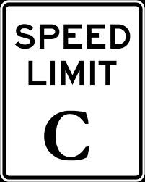
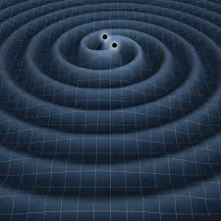
Dynamic Gravity
Crucial difference between Newton and Einstein’s theory is the speed of gravity
General relativity limits speed of gravity to speed of light $c$
Consistent with special theory of relativity
Similar to Maxwell’s equations compared to Coulomb’s law
Maxwell requires wave of electromagnetism → light
Comparable wave for gravity

Slide 22
Gravitational Waves
Propagation of gravity at speed of light called gravitational wave
Similar to light wave with two important differences
Effect much smaller $h=\frac{∆L}{L}≈10^{−21}$
Still two polarizations, but different shape
Distinctive pattern from gravitational waves
Electromagnetic Wave
Gravitational Wave

Slide 23
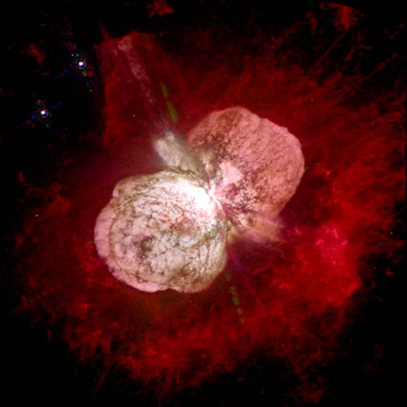
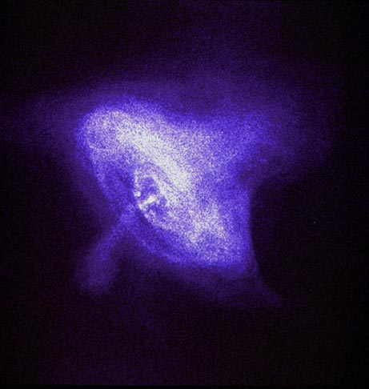
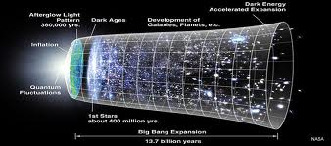
Sources of Gravitational Waves
Gravitational waves need astronomical masses moving near $c$ as sources
Pairs of black holes and neutron stars spirally together, supernova explosions, rapidly rotating pulsars
Left over waves from the Big Bang
Eta Carinae Supernova
Crab Pulsar

Slide 24
Polarized Light
Light is interacting electric and magnetic fields
These fields are vectors, have direction
Maxwell’s equation ensure that electric field points 90º from travel direction
Two ways to do this
Two polarizations
Some light mix of polarizations
Some light single polarization
Polarized light

Slide 25
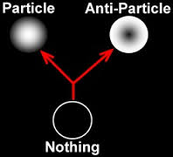
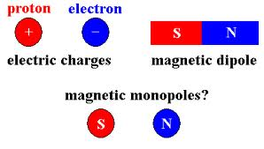
Predictions of Inflation
Isotropy of CMB
Anisotropy from quantum fluctuations
Isotropy of universe curvature
Expansion must be $10^{26}$ in length to explain observations
Lack of exotic high mass particles
No magnetic monopoles original reason for inflation proposal
Other particles predicted by some models not found

Slide 26
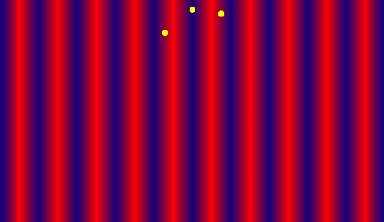
CMB Polarization
Anisotropic scattering of photons off of electrons causes polarization
Called quadropole because direction must be $90°=\frac{360°}{4}$
Must scatter off free electrons
Must not scatter afterwards
Only happens during recombination/last scattering
Most photons not polarized

Slide 27
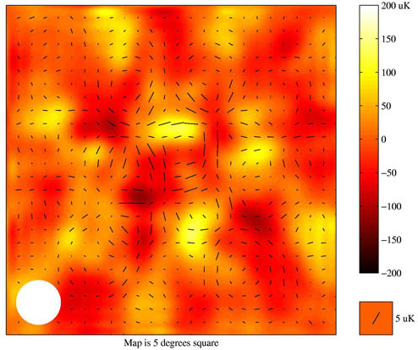
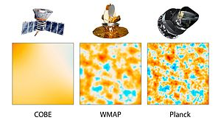
Previous Results
E mode detected 2002 Degree Angular Scale Interferometer (DASI)
DASI E Modes
Temperature correlations 2003 WMAP
South Pole Telescope (SPT) sees hints of B mode 2013
POLARBEAR sees B mode from lensing 2014
SPT/WMAP/Planck satellite limits on ratio $r<0.11$

Slide 28
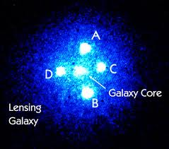
Gravitational Lensing
Gravitational lensing occurs when light goes near a massive object
Observed from Sun and quasars
CMB from galaxies
Gravitational lensing can convert E mode to B mode
Observe when comparing light nearby on the sky
High values of “$ℓ$”
Roughly $∆θ≈{180°}/ℓ$

Slide 29
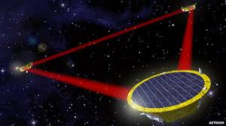
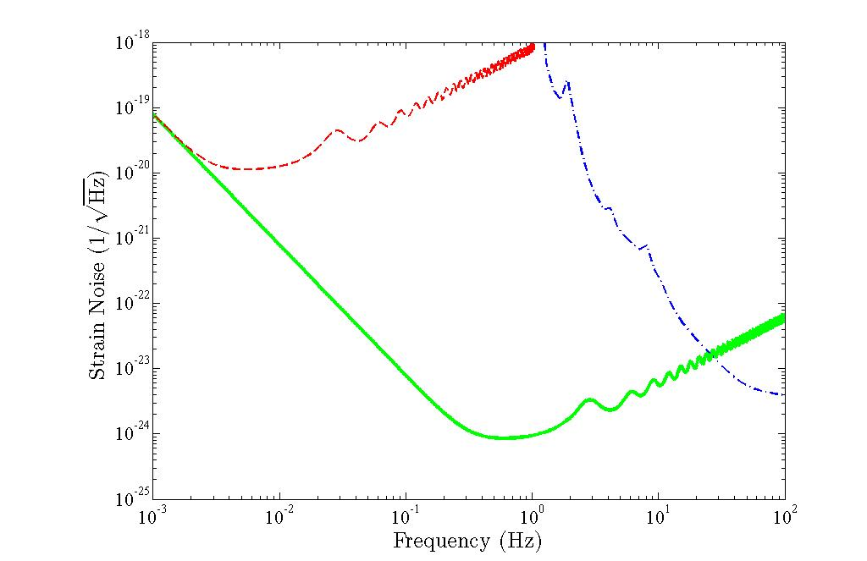
Space-based Detectors
Spaced based interferometers
LISA launch date 2034
Big Bang Observer (BBO) possible follow-up mission
Designed to see gravitational waves from Big Bang
Long arm lengths
$5×10^{6}$ km for LISA
Different frequency ranges

Slide 30
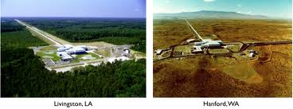
Ground-based Detectors
LIGO detectors in US
4 kilometer arm length
LIGO India likely as well
Advanced LIGO ready ~2016
Virgo in Italy
Lower frequency
GEO in Germany
Squeezed light
KAGRA in Japan
Underground/Cooled

Slide 31
LIGO Sources
Sources for ground based detectors astronomical, rather than cosmological
Binary neutron stars and/or black holes
Supernova explosions of stars
Also looking for waves from Big Bang
Eta Carinae Supernova

Slide 32
Other Models
Many different models of how to extrapolate CMB results to LIGO band
Preheating resonance
Peak from energy scale
Axion models
LIGO results crucial

