Slide 1
Core Optics related loss hierarchy of aLIGO
Hiro Yamamoto LIGO/Caltech
Introduction
Loss related to geometry
Loss related to as-built arms
Loss related to aberrations
Loss related to thermal deformations
Summary

Slide 2
Energy conservation or where the CR power goes
1W input H1
Max mode matching
No thermal effect

Slide 3
Arm loss designed vs as-built
Loss in arm : as-built vs design
Power Recycling Gain vs Arm loss

Slide 4
Introduction now that almost all COCs have been delivered and measured
Purpose of the talk
  Understanding the fundamental limitation by COC
Optics data
  Use as built / measured RoC, maps, losses
  https://galaxy.ligo.caltech.edu/optics/ and links from this URL
Simulation tool used
  FOGPrime13
    FFT-based IFO simulation using matlab
    Modular design to build FP ~ full aLIGO by adding optics and propagators
    Easy integration with real data files and other matlab tools like COMSOL

Slide 5
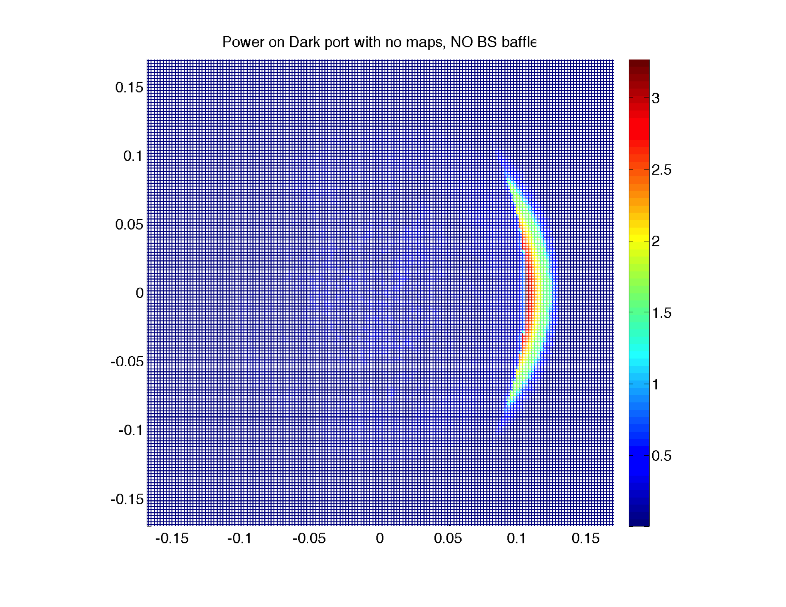
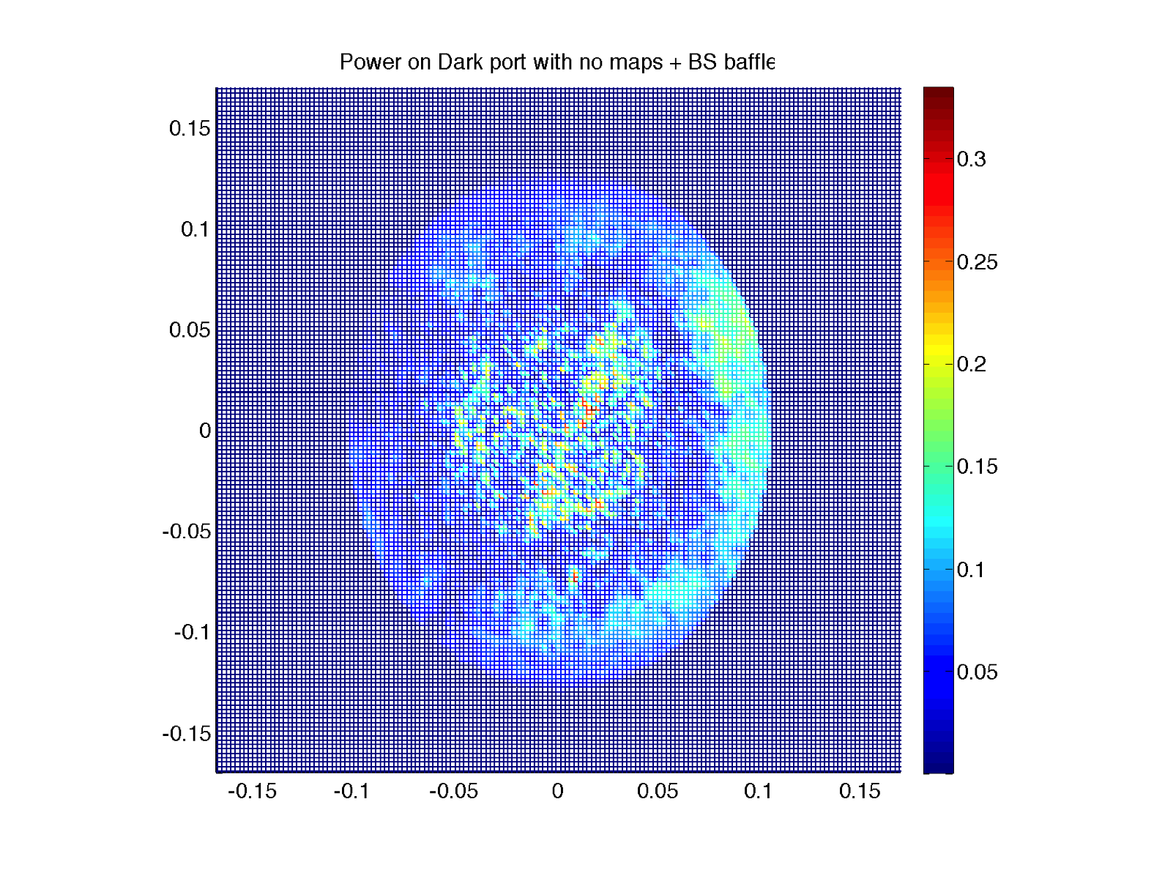
Loss related to geometry
Dark port with BS baffle : 7ppm
Dark port without
BS baffle : 210ppm

Slide 6
Performance limitation by geometrical design
LLO case
T1400055
1) no loss at all, with large mirrors. A finite HOM (3.7ppm) looks a nice gaussian so probably the base mode parameter is slightly off.
2) 1) + ETM transmittance 3.7ppm
3) 2) + test mass aperture 326mm, round trip loss by the aperture is 1.94ppm (with 340mm, RTL is 0.6ppm)
4) 3) + 266mm ESD aperture, placed using BS baffle (266mmx266mm) in front of BS
5) 4) + 35ppm arm loss
6) 5) + power recycling mirror and beam splitter loss and transmission. Sum of losses + RM2 transmission is 583ppm
7) 5) + ITM AR side loss, (ITMX loss 206ppm, ITMY loss 330ppm)
8) 5) + 6) and 7), i.e., losses and transmission in the PRC, BS and ITM AR
9) 8) + finite opening angles in PRC (0.79° for PRM2 and 0.615° for PRM3). Among the total HOM of 240ppm, major ones are HG(1,0) of 12ppm and HG(0,2) of 210ppm.
10) 9) + PRM3 aperture 262mm
11) 10) + BS 367.1mm/60mm no baffle
12) 11) + BS baffle (210mmx260mm). Total HOM goes up to 540ppm from 260ppm by clipping using BF baffle. The major is HG(4,0) of 170ppm.
13) 12) with BS baffle facing to X arm offset by 1mm in horizontal direction
14) 12) with BS baffle facing to X arm offset by 2mm in horizontal direction
15) 10) + BS 410mm/67mm with BS baffle (237mmx260mm)
16) 15) with BS baffle facing to X arm offset by 2mm in horizontal direction
17) 10) + BS 450mm/73.5mm with BS baffle (260mmx260mm) : no performance impact by the BS baffle
18) 17) with BS baffle facing to X arm offset by 2mm in horizontal direction
19) 10) + BS 490mm/80mm with BS baffle (260mmx260mm)
20) 19) with BS baffle facing to X arm offset by 2mm in horizontal direction

Slide 7
Arm performance only aberrations in arms included
Low arm loss (70 ppm design to 35-50 ppm expected)
High power recycling gain and high arm power
High (~0.15) reflected power
High higher order mode content in the bright port
 | LHO TITM=1.39%,1.42% | LLO TITM=1.48%,1.48% | LLO (no maps)
CD | 29 ppm | 48 ppm | 44 ppm
PRG | 63 | 61 | 74
Arm power | 8800 W (1W input) | 8100 | 9900
HOM in bright | 1900 | 1600 | 520
HOM in x/y arm | 95 / 114 ppm | 97 / 113 | 38 / 62
Round trip loss | 33 / 37 ppm | 40 / 38 | 23 / 26

Slide 8
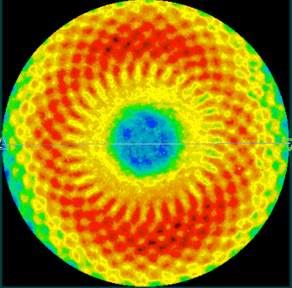
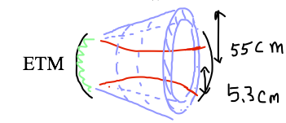
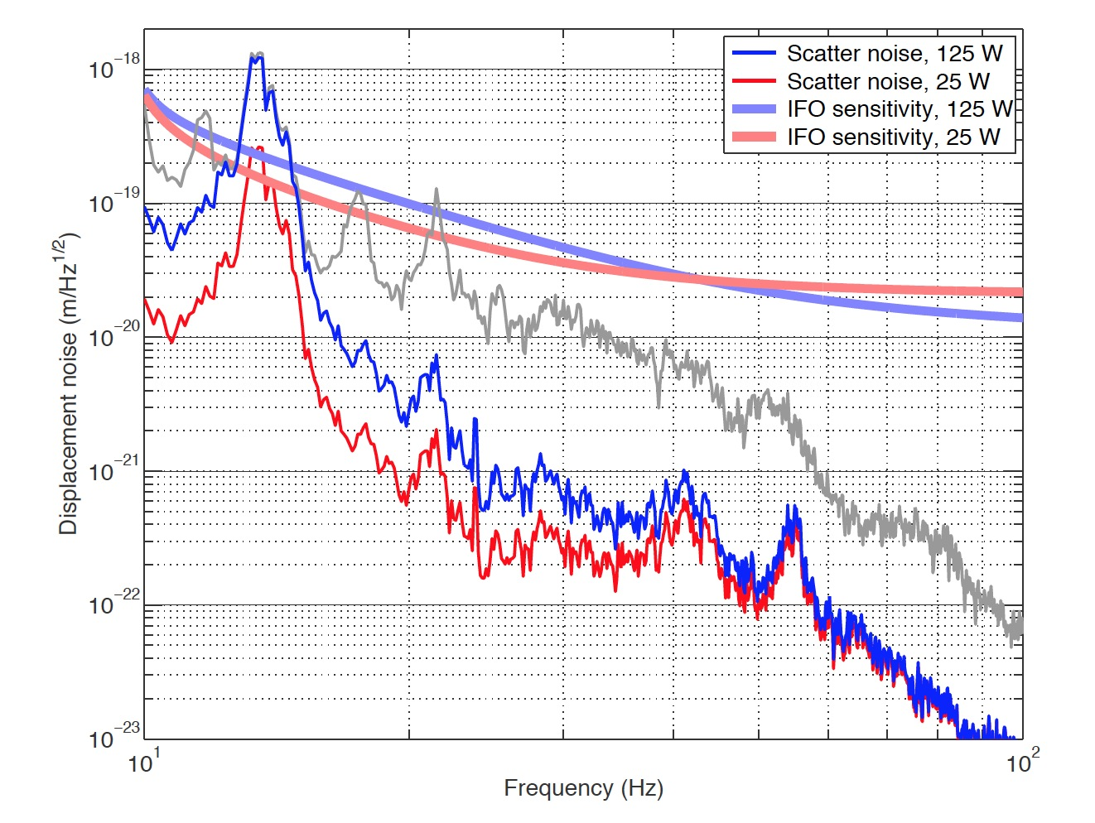
Noise injection by the spiral pattern on test mass coatings
Figure loss by two mirrors
~ 15-20ppm
ETM07 map
micro roughness, point scattering
~ 20 ppm
7.83mm
T1300354 by PF,HY
Phasemap resolution in simulation
main beam ⇒
ETM reflection ⇒
larger angle scattering into cone ⇒
reflected by beam tube baffles ⇒
back scattered into ETM ⇒
merged into the main beam

Slide 9
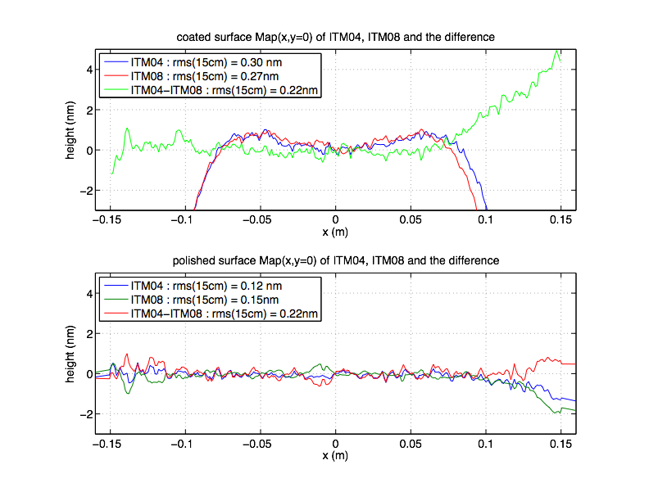
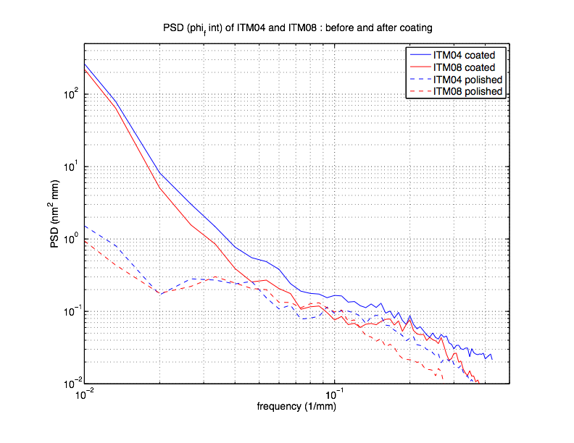
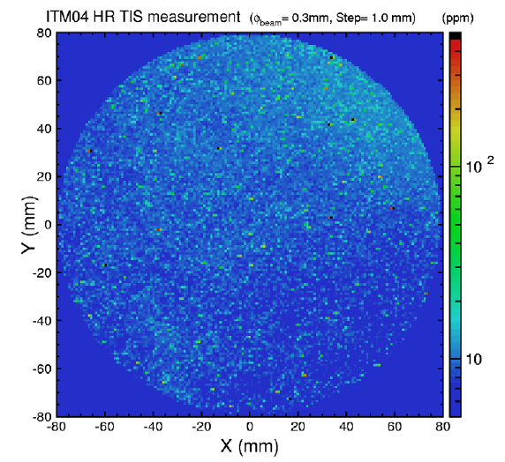
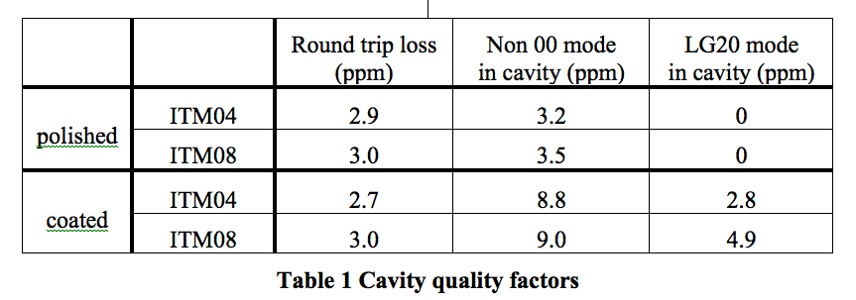
Higher order mode due to imperfect test mass coating figures
w(ITM)x1.5 : good
w(ETM)x1.5 : NG
Caltech : 10ppm
LMA : 4.5ppm
9

Slide 10
The sign flip basic

Slide 11
HOM amplification
Higher order mode power fraction (H1)
 | ITMX | ITMY | BS bright
LG10 | 26 | 43 | 83
LG20 | 40 | 38 | 890
LG30 | 7.8 | 9.9 | 47

Slide 12
ITM lens some sees, some not
CR (Eout) : don’t see
SB (Eref) : see
Signal SB (Eleak) : see

Slide 13
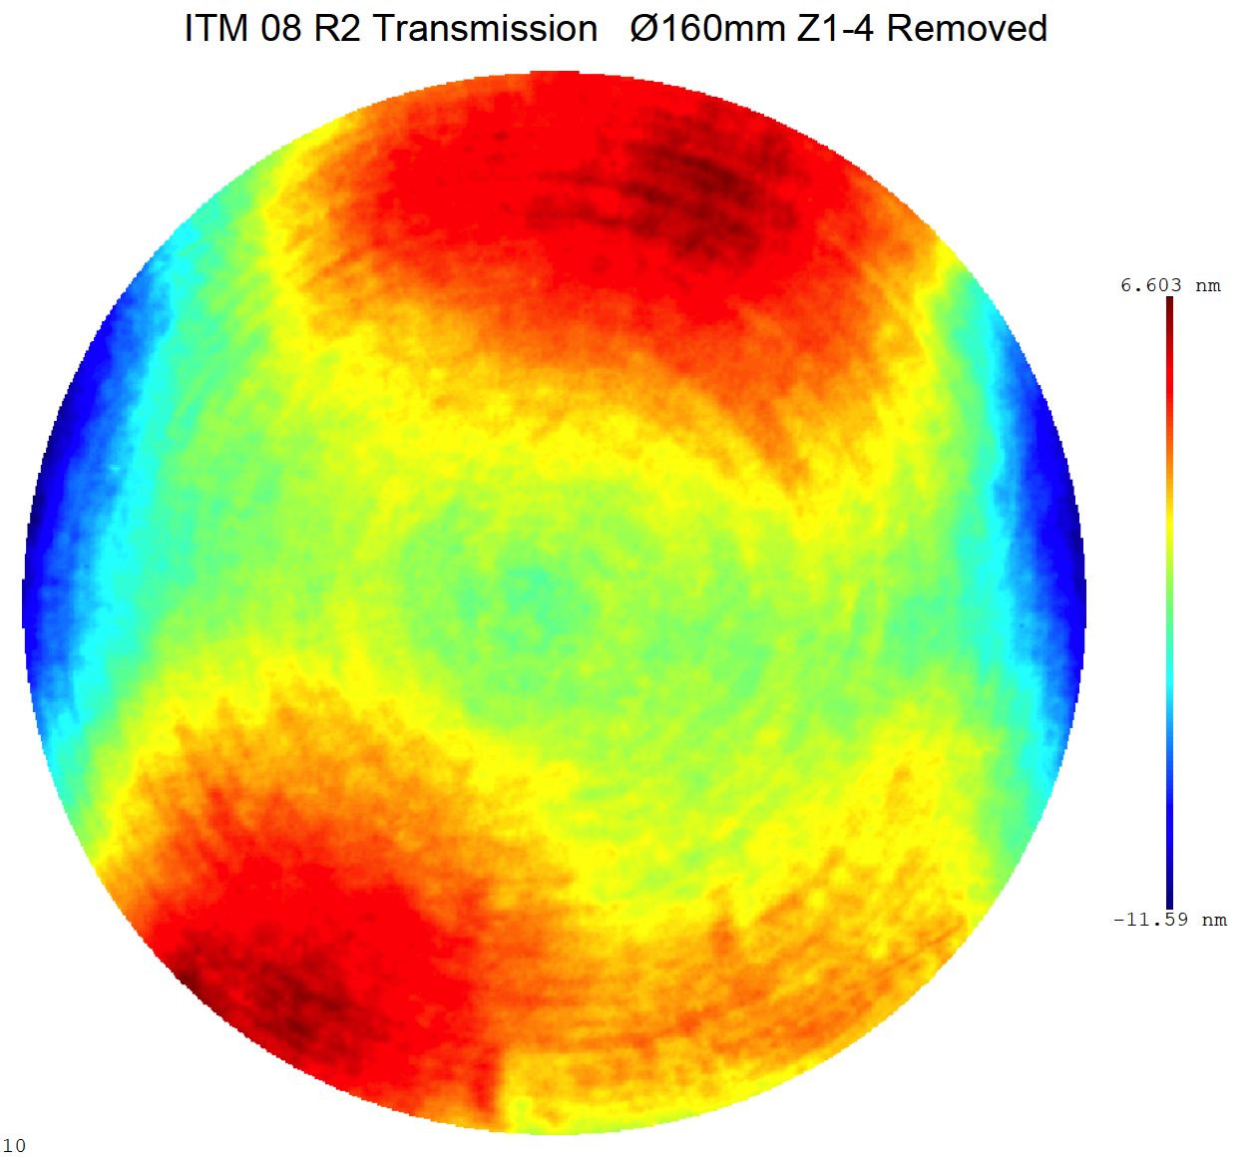
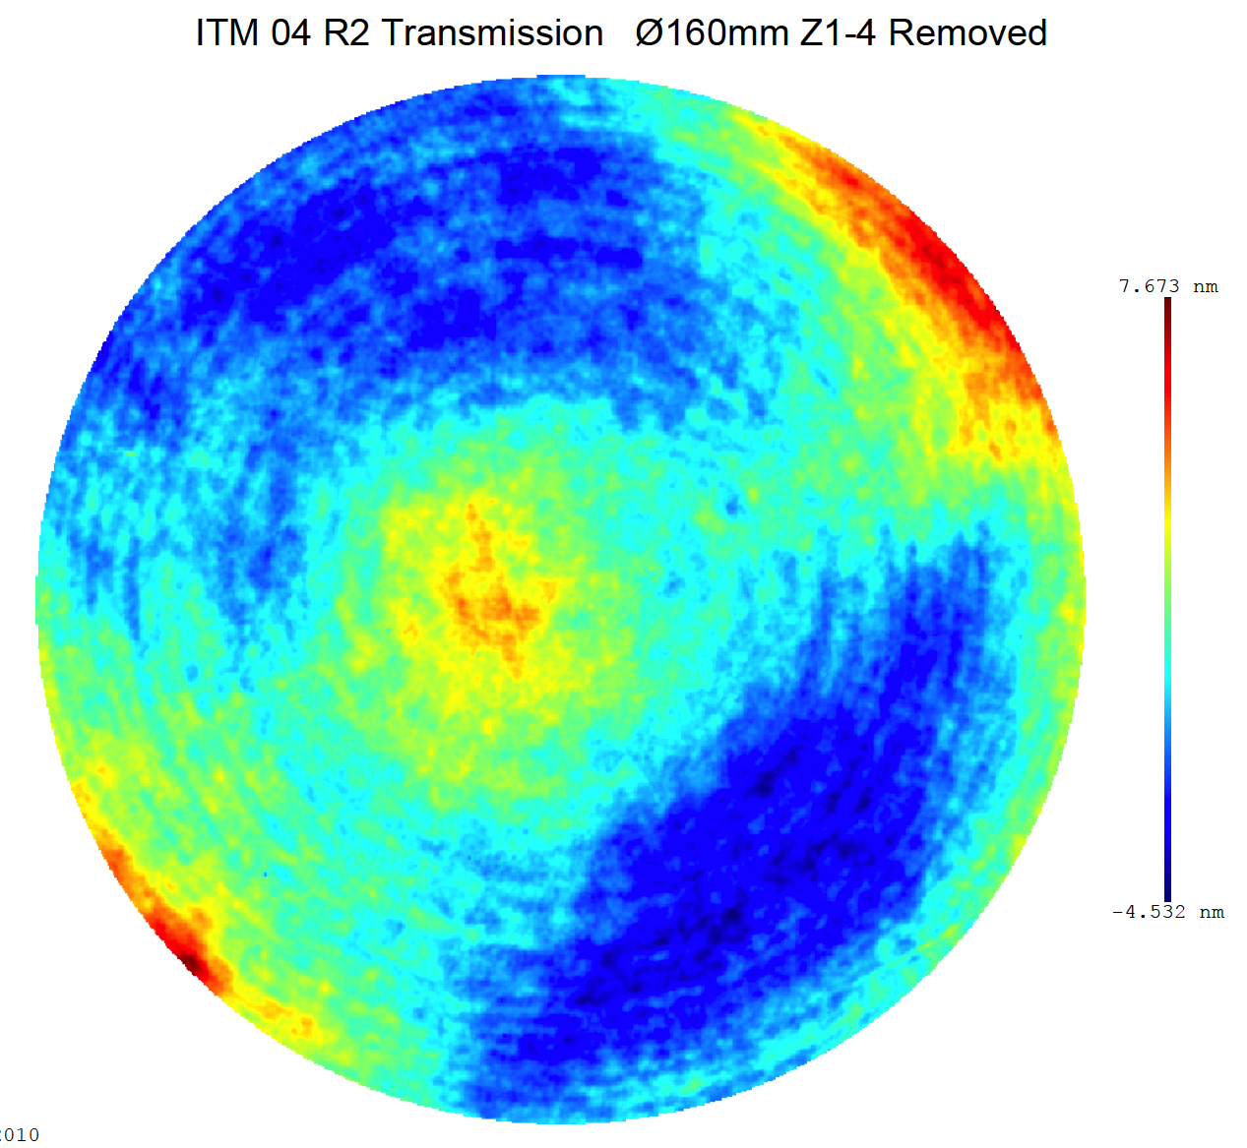
(In)Sensitivity on
ITM SPTWE + CP lens

Slide 14
BS, not quite well measured

Slide 15
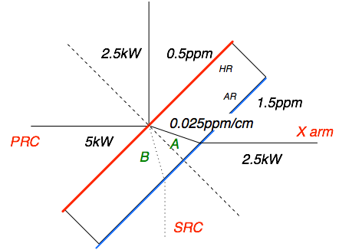
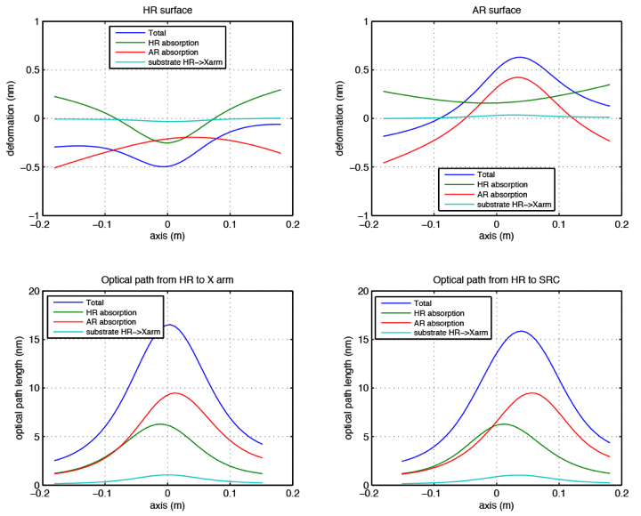
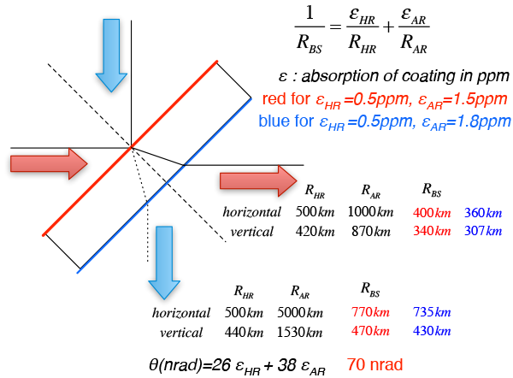
BS Thermal distortion
heated
no heating
15

Slide 16
Summary with maps, BS and thermal
abs(ITMX)-abs(ETMX)
abs(ITMY)-abs(ETMY)
 |  | PRC |  |  |  | X arm |  |  | Y arm
 |  | CD ppm | PRG | HOM (BS) | Refl | Power | HOM (ppm) | Round trip loss | Power | HOM (ppm) | Round trip loss
H1 | BS06 | 190 | 62 | 1380 | 0.14 | 8840 | 98 | 33 | 8660 | 115 | 38
 | No BS | 139 | 63 | 1380 | 0.14 | 8850 | 98 | 33 | 8670 | 115 | 38
 | BS thermal | 288 | 50 | 1330 | 0.06 | 7130 | 98 | 33 | 6990 | 115 | 38
 | 0.3-0.3 0.4-0.4 | 7 | 61.7 | 2400 | 0.14 | 8730 | 81 | 37 | 8550 | 137 | 37
 | 0.3-0.3 0.3-0.5 | 23 | 58.7 | 2900 | 0.11 | 8300 | 81 | 37 | 8110 | 151 | 45
L1 | BS05 | 112 | 61 | 1165 | 0.15 | 8090 | 98 | 41 | 8090 | 111 | 38
 | No BS | 64 | 61 | 980 | 0.15 | 8120 | 98 | 41 | 8100 | 110 | 38
With miracle
TCS

