Slide 1
LQR Linear Quadratic Regulator
A state space optimal control technique
Brett Shapiro

Slide 2
Summary
LQR description
LQR derivation
Double pendulum test mass control example
LQR observer formulation
Quad pendulum damping observer example
Augmenting the plant for more complexity
Example: Frequency domain LQR

Slide 3
References
Reference 1: Modern Control Engineering, 4th Ed. Katsuhiko Ogata. 2002, Prentice Hall.
Reference 2: Linear Optimal Control Systems. Huibert Kwakernaak, Raphael Sivan. 1972, Wiley-Interscience. Online access at http://www.ieeecss.org/publications/classic-books
Reference 3: T1300301 – LQR in the frequency domain

Slide 4
What is it?
An automated algorithm for finding optimal feedback for a linear system in state space form.
1 DOF pendulum example
Initial state
Final state
State trajectory
LQR determines the feedback law to minimize the size of the state vector in the least time with the least control effort.
Note, a state of [0,0] may be generalized to any arbitrary point.

Slide 5
System Description
System block diagram
Assumptions:
We have knowledge of all states
2) The system is completely controllable. This means that given infinite actuator range we can [ref 1, pgs 779-780, 829-832]
drive the system from one arbitrary state to another in finite time
or, equivalently
Set all closed loop poles to arbitrary values
LQR feedback gain
Matrix dimensions for n states and m control inputs

Slide 6
Identifying the Goal - the Cost Function with competing interests
System block diagram
We want to make the size of really small.
But…also want to the size of to be really small,
to minimize noise, keep the actuators in range, avoid exciting higher order dynamics, etc.
And, we want this to be true for all time. So we make the total cost:
But, we might care about the size of some states and actuators more than others. So we generalize the cost with some weighting matrices: and

Slide 7
Other LQR Cost Function Forms
Other forms you may see for the cost function
‘Infinite time horizon’. The simplest, and most common form. The one we use here. Ref [1].
‘Finite time horizon’. More general form. Used in the most rigorous LQR derivations. Results in a time variant feedback law, i.e. K = K(t). Ref [2].
You may also see this form, which is used by Matlab and also frequency domain versions of LQR.
In all cases, the weighting matrices are assumed to have these properties

Slide 8
Minimizing the Cost Function: Two Derivation Approaches
Calculus of variations – the super gory rigorous method.
See reference 2, Chap 3. Includes special cases, including stochastic noise.
Linear algebra – more concise. Get’s the point across with some hand-waving. See Reference 1, pages 897-899.

Slide 9
Minimizing the Cost Function
(1)
Plug in feedback relation
(2)
Factor out x
(3)
Then make the following substitution where . The time derivative allows us to brings the system dynamics into the cost function.
(4)

Slide 10
Minimizing the Cost Function
(5)
Then substitute in the system dynamics
(6)
Canceling the x’s
(7)
Splitting into ‘square roots’ , , and rearranging
(8)
It can be shown that minimization of with respect to requires the minimization of
(9)

Slide 11
Minimizing the Cost Function
But, since
(10)
This minimization is solved when
(11)
Which give us a relation between the feedback matrix and
(12)
Plugging this back into Eq. (7) (just after we substituted in the system dynamics)
(13)
Gives us the so called ‘Algebraic Riccati Equation’ (ARE), which we can solve for to get P for the complete solution. The ARE is generally solved for numerically. Only some very simple cases can be solved analytically.

Slide 12
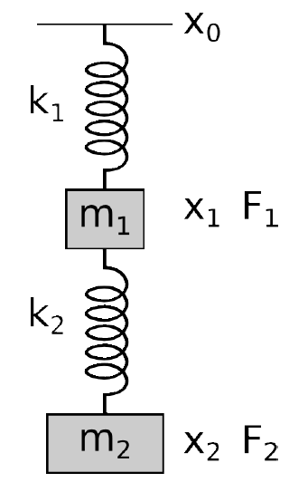
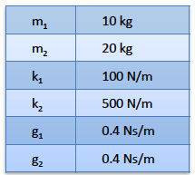
Example 1 – Double Pendulum Test Mass Control
See MATLAB Example 1
Problem:
design a controller to position the test mass using the two actuators
the test mass actuator has 1/10 the range of the top mass.
Courtesy Gabriele Vajente

Slide 13
Example 1 – Double Pendulum Test Mass Control
We are interested in controlling the test mass position using the two actuators to compensate for suspension point motion.

Slide 14
Example 1 – Double Pendulum Test Mass Control
State space equation
Cost function
For the states, just weight the test mass displacement
We try putting 10 times the weight on the test mass actuator since it has 10 times less range. Not necessarily an obvious relation to actuator range.
We will also include in R a scalar tuning factor λ.

Slide 15
Example 1 – Double Pendulum Test Mass Control
% State space matrices
...
system = ss(A,B,C,D);
% LQR weighting matrices
Q = diag([0 1 0 0]);
lambda = 1e-13;
R = lambda*diag([1 10]);
% LQR feedback matrix
K = lqr(A,Bu,Q,R);
% closed loop state space matrices
A_closed_loop = A-B*K;
C_closed_loop = [C;K];
D_closed_loop = zeros(size(A,1),size(C_closed_loop,2))
system_closed_loop = ss(A_closed_loop,B,C_closed_loop,D_closed_loop)

Slide 16
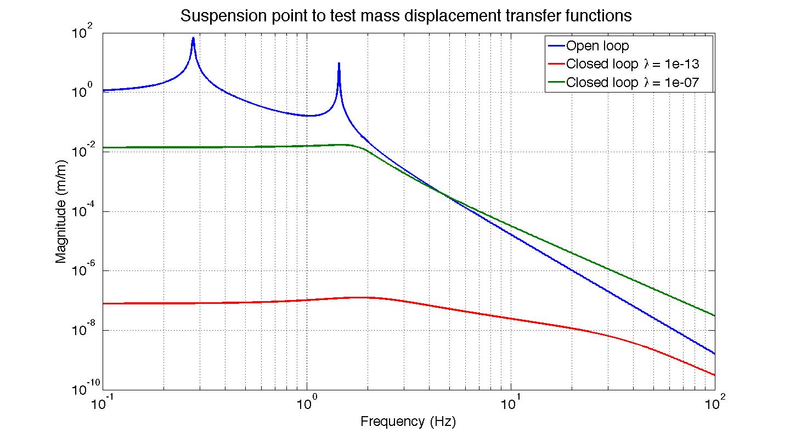
Example 1 – Double Pendulum Test Mass Control

Slide 17
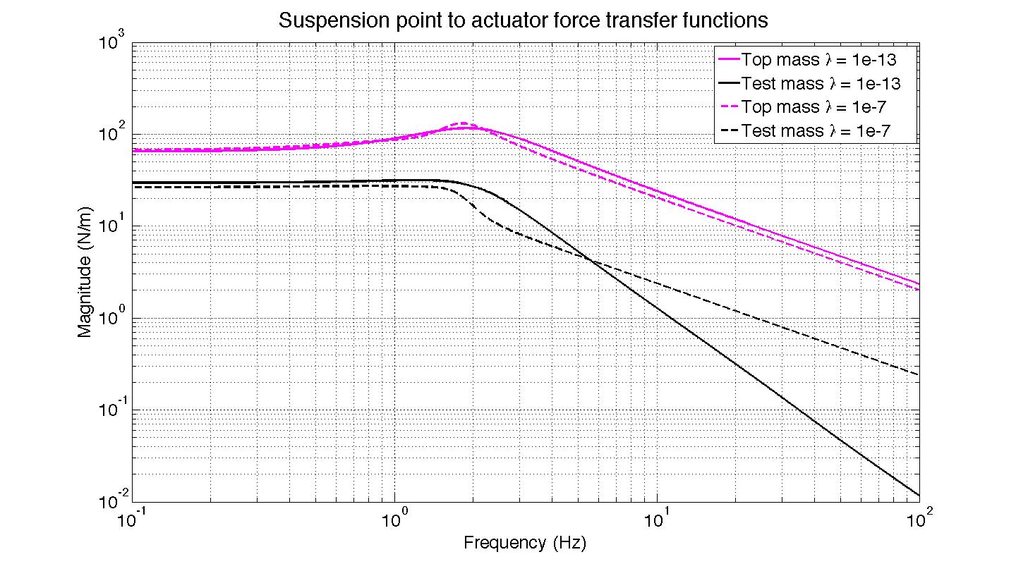
Example 1 – Double Pendulum Test Mass Control

Slide 18
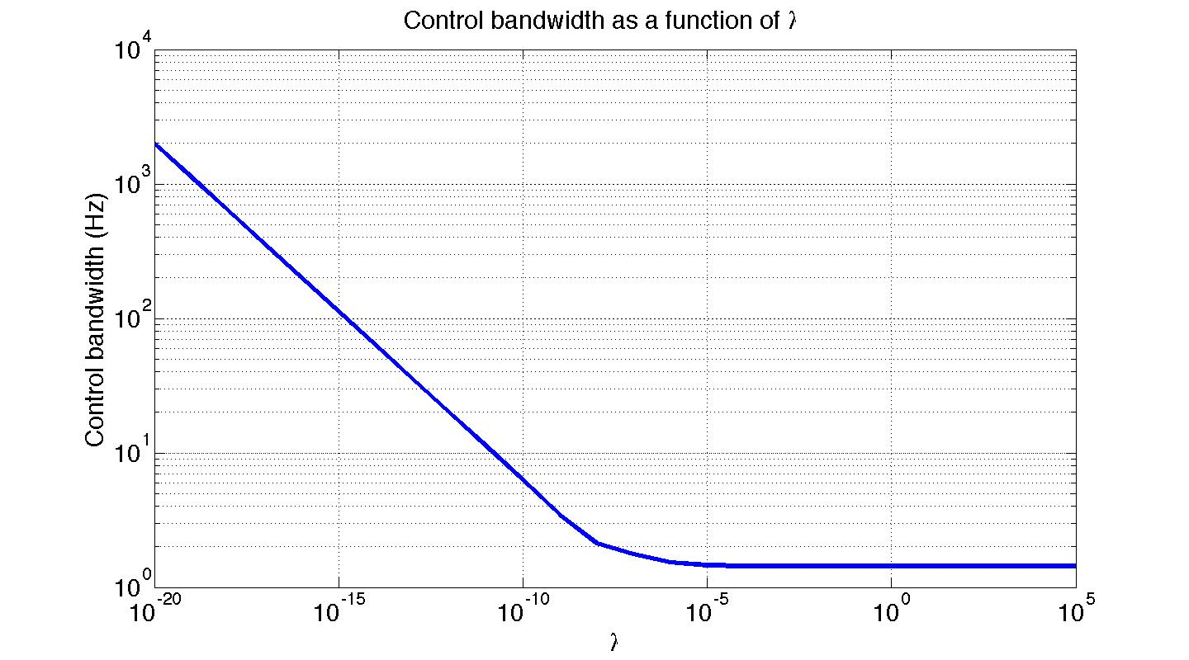
Example 1 – Double Pendulum Test Mass Control
λ
λ

Slide 19
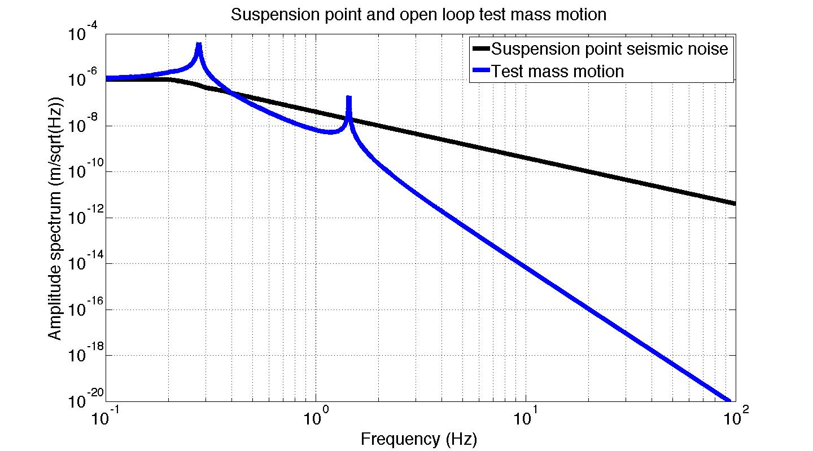
Example 1 – Double Pendulum Test Mass Control
How does the RMS test mass displacement change with λ?

Slide 20
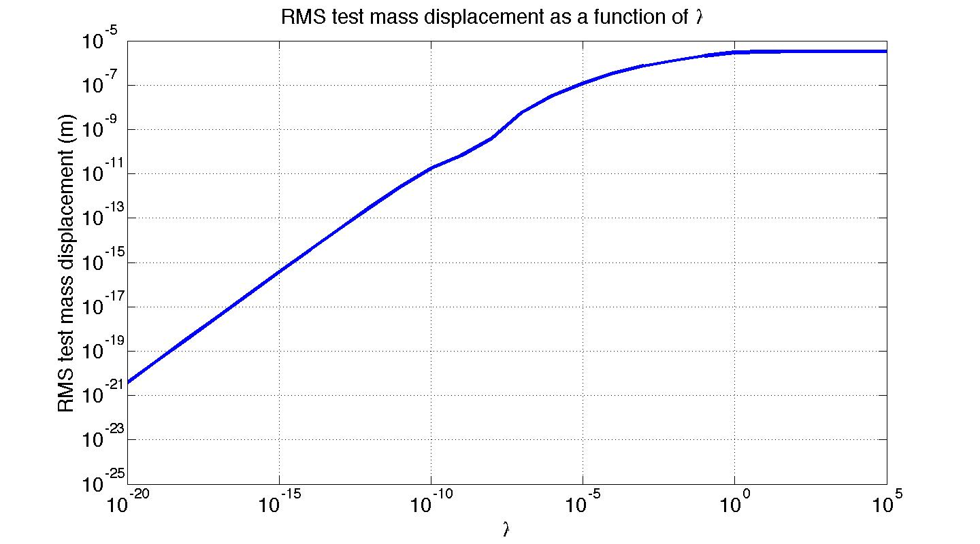
Example 1 – Double Pendulum Test Mass Control
λ
If this dashed line is the requirement, we need λ < 1e-18
λ

Slide 21
Observer Design with LQR
Recall from yesterday, a system of the form
has an observer of the form
where is the estimated state.
The observer error is then,

Slide 22
Control/Observer Separation Principal
For control feedback using the estimated state, the system state space is
Augmenting this plant with the state estimation error
We get the full closed loop system/compensator state space as
Because this matrix is block-triangular, the eigenvalues (poles) simple the combined set of the eigenvalues of (A-BK) and (A-LC). Thus, the poles of the control and estimator design are independent. So, one can design each piece individually, and be confident of where the closed loop poles will be.

Slide 23
Observer – Controller Duality
Observer error
Control error
Note that the poles of are the same as its transpose
Thus, we can think of the observer feedback design as the ‘control’ design of the fictitious system
Control-Observer Duals
Control design
Observer design

Slide 24
Observer LQR design
So, we can use LQR to chose how the estimation error evolves
Recall that
Q_{e} weights the estimation error
R_{e} weights the feedback of the noisy measured output
Where the dynamics are the same as e.
Matlab code
% LQR observer feedback matrix
L_transpose = lqr(transpose(A),transpose(C),Qe,Re);
L = transpose(L_transpose);

Slide 25
Example 2 – quad damping
Reference case, pure velocity feedback with no estimation
quad
Test mass displacement
Top mass
input
Top mass
displacement
-gain*derivative
See MATLAB
Example 2
Test case, velocity feedback using state estimation
quad
Test mass displacement
Top mass displacement
Top mass
input
Estimator
L^{T} = lqr(A^{T},C^{T},Qe,Re)
-gain
Top mass velocity estimate

Slide 26
Example 2 – quad damping
22 kg
We only consider the single degree of freedom along the laser beam axis for each stage (longitudinal motion). Thus, we have 8 states with 4 displacements and 4 velocities
We only care about estimating the top mass velocity. Thus,
22 kg
40 kg
We then scan for desirable values for the scalar
40 kg
when we have this pure velocity feedback law

Slide 27
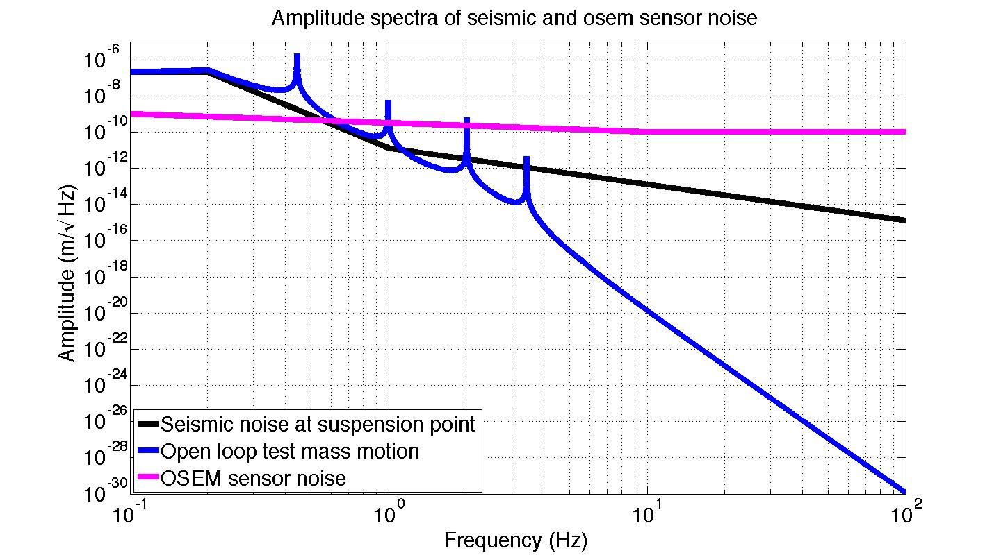
Example 2 – quad damping
We can see what R_{e} values give us convenient trade-offs between noise and damping

Slide 28
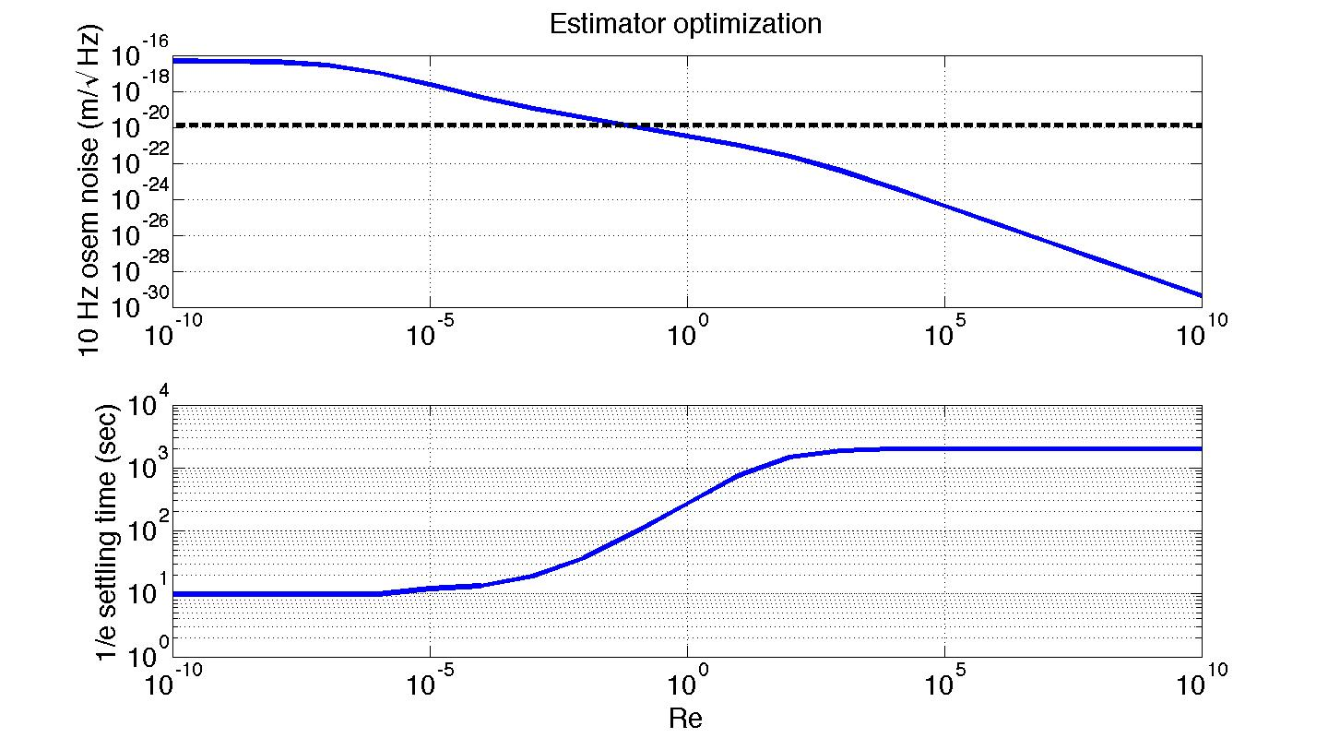
Example 2 – quad damping
Scanning test mass noise and damping time performance for
Test mass 10 Hz OSEM noise induced motion
10 Hz test mass seismic motion reference line
Test mass ringdown time from seismic impulse

Slide 29
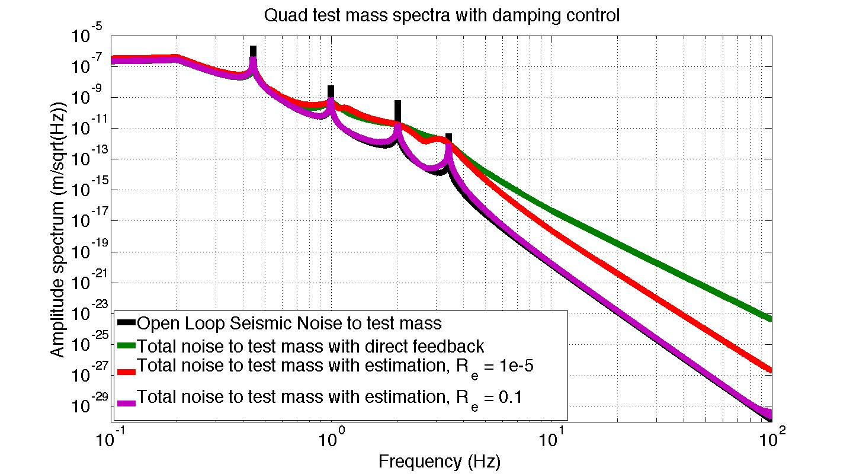
Example 2 – quad damping

Slide 30
Adding complexity – plant augmentation
One of LQR’s limitations is that the controller has no more complexity than the plant. Consequently, the controller design has finite degrees of freedom.
If we augment the plant with some fictitious states, we can achieve some more design degrees of freedom.

Slide 31
Example – double pendulum plant augmentation
Problem: we want to lock a cavity with this double pendulum
there is very large seismic noise around the microseism
The test mass actuator has limited range, but is most effective at high frequencies
See [3]

Slide 32
Example – double pendulum plant augmentation
Choose a low pass weighting function for the test mass displacement
magnitude
frequency
Choose a high and low pass weighting function for the top and bottom forces respectively
magnitude
magnitude
frequency
frequency

Slide 33
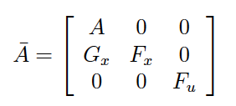
Combine the state spaces of the plant and weighting filters
See the details in T1300301 [3]
For a system state space
Weight function for system state
Weight function for control inputs
Augmented A matrix
Note: the Matlab functions zp2ss or tf2ss will take you from the frequency domain to state space matrices. This makes it easy to design weights with poles and zeros while still augmenting the state space.

Slide 34
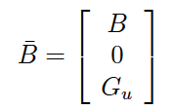
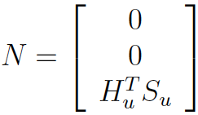
Combine the state spaces of the plant and weighting filters
Augmented B matrix
Augmented state vector
We then solve the LQR problem of the augmented state space
with the following cost function
where

Slide 35
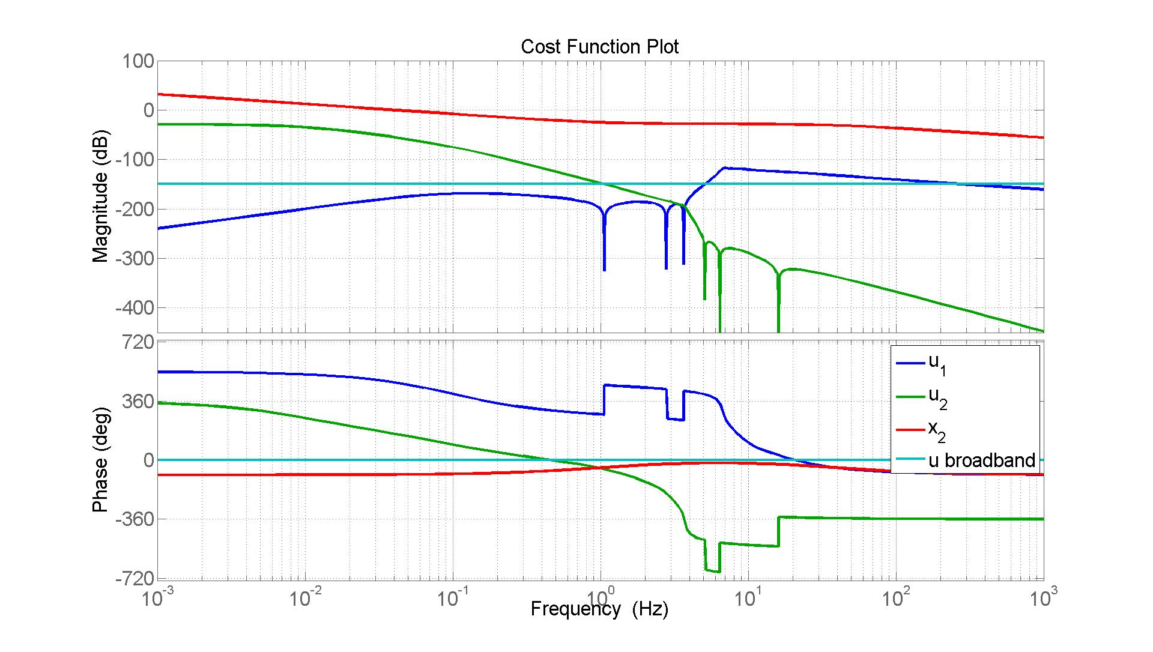
T1300301 Example

Slide 36
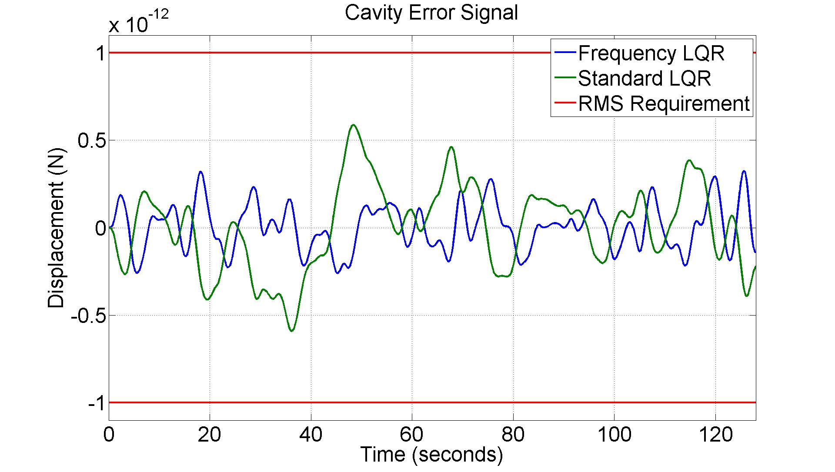
T1300301 Example
Cavity closed loop error chosen be the same for both standard and frequency weighted LQR

Slide 37
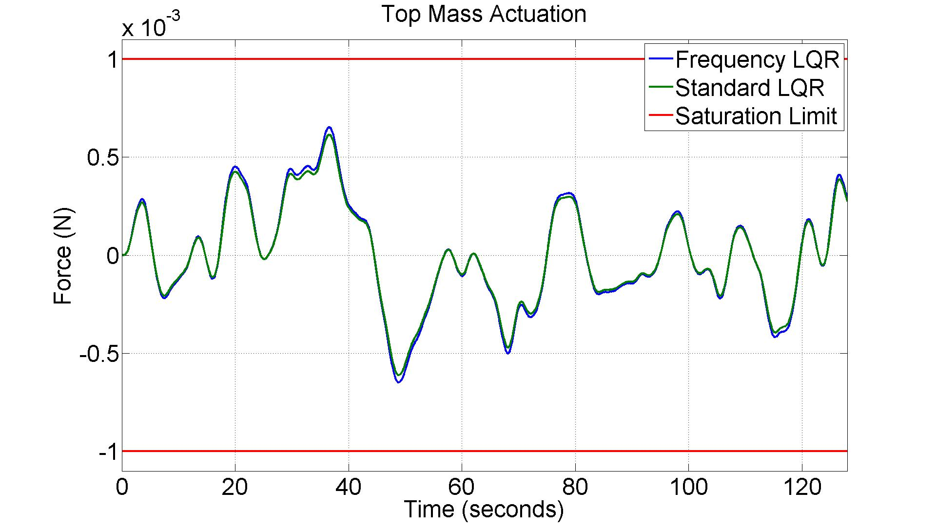
T1300301 Example
The top mass actuation is also approximately the same

Slide 38
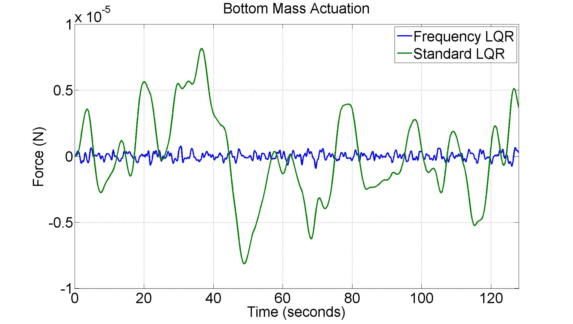
T1300301 Example
The frequency weighted approach is successful at reducing the test mass drive without compromising the error signal

Slide 39
Conclusions
LQR Benefits
Optimal solution to control problem
Automated (and very fast) method to design
Always stable with a good model
The controllers are typically robust
LQR Limitations
Only has as much complexity as the plant
This can be overcome by augmenting the plant
Identifying the best weighting matrices is an art

Slide 40
Backups

Slide 41
Intro to Observers/Estimators
A state observer estimates the state of a system based on the system measurements.
Useful if not all states are known, and/or they are measured with noisy sensors
The measurements can involve states and/or inputs
The system must be observable
Observability (dual of controllable) means that the full state can be reconstructed from the outputs in finite time (recall, controllability is the ability to drive the system to any state in finite time)
Ref 1, Chapter 12-5.

