Slide 1
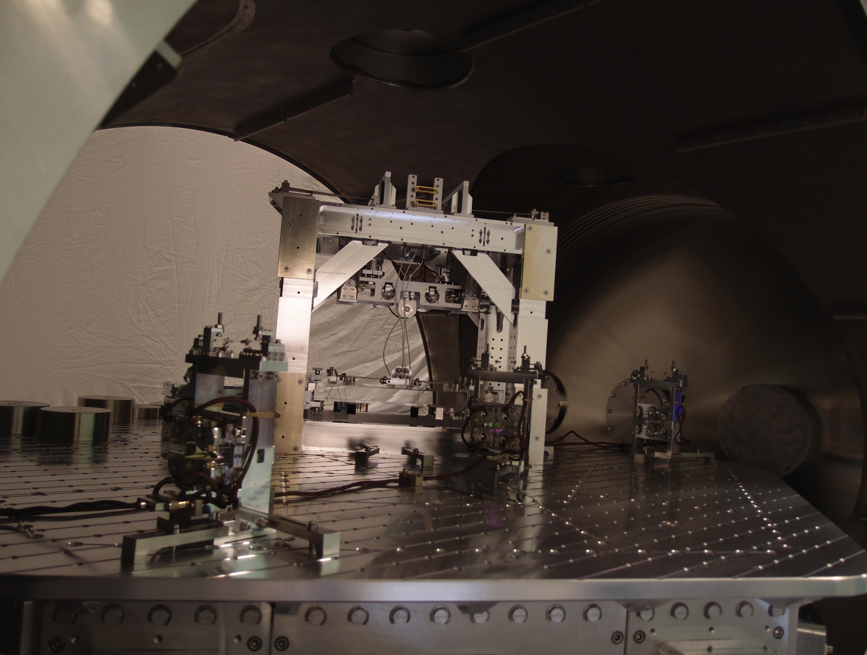
Advanced lIGo OMC: operation and characterization
Zach korth – lsc-virgo meeting – 9/24/2013
hannover, germany

Slide 2
the omc team
OMC design/fabrication/installation:
  CIT: Koji Arai, Jeff Lewis, Rich Abbott, Charles Osthelder, Zach Korth
  MIT: Peter Fritschel, Sam Barnum, Sam Waldman
OMC suspension team:
  Jeff Bartlett, Norna Robertson, Jeff Kissel, Stuart Aston, Derek Bridges
OMC commissioning team @ LLO:
  Valera Frolov, Suresh Doravari, Lisa Barsotti, Zach Korth
  (…with much help from the rest of the commissioners)

Slide 3
Outline
Preparation
  HAM6 layout
  OMC control design
  Salvage of eLIGO DCPDs
First light: in-air operation
  Stable length locking, but:
  Mode mismatch?
  PZT trouble?
Low noise: in-vacuum operation
  OMC
    Transmitted intensity noise
    Length noise
    Long-term drift
    Backscatter
  Simple Michelson
  PRMI
    Low-noise DC readout
Conclusion
  Lessons learned
  Future work

Slide 4
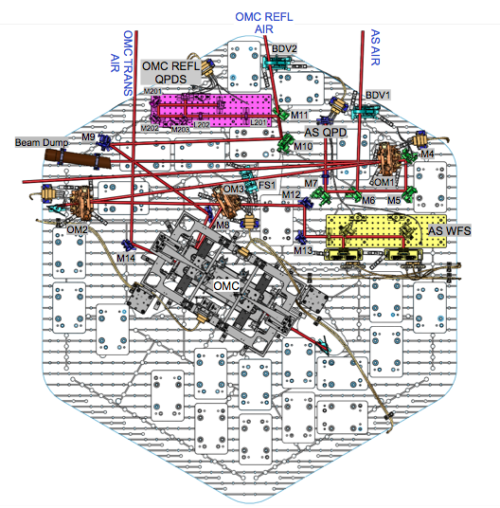
HAM6 layout

Slide 5
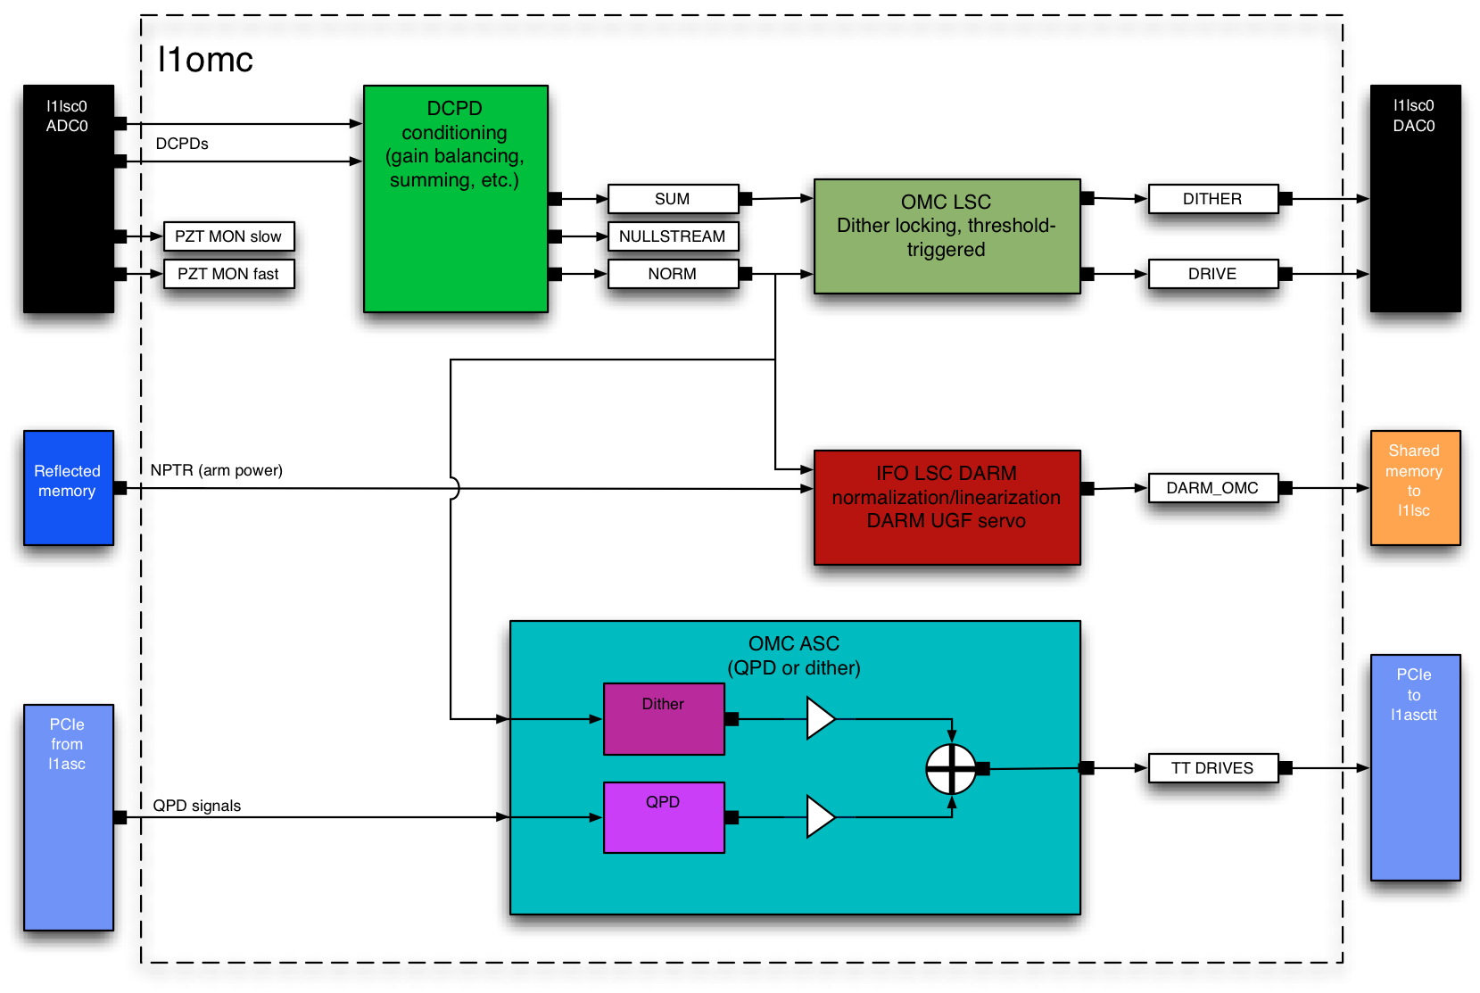
the omc control scheme

Slide 6
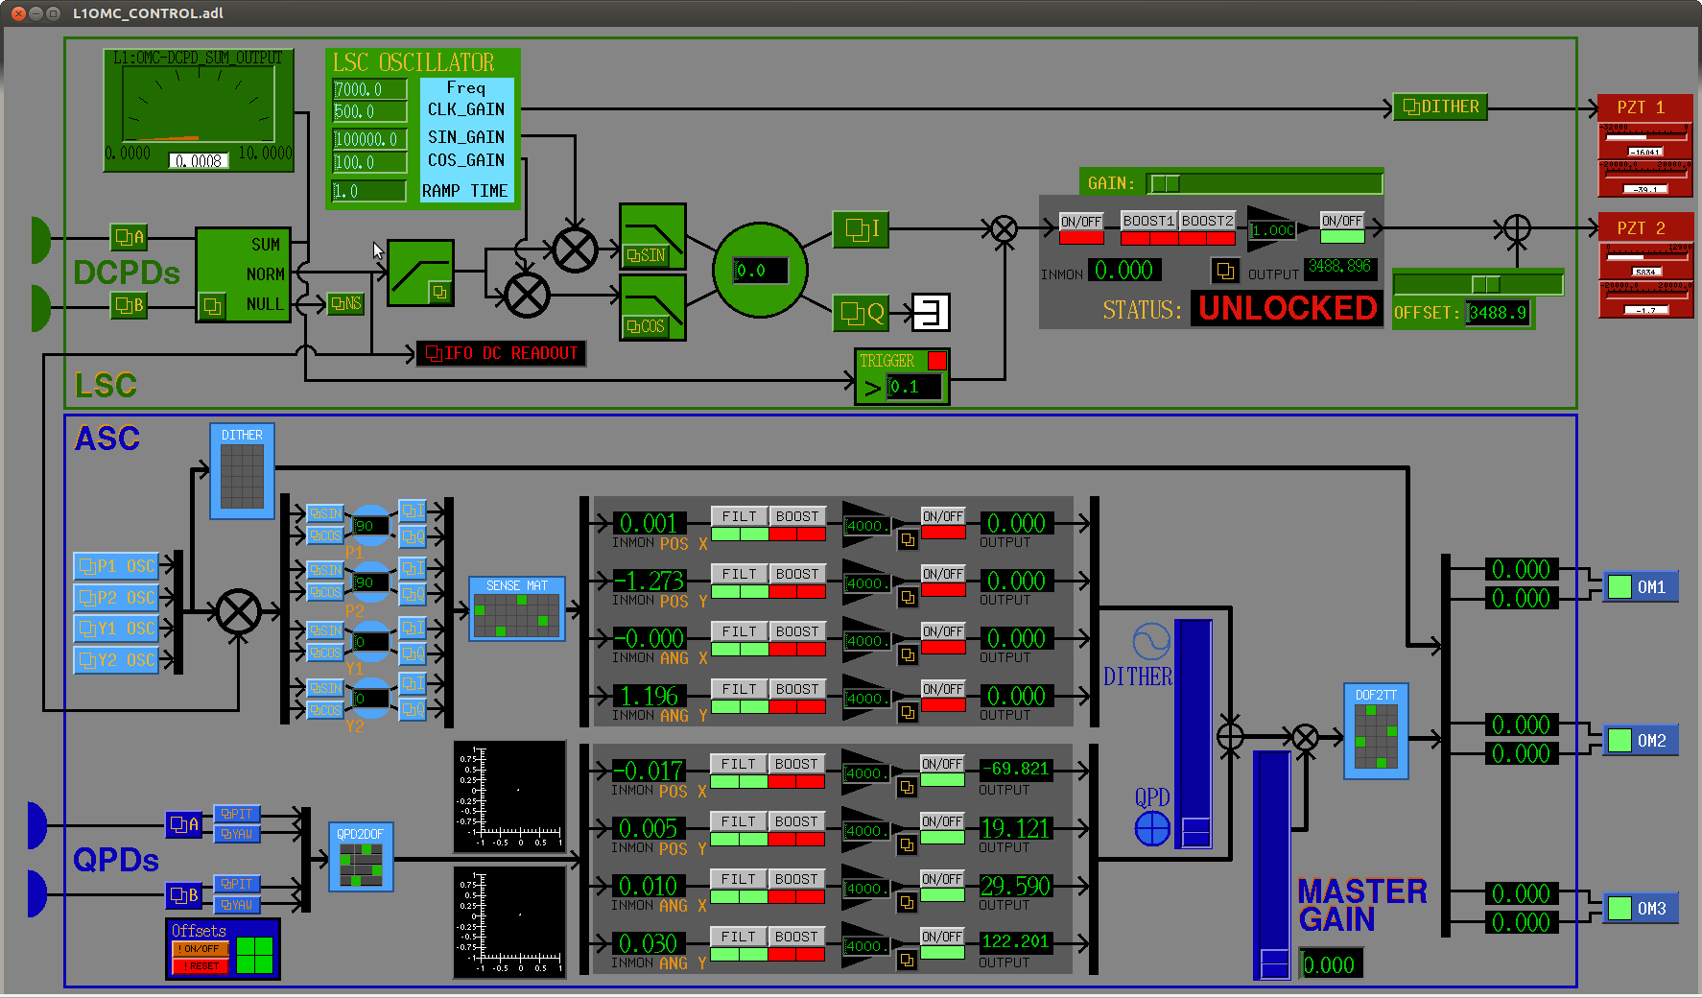
the omc control scheme

Slide 7
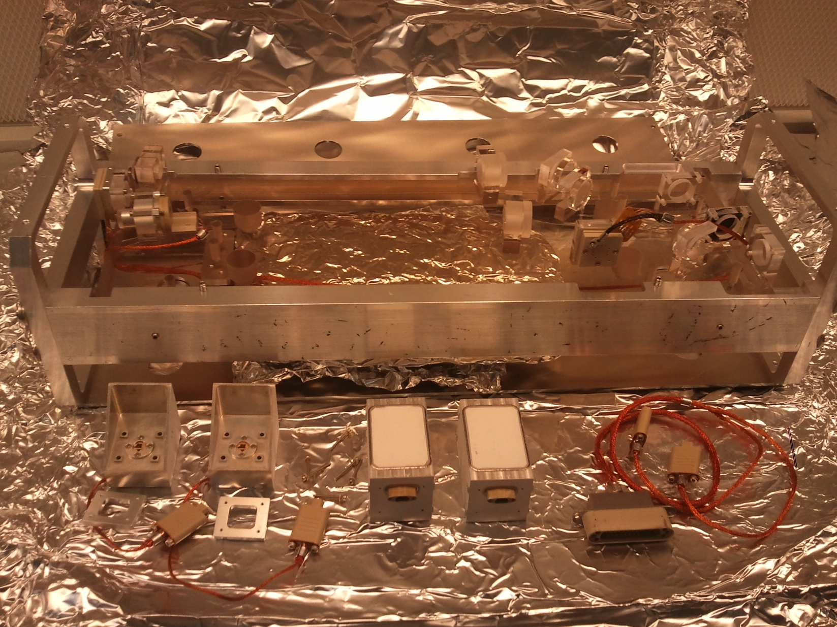
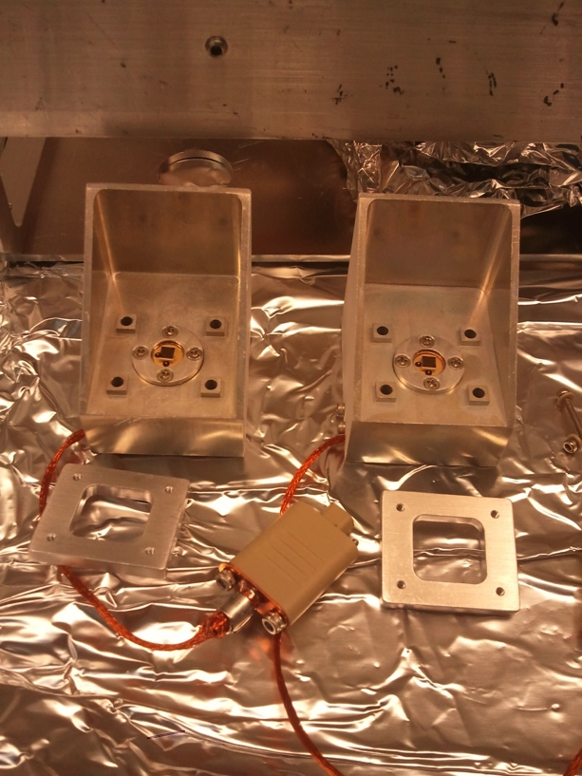
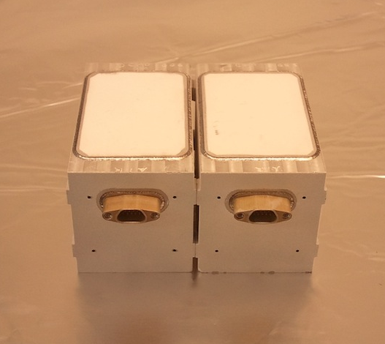
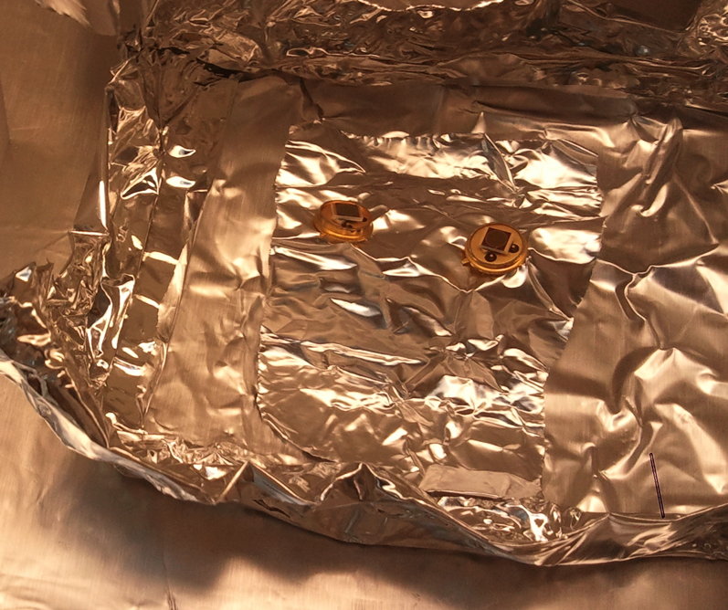
In with the old…

Slide 8
DCPD noise:

Slide 9
DCPD response:

Slide 10
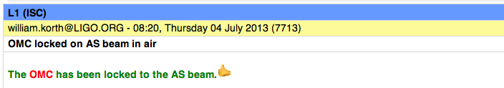
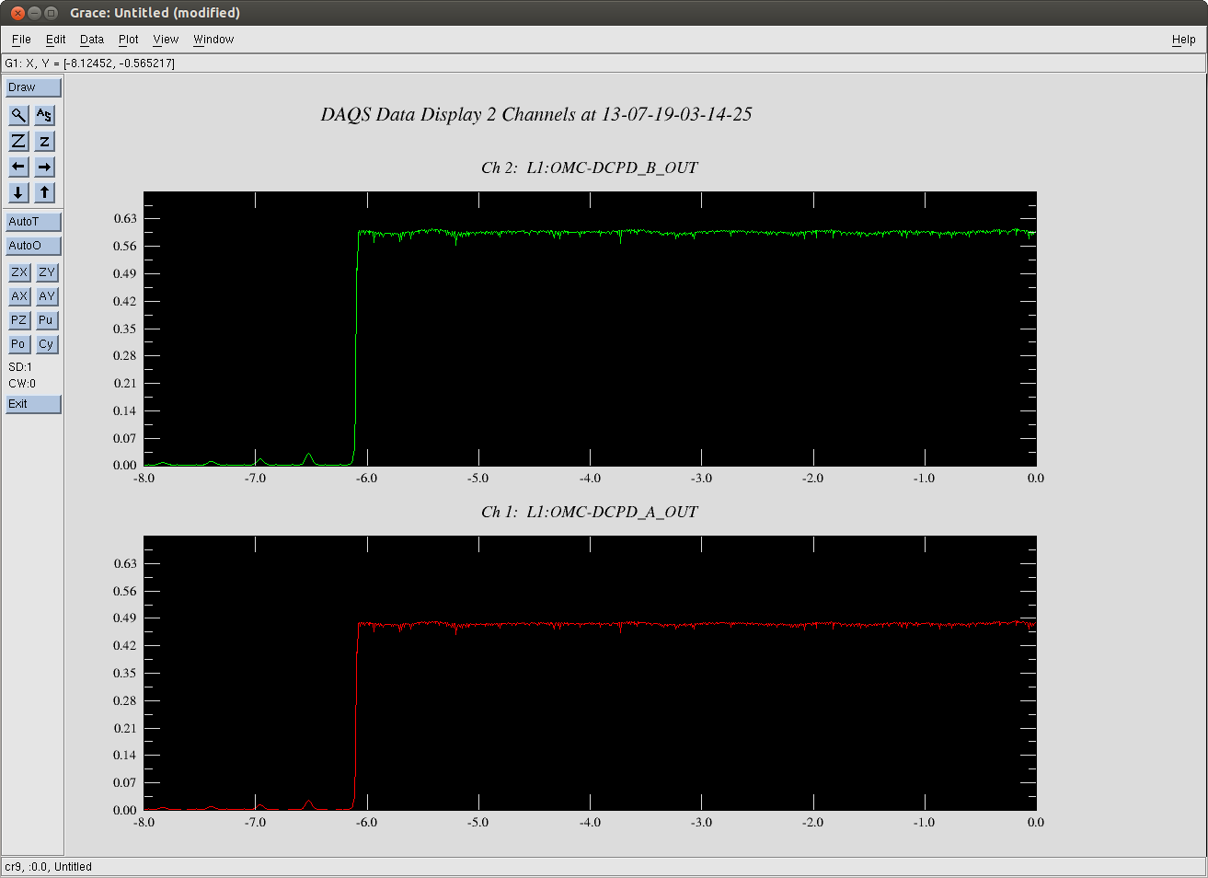
Stable in-air locking
BUT…

Slide 11
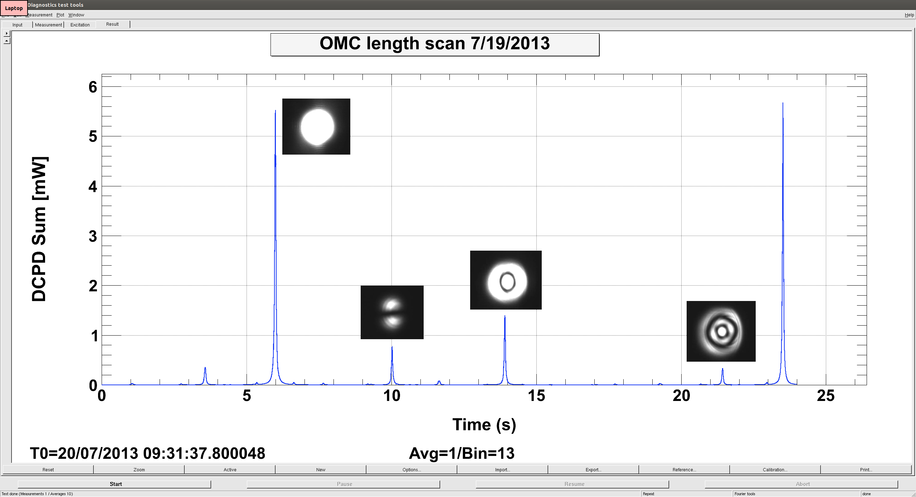
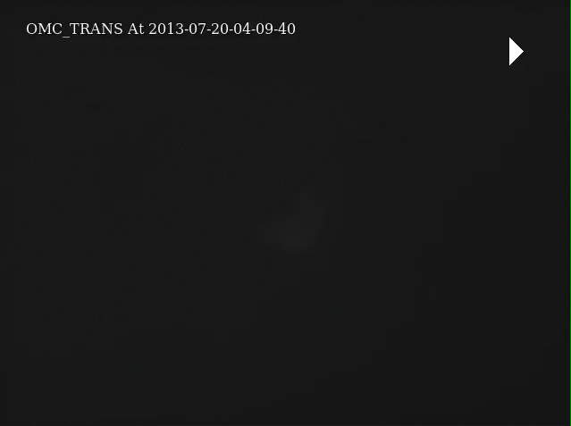
Mode mismatch?
See investigation summary by Chris M. and Lisa B.: LIGO-G1300909

Slide 12
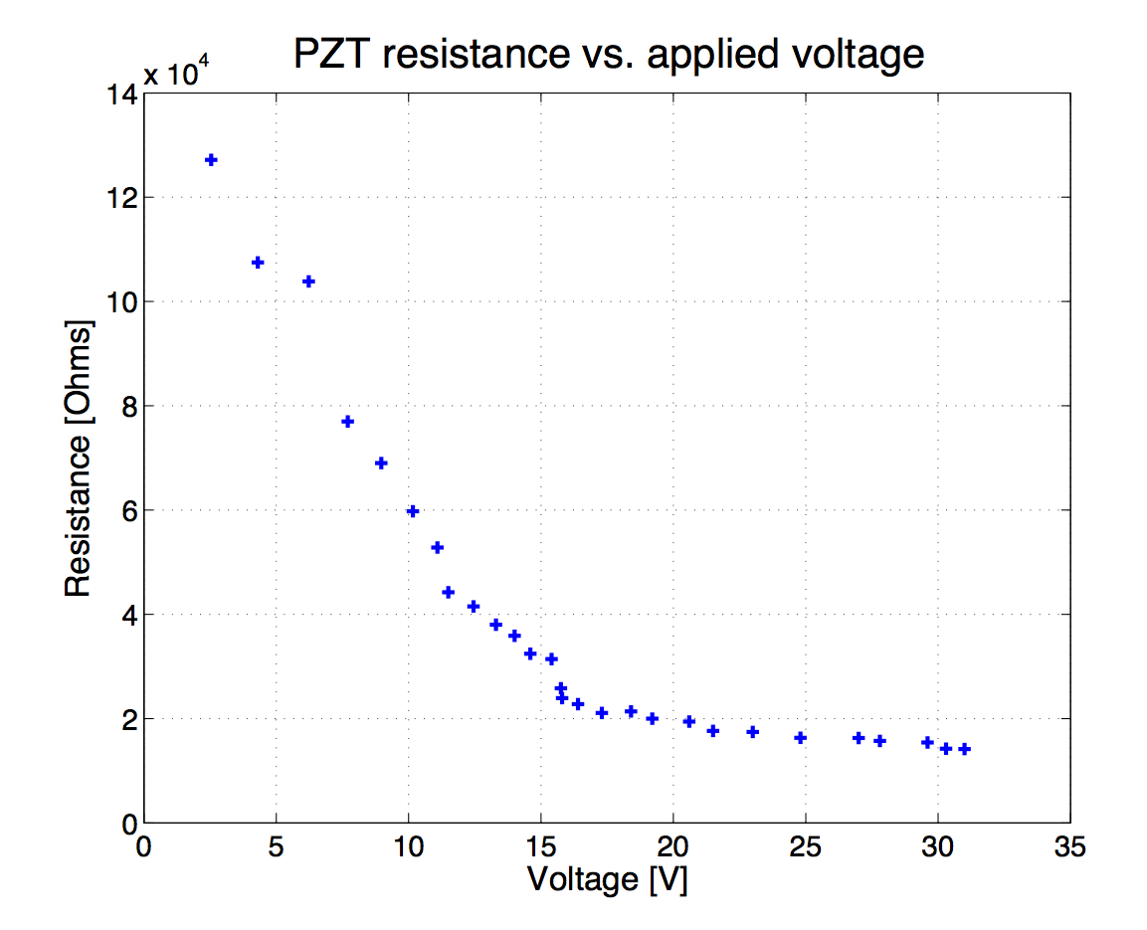
PZT trouble?

Slide 13
Reduced range—OK

Slide 14
Length control

Slide 15
Intensity noise

Slide 16
OMC length noise
???

Slide 17
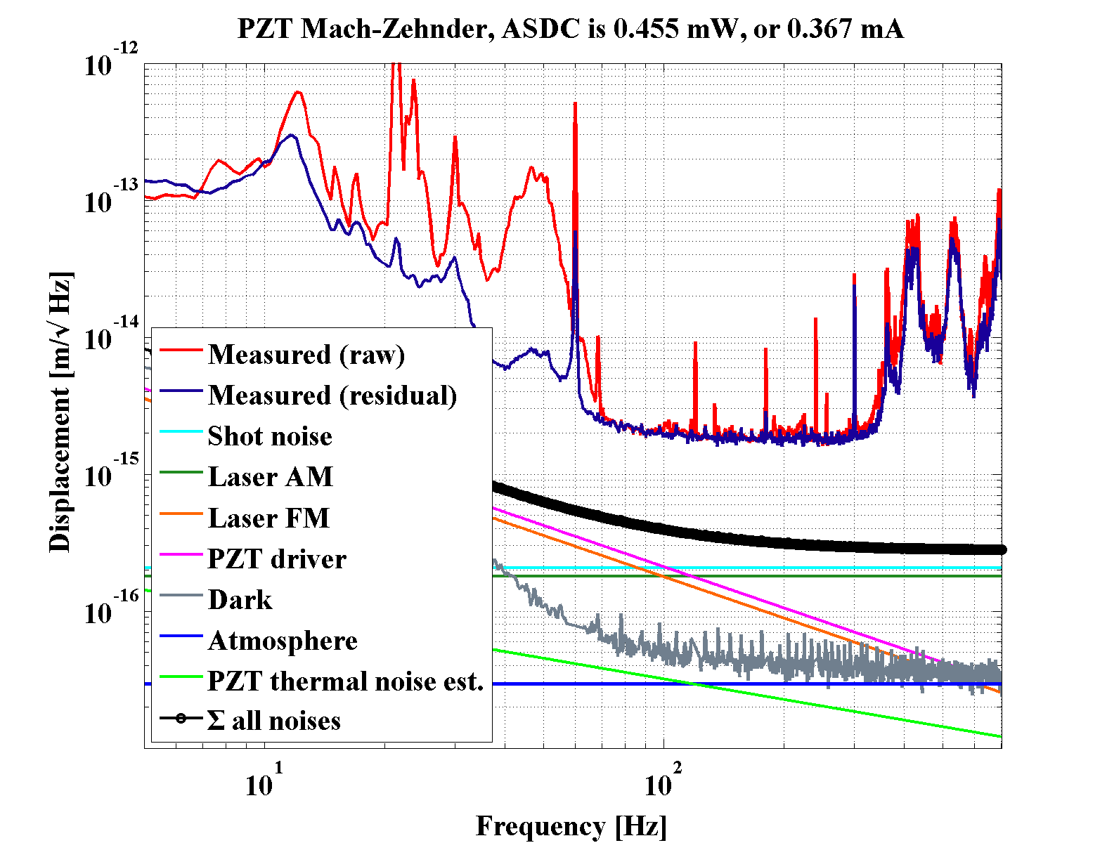
PZT noise?
R. DeRosa & V. Frolov
R. DeRosa and V. Frolov, 2013

Slide 18
In-loop noise
*
* See LIGO-T1000276

Slide 19
Long-term drift

Slide 20
Backscatter

Slide 21
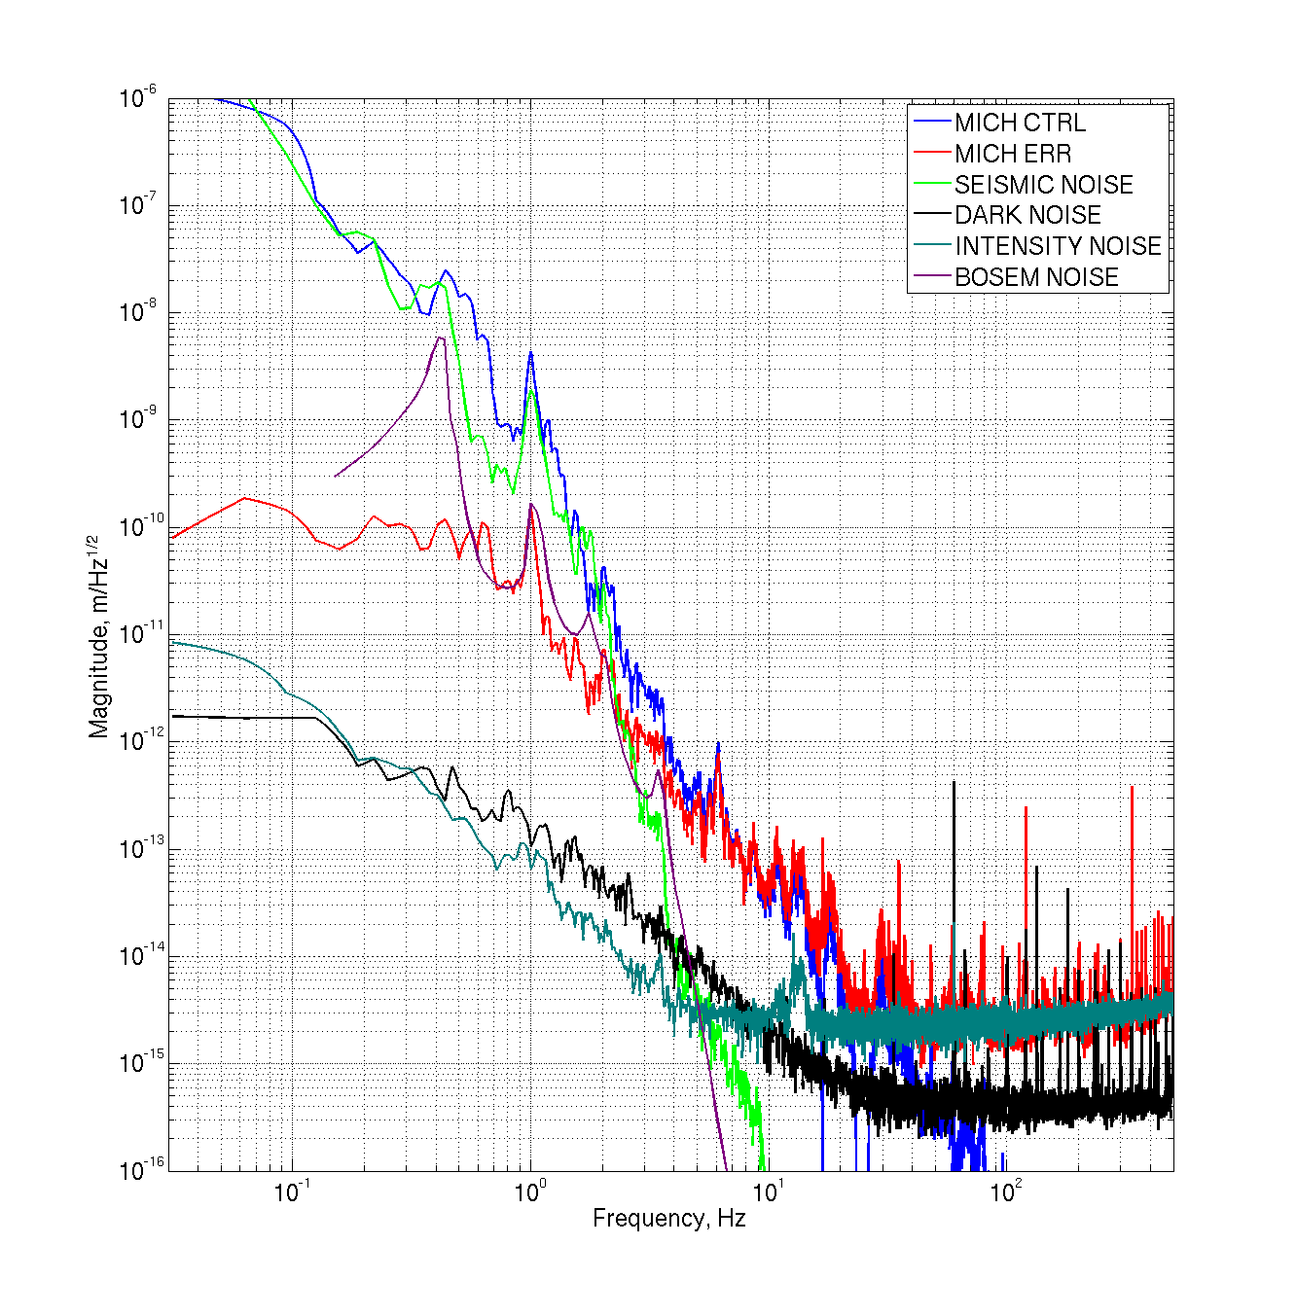
Simple Michelson, DC Readout

Slide 22
Low-noise PRMI, DC readout
CENSORED
(see R. DeRosa talk
in a little while…)

Slide 23
Conclusions / future work
OMC operates as expected and performs well, for the most part
  No devastating surprises, though plenty more work ahead.
To do…
  Investigate length noise more thoroughly
  Angular control
  Full integration
    Automation
    UGF servo
    etc.
Thanks for listening!
Danke für Ihre Aufmerksamkeit!

