Slide 1
Simulating the Advanced LIGO Interferometer Using the Real Control Code
Juan F. Castillo

Slide 2
Acknowledgments
Mentor
Joseph Betzweiser
California Institute of Technology and National Science Foundation
Summer Undergraduate Research Fellowship Program
National Society of Hispanic Physicist
Victor M. Blanco Undergraduate Summer Research Fellowship
Notes:
As everyone knows
Sites are undergoing a major renovation in Livingston and Hanford
Installing next generation of wave detectors
Will yield far superior results than initial and enhanced LIGO
New hardware systems are being installed
Some components are being tested for functionality and stability
Control codes constantly modified as hardware is being adjusted
Question has been raised - how to test the control system
Currently no easy methods
We wanted to build a model to use and improve on

Slide 3
What can be done?
Implementing a real-time simulation of the hardware that communicates to the control code will generate a practical troubleshooting technique.
Notes:
Goal - implement a real-time simulation of the physical model
Write a diagnostic tool
On a nightly basis, check that changes to control code work

Slide 4
Things to Keep in Mind
How do we develop a simulation?
What is noise and how do we simulate it?
What have we learned during this process?
Notes:
Key points
Structure of the simulation layout
Which noise being represented
Results and possible expansion
Solve a problem
Previous SURF’s created suspension and simple optical cavity simulations
Create simulation for the Horizontal Access Module’s internal seismic isolation (HAM ISI) system
HAM defines what the analog system of the interferometer senses
Takes control signals from actuator and transmits to sensors
Simple explanation of ISI - Table with multiple position and motion sensor
Create structure of layout using Simulink
Used as a drawing tool whose output is parsed by a script to generate C code
Actual C code used to run the simulation
Simulink is used as a drawing tool only

Slide 5
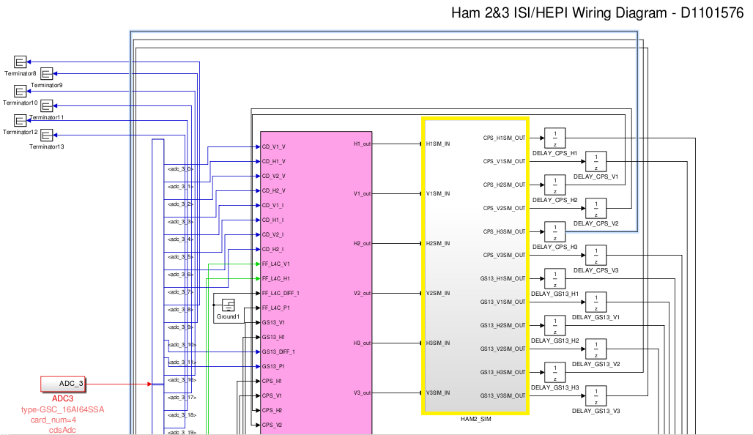
Notes:
Highlighted yellow box – simulation component
Pink box – library part identical to control code of HAM ISI
Control code input is simulation output
Control code output is simulation input
Background on noise and filters
Noise – anything that makes it harder to measure the gravitational wave signal in interferometer
Seismic noise (focus) – seismic fluctuations such as earthquakes, ocean tides, human traffic
Shot noise - fluctuation in the vacuum field beating against the radio frequency sidebars
Electronic noise – sensor and actuator noise
Filters components to simulate noise
Applied transfer functions from two different undamped data sets
Data between ground and sensors - undamped and left alone
Data between actuators and sensors - undamped with excitation
Create noise filters writing Matlab scripts
Existing functions used in LIGO lab
Takes vector (transfer function data set, amplitude and phase) and fits it to a state-space model with a common zero and pole set
Prepare and write zpk models to our components

Slide 6
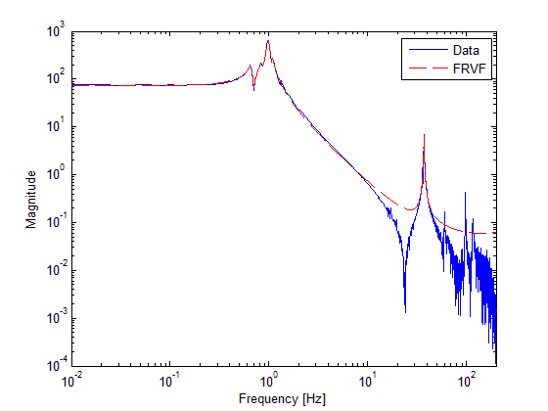
Notes:
Chart represents one of our filters simulation – actuator x and cps x sensor
Blue line is actual data gathered during one night
Red dashed line is simulated representation
Additional components – inverting filters and inverted matrices
Create inverting filters – correct calibration from digital signal measured in counts to actual units
Incorporated inverted matrices
Convert signal into sim from actuator basis to Cartesian basis
Convert outgoing signals – Cartesan basis back to the sensor basis

Slide 7
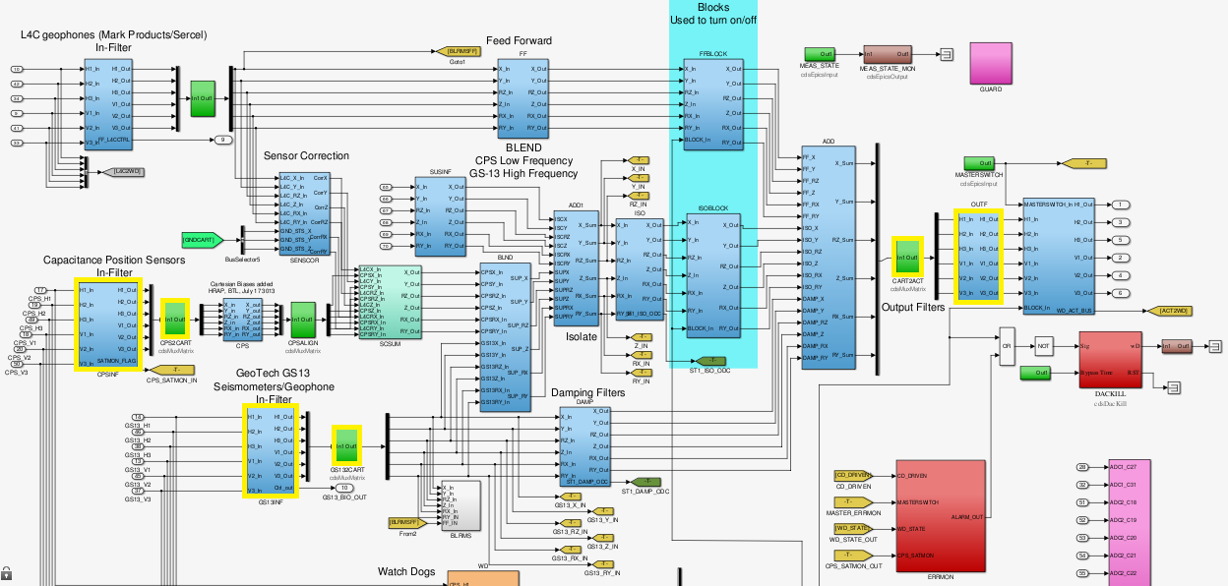
Notes:
The model inside HAM ISI control code library part
Yellow highlighted green boxes are matrices that must be inverted
Yellow highlighted blue rectangles are filters that must be inverted
Control code input is simulation output
Control code output is simulation input

Slide 8
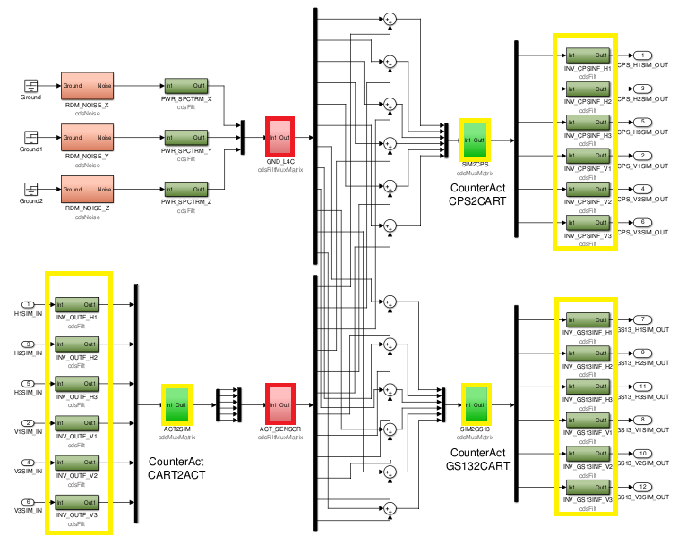
Notes:
The model inside our simulation part
Yellow highlighted boxes are inverted filters and matrices
Red highlighted boxes are filters for ground to sensor and actuator to sensor noise
Simulation input is control code output
Simulation output is control code input

Slide 9
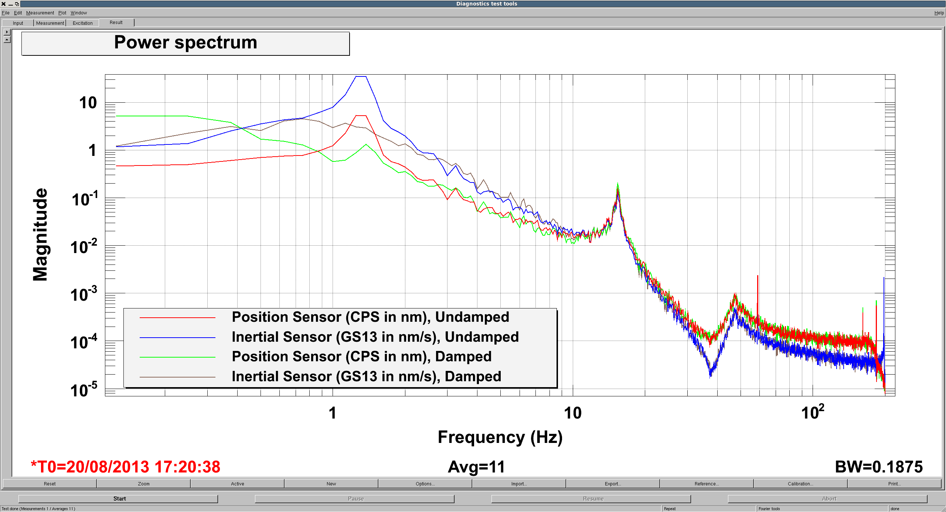
Results to this Point
Notes:
Results
Simulate a push in one direction
“See” controls dampen simulated ground noise in the same way the controls damp the real ground noise
Simulation is running and gathering results
Debugging stage to verify accuracy and reliability
Issues with the calibration of our data
Future Expansion
Incorporate noise sources we neglected – shot and electronic
Simulation for suspension system
Use alternate method to verify
From first principles
Size and mass of tables
Simulate using the established laws of physics vs. data model fitting

Slide 10
OVERVIEW
Learned about noise and filters
Discussed framework of simulation
Explained how to interpret and expand
Notes:
Explained noise and filters
Filters for seismic noise
How to assemble and incorporate filters
Explained simulation build
Structure of layout - Simulink
Matlab scripts for filters
Explained results and possible expansion
We have laid the groundwork for future models to be incorporated in an overall effective simulator to test the control code and hardware.
The ability to troubleshoot the overall system by using a simulation model is critical in effectively dealing with unforeseeable problems.
Questions?

