Slide 1
Operations Sparing Plan Approach
A brief presentation at the 7/31/2013 Systems weekly meeting to explain the basic approach for developing a sparing plan for aLIGO operations.
See also the companion document T1300519, "Sparing Analysis"
While purchase and maintenance of spares in the aLIGO era is an operations task, definition of the sparing plan is an aLIGO project task.

Slide 2
Sparing Plan
We need a bottom-up estimate of the spares required for minimal down-time
Budgeting
Logistics/ordering
Likely that best tool to use is “RAMI” (reliability, availability, maintainability, inspectability) software
Integrates spares list with system reliability model, FMECA model, etc.
Can readily update/maintain sparing analysis input based on experience/data
Can perform more sophisticated failure analysis if/as required
Expensive, requires training & learning curve, etc.
Currently investigating software, e.g. ReliaSoft …
For now use Excel template (T1300519) to gather inputs

Slide 3
Sparing Plan
Once each subsystem has provided sparing plan inputs using the Excel template (T1300519) –
An initial spares plan will be published [aLIGO project scope]
Consultants will be hired to review the initial reliability (failure/repair rates) for the electronics in an effort to provide better input data to the initial plan [aLIGO project scope]
The spares plan & analysis will be improved upon and maintained (including updates for as-experienced failure/repair rates) [Operations scope]
Eventually we will likely migrate from the Excel template to a RAMI software tool [Operations scope]

Slide 4
Sparing Analysis Inputs
LRU = Line-Replaceable Unit (or Lowest Replaceable Unit)
Component, or module, level at which spares are stocked and failed units are repaired and/or replaced
For each LRU:
Identified by LRU by name & part number
Also define the the next higher level assembly name & part number
Define source or manufacturer
Define replacement cost (hardware/supply/equipment/procurement cost, not labor)
Define repair cost (for most likely repair)
MTBF = Mean Time Between Failure; the mean (average) time between failures (repairable or not) [hrs]
FR = Failure Rate, λ = 1/MTBF [#/hr]
MTBR = Mean Time Between Repairs; the mean (average) time between repairs [hrs]
Quantities
#LRUs required per interferometer
#LRU spares likely to be delivered by aLIGO project to Operations
Don’t worry about the calculated spares inventory and replenishment rates & costs calculated in the Excel spreadsheet
Systems will review/fix/revise these in the integrated spares plan

Slide 5
Sparing Analysis Input Estimates
If you don’t know, then take a ‘best guess’ (aka an “engineering estimate”)
Better to have some reasonable spares plan base on estimates, than no spares plan due to lack of input!
This applies to failure & repair rates (MTBF and MTTR respectively) as well as quantities
Use the comment field to identify the source(s) of data and the maturity/reliability of the inputs, e.g.
“MTBF is just a order-of-magnitude estimate”
“Replacement costs is just a ballpark guess”
“Not sure of the surviving number of in-process spares; this is a conservative estimate”
This allows us to track which inputs need more attention/refinement as we improve the plan over time

Slide 6
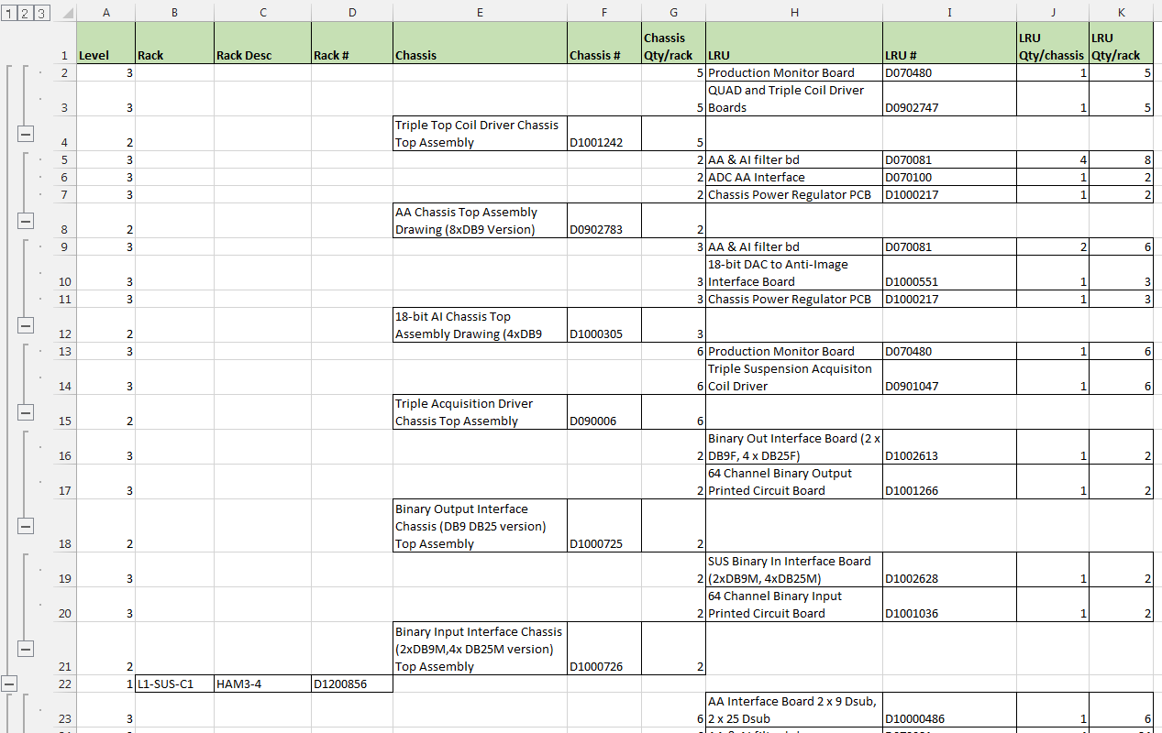
Sparing Plan Example – SUS partial/incomplete
Create/assemble bill of materials (BOM) for LRUs

Slide 7
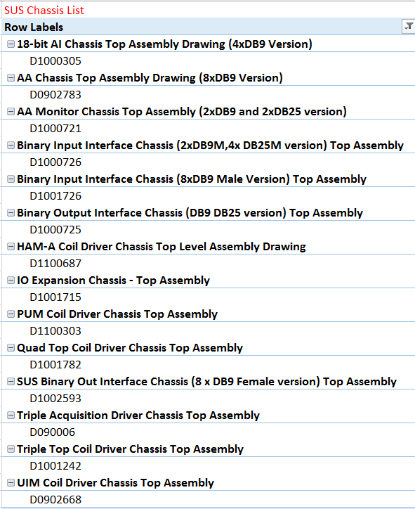
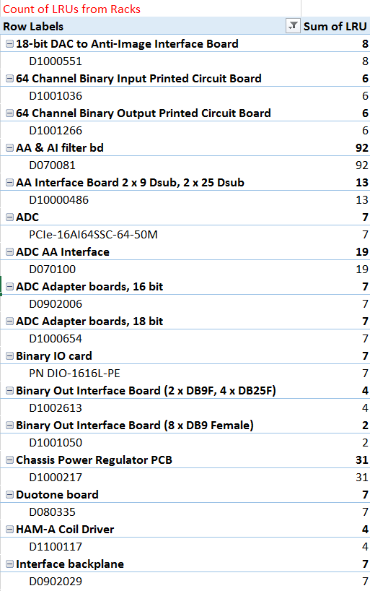
Sparing Plan Example – SUS partial/incomplete
Use LRU BOM to determine quantities

Slide 8
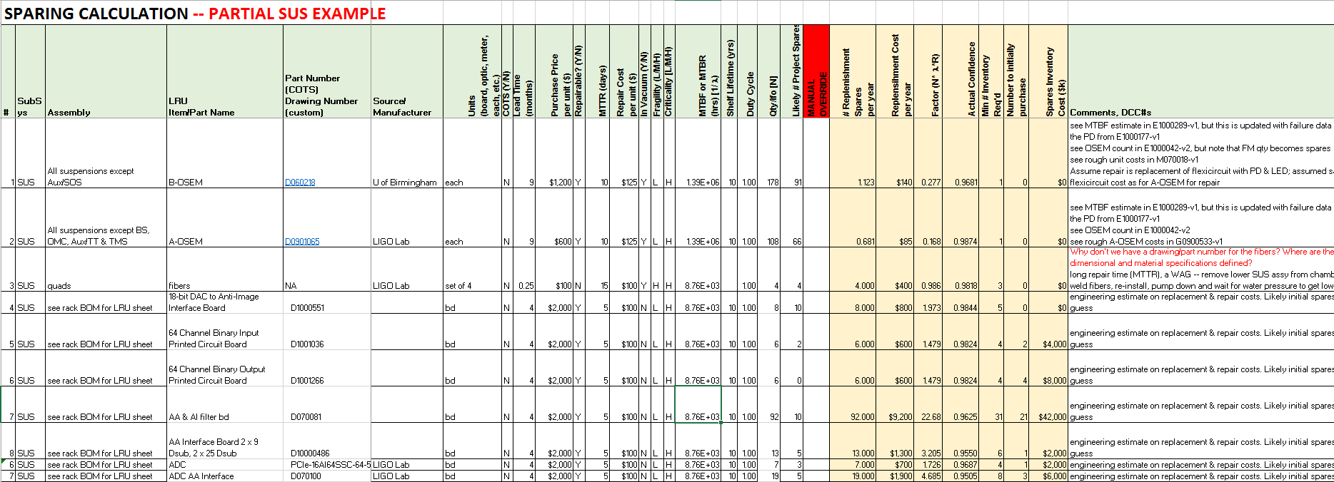
Sparing Plan Example – SUS partial/incomplete
Estimate, or look-up, input parameters for the LRUs

