Slide 1
Pier Motion and Control
David Tshilumba, Christophe Collette

Slide 2
Outline
Context (CERN structure)
Piers motion measurements
Modeling + comparison with other models
Possible solutions

Slide 3
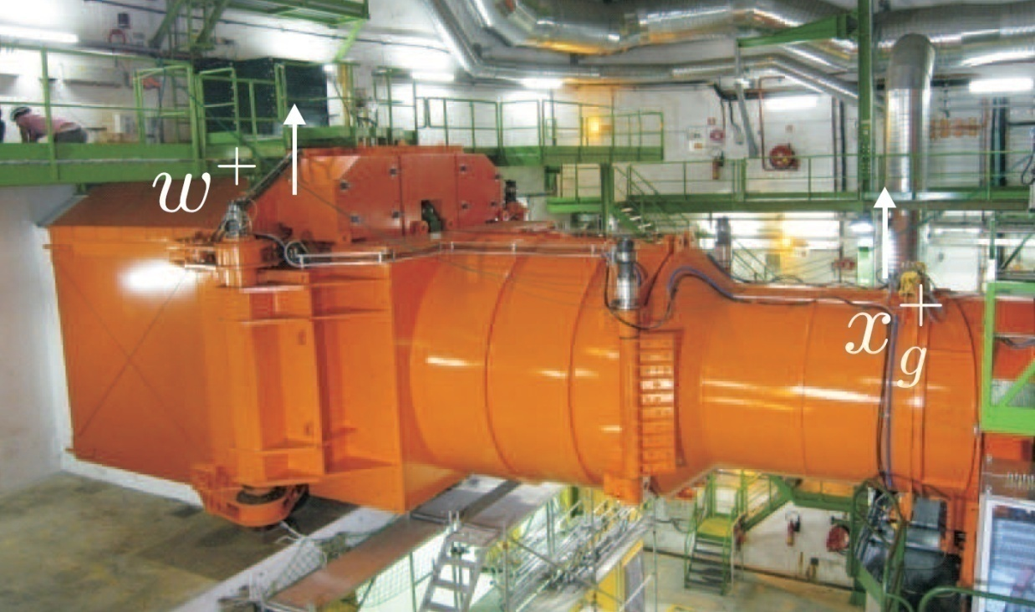
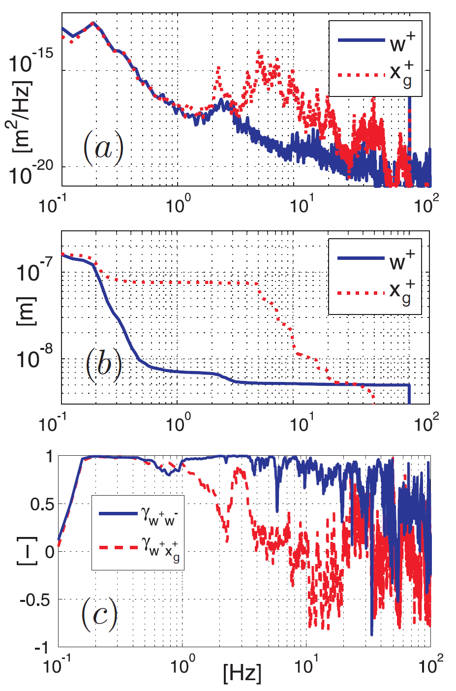
CMS Experiment (LHC tunnel at CERN)
Large cantilever beam

Slide 4
Experimental set-up

Slide 5
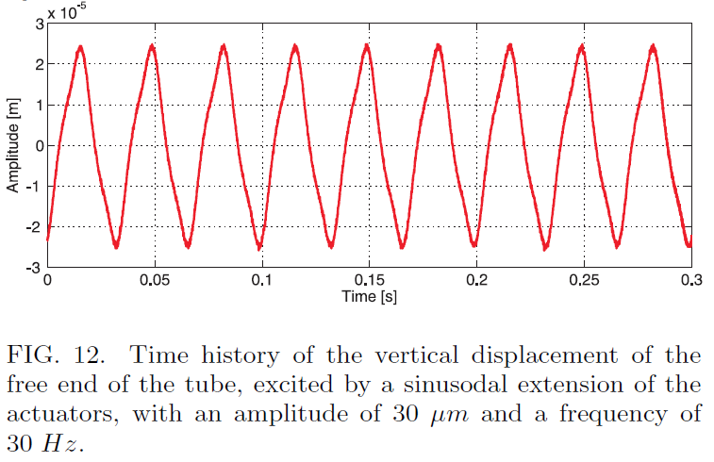
1
Divided by 30
2
Active damping of all the modes
3
Positioning:
out of phase sinusoidal signals in the two vertical actuators:
Amplitude: 30 µm
Frequency: 30 Hz

Slide 6
y
x

Slide 7
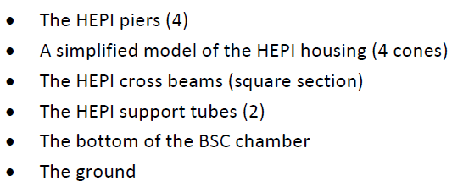
FE model

Slide 8
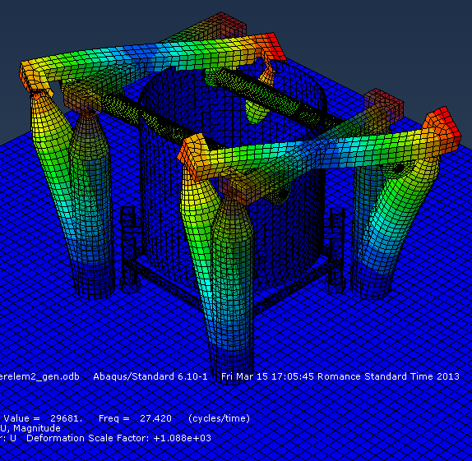
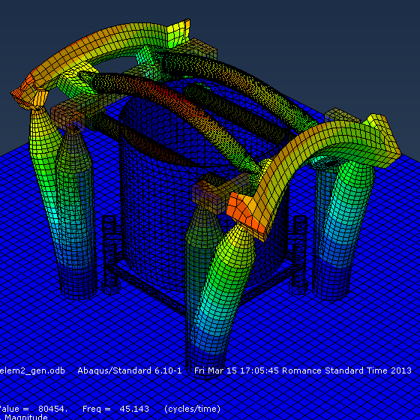

Slide 9
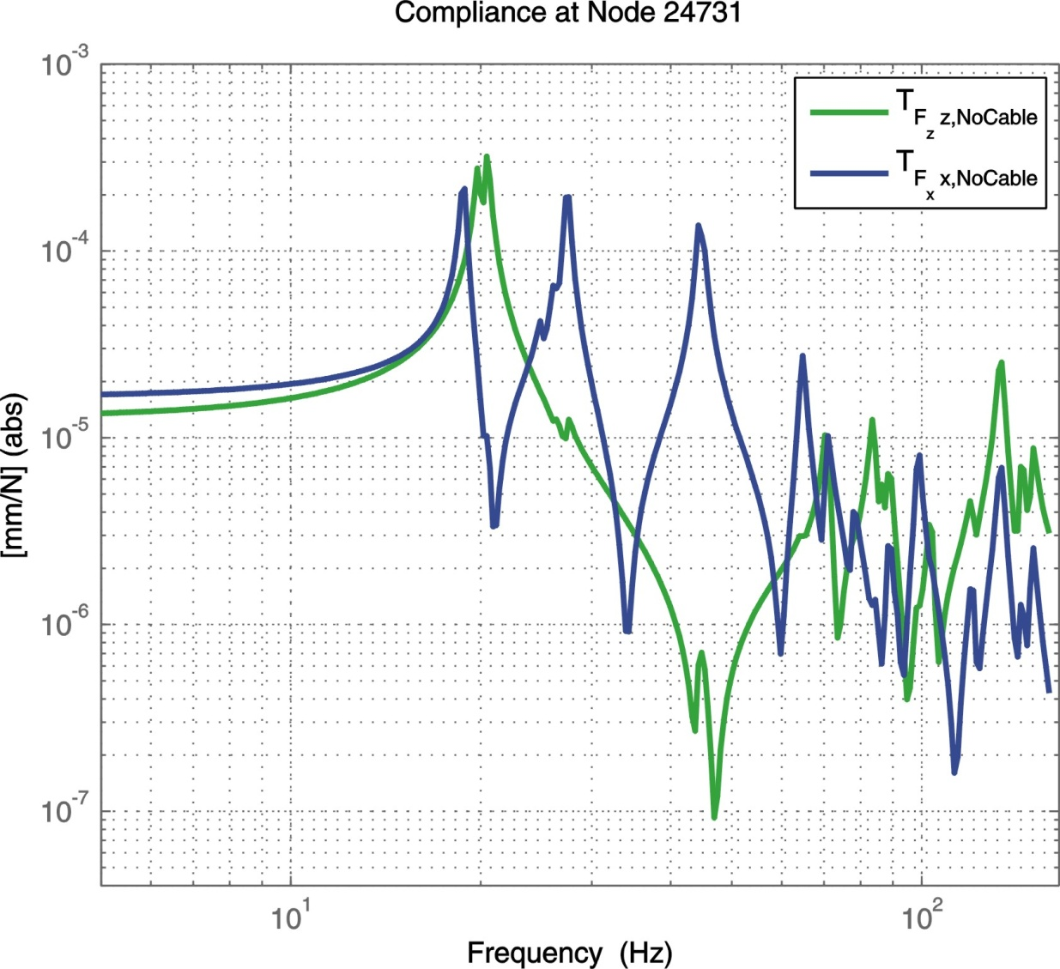
State space model ➔ compliance
y
z
x

Slide 10
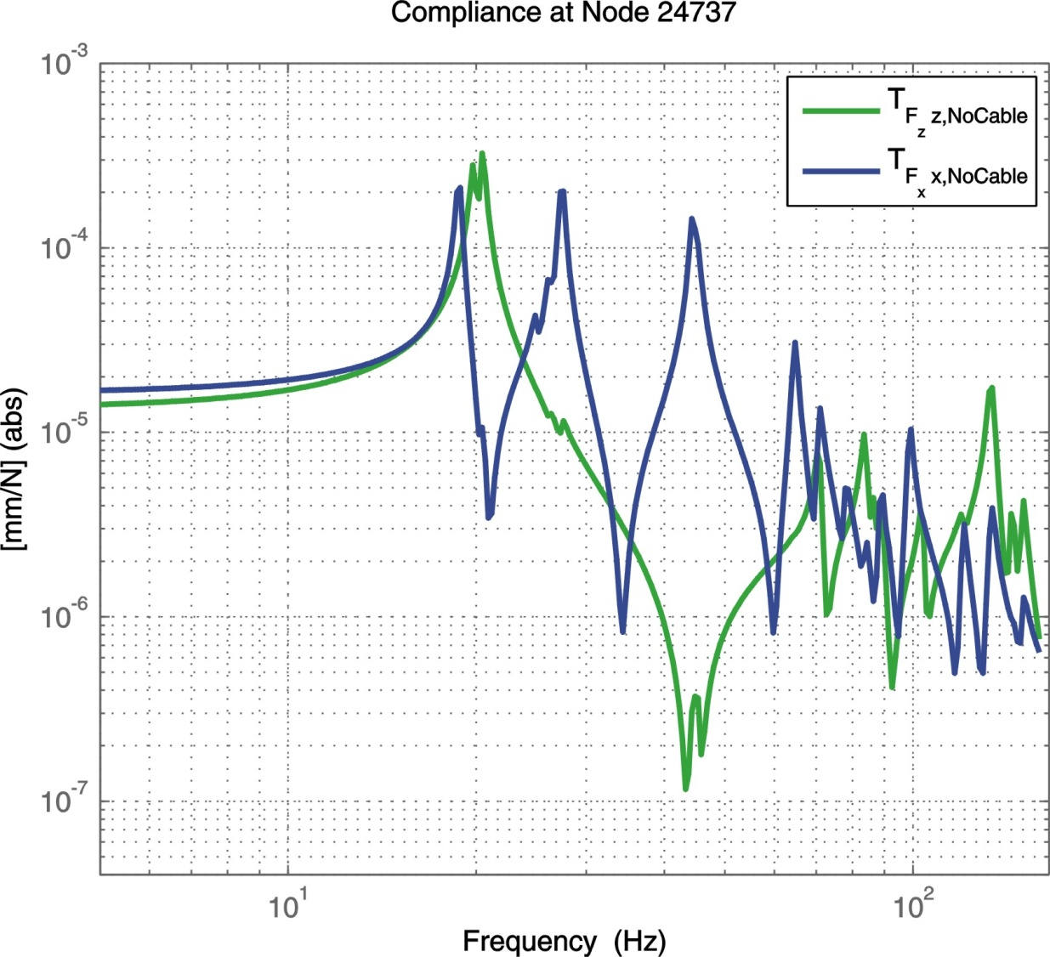
State space model ➔ compliance
y
z
x
Similar response below 50 Hz

Slide 11
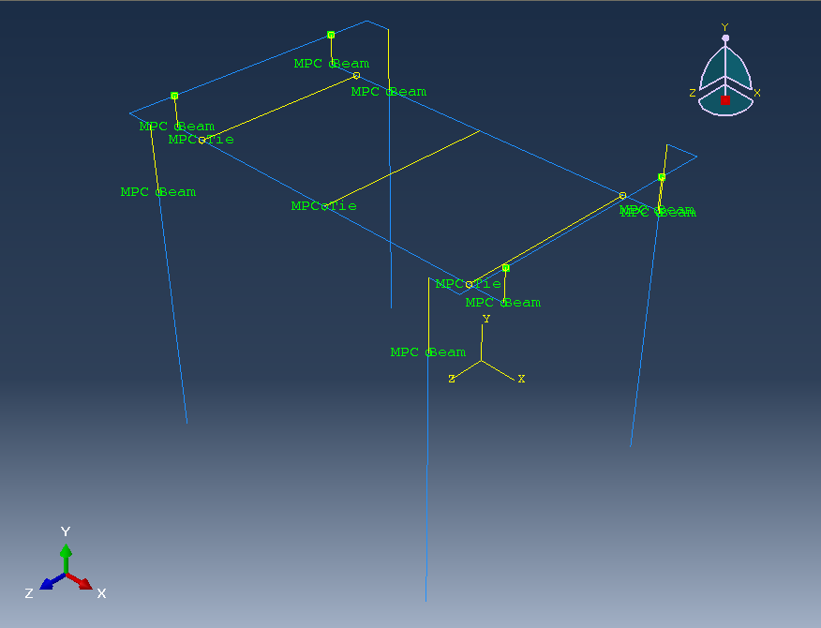
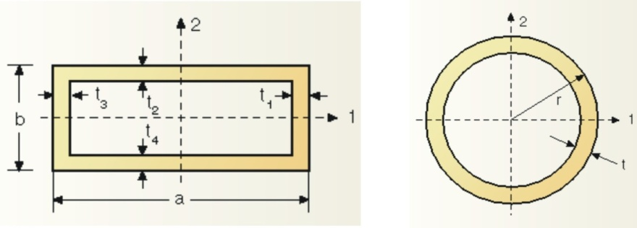
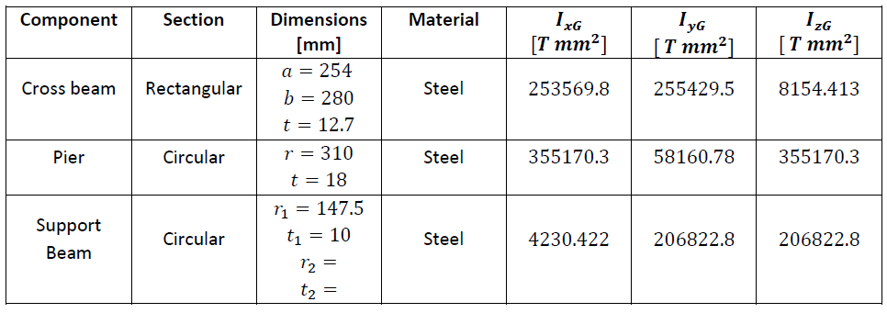
Simplified model
Cross beam
Pier

Slide 12
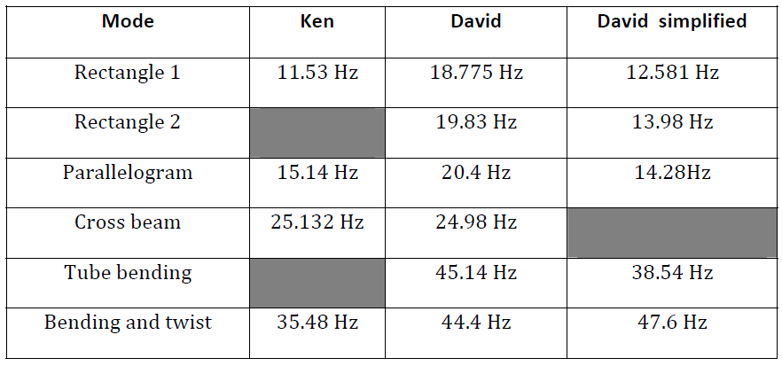
Comparison of the models

Slide 13
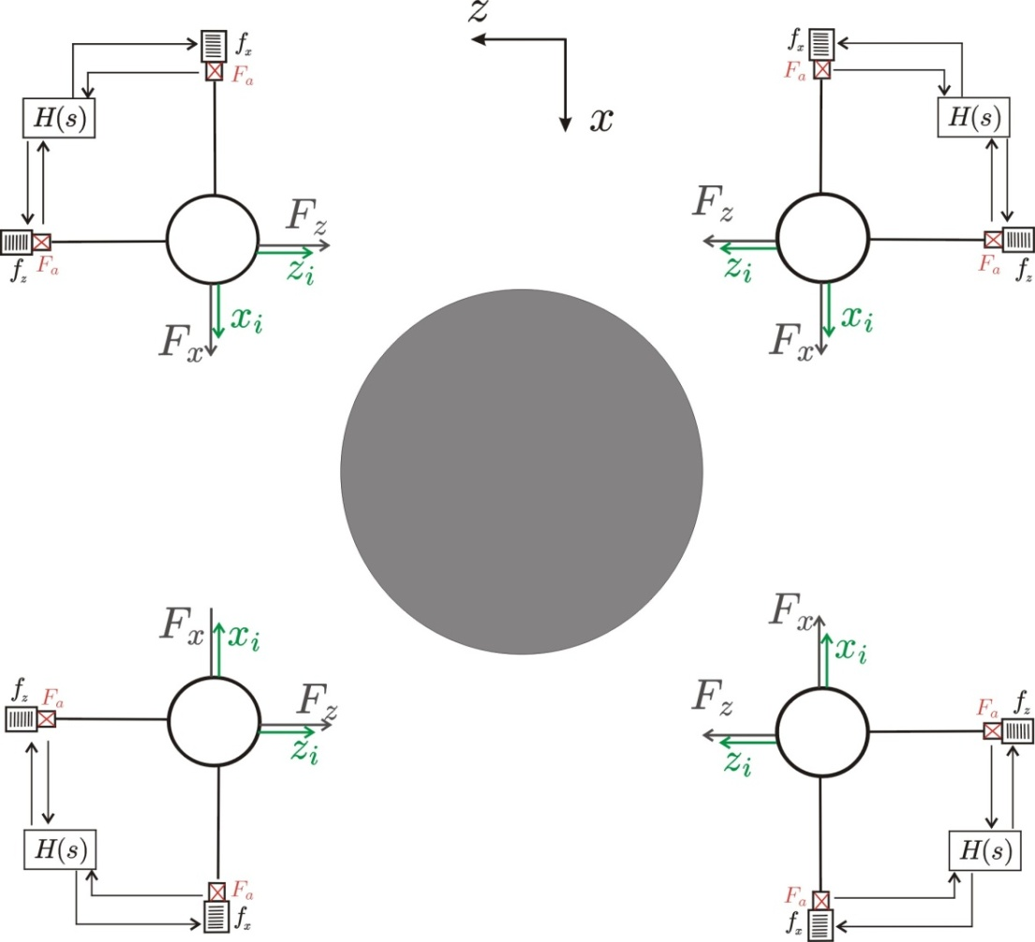
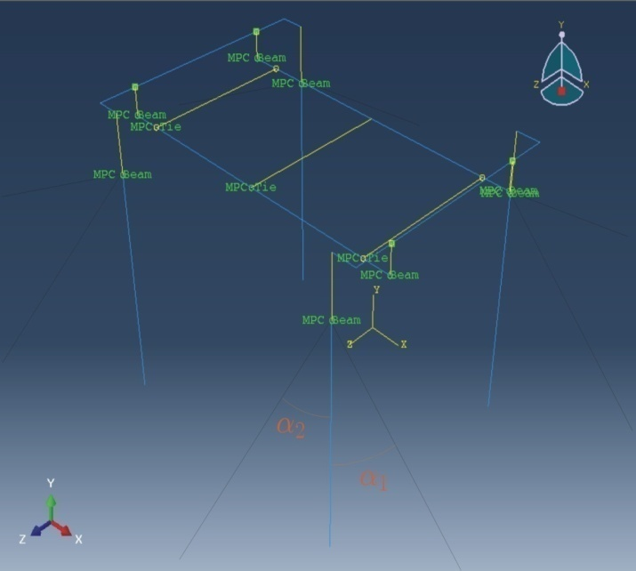
Idea 1: 2 active cables / pier linked to the ground
Top View of the structure with 8 controlled cables
3D view
Cable stiffness:
k_{c}=8e4 N/mm

Slide 14
Top of each pier connected to the ground with 2 active cables

Slide 15
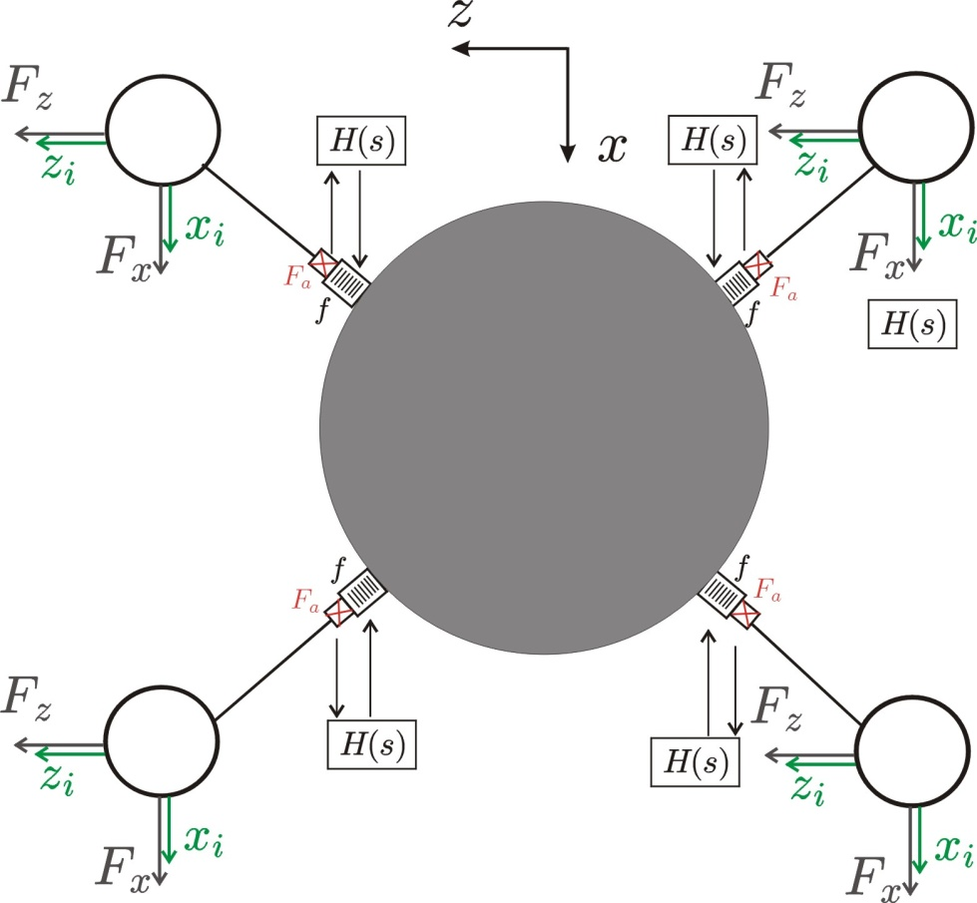
Idea 2: 1 active cable / pier linked to the chamber
k_{c}=4.05e5 N/mm
Kc [N/m] | 4,05E+08
Young modulus[Pa] | 1,80E+11
 | A/L [m] | L [m] | A [m^2] | d [mm]
 | 2,25E-03 | 0,6 | 1,35E-03 | 4,15E+01

Slide 16
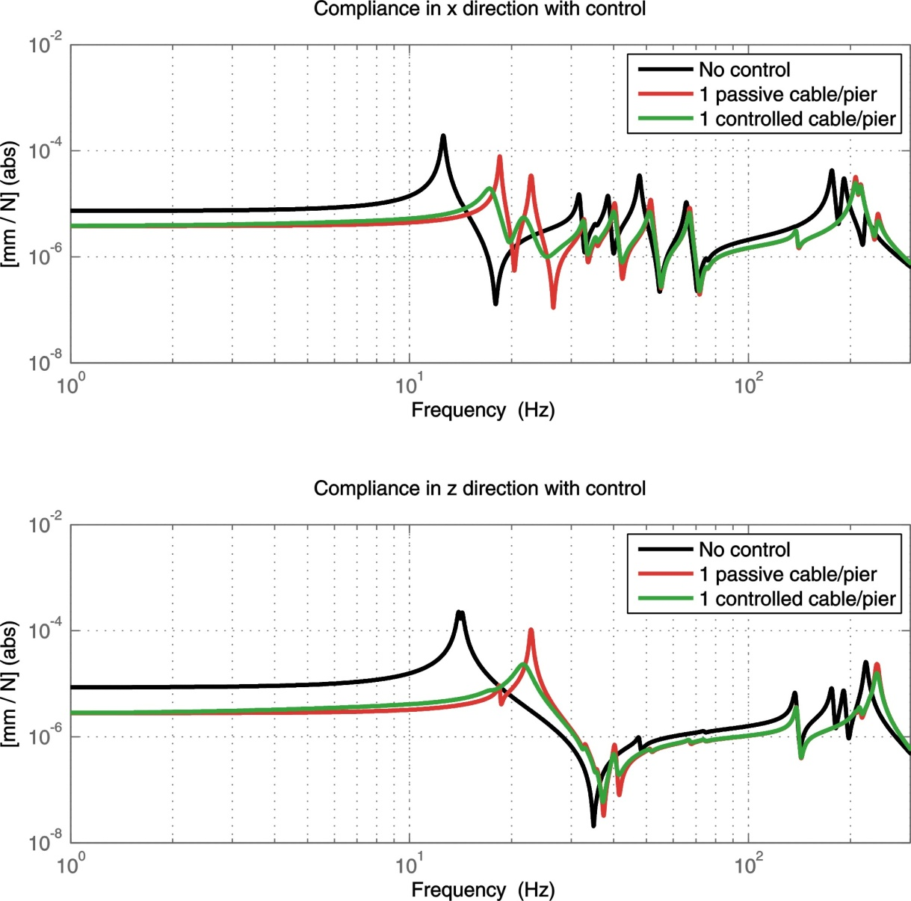
Top of each pier connected to the BSC chamber with 1 active cable

Slide 17
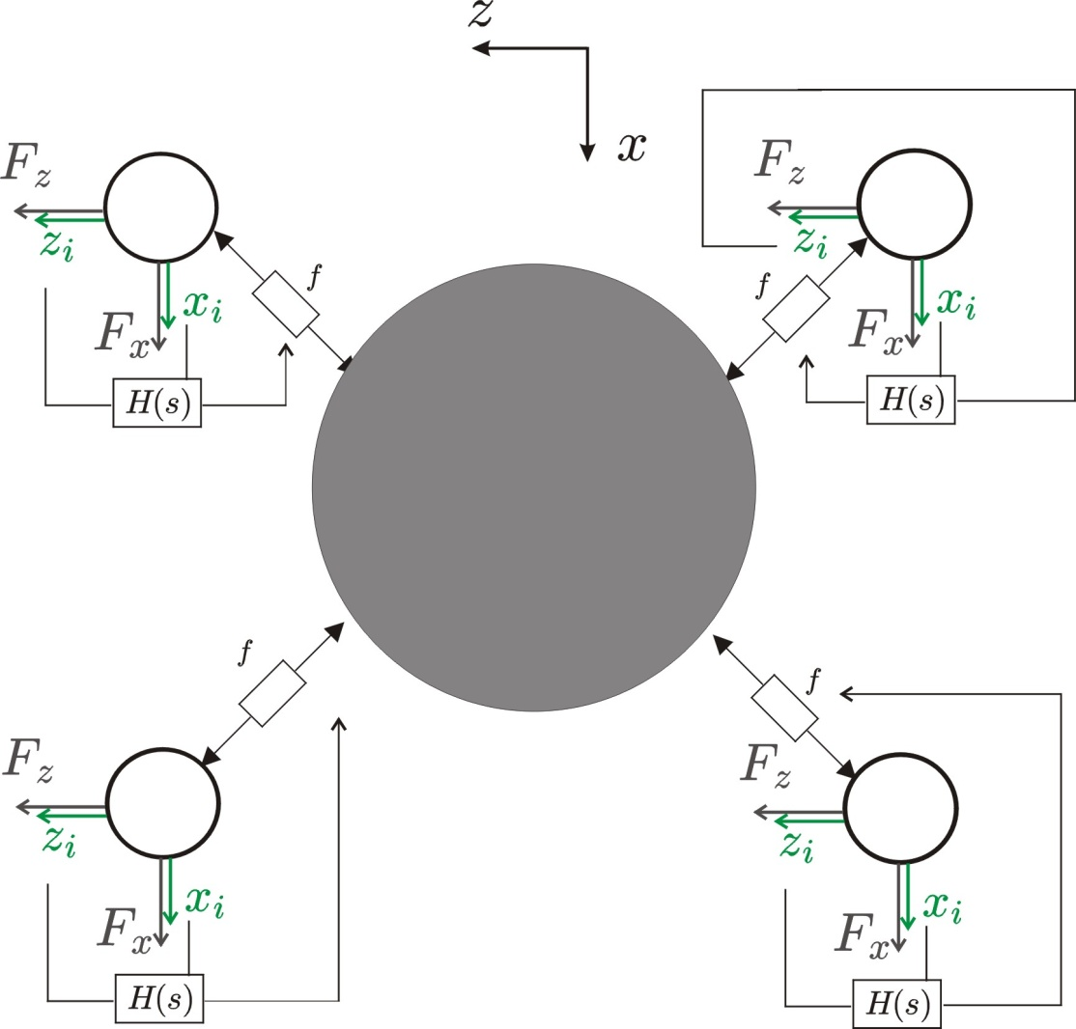
Idea 3: 1 damper / pier linked to the chamber

Slide 18
Top of each pier connected to the BSC chamber with 1 active cable

Slide 19
Comparison
 | Advantages | Disadvantages
Idea 1 : 2 cables /pier | Cables oriented along the modal displacements. No coupling between the BSC chamber and the piers. | Need space around the piers to mount the cables. Limited cable stiffness because cables are long.
Idea 2 : 1 cable /pier | Decrease the compliance by a factor 4 at low frequency. | Cables are not oriented along the modal displacements. Coupling between the BSC chamber and the piers.
Idea 3 : 1 damper /pier | It can be passive solution. Good damping performance | Dashpots are not oriented along the modal displacements. Coupling between the BSC chamber and the piers. No reduction of the compliance.

Slide 20
Conclusions
Tools are developed:
FE model of the piers (volume elements)
Simplified model (beam elements) + state space model
3 ideas have been tested and compared
2 cables/pier to ground;1 cable/pier to chamber; 1 damper/pier to the chamber
An experimental modal analysis is necessary
One have to define the control objective

