Slide 1
aLIGO QUAD "Level 2" Damping Loop Design
(Supplemental to LLO aLOG 6949)
J. Kissel

Slide 2
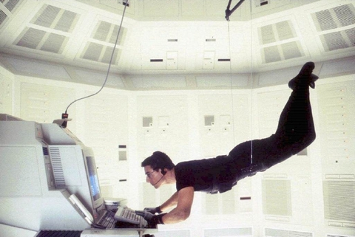
aLIGO QUAD "Level 2" Damping Loop Design
Mission Statement
The damping loops installed during the SUS testing phase
merely to prove that the suspensions could be damped
damped quickly and robustly
little-to-no regard to re-injection of sensor noise
very aggressive, but poorly placed elliptic filters to rolloff noise
The mission here was to design a set of loops, that
doesn’t take you years to design and tweak
isn’t on the hairy edge of instability
doesn’t require any “Brett Shapiro” trickery (damping in Modal, Global bases)
doesn’t require and new infrastructure (which Modal and Global damping would),
but still
designed with what modeling experience we’ve gained
gets us close to what we’ll need for aLIGO, primarily focusing on Longitudinal
will be sufficient for the first several stages of integrated testing
Level 1
Level 2

Slide 3


Damping Loop Design
Model Figures of Merit
Stability: Bode plots of Open and Closed Loop Gain Transfer Functions
Cross-Coupling: The above, Modeled both as SISO and MIMO systems, the below as MIMO
Modeled Performance: Compute all DOF’s of Top Mass sensor noise contribution to Test Mass degree of freedom of interest
Compare: with other noise sources, requirements, etc.
Measured Performance: With what we can: Closed Loop TOP2TOP Open and Closed Loop TFs, TOP Sensor ASDs, TOP Control Signal ASDs

Slide 4
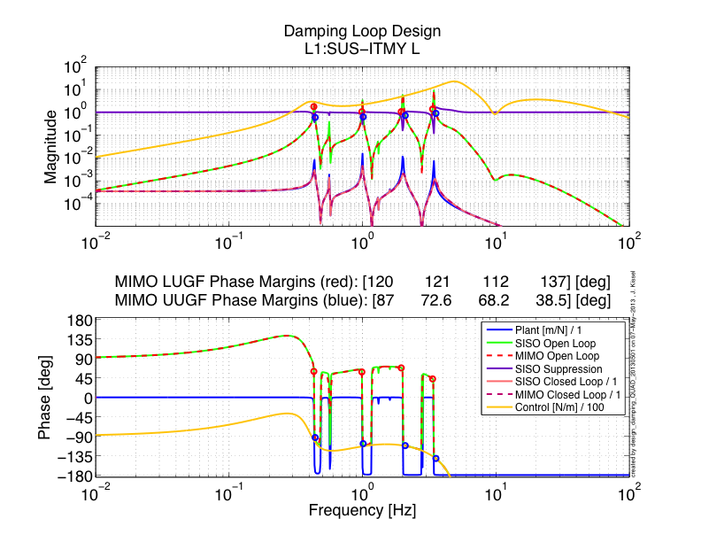
Damping Loop Design
Stability (New Filters)
Plant:
SISO Model = P_{L}
Controller:
SISO Model = K_{L}
Not-so-high-Q Elliptic Filter
Boost on low-frequency modes to reduce RMS
Open Loop Gain TF:
SISO Model = P_{L} * K_{L}
MIMO Model = Full
State Space System
Elliptic first, then rolloff
Suppression:
SISO Model = 1 / (1 - G_{L})
Close Loop Gain:
SISO Model = P_{L} / (1 - G_{L})
MIMO Model = Full State
Space System
Not just velocity damping anymore:
[z:p]=[~1:~10] Hz pair for more phase with which to play
Unconditionally Stable

Slide 5
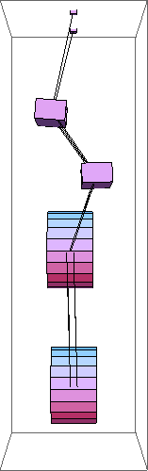
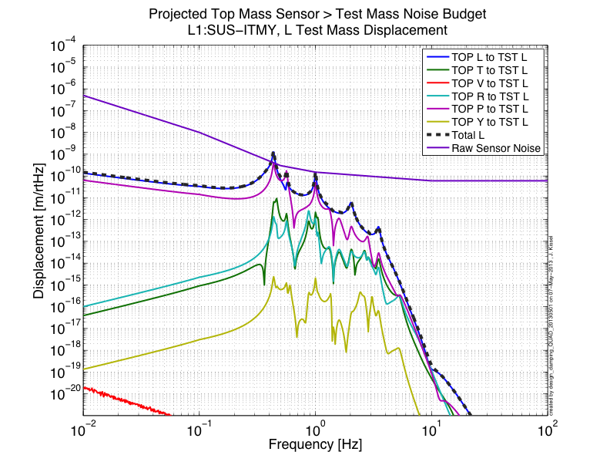
Damping Loop Design
All DOF’s TOP Sensor Noise Contribution (New Filters)
When you start carving out the L contribution to L Test Mass Motion, P, R, and T’s contribution are there waiting for you too!
T and R loops are harder to design, because their last resonances are higher in frequency, so can’t be as aggressive with noise roll-off
Sensor noise contributions to L Test Mass Motion @ 10Hz [m/rtHz]:
L2L = 2.0e-19
R2L = 1.1e-19
P2L = 8.7e-20
T2L = 5.0e-20
L Reqs = 1e-20
4th “L” resonsance is a mess of L, T, R, and P

Slide 6
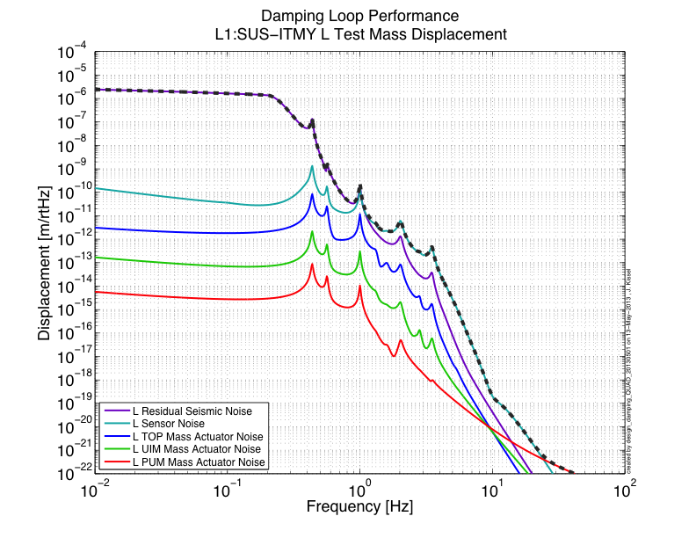
Damping Loop Design
Compare with other Noises (New Filters)
Residual Seismic Noise
Dominates below 1 Hz
Longitudinal BOSEM Sensor Noise still dominates between 1-30 Hz
Now only a factor of 5-10 away from residual seismic, instead of 500-1000
But…
PUM Actuator Noise finally takes over at 30 Hz

Slide 7
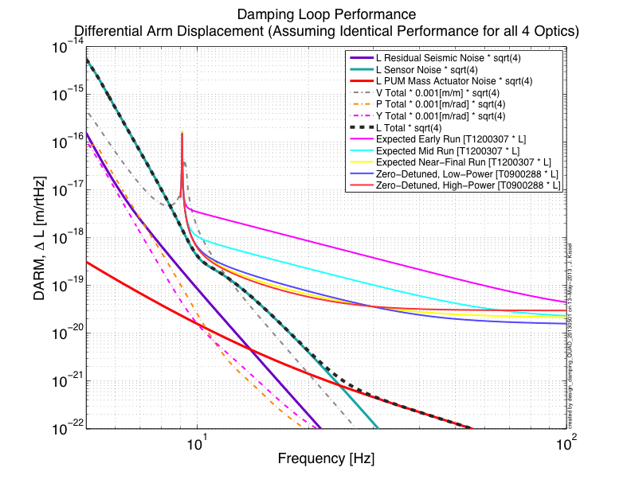
Damping Loop Design
Compare with Cavity Displacement (New Filters)
Vertical DOF is also dominated by sensor noise at 10 Hz, and could play a role assuming the 0.001 [m/m] coupling over the 4km arms

Slide 8
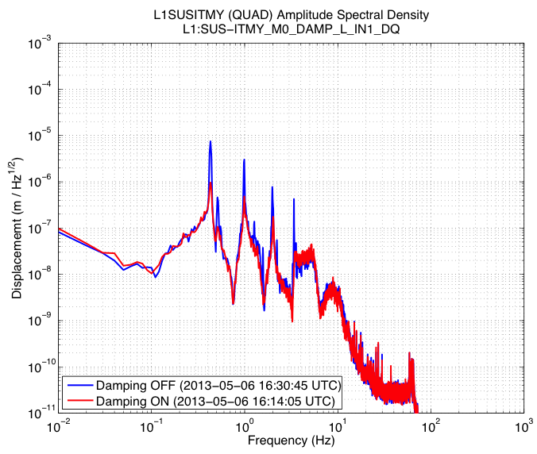
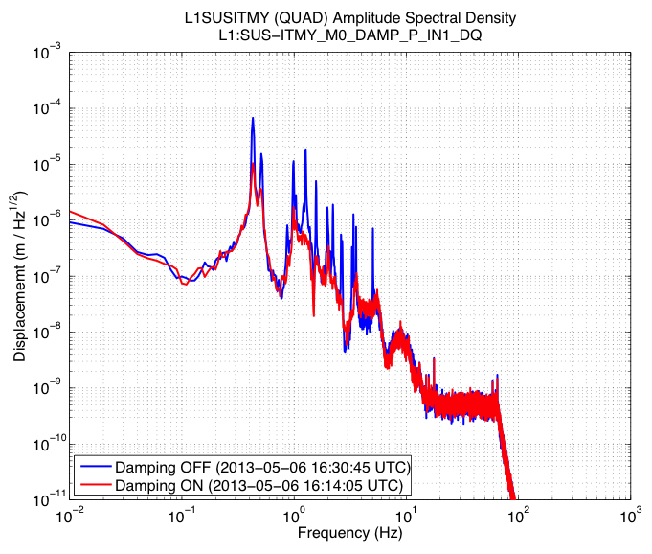
TOP Mass ON/OFF Spectra
(New Filters)
Longitudinal
Lowest L/P Modes gave us grief in the H2OAT
10⁻⁵ [rad]
0.43 Hz
0.43 Hz
0.56 Hz
Pitch
0.56 Hz
BUT, ISI is only damped in this measurement, so we’ll probably be fine (as we were once the l.f. performance of the ISIs were tuned)

Slide 9
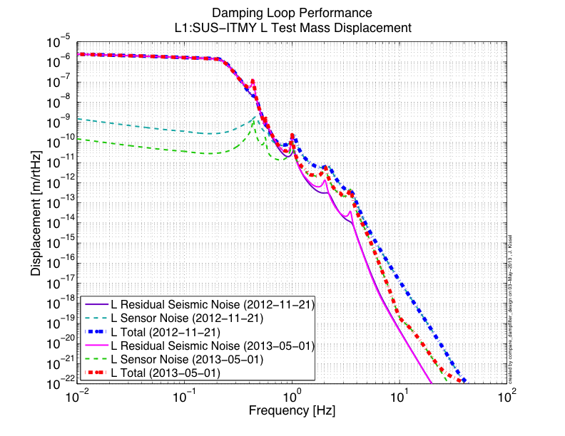
Level 1 vs.Level 2
Old 0.43 Hz mode from Res. Seis. is squashed entirely
New 0.43 Hz mode from Res. Seis. has a Q of ~10-50, but still not dominating the RMS
Old Sensor Noise takes over at ~0.5 Hz
New Sensor Noise takes over at ~1.0 Hz
New Sensor Noise is a factor of ~5 better than Old Sensor Noise in between resonces
Old Sensor Noise is 1.3e-17 [m/rtHz]@ 10Hz
New Sensor Noise is 2.0e-19 [m/rtHz]@ 10Hz

Slide 10
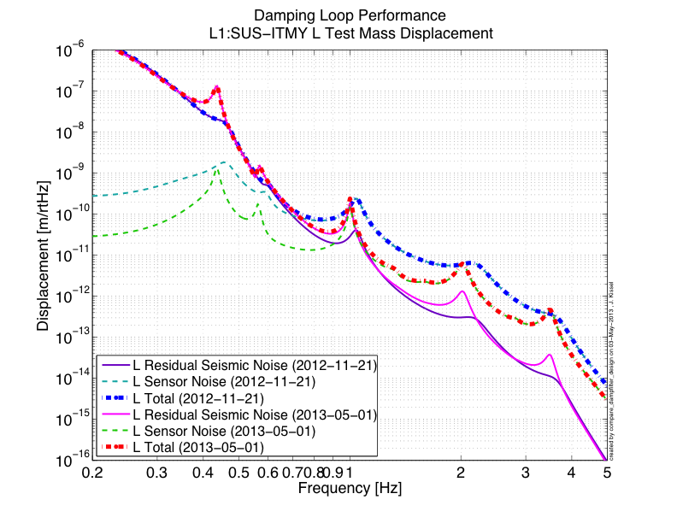
Level 1 vs.Level 2
Old 0.43 Hz mode from Res. Seis. is squashed entirely
New 0.43 Hz mode from Res. Seis. has a Q of ~10-50, but still not dominating the RMS
Old Sensor Noise takes over at ~0.5 Hz
New Sensor Noise takes over at ~1.0 Hz
New Sensor Noise is a factor of ~5 better than Old Sensor Noise in between resonces

Slide 11
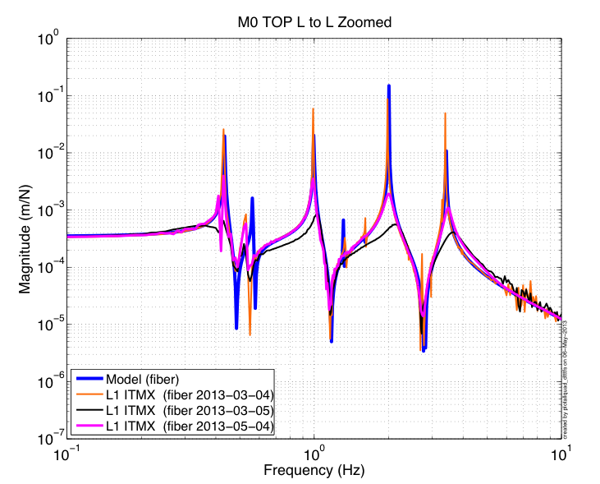
Level 1 vs.Level 2
TOP to TOP Mass Transfer Function
Model
No Damping
New Filters
Qs of resonances increased only by a factor of ~10
Old Filters

Slide 12

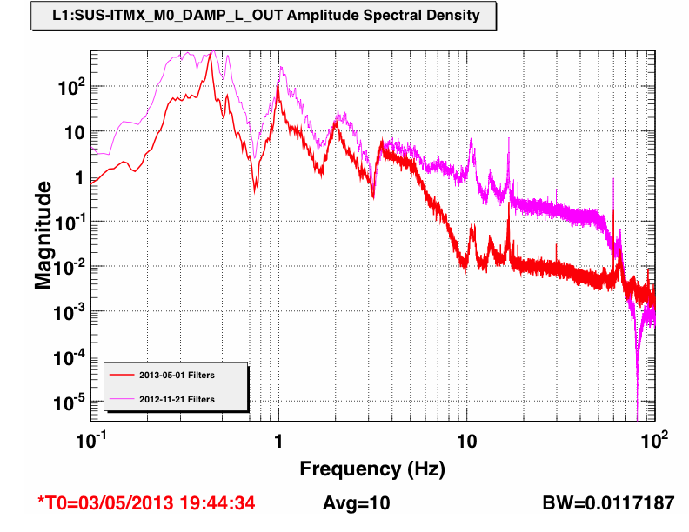
Level 1 vs.Level 2
Can’t measure Test Mass noise improvement directly yet…
If sensor noise dominates above 1 Hz both before and after, then TOP control signal should be ~100 times less at 10 Hz.
And it is!

Slide 13
Remaining Questions
Is it worth keeping Level 1 around?
  (As I installed it at L1 ITMs, I removed Level 1)
Tradition to have the overall gain “tunable” as an EPICs variable. Should it be absorbed in the filter banks?
Would like to look into
  Stability of loops if gains are increased to improve ring-down-time (more tradition)
  Should build infrastructure / standard plot for quantifying ring down

Slide 14

Bonus Material For the Curious
Remember, for even more text, plots, details see LLO aLOG 6949

Slide 15
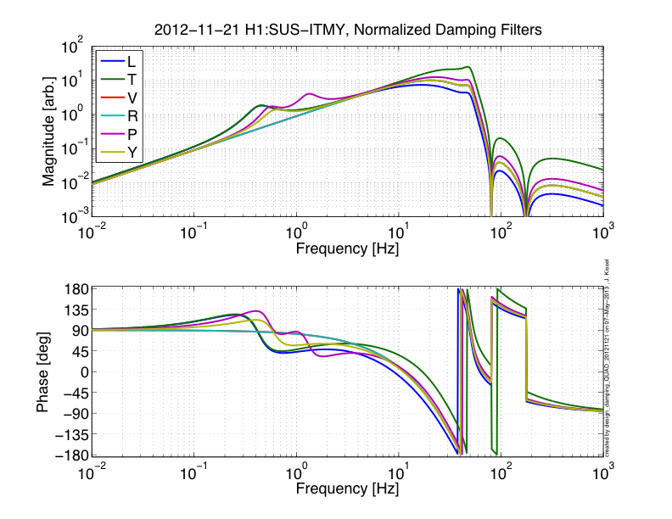
Damping Loop Design
OLD Filters

Slide 16
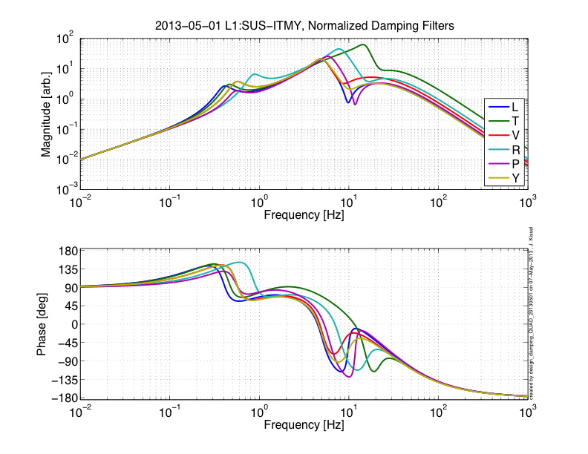
Damping Loop Design
NEW Filters

Slide 17
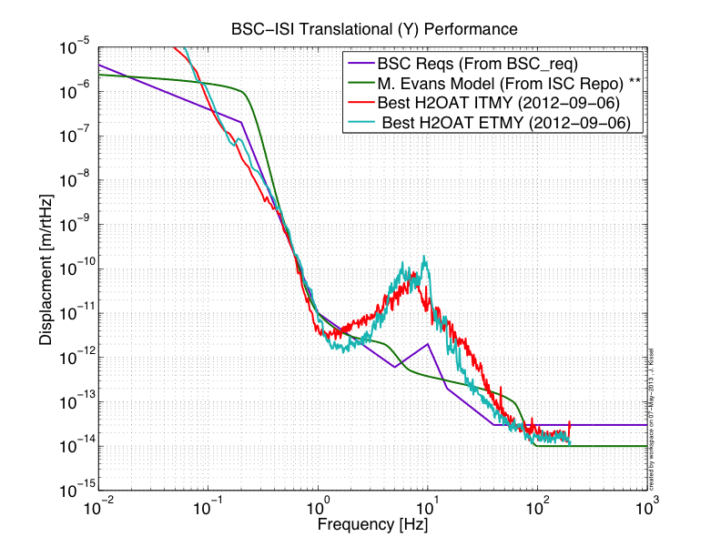
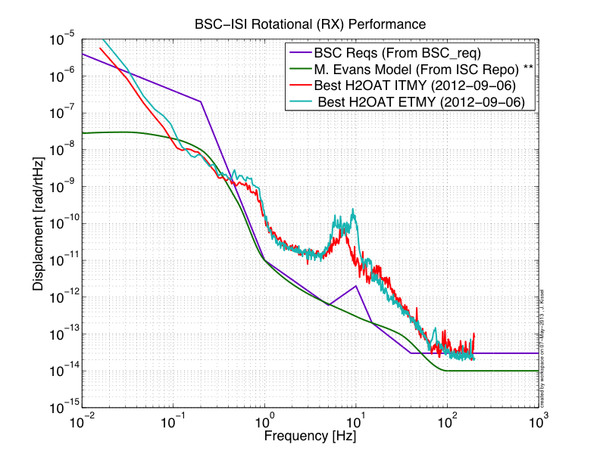
Seismic Input Motion
In the absence of real, best-possible performance data from the BSC-ISIs, there are a few choices for Residual Ground Input Motion to the QUAD:
- Use the Requirements for all DOFs
- Use M. Evans’ Model of the “Translation” (same for X, Y, Z) and “Rotational” (same RX, RY, RZ)
- Use not-yet-awesome, but real H2OAT data (different for every DOF, and even between ISIs)
We know every degree of freedom will be different, so I don’t like using the Reqs.
We know the very low frequency data of the H2OAT data is all tilt (if not sensor noise), and we know the mid-frequency band will be better
So I went with Matt’s Model since it seems to fold in the most (optimistic?) realism

Slide 18
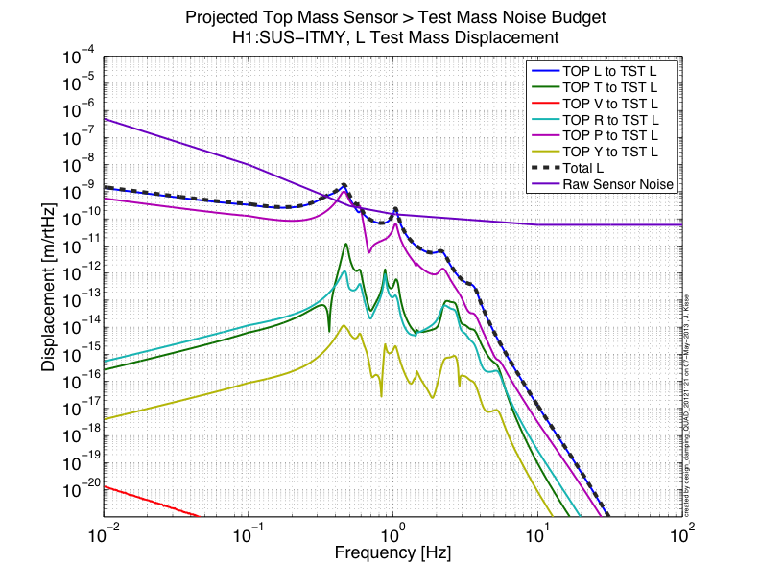
Damping Loop Design
All DOF’s TOP Sensor Noise Contribution (Old Filters)
Sensor noise contributions to L Test Mass Motion @ 10Hz [m/rtHz]:
L2L = 1.3e-17
P2L = 3.1e-18
R2L = 2.8e-19
Reqs = 1e-20

Slide 19
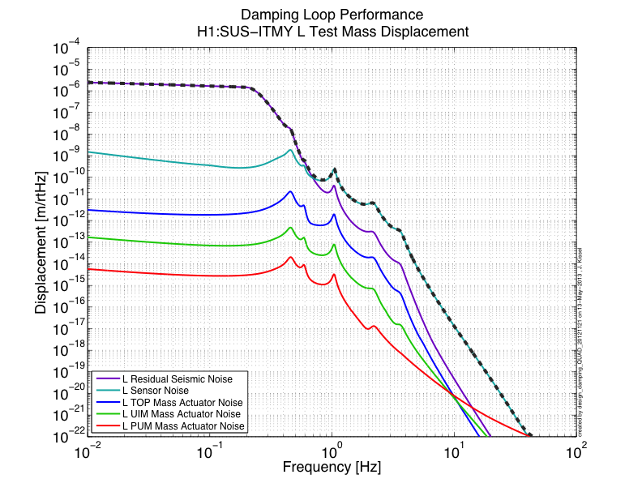
Damping Loop Design
Compare with other Noises (Old Filters)

Slide 20
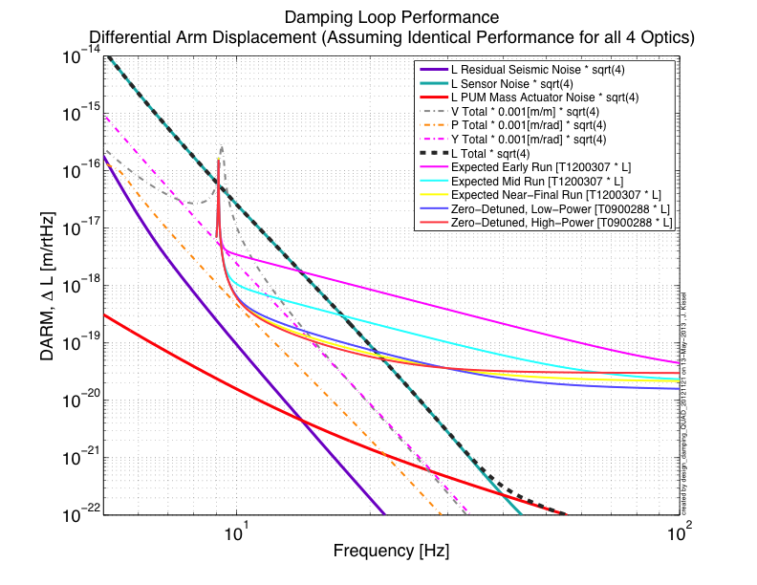
Damping Loop Design
Compare with Cavity Displacement (Old Filters)

Slide 21
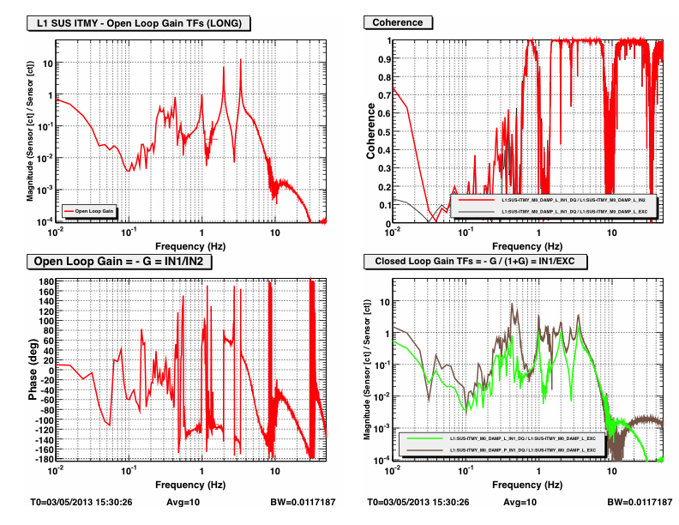
Measured Open Loop Gain TF
(New Filters)

Slide 22
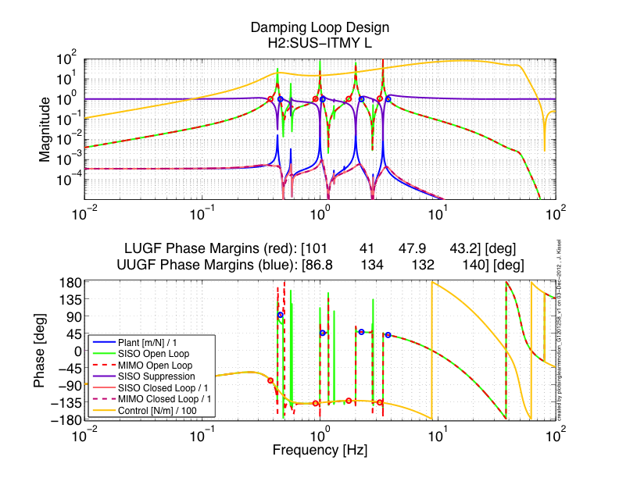
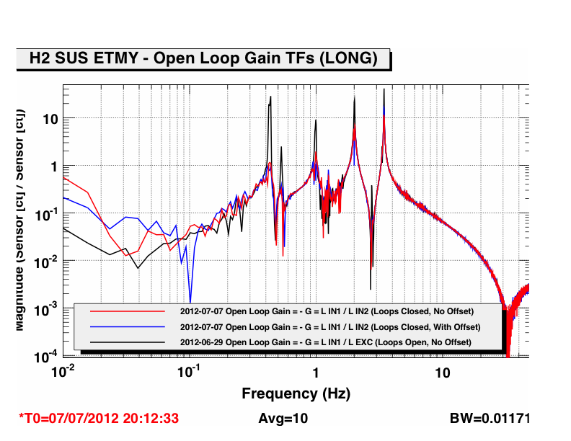
Damping Loop Design
Proof that MIMO Matters!!
SISO Model
MIMO Model

Slide 23
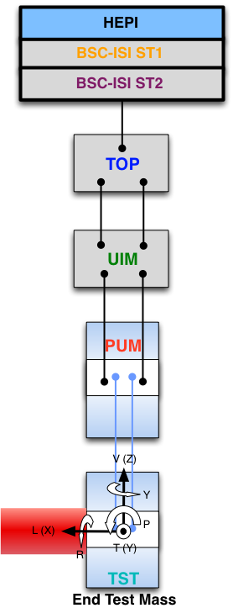
QUAD Performance Modeling
All the bits and pieces
Suspension Point
Residual Seismic Noise
Damping Loop
Design
Top Mass
Sensor Noise
Actuator Noise
Steps to computing test mass motion:
Measure / compute every DOF of input noise at every stage
Propogate each stage input DOF to single test mass DOF of interest for cavity (i.e. longitudinal) using SUS model
Add each stage’s input DOF contribution in quadrature
UI Mass
Actuator Noise
PU Mass
Actuator Noise
Test Mass
Displacement

