Slide 1
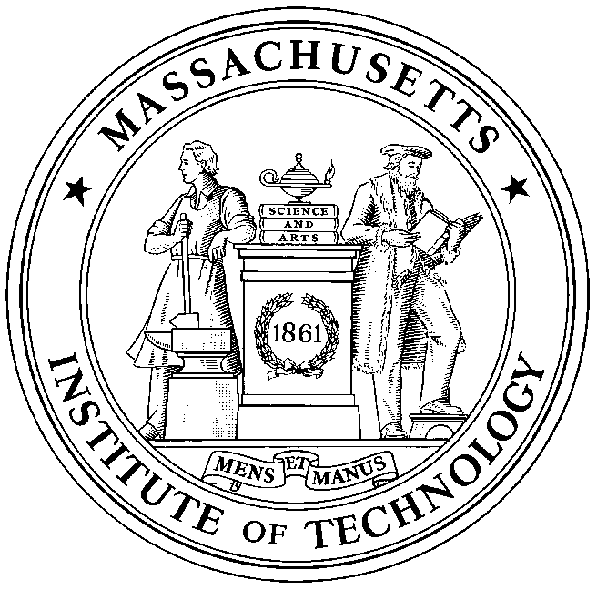
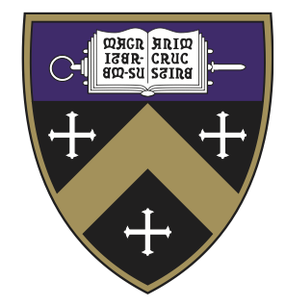
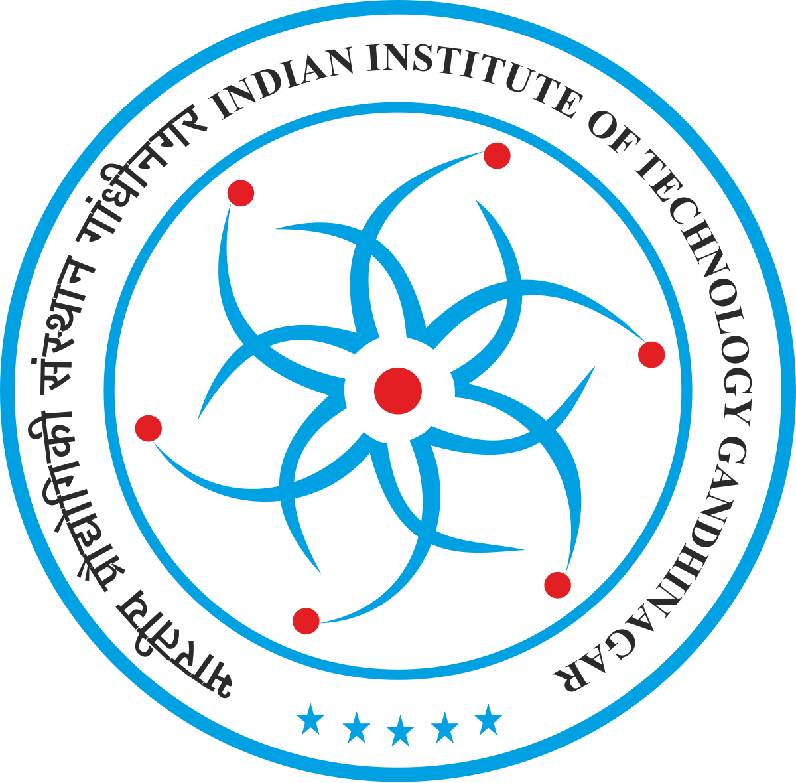
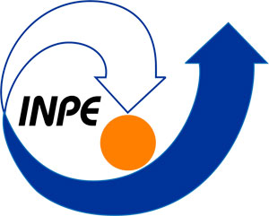
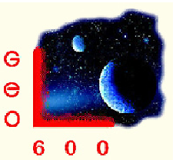
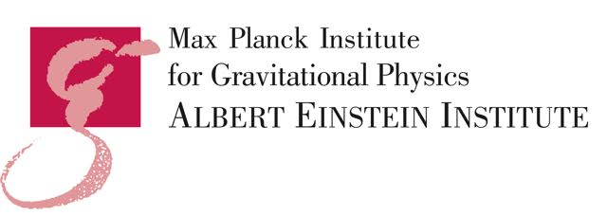
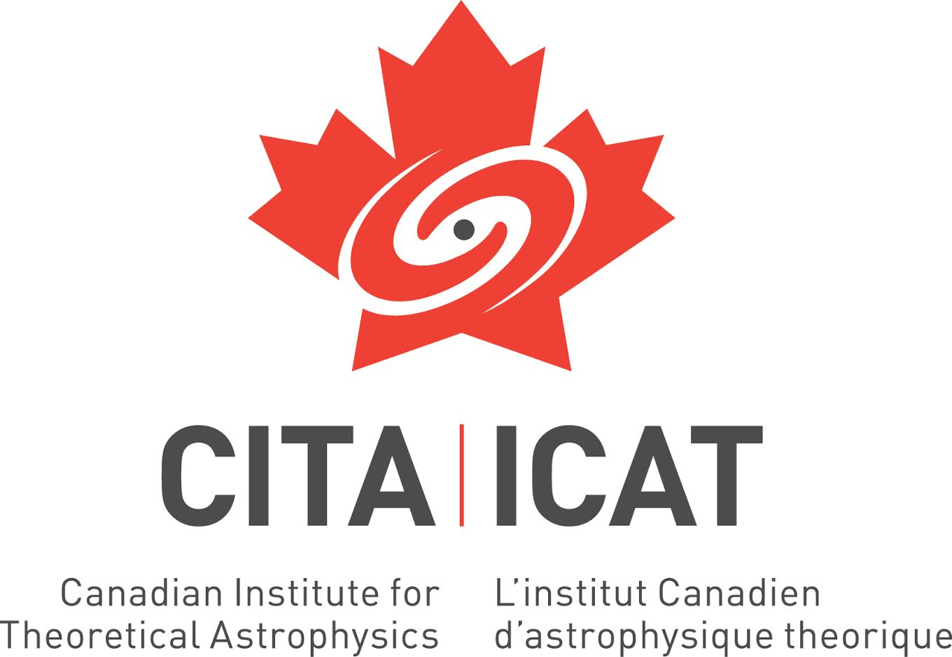
LIGO Scientific
Collaboration
Abilene Christian University
Albert-Einstein-Institut
American University
Andrews University
Bellevue College
California Institute of Technology
California State Univ., Fullerton
California State Univ., Los Angeles
Canadian Inst. Th. Astrophysics
Carleton College
Chinese University of Hong Kong
College of William and Mary
Colorado State University
Columbia U. in the City of New York
Cornell University
Embry-Riddle Aeronautical Univ.
Eötvös Loránd University
Georgia Institute of Technology
Goddard Space Flight Center
GW-INPE, Sao Jose Brasil
Hillsdale College
Hobart & William Smith Colleges
IAP – Nizhny Novogorod
IIP-UFRN
Kenyon College
Korean Gravitational-Wave Group
Louisiana State University
Marshall Space Flight Center
Montana State University
Montclair State University
Moscow State University
National Tsing Hua University
NCSARG – Univ. of Illinois,
Urbana-Champaign
Northwestern University
Penn State University
Rochester Institute of Technology
Sonoma State University
Southern University
Stanford University
Syracuse University
Texas Tech University
Trinity University
Tsinghua University
U. Montreal / Polytechnique
Université Libre de Bruxelles
University of Chicago
University of Florida
University of Maryland
University of Michigan
University of Minnesota
University of Mississippi
University of Oregon
University of Sannio
University of Szeged
University of Texas Rio Grande Valley
University of the Balearic Islands
University of Tokyo
University of Washington
University of Washington Bothell
University of Wisconsin – Milwaukee
USC – Information Sciences Institute
Villanova University
Washington State University – Pullman
West Virginia University
Whitman College
LIGO Laboratory: California Institute of Technology; Massachusetts Institute of Technology;
LIGO Hanford Observatory; LIGO Livingston Observatory
Australian Consortium for Interferometric Gravitational Astronomy (ACIGA):
Australian National University; Charles Sturt University; Monash University; Swinburne University; University of Adelaide; University of Melbourne; University of Western Australia
German/British Collaboration for the Detection of Gravitational Waves (GEO600):
Albert-Einstein-Institut, Hannover; Cardiff University; King's College, University of London; Leibniz Universität, Hannover; University of Birmingham; University of Cambridge;
University of Glasgow; University of Hamburg; University of Sheffield; University of Southampton; University of Strathclyde; University of the West of Scotland; University of Zurich
Indian Initiative in Gravitational-Wave Observations (IndIGO):
Chennai Mathematical Institute; ICTS-TIFR Bangalore; IISER Pune; IISER Kolkata; IISER-TVM Thiruvananthapuram; IIT Madras, Chennai; IIT Kanpur;
IIT Gandhinagar; IPR Bhatt; IUCAA Pune; RRCAT Indore; University of Delhi

