Slide 1
Progress on Acoustic Mode Damper design
Slawek Gras, 2013
S.Gras LVC meeting, Bethesda 2013

Slide 2
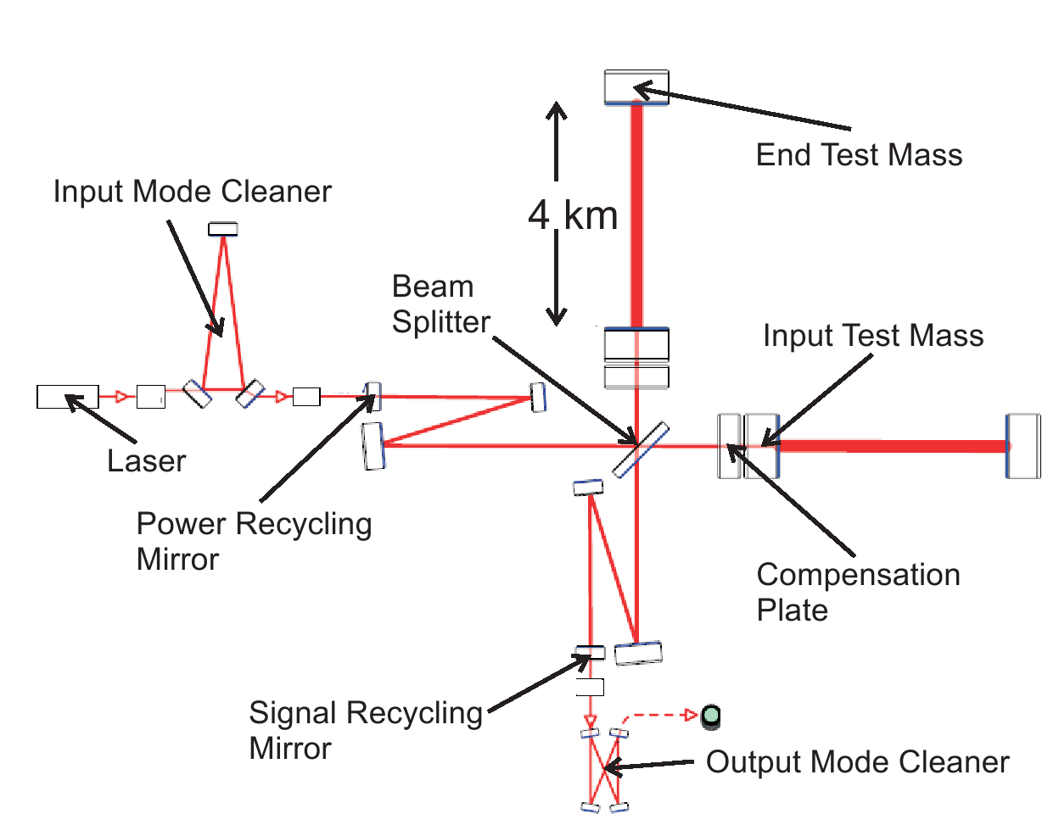
High power interferometer
Courtesy of G. Harry
S.Gras LVC meeting, Bethesda 2013

Slide 3
Parametric Instability
Parametric Instability as
a feedback loop:
Two processes present in the loop:
1. Test mass mechanical mode scatters fundamental mode (pump) into the higher order mode
2. After round trip scattered mode returns to the test mass and couples via radiation pressure into the mechanical mode
Courtesy of R. Adhikari
Feed back loop gain (R) describes the dynamic of the system:
- Gain > 1 energy is pumped in to the test mass -> positive feed back - > Parametric Instability
- Gain < 0 energy is extracted from the test mass -> negative feed back-> TM cooling process
S.Gras LVC meeting, Bethesda 2013

Slide 4
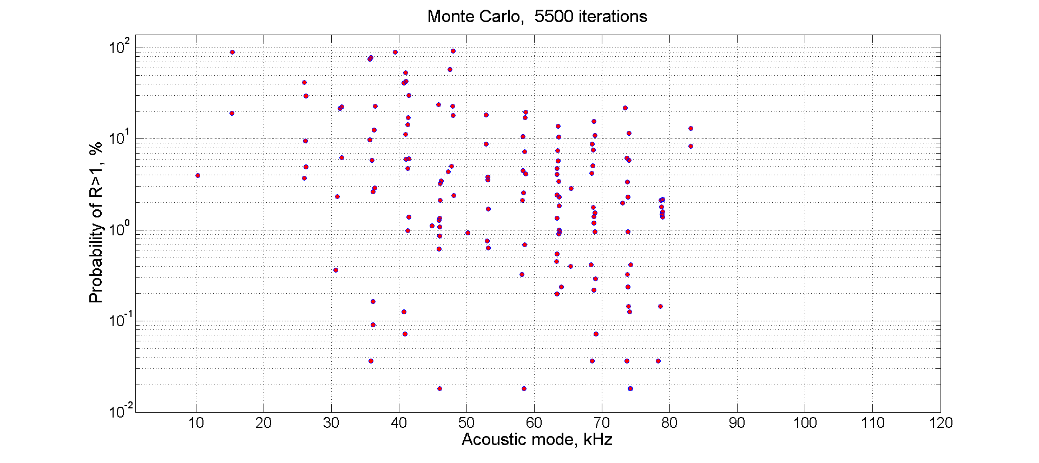
PI in Advanced LIGO
Unstable modes can occur in the frequency range 10- 90 kHz.
Initial results! Possibly overestimated statistics due to the small population.
Nevertheless, parametric instability cannot be ignored.
S.Gras LVC meeting, Bethesda 2013

Slide 5
Parametric gain
Optical power in the arm cavities
~ 830 kW
Test mass
Q-factor
~ 1e+7
Overlapping parameter
(spatial matching)
< 0.01
Detuning parameter
(frequency matching)
~ 0
different
TM topology, coating?
lower power ?
lower Q?
doesn’t solve the problem
Yes, we think we can
but... can help
S.Gras LVC meeting, Bethesda 2013

Slide 6
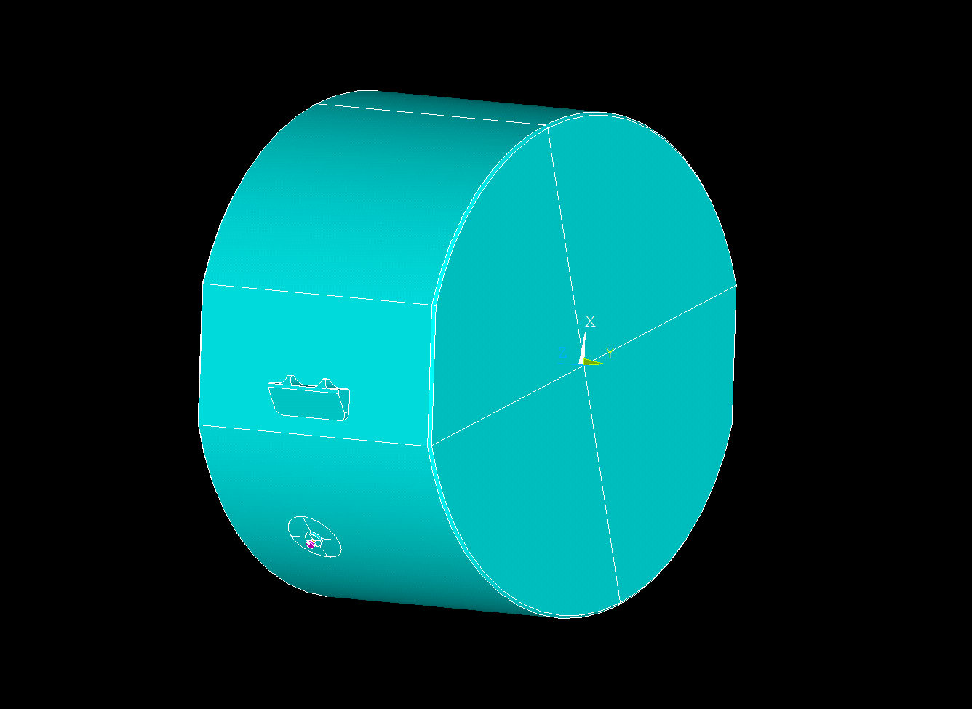
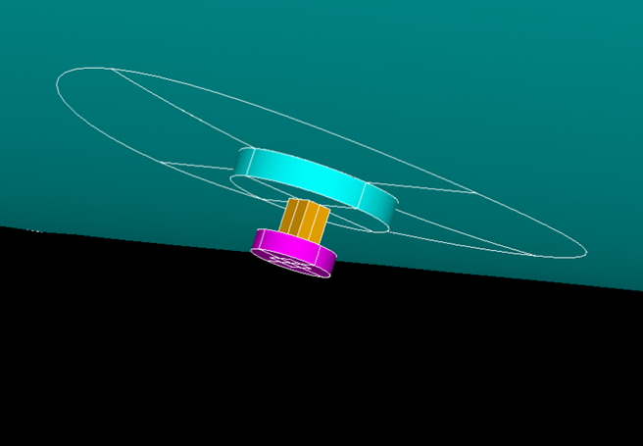
Let’s stick something lossy to the test masses
Danger: adding lossy element to the test mass can cause thermal noise elevetaion of the detectot.
What if we can control the loss value in the frequency domain?
-> minimizes effect on thermal noise in the detection band.
Objectives:
1) Damping in the frequency range 10-90 kHz.
2) Minimum 10 -fold Q-factor reduction .
3) Negligible thermal noise degradation in 10 – 1000 Hz,
negligible = < 1% detector strain degradation.
S.Gras LVC meeting, Bethesda 2013

Slide 7
Damping mechanism
By adding a lossy element to the test mass , the effective loss factor of the test mass + lossy element can be increased.
The loss factor η of the system can be visualized as a weighted of the loss factors of the parts with stored energies as weighted constants.
A highly dissipative element cannot contribute significantly to the total loss factor if it does not participate considerably in the total strain energy.
If a damper is in the form of a resonator, high E can be obtained despite of high loss factor of the damper -> better damping performance.
On the other hand, thermal noise is proportional to W - the averaged energy dissipation. Therefore is required to keep η as low as possible at 10 – 1000 Hz.
S.Gras LVC meeting, Bethesda 2013

Slide 8
Acoustic mode damper (AMD)
PZT/Piezo crystal
Reaction mass
R
Heat
RI²
Electrical conductive epoxy
(+C,L)
Base
Epoxy
TEST MASS
S.Gras LVC meeting, Bethesda 2013

Slide 9
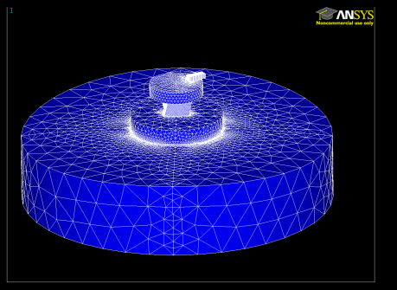
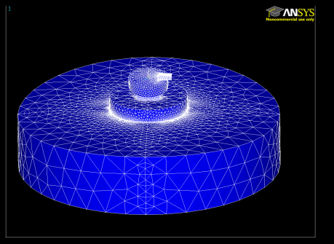
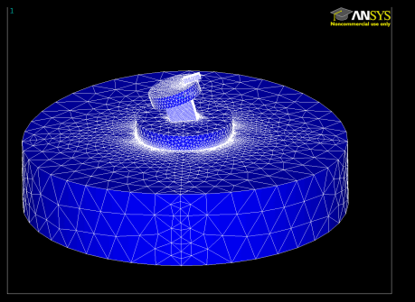
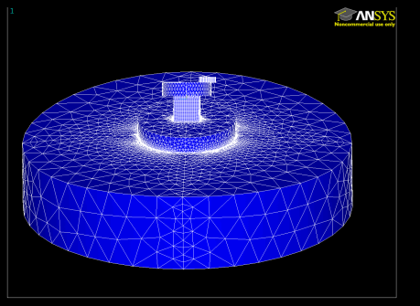
AMD resonances
6 resonant AMD modes available to extract energy from test mass: 12 kHz – 65 kHz
R-mode
C-mode
Rotation
Compression
Fx-mode
Fy-mode
2 x Flag-poles
aFx-mode
aFy-mode
2 x antiFlag-poles
S.Gras LVC meeting, Bethesda 2013

Slide 10
Active direction of piezo material
Mode 15
Mode 31
Mode 33
σ
σ
electrode
σ
σ
σ
σ
compression
bending
piezo
shear
Careful design of electronic circuit allows controlling piezo element mechanical properties to the desired values.
~
external
impedence
C
R,I,C
S.Gras LVC meeting, Bethesda 2013

Slide 11
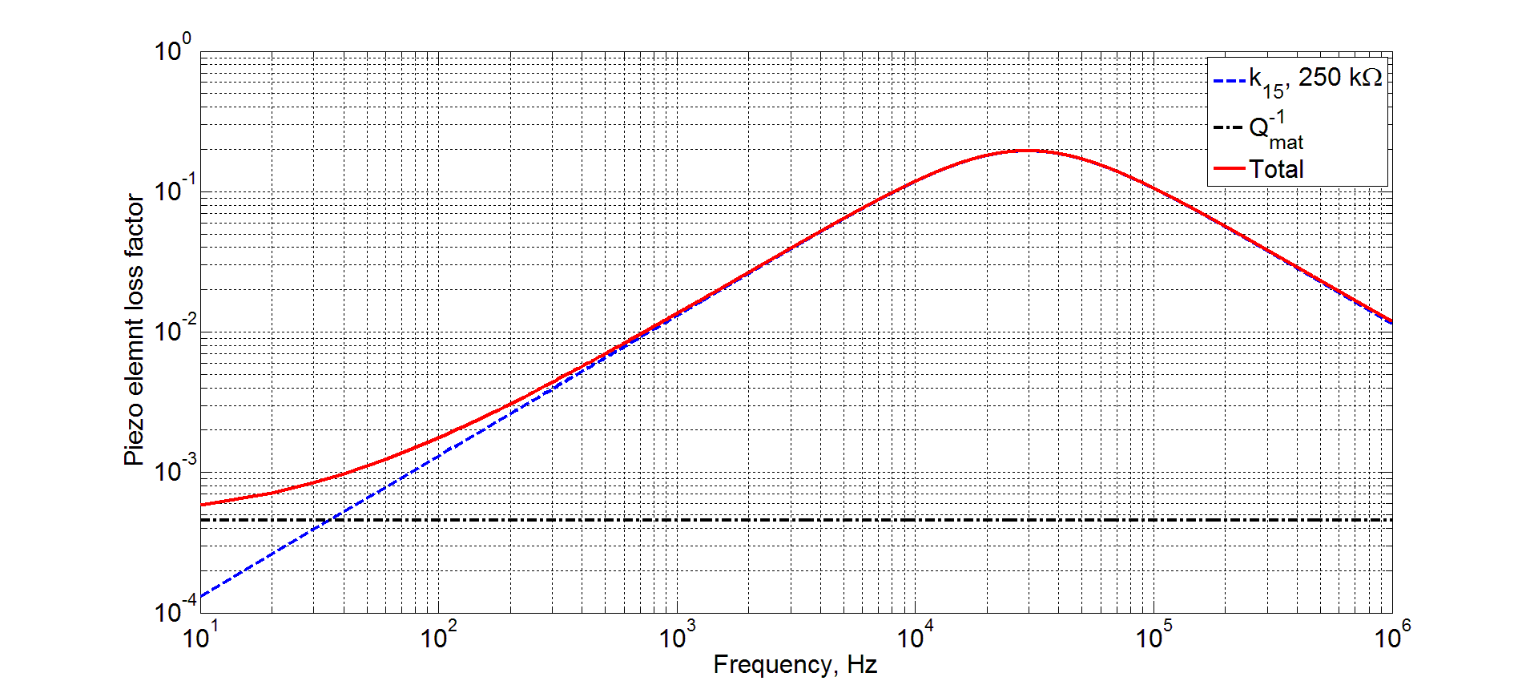
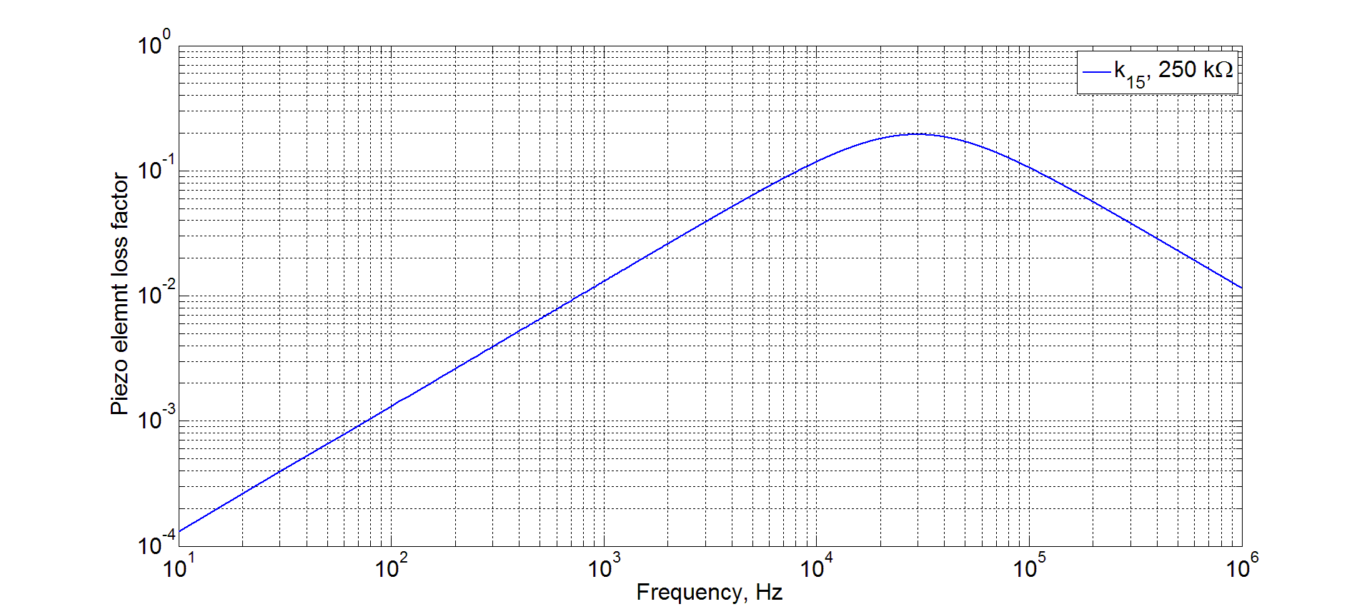
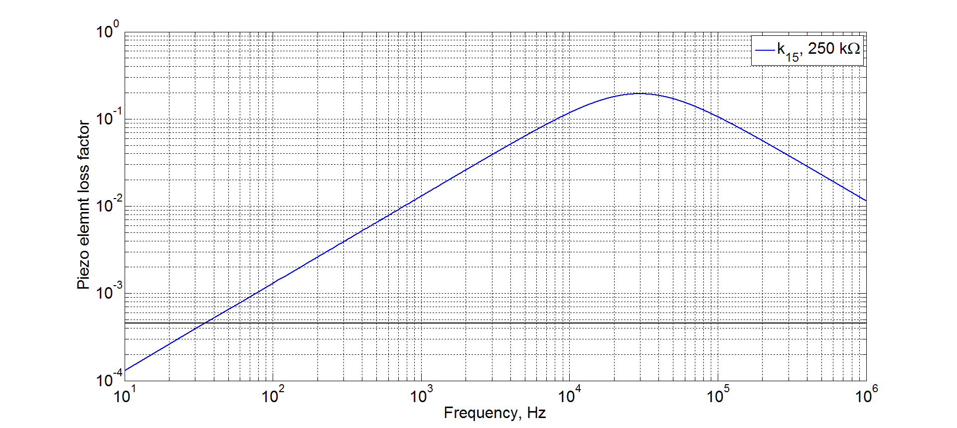
Piezo element loss factor
high R
low R
high k
low k
k – electromechanical coupling coefficient,
R - resistor
S.Gras LVC meeting, Bethesda 2013

Slide 12
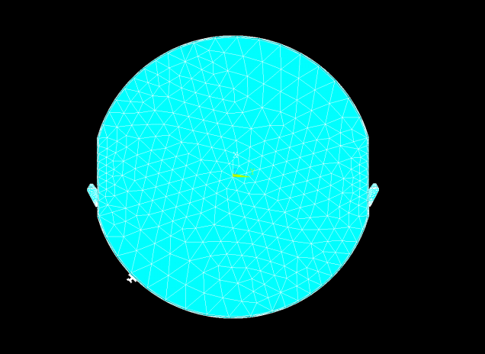
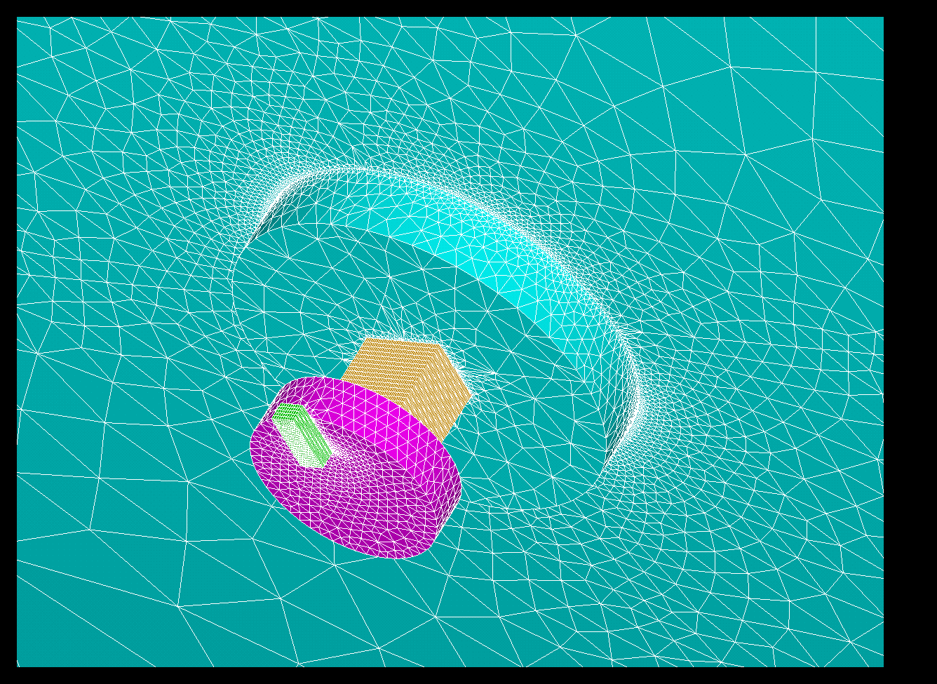
Thermal noise
Epoxy
AMD
Finite element modeling is used for thermal noise analysis.
S.Gras LVC meeting, Bethesda 2013

Slide 13
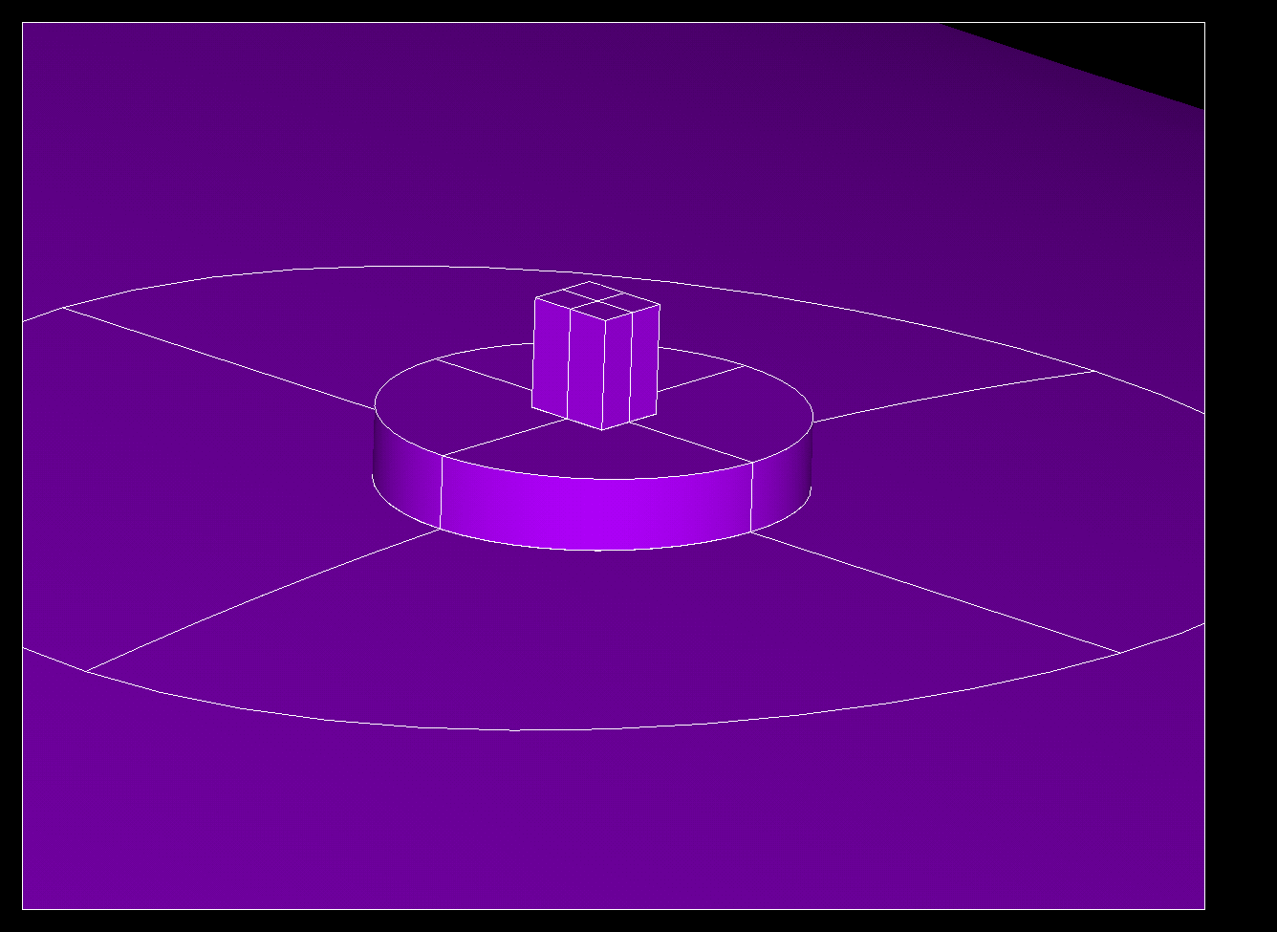
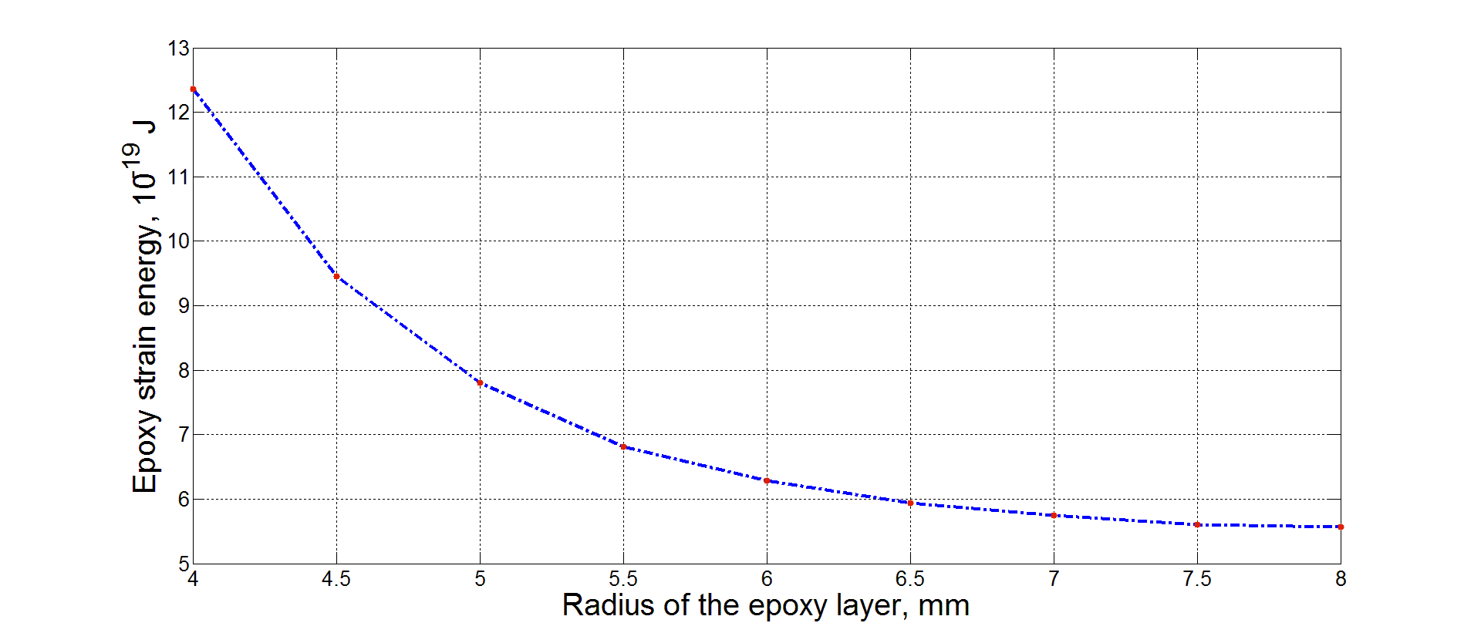
Epoxy area
Epoxy thickness = 4μm
Top mass area = 3x3 mm^2
Small epoxy area is more dissipative.
S.Gras LVC meeting, Bethesda 2013

Slide 14
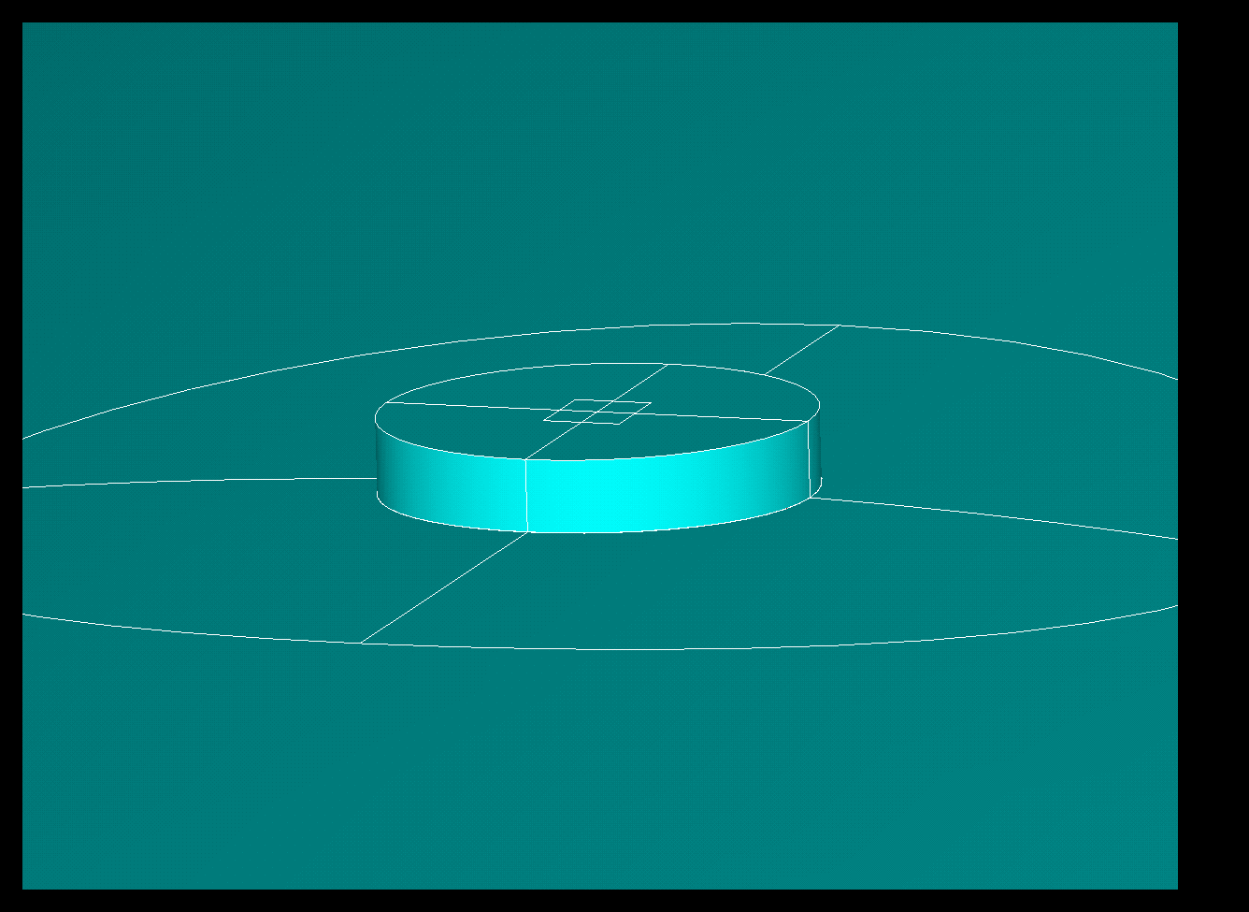
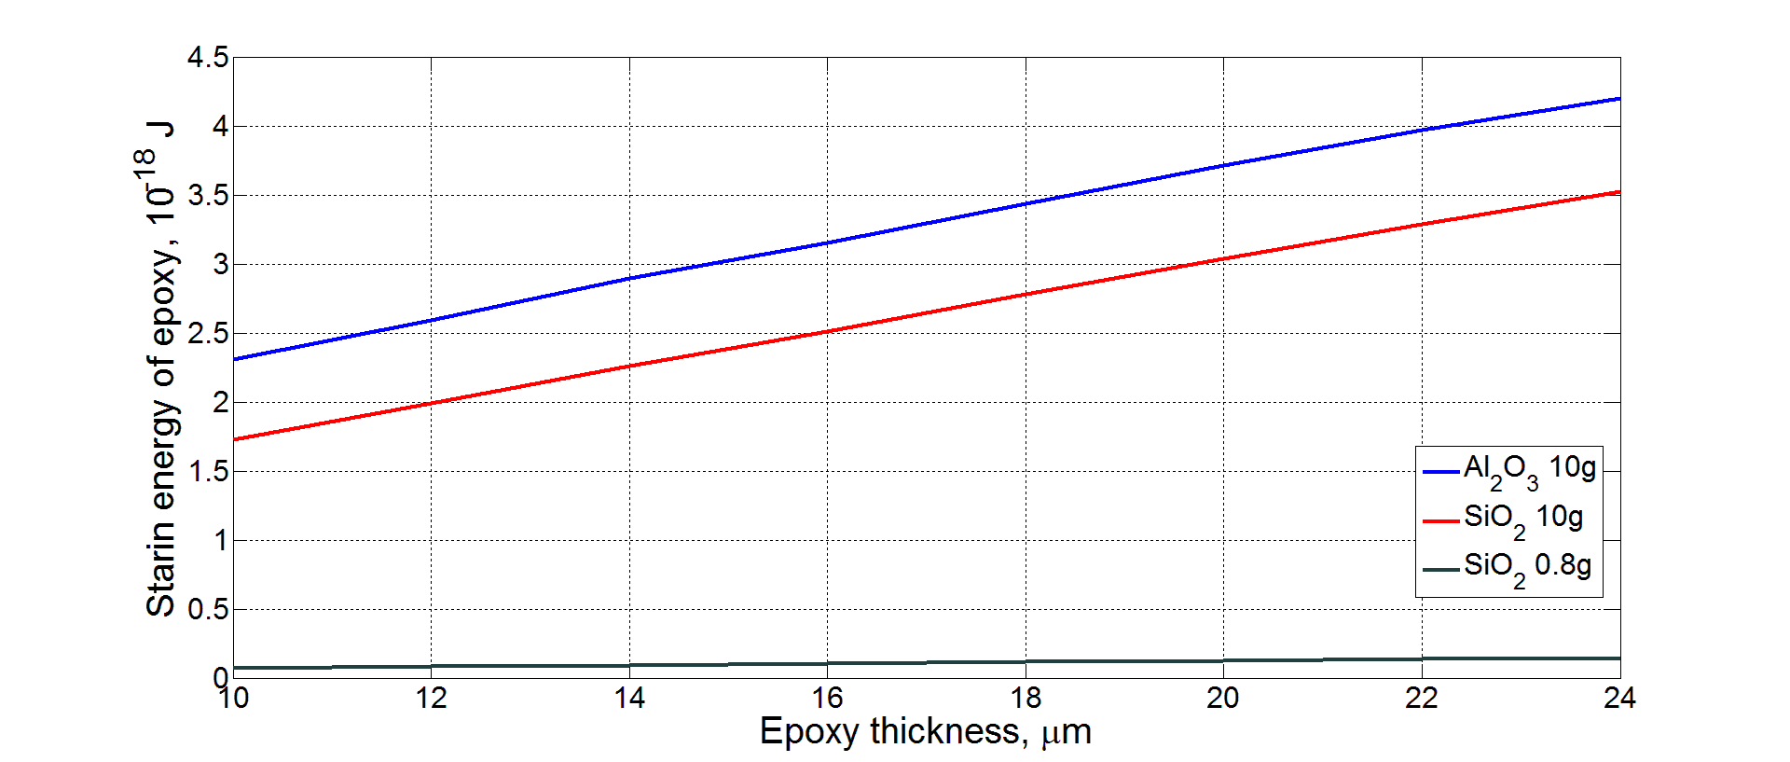
Epoxy thickness
1) Epoxy thickness scales linearly with energy dissipation.
2) Inertia effect has significant impact on energy dissipation.
S.Gras LVC meeting, Bethesda 2013

Slide 15
Thermal noise analysis
Specification:
Piezo element dimenssions:
Test Mass: ITM,
Piezo manufacturer: Physics Instruments,
Q-factor: 2200,
k15 = 0.63,
R = 250 kΩ,
Polarization: perpendicular to the laser beam
Base diameter: 120 mm
Reaction mass: 1g
AMD location: 130 mm from the front face
No of AMDs: 1 AMD per TM
2.0 mm
2.5 mm
3.0 mm
3.0 mm
2.0 mm
S.Gras LVC meeting, Bethesda 2013

Slide 16
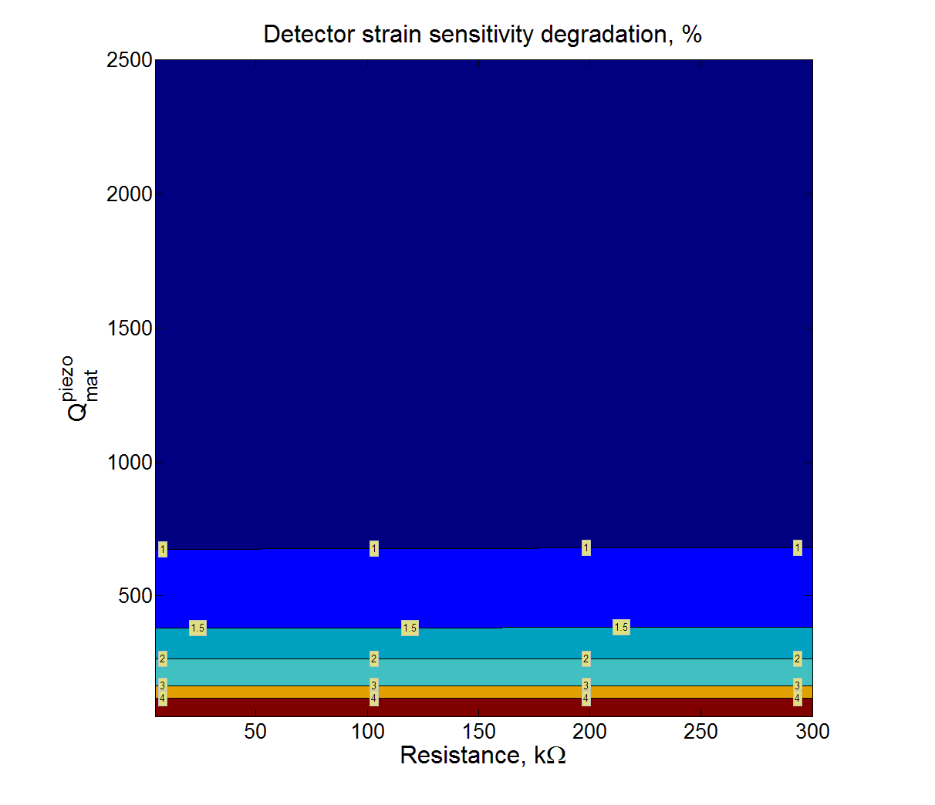
Shear AMD
0.055%
Max degradation in the range 10 – 1000 Hz.
at
If 2 AMDs per TM
expected degradation is ~1.0%
S.Gras LVC meeting, Bethesda 2013

Slide 17
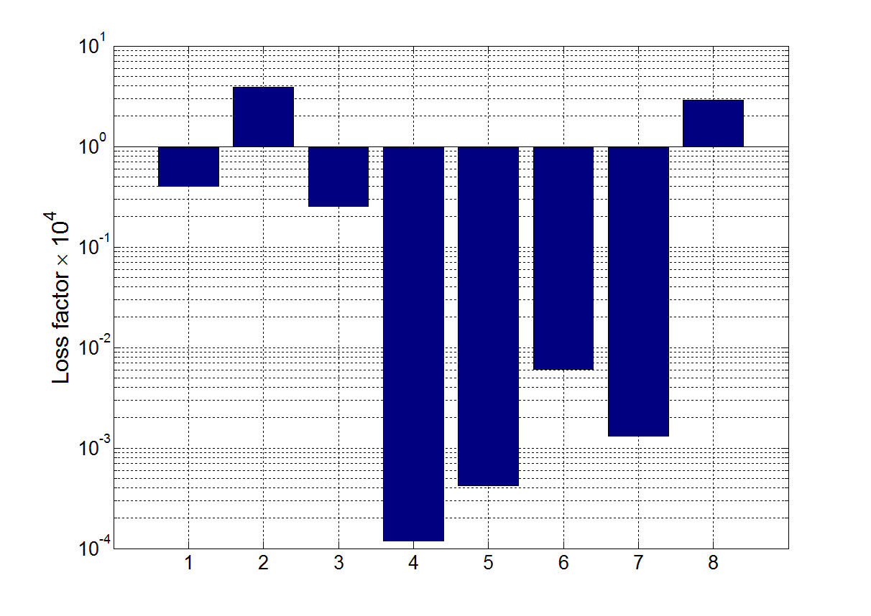
AMD loss budget at 300 Hz
-
1- epoxy TM-base (0.04)
2- epoxy base-piezo (0.04)
3- epoxy piezo-RM (0.04)
4- epoxy RM-Resistor (0.04)
5- Base (1e-7)
6- RM (1e-4)
7- Resistor (0.1)
8- Piezo (4.3e-3 at 300Hz)
dominant
TN source
S.Gras LVC meeting, Bethesda 2013

Slide 18
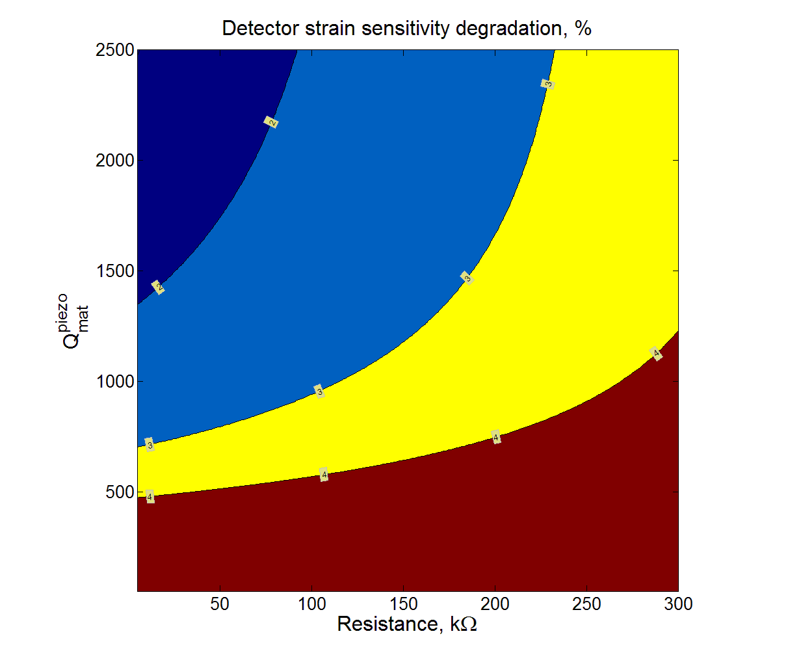
Compression AMD
Max degradation in the range 10 – 1000 Hz.
Orientation of polarization
S.Gras LVC meeting, Bethesda 2013

Slide 19
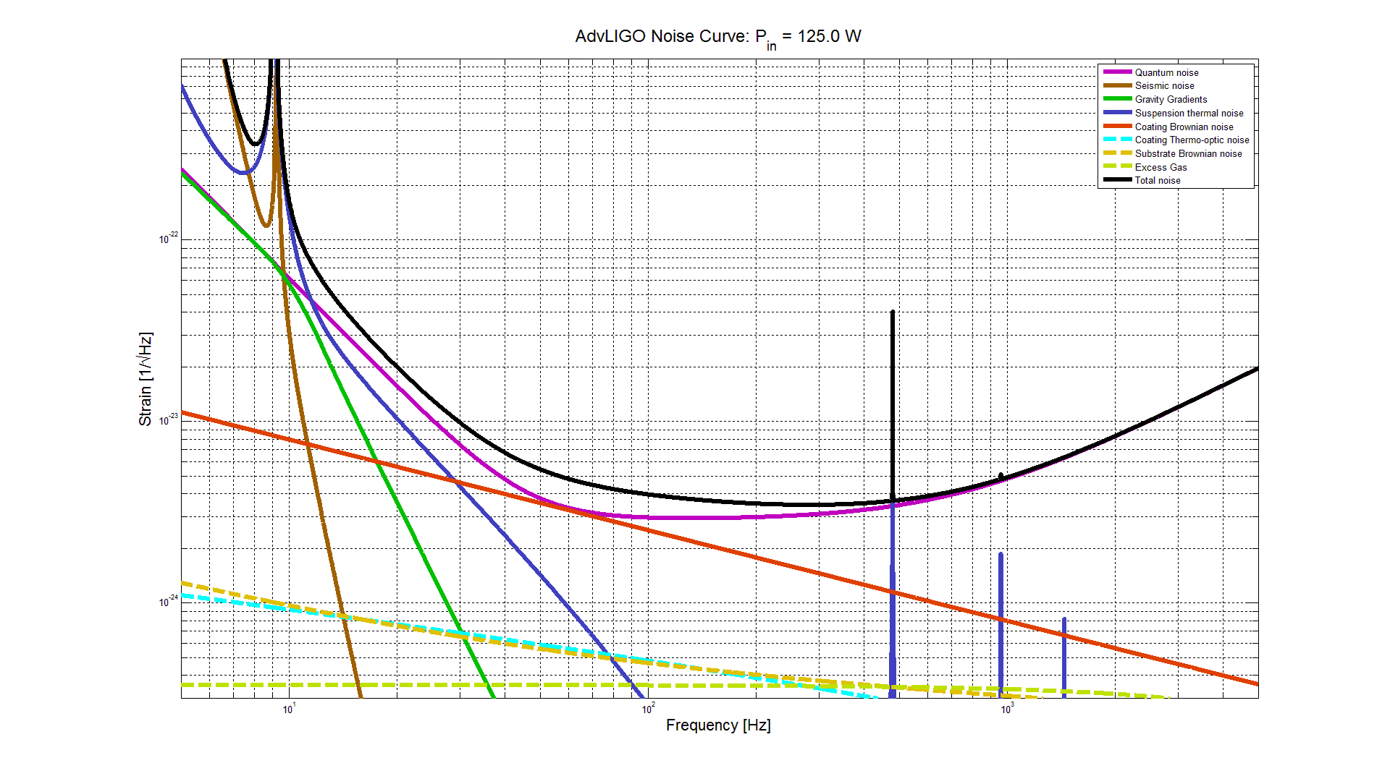
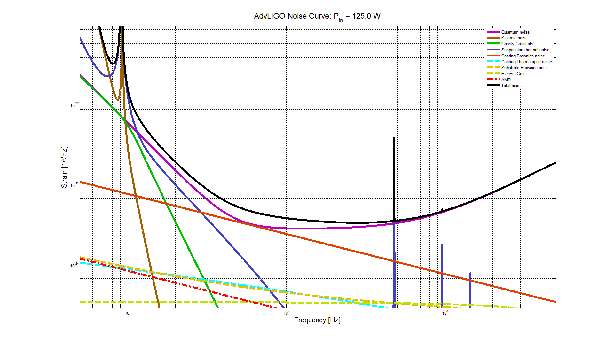
Advanced LIGO noise curve + AMD noise
S.Gras LVC meeting, Bethesda 2013

Slide 20
Conclusions
1) Analysied AMD configuration shows acceptable thermal noise level not exceeding 1% of the strain degradation
2) Dominant source of thermal noise is from epoxy layer between AMD base and piezo element,
3) Better choce of epoxy can further reduce influance of AMD on thermal noise,
4) High Q-factor shear piezo cermics is the best candidate for AMD,
5) AMD damping preformance analysis is required for final conclusion on AMD application for PI control.
S.Gras LVC meeting, Bethesda 2013

