Slide 1
Challenges in the High Frequency Region - Squeezing -
Lisa Barsotti, LIGO-MIT
GWADW2012 – Round Table
LIGO-G1200571

Slide 2
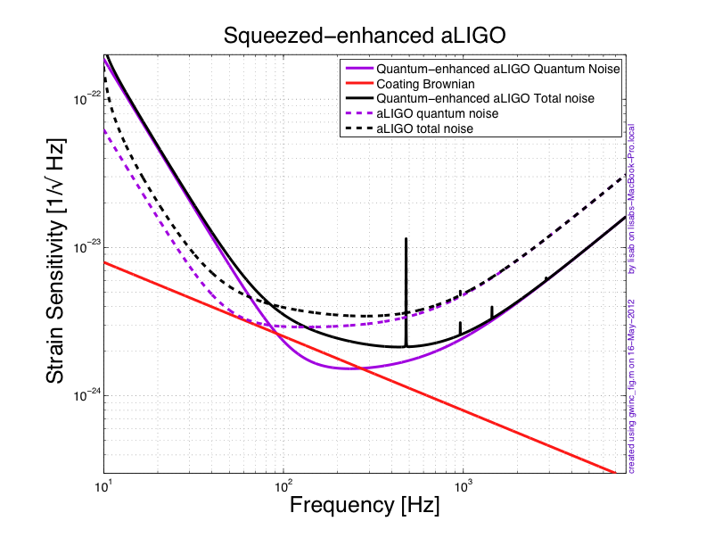
Quantum-Enhanced Advanced LIGO
6 dB measured
Same NS-NS as aLIGO,
better high frequency performance
LIGO-G1200571

Slide 3
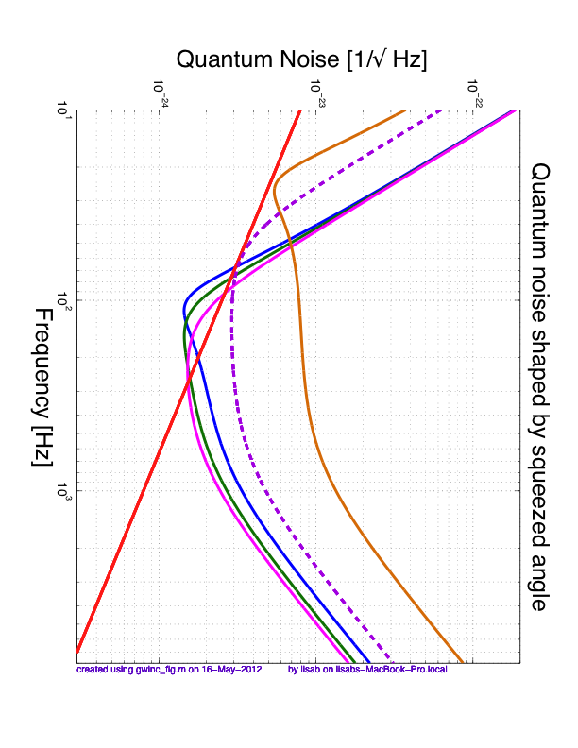
Still with frequency independent squeezing (no filter cavities)
LIGO-G1200571

Slide 4
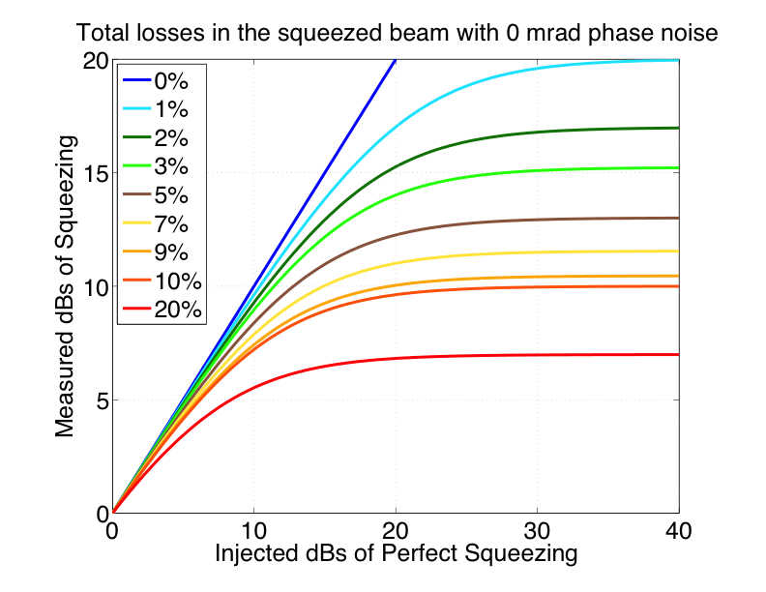
LIGO-G1200571

Slide 5
LIGO-G1200571

Slide 6
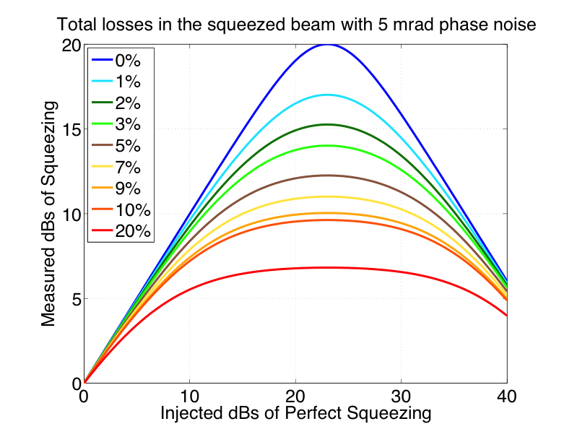
LIGO-G1200571

Slide 7
The Message
We know how to get ready for aLIGO (6 dB)
Auto-alignment, better sqz angle sensing, mode matching, OPO temperature control, high OMC transmission,…
10 dB is really hard, 15 dB is a dream, unless
Think 0 losses, 0 phase noise
If you have 10 things which have 0.5% losses each,
total losses are >> 2%
LIGO-G1200571

Slide 8
The Quantum Future (1 dB/year)
2012
2016
2020
2025
2 dB
6 dB
10 dB
15 dB
Long term stability (alignment, OPO temperature, sqz phase,..)
macroscopic losses
1-2% losses in Faradays, >98% mode matching, OMC > 99%
Filter cavity to mitigate additional quantum noise at low frequency
Everything <<1% losses (Faradays, OPO, OMC , IFO, ..)
Filter cavities to beat radiation pressure noise
…or some new idea!
LIGO-G1200571

