Slide 1
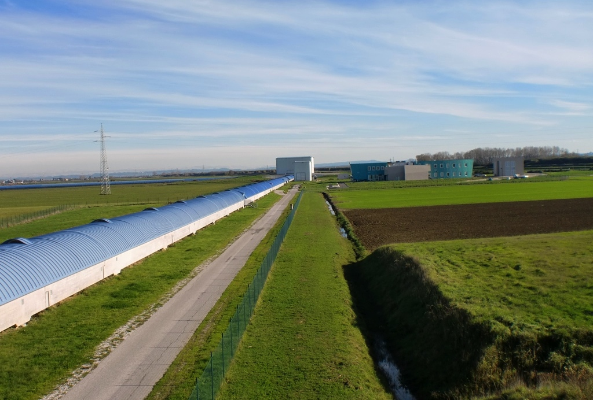
Compact, in-vacuum seismic isolation systems for Advanced Virgo
Mark Beker
LV Meeting Boston 2012
M.Beker@Nikhef.nl
LIGO-G1200332-v1
19 March 2012

Slide 2
Nikhef is responsible for a number of Advanced Virgo upgrades
Read-out and electronics for linear alignment
New phase camera for wave-front sensing
Dihedron and end-mirror for input mode
cleaner
Suspension of optical benches
  5 in vacuum
  1 external
EIB suspension first major upgrade towards Advanced Virgo
(Previous talk)
LIGO-G1200332-v1

Slide 3
End benches and other ITF alignment optics need to be seismically isolated as well
Their movement must not exceed shot noise contribution of read-out noise (~30 pA)
Optimized for DC and high freq. read-out
Stringent angular requirements due to focusing of laser beam
In total 5 in-vacuum suspensions
need to be made
  → MultiSAS
LIGO-G1200332-v1

Slide 4
Stringent angular MultiSAS requirements
(Similar to AdvLIGO TMS)
 | MultiSAS Requirements M. Mantovani, VIR-0101A-12
δx | 2∙10⁻¹² m/√Hz @ 10 Hz
δθ | 3.3∙10⁻¹⁵ rad/√Hz @ 10 Hz
x_{rms} | 24∙10⁻⁶ m
θ_{rms} | 0.033∙10⁻⁶ rad
The requirements are still evolving yet look very challenging in terms of angular motion.
Similar specs have been produced for the AdvLIGO transmission monitor telescope suspension, hanging from ETM dual stage active isolator.
LIGO-G1200332-v1

Slide 5


MultiSAS is a hybrid isolator is which bulk attenuation is provided passively
Each stage provides an extra 1/f ² attenuation
Horizontal most important for angular motion
1x horizontal
1x vertical
+
1x horizontal
1x vertical
+
1x horizontal
----------------------
3x horizontal
2x vertical
Top filter
OPTICAL BENCH
Intermediate filter
Bench

Slide 6
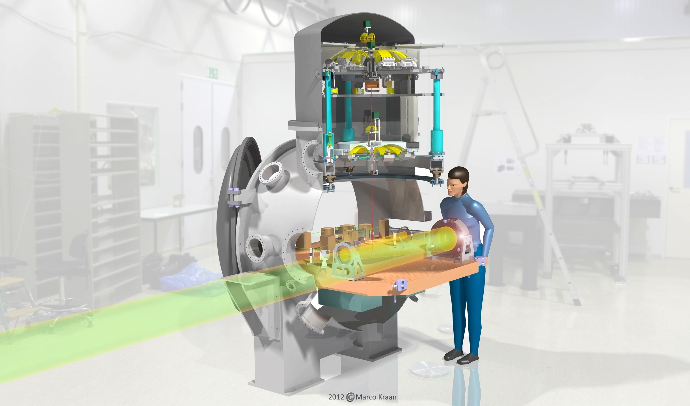
LIGO-G1200332-v1

Slide 7
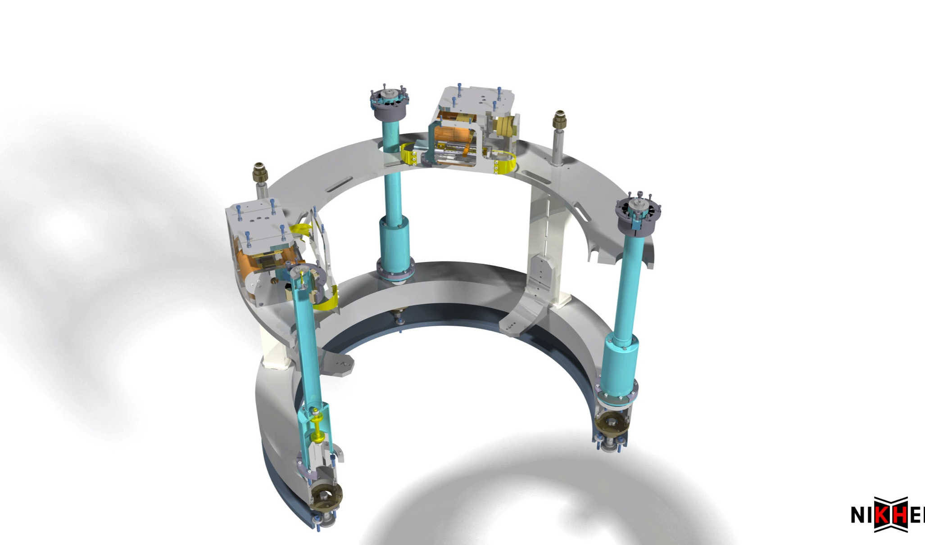
LIGO-G1200332-v1

Slide 8
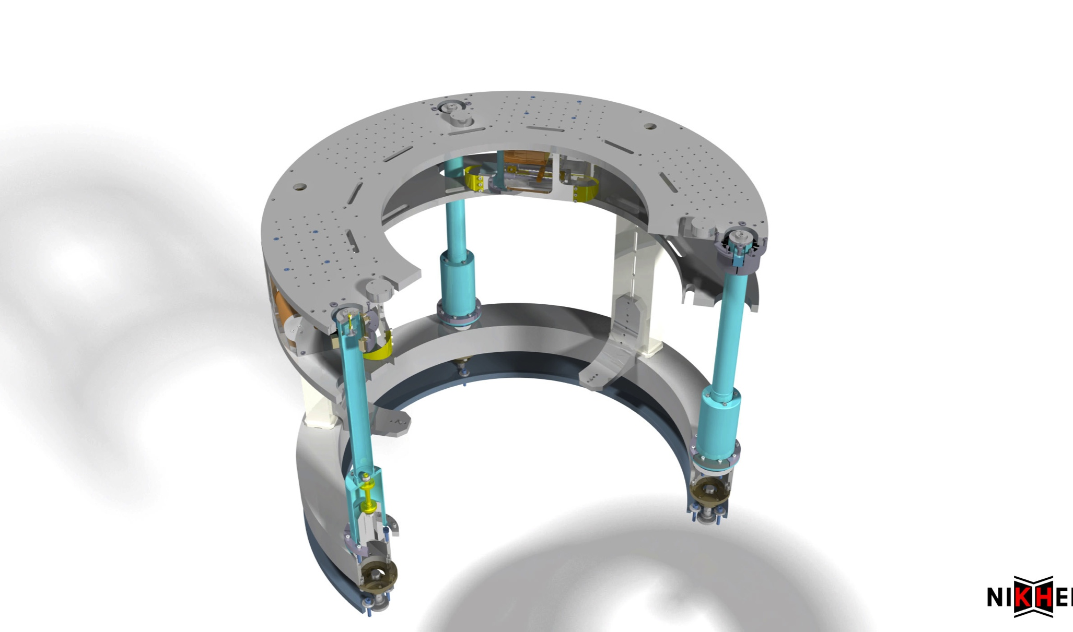
LIGO-G1200332-v1

Slide 9
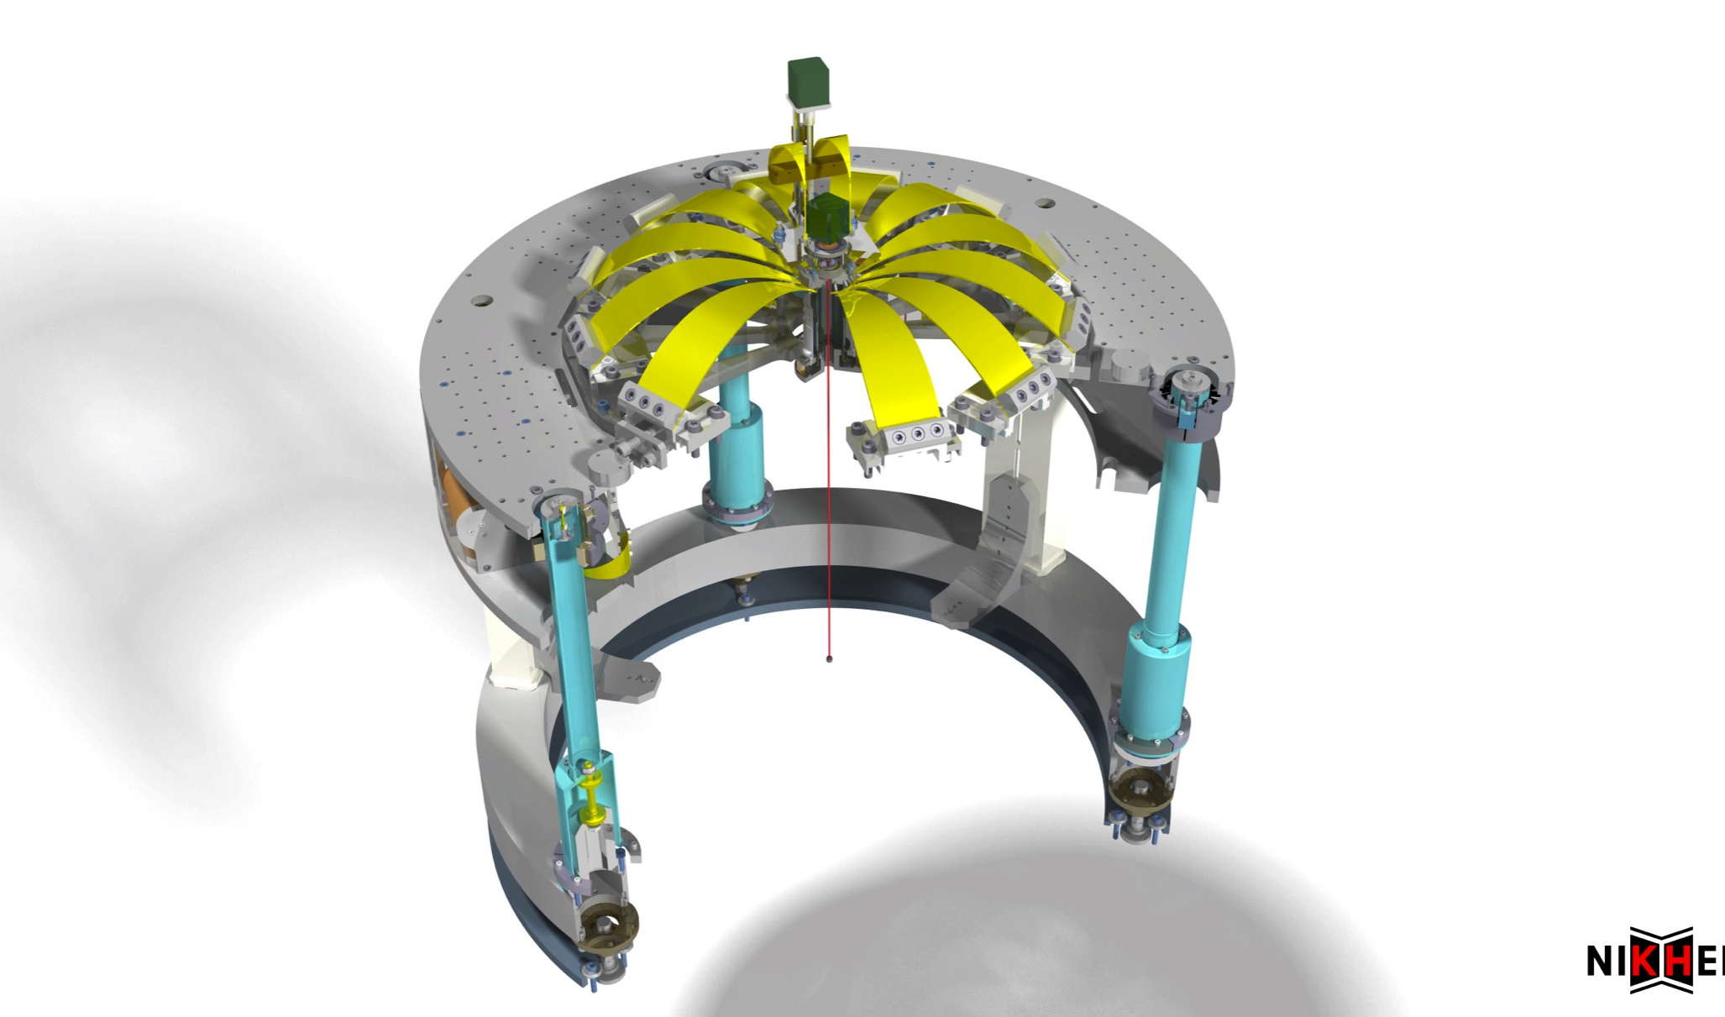
LIGO-G1200332-v1

Slide 10
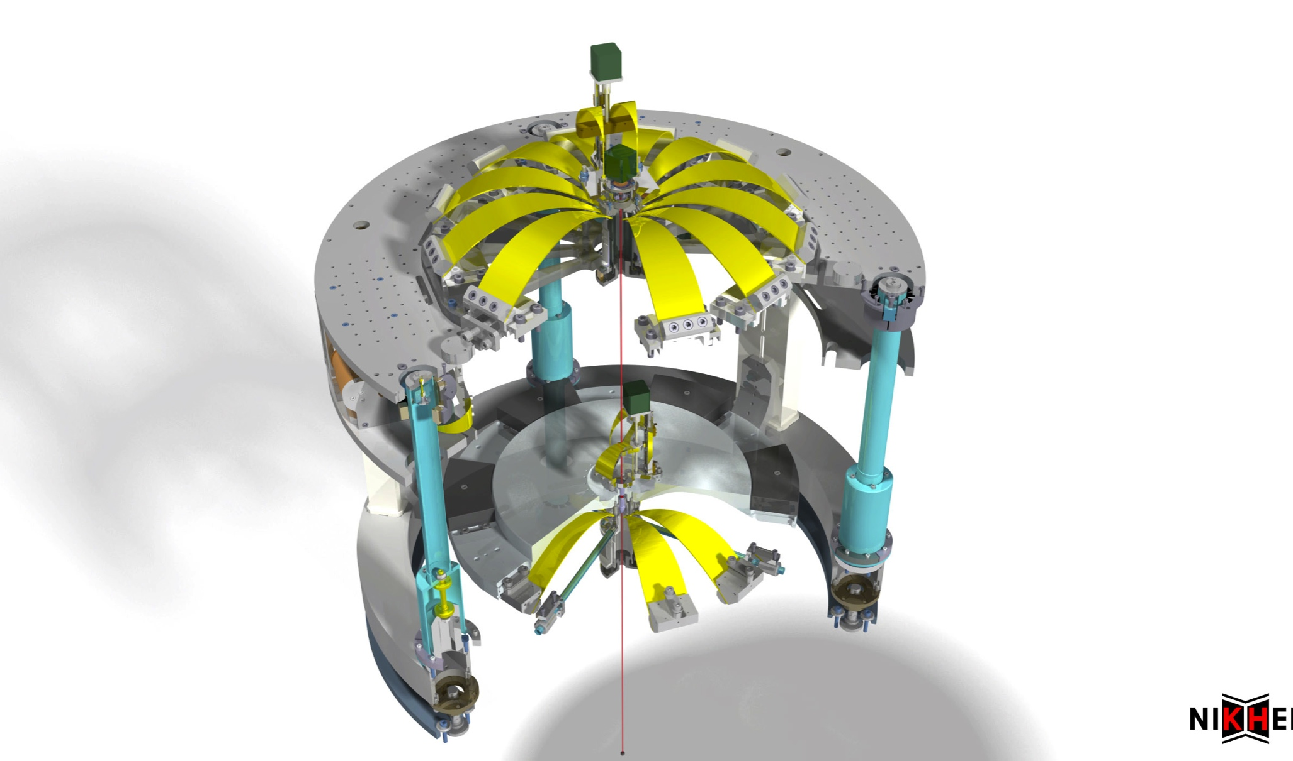
LIGO-G1200332-v1

Slide 11
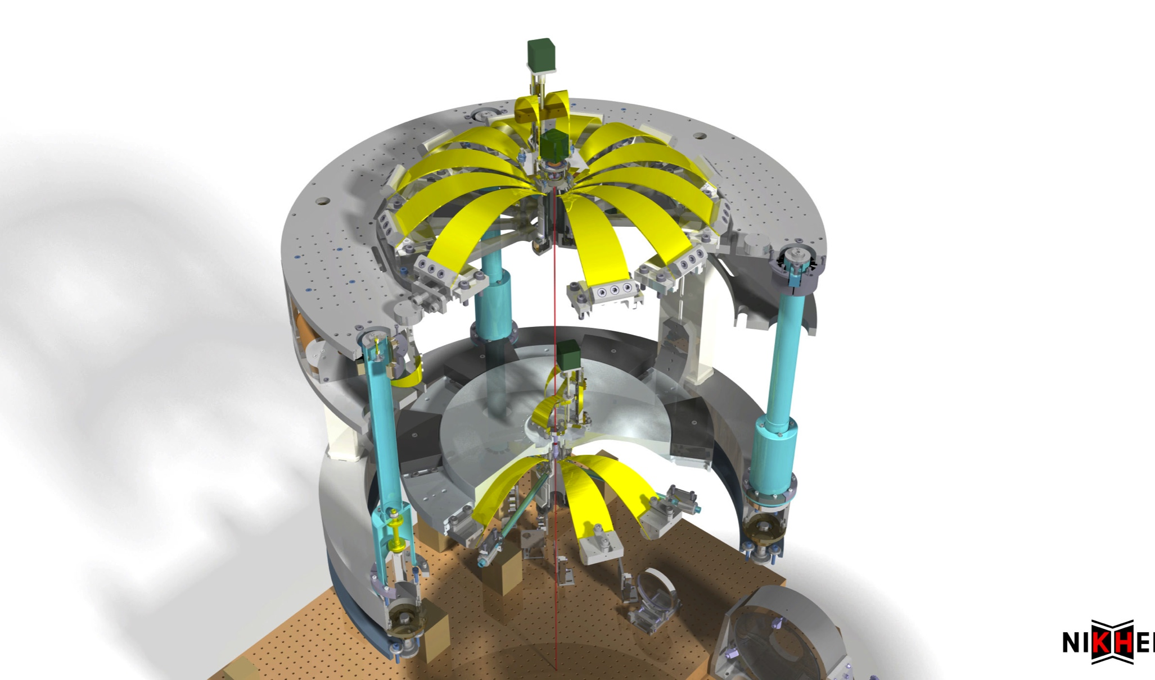
LIGO-G1200332-v1

Slide 12
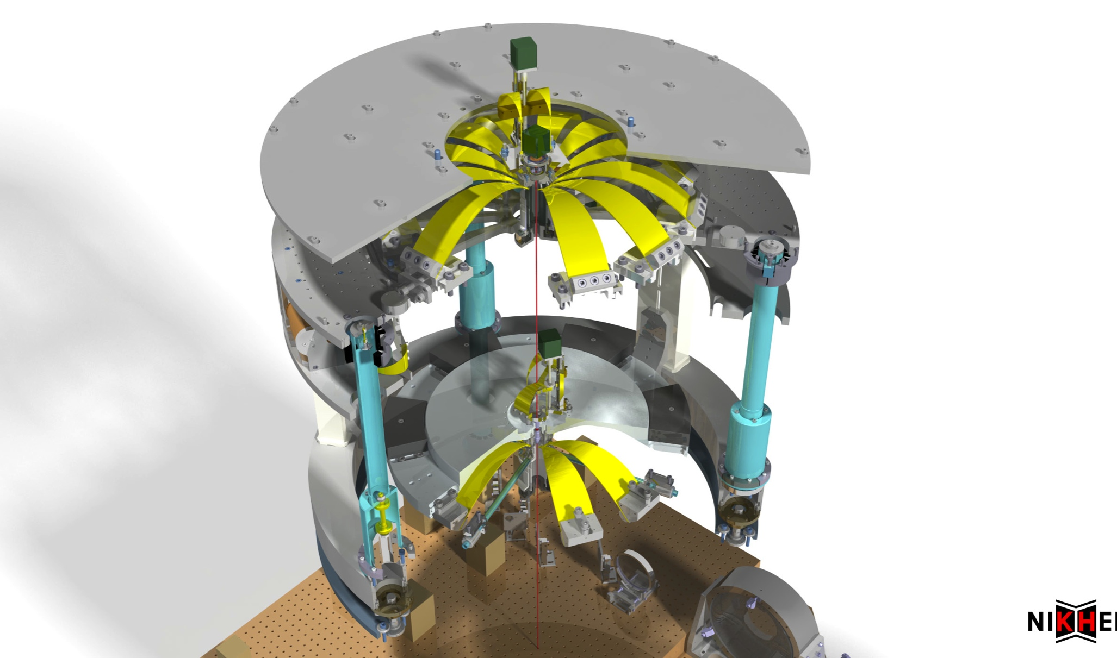
LIGO-G1200332-v1

Slide 13
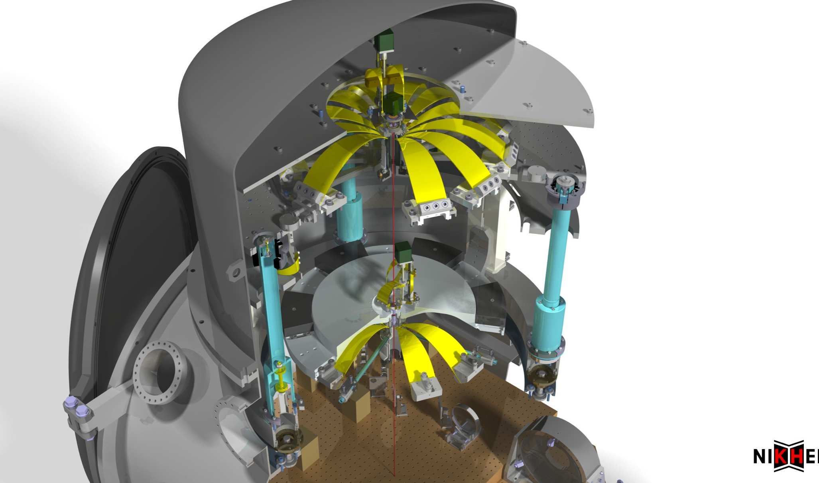
Vacuum chamber:
B. Mours / LAPP
LIGO-G1200332-v1

Slide 14
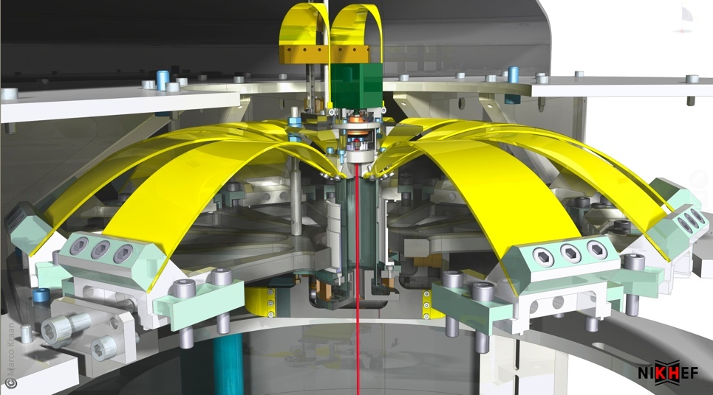
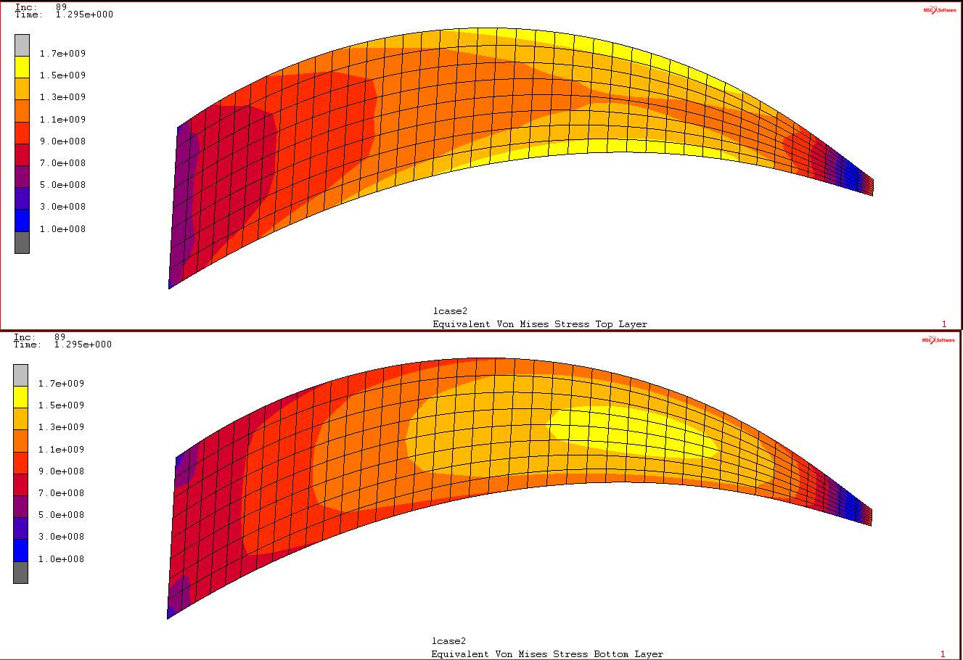
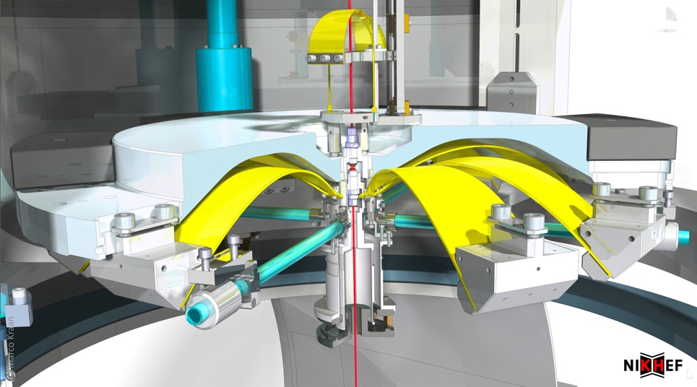
Vertical filters implement anti-springs and
“magic wands”
Top filter
  Up to 12 blades for max load of 600 kg
  Vertical DC position controlled by dual blade fishing rods
  θy rotation controlled by harmonic drive
FEA: Max von Mises stress: 1.7 GPa
Bottom filter
  “Inverted” design to better place wire bending point at COM
  Magic wands used to lower saturation point
Notes:
----- Meeting Notes (3/16/12 15:38) -----
1.7 is upper limit!

Slide 15
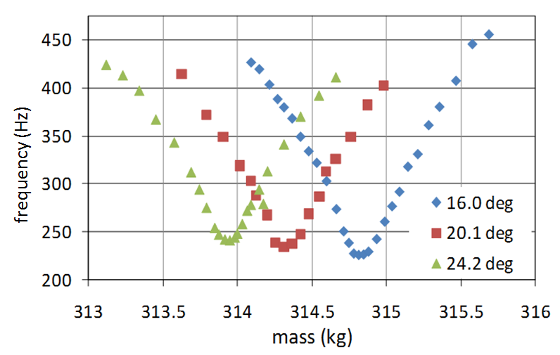
Tuning of vertical filter stages
Top filter has been tuned below 100 mHz
  (will be 200 mHz)
  Bottom filter: 400 mHz
Temperature dependence
  Change in thermal elasticity
    (and thermal expansion)
  Top filter: -1.44 mm/K
  Bottom filter: -0.35 mm/K
  Need to be able to provide long-term DC positioning
Top filter tuning to 100 mHz
Eric Hennes
Temperature dependence
LIGO-G1200332-v1

Slide 16
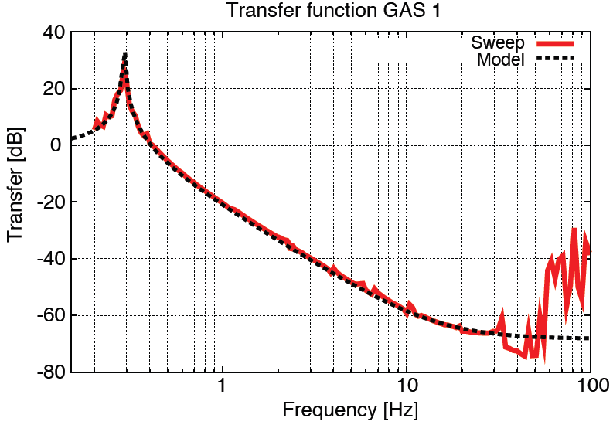
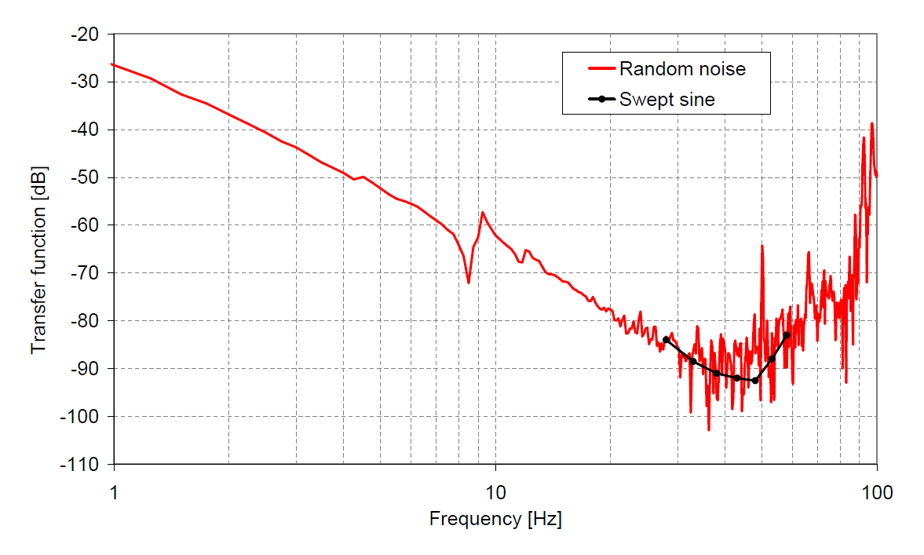
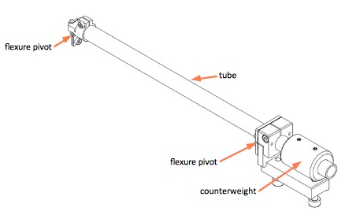
Magic wands decrease GAS saturation level to
< 80 dB
Mass and moment of inertial not negligible wrt pay-load
Results in saturation of transfer function
Magic wands allow tuning of moment of inertia (and β)
Lowers saturation level to < 80 dB
With wagic wands
Courtesy of AEI Hannover
LIGO-G1200332-v1

Slide 17
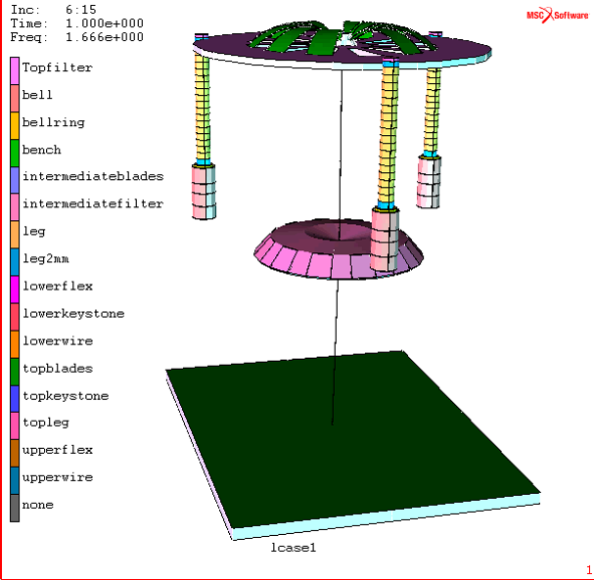
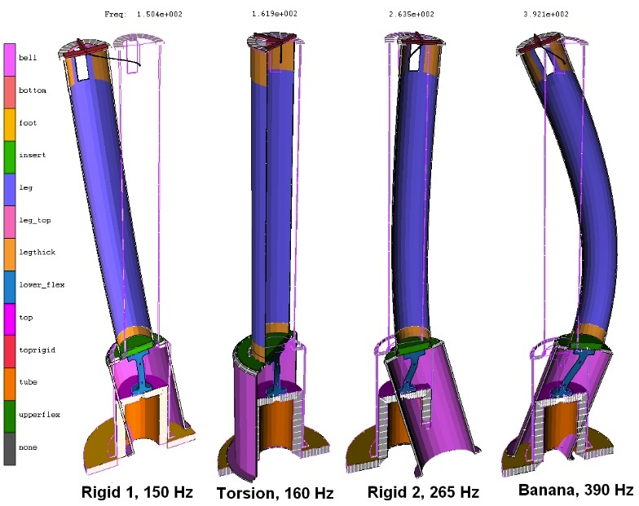
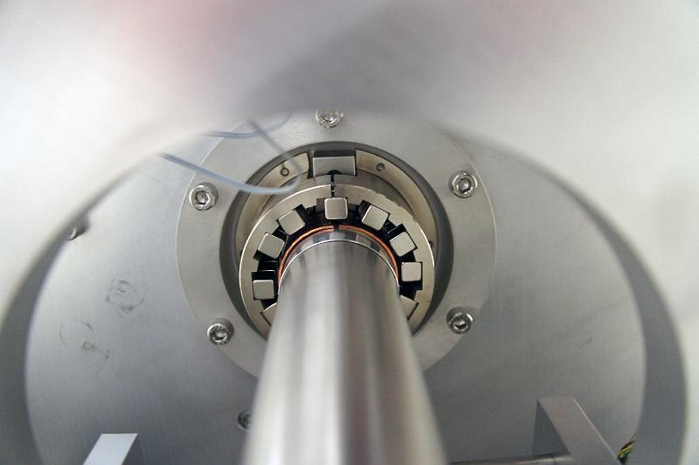
Finite element models used to identify all modes of the system
1.6 Hz
IP leg modes
Where needed passive eddy current dampers can be used to lower Q-factor of higher order resonances
Eric Hennes
LIGO-G1200332-v1

Slide 18
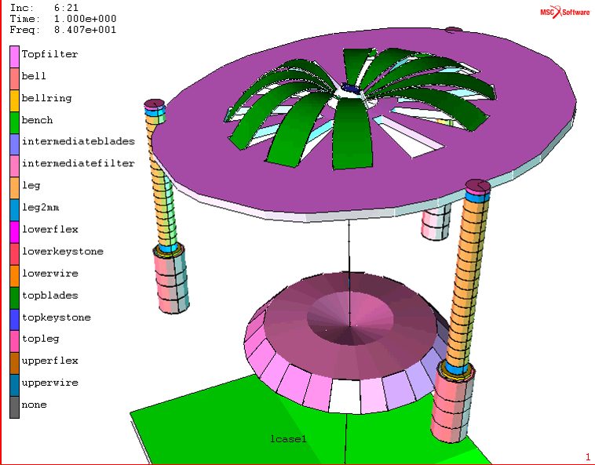
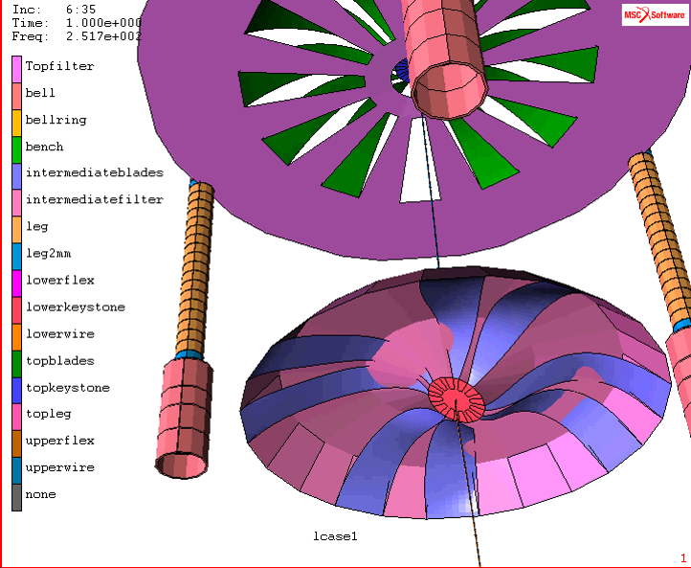
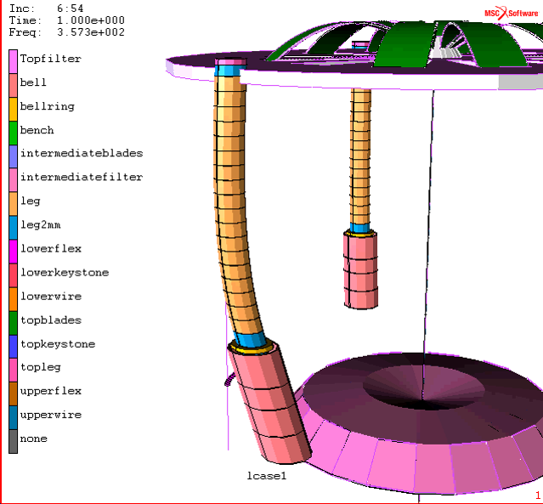
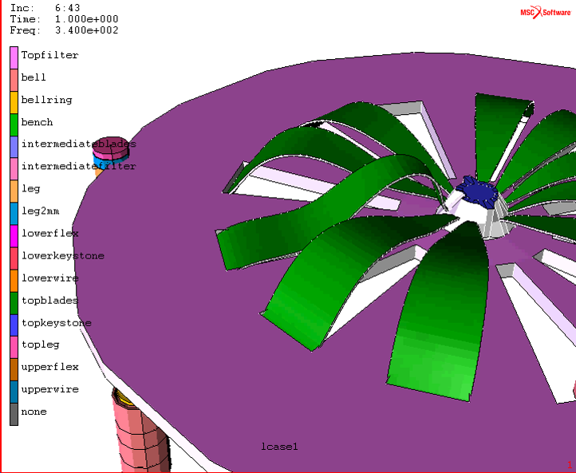
Finite element model: Higher order modes
84 Hz
252 Hz
Non-rigid leg modes
Higher order GAS modes
357 Hz
340 Hz
LIGO-G1200332-v1

Slide 19
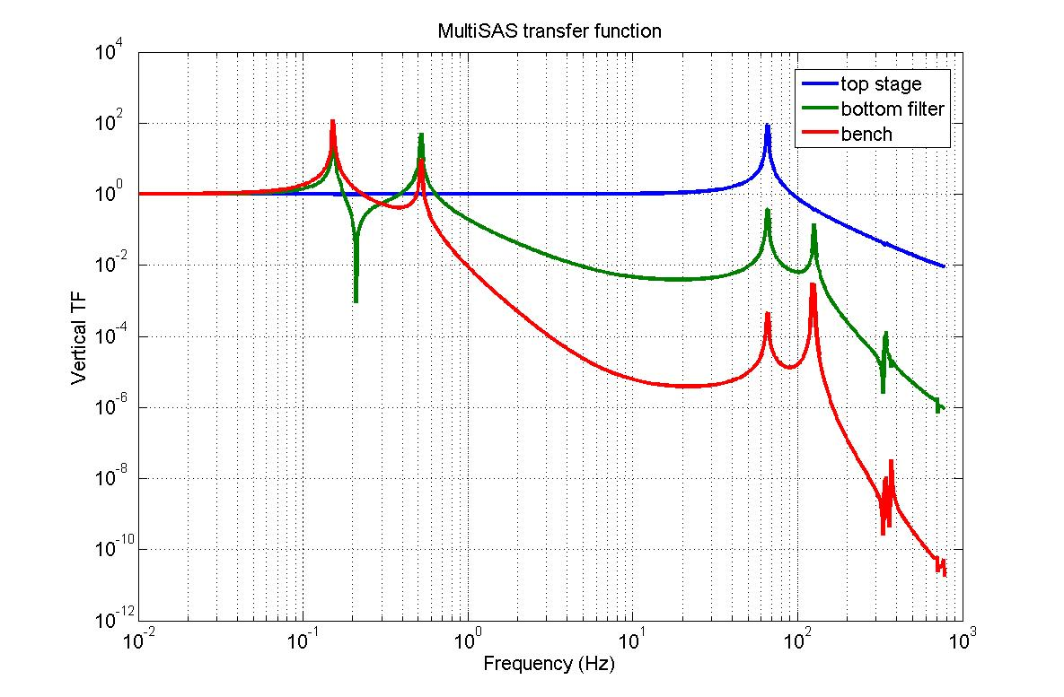
Simulated performance
Vertical transfer function
LIGO-G1200332-v1

Slide 20
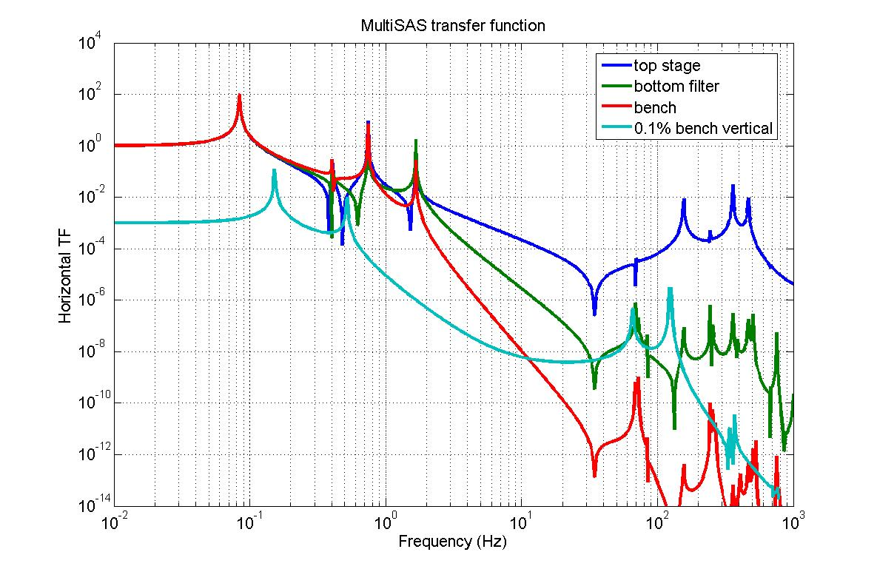
Simulated performance
Horizontal transfer function
Vertical to horizontal coupling will dominate performance above 10 Hz
LIGO-G1200332-v1

Slide 21
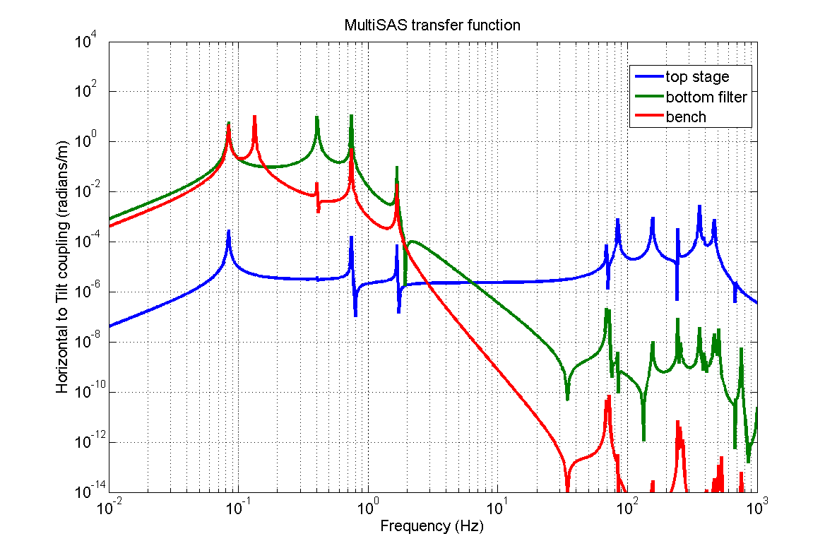
Simulated performance
Horizontal to tilt coupling
LIGO-G1200332-v1

Slide 22
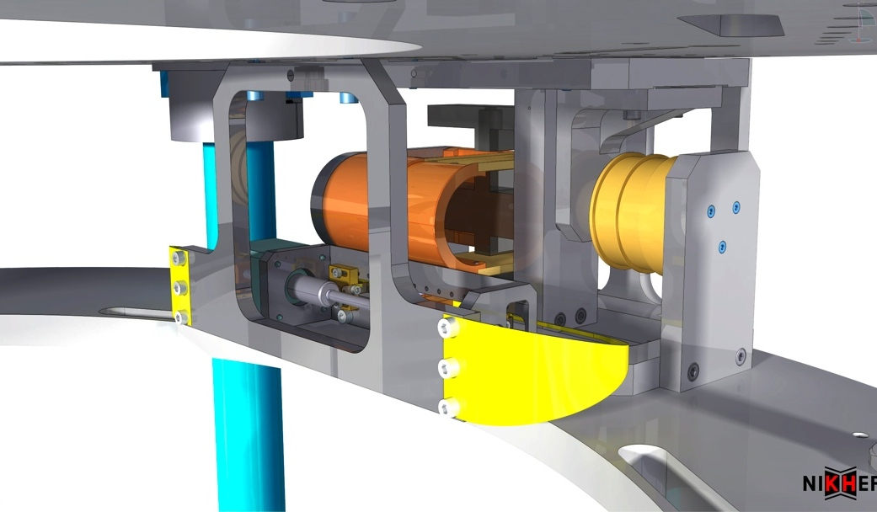
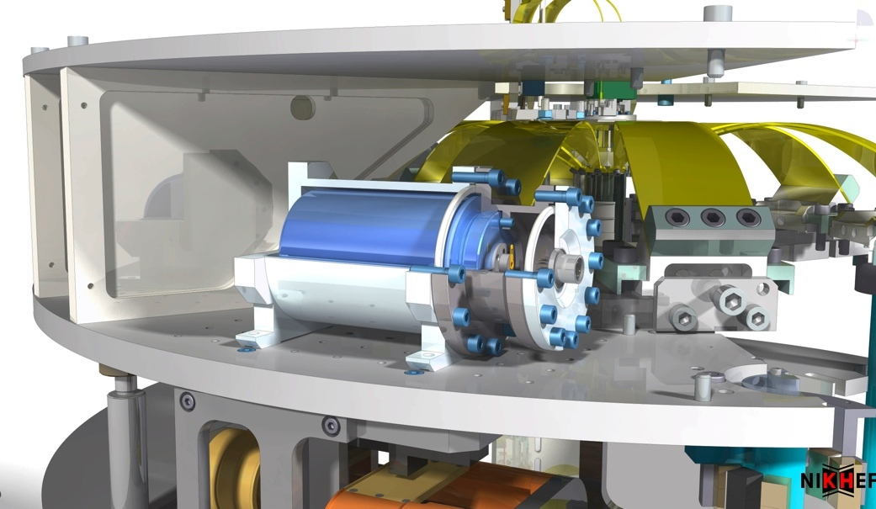
Control systems for DC positioning and resonance frequency damping
Static positioning
  Eight stepper motors for bench movement in 6 DOF
  Used for long-term temperature effects
  Tilt correction of optical bench
Dynamic controls
  3 horizontal LVDTs
  3 horizontal L4-C geophone
  1 vertical LVDT is each filter
  3 horizontal and 1 vertical co-located voice-coil actuators
Angular modes of bench controlled via direct feedback on bench itself
LIGO-G1200332-v1

Slide 23
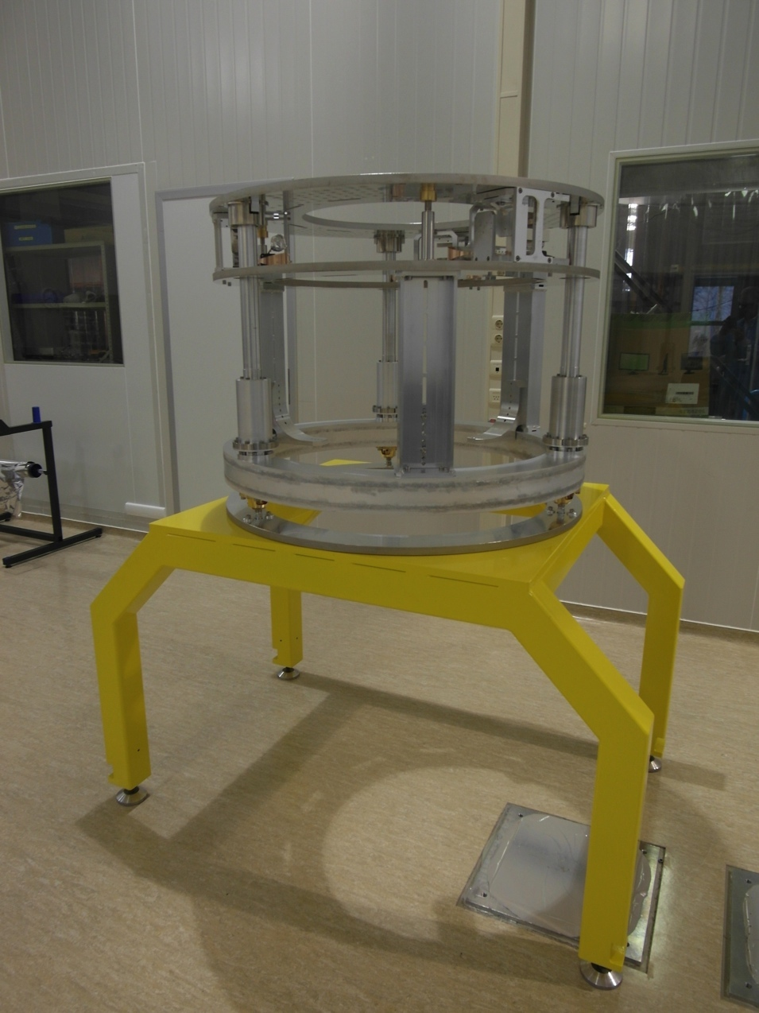
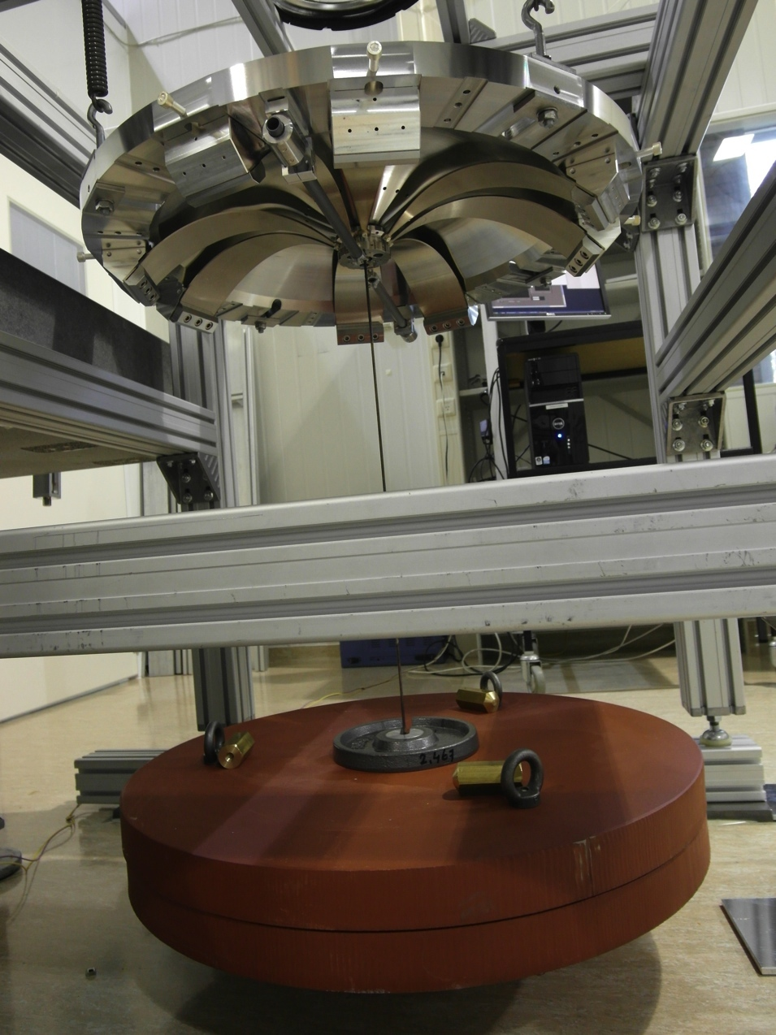
Construction has started, first prototype will be completed by summer 2012
LIGO-G1200332-v1

Slide 24
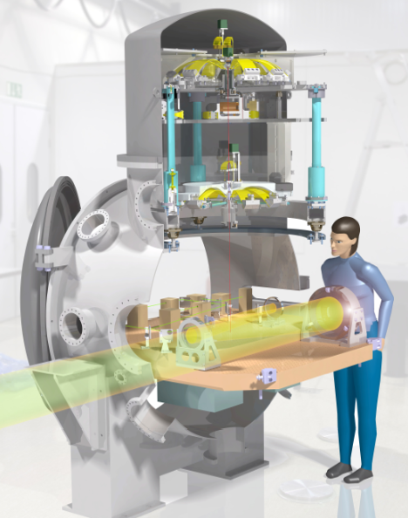
Summary
Five suspension systems for Virgo’s end benches and alignment optics
MultiSAS is a hybrid isolation system in which bulk attenuation is provided passively
(Inverted) pendulums and anti-spring vertical filters
Stringent requirements
  Angular requirements are most challenging
Current design performance
  Vertical: 90 dB @ 10 Hz
  Horizontal: 160 dB @ 10 Hz, limited by
  vertical -> horiz. coupling > 10 Hz
  Rotational: 160 dB @ Hz, horiz. -> tilt coupling
First prototype ready this summer
LIGO-G1200332-v1

Slide 25
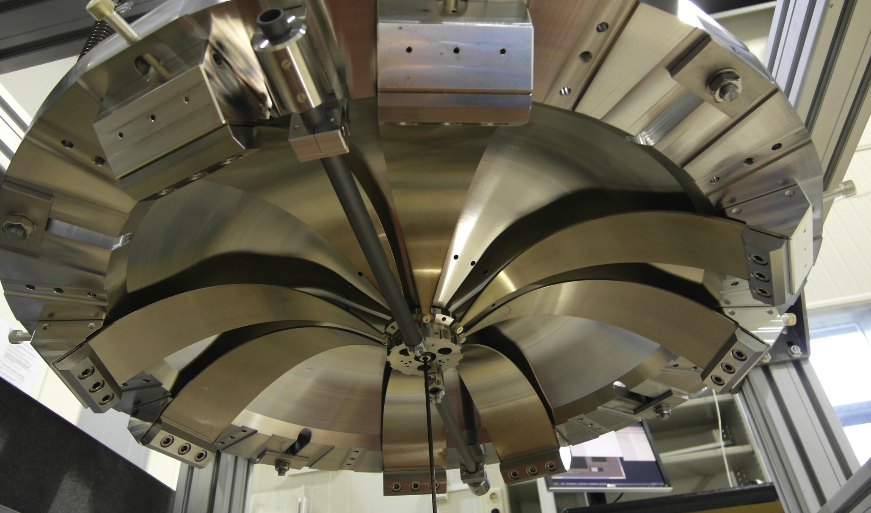
Thank you for your attention
LIGO-G1200332-v1

