Slide 1
Input Optics
Technical Status
NSF Review of Advanced LIGO Project
David Reitze
David Tanner
University of Florida
LIGO-1100491-v4

Slide 2
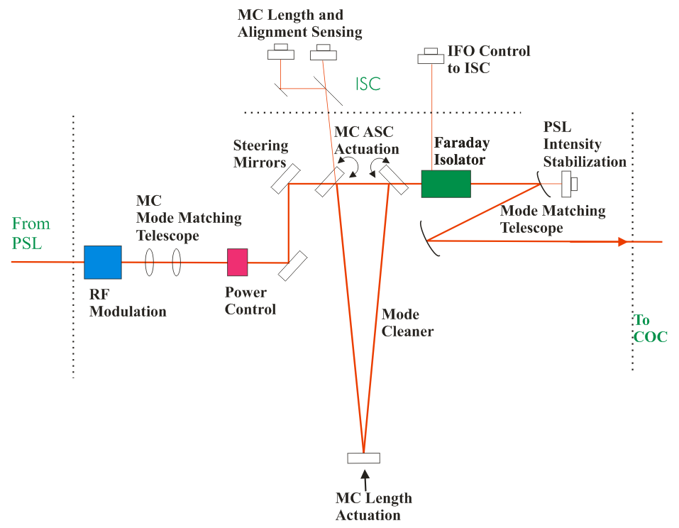
IO Functions
Project cost for
IO is $4.37M
The Input Optics (IO) conditions the PSL laser light and delivers it to the interferometer.
It provides:
RF modulation for length and alignment control functions
Power control
Laser mode cleaning and frequency stabilization
Isolation of laser from interferometer reflected light
Optical signal distribution to length and alignment control
Mode matching to recycling and arm cavities
Design and fabrication of small PRMs and SRMs
The IO has interfaces with many aLIGO other subsystems
PSL = pre-stabilized laser
COC = core optical components
IMC = input mode cleaner
ISC = interferometer sensing and control
PRM = power recycling mirror
SRM = signal recycling mirror
2

Slide 3
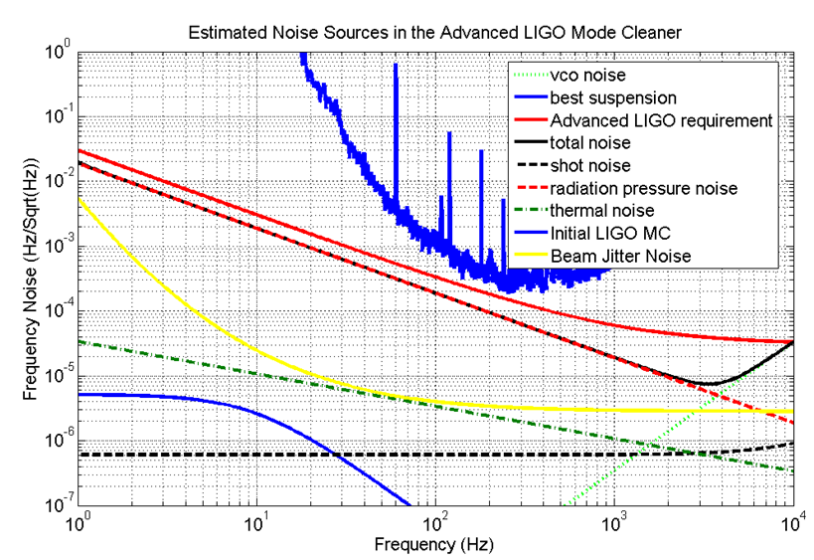
IO Requirements I
Phase modulated light:
  Straight interferometer f₁ ~9.1; f₂ ~45.5 MHz, f_{IMC} ~24.1 MHz
  Folded interferometer f₁ ~8.7; f₂ ~43.4 MHz f_{IMC} ~23.0 MHz
  Modulation index range for f_{1,2} Γ = 0.1-0.8
  RF amplitude modulation: ΔΓ < 10⁻⁹/Γ (10 Hz)
Power control:
  Operate from 1 to 165 W
Mode cleaning:
  Suppress laser beam jitter by 250x
  Provide intermediate length standard for laser frequency stabilization for ISC
Modeled noise sources in the input mode cleaner. Solid red line is the requirement. The solid black line is calculated noise, dominated by radiation pressure noise.
(The upper blue line is the initial LIGO IMC measured frequency noise)

Slide 4
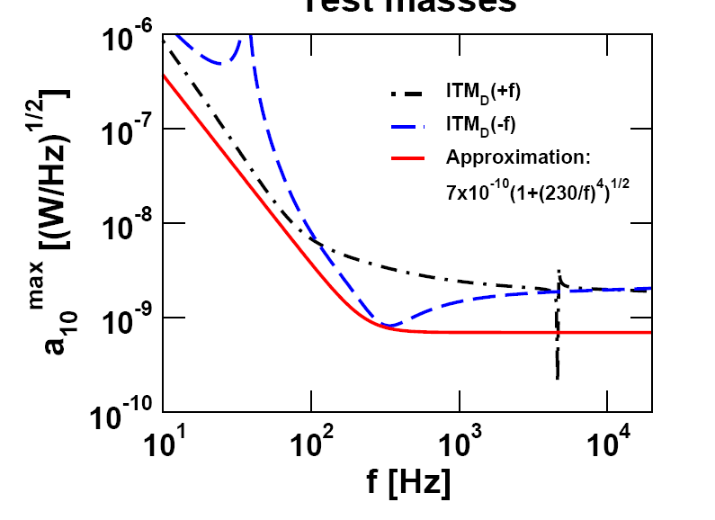
IO Requirements II
Optical isolation and beam routing via Faraday isolator:
  >30 dB isolation
  Deliver diagnostic beams to interferometer sensing and control system
Mode matching:
  PSL → modulator
  modulator → input mode cleaner
  Input mode cleaner → power recycling cavity
  Minimal thermal modal distortions
High overall optical throughput
  > 75%
Stable power and signal recycling cavities:
  Incorporates beam expanding/reducing telescope size to match arm cavities
  IO designed telescope, specifies radii of curvature, purchases small RMs
Beam Pointing Requirements
REFL = interferometer reflected beam
ISC = interferometer sensing and control
PSL = pre-stabilized laser
EOM = electro-optic modulator
IMC = input mode cleaner
PRC = power recycling cavity
SRC = signal recycling cavity
4

Slide 5

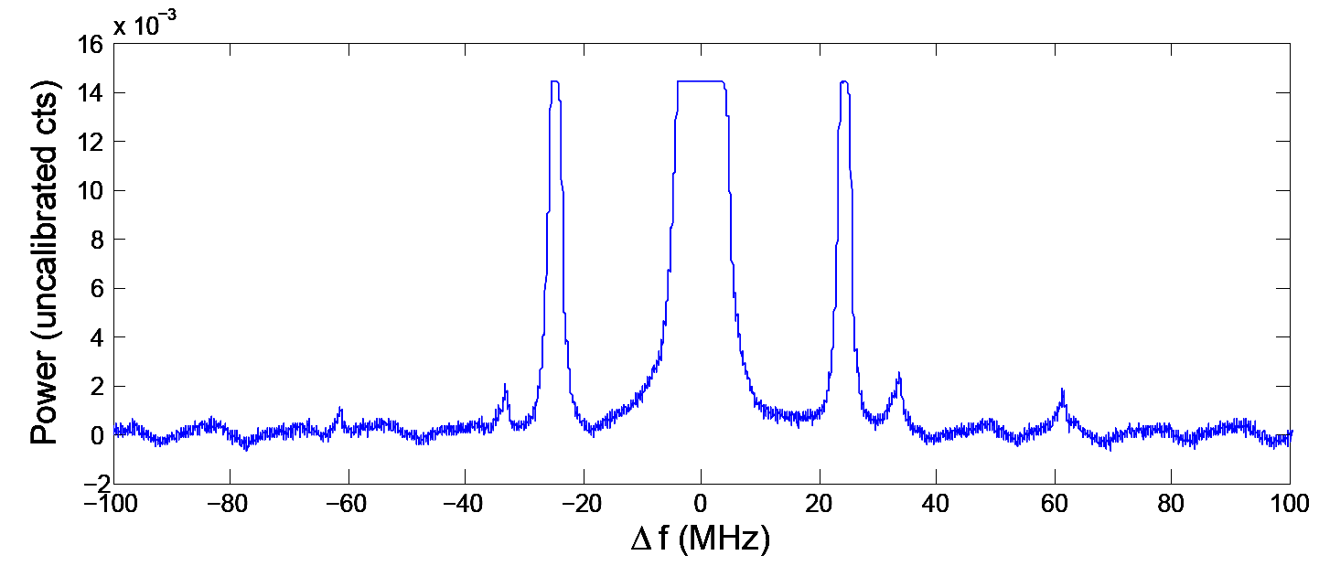
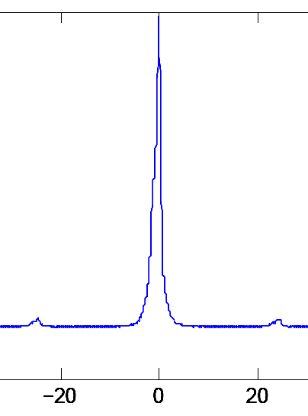
Modulator: eLIGO certified
f₁
f₂
f₃
Three electrodes – one crystal
Wedged cut to suppress amplitude modulation
RF matching circuit in separate housing
Rubidium titanyl phosphate
  High damage threshold
  Low absorption (~50 ppm/cm)
Operated in eLIGO for 2 years; no problems
  Also tested at 100 W levels for 300+ hours
Patented by UF
aLIGO triple modulation
(in eLIGO)
f₂
carrier
f₁
f_{MC}

Slide 6
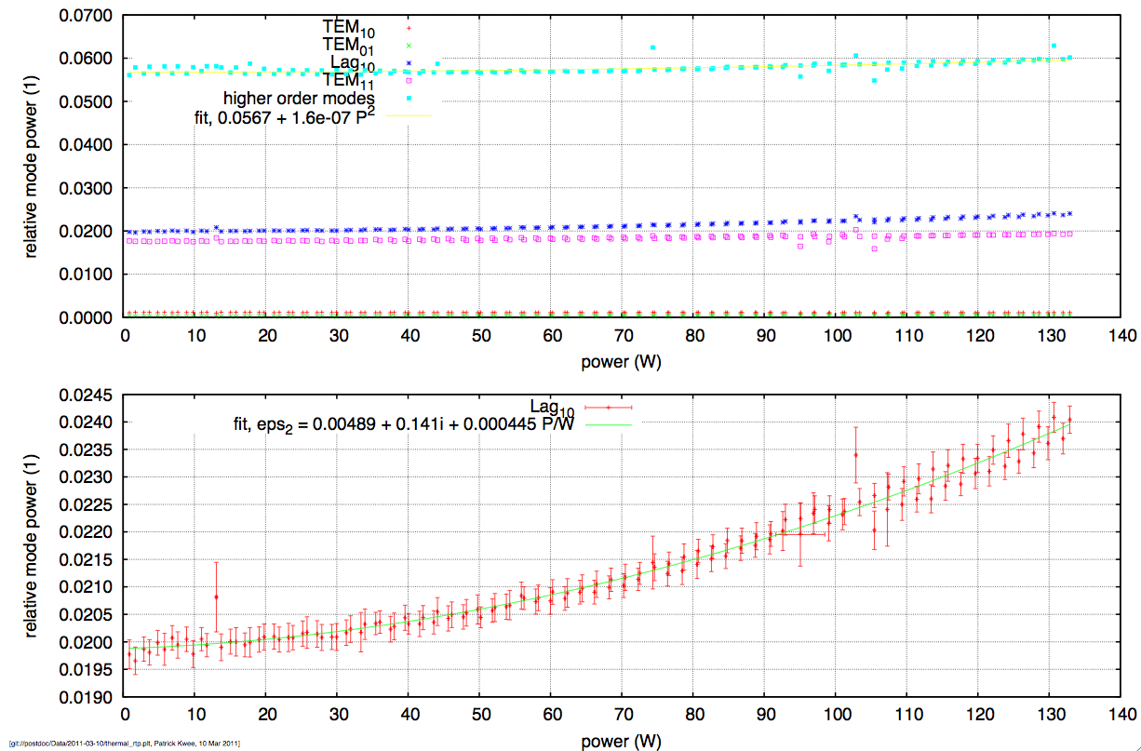
Thermal modal distortions at aLIGO laser power
Data from Patrick Kwee, AEI

Slide 7
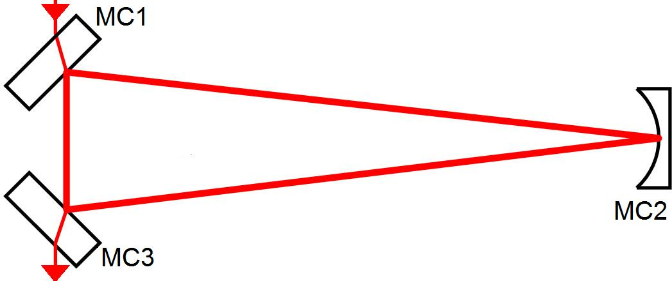
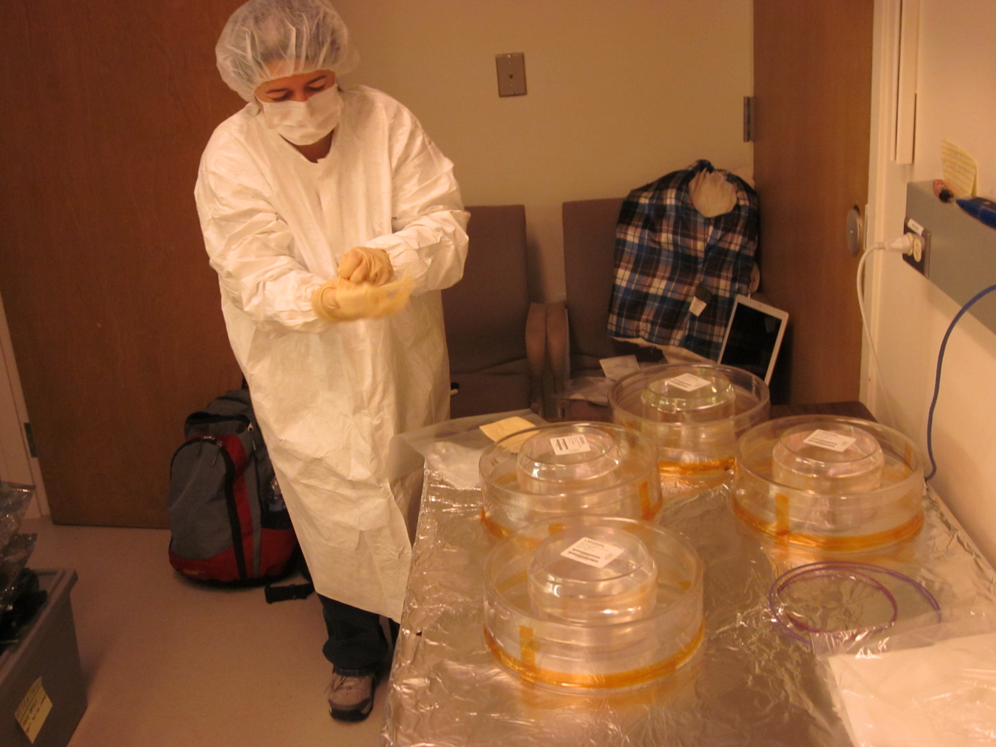
Input Mode Cleaner Design Concept
Triangular ring cavity design
Length, L/2 = 16.5 m (straight); 17.3 m (folded)
FSR = 9.1 MHz (straight); 8.7 MHz (folded)
Finesse ~ 520
  P_{store} = 23,200 W (@ 165 W input)
All three mirrors on “HAM small triple suspensions”
Low coating absorption – minimize thermally-induced modal distortions
  0.5 ppm (goal); 1.0 ppm (required)
Low scatter loss: < 30 ppm/mirror
HR
T = 0.994
T = 0.994
FSR = free spectral range
SUS = suspensions subsystem
HAM = horizontal access module chamber
7

Slide 8
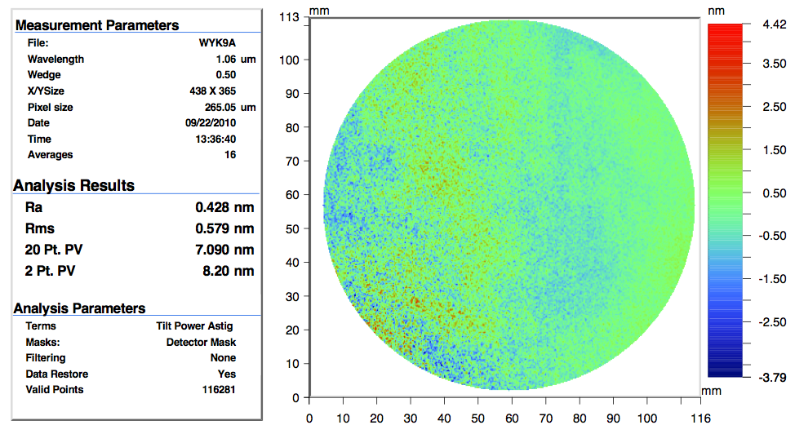
IMC mirror phase maps

Slide 9
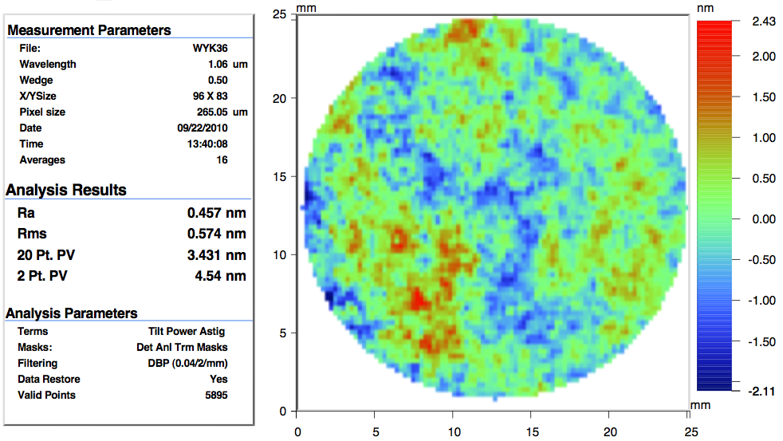
IMC mirror phase maps

Slide 10
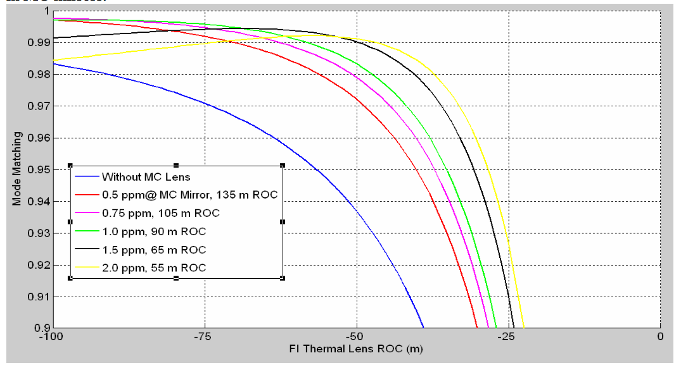
Thermal effects in the IMC
Substrate Thermal Lensing in Mode Cleaner, LIGO- T070095-00-E

Slide 11
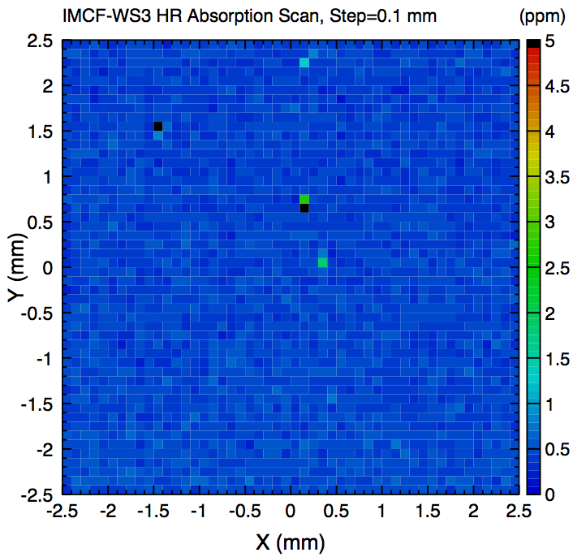
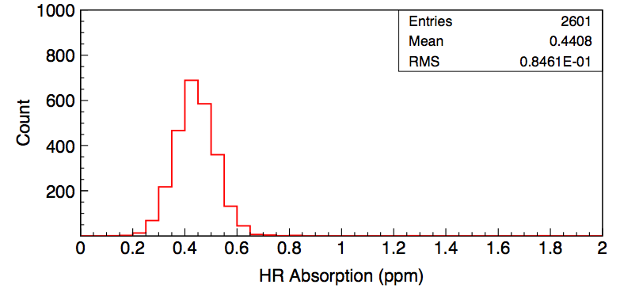
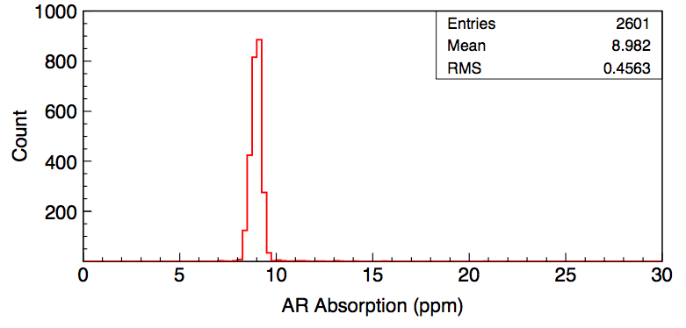
IMC Mirror Absorption
MCF-WS3 witness sample absorption scan
HR absorption
AR absorption

Slide 12
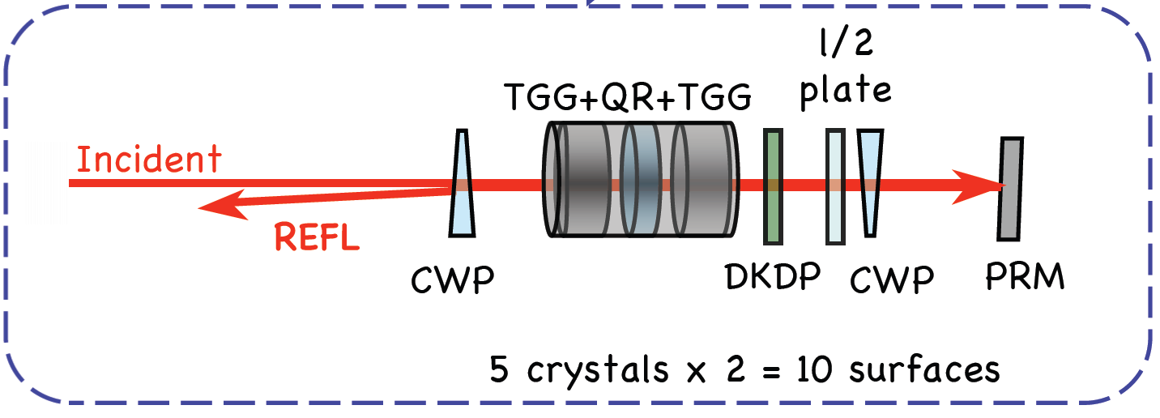
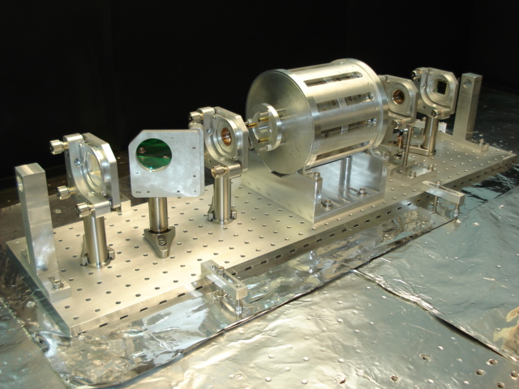
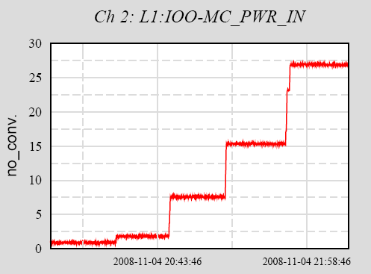
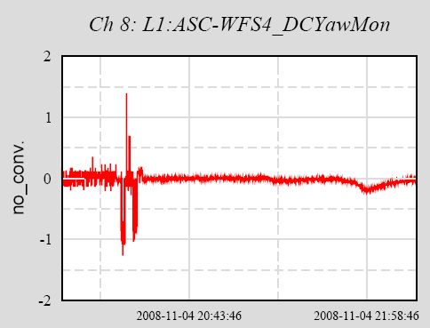
Input Faraday Isolator
Another battle-tested eLIGO component
  Operating at ~ 10 - 20 W power levels over two years with no problems
  Prototype tested to 100 W (100 hours)
  Adjustable ½ waveplate for in-vacuum tuning of isolation ratio
Architecture
B_{o}
B_{o}
E-LIGO Faraday Isolator
Thermal angular drift of back-rejected beam
0.6
27 W
Δx/w₀
0.3
1 W

Slide 13
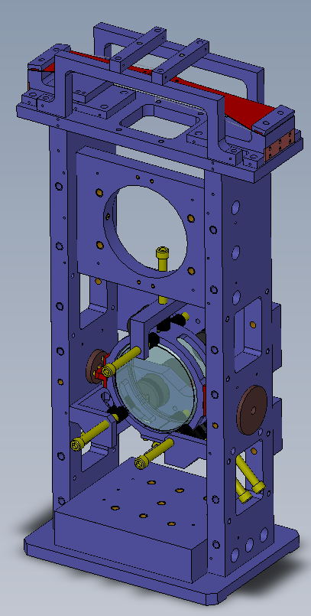
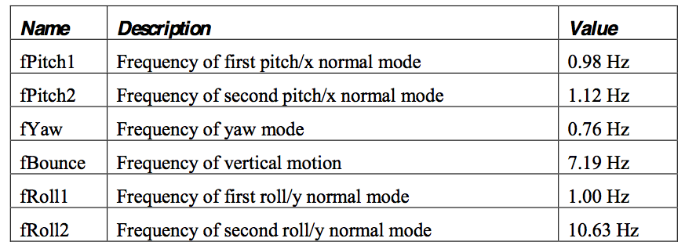
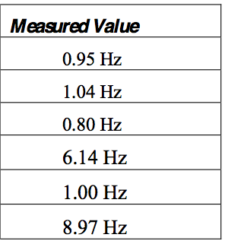
HAM Auxiliary Suspensions: Requirements and Design
The HAM Auxiliary suspensions are single stage suspensions that route the beam from the IMC to the PRM
Requirements:
  10 mrad pitch, yaw range
  Resonant frequencies < 10 Hz
  Passive damping
  Displacement noise 10⁻¹¹,10⁻¹⁴ m/Hz^{1/2} (10 Hz, 100 Hz)
  RMS pointing to < 1 urad
  In-band pointing < 6 x 10⁻¹³ rad/Hz^{1/2} (100 Hz)
HAM
Auxiliary Suspension
IMC = input mode cleaner
PRM = power recycling mirror
Model

Slide 14
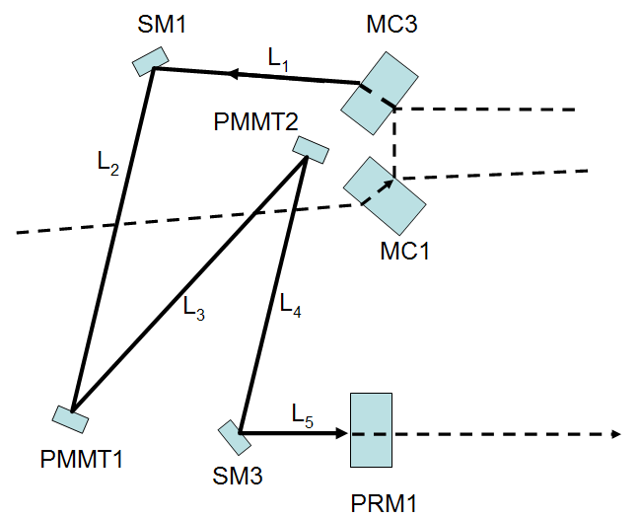
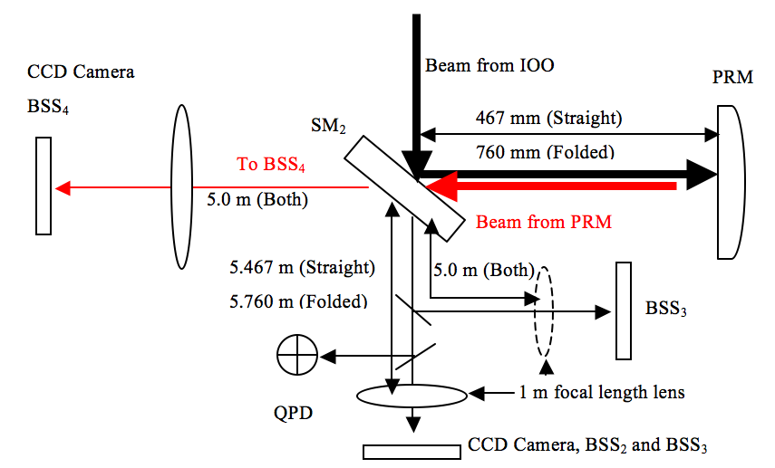
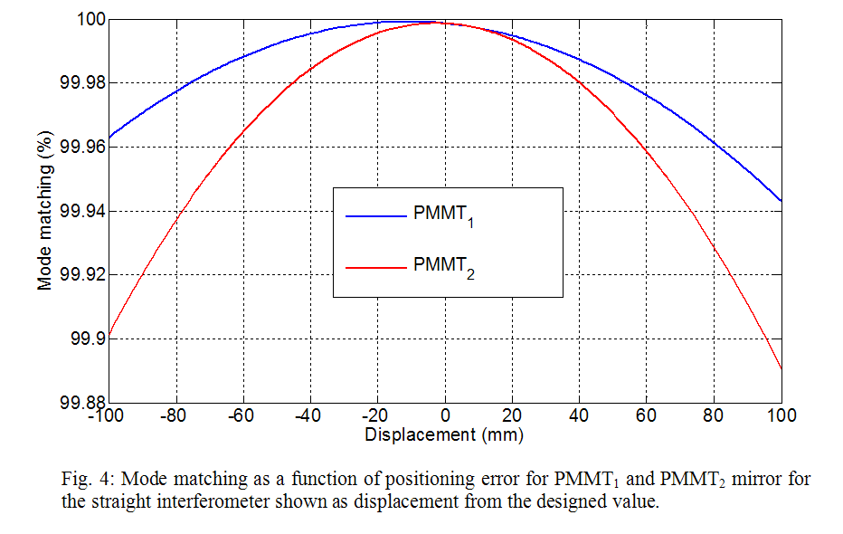
Mode Matching Design Concept
IO mode-matching allocated in two phases:
  PMMTs mirrors mode-match from IMC to power recycling mirror
  PRM, PR2, PR3 mode-match into arm cavities
PMMT telescope designed to be very insensitive to position
Mode-matching sensors (CCDs) provide online sensing of mode size
BSS = Beam Size Sensor
PRM = power recycling mirror
SM = steering mirror
Optical layout for the BSS sensors for monitoring mode matching into the interferometer

Slide 15
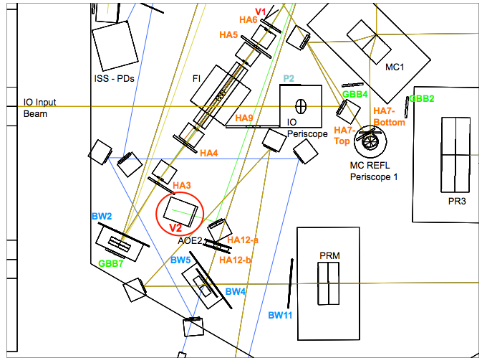
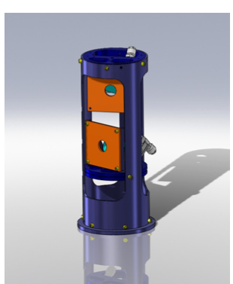
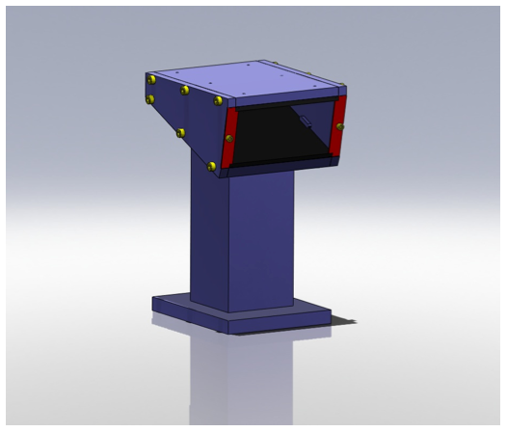
IO Baffles
The IO has a high density of high power lasers beams in a very confined space.
The IO baffles serve two purposes:
  To prevent scattered light from entering sensing the interferometer and sensing photodiodes
  To protect the in-vacuum components from laser damage
A variety of IO baffles: parking beam dumps, suspensions, hard apertures, scrapers, ghost beams
Layout in Zemax
Baffles in HAM2
Periscope Baffle
REFL Beam Dump

Slide 16
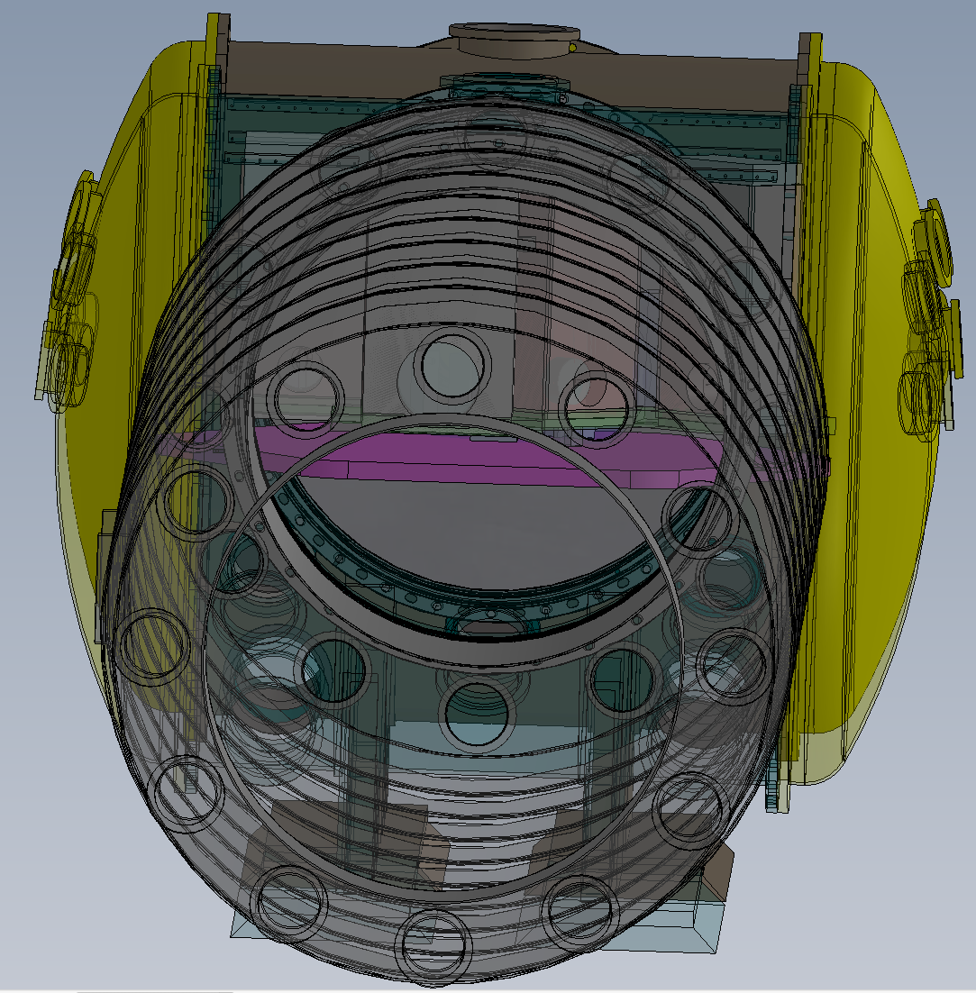
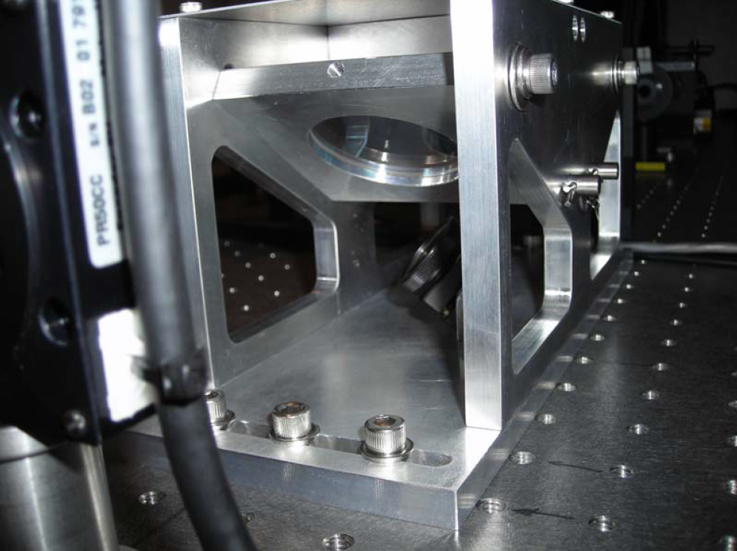
Other Items: Design Concepts
All main beam line optical components super-polished (except for a few FI components)
Power control: motorized waveplate and 2x thin-film polarizers on PSL table, behind EOMs.
  Custom thin film polarizers with 99% throughput
Mode-matching to IMC: 2 lens telescope on PSL table
Cameras for viewing all IO components in vacuum
Double window viewport for safety on all high power beam entry and exit points
PSL = pre-stabilized laser
IMC = input mode cleaner
EOM = electro-optic modulator
PR3
PRM
IMC1
Power control
16

Slide 17
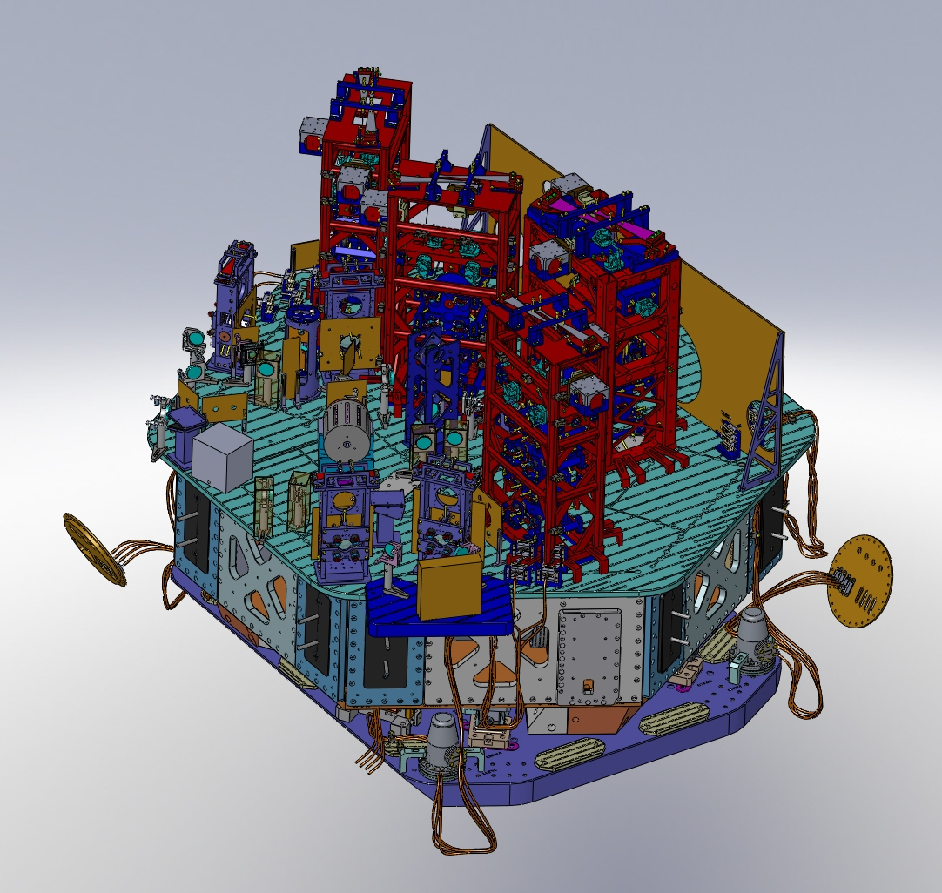
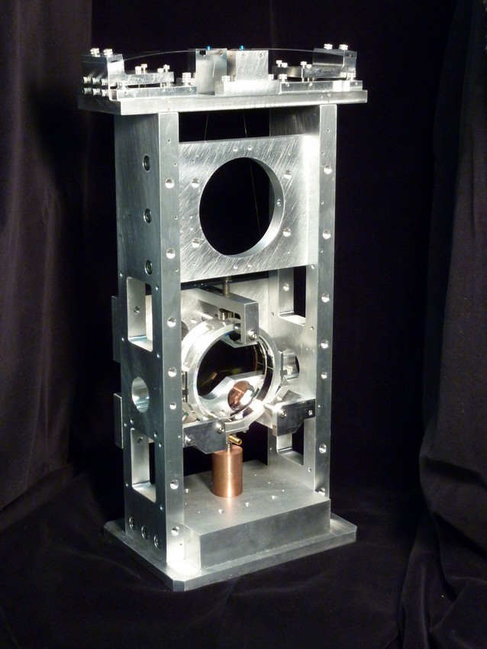
Selected
IO Design Accomplishments
IO optical layout for straight interferometers complete
  Folded interferometer almost complete
PSL and auxiliary IO sensing table layouts complete
HAM Auxiliary Suspension prototyped and tested
HAM 2 ‘Manhattan Skyline’
HAM
Auxiliary Suspension
HAM = horizontal access module chamber

Slide 18
IO Development Status
The IO has completed all designs and design review documentation; final approval from project management pending
Awaiting reports from review committees on
  IO baffles in final phase of design review (awaiting committee report)
  IO installation plan
Control and Data System interface with IO currently under review.

Slide 19

IO Subsystem Project Organization
University of Florida has primary responsibility for IO design and project phase
  UF did the IO for initial LIGO
Design, procurement, fabrication efforts centered at University of Florida
Project Team:
  Leads: David Reitze, David Tanner
  Optical: Rodica Martin
  Mechanical Engineers: Luke Williams, Joe Gleason, Deepak Kumar
  Site liaisons: David Feldbaum, Matt Heintze
Design Team:
  Project Team + Guido Mueller, Giacomo Ciano

Slide 20
Project Phase Status
Procurements/Fabrication:
  Major optics fabrication for all custom IO and recycling mirror optics completed
  Custom optical crystals and components for EOMS, Faraday completed
    Awaiting delivery on final FI components
  HAM Auxiliary Suspensions components fabricated
  EOM and FI mechanical components in fabrication: 50% complete
  Ancillary in-vacuum optics mounts procurement/fabrication: 40% complete
  Commercial opto-mechanical components for out-of-vacuum optical procurement/fabrication: 35% complete
  Custom optics transport containers, alignment and installation fixtures: 60% complete
Metrology for mirrors (phase maps & radii of curvature, absorption): 25% complete
  IMC flat mirrors complete, awaiting reference spheres for other mirrors
De-installation and recovery of IO components from Livingston and Hanford 2 km interferometer complete
  Will re-use Livingston EOM and FI housings (but not optics and crystals)
FI = Faraday isolator
IMC = input mode cleaner
EOM = electro-optic modulator
HAM = horizontal access module chamber

Slide 21
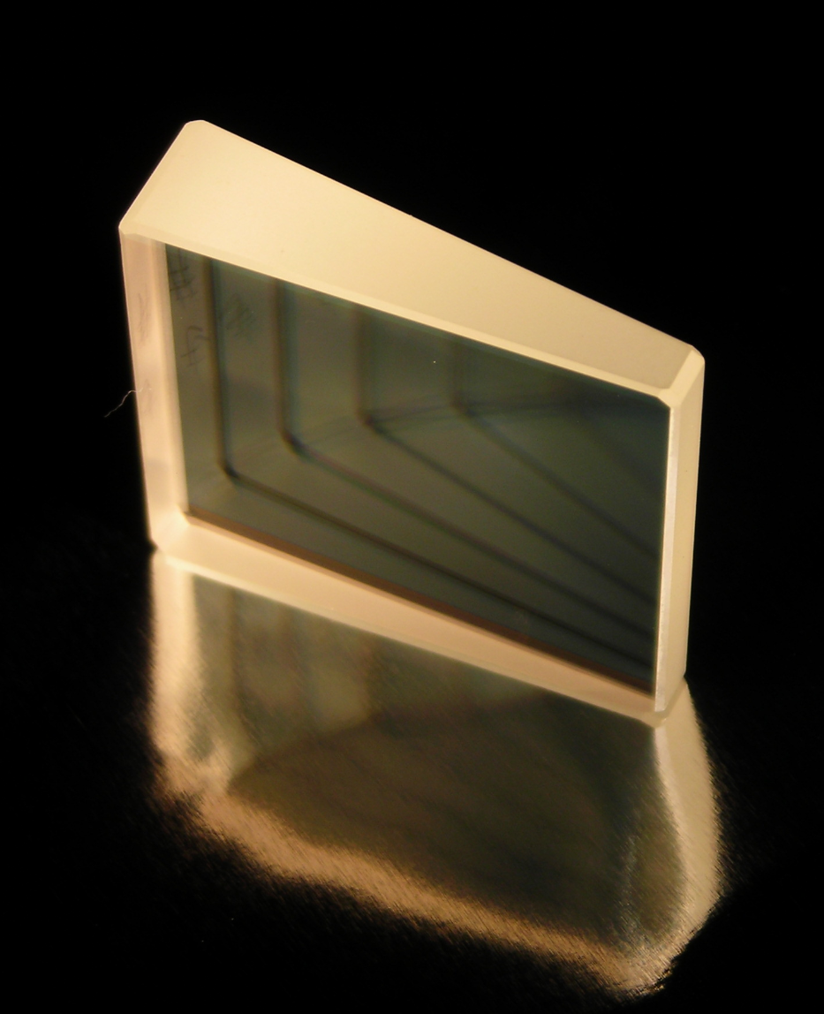
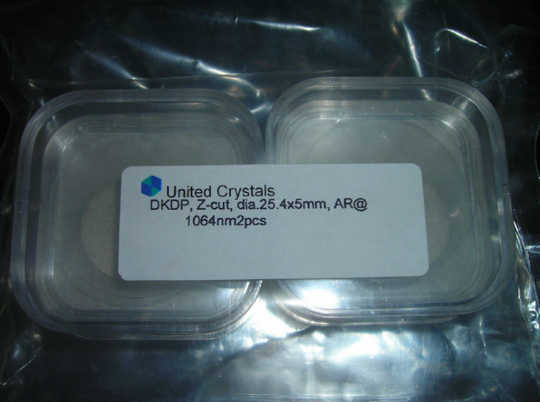
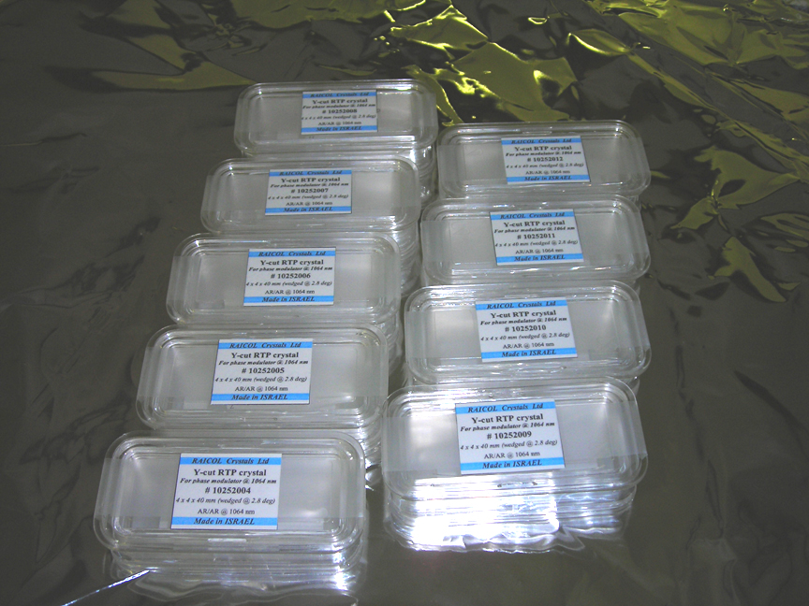
Project Phase
DKDP crystals for FIs
RTP crystals for EOMs
Low absorption FI
calcite wedge polarizer
ALIGO Faraday Rotator Housing
(pre-owned by eLIGO)
ALIGO EOM (pre-owned by eLIGO)
21

Slide 22
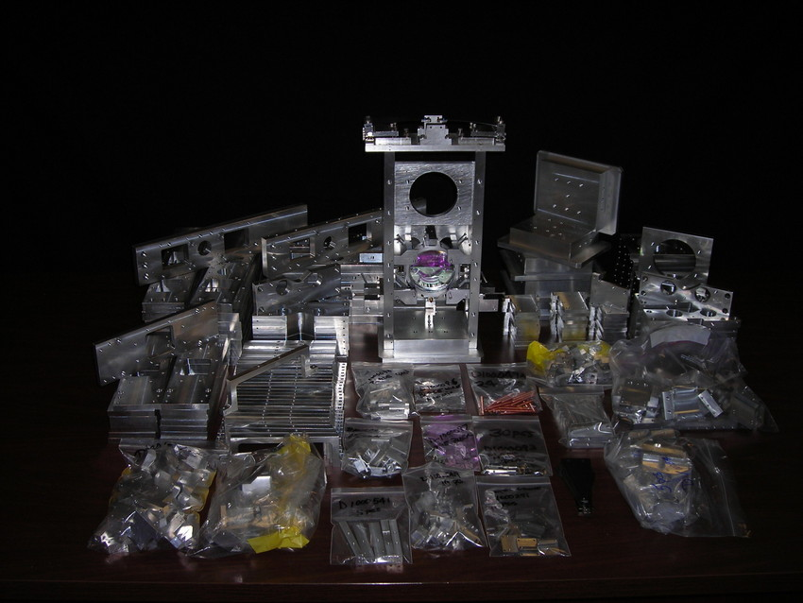
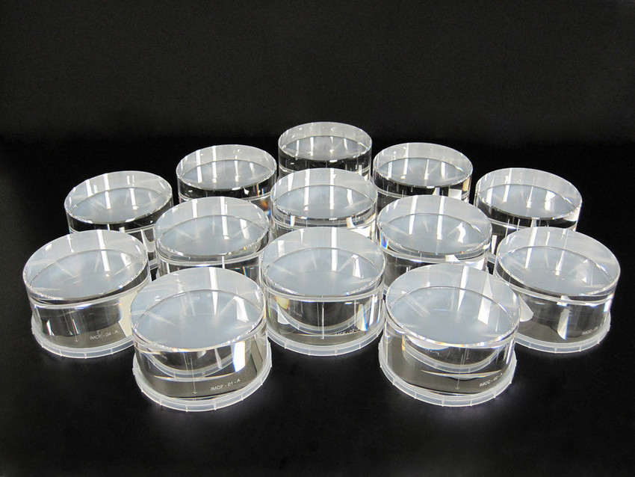
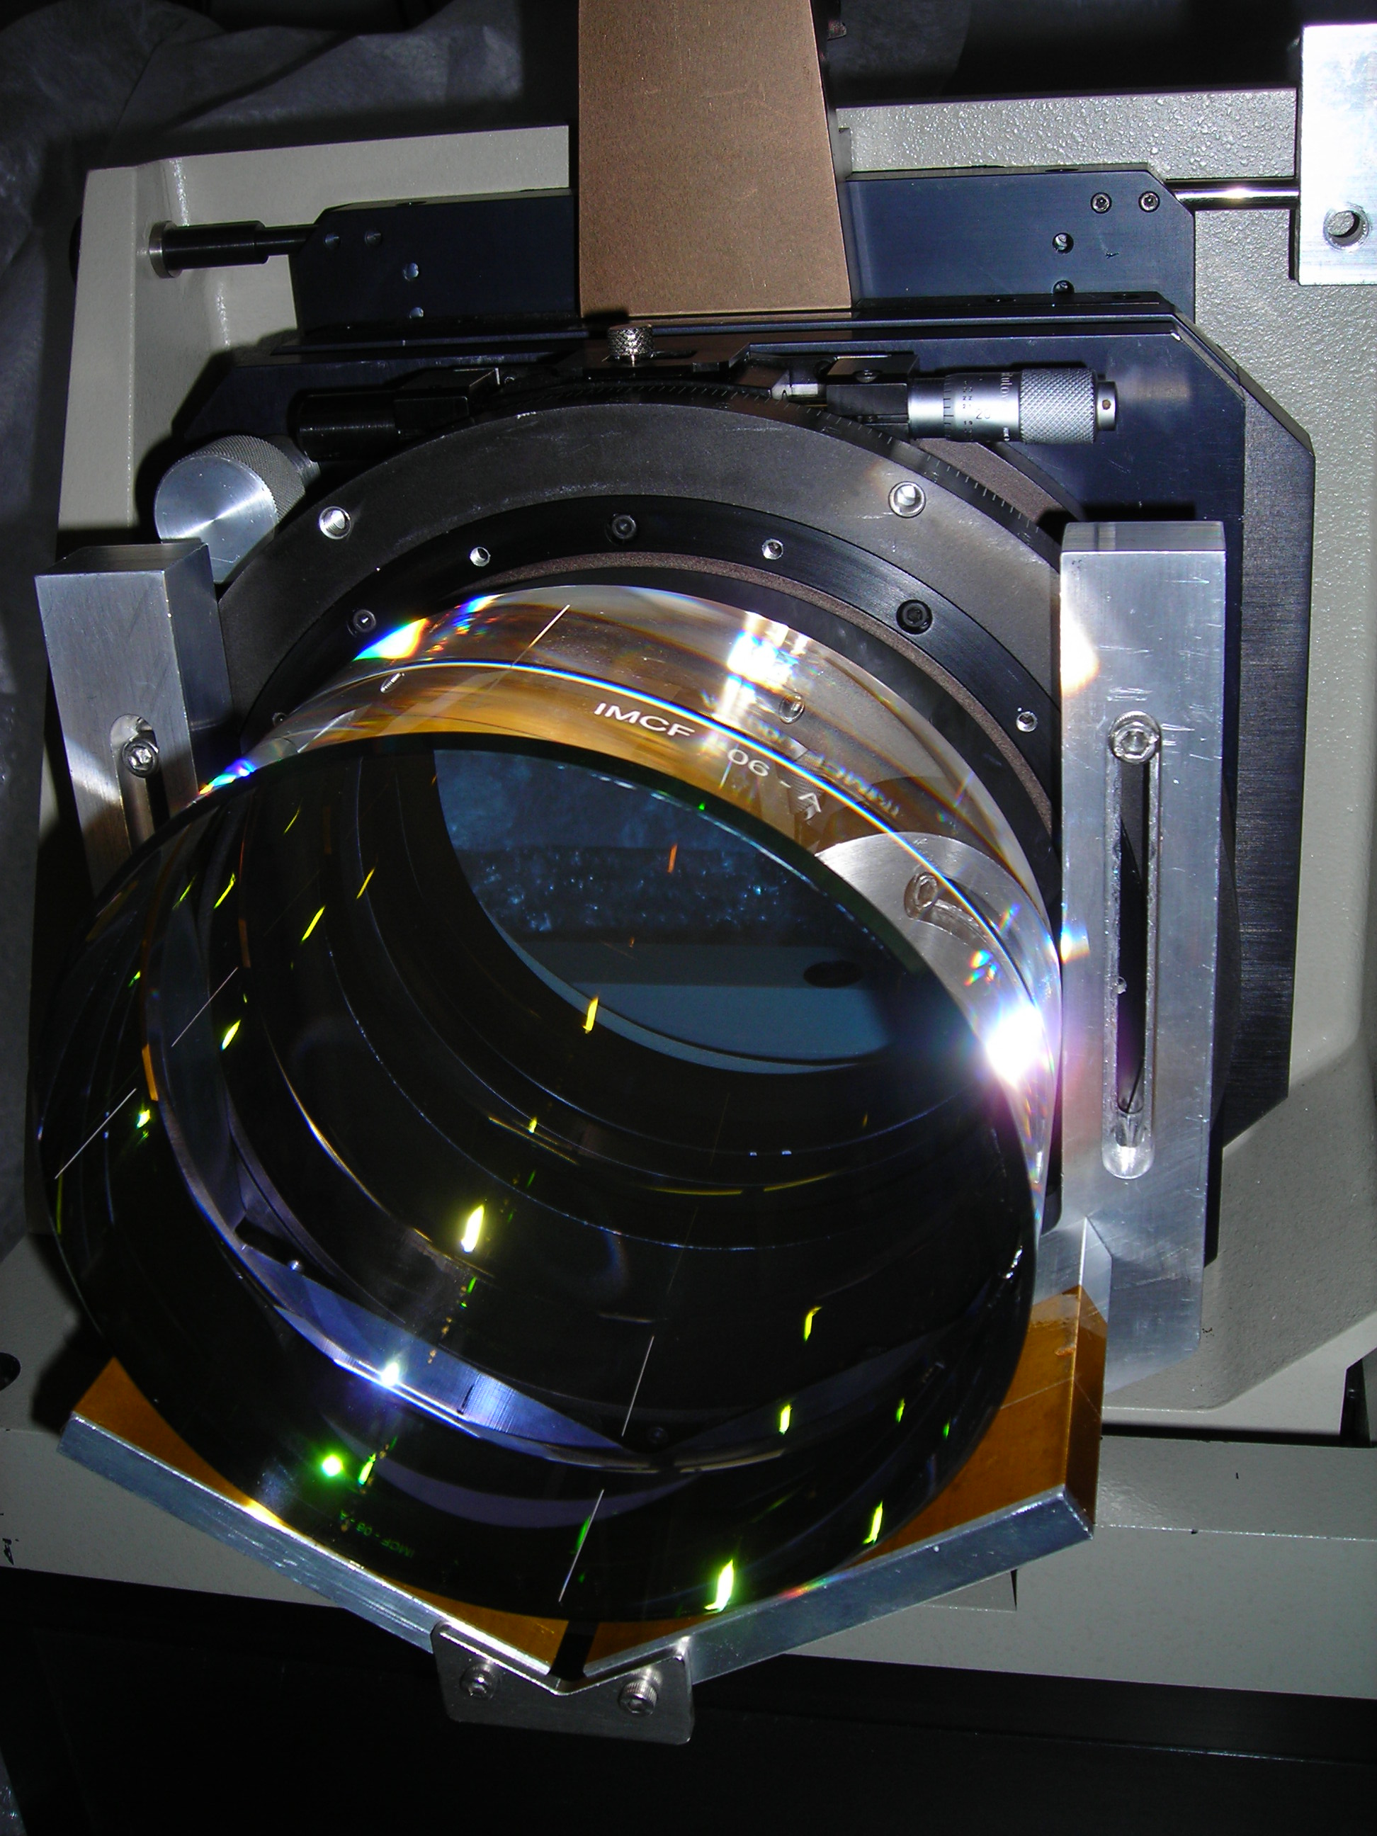
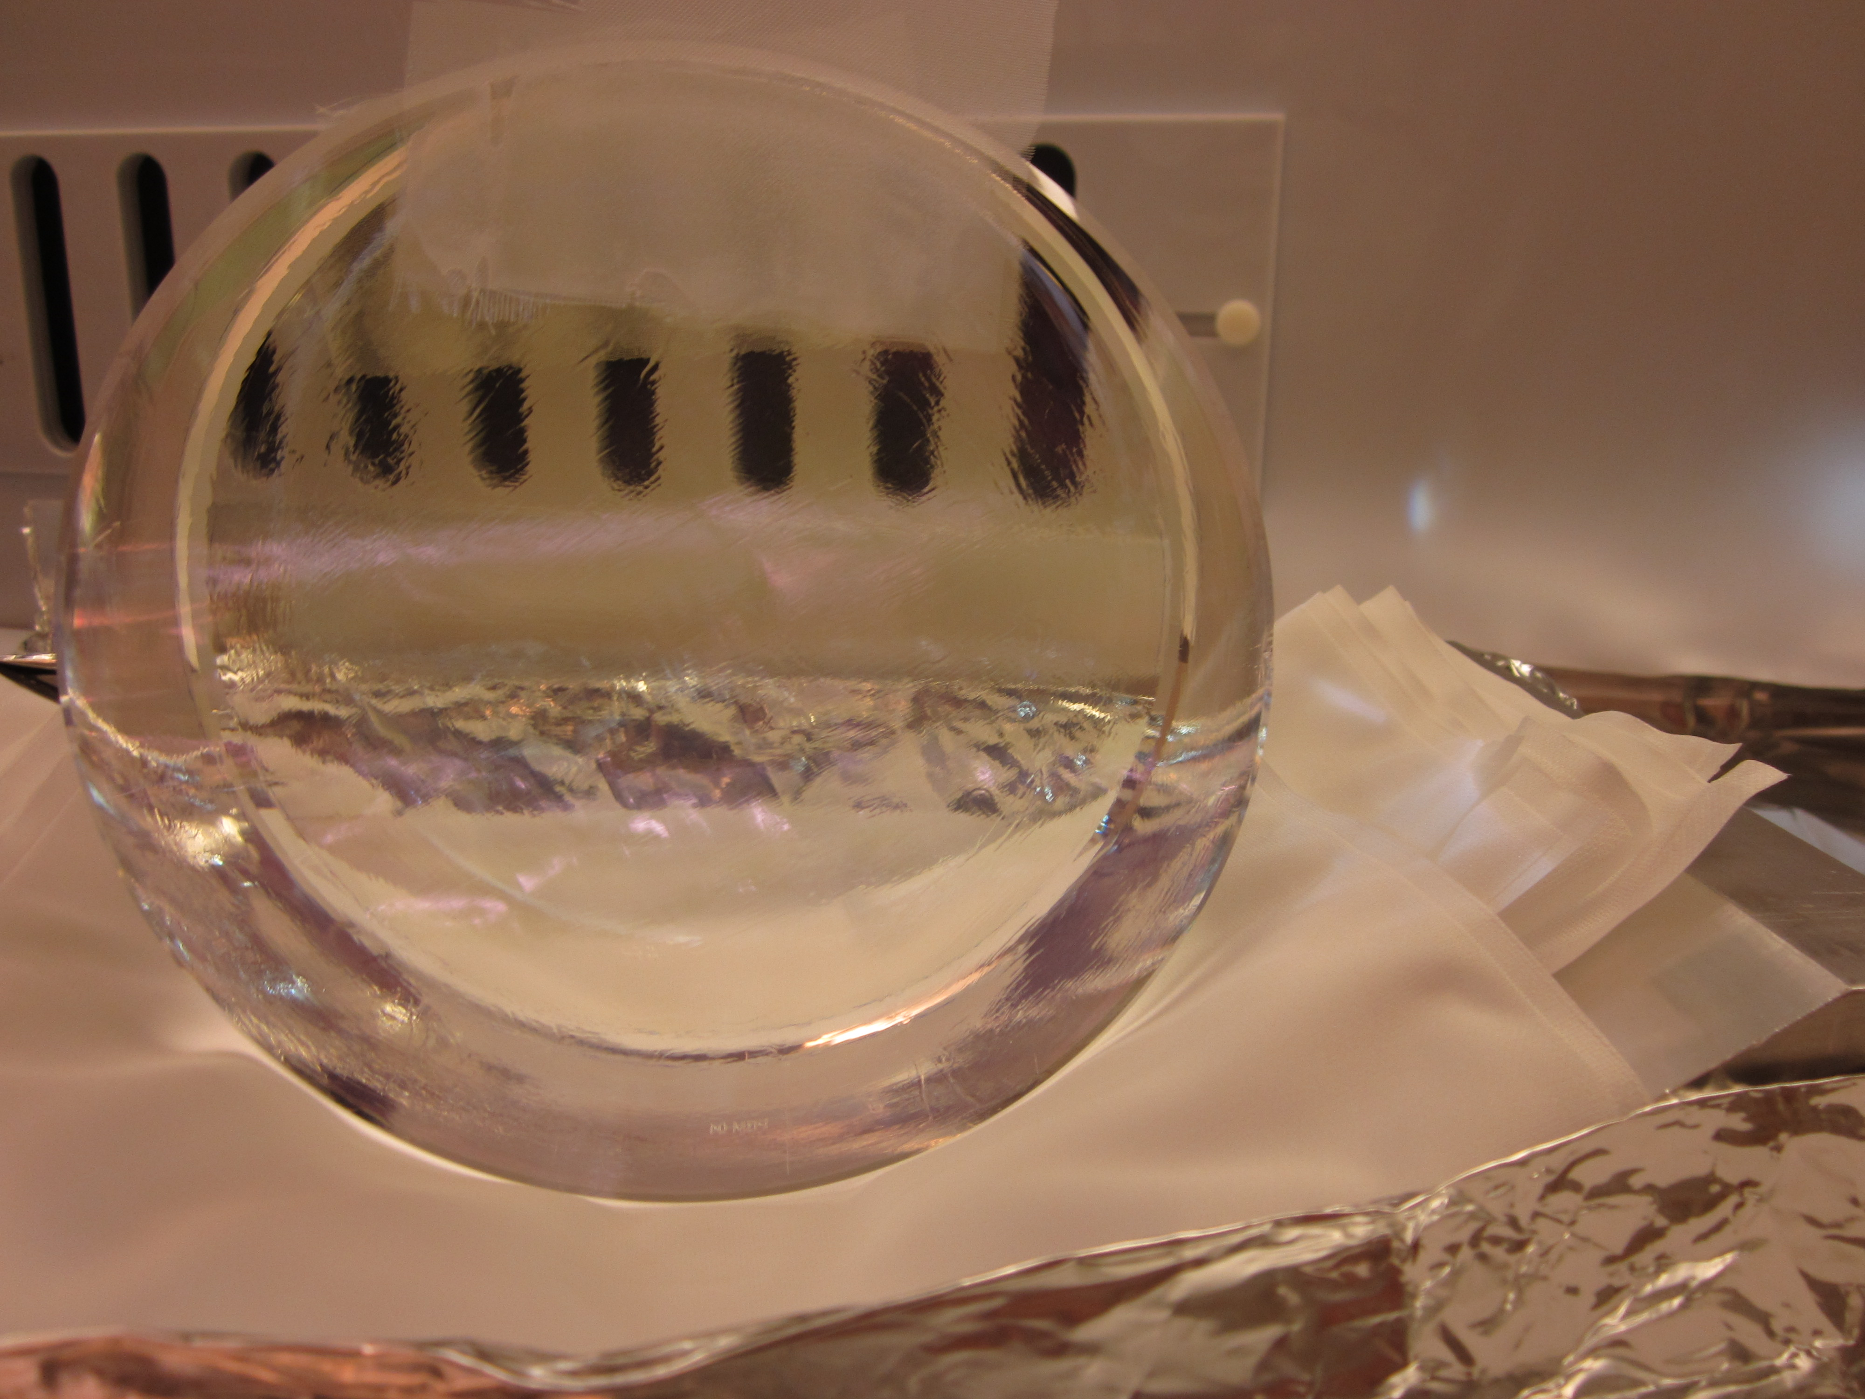
HAM Auxiliary Suspension components
IMC mirror substrates: precoat
IMCF-06 undergoing
metrology
First Contact™ on an IMC mirror

Slide 23
Challenges, Risks, and Mitigations
Concern: The IO group (like everyone) has a significant amount of assembly, test, and installation work in the coming 6 month period – installation of much of the of LIGO Livingston Input Optics, and assembly of Hanford H2 IO components. Schedules and delays in the IO internally (procurements, assembly, test) or in other parts of the project will push out the schedule and present logistical challenges
Mitigation:
  close coordination with Installation subsystem to maintain awareness of schedule
  Re-prioritize activities as needed to optimize installation

Slide 24
Challenges, Risks, and Mitigations
Concern: Delay in procurement of reference spheres for recycling mirror metrology may delay of measurements of radii of curvature needed for installation in L1
Mitigation: fall back plan is to use LIGO1 methods (2f imaging) to get 1% accuracy
Concern: Delays in HAM small triple suspension fabrication (welding) and test may delay HSTS assembly and installation
Mitigation:
  Structure welding difficulties resolved, HSTS frames now in production.
  Build second test stand. Enlist additional staff to help with assembly.

Slide 25
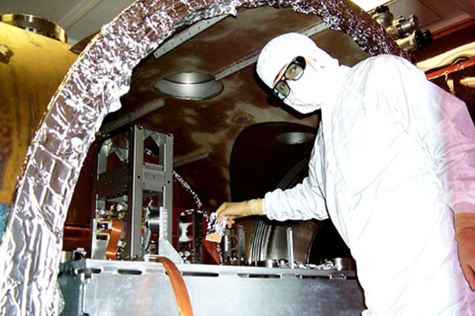
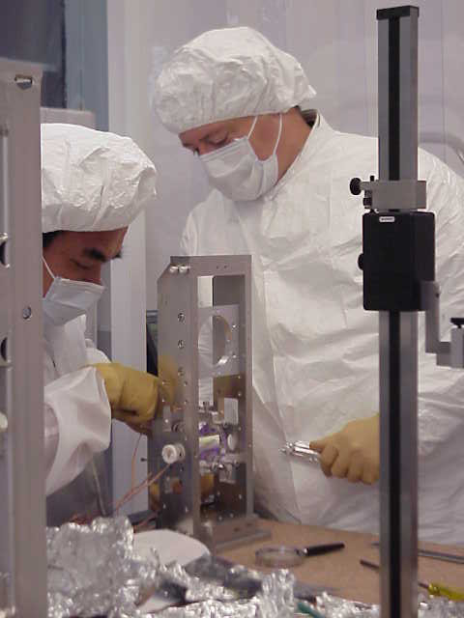
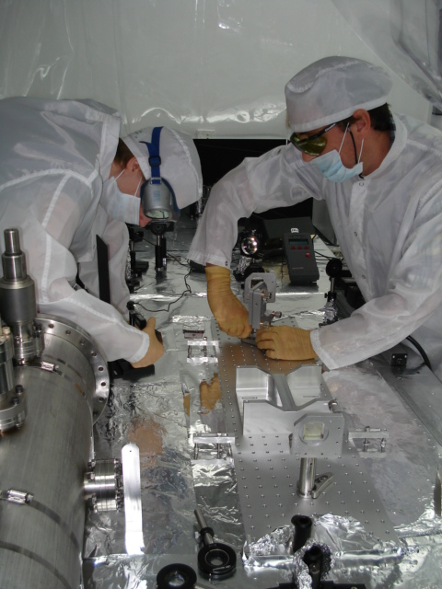
Input Optics: Next 6 months
Complete procurements for all three interferometers
Complete fabrication of L1 custom components
Complete metrology of small recycling mirrors
L1 interferometer assembly and installation
  Assemble/Test electro-optic modulator
  Assemble/Test HAM auxiliary suspensions
  Assemble/Test Faraday isolator
  Assemble/Test HAM Small Triple Suspensions (with SUS group)
  Install IO optics on PSL table
  Begin installation in HAM vacuum chambers
25

