Slide 1
Thermal Compensation System – TCS
Technical Presentation aLIGO NSF Review
LIGO Livingston Observatory
25-27 April 2010

Slide 2
TCS Functions
Measures the thermal lens in the Input Test Mass substrate and Compensation Plate using a Hartmann Sensor
Compensates thermal lensing in the Input Test Mass substrate and Compensation Plate using a CO₂ laser projector system
Controls the radii of curvature in the Input Test Mass and End Test Mass using ring heaters
Intermittently measures the End Test Mass with the Hartmann sensor to investigate thermal loading
2

Slide 3
TCS Requirements
Provide up to -5% radius of curvature change to test mass high-reflectance faces
Maintain radiofrequency sideband gain in power recycling cavity up to 120W input power
Maintain arm cavity power buildup to 95% of cold cavity value
Maintain gravitational wave sideband extraction through signal recycling cavity to 95% of cold cavity value
Maintain homodyne power at dark port to within 1mW
Above requirements met by maintaining thermal aberrations to within λ/47 (Core Optics requirements are ~λ/300)
Must meet these requirements without injecting noise above technical noise requirements (phase noise, magnetic noise, etc.)

Slide 4
TCS Design Concept
TCS consists of sensors to detect thermal aberrations and actuators to correct thermal aberrations
  Sensors:
    Hartmann wavefront sensor to measure thermal phase profile in individual End Test Masses and Input Test Mass/Compensation Plate pairs
    Phase camera and bull’s-eye sensor to measure interferometer beam profiles
  Actuators:
    Carbon dioxide laser projector acting upon compensation plate to correct thermal lens in recycling cavities
    Radiant ring heaters to correct test mass mirror surface radii of curvature
4

Slide 5
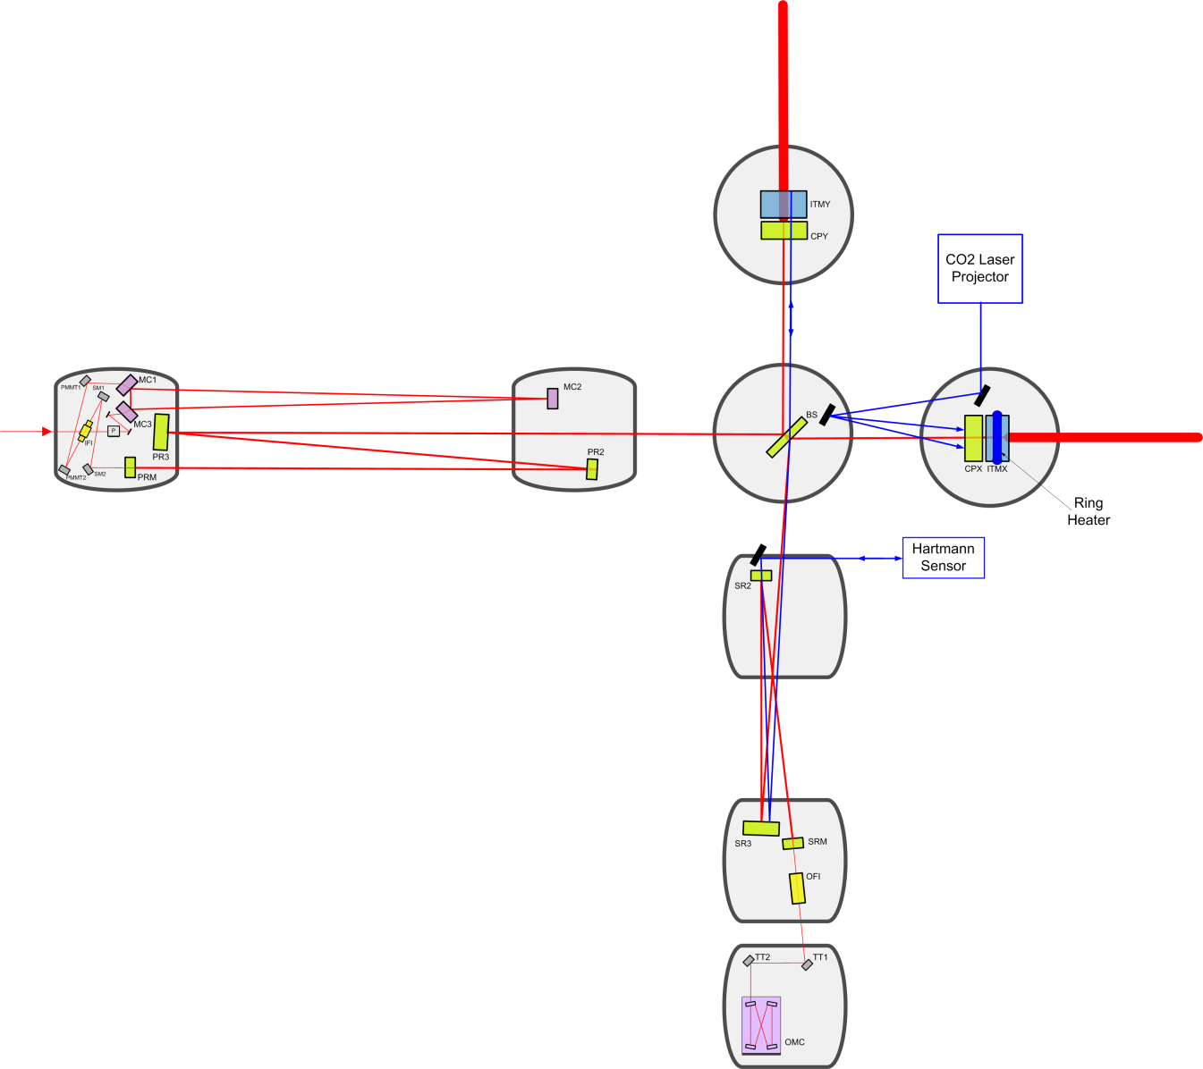
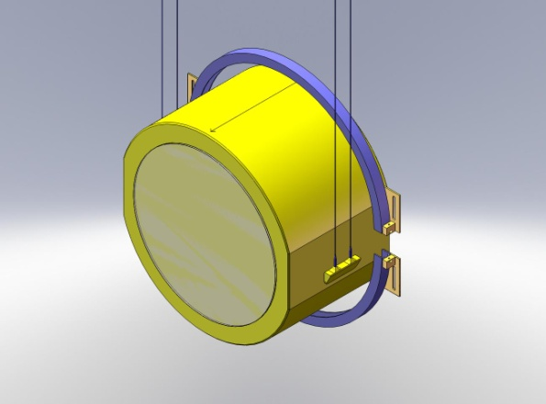
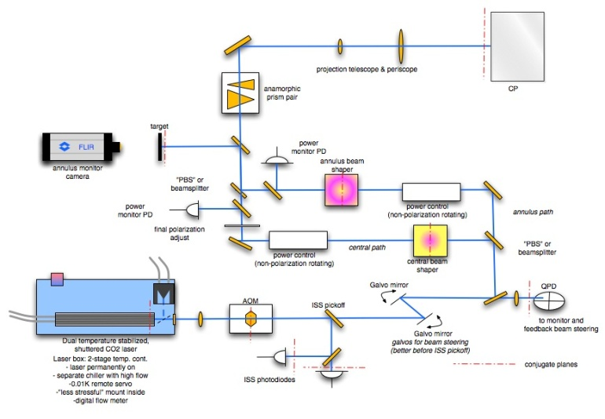
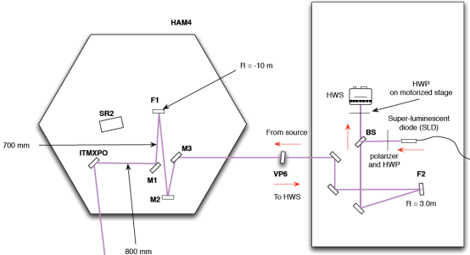
Thermal Compensation System
(TCS)
5

Slide 6
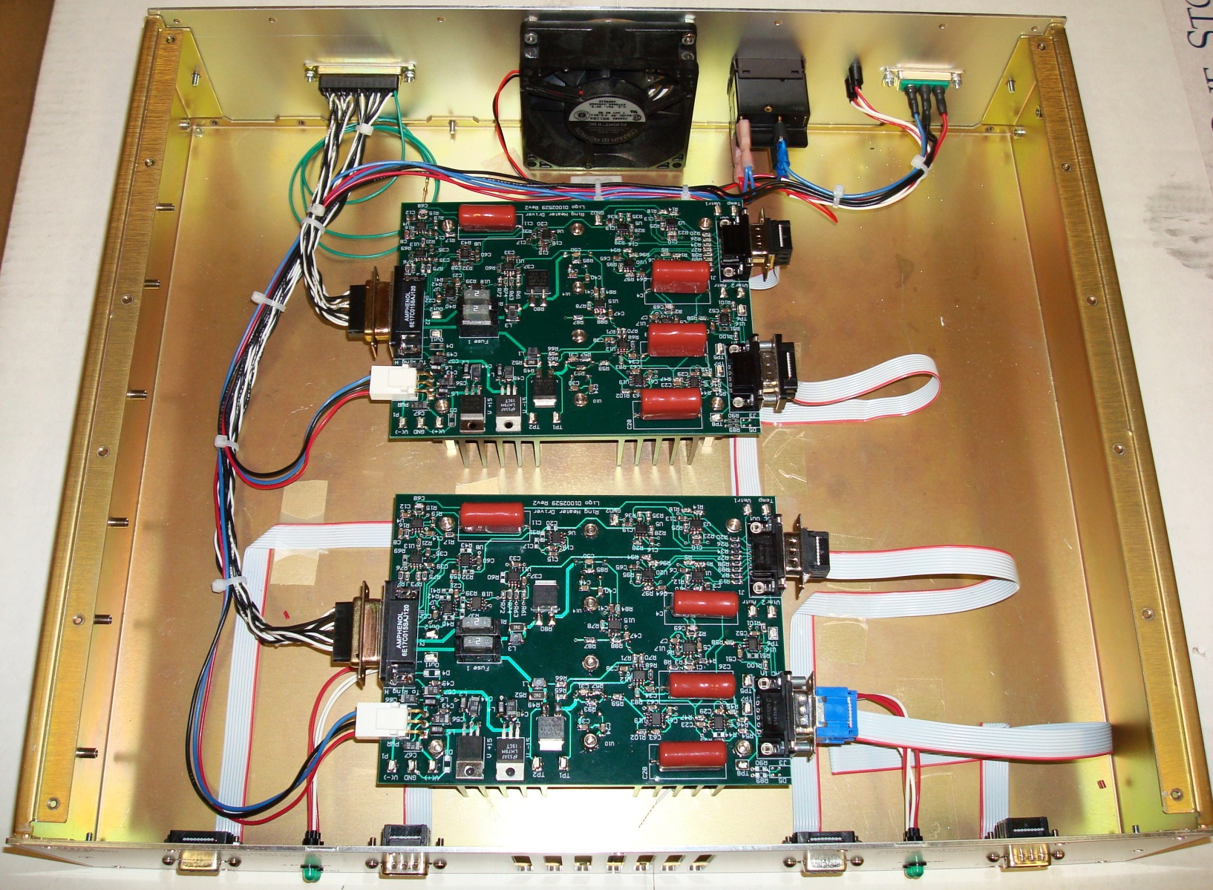
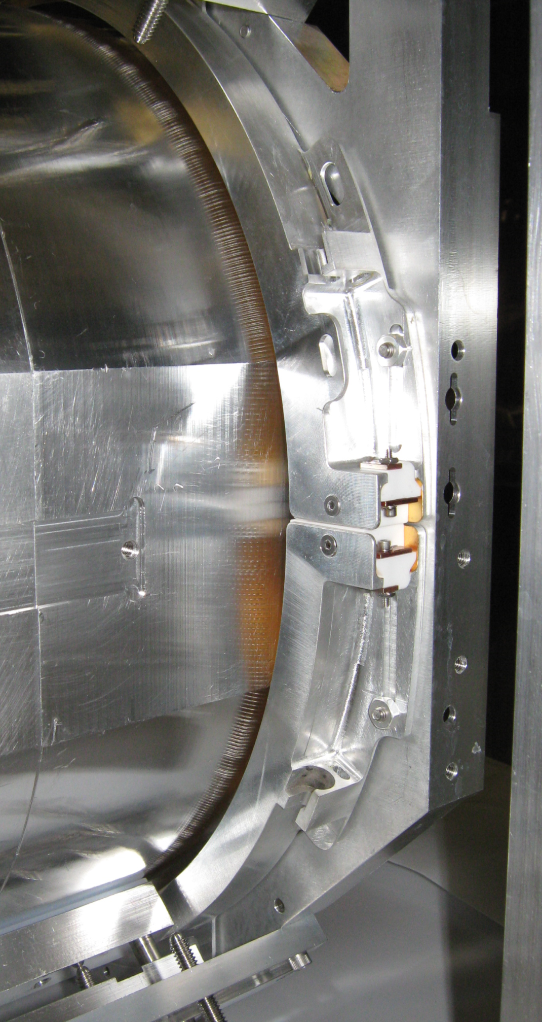
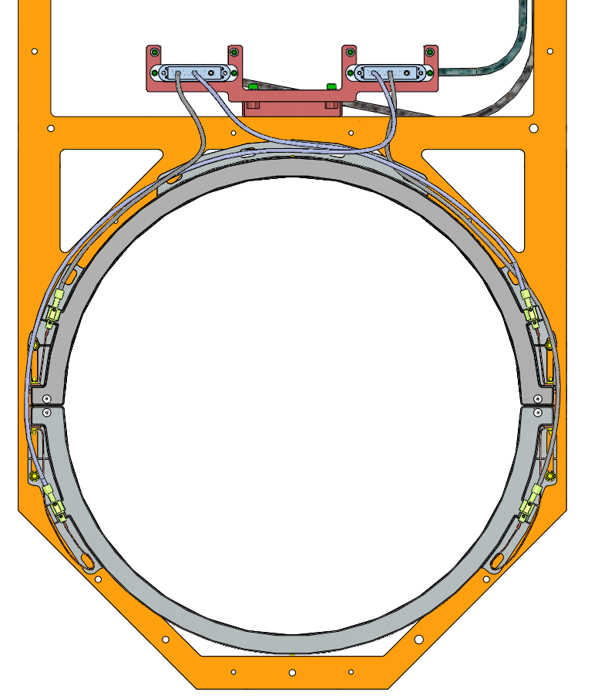
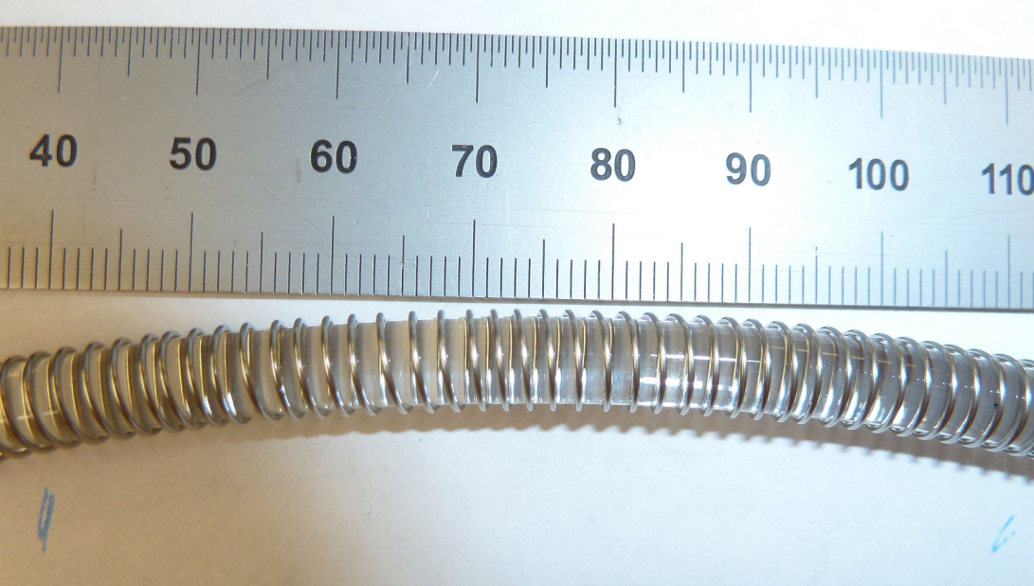
TCS Production Units
Ring Heater
The ring heater has passed final design and is now on project.
  PDR completed July 2010
  FDR completed December 2010
University of Florida group is verifying heating pattern in vacuum of delivered heaters and developing alternative risk-reduction ring heater design
6

Slide 7
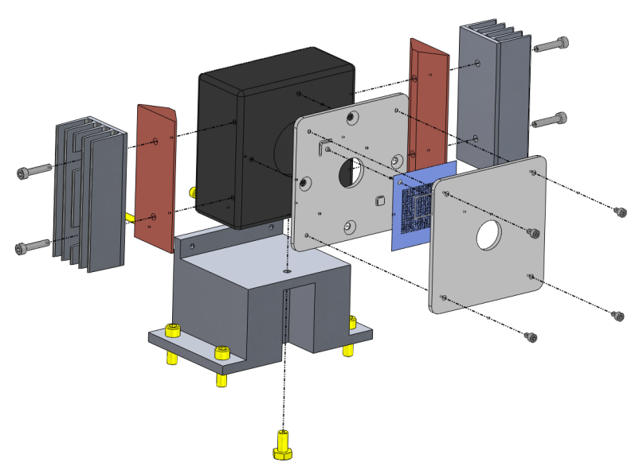
TCS Development Plan
Hartmann Sensor
Hartmann sensor camera FDR completed August 2010
Remaining Hartmann sensor PDR completed April 2011
Remaining FDR: October 2011
University of Adelaide is making significant contributions to aLIGO TCS: now purchasing cameras for aLIGO as per MOU with LIGO and writing Hartmann Wavefront Sensor software.
Hartmann sensor probe beam wavelengths have been chosen, layout is being finalized. Beamsplitter antireflection coating design optimization for Hartmann Wavefront Sensor is still being considered.
7

Slide 8
TCS Development Plan
CO₂ Laser Projector
CO₂ projector design operated on Enhanced LIGO with high power − most noise couplings were identified and mitigated
A search is ongoing for a stable, higher-power laser to handle aLIGO thermal lens with desired power margin
PDR: July 2011
  Optical path layouts to be optimized for safety, facility and performance requirements
FDR: November 2011
8

Slide 9
CO₂ Laser Procurement
The initial vendor for the CO₂ laser failed to deliver a laser that met requirements
The CO₂ laser choice presents no technical risk to the CO₂ laser projector design, only cost or schedule risk.
We can adopt an off-the-shelf 30W laser presenting:
  No budgetary risk
  No schedule risk
  Low to moderate technical risk to initial realization of adequate power margin, to be met with higher power development if deemed necessary
We can adopt an upgraded off-the-shelf 50W laser:
  High budgetary risk (+50%)
  Moderate schedule risk
  Low technical risk to realization of adequate power margin
Other vendors also under consideration

Slide 10
TCS Project Organization
TCS Team Leader/Mechanical Engineer - Mindy Jacobson - Caltech
Cognizant Scientist - Phil Willems - Caltech
Electronics Engineer - Steve O’Connor - Caltech
Staff scientist - Aidan Brooks - Caltech
Operator/Technical support - Cheryl Vorvick – Hanford Observatory; Chris Guido – Livingston Observatory
Mechanical Engineer/Draftsperson - Caltech
Ring heater design support - Guido Mueller, Giacomo Ciani, Deepak Kumar, Chris Mueller- University of Florida group
Hartmann sensor design and material support - Jesper Munch, Peter Veitch, David Ottaway, Won Kim - University of Adelaide
People/positions in red are new or unfilled
10

Slide 11
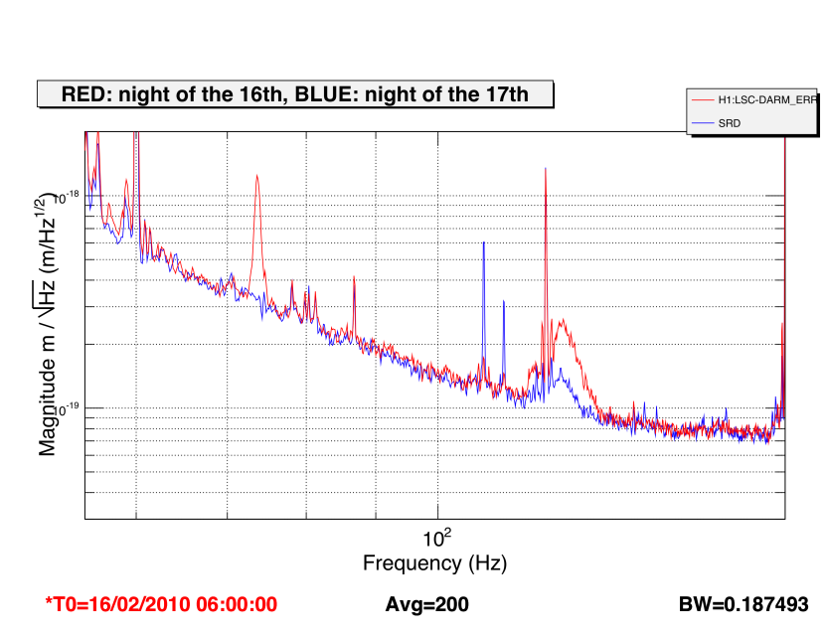
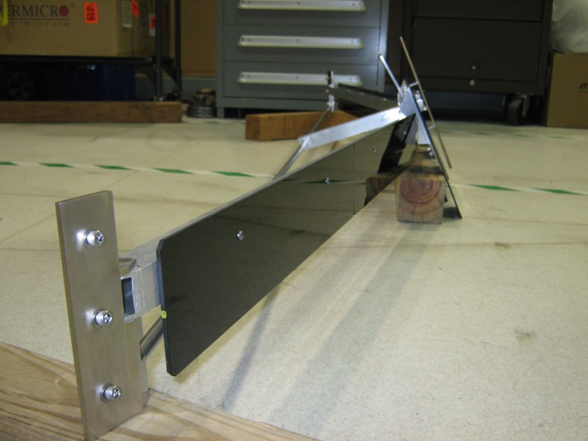
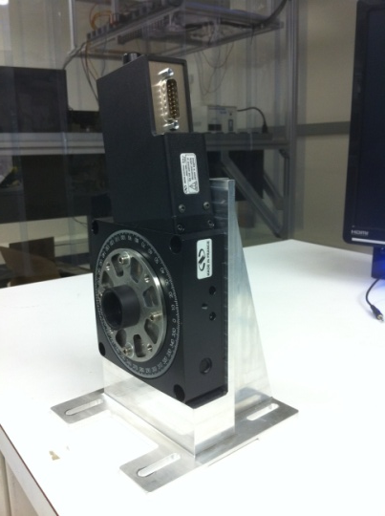
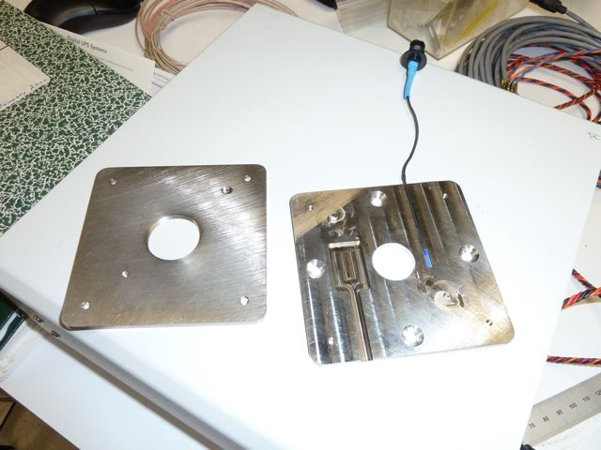
TCS Development Accomplishments
CO₂ laser projector operated successfully on Enhanced LIGO; projector in-vacuum steering mirror for H2 reviewed and in fabrication, with one to be installed during H2 single-arm test; power control waveplate mount designed
HWS probe beam wavelengths chosen and optical layout nearly finalized; HWS cameras on project and currently in procurement. Beta version of core HWS software complete.
TCS periscope mirror resonances pre- and post-alignment
Hartmann sensor mounting plate with
thermal sensor
Power control waveplate mount
11
CO2 projector in-vacuum steering mirror

Slide 12
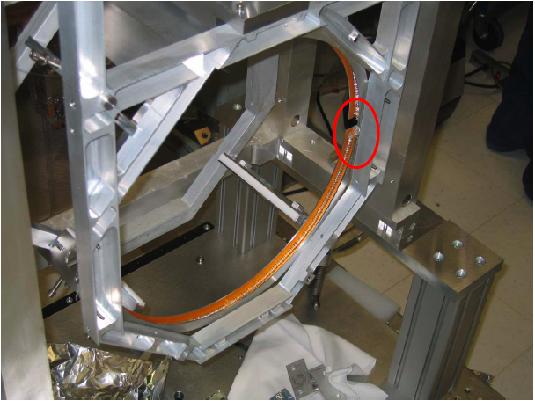
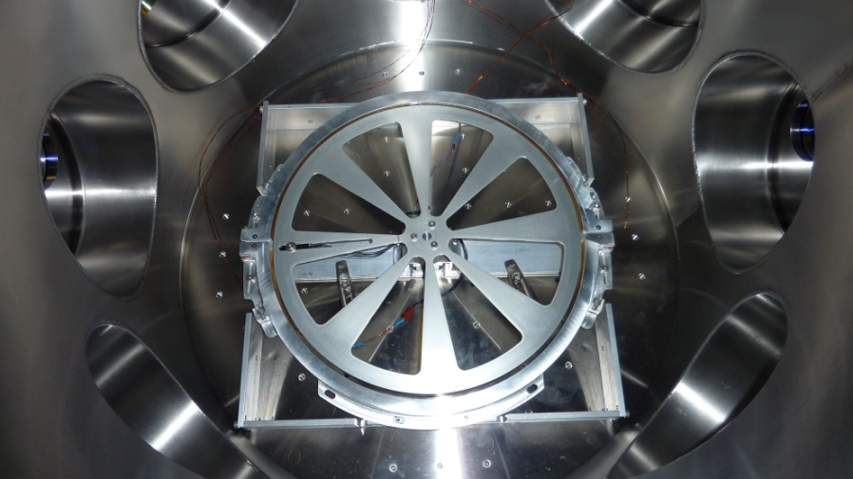
TCS Development Accomplishments
Ring heater through design phase and in fabrication for installation during H2 single-arm test- heater pattern uniformity meets requirements, current driver meets magnetic noise requirements
TCS/SYS integration: laboratory floor layout, vacuum compatibility of fabrication, interfaces with CDS,SUS,COC,ISC
red circle shows gap between ring heater segments for SUS fiber welding
Ring heater seen during prototype quad SUS assembly
Vacuum ring heater tester at University of Florida
Sample ring heater temperature profile

Slide 13
TCS Fabrication Plan
Much of the TCS optical and mechanical components are off-the-shelf
Remaining components (e.g. ring heaters, in-vacuum mirrors, installation tooling) are being designed in-house and manufactured by local machine shops using established processes
The University of Adelaide is procuring and delivering part of the TCS hardware (Hartmann sensor cameras) and has delivered a prototype baseline camera assembly.
  Procurement contribution is on the order of US$750k
13

Slide 14
TCS Project Phase Plans
TCS entered the Project Phase in October 2010 to meet early need-by dates for in-vacuum TCS components integration
  Ring heater
  H2 in-vacuum steering mirror
  ZnSe viewports
TCS will fully transition to Project Phase in December 2011 in order for remaining TCS components to meet later integration need-by dates.
14

Slide 15
TCS Challenges, Risks, and Mitigations
Moderate TCS risks
  Noise due to TCS power instability, which are being mitigated by prototype study (projector noise reduction on eLIGO), and by optimizing ring heater components [AOS RR-003]
  Initial vendor for CO₂ laser proved unable to deliver suitable high power laser; we are currently investigating alternative vendors, and possibly installing lower power laser initially while pursuing higher power laser development [AOS RR-009]
Major TCS risks
  Main risk is excessive or inhomogeneous absorption in ITM coatings. As-built coating prototypes meet (even exceed) spec; in-vacuo contamination is the remaining threat. In-situ cleaning procedures are currently under study to reduce contamination. [AOS COC RR-010]
15

Slide 16
TCS Near Term Activities
Fabrication and installation of ring heaters and initial testing of Hartmann sensor on H2 single arm test
CO₂ laser requirements and vendor re-evaluation
CO₂ laser projector component design:
  Upper periscope mirror/ZnSe viewport design
  Beam shaping optics
  Intensity/beam drift stabilization
  In-vacuum steering optics for H1/L1
Hartmann sensor PDR closeout and begin of Final Design phase
  Alignment optics for sensor installation
  Prototype electronics for Hartmann sensor at H2 single-arm integration

