Slide 1
Auxiliary Optical Systems - AOS
Transmission Monitoring Telescope and Suspension – TMS
Eric Gustafson
aLIGO NSF Review
LIGO Livingston Observatory
April 25-27, 2011

Slide 2
Auxiliary Optical System Talks Outline
Transmission Monitoring Telescope and Suspension (TMS) – Eric Gustafson
Optical Levers (OptLev) – Eric James
Thermal Compensation System (TCS) – Phil Willems
Initial Alignment System (IAS) – Doug Cook
Photon Calibration System (PhotonCal) – Rick Savage
Stray Light Control (SLC) and Viewports (VP) – Mike Smith

Slide 3
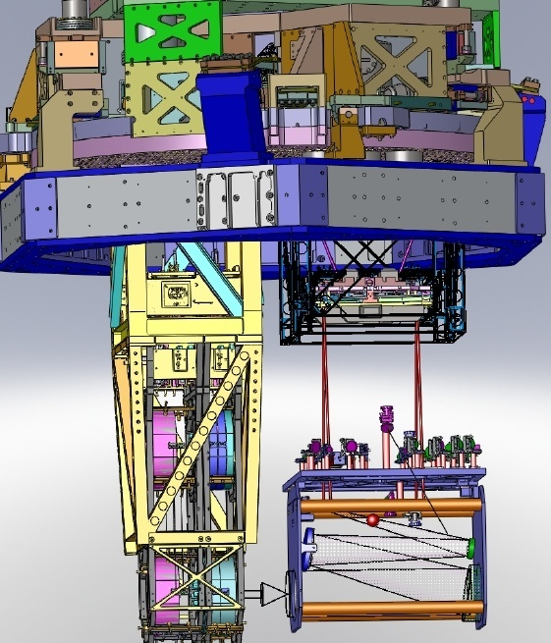
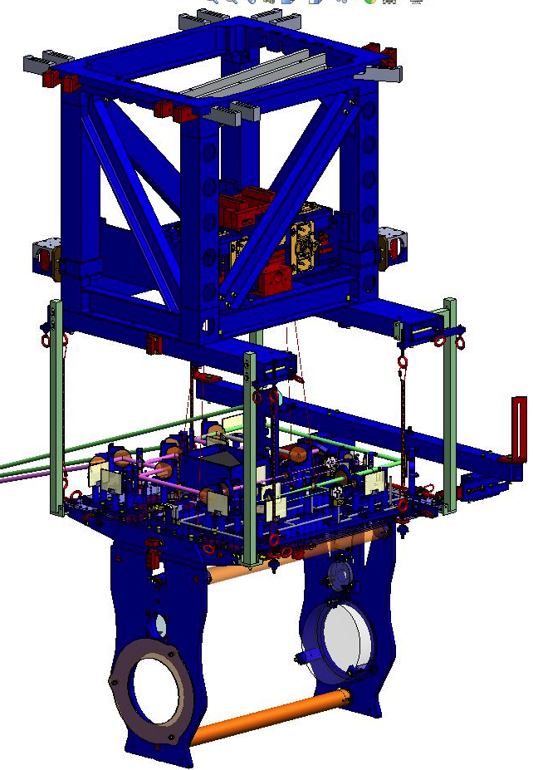
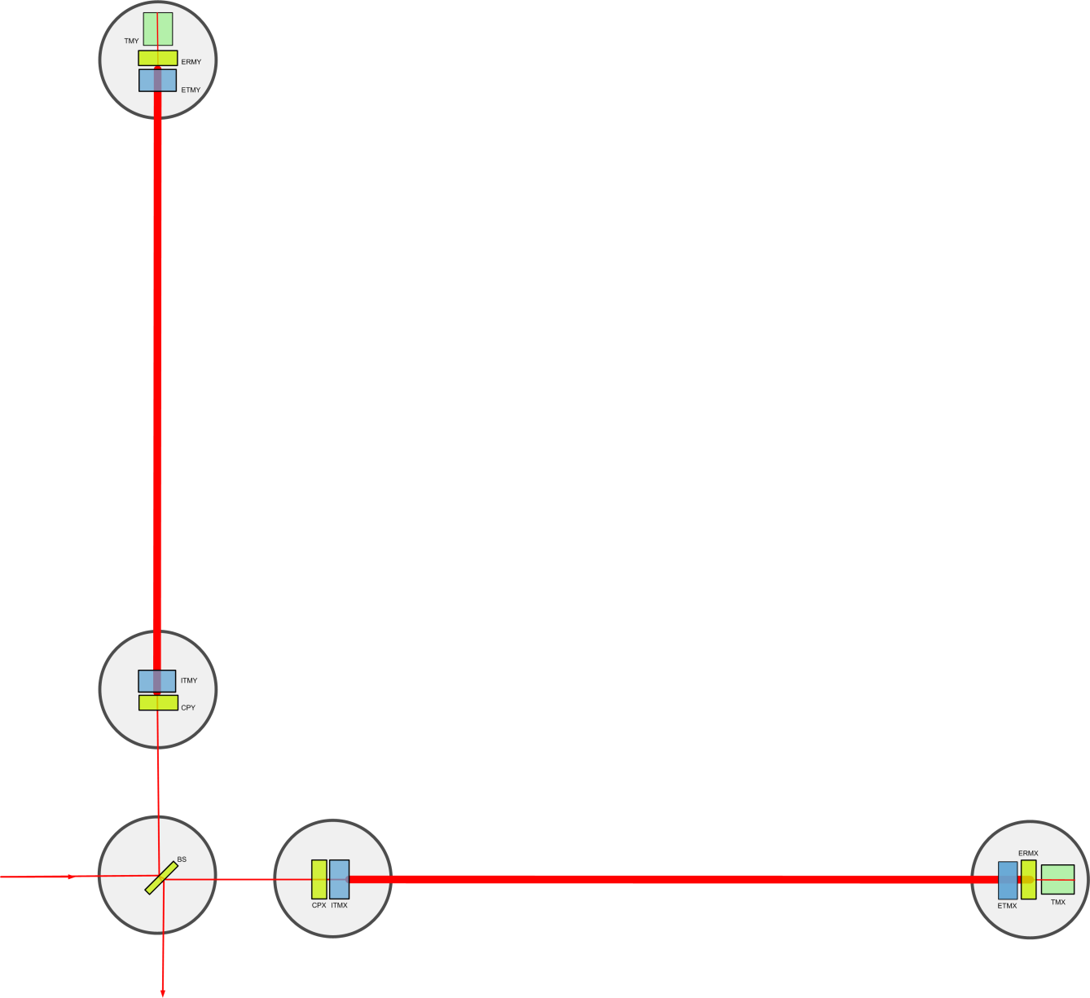
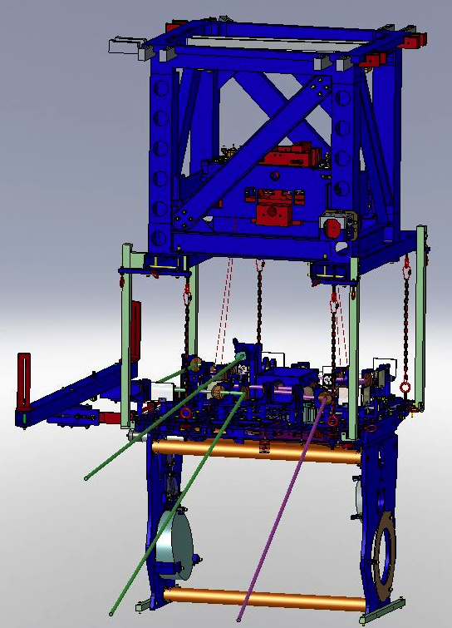
Transmission Monitoring Telescope and Suspension - TMS
TMS
TMS

Slide 4
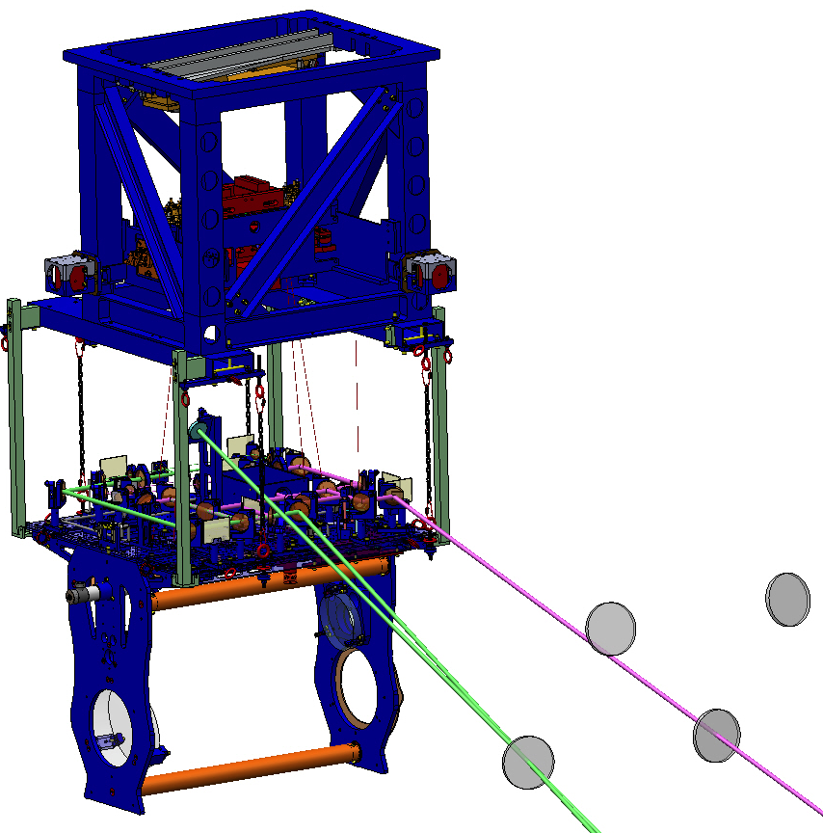
TMS Functions
Collects 1064 nm light transmitting through ETM and provides it for Interferometer Sensing and Control
Transmits 532 nm light for Arm Length Stabilization
Transmits 532 nm for intermittent Hartmann ETM monitoring
Transmit any residual 1064 nm radiation to beam dump

Slide 5
TMS Requirements
Suspension and Noise
  6 DOF of platform are isolated
  Suspension Eigen frequencies between 0.5-5 Hz
  All rigid body modes damped to Q<10
  Above 10 Hz isolation factor > 1000 all 6 DOF
    Displacement noise < 1 pm/ √(Hz)]
    Angular noise < 1 frad/ √(Hz)]
  Internal modes of suspension structure 150 Hz or higher
  At 3 Hz isolation factor >10 all DOF
Telescope
  Reduce 1064 nm beam by 20x to fit 2 inch optics on optics table
  Alignment sensors with 90 degree Gouy phases within ± 10 deg.
  Handle 1064 nm, 532 nm sensor wavelengths

Slide 6
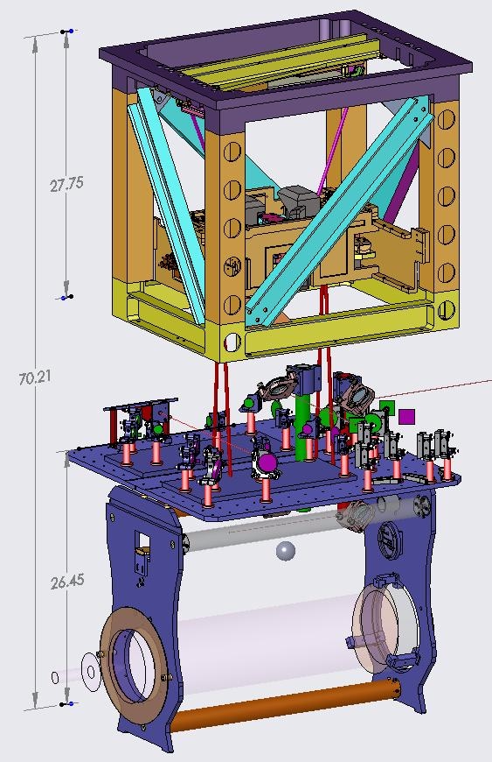
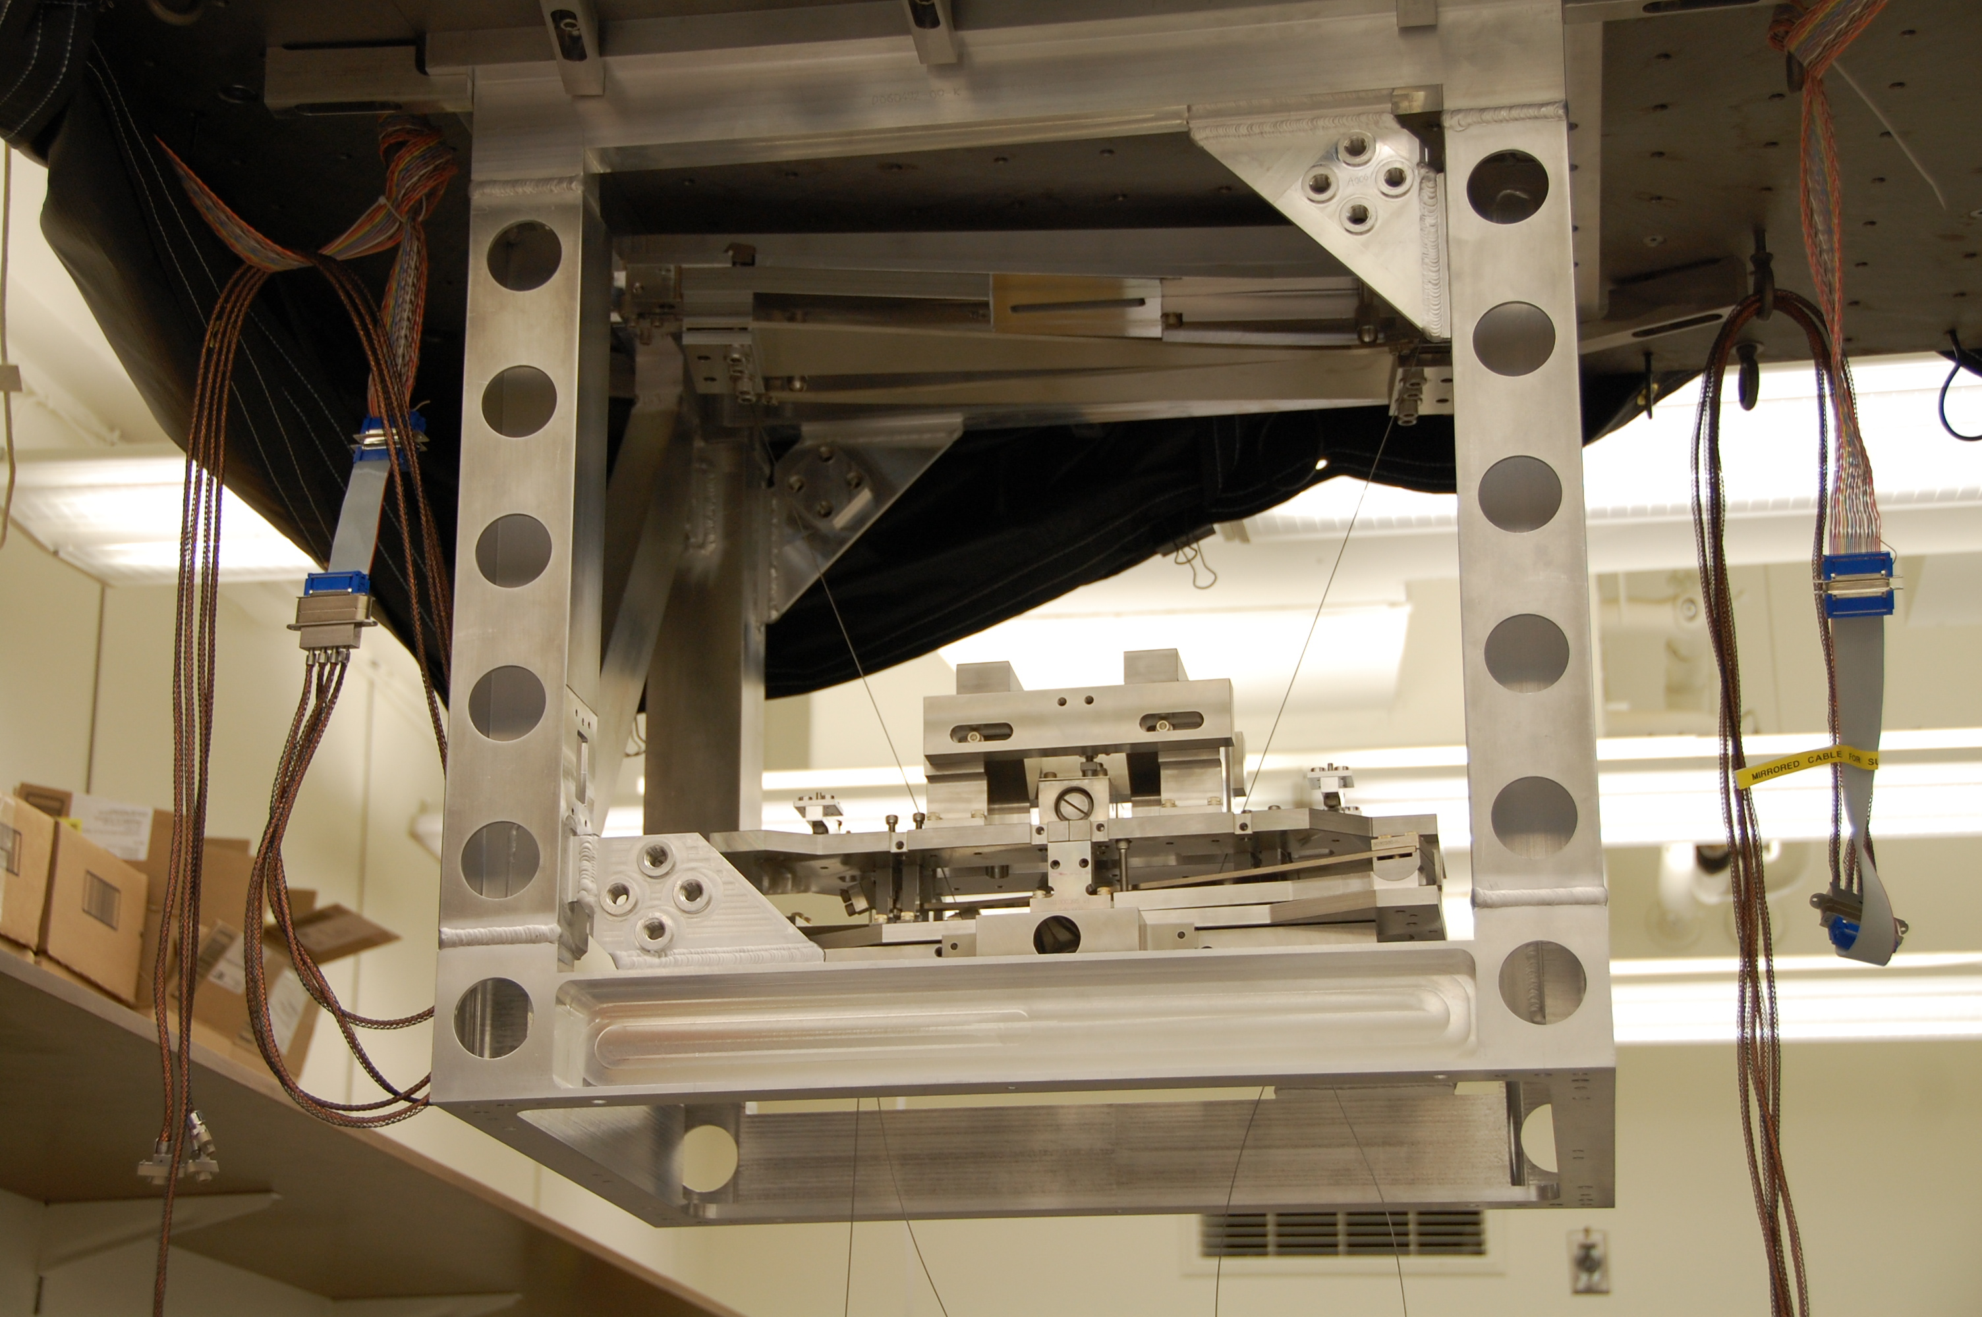
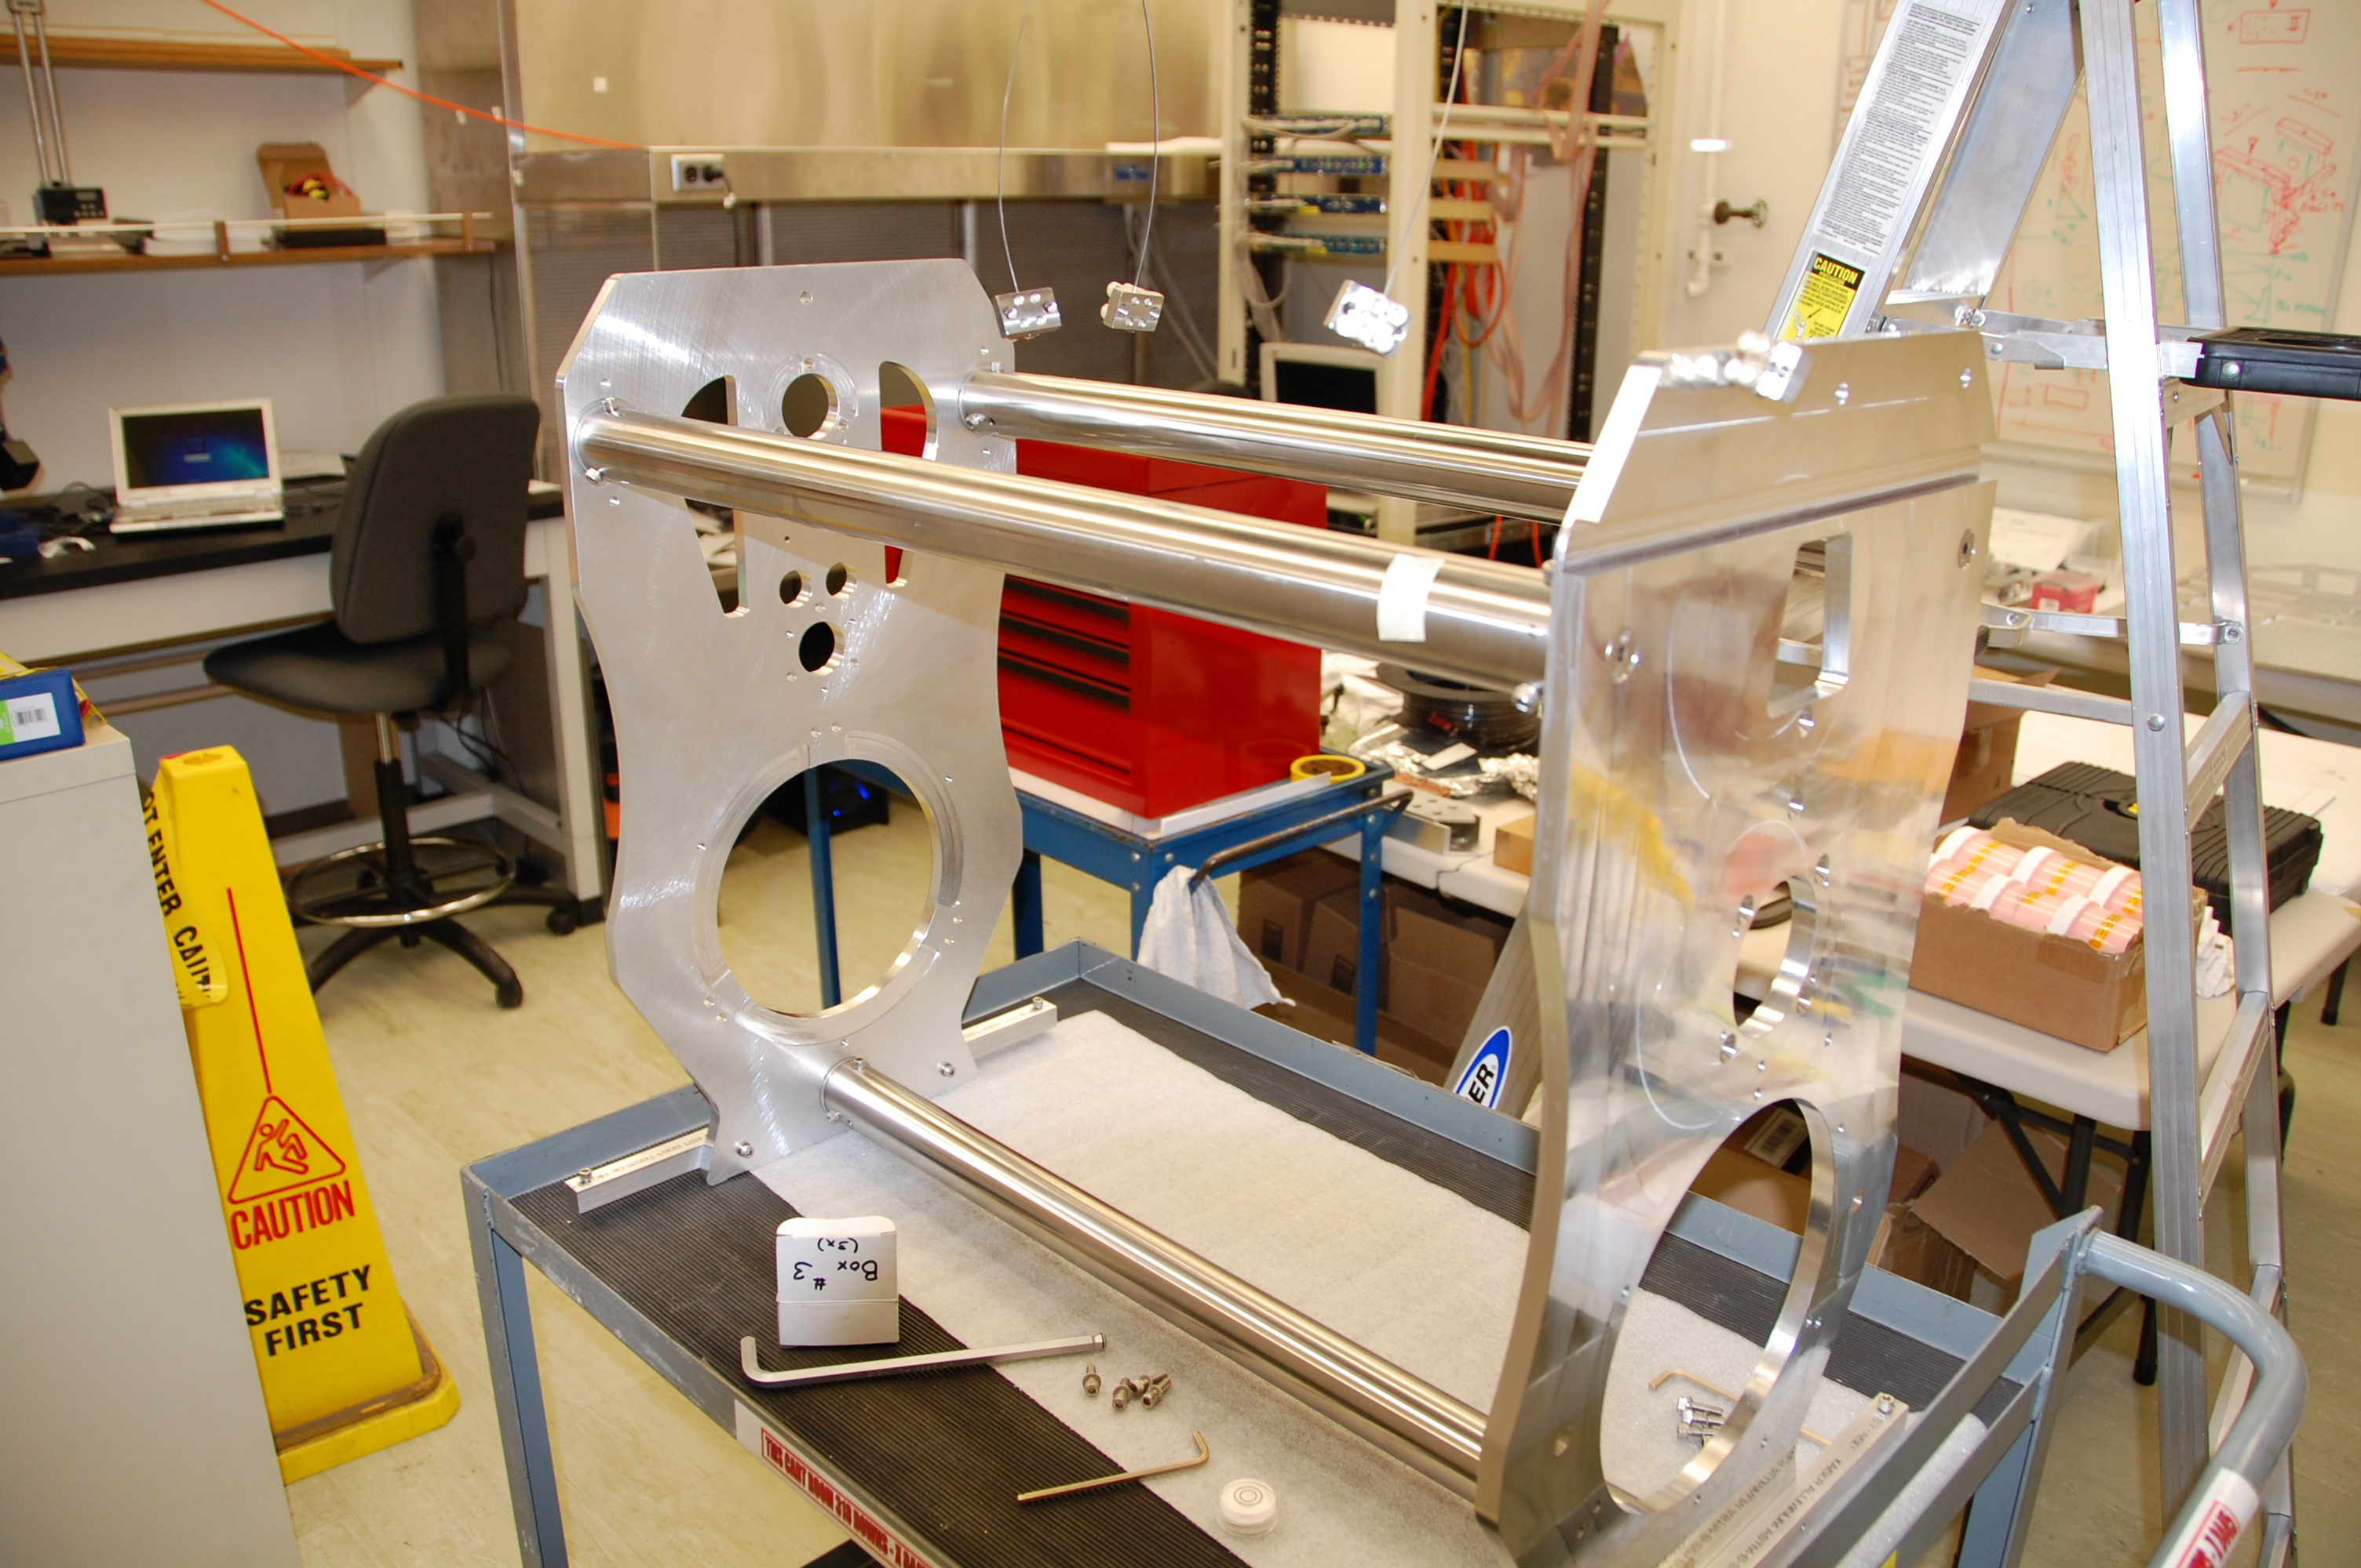
TMS Design Concept
Double pendulum suspension based on upper stage of Quad Suspension
Telescope
  Reflective off-axis parabolic mirrors
  Folded design
Optical routing done on optical table
High Power in vacuum beam dump

Slide 7
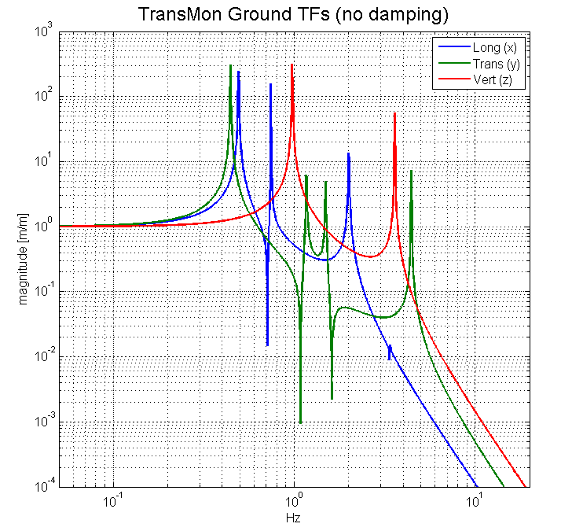
TMS Development Accomplishments
Compared Three Telescope Designs and selected off axis parabolic design
Telescope modeled with Ray Tracing Program
Modeled Suspension Transfer Functions with LIGO Software

Slide 8
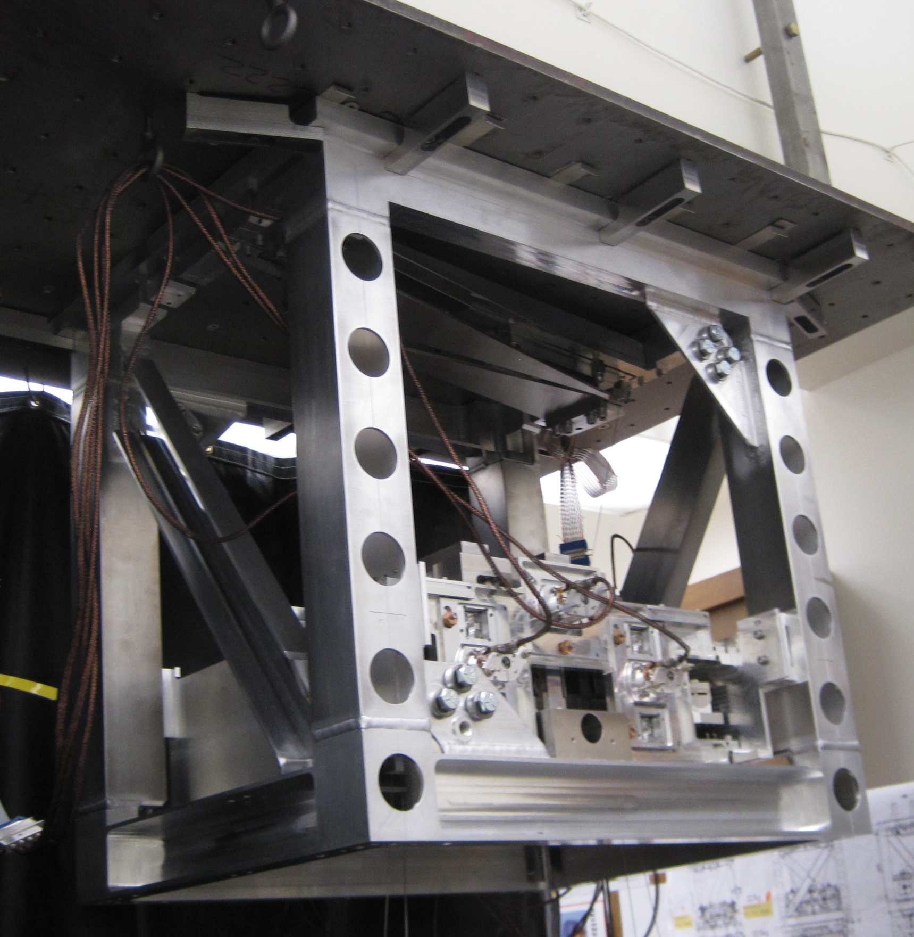
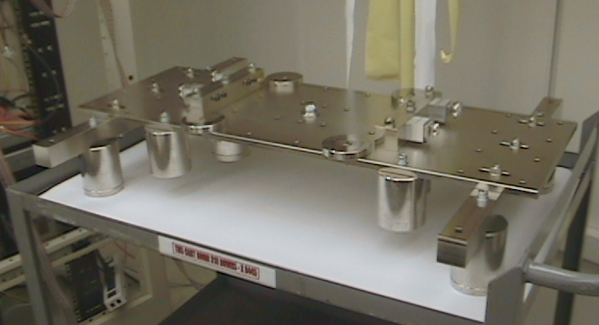
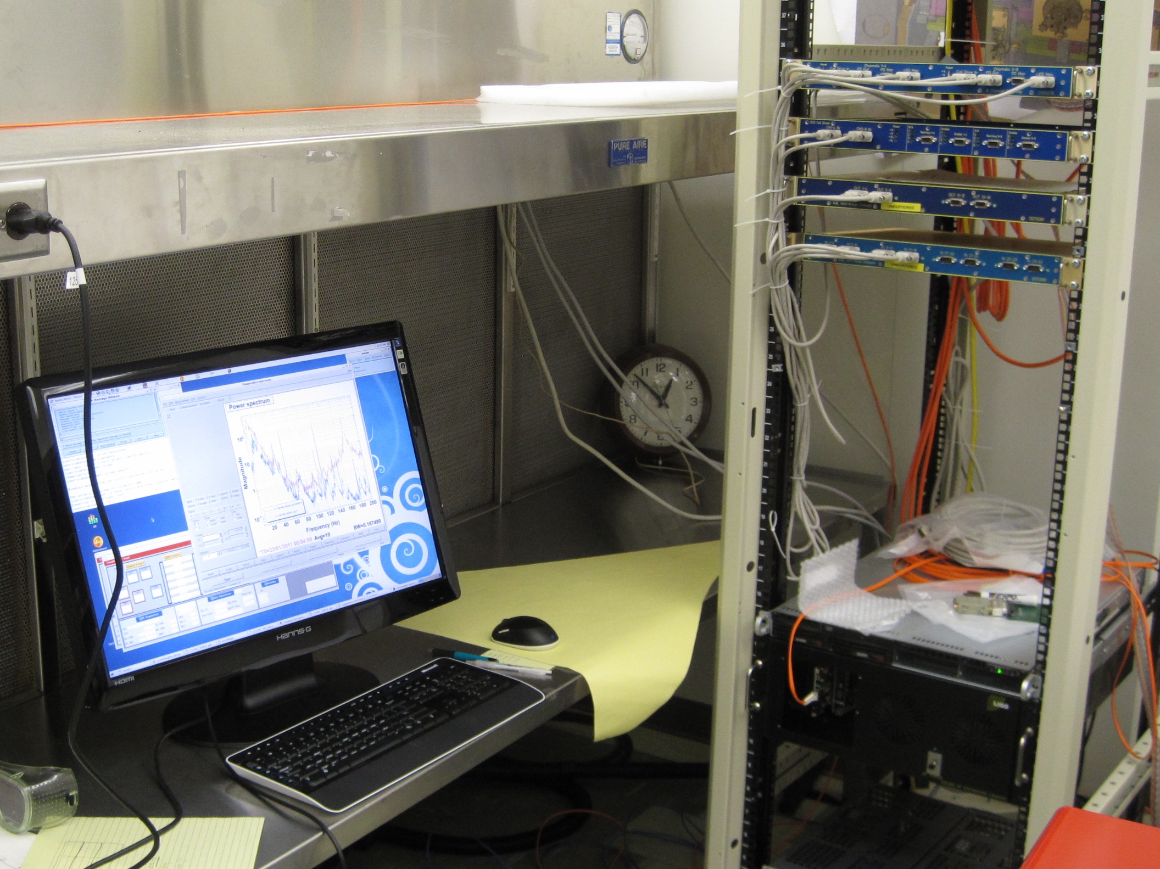
TMS Suspension Prototype Tests
Establish all 6 BOSEMs operational and interference free
Measured all 12 body resonance frequencies
Response Rough cut at orthogonalizing
DOF response
Confirm resonant frequencies assignments via TF for all DOFs
Good agreement with
prototype model
Established good damping
Roll resonances
Roll (red) sensed
Typical broadband noise excitation TF (nominal Roll drive)

Slide 9
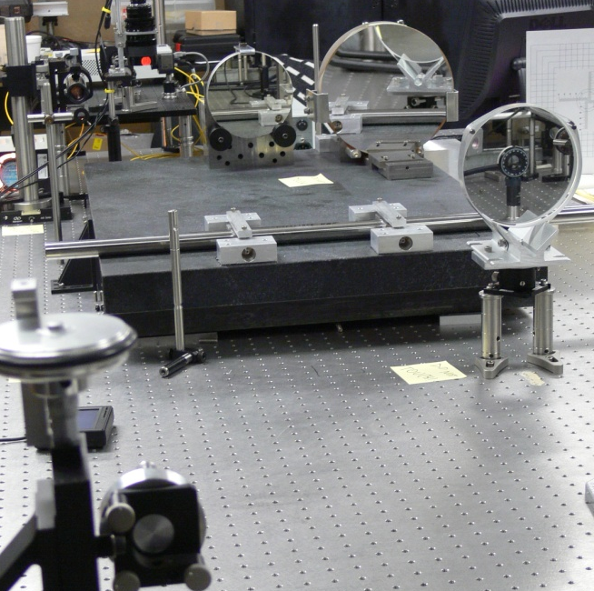
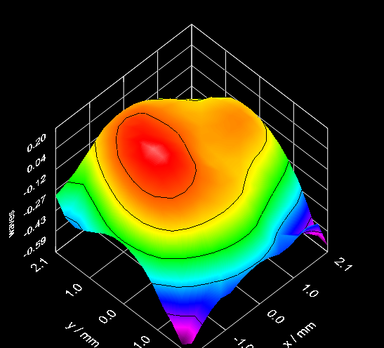
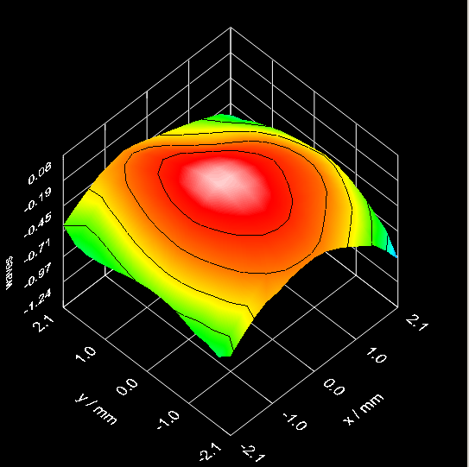
TMS Telescope Mirror Alignment & Characterization
Shack-Hartmann Test Facility @ Caltech
Telescope astigmatism spec: <1/20λ @ 1064nm
  Requires Zernike coefficients Z4 and Z6 < 0.02 waves
  Zernike 5 defocus TBD
Off-axis Parabolic Mirror Incoming Inspection
Telescope Meets Astigmatism Specification
Z₄ = -0.001
Z₆ = 0.000
Z₄ = -0.030
Z₆ = 0.036
Zernike Polynomial Coefficient
Preliminary autocollimator alignment
Final Shack-Hartmann alignment

Slide 10
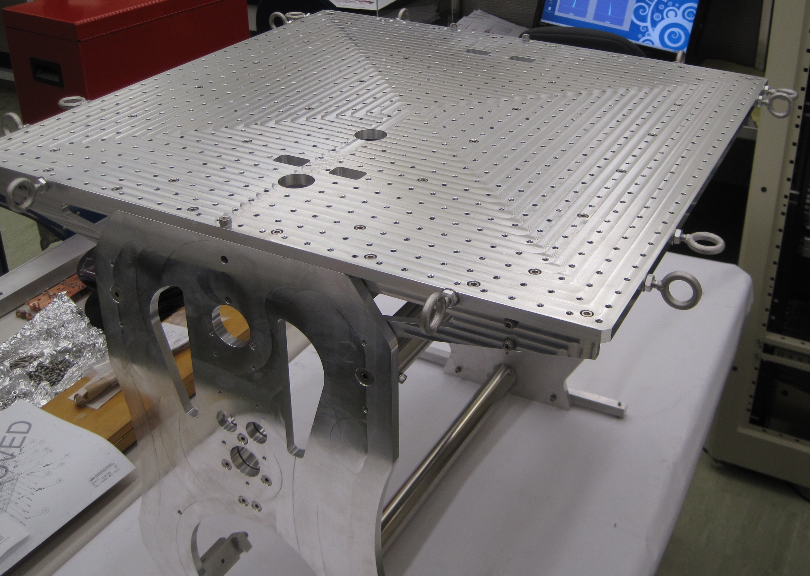
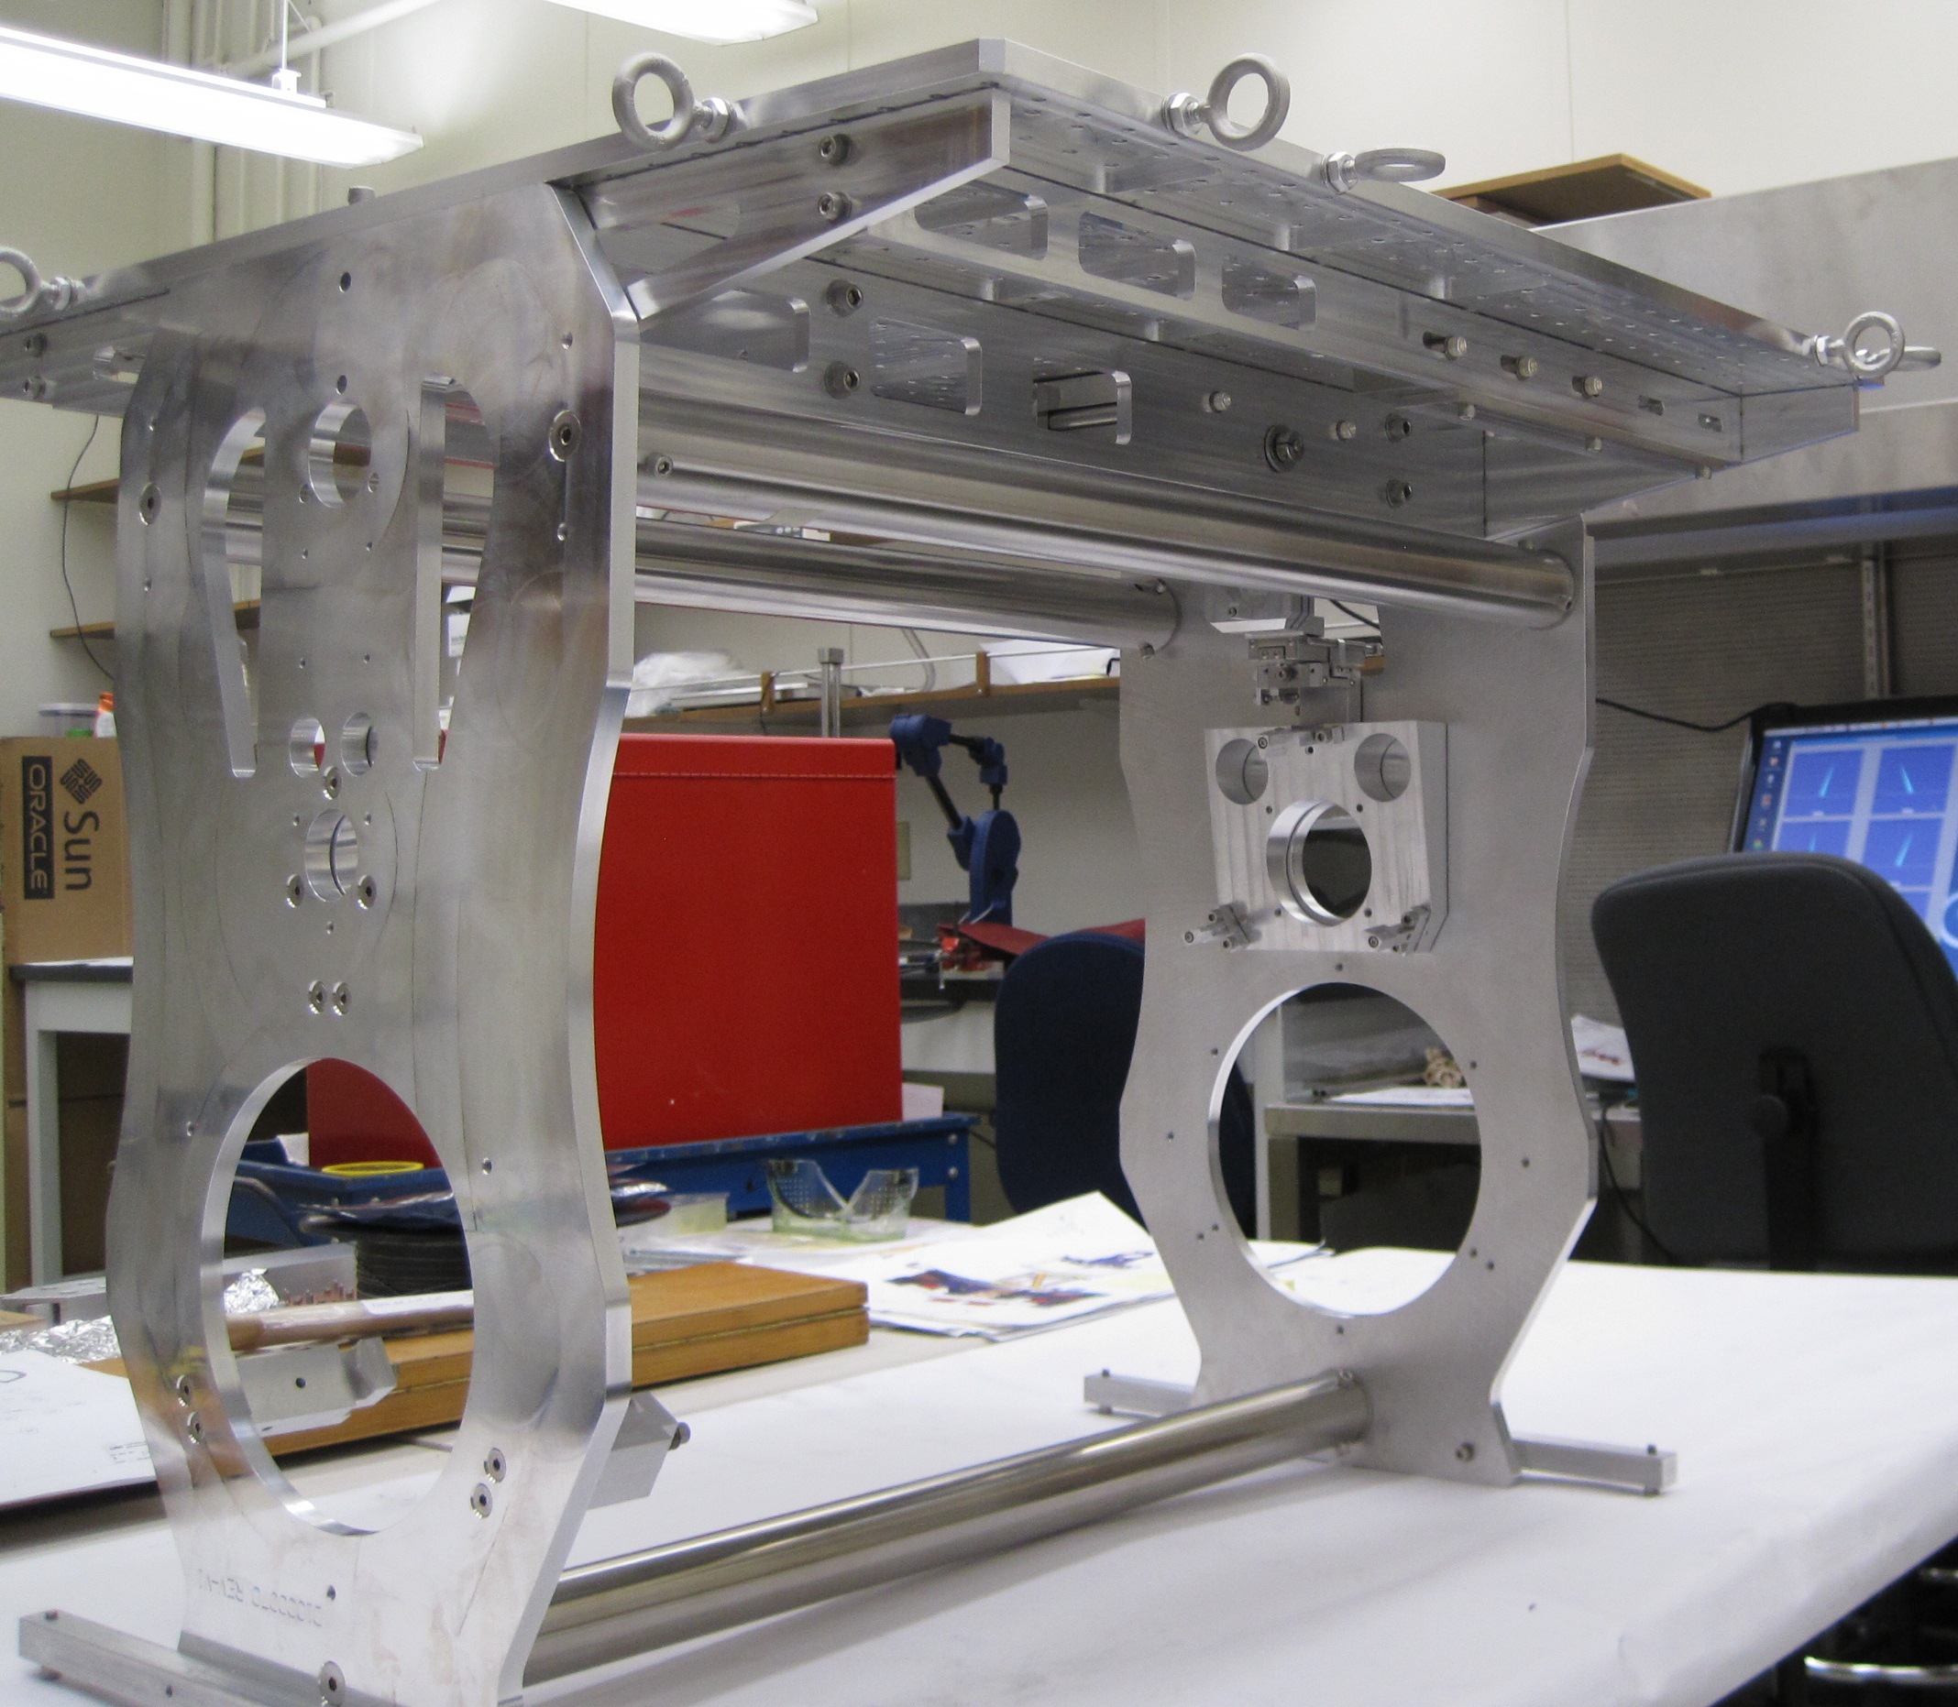
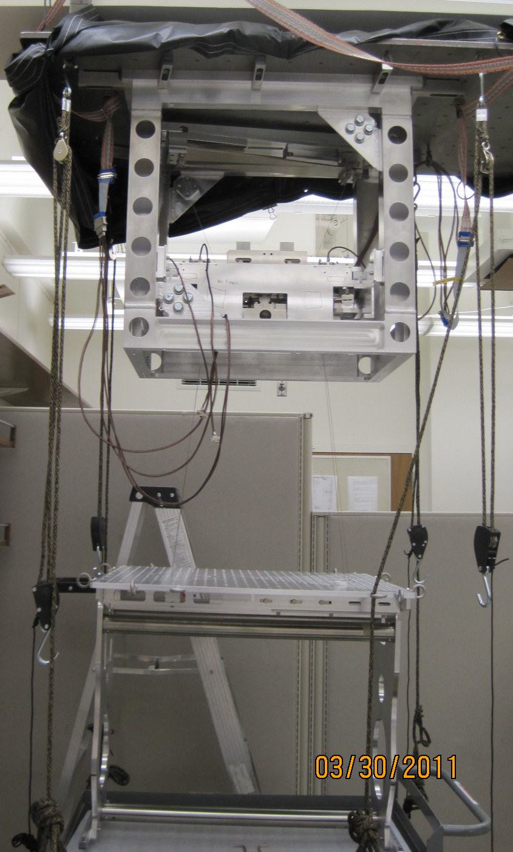
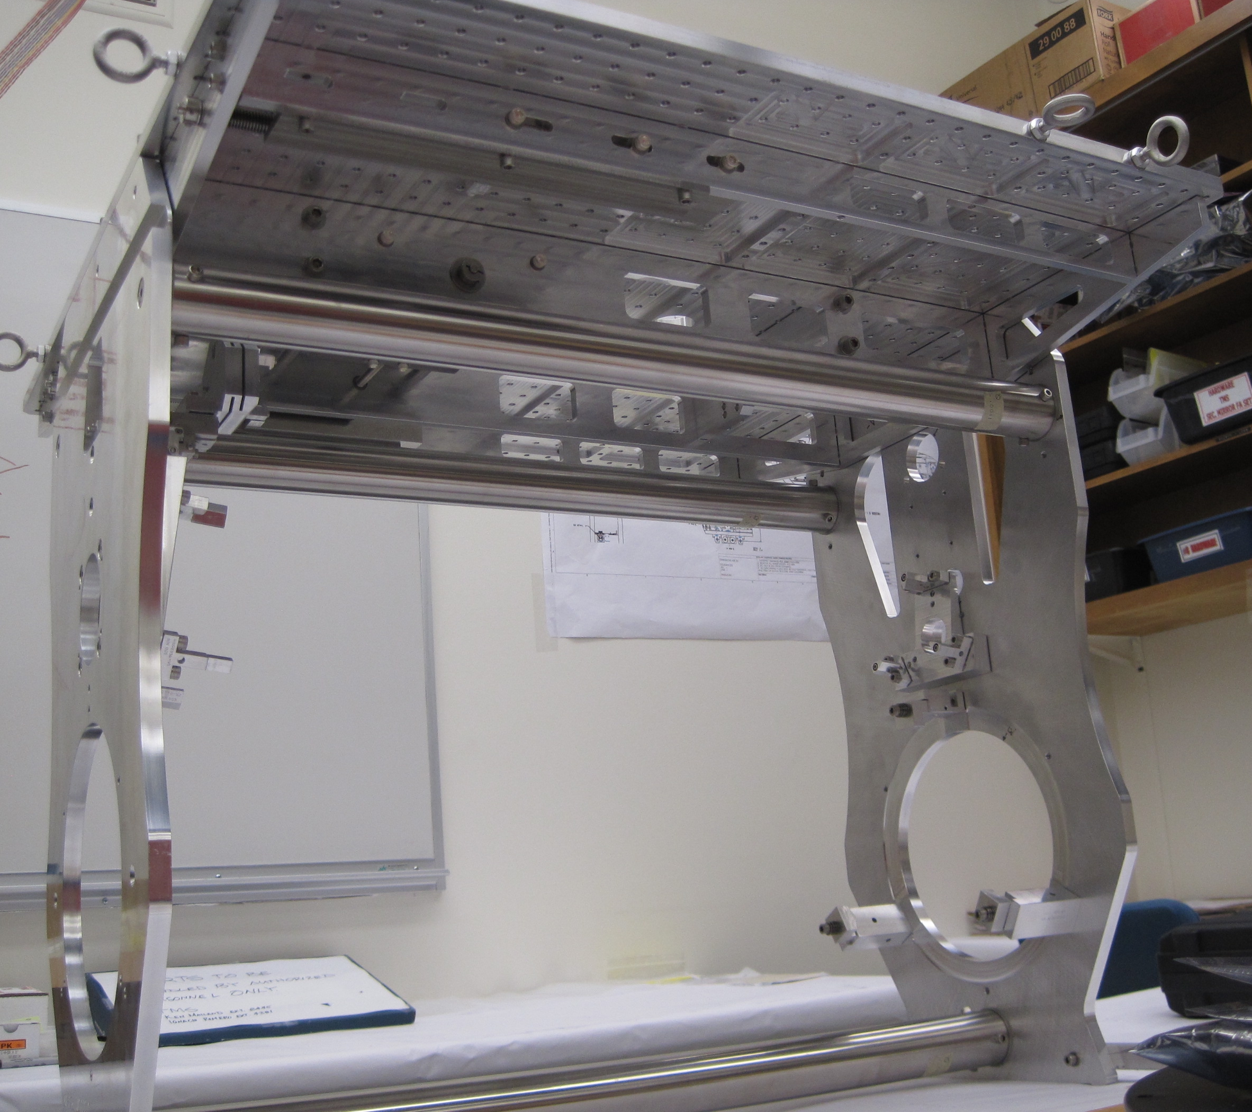
TMS Development Plan
Preliminary Design Review completed - May 2010 ✔
Telescope First Article build – May 2011
Final Design Phase
  Optical Table tests completed – April 2011 ✔
  Telescope First Article tests completed – June 2011
  Suspension testing completed – March 2011 ✔
  FDR completed – June 2011
  Update all drawings – June 2011

Slide 11
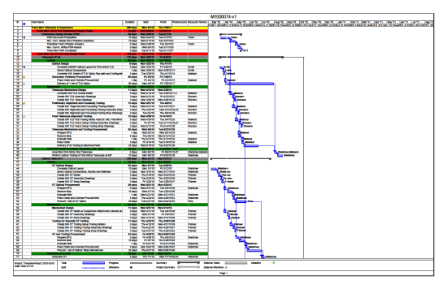
TMS Project Organization and Plans
Project Organization
  Team Leader/Mechanical Engineer - Ken Mailand - Caltech
  Cognizant Scientist - Sam Waldman – MIT
  Telescope Optical Design – Mike Smith - Caltech
  Mechanical Designer – Mike Miller– Caltech
  Draftsperson - Jesse Terraza – Caltech
  Electronics – Jay Heefner – Caltech
  Suspensions Modeling - Matt Evans - MIT
  Suspensions Testing – Bill Kells - Caltech
  Optical Testing - Virginio Sannibale – Caltech
  Assembly Technician – Larry Mossberger - Caltech
  Project Engineer and Planning – Lisa Austin - Caltech
Project Plans
  Reworked First Article available for Long Arm Test – June 2011
  Remaining production units available – December 2011

Slide 12
TMS Challenges, Risks, and Mitigations
Getting First Article delivered to Hanford in time for the Long Arm Test
  Draftsperson
  Assembly Technician
  Project Engineer and Planning
Optical Aligning and focusing double off axis parabolic telescope
  Course alignment with auto collimating telescope
  Fine alignment with Shack-Hartmann sensor
  Simulation of final alignment with ray tracing simulation
  Incoming testing of all parabolic mirrors
Delivery of off-axis parabolic mirrors
  Two suppliers
  First Article already Received August 2010 and second Due April 2011

Slide 13
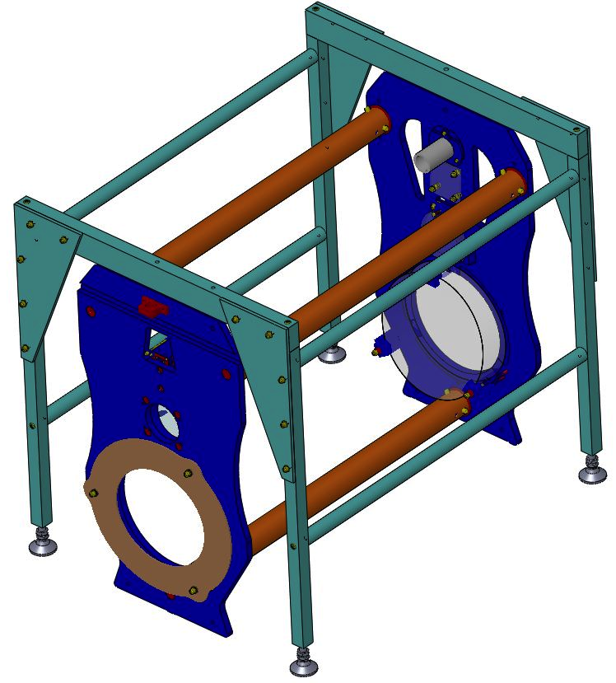
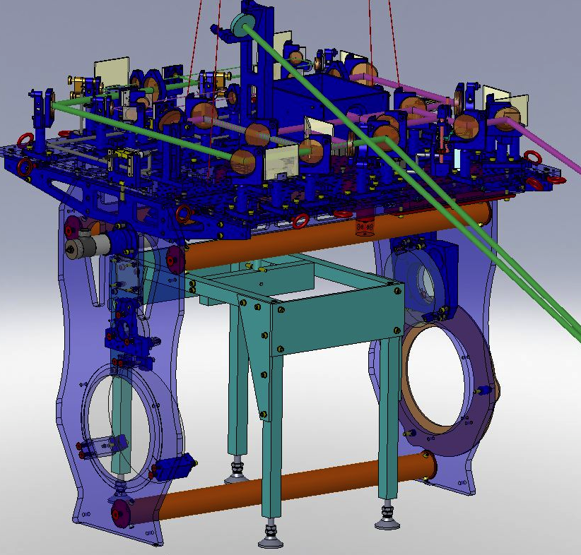
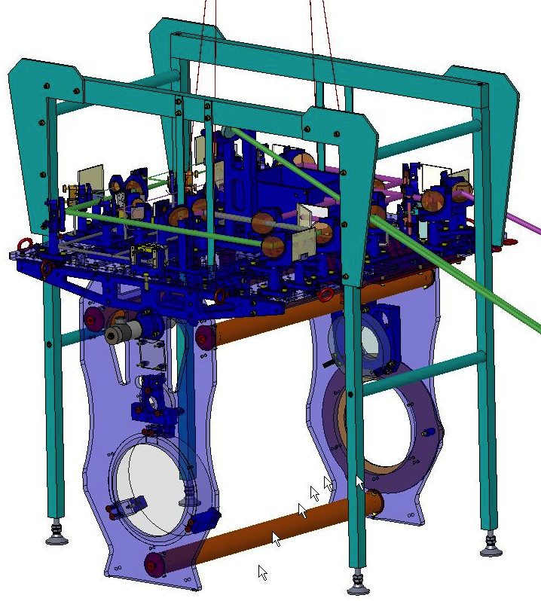
TMS Near Term Activities
Build and Test First Article Telescope – June 2011
Design and procure the equipment needed for testing
  Suspension test stand – Caltech – May 2011
  Electronics test stand – Caltech Completed ✔
  Fixturing for Telescope testing – Caltech – May 2011
Final Design Review – June 2011
Rework First Article Telescope in time for Long Arm Test

