Slide 1
Advanced LIGO Core Optics expanding the imagination….
Some things we have learned in Advanced LIGO have been surprising.
0.1nm rms figure error is achievable over large diameters
Some fused silica can have high spatial frequency inhomogeneity
Some fused silica isn’t stable
A q-tip can polish glass
Drag-wiping can damage glass
Low absorption AR coatings are more difficult to achieve than HR
G. Billingsley

Slide 2
Surface Figure: better than we thought possible (Subcontractor L3 Tinsley)
Φ 160 mm 0.0966 nm rms Φ 300mm 0.17 nm rms

Slide 3
Compare Initial LIGO and Advanced LIGO PSD
ETM04 diffractive loss = 4.7 ppm
ITM04 diffractive loss = 2 ppm
These are typical/high for aLIGO TMs
Data analysis:
Hiro Yamamoto

Slide 4
CP04 transmitted wavefront 0.16 nm rms (Image Zygo)
Neither surface shows the high frequency structure.
Heraeus 3001 ~2.4nm PV

Slide 5
Fused Silica Figure Stability

Slide 6
Careful cleaning can leave a mark (Image Zygo)
129 nm Peak to valley – Possibly caused by cleaning with a Q-tip. Cotton does not polish, but dust does.
Two other optic show this to a lesser degree ~10nm PV, some in multiple spots.
This optic was repolished.

Slide 7
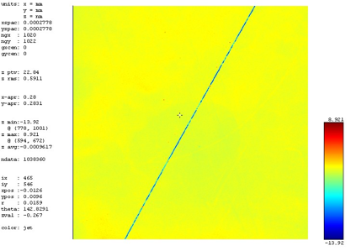
Wiping can leave sleeks (Image L3 Tinsley)
Sleeks can be caused by wiping; defect depends on the particulate being wiped.
Recommend using First Contact.
LIGO-E1000079

Slide 8
Exploring AR coating loss vs coating depth (Image CSIRO)

Slide 9
Acknowledgements
Advanced LIGO Core Optics Team:
GariLynn Billingsley, Gregg Harry, Bill Kells, Patrick Murphy, Margot Phelps, Hiro Yamamoto, Liyuan Zhang
With significant help from: Dennis Coyne, Peter Fritschel and Eric Gustafson
Advanced LIGO Core Optics Vendors:
Glass: Heraeus Quartz America, Corning
Polishing: Coastline, Zygo (formerly ASML) under contract to L3 SSG Tinsley
Coating: CSIRO, LMA

Slide 10
Follow our progress
https://nebula.ligo.caltech.edu/optics/
Some reports are “C” documents, limited to LSC viewing since they are provided as contractual documents.

