Slide 1

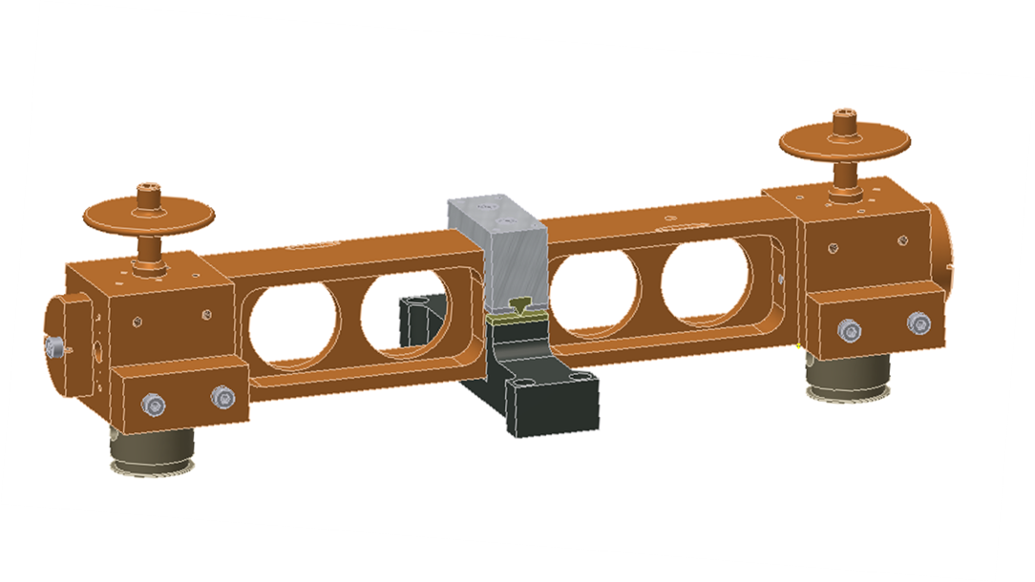
LIGO tiltmeter development
LIGO-G1000989
R. Desalvo, C. Kim, A. Lottarini, Y. Minenkov, C. Murphy,
A. O’Toole, G. Pu, A. Rodionov, M. Shaner., M. Asador,
A. Bhawal, V. Dergachev

Slide 2
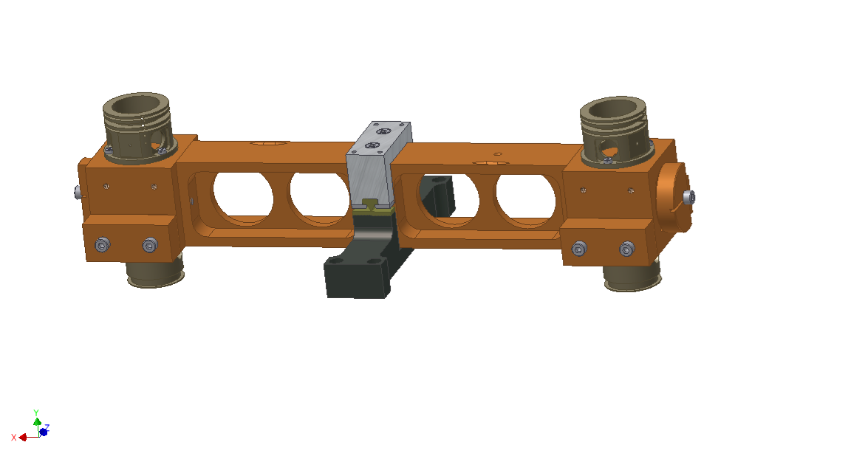
Introduction

Slide 3
What is a tiltmeter for
High precision tiltmeters are:
  useful for passive seismic attenuation systems
  and
  necessary for active ones
Tilt seismometers of sufficient precision would allow the development of rotational seismology

Slide 4

Use for passive attenuation
Most of a passive seismic chain unaffected by tilt, no need
The first stage is an inverted pendulum
like a horizontal accelerometer
Sensitive to tilt through g
Sufficient performance with position sensor correction but . . .
Better performance correcting with a tiltmeter feed-forward loop

Slide 5
Use for Active attenuation
Horizontal accelerometer signal fooled by g
Impossible on Earth to distinguish a tilt from an acceleration (Equivalence principle)
Signal pollution proportional to
Position correction negates attenuation performance
Active attenuation impossible at low frequency
without a high sensitivity tiltmeter

Slide 6
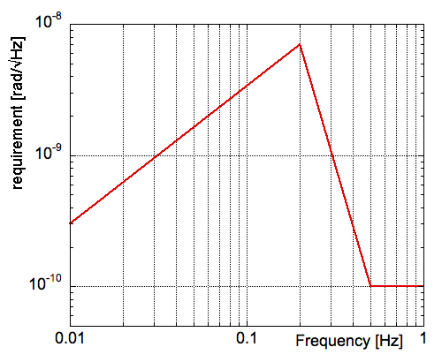
AdLIGO Active attenuation requirements
Requirements are more than an order of magnitude better than any existing tiltmeter
Lantz, B., et al. (2009). “Requirements for a Ground Rotation Sensor to Improve Advanced LIGO." Bulletin of the Seismological Society of America 99(2B): 980-989.

Slide 7
Uses for rotational seismology
Surface waves are transversal waves
Rotational behavior not trivial at surface or near other discontinuities
Rotational accelerometers complementing the linear ones would make better sensor suites.

Slide 8
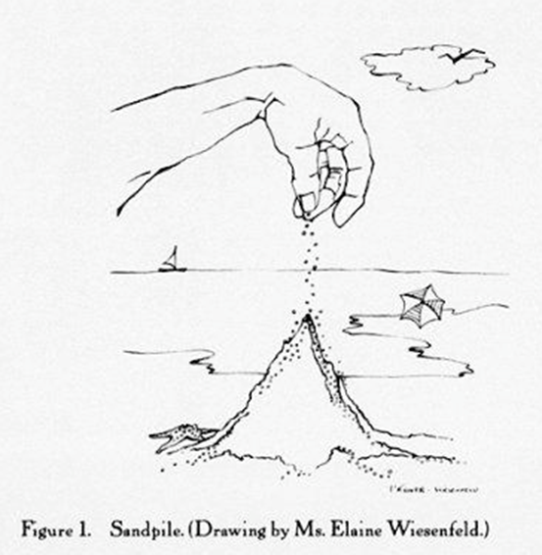
Tiltmeter performance limits
All recent mechanical tiltmeters are based on a bar suspended by a thin metal flexure from its center of weight
All failed to satisfy expectations at low frequency, mainly with 1/f noise
Recent discovery of Self Organized Criticality noise in dislocation movement explains this excess noise
R. DeSalvo (2010) “The Role of Self Organized Criticality in Elasticity of Metallic Springs; Observations of a new Dissipation Regime.” LIGO-P1000105
Per Bak 1996, How nature works: The Science of Self-Organized Criticality

Slide 9

How to avoid the limitation
The identified noise derives from dislocation collective movement in the flexure.
Solution:
replace flexure with
a non metallic hinge
Back to the future, return to the
knife edge design of precision scales

Slide 10
Beyond the old knife edge design
Old design based on natural hard stones to manufacture low loss knife edge hinges
We are past the stone age
Tungsten carbide (WC) is a high tech, precision machinable, very hard stone
Advanced coating (TiN, DLC, Diamond, et c.) allow for even harder stones and less losses

Slide 11
Tiltmeter design
Pivot and arm
Differential displacement sensor
Differential actuation
Gravitational frequency tuning

Slide 12
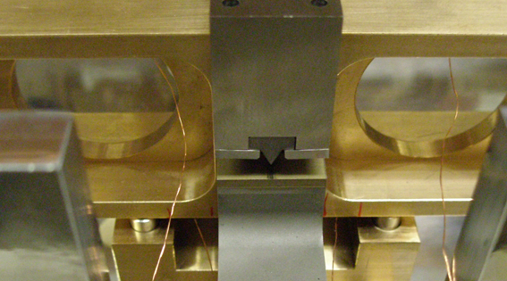

Features of LIGO tiltmeter
Pivot: Knife edge
  Implemented to prevent SOC noise*.
  Wedge & Anvil
  Both precision
  machined WC
R. DeSalvo (2010)
“The Role of Self Organized Criticality in
Elasticity of Metallic Springs; Observation of a new Dissipation Regime.”
LIGO-P1000105

Slide 13
Features of LIGO tiltmeter
Rigid case: Aluminum

Slide 14
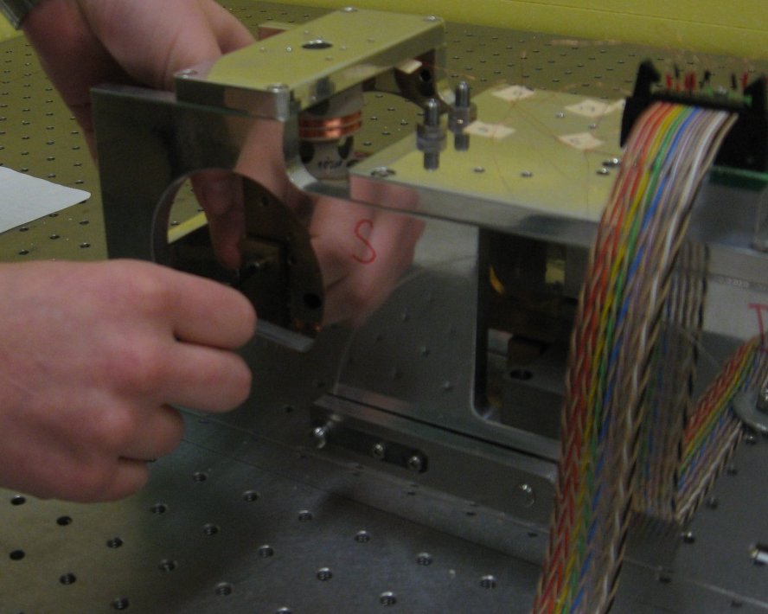
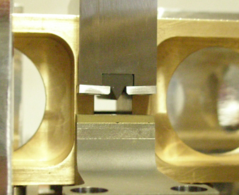
Features of LIGO tiltmeter
Compact and portable design for easy implementation.
Ultra-high vacuum (UHV) compatible including those implemented in LIGO.
Balance arm can be lifted and locked for transport.
Notes:
For feed back compact and UHV so can be used for feed back. Protect and position the tilt arm

Slide 15
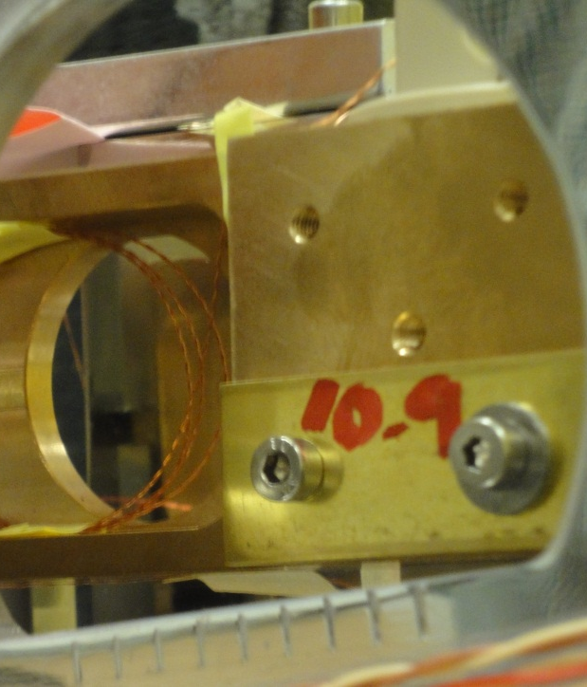
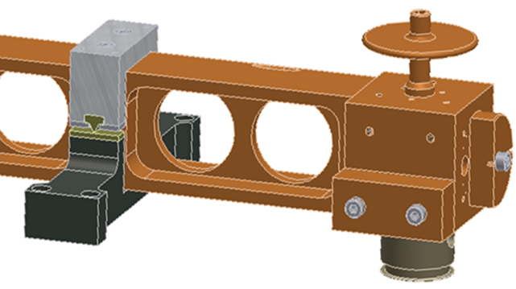
Features of LIGO tiltmeter
Frequency can be tuned by positioning masses in eight locations on either end and above and below the center of mass.
Tuning to zero frequency means insensitivity to horizontal acceleration
Notes:
Demonstrate how the resonance works and that it is important for implementation

Slide 16
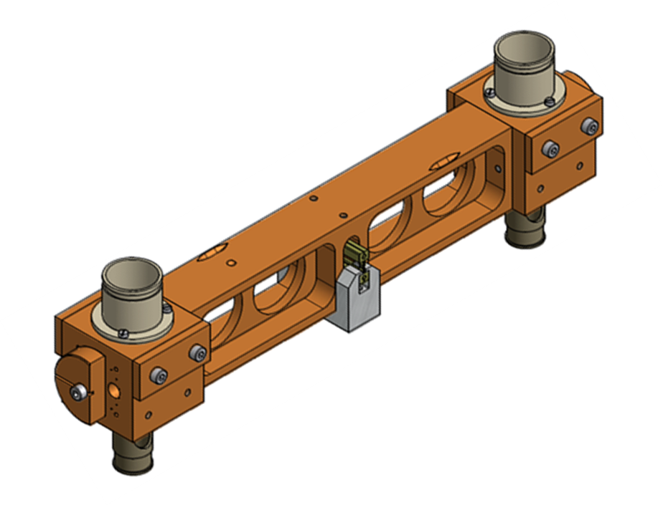
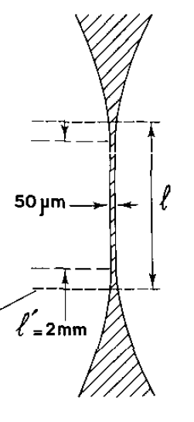
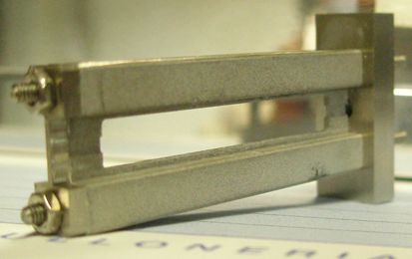
Optionals in LIGO tiltmeter
(for comparative studies)
Pivot: Flexure hinge
Allow study of SOC
Quinn, T. J. (1992). "The beam balance as an instrument for very precise weighing." Measurement Science and Technology 3(2): 141.
Notes:
Add more detial, made to about 30% of yield limit depending on material for us trypically 100 microns

Slide 17
Experimental Results

Slide 18
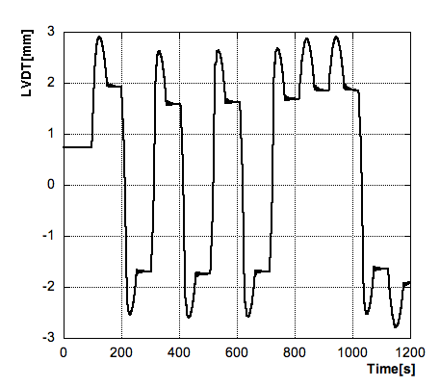
Results
Knife edge was implemented to avoid hysteresis
Example:
Hysteresis in a
Maraging filter

Slide 19
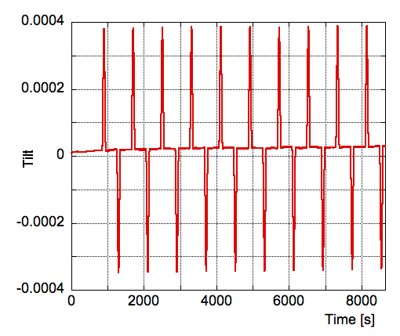
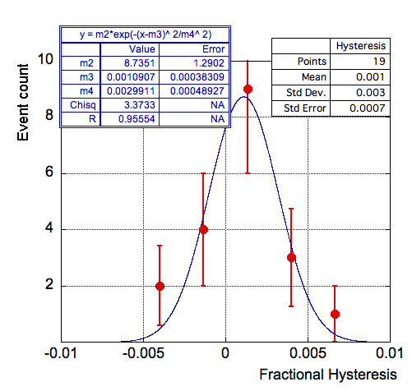
Results
Knife edge implemented to avoid hysteresis
~ No Hysteresis
in tiltmeter

Slide 20
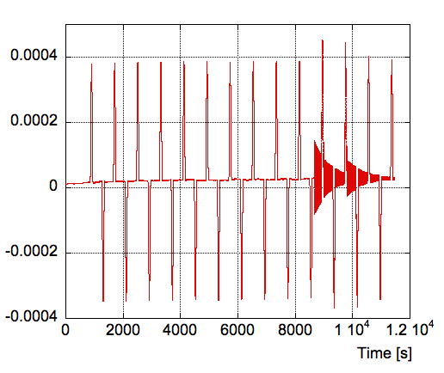
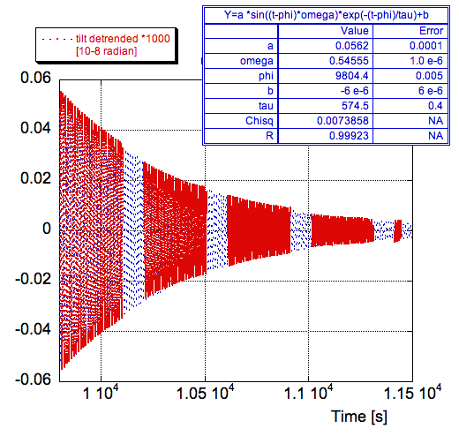
Quality checks
Seismic event
Very good fit
Coherent decay
Through excitations

Slide 21
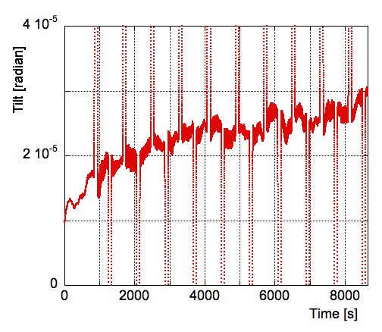
Quality check
Real table tilt

Slide 22
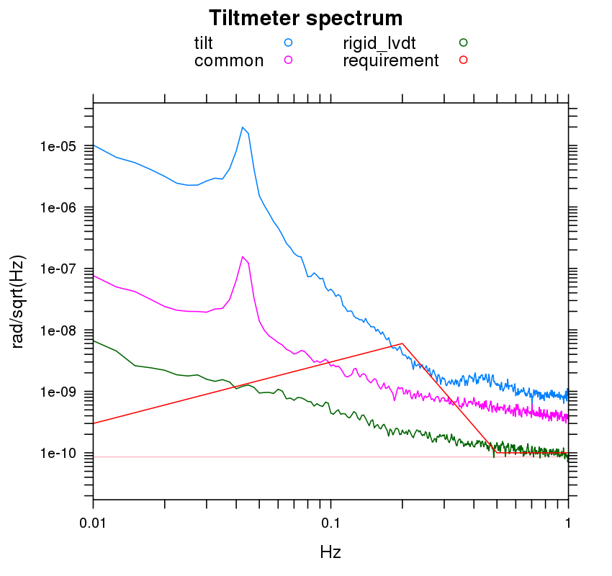
Preliminary performance
Rough hinge
In air
On table with
rubber feet
Copper wires

Slide 23
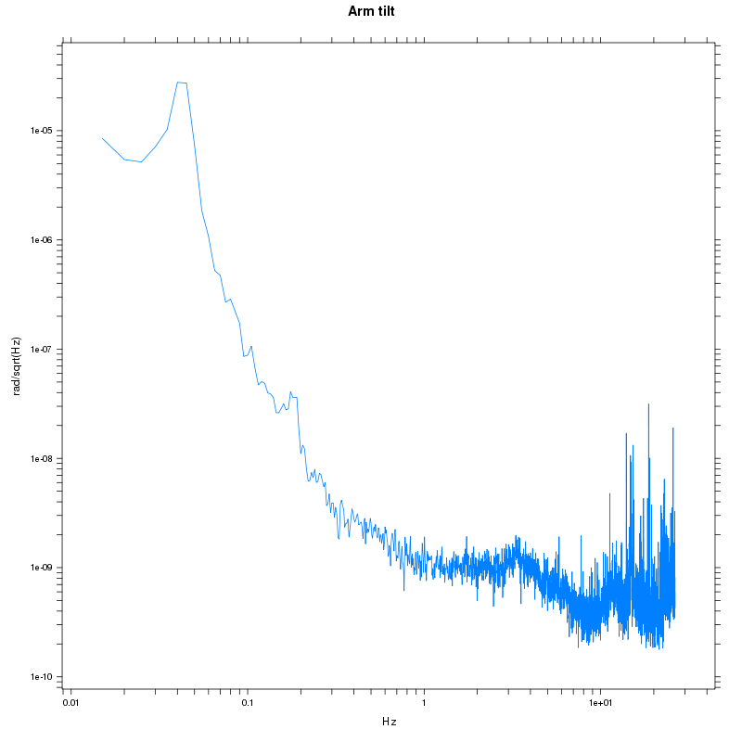











4. Current tilt sensitivity
Recent plot:
$${10}^{−5}$$
Resonance of tiltmeter
Acoustic noise ??
$${10}^{−6}$$
Microseismic peak ?
Rad/Sqrt(Hz)
$${10}^{−7}$$
Electronics noise
$${10}^{−8}$$
Limited by air and/or hookup wires.
$${10}^{−9}$$
$${10}^{−10}$$
$${10}^{−2}$$
$${10}^{−1}$$
$$Hz$$
$${10}^{0}$$
$${10}^{1}$$

Slide 24
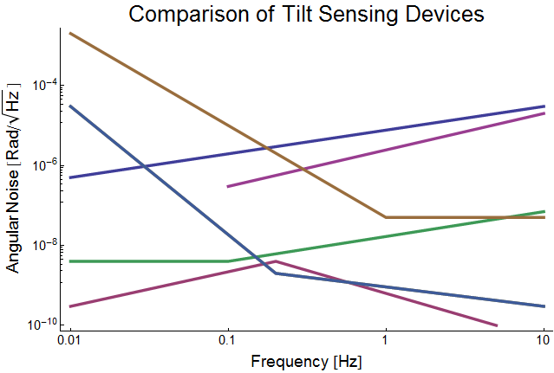
Other rotation sensing devices
Fiber Gyro, Stanford 1982
Flexure Tiltmeter, Pisa 1997
Active Laser Gyro, Pisa 2010
Flexure Tiltmeter, Pisa 2010
Knife-Edge Tiltmeter, LIGO 2010
Adv. LIGO Requirements

Slide 25
Instrument development

Slide 26
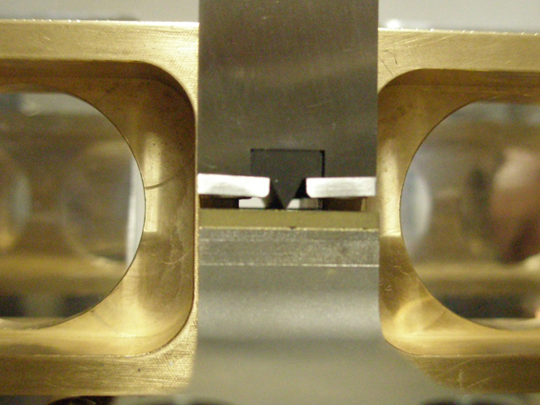
Knife-edge development

Slide 27
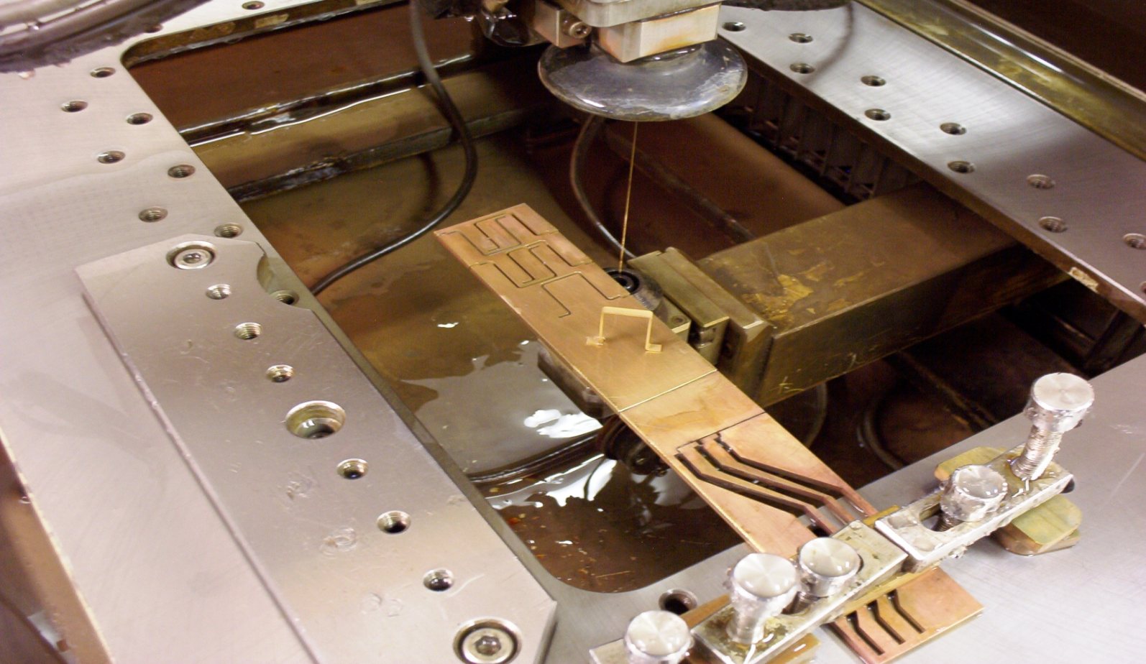
Knife-edge manufacturing
Knife edge made of tungsten carbide, Young’s modulus of ≈ 550 GPa.
Knife edge cut from tungsten carbide block using wire Electrical Discharge Machining (EDM).
Image source: http://www.cumberlandmodelengineering.com/

Slide 28
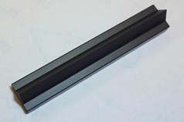
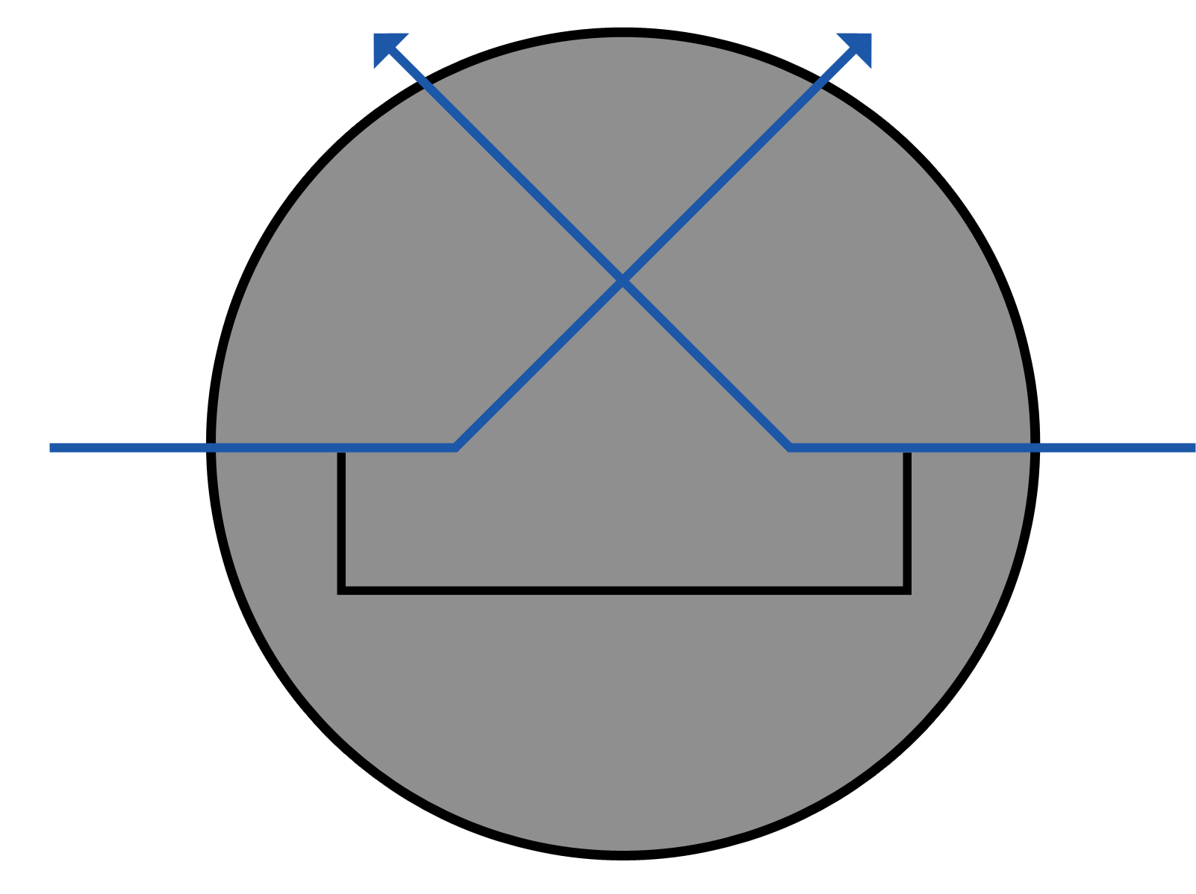
Knife-edge manufacturing
Cutting profile first
implemented.
Notes:
Here we have a long cylinder of WC so…

Slide 29
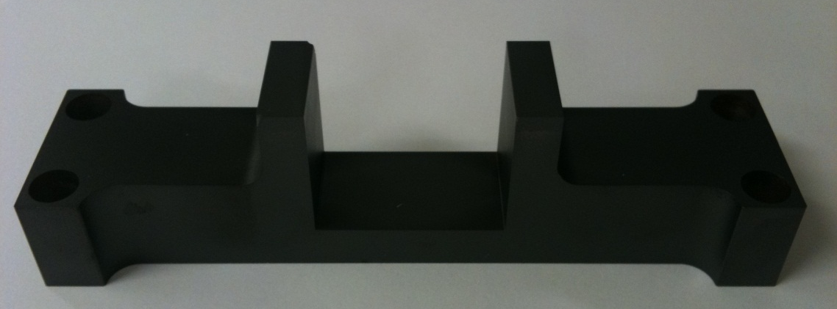
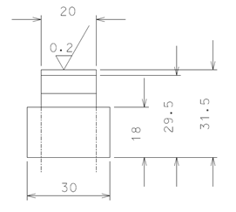
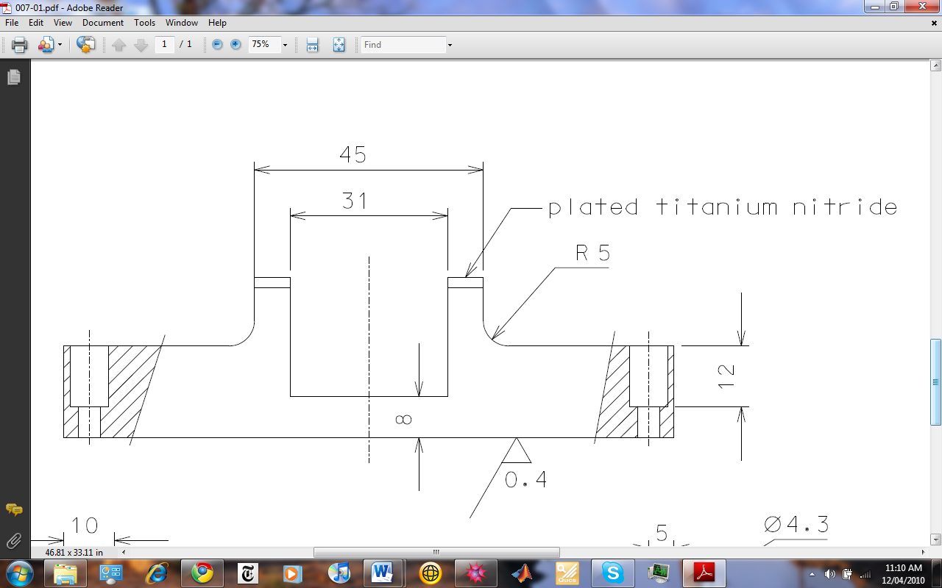
Anvil development
16mm of pivot contact on standard anvil
Tungsten Carbide anvil

Slide 30
Knife-edge development
Clean even sharp edge should give low noise.
Analysis was performed using SEM.
Notes:
Although EDM has nominally no stress on the cutting wire, a minimum of catenarian bending of the wire is present while advancing. This would generate a small deformation of the cutting edge. Halting the cut and dwelling at the cutting edge to eliminate the catenarian before continuing the cut in the other direction may generate a small cut thickness increase just where we want the best precision.

Slide 31
Knife-edge development
Major cracks were found on some edges!
On the worst end only 4.8% of the leading edge was of suitable sharpness.
Mean crack width: 34 μm

Slide 32
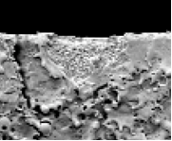
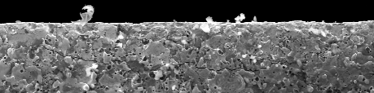
Knife-edge development
Underlying cracks were also found!
350 µm
What happened?

Slide 33
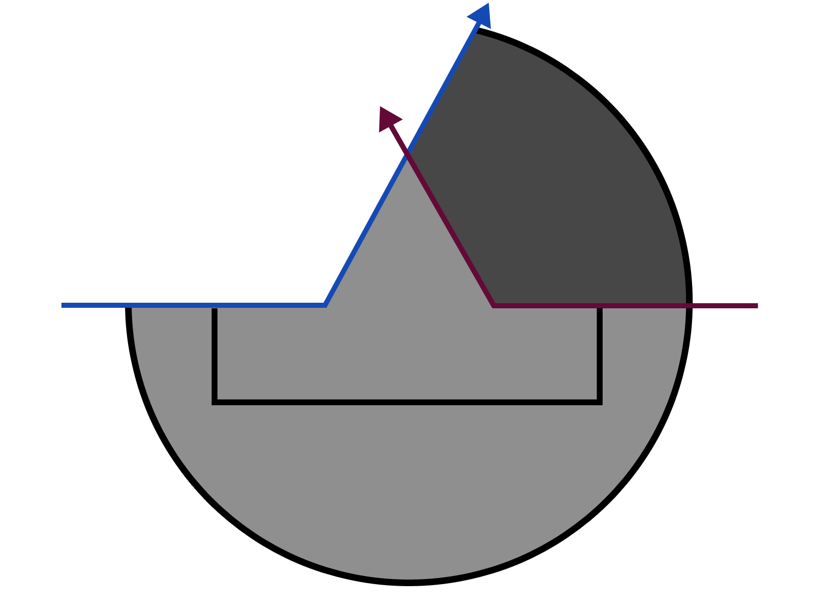
Knife-edge development
Cutting scheme first employed is to blame for the crack.
Huge force concentration on the business end of knife edge when finishing the cut

Slide 34
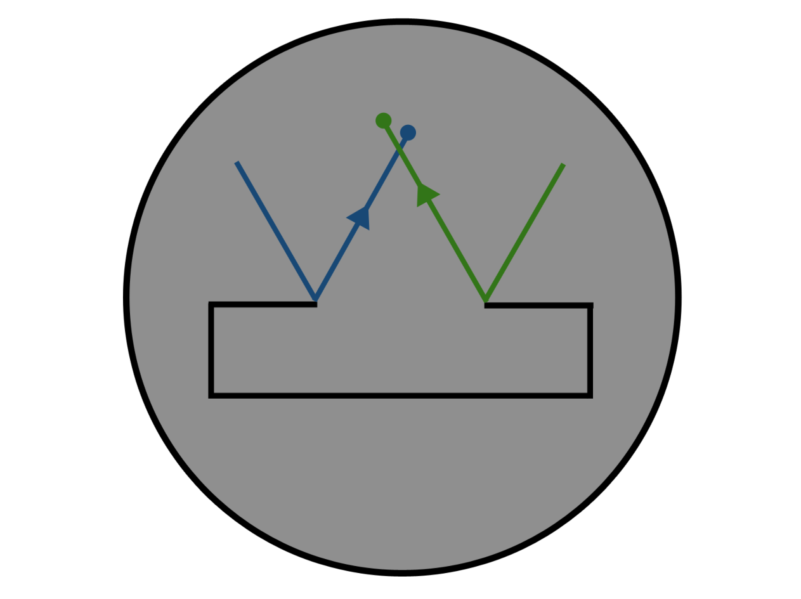
Knife-edge solution
Cutting scheme that avoids the large force concentration on the tip of the knife edge.

Slide 35
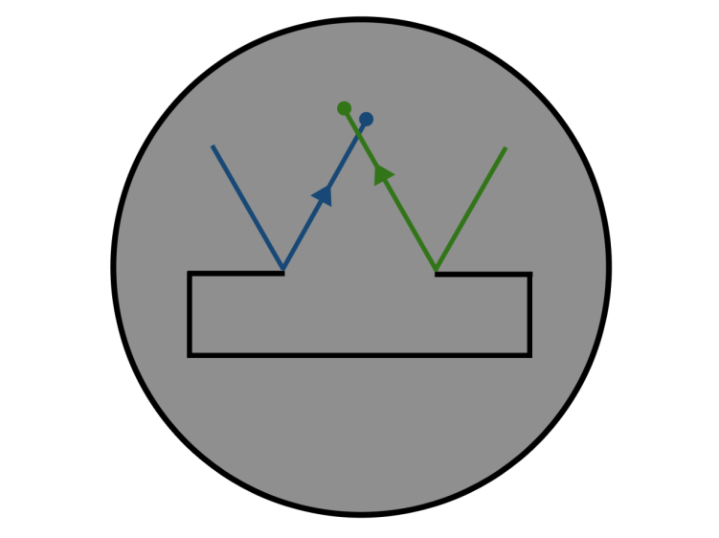

Knife-edge development
Wedge cut with new scheme was found to not contain the crack defect .

Slide 36
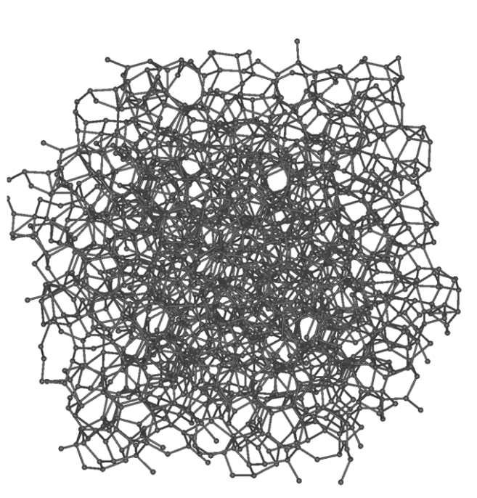
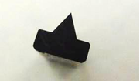
Knife-edge further developments
Currently implemented 45mm WC blade is uncoated “naked
Future coating options:
  PVD Diamond Like Carbon (DLC)
  CVD DLC
  Tungsten carbide (Glass)
  Titanium Nitride
  Diamond
Source: Wikipedia-Amorphous carbon

Slide 37
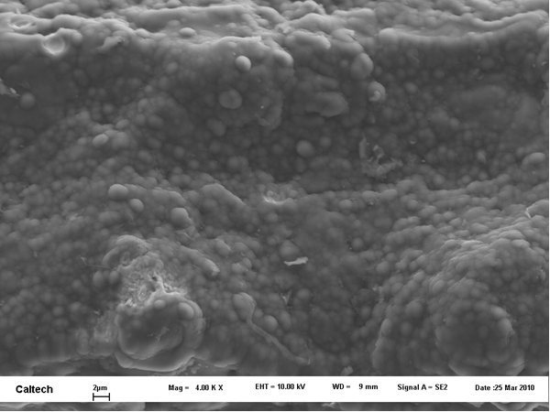
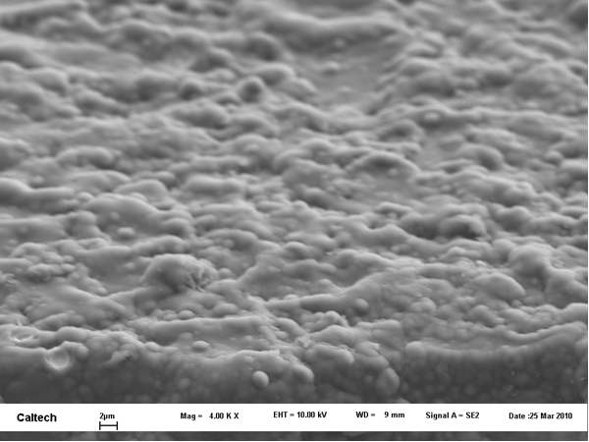
Knife-edge material details
0.8 μm diameter WC powder balls.
~8% cobalt binder

Slide 38
Position redout

Slide 39
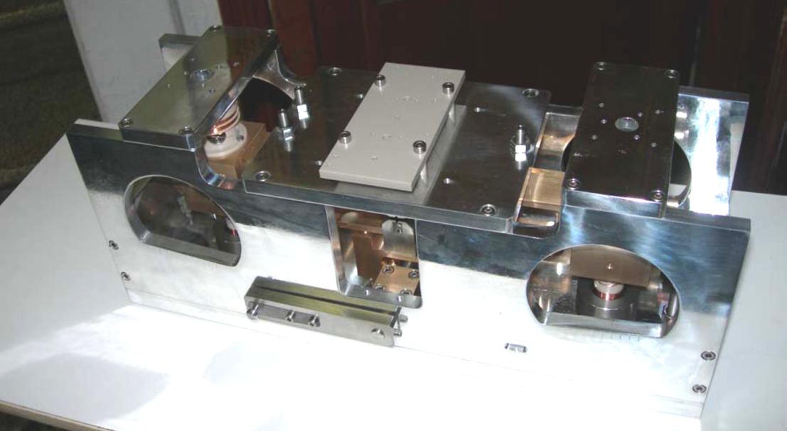
Current design: LVDT measurement
Easiest UHV implementation
Moderate Eddy current forces
Three coil design
Sufficient sensitivity

Slide 40
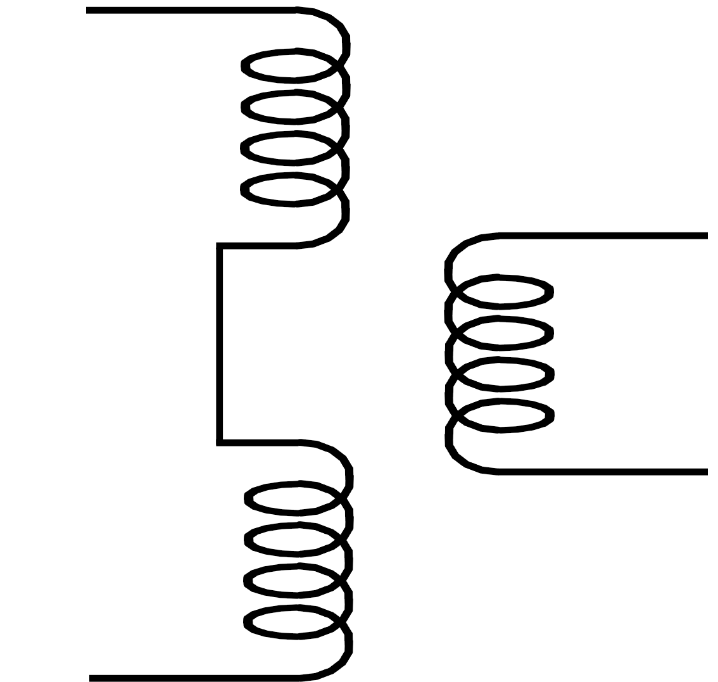
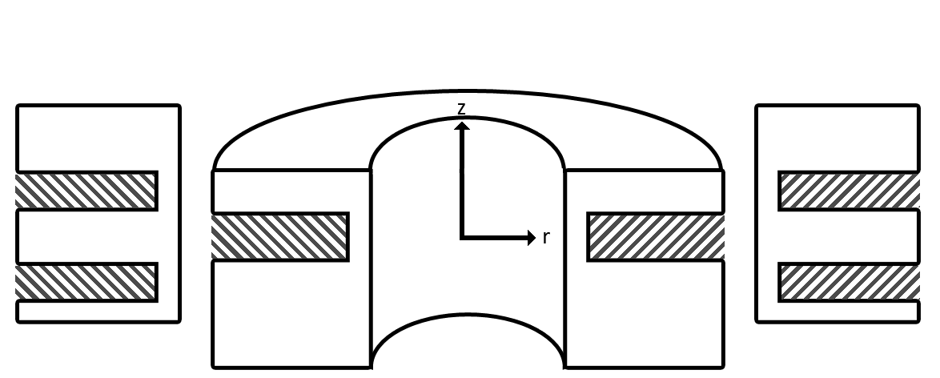
Position measurement
Differential measurement.
Linear variable differential transformer (LVDT)
Pickup
Coils
Excitation
Coil

Slide 41
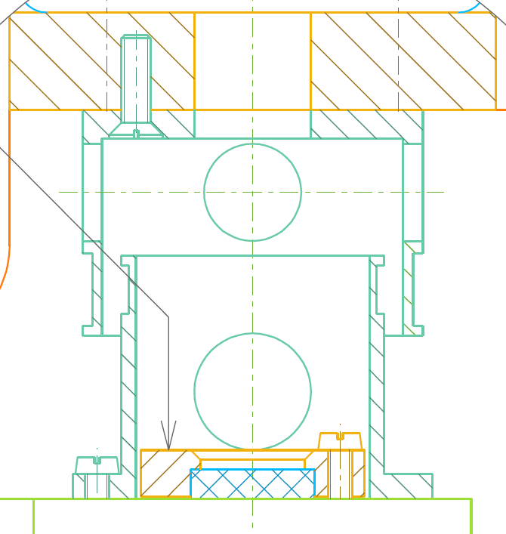
LVDT development
Excess forces occurring, correlated with emitter strength
Coupling between the LVDT and aluminum case was suspected: Eddy currents
Peek bridges were introduced to reduce non-linear forces.
Noticeable reduction in excess forces

Slide 42
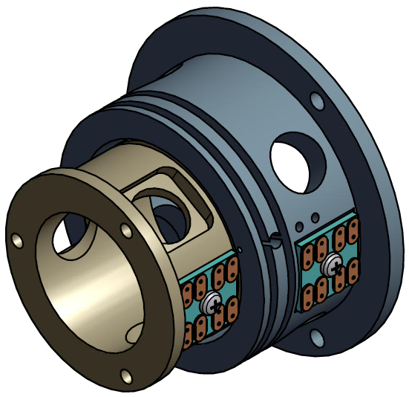
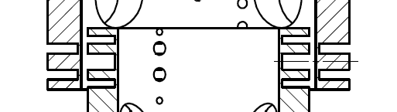
LVDT development
Cancel magnetic field into top plate to reduce eddy currents.
Three coil design.
Notes:
It was 0.5/1/0.5 so that field decays by a factor of 4, also for good coupling we use even amounts.

Slide 43
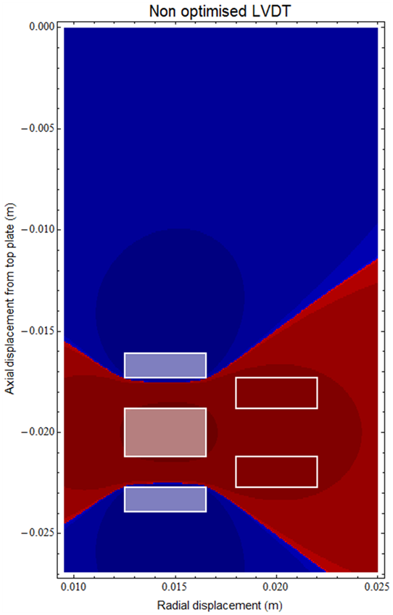
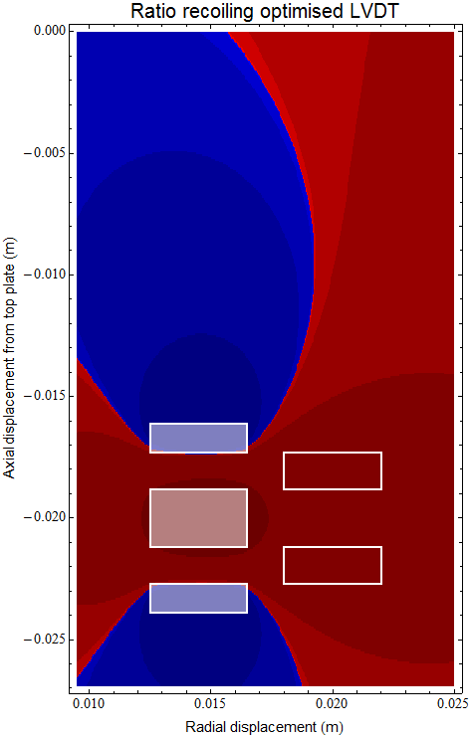
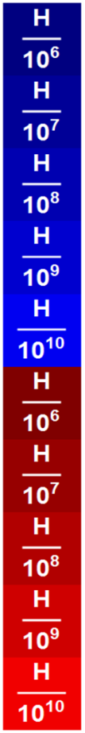
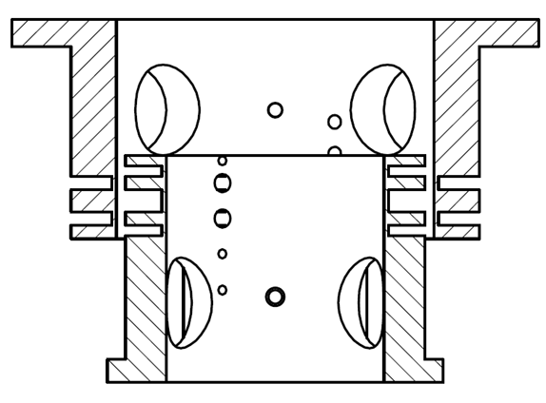
LVDT optimization
Optimization is achieved through unequal coiling
Coiling: (167,-351,167) Ratio:(1:-2.0989:1)
Total mutual induction into top plate after optimization is 5 10^(-9) H
New LVDT.
New LVDT with recoiling.
10^(-7) H
10^(-7) H

Slide 44
LVDT development
With optimization inductance to top plate is reduced by
Total reduction factor of 500!
Each spool has height of 1.15 mm
Centre spool has height of 2.4 mm
Each spool has height of 1.5 mm
Spool spacing of 2.4 mm
Spool spacing of 1.5 mm

Slide 45
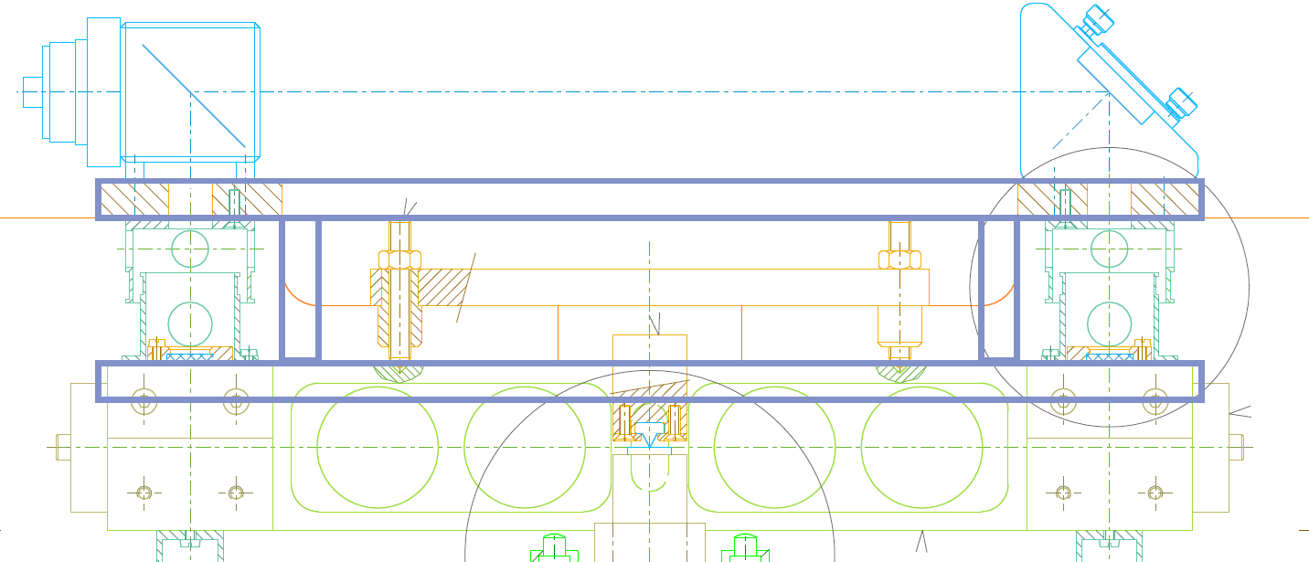
Interferometric Displacement measurement
Differential measurement.
Highest sensitivity
Self calibrating
Difficult UHV implementation

Slide 46
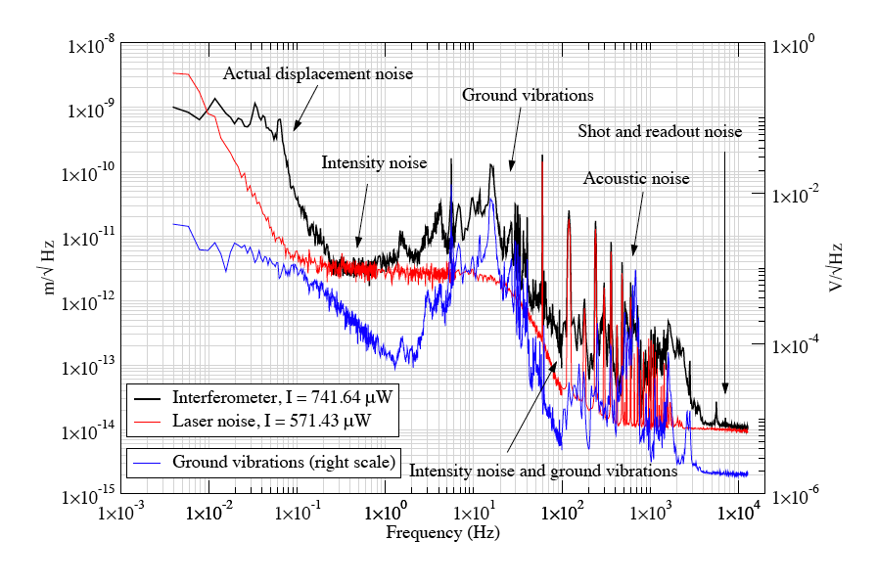
Potentiality with interferometer
i

Slide 47
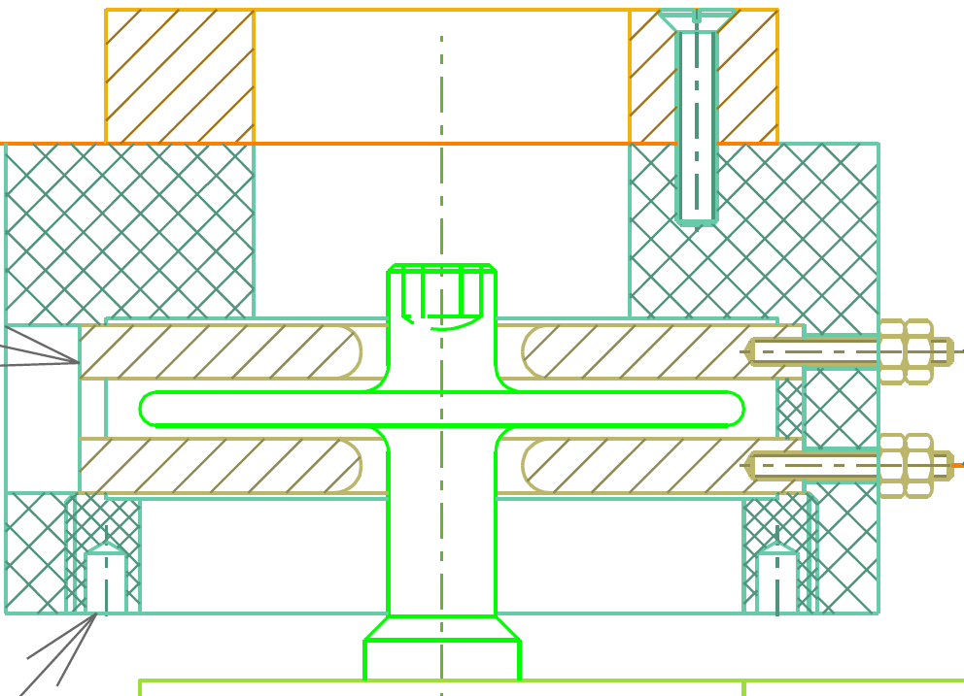


Capacitive Displacement measurement
Possibel better sensitivity
Problem with stray forces

Slide 48
Future developments
DLC coating
Place two tiltmeters in vacuum!
Michelson interferometer in combination with LVDT
Diamond coating
Quadrupole actuator
Optical only position recording
Flexure for SOC study!!

Slide 49
End of talk.

