Slide 1
H1 Squeezer Experiment Update
March 18, 2010
LVC Meeting, Arcadia
ANU, AEI, MIT, CIT and LHO collaboration

Slide 2
Progress
On budget & no major roadblocks so far
No major schedule setback (maybe ~2 month behind with optics procurement)
2nd update review was held on February 9, 2010
New postdoc (Lisa B.)
Lasers ready at MIT; locked together
OPO ready at ANU with 5-6dB of squeezing
Ready to ship in March, required in early May
Electronics is 80% complete; will be done by May
Developed a noise and servo model
Next: Set up the AEI SHG at MIT

Slide 3
Highlights
ANU OPO development
Ready to ship (schedule says March 2010).
Traveling wave bowtie design works.
Grad. students will travel to MIT to set it up.
LHO
RF electronics: built, 80% installed, working.
TTFSS for laser locking: built, installed, working.
Demodulator design by Rich A., 1st unit in hand, working.
Servo boards (CM): 2 units built, testing, remainder in production.
Slow controls (Beckhoff): 1 unit built, working.
Completion expected: May 2010.
MIT
Lasers fully operational, locked with 1MHz bandwidth.
Optics ordered for SHG/OPO mirrors, HR mirrors, beam splitters, dichroics, etc.

Slide 4
Block Schematics
Interferometer
S
0
Fiber
Homodyne Detector
Faraday
S
4
Laser
SHG
OPO
S
3
S
1
S
S
5
2
OMC
Auxiliary
Laser
AS Port
Squeezer
DC

Slide 5
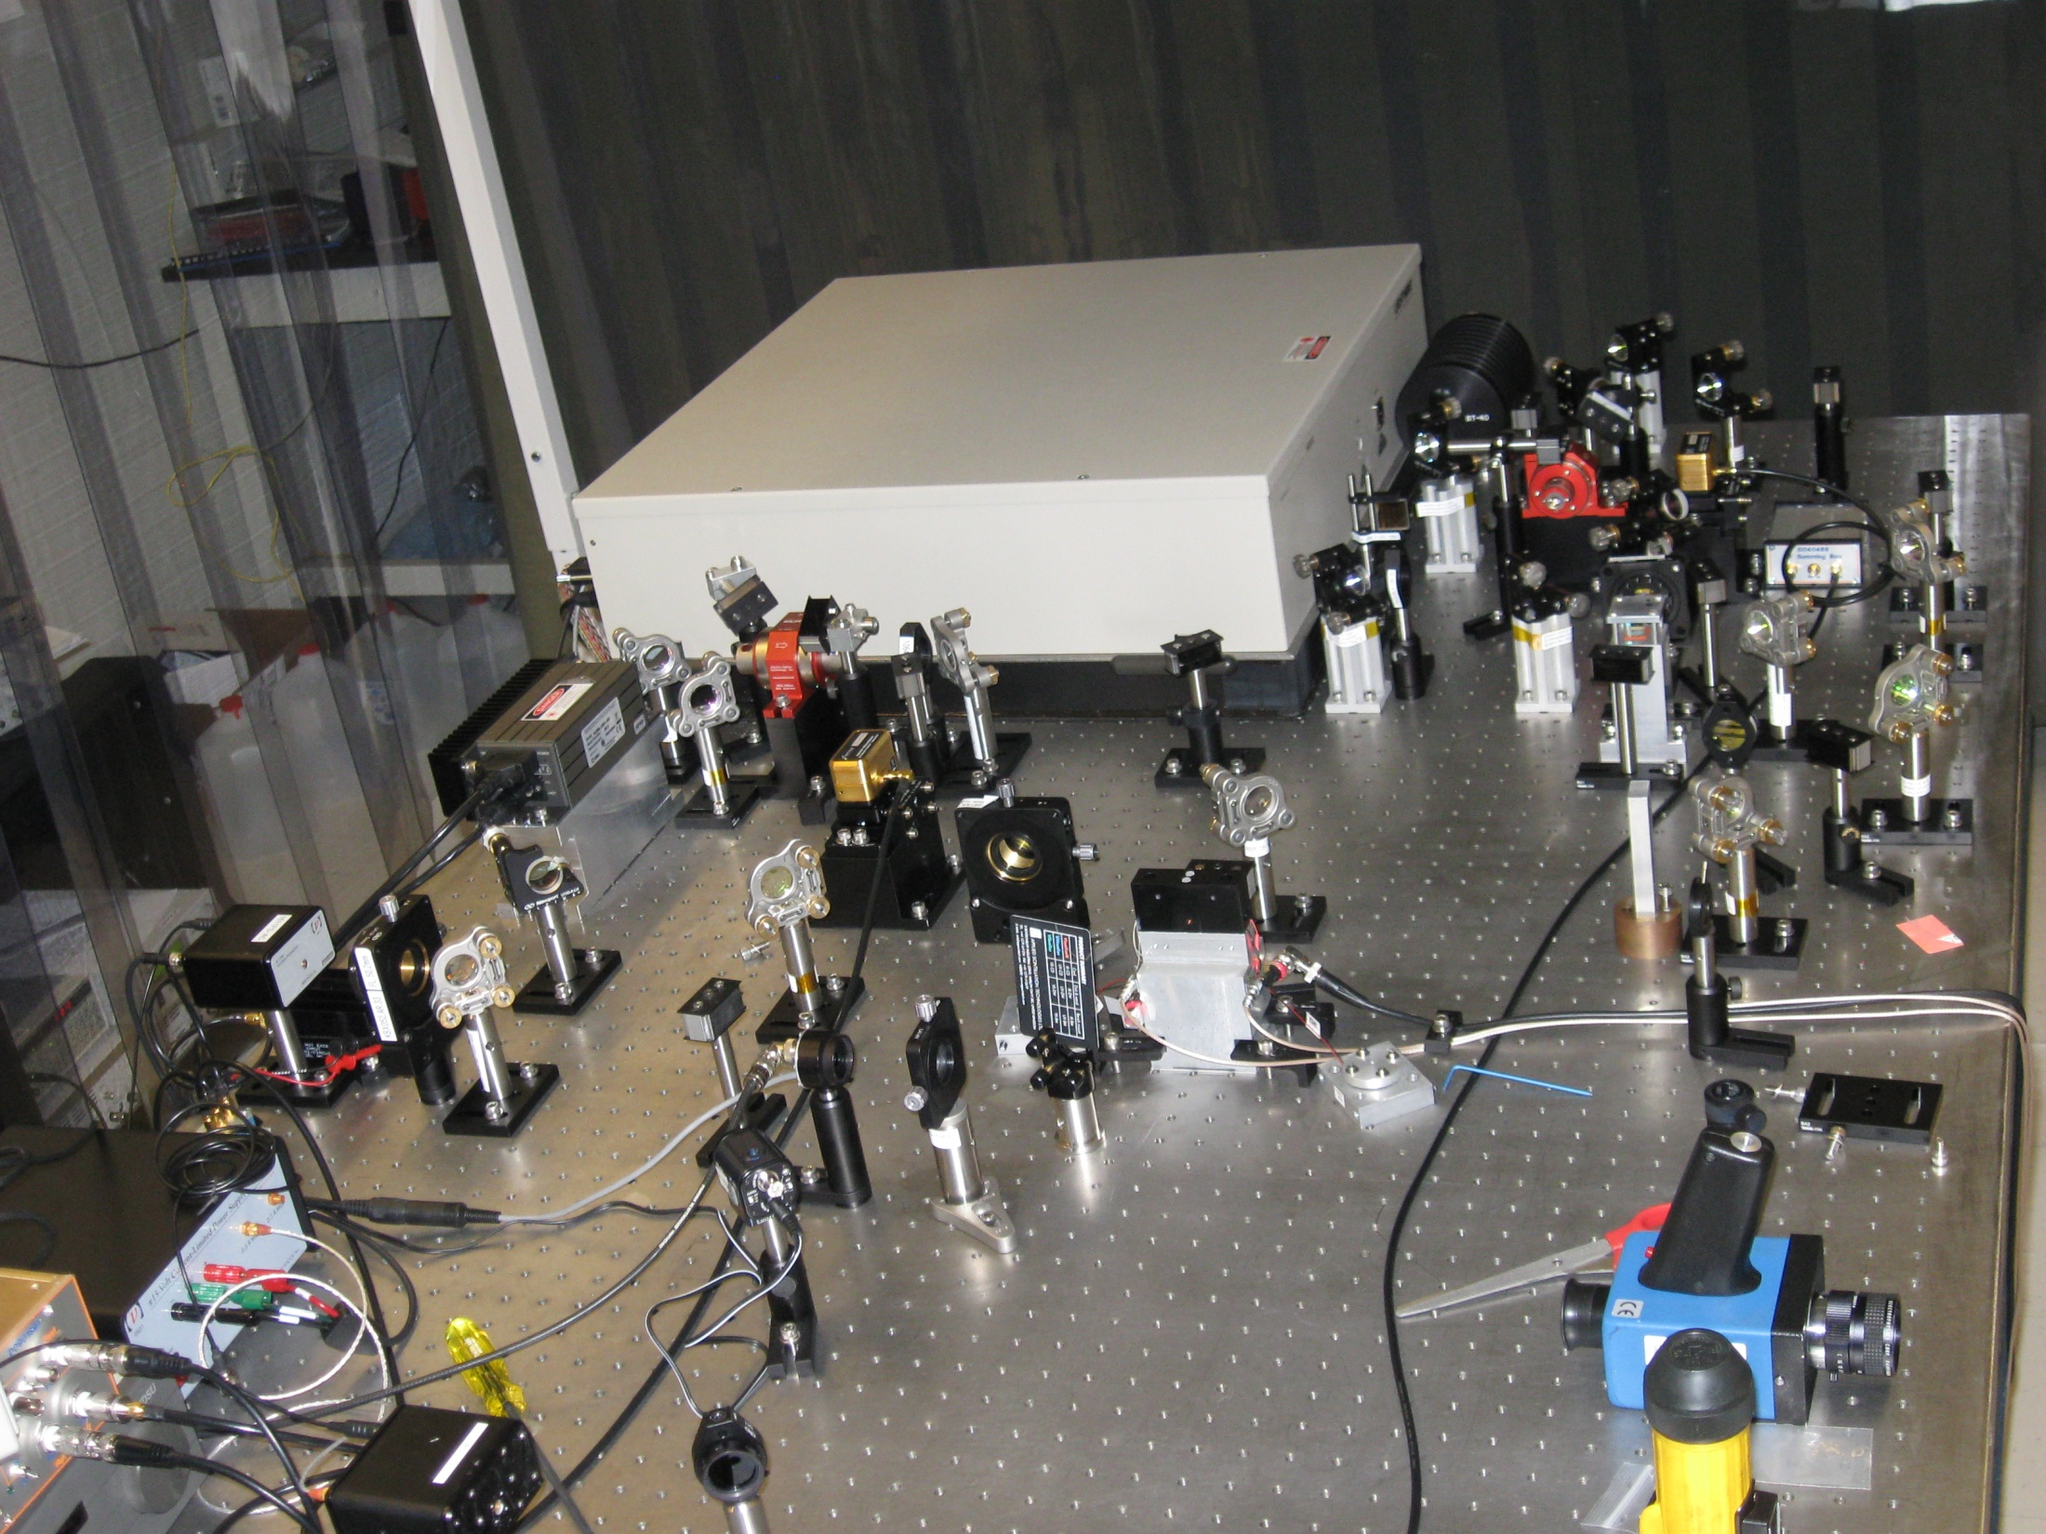

Slide 6
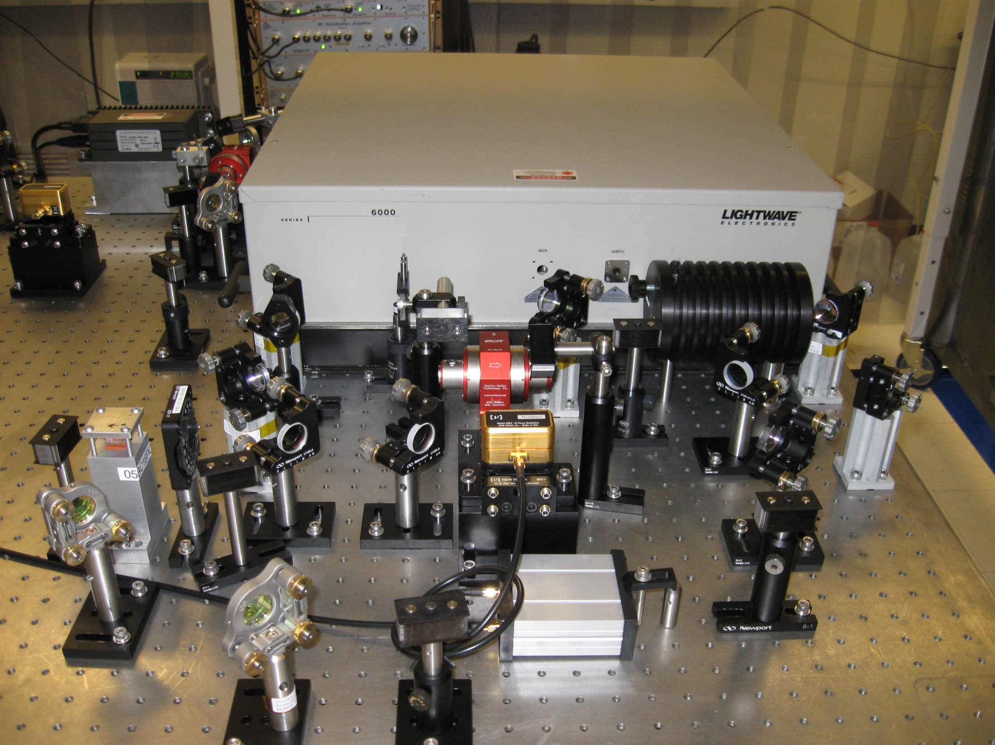

Slide 7
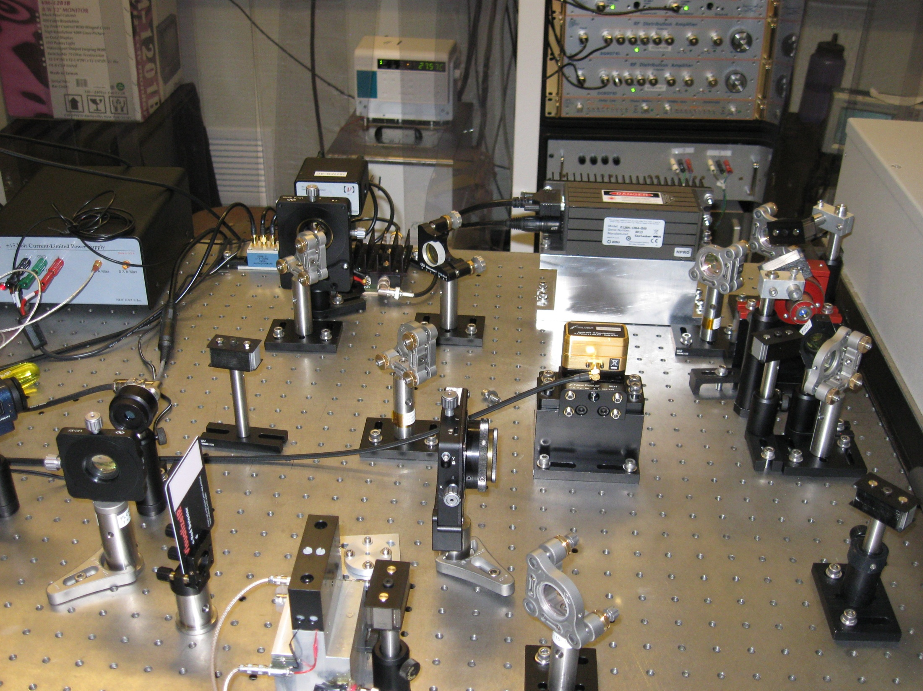

Slide 8
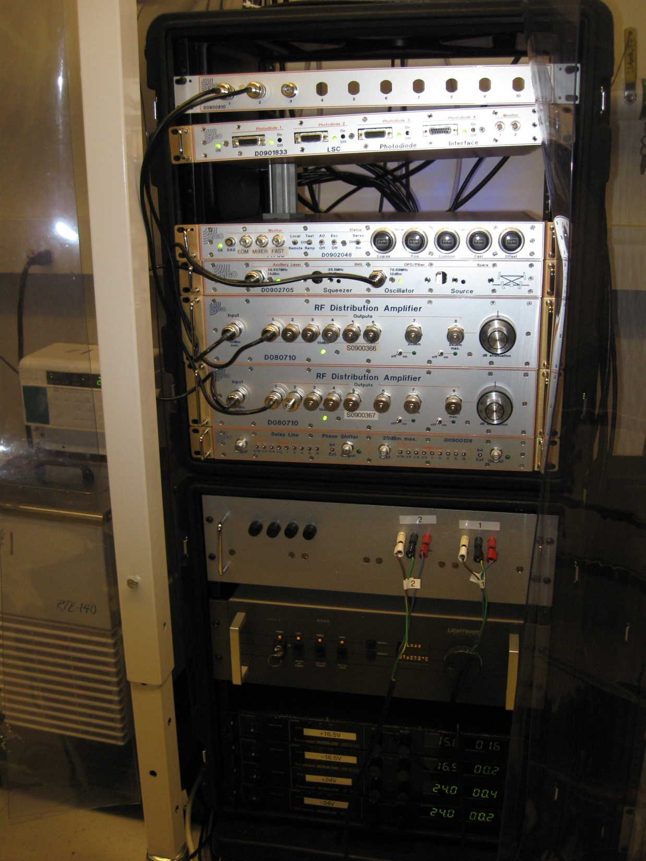

Slide 10
ANU Traveling wave OPO

Slide 11
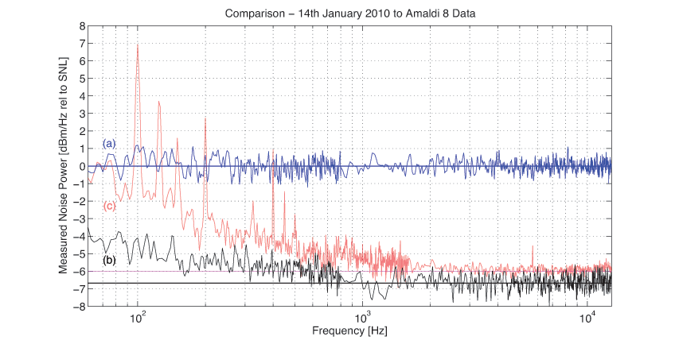
OPO Performance

Slide 12
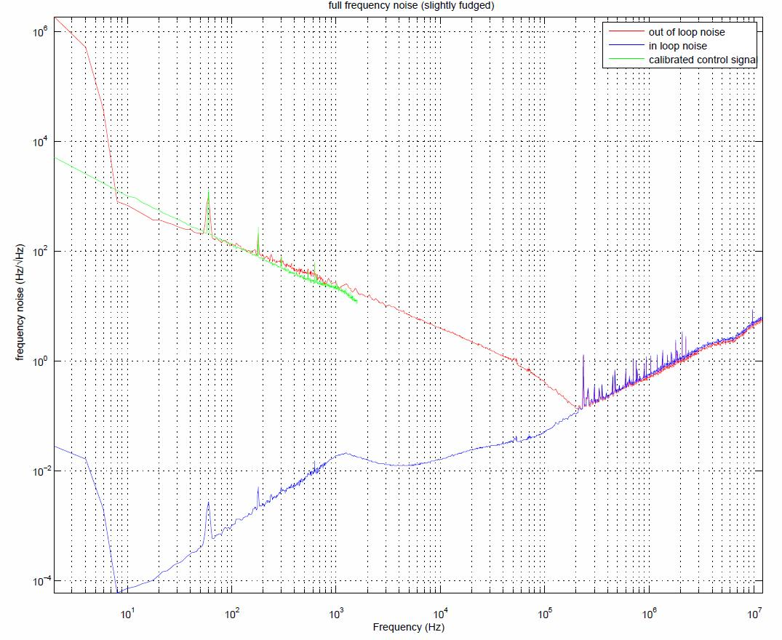

Slide 13
Plan
Continue to test AEI SHG Built our own when we get the optics
OPO to arrive in May 2010
OPO integration will start immediately afterwards
Electronics production will wrap up in May 2010
Advanced LIGO Faraday isolator (Mike S.) assembled by June 2010
Need to start thinking about in-vacuum work
Additional funding was approved

Slide 14
Summary
Lasers and OPO ready
Electronics is nearing completion
No major roadblocks so far
On budget & on schedule

