Slide 1
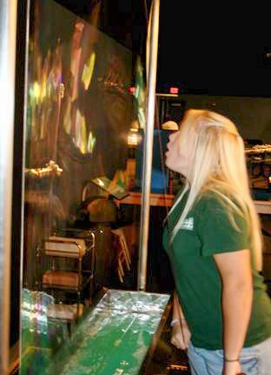
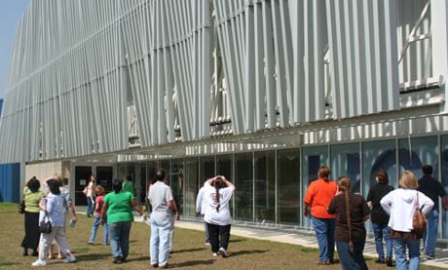
Immersing Southeastern Louisiana Middle School Students in Physics at the LIGO Livingston Science Education Center
Amber L. Stuver
LIGO Livingston Observatory

Slide 2
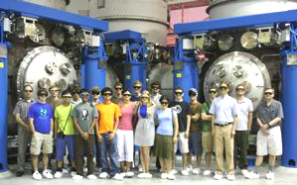
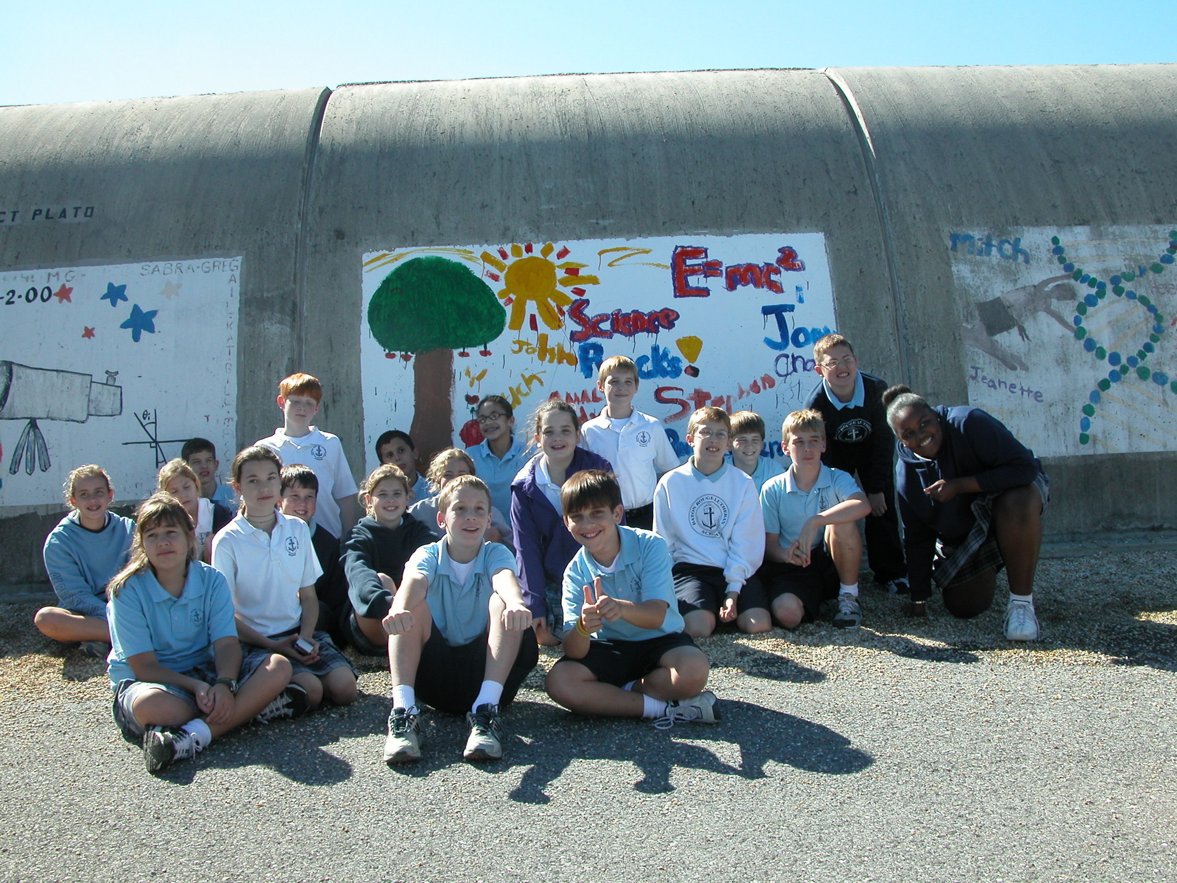
Overview
LIGO and the Science Education Center (SEC)
Collaboration
Mission and Structure
Student Programs
Introduction
Science at Work
Inquiry-Based Activities
Teacher Professional Development
Educational Research
SEC Next Phase
LIGO Hanford Education

Slide 3
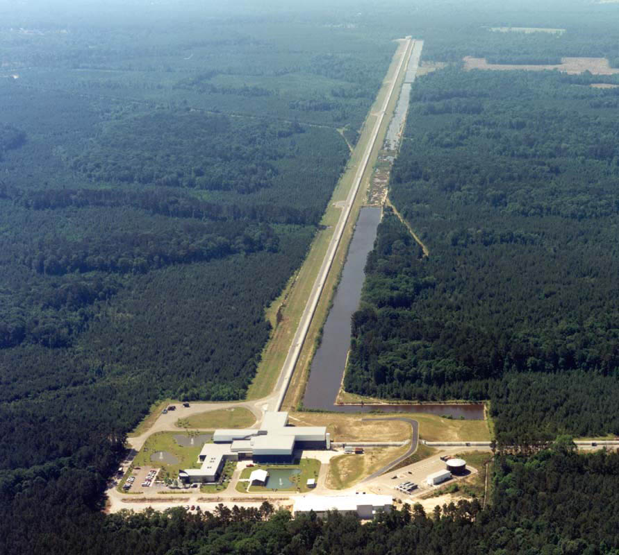
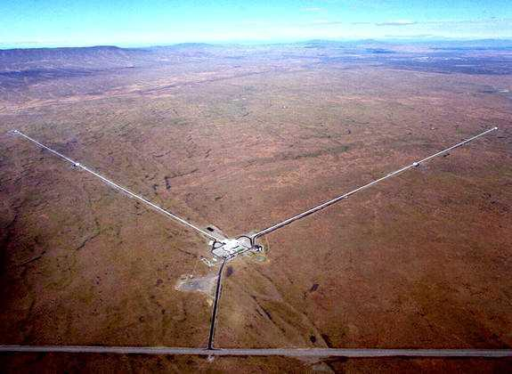
LIGO
NSF large facility seeking to directly detect gravitational waves (GW) originating from massive, energetic events in the universe.
Two facilities:
Hanford, WA Livingston, LA
Along with detection, education is one of LIGO’s central goals.

Slide 4
LIGO Science Education Center (SEC)
First class outreach program complements LIGO as an NSF large facility
Built on a partnership with the Exploratorium, SUBR, LaSIP and La GEAR UP
Informal learning environment housing 50 hands-on exhibits focusing on LIGO science, all but ~10 made by the Exploratorium
Exposes students, teachers and the public to LIGO concepts and scientists while being a platform for educational research
Notes:
* All of the staff have been trained at the Exploratorium’s Institute for Inquiry.

Slide 5
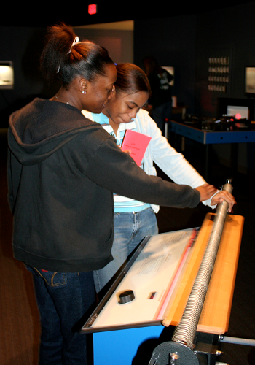
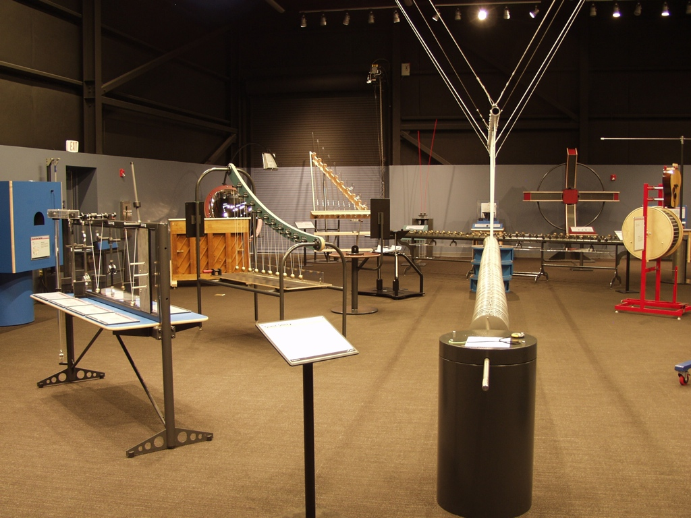
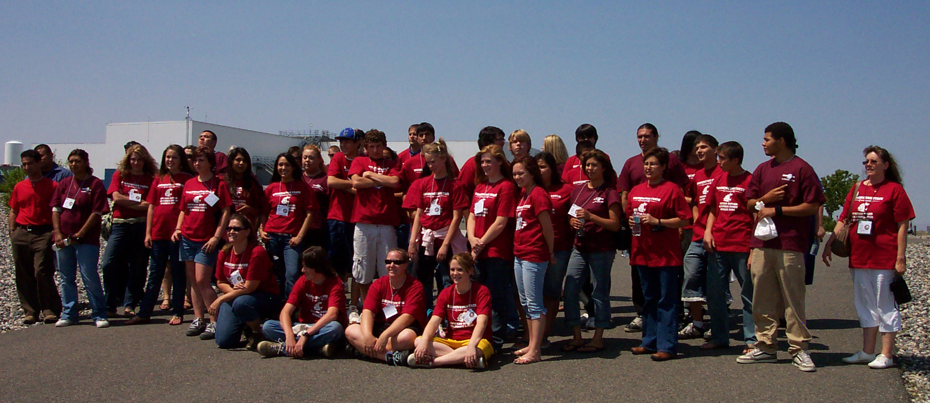
Mission and Structure
Leverage the scale, technology and science backdrop
of the Observatories to create rich visitor
experiences:
Student field trips integrate hands-on standards-based activities with explorations of LIGO science and technology.
Teacher professional development programs emphasize science inquiry along with key LIGO science concepts.
Programs for the general public address a variety of interests and ages.
Outreach programs are built on partnerships.

Slide 6
Student Programs
When students visit the SEC, they get the opportunity to explore the science of waves and gravity through inquiry-based activities and exhibits as well as see science at work.
All activities and experiences are tailored to address points in the LA Grade Level Expectations and the LA Comprehensive Curriculum.
Programs are targeted to middle school students.
Programs are also offered to elementary, secondary and post-secondary students.
Monthly “Science Saturdays” are open house style programs for the general public.
This academic year (through end of Feb.): 3875 students + 76 accompanying adults.
Notes:
1 Sept to 28 Feb : 3875 field trips + 76 adults
Non PD: 770
Total contact (not PD): 5068
Outreach (not PD): 106
PD events: 6
PD contacts (not conf.): 150
(Much PD in summer)
12-10-08 to 11-30-09 LLO SEC non PD contacts: 6634
Program: 144
PD 284
Presentation (public): 9

Slide 7
Student Introduction to LIGO
Pre-visit materials are mailed to teachers prior to the field trip.
Includes a ~20 min. documentary,
Einstein’s Messengers, to introduce
students to the science of LIGO.
When students arrive on site, they are briefly introduced to LIGO, GWs and concepts dealing with scale and scientific notation.
Scale makes connections on how far away typical GW sources are and how small GWs are upon arrival at Earth.
Students are also introduced to docents (more later).
Docents are STEM or education majors, trained in LIGO concepts and often from groups under-represented in STEM fields.

Slide 8
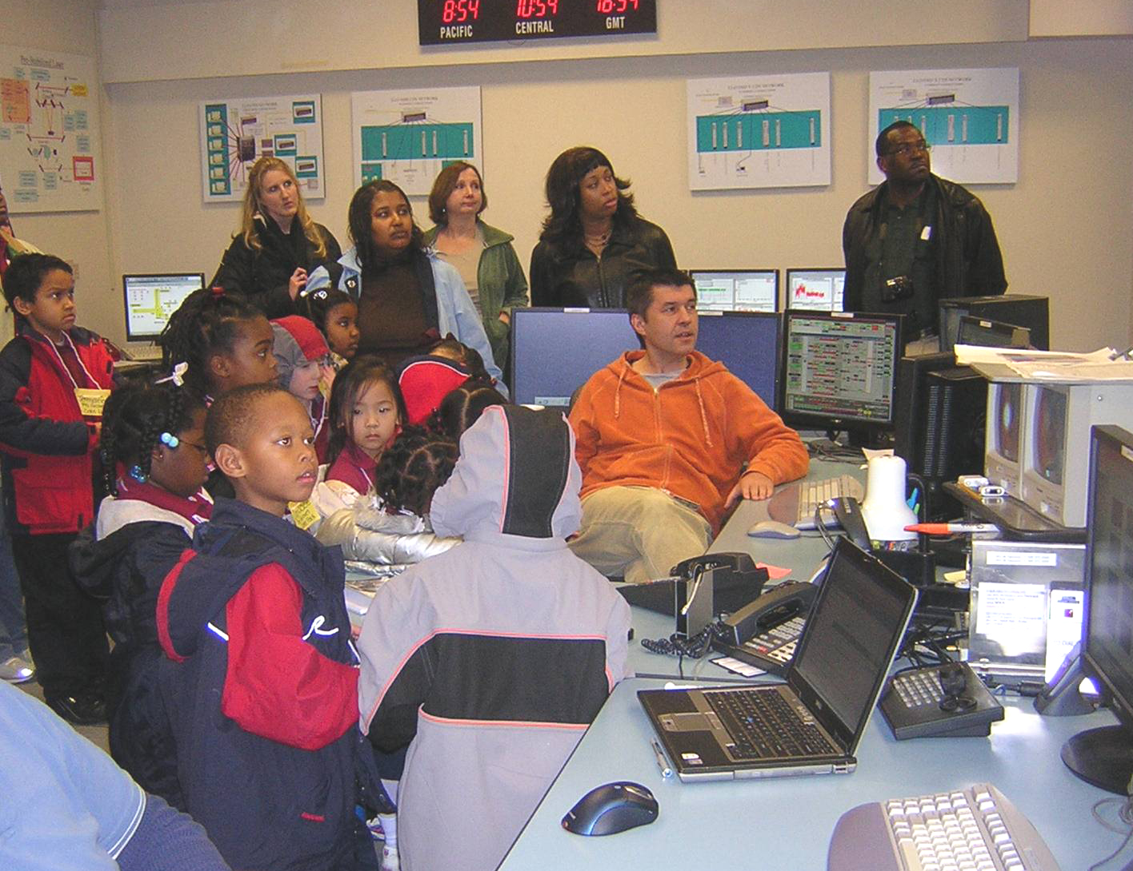
Science at Work
Pre-Control Room Tour
Students are introduced to vacuum properties to make the connection with LIGO’s large scale ultra-high vacuum and shown a full scale mirror suspension to make the connection to the actual mirrors that will be seen through IR cameras in the control room.
Control Room Tour
Students then visit the LIGO control room where staff are currently working; they are either led by SEC staff or a LIGO scientist.
The need for a control room is explained, the staff positions that man the control room are explained and a live video tour of the site is given.
Students are free to ask questions on anything they see in the control room, on how to become a scientist/engineer/etc., what life is like for staff, etc.

Slide 9
Inquiry Based Activities
Classroom Activities
Hands-on, staff member facilitated inquiry activities are available
Most focus on light and wave properties (e.g. interference, refraction, etc.) with a few on gravity (e.g. gravity blanket)
Exhibit Hall Exploration
About 45 minutes is allotted for free exploration of the hands-on exhibits housed in the SEC.
Students are given 4 “rules” for their experience: interact with the exhibits, learn something, share something, and have fun.
A short exhibit demo is performed by a staff member not
only to teach a targeted concept, but to show students
that there are multiple ways to use the exhibits.
Notes:
Orally note again that the exhibits were designed by the Exploratorium.

Slide 10
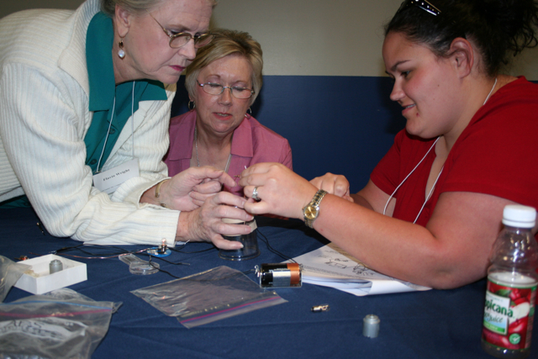
Teacher Professional Development
Two types of focus are provided in PD programs: “snacks” and inquiry.
“Snacks” programs provide teachers with information and materials to construct small scale classroom demonstrations that are inexpensive, made with common items and mirror an exhibit at the SEC.
Inquiry programs provide experience focused on the facilitation of inquiry based activities in their classrooms.
Three MSP programs are funded by LaSIP and are organized by university or school systems.
All LIGO science PD programs have La GEAR UP
schools participating.

Slide 11
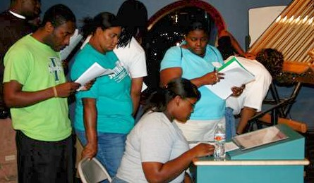
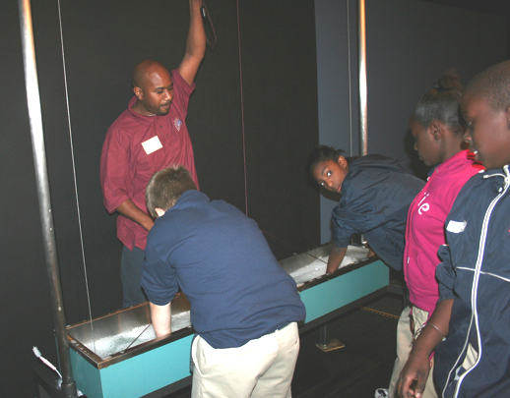
Docents
In cooperation with Southern University - Baton Rouge, undergraduate students in STEM and education majors are trained and serve as docents explaining exhibits to visitors.
Docents are trained on the SUBR campus in their local “Inquiry Laboratory” (complete with 6 exhibits) as well as on-site at the SEC.
Docents represent a step in the pathway to being a scientist and serve as role models to students from underrepresented groups in the STEM fields.
3 cohorts of ~15 students each have completed training.
Notes:
Docents facilitate student learning in the exhibit hall and also help promote the smooth progression of student activities.
Docents are STEM and education majors from Southern University who have been trained in the concepts presented in SEC programs.
Docents represent a step in the progression from middle school student to scientists or teachers. (What are the current number on trained docents and active docents.)

Slide 12
Educational Research
Student Perceptions of Science and Scientists
Investigating students’ attitudes toward science, the people who do science, its utility, its process and personal interest before & after visiting LIGO.
Parent-Child Interactions
Parents employed various strategies to explain exhibits to children
Those with better attitudes towards science visited more exhibits
Student Exhibit Interaction Pre- & Post- Facilitated Inquiry Activity
Compare the behaviors of kids who went to the exhibit hall either before or after engaging in an inquiry-based activity in the classroom
Children who did the inquiry activity first demonstrated more inquiry behaviors (e.g., asking questions, making observations, etc.)
This work is done in cooperation with a Tulane psychology faculty member, Dr. Lisa Szechter.

Slide 13
SEC Next Phase
NSF funded the 5 year plan of a continuum of engagement.
Longitudinal: Repeat Engagement
Whole grades of small school districts of both high and low performance
The same students visit the LIGO SEC every year between 5th-9th grade (except 7th)
Will study how interactions with exhibits change pre- & post-classroom inquiry activity and how students’ attitudes towards science change through this progression
Funding buses to transport students

Slide 14
SEC Next Phase (cont’d)
Broad Impact: 9th Grade Academy
Teacher PD offered to entire school system’s 9th grade teachers annually
Student field trips for an entire school’s 9th grade class (rotates within system)
Goal: provides repeated teacher exposure to different experiences in multiple contexts to enhance student learning
Funding substitute teacher costs

Slide 15
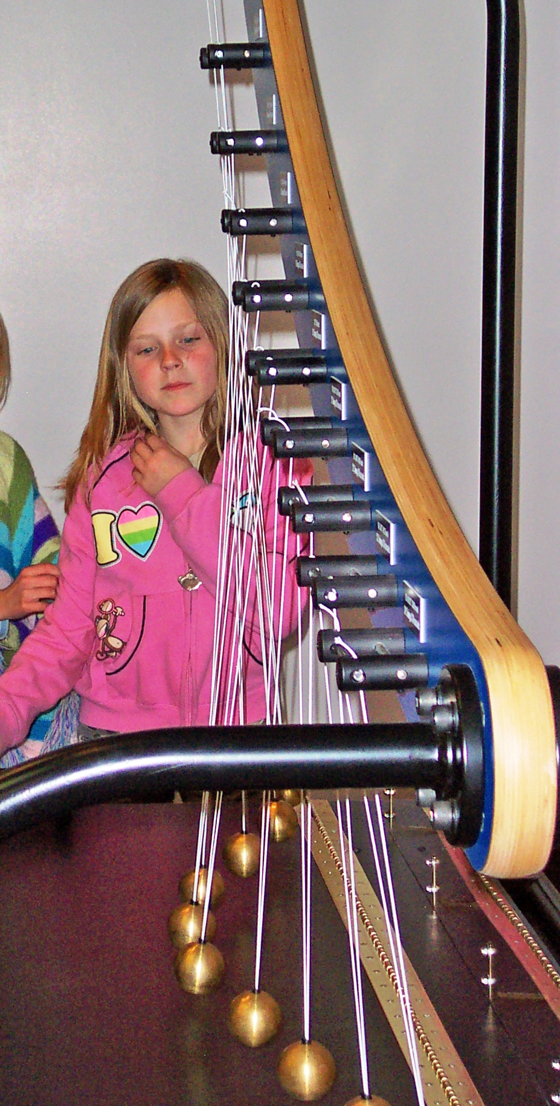
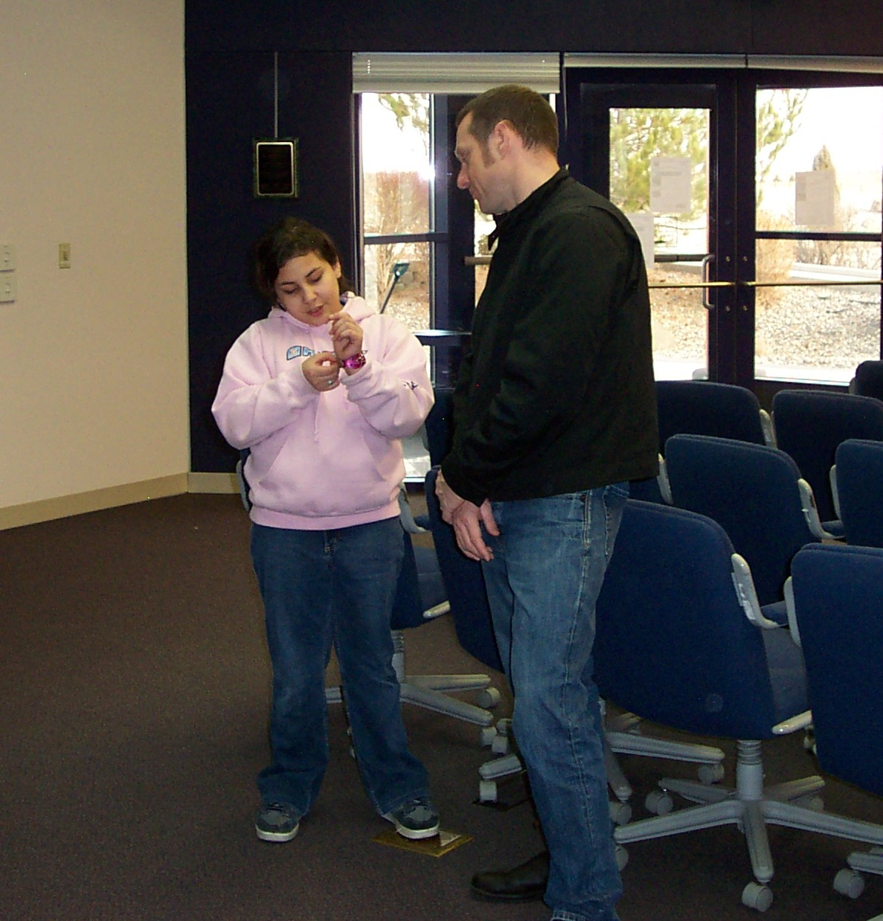
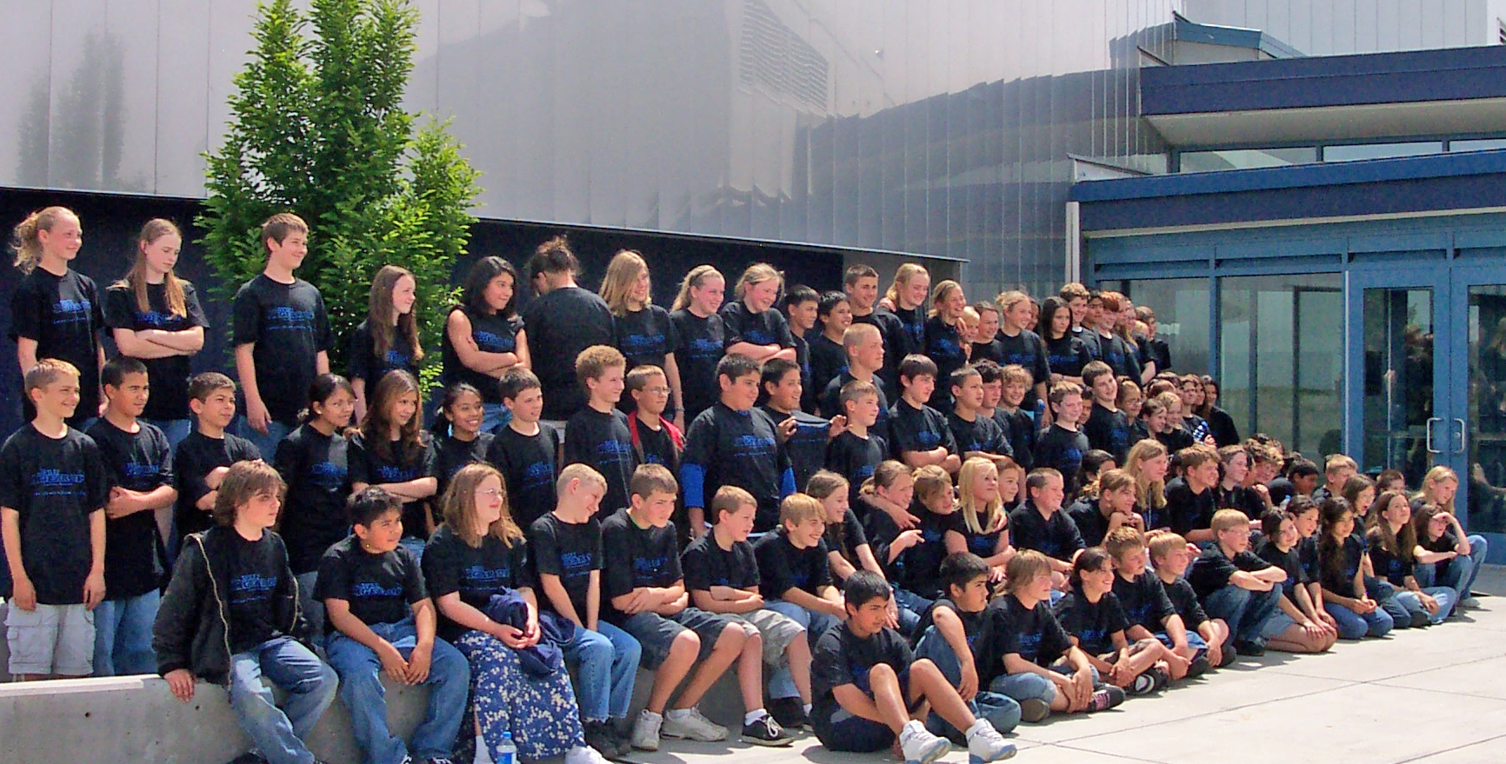
LIGO Hanford Student Outreach
GEAR UP and Yakima Valley/Tri-Cities MESA bring hundreds of middle school students to the LIGO Hanford each year.
The majority of these students are from homes where English is not the first language.
A field trip to LIGO is the first look at a professional science facility for many of the region’s middle school students.
These field trips amplify the “Prepare Yourself for College” message of the partners by offering real-time examples of college education at use in the world of work.
Math is a particular point of emphasis.

Slide 16
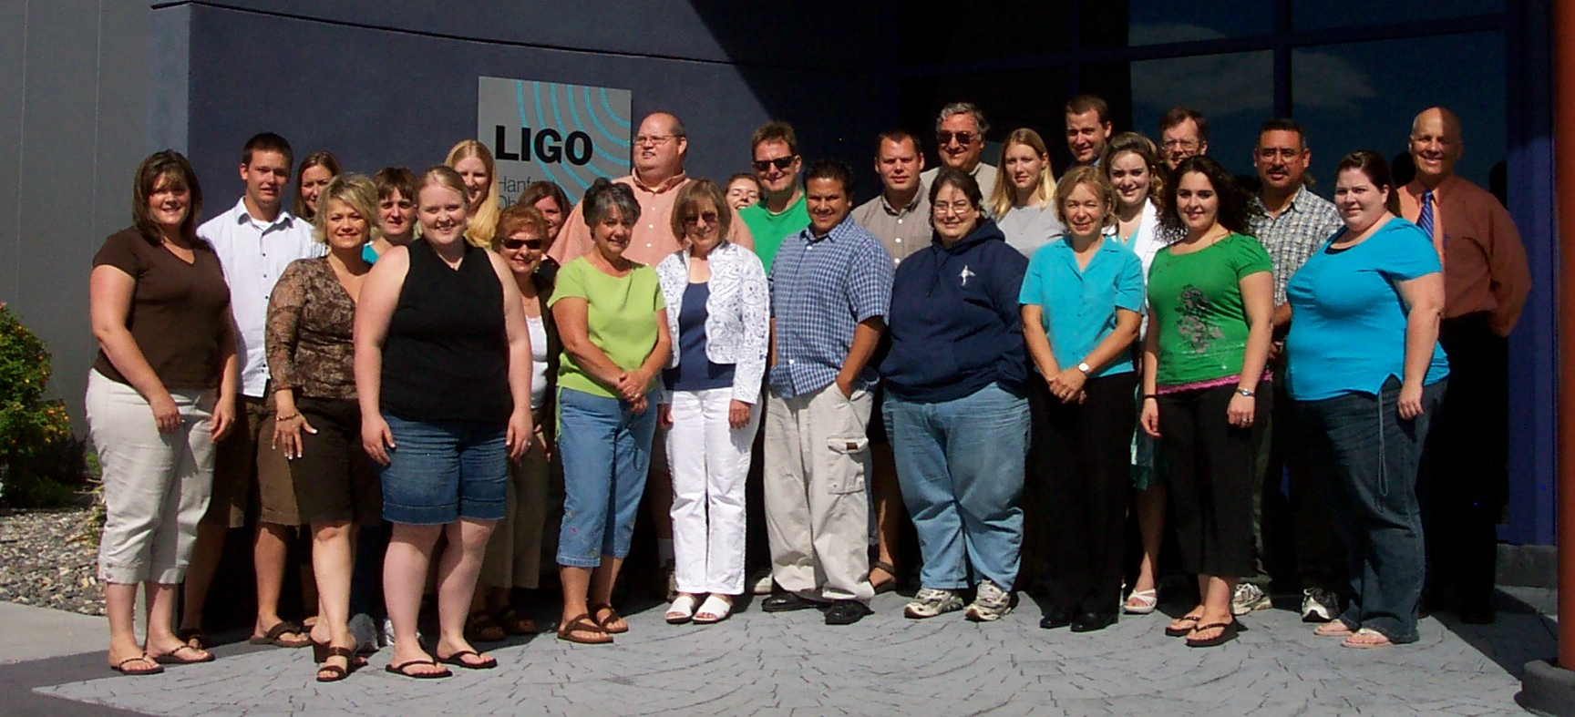
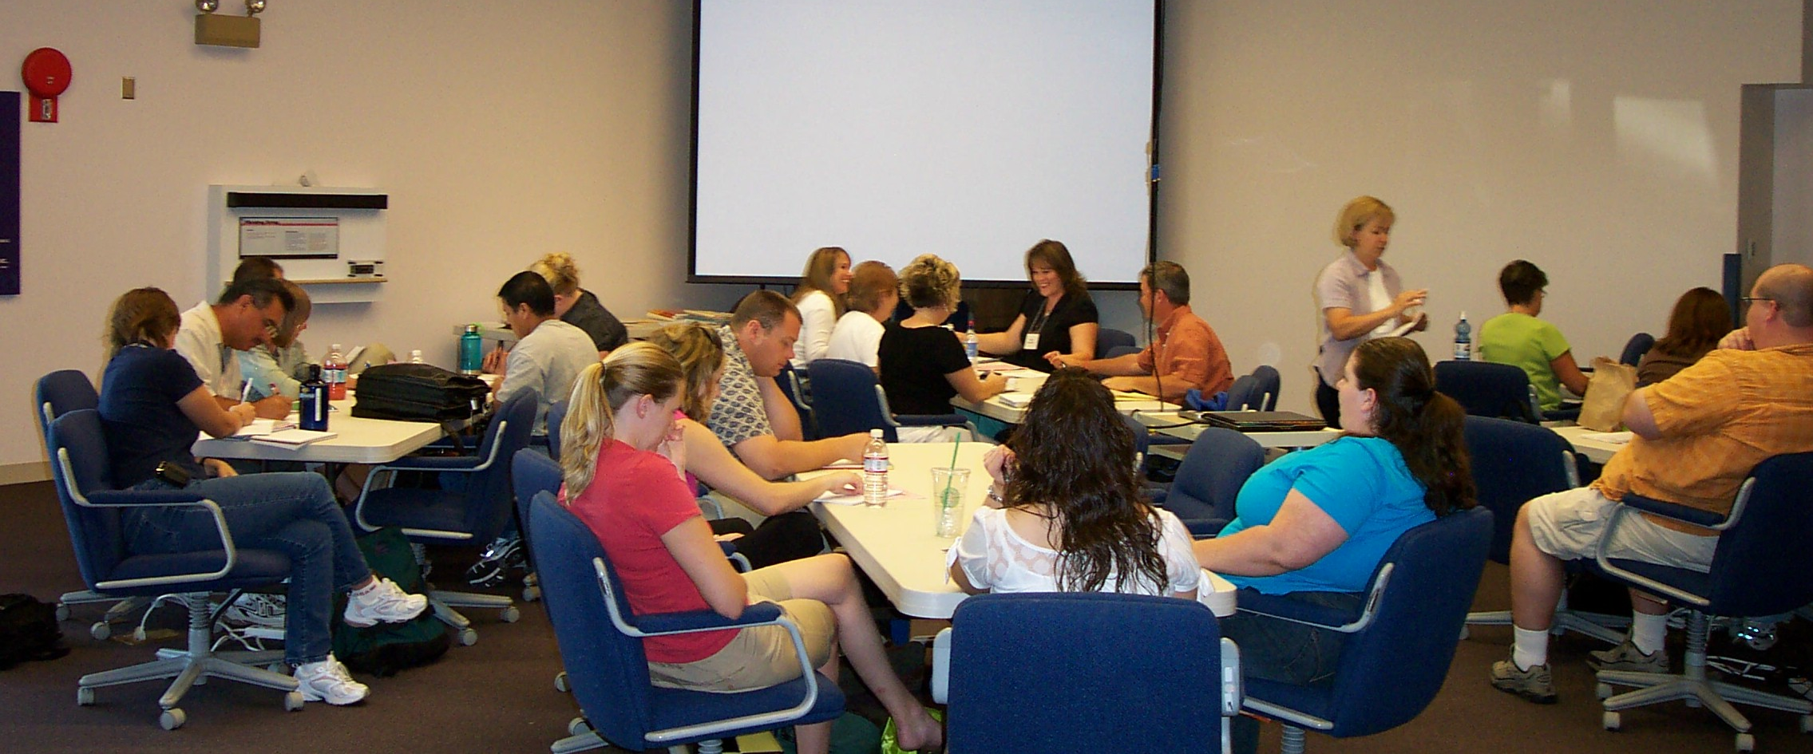
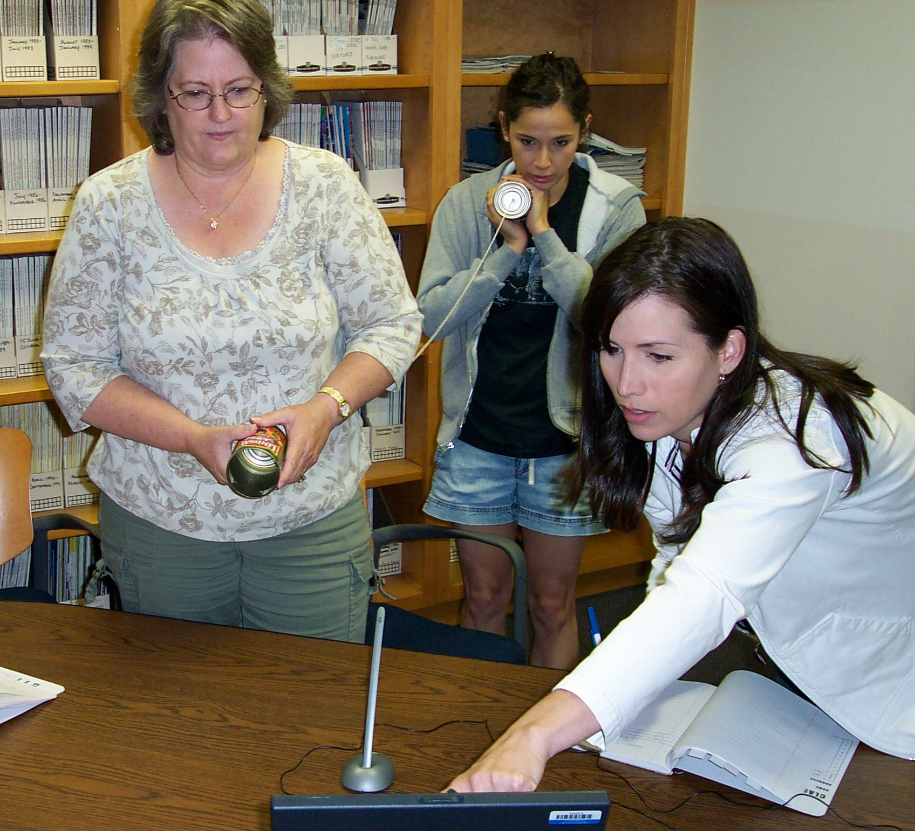
LIGO Hanford Teacher PD
Teacher PD focuses on the improvement of inquiry-based instruction across grades 3-8.
The MSP grant is administrated by Educational Service District 123 and partners with WSU Tri-Cities, Columbia Basin College, LIGO, and the Pasco and Othello School Districts.
The program:
A two-week 60-hour summer academy for ~30 teachers at LIGO, with facilitation provided by the team of partners
Followed by quarterly three-hour follow-up workshops
during the school year.

Slide 17
Summary
Inquiry-based experiences dominate the LIGO’s outreach efforts.
To reach middle school students, LIGO combines field trips for students, role models for students, and training for teachers.
LIGO provides the opportunity to see science and scientists in action – math and science are not just taught in school, but are really used!
Educational research provides a measure of outcomes and disseminates this to the professional community.
Changing the way that middle school students see the world and their own potential may be the most significant outcome that these visits achieve.

Slide 18
LIGO Outreach
LIGO Livingston
William Katzman – SEC Program Leader
Kathy Holt – SEC Staff
Tien Huynh-Dinh – SEC Staff
Joe Giaime – LIGO Livingston Observatory Head
LIGO Hanford
Dale Ingram – Outreach Leader
Erin Steinert – Outreach Staff
Fred Rabb – LIGO Hanford Observatory Head

