Slide 1
Squeezer Update Review
August 25, 2009
H1 Squeezer Experiment
ANU, AEI, MIT, CIT and LHO collaboration

Slide 2
Highlights
Grad. students Sheila D. (MIT), Sheon C. (ANU) and Michael S. (ANU)
OPO development at ANU
6 dB of squeezing observed
Traveling wave bowtie design works
AEI loaner SHG at MIT
In the process of building our own (copy AEI design)
Laser, optical table and clean room installed at MIT
Noise model and simulation done
Electronics design done for RF distribution
Shared with advanced LIGO

Slide 3
Block Schematics
Interferometer
S
0
Fiber
Homodyne Detector
Faraday
S
4
Laser
SHG
OPO
S
3
S
1
S
S
5
2
OMC
Auxiliary
Laser
AS Port
Squeezer
DC

Slide 4
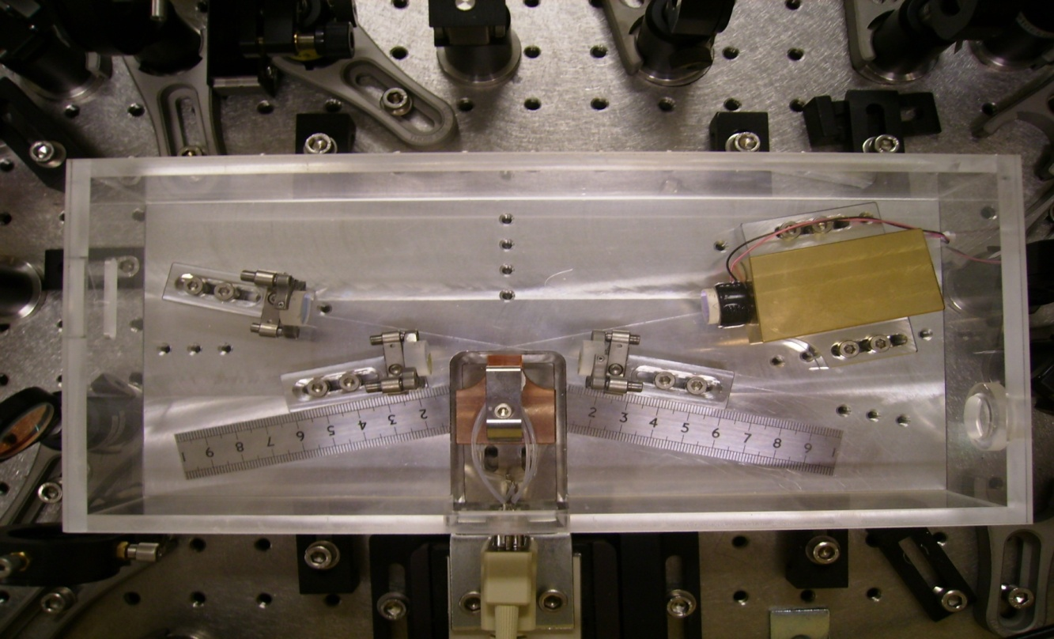
ANU Traveling Wave OPO
PZT Actuator
Squeezing
Out
Pump light In
150 mm
Crystal
Oven/
Temperature
Sensor
200 mm

Slide 5
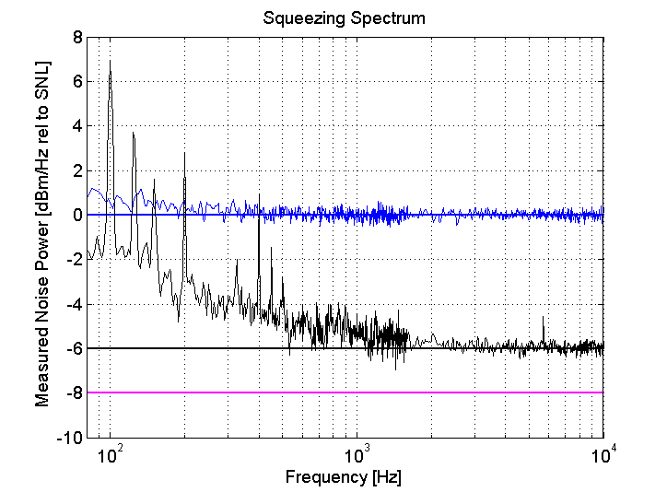
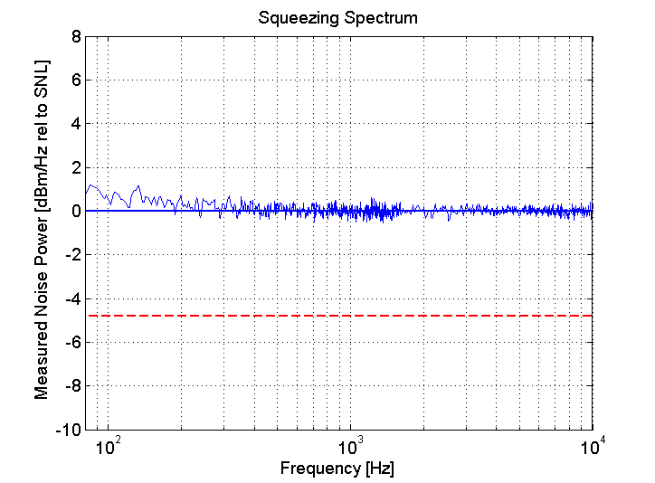
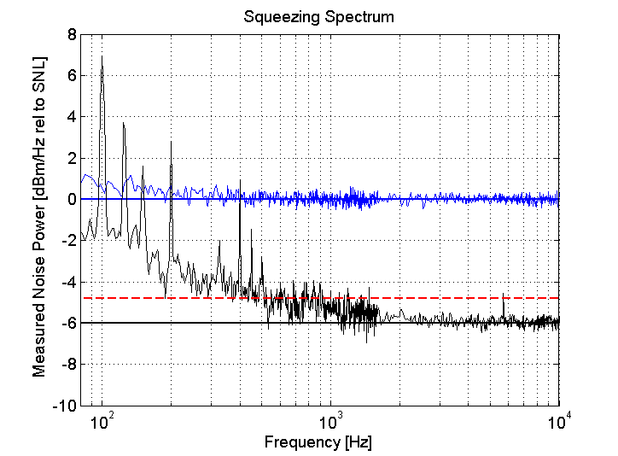
Squeezing Performance
Electronics
Mains harmonics
Cross coupling from Coherent Lock
Quantum noise
Electronic Noise?
Lab environment
Acoustic Noise
6dB
Observed squeezing
8dB
Inferred squeezing

Slide 6
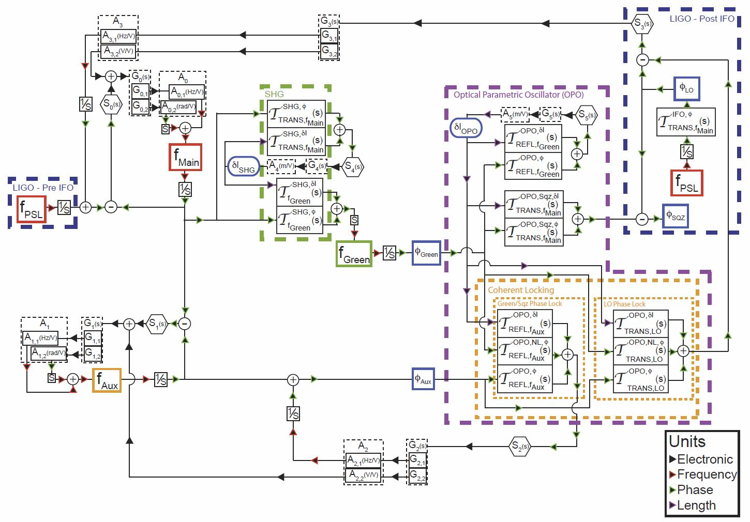

Slide 7
Servo Model
Laser 0: Frequency locked to PSL using FSS
Laser 1 (aux): Frequency locked to laser 0 using FSS
Coherent Lock 2: Phase lock laser 1 to green light using feedback to PZT & laser 1 additive offset
LO Lock 3: Phase lock squeeze angle to AS port light using feedback to PZT & laser 0 additive offset
SHG Lock 4: PDH to cavity PZT
OPO Lock 5: PDH to cavity PZT

Slide 8
Servo Model (2)
Servo | Description | Bandwidth | Crossover
0 | Laser 0 | 500kHz | 10kHz
1 | Laser 1 | 500kHz | 10kHz
2 | Coherent field | 100kHz | ~2kHz
3 | Local oscillator | 100kHz | ~2kHz
4 | SHG length | ~1kHz | —
5 | OPO length | ~1kHz | —
Fiber Stabilization no longer needed:
Laser 0 is frequency locked to PSL and
phase locked to AS port light

Slide 9
Noise Model
No bad surprises
Acoustic couplings
Direct back scattering under control
Require second in-vacuum Faraday
OPO ring topology is very helpful
Phase noise requirement: <50 mrad rms
Remaining modulation sidebands after OMC are important
Noise couplings
Laser frequency noise not important due to large bandwidth
Path length variations not important due to large bandwidth
Shot noise: 1 mW per detector seems enough
OPO length fluctuations are not getting suppressed by LO servo!

Slide 10
Schedule
ANU/OPO well on track
Noise model completed
AEI homodyne detector will be shipped to ANU ahead of schedule
Assembly at MIT
Optical layout on track
Parts late by ~2 months (initial funds exhausted)
Electronics production at LHO
Design on track
Procurement late by ~2 months (person power & money & H2 unavailable)

Slide 11
Plan
Need get some additional resources for
Electronics production at LHO
Setup at MIT
Procurement
ANU will continue on development of OPO
On track for 2010 delivery
Setup at MIT will continue with SHG & laser locking
Electronics production can go forward
RF, PDs, TTFFS and length servos (common mode board)
Additional funding is required now

Slide 12
Budget Request
Task | Amount
Optics | 90k
Electronics | 80k
Travel | 40k
Total | 210k

Slide 13
Summary
Impressive progress on the OPO
Setup at MIT is coming along
No major roadblocks so far
More funding is required now
Some additional person-power is required at MIT and LHO for the second half of this year

