Slide 1
E14/WSR13 run
Gabriela González,
Louisiana State University
On behalf of the LIGO DetChar group

Slide 2
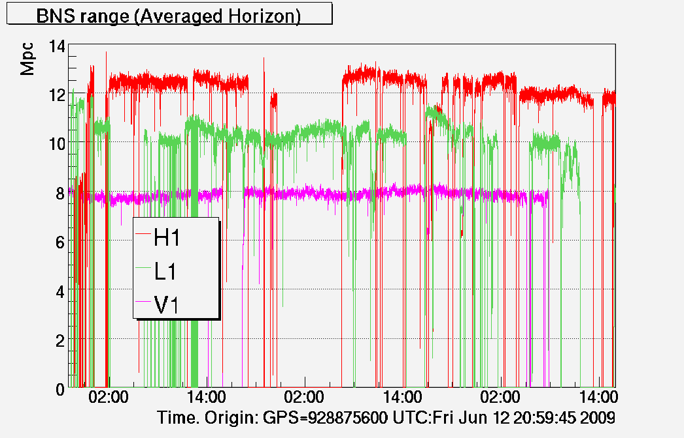
Executive summary
Preliminary calibration!!

Slide 3
Duty cycle
<30 mins
30+ mins
60+mins
H1
30+ mins
60+mins
<30 mins
Science mode
Non science mode
<30 mins
30+ mins
60+mins
30+ mins
L1
<30 mins
60+mins

Slide 4
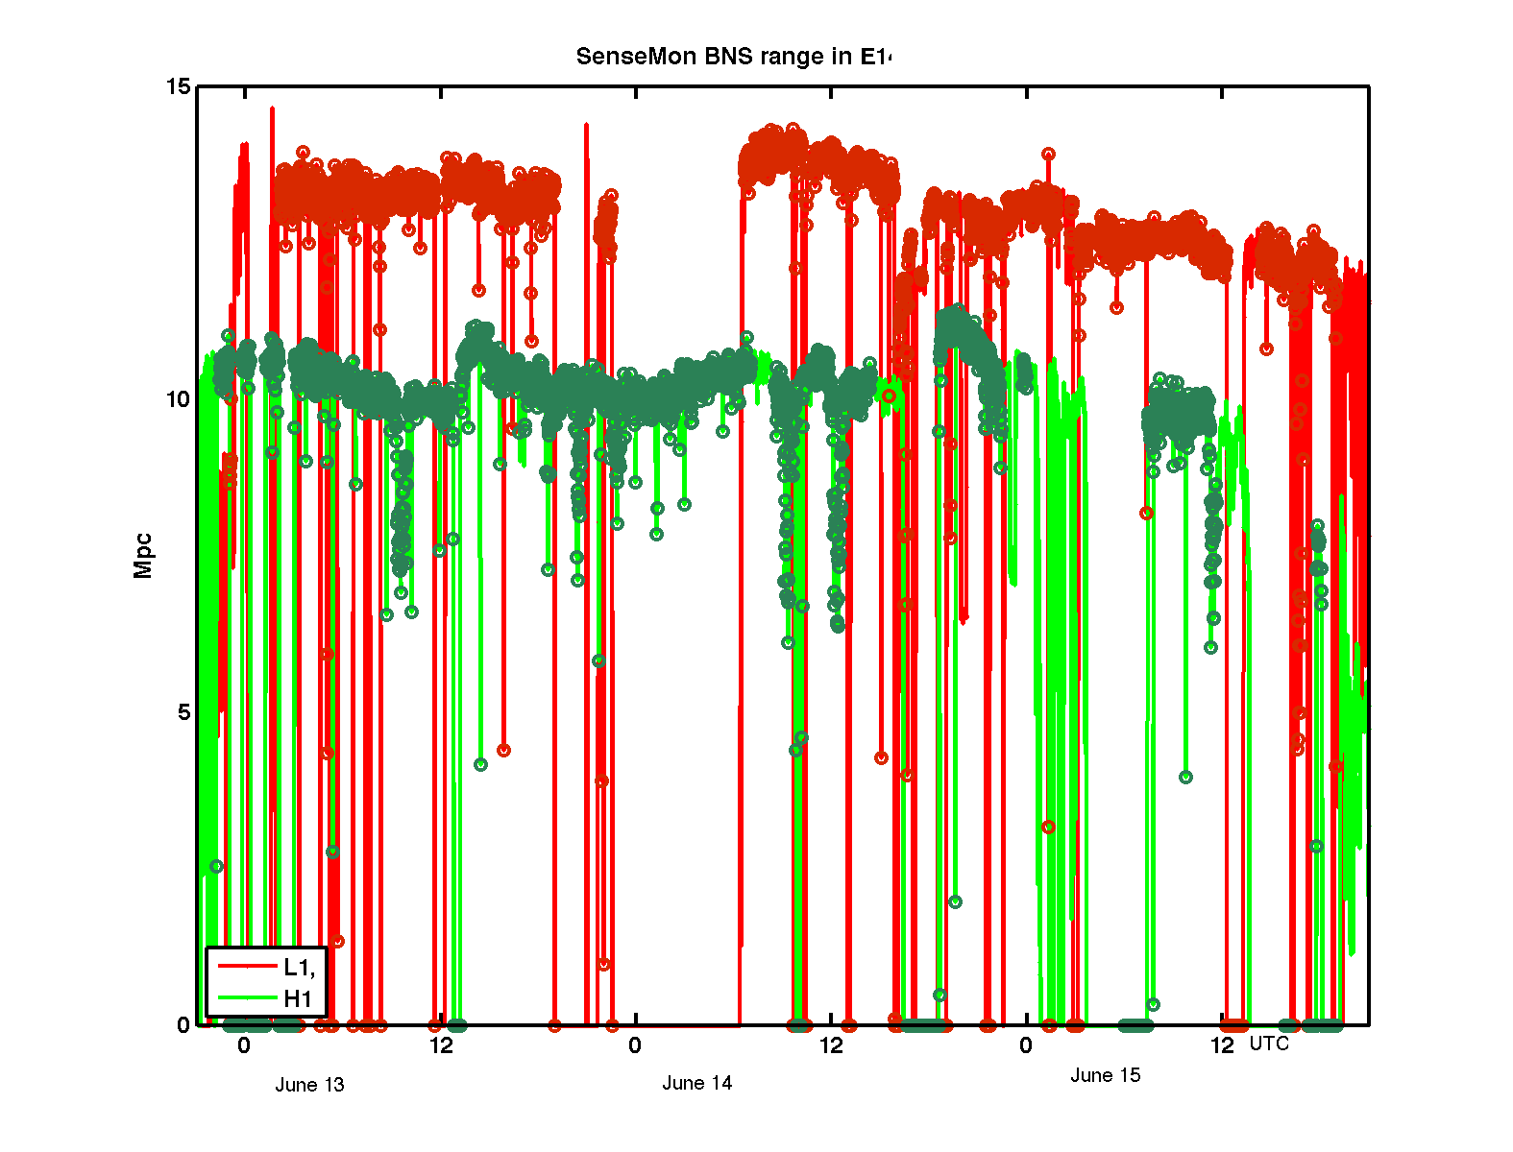
E14 history
AWG
MMT2
Road constr
Ch hop
OMC ASC
OMC no-lock
Comm.
OMC no-lock
EX logging

Slide 5
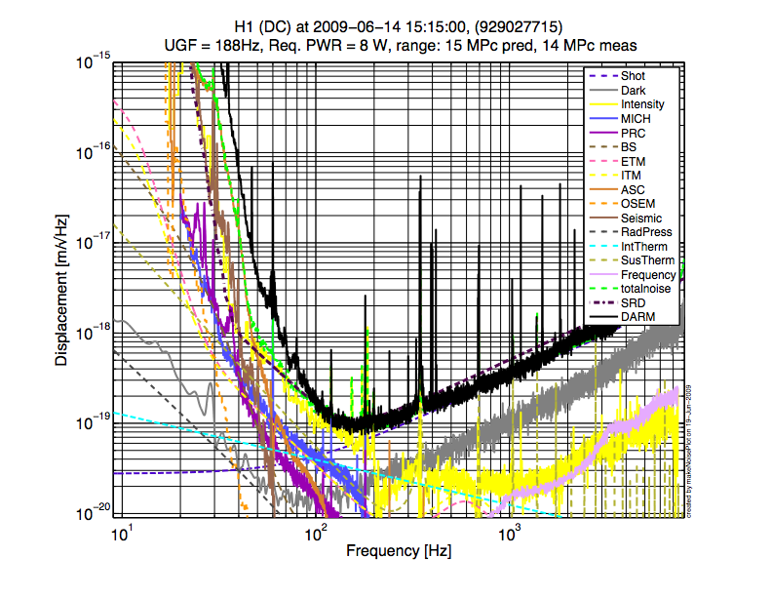
H1 Noise budget
Preliminary calibration!!

Slide 6
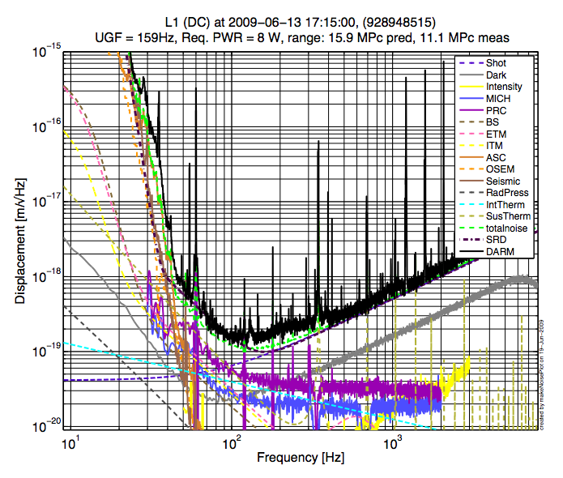
L1 Noise budget
Preliminary calibration!!

