Slide 1
LIGO G0900207
Design constraints and optimization for a white light cavity based GW interferometer including power and signal recycling
Selim Shahriar, Northwestern University
Laboratory of Atomic and Photonic Technologies
URL: http://lapt.ece.northwestern.edu
Northwestern University Gravitational Wave Astrophysics
Workgroup (Head: Vicky Kalogera)

Slide 2

White Light Cavity: Basic Idea
Negative Dispersion Medium
λ=2πC_{o}/(nω)
Source Laser
Ideal WLC is infinitely broadened, without any drop in storage time / sensitivity
Ideal WLC is also infinitely sensitive to variation in cavity length
In practice, broadening and sensitivity limited by finite bandwidth of negative dispersion

Slide 3
Active Superluminal Cavity: Superluminal Ring Laser (SRL)
Beat Signal
Neg Dispersion Medium
Gain Medium
Frequency change is enhanced in sensitivity by a factor of 10 million
Beat note does not experience the broadening effect

Slide 4
Demonstration of White Light Cavity

Slide 5
Demonstration of White Light Cavity
G.S. Pati, M. Messal, K. Salit, M.S. Shahriar, “Demonstration of a tunable-bandwidth white light
interferometer using anomalous dispersion in atomic vapor,” Phys. Rev. Lett. 99, 133601 (2007)

Slide 6
Demonstration of White Light Cavity
Experiment
Theory
G.S. Pati, M. Messal, K. Salit, M.S. Shahriar, Optics Communications, 281 (19), p.4931-4935, (2008)

Slide 7
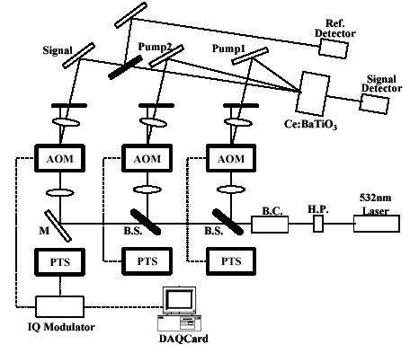
Fast-light in Photorefractive Crystal for WLC
H.N. Yum, M. Salit, G.S. Pati, S. Tseng, P.R. Hemmer, and M.S.Shahriar, Optics Express, Vol. 16 Issue 25, 20448 (2008)

Slide 8
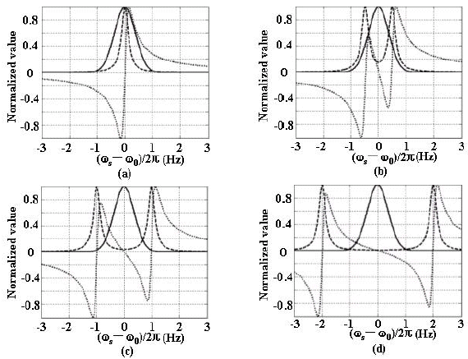
Fast-light in Photorefractive Crystal for WLC

Slide 9
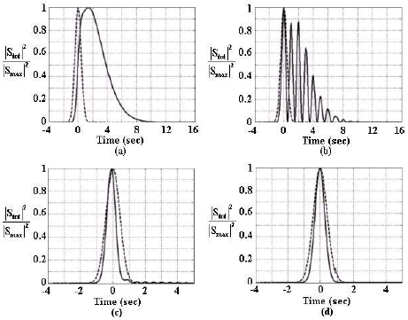
Fast-light in Photorefractive Crystal for WLC

Slide 10
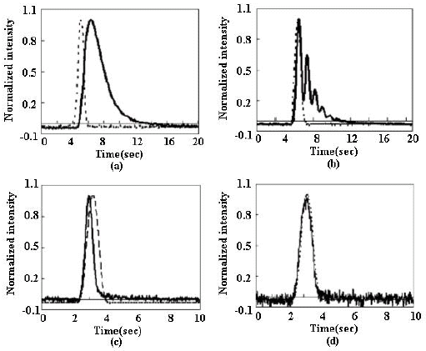
Fast-light in Photorefractive Crystal for WLC

Slide 11
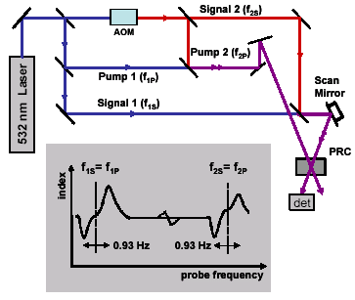
Fast-light in Photorefractive Crystal for WLC

Slide 12
Simple (Meers) Model for Signal and Power Recycling
NPBS
Power Recycling Mirror
Signal Recycling Mirror
detector

Slide 13
Enhancing the bandwidth-sensitivity product
Laser
PRM
SRM
det
Laser
PRM
WLC element
SRM
det

Slide 14
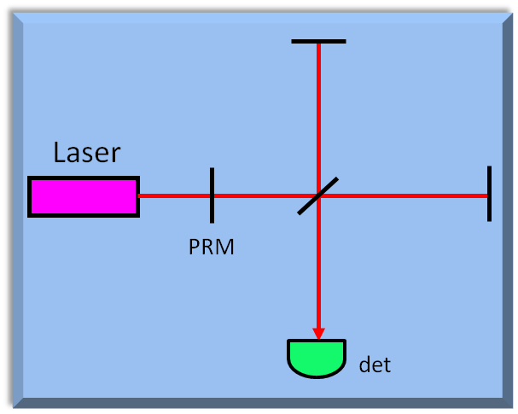
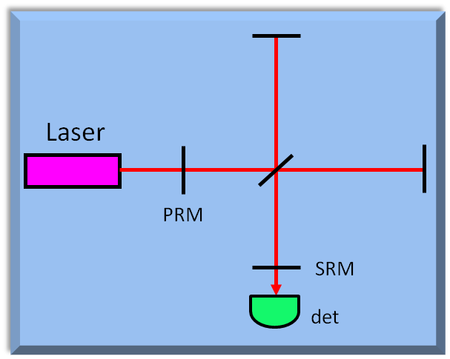
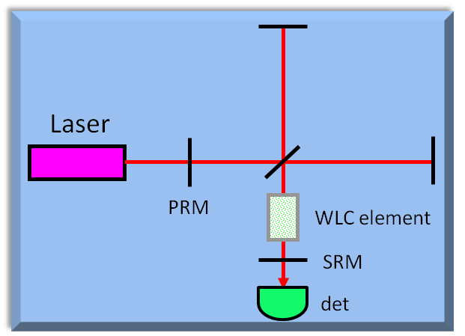
Enhancing the bandwidth-sensitivity product

Slide 15
Enhancing the bandwidth-sensitivity product
WLC / T_{SRM} =0.001
No WLC / T_{SRM} =0.001
WLC / T_{SRM} =0.1
No WLC / T_{SRM} =0.1
No WLC / T_{SRM} =1

Slide 16
Signal and Power Recycling in the Presence of Arm Cavities

Slide 17
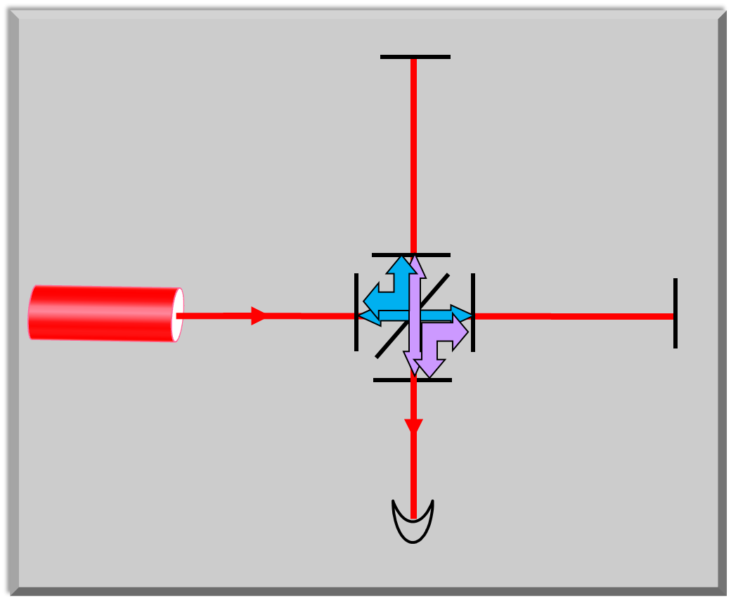
Signal and Power Recycling in the Presence of Arm Cavities
compound mirror
for signal recycling
compound mirror
for pump recycling

Slide 18
Sensitivity-Bandwidth Enhancement for AdLIGO Configuration
WLC element
WLC element

Slide 19
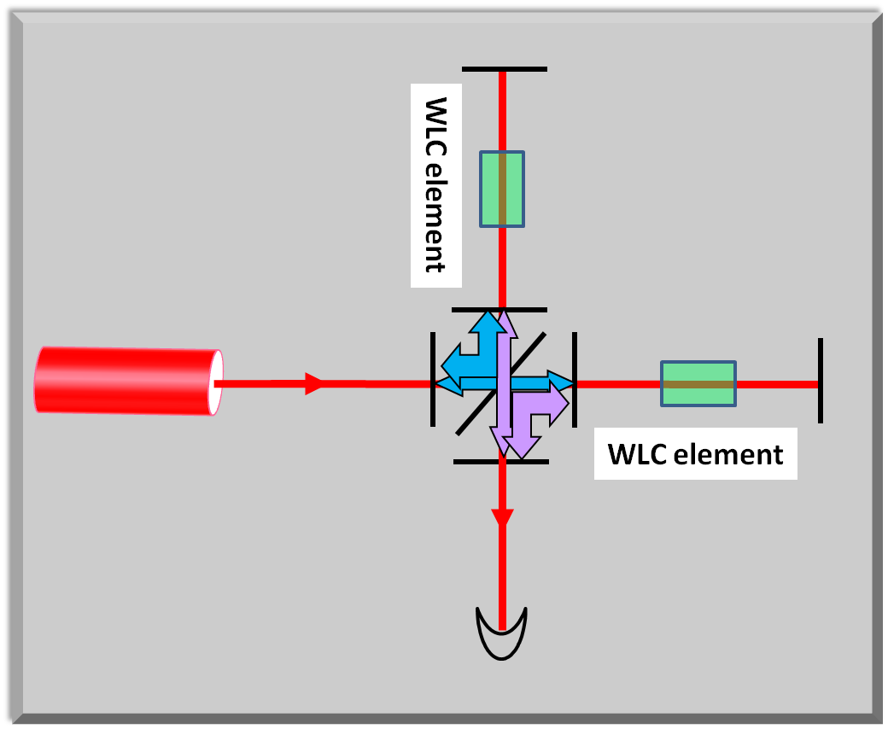
Sensitivity-Bandwidth Enhancement for AdLIGO Configuration
compound mirror
for WLC signal recycling
Signal
Extraction
Cavity (SEC)
compound mirror
for WLC pump recycling

Slide 20
Sensitivity-Bandwidth Enhancement for AdLIGO Configuration

Slide 21

Sensitivity-Bandwidth Enhancement for AdLIGO Configuration
Tuned Mode
Detuned by 20 deg
Detuned by 25.2 deg
Detuned by 36 deg
Detuned by 54 deg
Without WLC
With WLC

Slide 22
Sensitivity-Bandwidth Enhancement for AdLIGO Configuration
Tuned Mode
Detuned by 20 deg
Detuned by 25.2 deg
Detuned by 36 deg
Detuned by 54 deg
Without WLC
With WLC

Slide 23
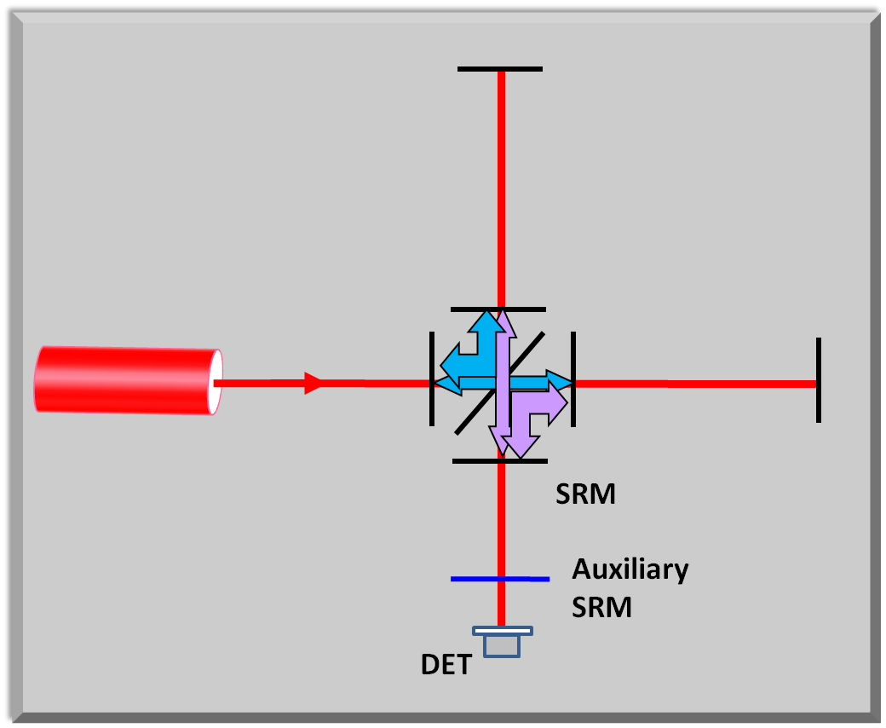
Proposal for Adding an Auxiliary Mirror for Practical WLC
Match SRM to
Input Test Mass
and tune SEC
to resonance
compound mirror
for pump recycling

Slide 24
Proposal for Adding an Auxiliary Mirror for Practical WLC
WLC
Element
WLC
Element
WLC
Element
compound mirror
for pump recycling

Slide 25
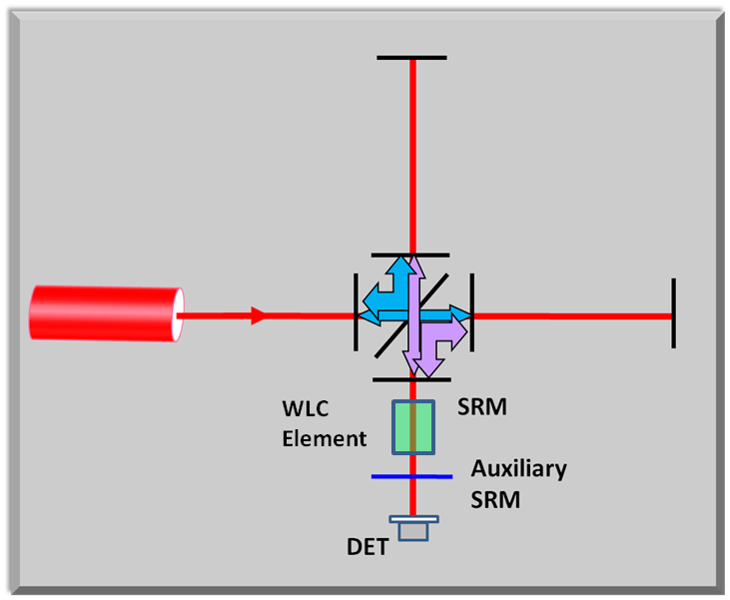
Proposal for Adding an Auxiliary Mirror for Practical WLC

Slide 26

Proposal for Adding an Auxiliary Mirror for Practical WLC
WLC / T_{ASRM} =0.001
No WLC / T_{ASRM} =0.001
WLC / T_{ASRM} =0.1
No WLC / T_{ASRM} =0.1
No WLC / T_{ASRM} =1
M. Salit and M.S. Shahriar, “Enhancement of Sensitivity-Bandwidth Product of Interferometric Gravitational Wave Detectors using White Light Cavities,” (http://arxiv.org/ftp/arxiv/papers/0809/0809.4213.pdf)

Slide 27
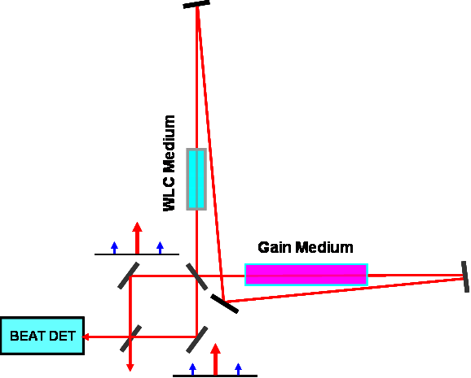
Active Sagnac Ring Laser in a WLC for Enhancing Strain Sensitivity
Phase Shift Without Anomalous Dispersion
Phase Shift With Anomalous Dispersion
M.S. Shahriar and M. Salit, (2008) Journal of Modern Optics Vol. 55, Nos. 19–20, 10–20 November 2008, 3133–3147
M. S. Shahriar and M. Salit, “A Fast-Light Enhanced Zero-Area Sagnac Ring Laser Gravitational Wave Detector,” (http://lapt.eecs.northwestern.edu/preprints/FE-ZASRLGWD.pdf)

Slide 28
Journal publications and preprints
G.S. Pati, R. Tripathi, V. Gopal, M. Messal, Phys. Rev. A 75, 053807 (2007)
G.S. Pati, M. Messal, K. Salit, M.S. Shahriar, Phys. Rev. Lett. 99, 133601 (2007)
M. Salit, G.S. Pati, K. Salit, and M.S. Shahriar, (2007) Journal of Modern Optics, 54:16, 2425 - 2440
G.S. Pati, M. Messal, K. Salit, M.S. Shahriar, Optics Communications, 281 (19), p.4931-4935, (2008)
H.N. Yum, M. Salit, G.S. Pati, S. Tseng, P.R. Hemmer, and M.S.Shahriar, Optics Express, Vol. 16 Issue 25, 20448 (2008)
M.S. Shahriar and M. Salit, (2008) Journal of Modern Optics Vol. 55, Nos. 19–20, 10–20 November 2008, 3133–3147
M. S. Shahriar and M. Salit, “A Fast-Light Enhanced Zero-Area Sagnac Ring Laser Gravitational Wave Detector,” (http://lapt.eecs.northwestern.edu/preprints/FE-ZASRLGWD.pdf)
M. Salit and M.S. Shahriar, “Enhancement of Sensitivity-Bandwidth Product of Interferometric Gravitational Wave Detectors using White Light Cavities,” (http://arxiv.org/ftp/arxiv/papers/0809/0809.4213.pdf)

Slide 29
