Slide 1
Performance of eLIGO Prototype HAM ISIs and improvements for aLIGO HAM ISIs
Jeffrey Kissel for the SEI team
Graduate, Physics
Louisiana State University
March 19, 2009
LIGO-G0900141

Slide 2
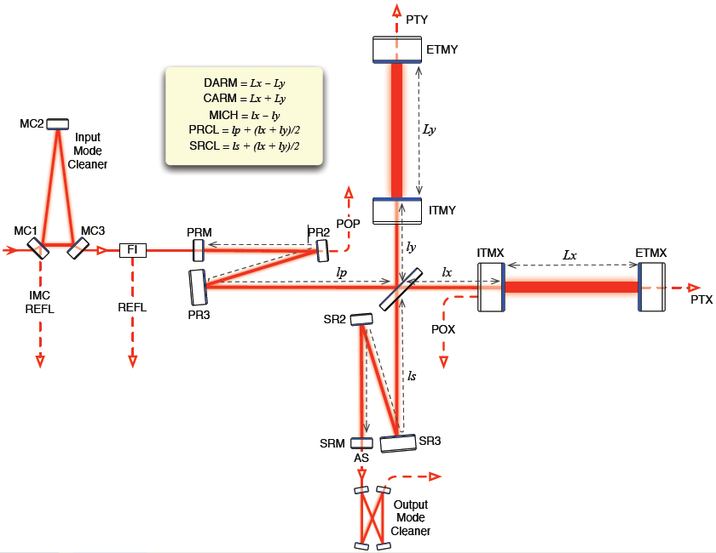
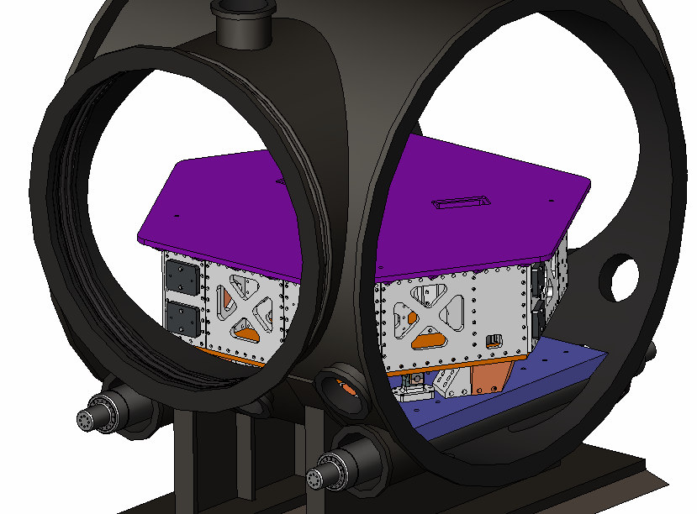
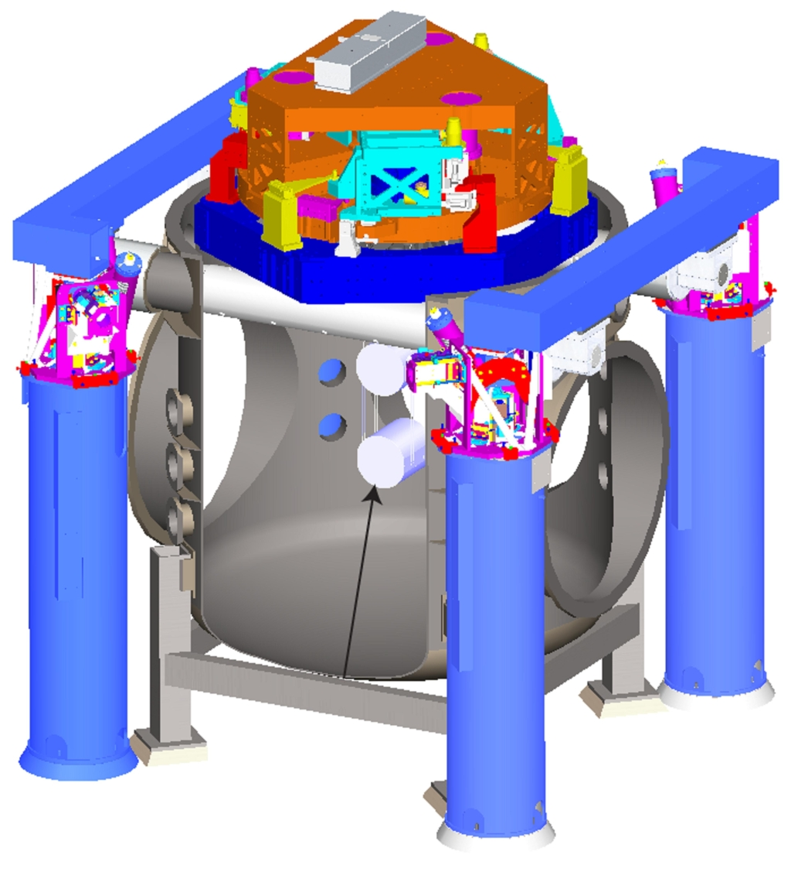
Advanced LIGO Seismic Isolation
In-vacuum Seismic Isolation
HAM Chambers
BSC Chambers
Single Stage ISI
Double Stage ISI
50 at 10 Hz
3000 at 1 Hz
HAM ISI
(eLIGO Prototype results: this talk)
BSC ISI
(LASTI Prototype progress: previous talk)
Notes:
See Fabrice’s talk next!!

Slide 3
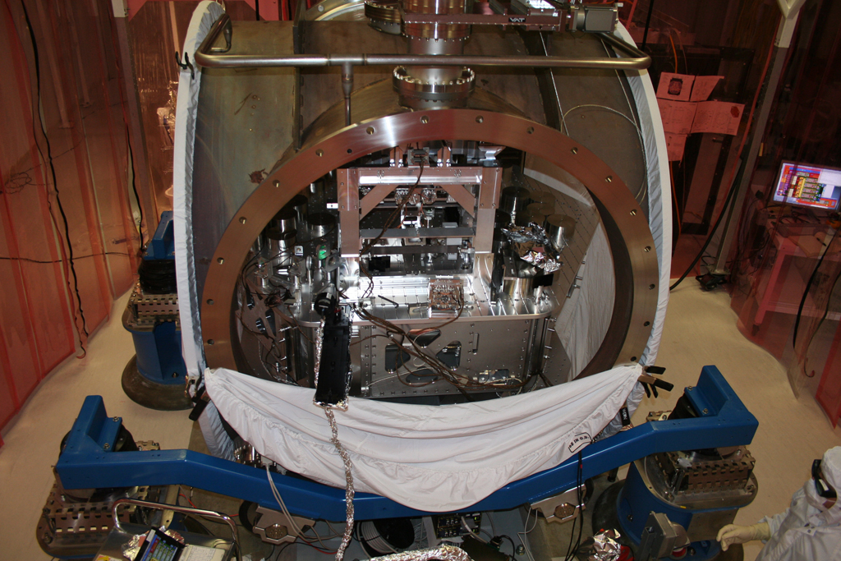
Enhanced LIGO Seismic Isolation
In-vacuum Seismic Isolation
L1 HAM ISI built and installed Feb/Mar ‘08
H1 HAM ISI built and installed Apr/May 2008
H1 HAM ISI commissioning June ‘08 and Feb/Mar ‘09
L1 HAM ISI commissioning Sep/Oct ’08 and Jan ‘09

Slide 4
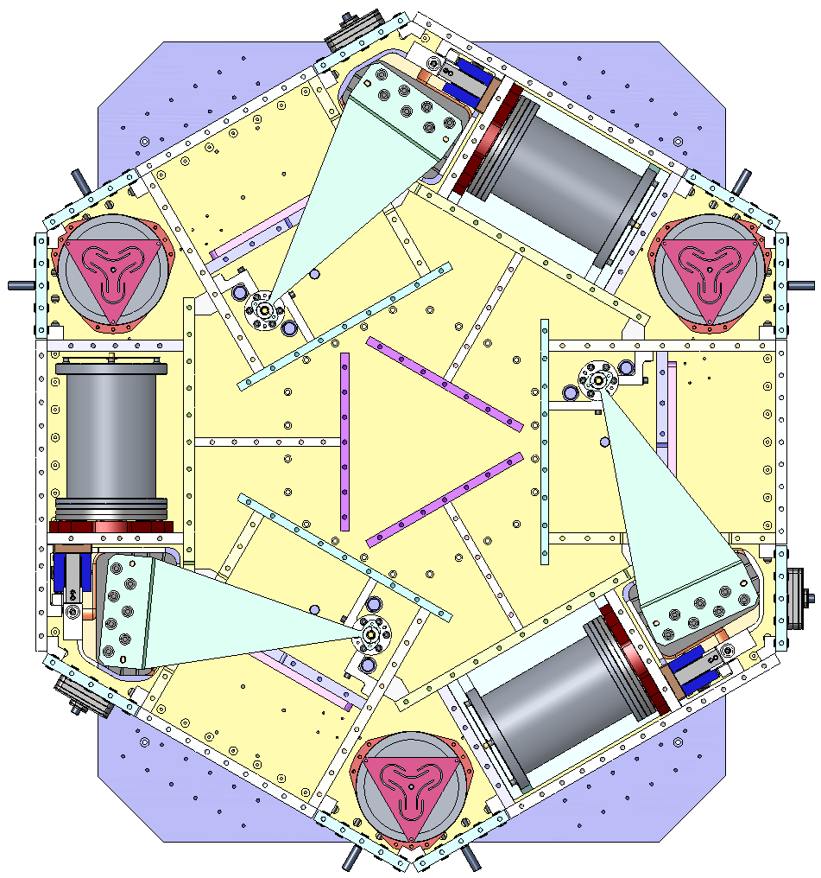
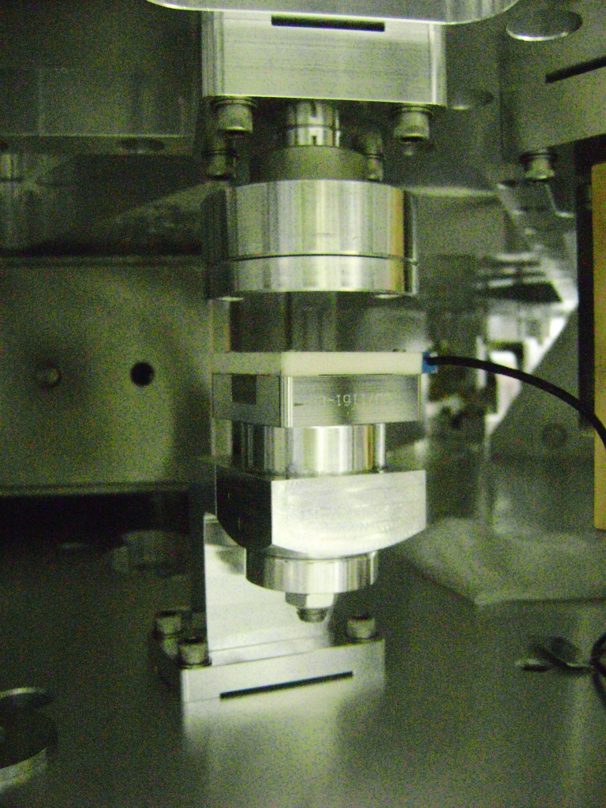
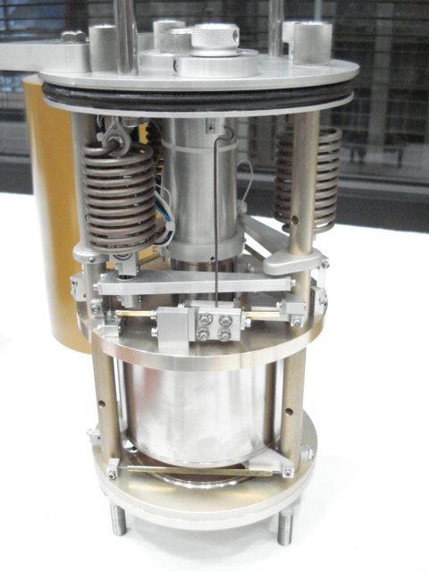
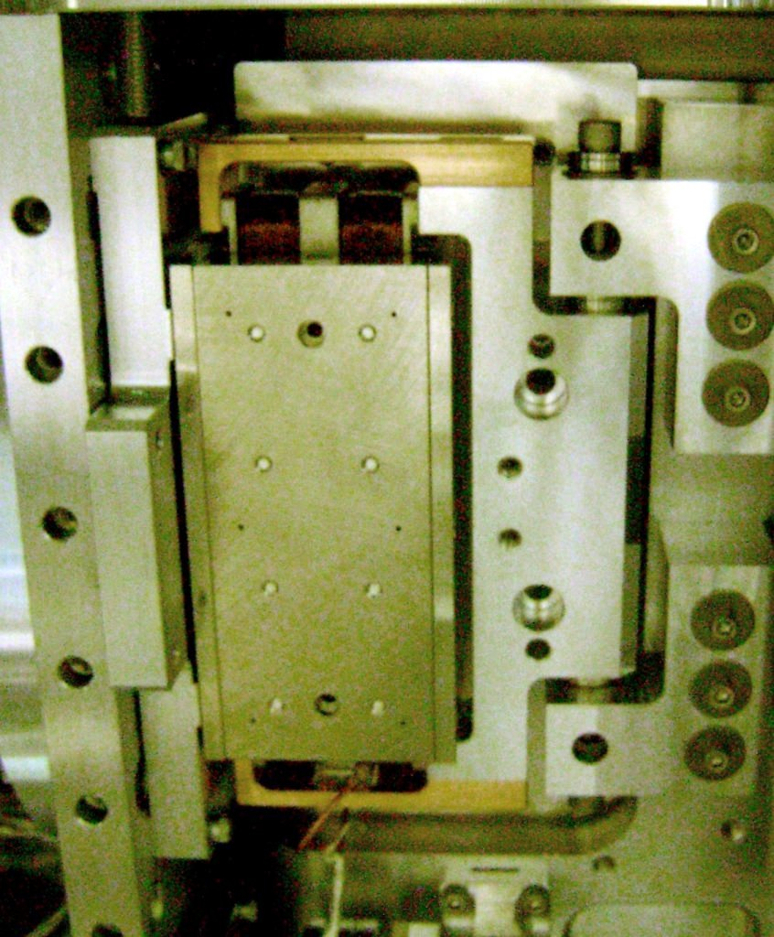
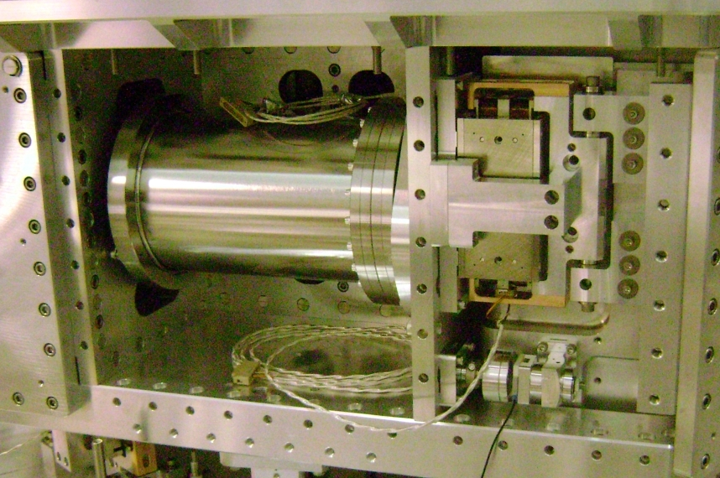
The HAM ISI
Active Components – Refresher!
#2
Y
#1
Z
X
#3
Displacement Sensor
Inertial Sensor
Electromagnetic Actuator
Displacement sensors provide alignment and low frequency information
Inertial Sensors (Geophones) provide high frequency information
Electromagnetic actuators provide drive and control of the table at all frequencies
Six sensor clusters mounted symmetrically on the table, one of each of the above in each cluster

Slide 5
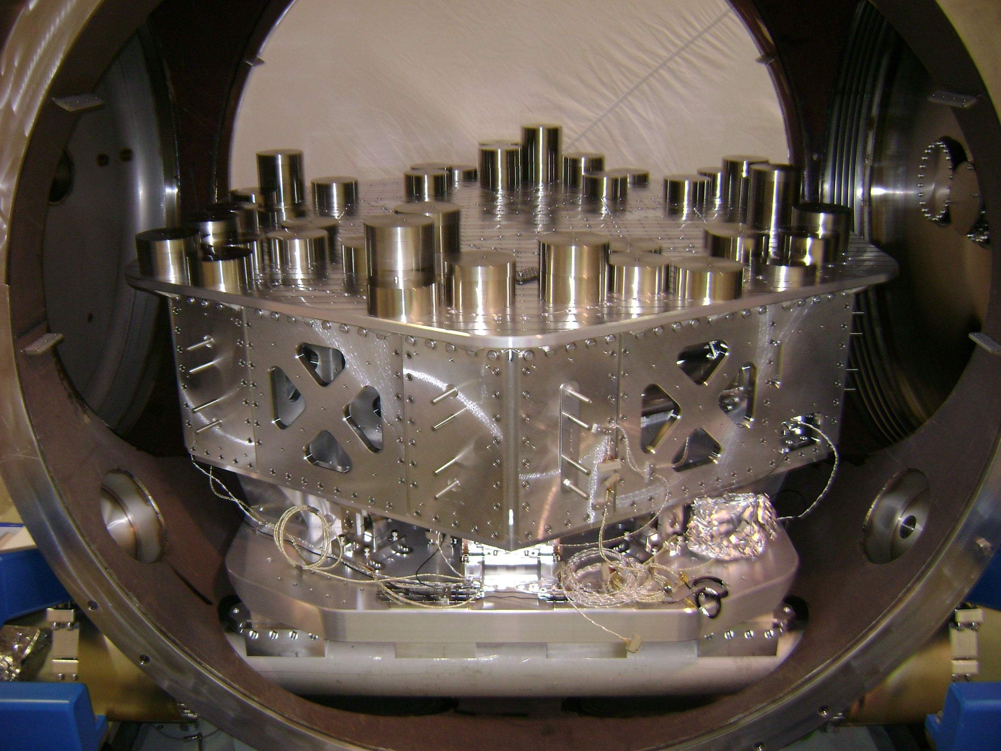
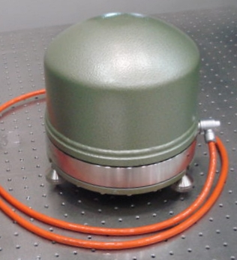
The HAM ISI
Active Control Loops – Refresher!
Sensor Correction
Displacement Sensors
Blend Filters
Isolation Filters
Super
Sensor
Damping Filters
Inertial Sensors
Software
Hardware
On Board Sensors
Ground Sensor
HAM ISI “Plant”
Actuators

Slide 6
Enhanced LIGO Seismic Isolation
RESULTS!!
Thanks to R. Mittleman,
C. Gray, and B. Lantz who did all the work!!

Slide 7
Enhanced LIGO Seismic Isolation
RESULTS!!
Thanks to R. Mittleman,
C. Gray, and B. Lantz who did all the work!!

Slide 8
Enhanced LIGO Seismic Isolation
RESULTS!!
Thanks to R. Mittleman,
C. Gray, and B. Lantz who did all the work!!

Slide 9
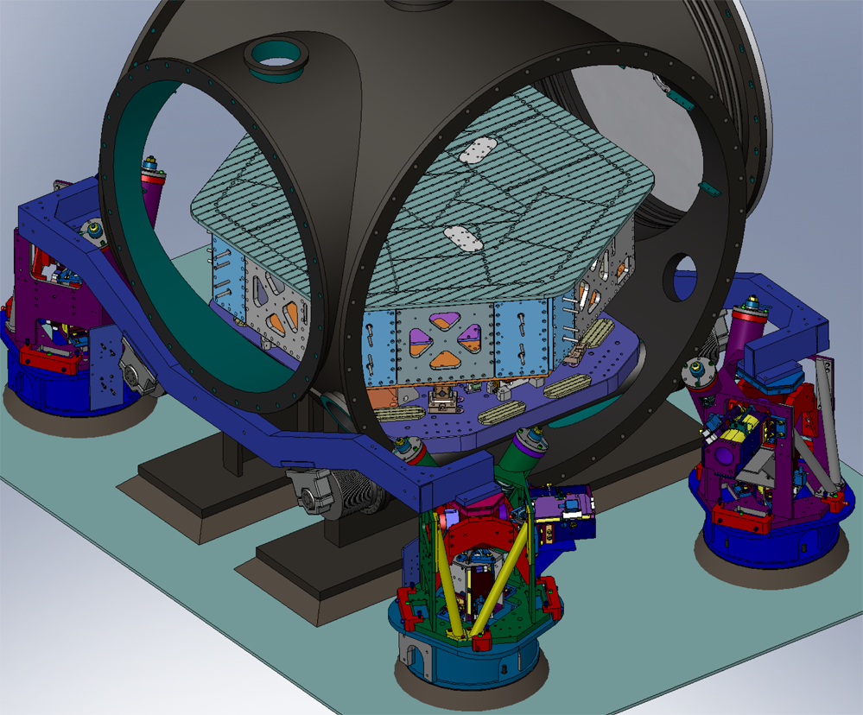
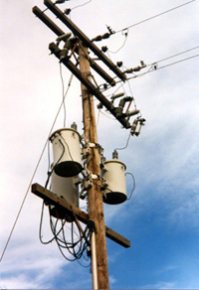
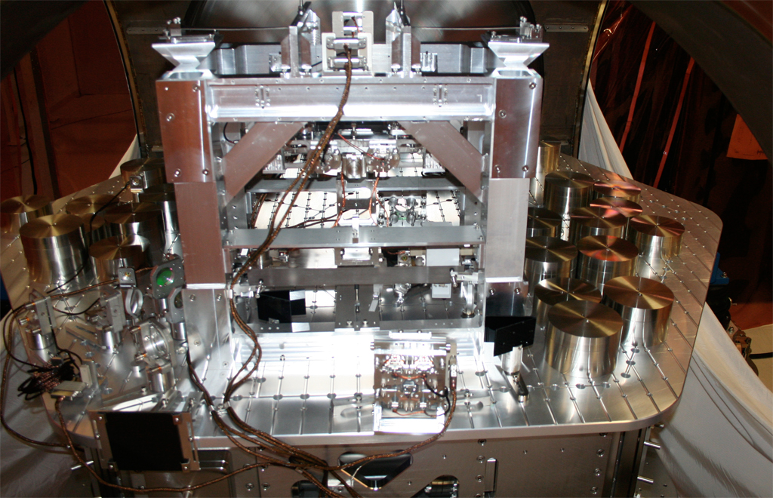
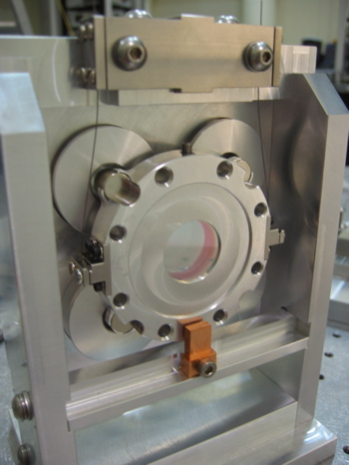
The eLIGO HAM ISI Noise and Resonance Couplings to DARM
March 10, 2009
H1 at 14 W
(m/rtHz)
33 Hz (in X)
n*60 Hz
153 Hz
110 Hz
169 - 200 Hz
362 Hz
MAYBE
MAYBE
iLIGO Gullwing
ISI Blade Spring
The OMC Cage
The TT
Bounce
ISI Pringle
Power Lines

Slide 10
The eLIGO HAM ISI Noise and Resonance Couplings to DARM
Ideas / Solutions?
33 Hz (in X)
Squeezed film damping (Dash Pot)
153 Hz
iLIGO Gullwing
Constrained layer damping (Viton)
110 Hz
ISI Blade Spring
Mo-better clamping (Dog Clamps),
Constrained layer damping (Viton)
170 - 200 Hz
The OMC Cage
362 Hz
Blade springs or thinner suspension wiring
Hrmm…..
The TT
Bounce
ISI Pringle

Slide 11
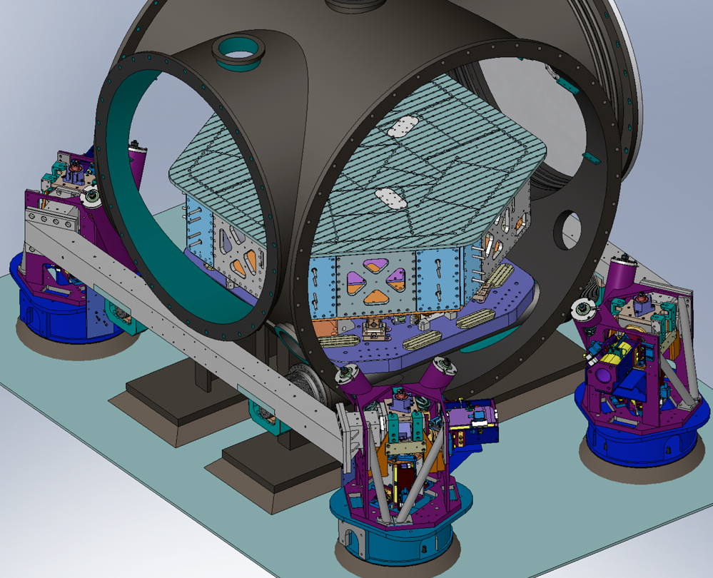
The aLIGO HAM ISI Improving the Performance in Advanced LIGO
The Dreaded Gullwing Resonance:
Build a better support structure, and add HEPI!
Gullwings Crossbeams
Support structure has been redesigned for aLIGO, have already been purchased! (Thanks to Andy Stein @ MIT!)
HEPI will be installed under HAMs, redesigned to use the new crossbeams
Increase f by ~2
Reduce Q by ~10

Slide 12
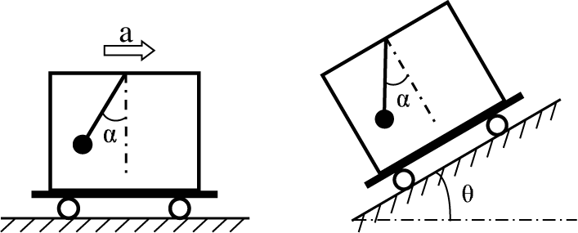
The aLIGO HAM ISI Improving the Performance in Advanced LIGO
Optimize DISP to GEO (Isolation),
and STS to DISP (Sens. Corr.) blend filters!
Found that noise in vertical GS-13s is misconstrued as differential motion >> TILT
TILT couples into horizontal motion degrades performance at low frequencies
Tilt Sensor anyone??

Slide 13
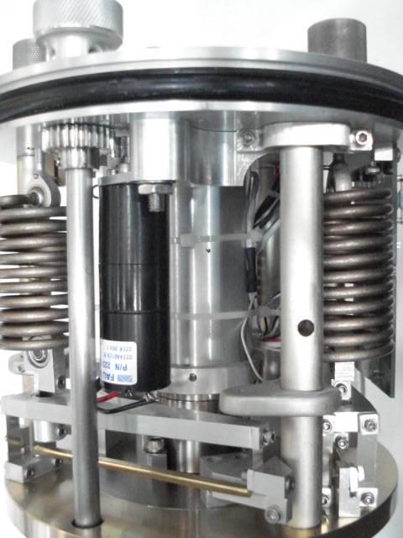
The aLIGO HAM ISI Improving the Performance in Advanced LIGO
The tricked-out SUPER GS-13s
See Dan Clark’s Poster (G0900128)
Example Features
Damping ring on vertical configuration’s restoring springs
105.2 Hz
Inertial Sensor
Stripped down horizontal configuration
NO MORE LOCKING MOTORS!

Slide 14
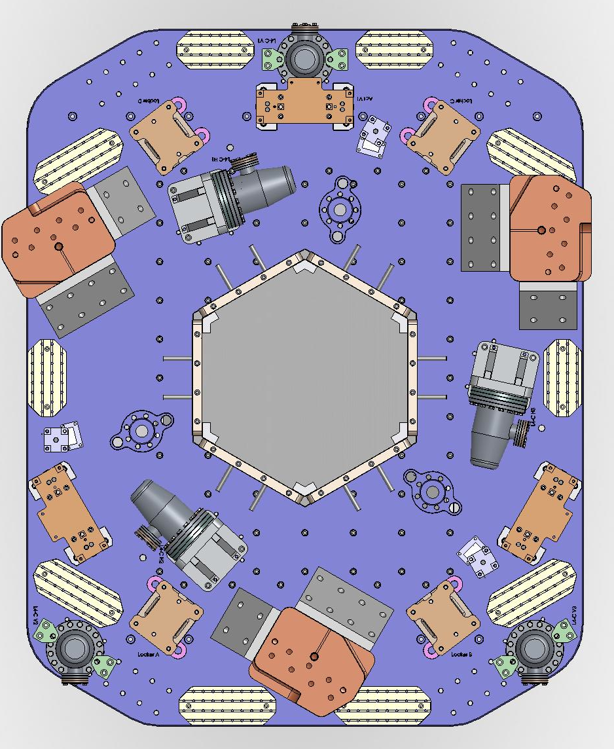
The aLIGO HAM ISI Improving the Performance in Advanced LIGO
More Feed-forward!
ISC Group says they need performance better than the requirements between 5 and 20 Hz
We’ll try 6 additional seismometers (L4-Cs) that feed-forward from support stage to suspended stage (Three Horizontal, Three Vertical)
Prototyping fall/winter of 2009 at LASTI

Slide 15
The HAM ISI So what’s next?
Enhanced LIGO
Finish up commissioning at L1 during site shutdown
Find solutions for DARM couplings
Detect gravitational waves
Preliminary and (first half of) Final Reviews finished
Procurement of most parts already purchased or in final stages of approval
Build and commission LASTI prototype in Fall of 2009
Advanced LIGO

Slide 17
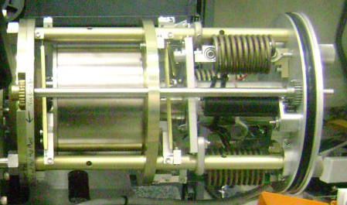
Enhanced LIGO Seismic Isolation
Why No Isolation Microseism for X and Y??
AAAHHHH!!!
TILT HORIZONTAL COUPLING!!
We have not yet redone the
displacement sensor alignment
since last June
Model (Shown in Purple) shows Y
Spectrum dominated by tilt

Slide 18
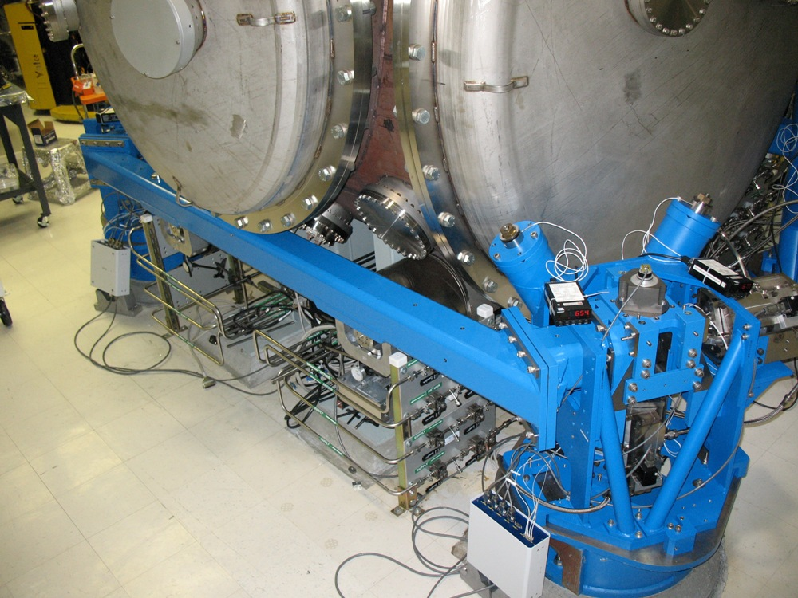
The HAM ISI Improving the Performance in Advanced LIGO
Factor of 20 reduction in Q
Installed at LASTI on Dec 18th 2008
Direction | Gullwing FEA (Hz) | X-Beam FEA (Hz) | Gullwing Meas. From eLIGO (Hz) | X-Beams Meas. @ LASTI (Hz)
X | 6.9 | 11.8 | 7.5 | 9.5
Y | 11.4 | 24.0 | 9.5 | 19
Z | 11.4 | 16.5 | 12 | 16

